Slide 1
Please note, these are the actual video-recorded proceedings from the live CME event and may include the use of trade names and other raw, unedited content.

Slide 2
Predictors of Response to Immune Checkpoint Inhibitors
Matthew Hellmann
Memorial Sloan Kettering Cancer Center
RTP Satellite Symposium AACR2018
Saturday, April 14th 2018

Slide 3
Disclosures
Consulting Agreements | AstraZeneca Pharmaceuticals LP, Bristol-Myers Squibb Company, Genentech BioOncology, Janssen Biotech Inc, Merck, Novartis

Slide 4
Topics for discussion
PD-L1 expression and response to PD-1 blockade
Tumor mutation burden (TMB) as predictor in PD-1 and combination with CTLA-4

Slide 5
PD-L1 expression and response to PD-1 blockade

Slide 6
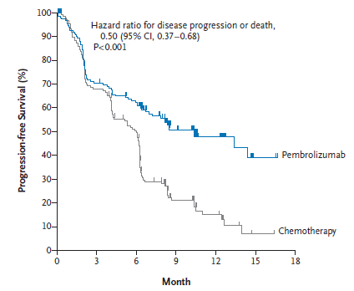
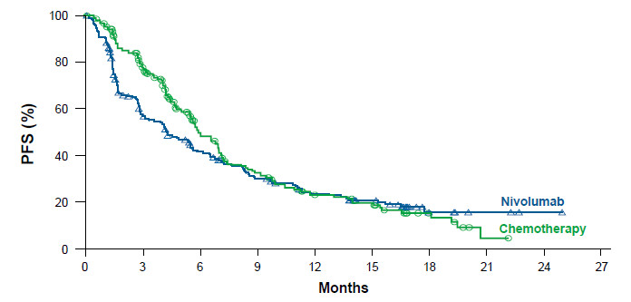
PD-L1 as a biomarker: 1st Line
≥ 50% cut point
≥ 5% cut point
HR = 0.50 (95% CI 0.37-0.68), P < 0.001
HR = 1.15 (95% CI: 0.91, 1.45), P = 0.2511
PD-L1 testing should be routine, and in those with >50% expression, pembrolizumab is SOC
Reck, NEJM 2016
Carbone, NEJM 2017

Slide 7
PD-L1 as a biomarker: 1st Line
Key pending questions:
KEYNOTE-189: Role of monotherapy vs chemo/PD-1 in PD-L1 high?
(KEYNOTE-189 at AACR)
KEYNOTE-042: PD-L1 ≥ 1% cutpoint succeeds (PR)
Does the 1-49% group benefit, or is the OS benefit driven all by the >50% cohort?

Slide 8
Phase III KEYNOTE-042 Study: Pembrolizumab Monotherapy Significantly Improves OS as First-Line Therapy in Locally Advanced or Metastatic NSCLC Expressing PD-L1 in at Least 1% of Tumor Cells Press Release — April 9, 2018
“The pivotal Phase 3 KEYNOTE-042 trial evaluating pembrolizumab as monotherapy for the first-line treatment of locally advanced or metastatic non-small cell lung cancer (NSCLC, including nonsquamous or squamous histologies) met its primary endpoint of overall survival (OS). An interim analysis conducted by the independent Data Monitoring Committee (DMC) demonstrated that treatment with pembrolizumab resulted in significantly longer OS than platinum-based chemotherapy (carboplatin plus paclitaxel or carboplatin plus pemetrexed) in patients with a PD-L1 tumor proportion score (TPS) of ≥1 percent…
The safety profile of pembrolizumab in this trial was consistent with that observed in previously reported monotherapy studies involving patients with advanced NSCLC.”
https://www.businesswire.com/news/home/20180409005424/en/KEYTRUDA%C2%AE-pembrolizumab-Monotherapy-Met-Primary-Endpoint-Phase

Slide 9
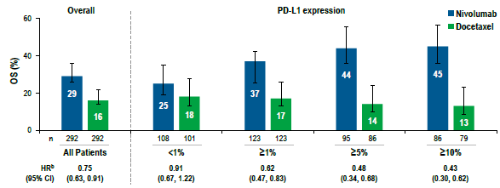
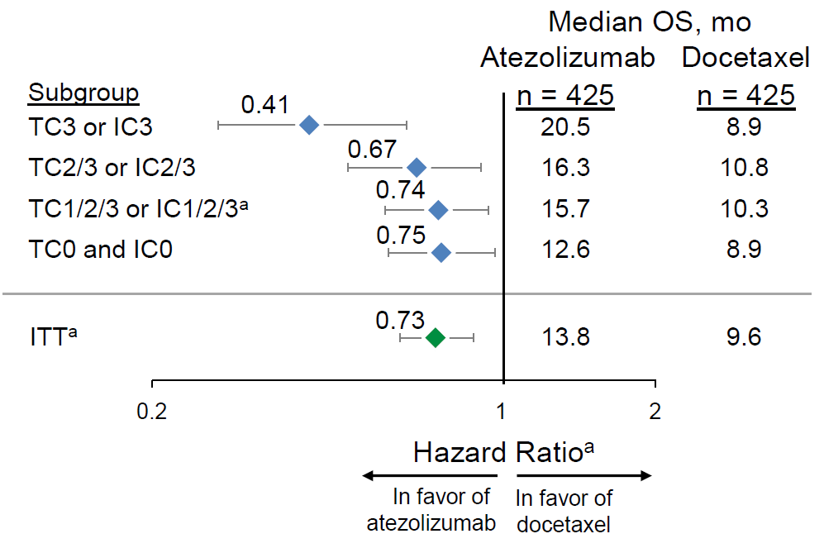
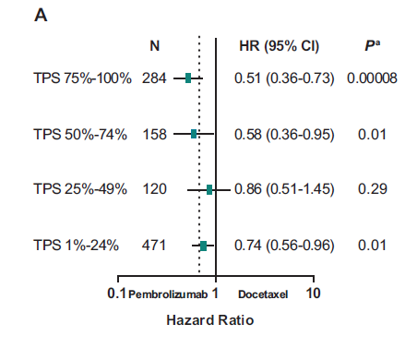
PD-L1 as a biomarker: 2nd line?
Nivolumab
Atezolizumab
HR
0.75
0.91
0.62
0.48
0.43
(95% CI)
(0.83, 0.91)
(0.67, 1.22)
(0.47, 0.83)
(0.34, 0.68)
(0.30, 0.62)
Pembrolizumab
N
HR (95% CI)
P
ITT
In most cases, anti-PD-(L)1 is best 2nd line option regardless of PD-L1 expression
Barlesi, ESMO 2016
Bass, ASCO 2016
Barlesi, ESMO 2016

Slide 10
PD-L1 as a biomarker: Which assay?
IVD = in vitro diagnostic
Rimm, IASLC-Chicago 2016

Slide 11
TMB as predictor in PD-1 and combination with CTLA-4

Slide 12
NSCLC and pembrolizumab
All tumors
All tumors
High nonsynonymous burden
Low nonsynonymous burden
P=0.0008
# nonsynonymous mutations/tumors
Percent progression-free
299
HR 0.19 95% CI (0.08-0.47)
P=0.0004
127
DCB
NCB
Months
Rizvi, Hellmann, Snyder, et al Science 2015

Slide 13
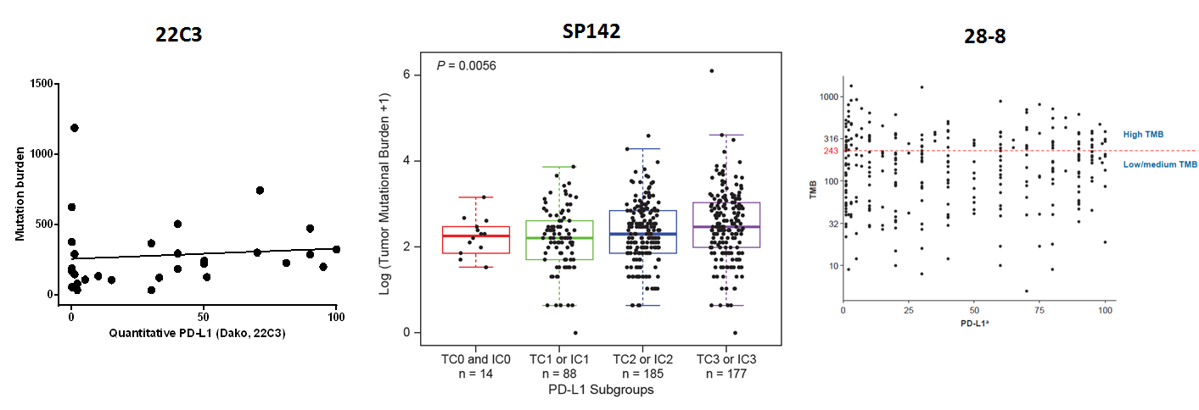
Mutation burden and PD-L1 are (essentially) independent variables
Unpublished
Kowanetz, ESMO 2016
Carbone, NEJM 2017

Slide 14
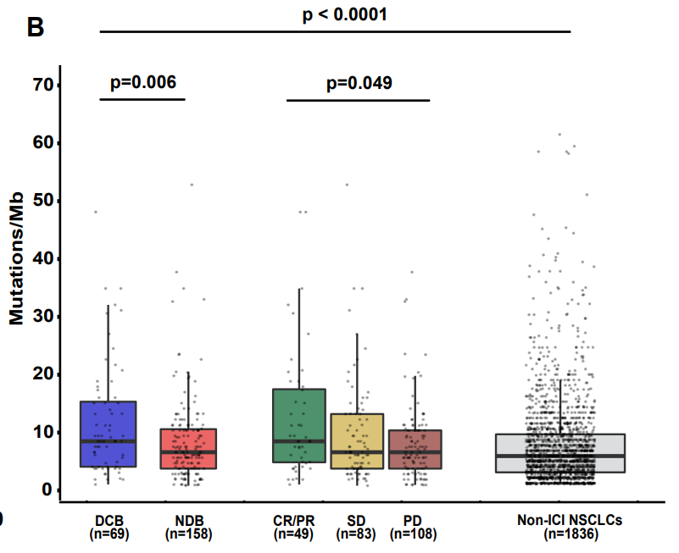
Direct use of TMB from targeted sequencing as a biomarker
Rizvi H, Sanchez-Vega, JCO 2018

Slide 15
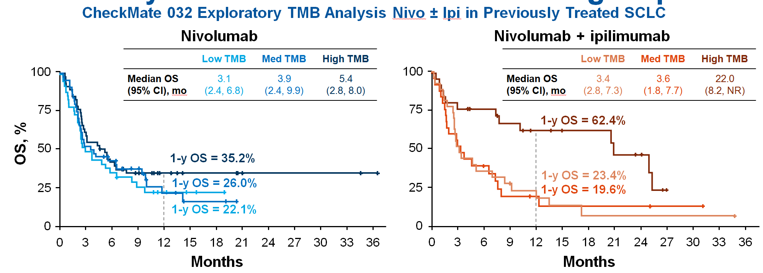
TMB to predict benefit to combination PD-1 + CTLA-4 in SCLC
TMB matters for PD-1 treatment across lung cancers… and may be even more important in context of combo therapy
Antonia… Hellmann, WCLC 2017

Slide 16
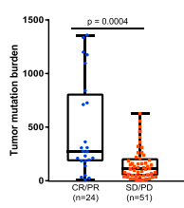
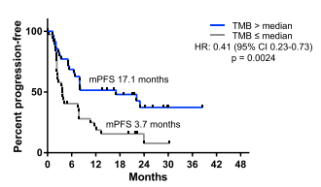
TMB to predict benefit to combination PD-1 + CTLA-4 in NSCLC
TMB matters for PD-1 treatment across lung cancers… and may be even more important in context of combo therapy
Hellmann, Cancer Cell 2018

Slide 17
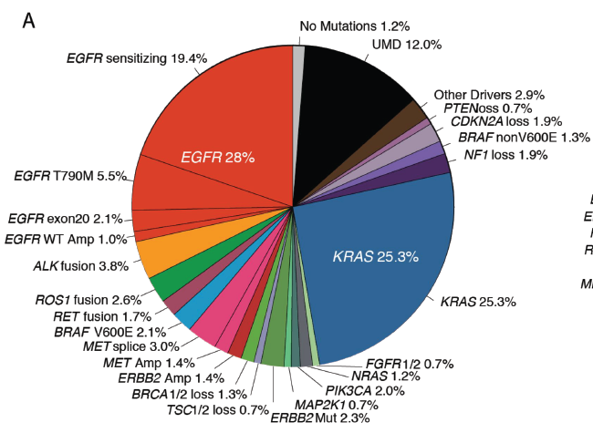
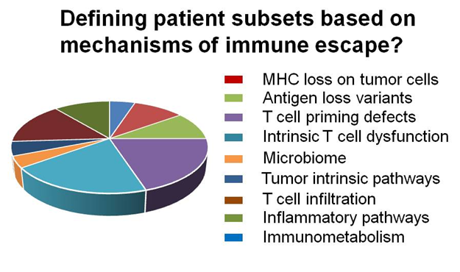
Assessment of TMB isn’t a “separate” test, but efficiently identifies molecular targets, and can include immunologic response/resistance targets
Jordan, Cancer Disc 2017
Beatty, ASCO 2017

Slide 18
CheckMate 227 Part 1 Study Design
Patients for PD-L1 co-primary analysis
Nivolumab 3 mg/kg Q2W Ipilimumab 1 mg/kg Q6W
n = 396
N = 1189
Nivolumab + ipilimumab n = 396
≥1% PD-L1 expression
R
1:1:1
Histology-based chemotherapyª
n = 397
Chemotherapyª
n = 397
Key Eligibility Criteria
Stage IV or recurrent NSCLC
No prior systemic therapy
No known sensitizing EGFR/ALK mutations
ECOG PS 0–1
Stratified by SQ vs NSQ
Patients for TMB co-primary analysis^{b}
Nivolumab 240 mg Q2W
n = 396
Nivolumab + ipilimumab n = 139
Nivolumab 3 mg/kg Q2W Ipilimumab 1 mg/kg Q6W
n = 187
Chemotherapyª
n = 160
N = 550
Co-primary endpoints: Nivolumab + ipilimumab vs chemotherapy
OS in PD-L1–selected populations
PFS in TMB-selected populations
<1% PD-L1 expression
R
1:1:1
Histology-based chemotherapyª
n = 186
Nivolumab 360 mg Q3W + histology-based chemotherapyª
n = 177
ª Gemcitabine with cisplatin or carboplatin for squamous histology; pemetrexed with cisplatin or carboplatin for nonsquamous histology.
^{b} The co-primary endpoints are OS and PFS with nivolumab monotherapy or nivolumab/ipilimumab combination regimens vs platinum doublet chemotherapy.
Notes:
Study design: CSR section 5/pg 102
DBL: CSR section 8.1/pg 173
Min FU from email: FW CA209-227 Last patient randomized in Part 1--January 2017 not December 2016

Slide 19
Ongoing Phase III Studies of Anti-PD-1/PD-L1 and Anti-CTLA-4 Antibody Combinations as First-Line Therapy in Advanced NSCLC
Study ID | Target accrual | Randomization
POSEIDON | 801 | Durvalumab + tremelimumab + SOC chemo Durvalumab + SOC chemo SOC chemo alone
NEPTUNE | 960 | Durvalumab + tremelimumab SOC chemo
CheckMate 9LA | 420 | Nivolumab + ipilimumab + chemo Chemo alone
eNERGY | 242 | Nivolumab + ipilimumab Chemo alone
DICIPLE | 1,360 | Nivolumab + ipilimumab Observation After response to induction nivolumab/ipilimumab
KEYNOTE-598 | 548 | Pembrolizumab + ipilimumab Pembrolizumab + placebo
MYSTIC | 1,118 | Durvalumab alone Durvalumab + tremelimumab SOC chemo alone
SOC = standard of care
www.clinicaltrials.gov, Accessed April 2018

