Slide 1
Please note, these are the actual video-recorded proceedings from the live CME event and may include the use of trade names and other raw, unedited content.

Slide 2
Cases from the Community Clinical Investigators Provide Their Perspectives on Emerging Research and Actual Patients with Non-Small Cell Lung Cancer Friday, June 1, 2018
7:00 PM – 9:00 PM Chicago, Illinois
Faculty
Matthew D Hellmann, MD
Corey J Langer, MD
Geoffrey R Oxnard, MD
Martin Reck, MD, PhD
Alice Shaw, MD, PhD
Moderator Neil Love, MD

Slide 3
Disclosures for Moderator Neil Love, MD
Dr Love is president and CEO of Research To Practice, which receives funds in the form of educational grants to develop CME activities from the following commercial interests: AbbVie Inc, Acerta Pharma — A member of the AstraZeneca Group, Adaptive Biotechnologies, Agendia Inc, Agios Pharmaceuticals Inc, Amgen Inc, Ariad Pharmaceuticals Inc, Array BioPharma Inc, Astellas Pharma Global Development Inc, AstraZeneca Pharmaceuticals LP, Baxalta Inc, Bayer HealthCare Pharmaceuticals, Biodesix Inc, bioTheranostics Inc, Boehringer Ingelheim Pharmaceuticals Inc, Boston Biomedical Pharma Inc, Bristol-Myers Squibb Company, Celgene Corporation, Clovis Oncology, CTI BioPharma Corp, Dendreon Pharmaceuticals Inc, Eisai Inc, Exelixis Inc, Foundation Medicine, Genentech BioOncology, Genomic Health Inc, Gilead Sciences Inc, Halozyme Inc, ImmunoGen Inc, Incyte Corporation, Infinity Pharmaceuticals Inc, Ipsen Biopharmaceuticals Inc, Janssen Biotech Inc, administered by Janssen Scientific Affairs LLC, Jazz Pharmaceuticals Inc, Kite Pharma Inc, Lexicon Pharmaceuticals Inc, Lilly, Medivation Inc, a Pfizer Company, Merck, Merrimack Pharmaceuticals Inc, Myriad Genetic Laboratories Inc, NanoString Technologies, Natera Inc, Novartis, Novocure, Onyx Pharmaceuticals, an Amgen subsidiary, Pfizer Inc, Pharmacyclics LLC, an AbbVie Company, Prometheus Laboratories Inc, Puma Biotechnology Inc, Regeneron Pharmaceuticals Inc, Sanofi Genzyme, Seattle Genetics, Sigma-Tau Pharmaceuticals Inc, Sirtex Medical Ltd, Spectrum Pharmaceuticals Inc, Taiho Oncology Inc, Takeda Oncology, Tesaro Inc, Teva Oncology and Tokai Pharmaceuticals Inc.
Notes:
3
3
3

Slide 4
RTP ASCO Symposia

Slide 5
Agenda
Module 1 – Long-Term Management of NSCLC in Patients with an Activating EGFR Mutation — Dr Oxnard
Module 2 – Recent Treatment Advances for Patients with ALK/ROS1- and BRAF-Positive NSCLC; Other Targets with the Potential to Affect Treatment Decision-Making — Dr Shaw
Module 3 – Optimal Integration of Immune Checkpoint Inhibition into Clinical Decision-Making for Patients with Locally Advanced NSCLC — Dr Reck
Module 4 – Current Role of Immune Checkpoint Inhibitors in Combination with Chemotherapy and/or Anti-angiogenic Agents in the Treatment of Metastatic Disease — Dr Langer
Module 5 – Potential Role of Anti-PD-1/PD-L1 and Anti-CTLA-4 Antibodies in Combination; Future Directions for Clinical Research — Dr Hellmann

Slide 6
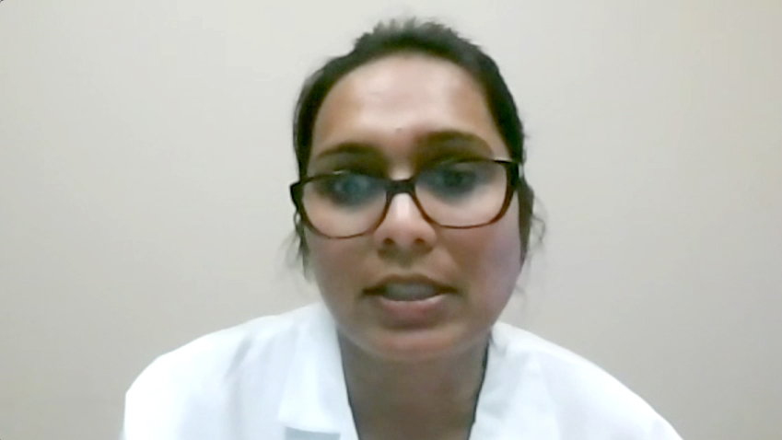
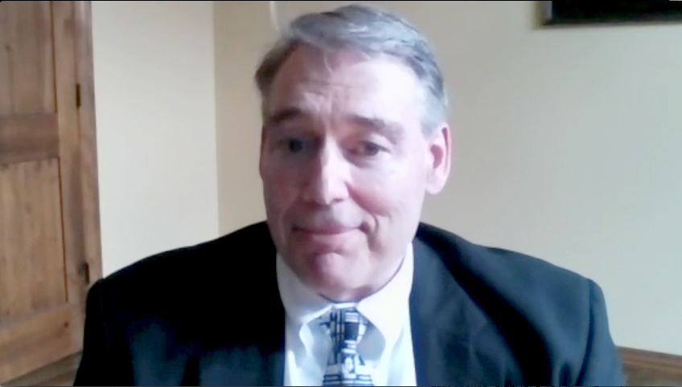
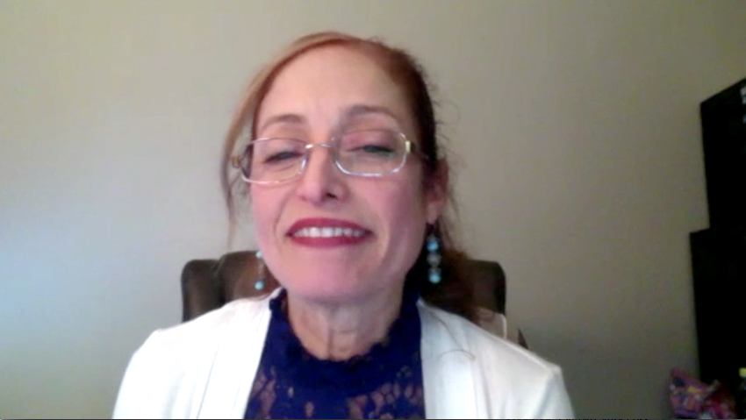
Contributing Community Oncologists
Ranju Gupta, MD
Bethlehem, Pennsylvania
Raymond Lobins, DO
Springfield, Missouri
Maria Picton, MD
Greenville, North Carolina
Estelamari Rodriguez, MD, MPH
Miami Beach, Florida

Slide 7
The New Taxonomy of Metastatic Non-Small Cell Lung Cancer
Squamous (no targetable mutation)
Nonsquamous
Low TPS
High TPS
No targetable mutation
EGFR mutation
ALK rearrangement
ROS1 rearrangement
BRAF V600E mutation
MET exon 14 mutation
RET rearrangement
HER2 mutation
Low TPS
High TPS
Low TPS
High TPS
Low TPS
High TPS
Low TPS
High TPS
Low TPS
High TPS
Low TPS
High TPS
Low TPS
High TPS
Low TPS
High TPS
T790M mutation-positive
T790M mutation-negative
T790M mutation-positive
T790M mutation-negative
TPS = PD-L1 tumor proportion score
Low TPS = 10%; high TPS = 60%
Targeted treatment
Chemotherapy + checkpoint inhibitor
Chemotherapy ± biologic
Checkpoint inhibitor
Love N et al. Proc IASLC 2017;Abstract 75.
Notes:
7
7

