Slide 1
Please note, these are the actual
video-recorded proceedings from the
live CME event and may include the use of trade names and other raw, unedited content.

Slide 2
Emerging Therapeutic Landscape in Mutation (-) Advanced Non-small Cell Lung Cancer (NSCLC):
The New Immunotherapy Paradigm
Corey J. Langer, MD, FACP
Director of Thoracic Oncology
Abramson Cancer Center
Professor of Medicine
University of Pennsylvania
Philadelphia, PA

Slide 3
Disclosures
Advisory Committee | Abbott Laboratories, AstraZeneca Pharmaceuticals LP, Boehringer Ingelheim Pharmaceuticals Inc, Celgene Corporation, Genentech BioOncology, Lilly, Merck, Pfizer Inc, Roche Laboratories Inc, Takeda Oncology
Consulting Agreements | AstraZeneca Pharmaceuticals LP, Bayer HealthCare Pharmaceuticals, Boehringer Ingelheim Pharmaceuticals Inc, Bristol-Myers Squibb Company, Celgene Corporation, Eisai Inc, Genentech BioOncology, Lilly, Merck, Novartis, Pfizer Inc, Roche Laboratories Inc, Takeda Oncology
Contracted Research | Advantagene Inc, Ariad Pharmaceuticals Inc, GlaxoSmithKline, Inovio Pharmaceuticals Inc, Merck, Takeda Oncology,
Data and Safety Monitoring Board | Amgen Inc, Lilly, Peregrine, Synta, SWOG

Slide 4
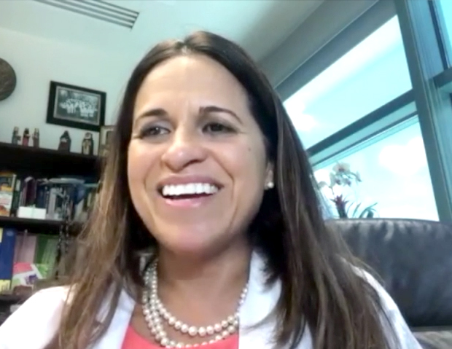
Case presentation: Dr Rodriguez
63-year-old woman (former light smoker)
7/2016: RUL mass
  EBUS: adenocarcinoma with mediastinal involvement,
  no important genomic alterations
  MRI: brain metastases
Clinical trial (IMpower150): carboplatin/paclitaxel/bevacizumab/atezolizumab x
4 cycles
  Maintenance bevacizumab/atezolizumab (currently on cycle 34)

Slide 5

Case presentation: Dr Gupta
61-year-old woman with history of rheumatoid arthritis
(never smoker)
2/2016: LLL mass, supraclavicular, mediastinal adenopathy,
mets to R adrenal gland, bone and brain
  Biopsy: adenocarcinoma, EGFR exon 20 insertion (A767-V774); PD-L1 = 5%

Slide 6
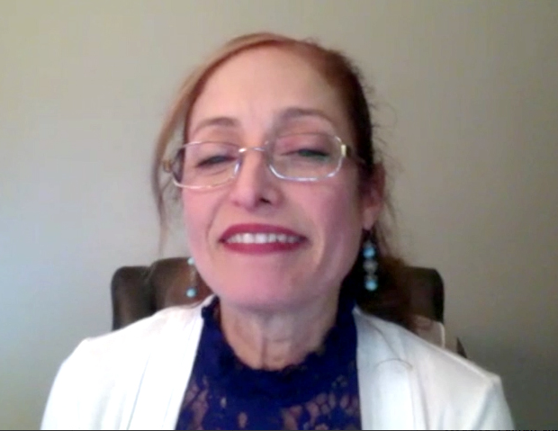
Case presentation: Dr Picton
77-year-old man (smoker)
Multiple comorbidities, including DM, end-stage renal disease on
peritoneal dialysis, CAD, post-CABG, CHF, stroke, sleep apnea,
hypertension, asbestosis and GI bleeding
7/2017: Hoarseness; vocal cord paralysis
  LUL mass with LN involvement
Biopsy: Squamous cell carcinoma; PD-L1 = 85%
9/2017-1/2018: Pembrolizumab — partial response, well tolerated
12/2017-2/2018: Admitted multiple times due to hypotension, COPD and CHF exacerbations

Slide 7

Study Design
Patients:
Metastatic non-squamous NSCLC
First line metastatic treatment
Measurable disease
ECOG PS 0-1
Tissue for biomarker available
EGFR wild type
EML4/ALK fusion negative
No active CNS metastases
R
A
N
D
O
M
I
Z
A
T
I
O
N
2:1
N=570
Carboplatin/Cisplatin
Pemetrexed
Pembrolizumab
200 mg Q3W
X4 cycles
Pemetrexed
Pembrolizumab
PD
Follow
Carboplatin/Cisplatin
Pemetrexed
+Saline
X4 cycles
Pembrolizumab
Pemetrexed
+Saline
PD
Stratify:
PD-L1 prop score: ≥1%, <1%
Smoking status
cisplatin vs carboplatin
Primary Endpoint: PFS – target HR 0.7
Secondary Endpoints: OS, ORR, AE
Exploratory Endpoints: QoL

Slide 8
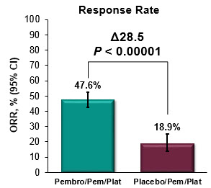
KEYNOTE-189: Results
Pem/Carbo +/- Pembro
12-mo rate
69.2%
49.4%
OS:
HR 0.49 [95% CI: 0.38-0.64]; p <0.0000001
Median (95% CI)
NR (NE-NE)
11.3 mo (8.7-15.1)
12-mo rate
34.1%
17.3%
Median (95% CI)
8.8 mo (7.6-9.2)
4.9 mo (4.7-5.5)
Subgroup Analyses
OS: Positive across all subgroups
PFS: Positive across all subgroups except for PD-L1 TPS <1%
PFS:
HR 0.52 [95% CI: 0.43-0.64]; p <0.00001

Slide 9
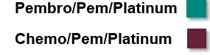
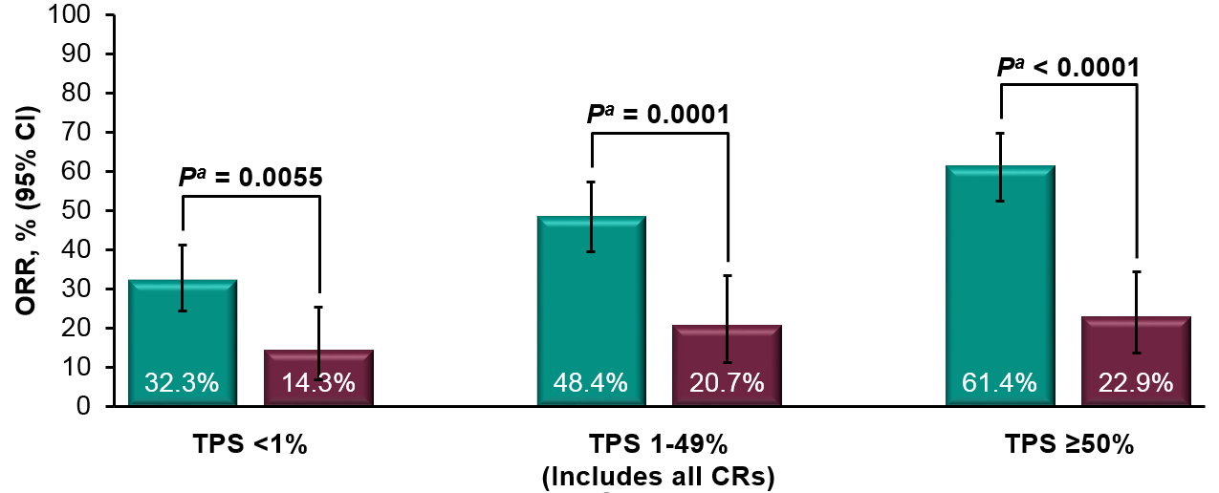
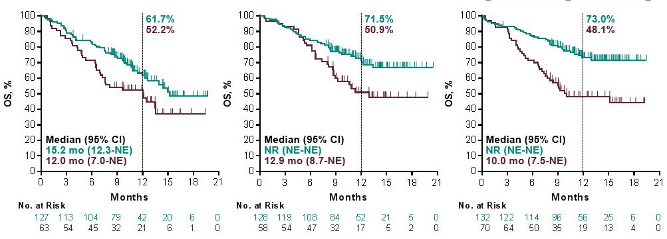
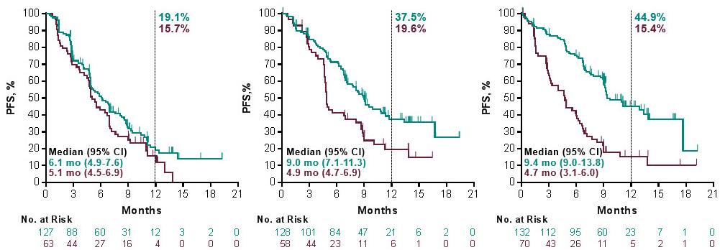
KEYNOTE-189: Results by PD-L1 status
OS
TPS <1%
TPS 1-49%
TPS ≥50%
PFS
TPS <1%
TPS 1-49%
TPS ≥50%
HR 0.59 (0.38-0.92)
HR 0.55 (0.34-0.90)
HR 0.42 (0.26-0.68)
HR 0.75 (0.53-1.05)
HR 0.55 (0.37-0.81)
HR 0.36 (0.25-0.52)

Slide 10
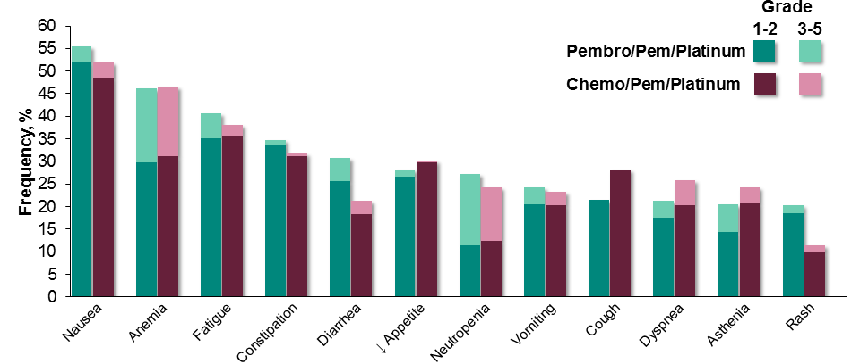
KEYNOTE-189: Adverse Events Summary
Adverse Events with Frequency ≥20%
patients who discontinued pembrolizumab or placebo, pemetrexed, and carboplatin for an adverse event at any time and patients who discontinued pembrolizumab or placebo and pemetrexed for an adverse event after completing 4 cycles of platinum.
 | Pembro/Pem/Platinum N = 405 | Placebo/Pem/Platinum N = 202
Any | 404 (99.8%) | 200 (99.0%)
Grade 3-5 | 272 (67.2%) | 133 (65.8%)
Led to death | 27 (6.7%) | 12 (5.9%)
Led to discontinuation
All treatmentª | 56 (13.8%) | 16 (7.9%)
Any treatment | 112 (27.7%) | 30 (14.9%)
Pembrolizumab or placebo | 82 (20.2%) | 21 (10.4%)
Pemetrexed | 93 (23.0%) | 23 (11.4%)
Platinum | 31 (7.7%) | 12 (5.9%)
Minimal Additive Toxicity
Renal Toxicity: Rates of Acute Renal Failures 5% vs 1% in Pembro/Pem/Plat vs. Placebo/Pem/Plat
ªIncludes patients who discontinued pembrolizumab or placebo, pemetrexed, and carboplatin for an adverse event at any time and patients who discontinued pembrolizumab or placebo and pemetrexed for an adverse event after completing 4 cycles of platinum.
Discontinuation of all Tx b/o AEs: 13.8 % vs 7.9%
Immune-mediated AEs: 22.7% vs 11.9%

Slide 11
Langer’s Practical Strategy for PD-L1 > 50%
Pembro alone
  Older, frailer patients
  Lower metastatic burden
  Significant co-morbidity
Combination Pembro and Pem/Carbo
  Younger, heartier patients
  Higher metastatic burden
  More aggressive tumors
  Limited co-morbidity

Slide 12
Expanding the Role of Checkpoint Inhibitors
Angiogenesis Inhibition
ALK and EGFR (+) Pts

Slide 13
IMpower150 study design
Maintenance therapy
(no crossover permitted)
Stage IV or
recurrent metastatic non-squamous NSCLC
Chemotherapy-naiveª
Tumour tissue available for biomarker testing
Any PD-L1 IHC status
Stratification factors:
Sex
PD-L1 IHC expression
Liver metastases
N = 1202
Arm A
Atezolizumab^{b} + Carboplatin^{c} + Paclitaxel^{d}
4 or 6 cycles
Atezolizumab^{b}
Treated with atezolizumab until PD by RECIST v1.1
or loss of clinical benefit
AND/OR
Treated with bevacizumab until PD by RECIST v1.1
Survival follow-up
Arm B
Atezolizumab^{b} + Carboplatin^{c} + Paclitaxel^{d}
+ Bevacizumab^{e}
4 or 6 cycles
Atezolizumab^{b}
+
Bevacizumab^{e}
R
1:1:1
Arm C (control)
Carboplatin^{c} + Paclitaxel^{d}
+ Bevacizumab^{e}
4 or 6 cycles
Bevacizumab^{e}
ª Patients with a sensitising EGFR mutation or ALK translocation must have disease progression or intolerance of treatment with one or more approved targeted therapies.
^{b} Atezolizumab: 1200 mg IV q3w. ^{c} Carboplatin: AUC 6 IV q3w. ^{d} Paclitaxel: 200 mg/m² IV q3w. ^{e} Bevacizumab: 15 mg/kg IV q3w.
The principal question is to assess whether the addition of atezolizumab to Arm C provides clinical benefit
Reck M et al ESMO 2017

Slide 14
IMpower150 study populations and objectives
Teff-high WTª
High T-effector gene signature expression
ITT-WTª
(87% of patients)
ITT
All randomised patients
ª WT refers to patients without EGFR or ALK genetic alterations.
Teff-low WTª
Low T-effector gene signature expression
EGFR/ALK +
(13% of patients)
1
1
Co-primary objectives
Investigator-assessed PFS in ITT-WT
Investigator-assessed PFS in Teff-high WT
OS in ITT-WT
2
Key secondary objectives
Investigator-assessed PFS and OS in ITT
Investigator-assessed PFS in PD-L1 IHC subgroups
Independent review facility (IRF)-assessed PFS
ORR and DOR per RECIST v1.1
Safety in ITT
The T-effector (Teff) gene signature is defined by expression of PD-L1, CXCL9 and IFNγ and is a surrogate of both
PD-L1 IHC expression and pre-existing immunity (Kowanetz M, et al. WCLC, 2017).

Slide 15
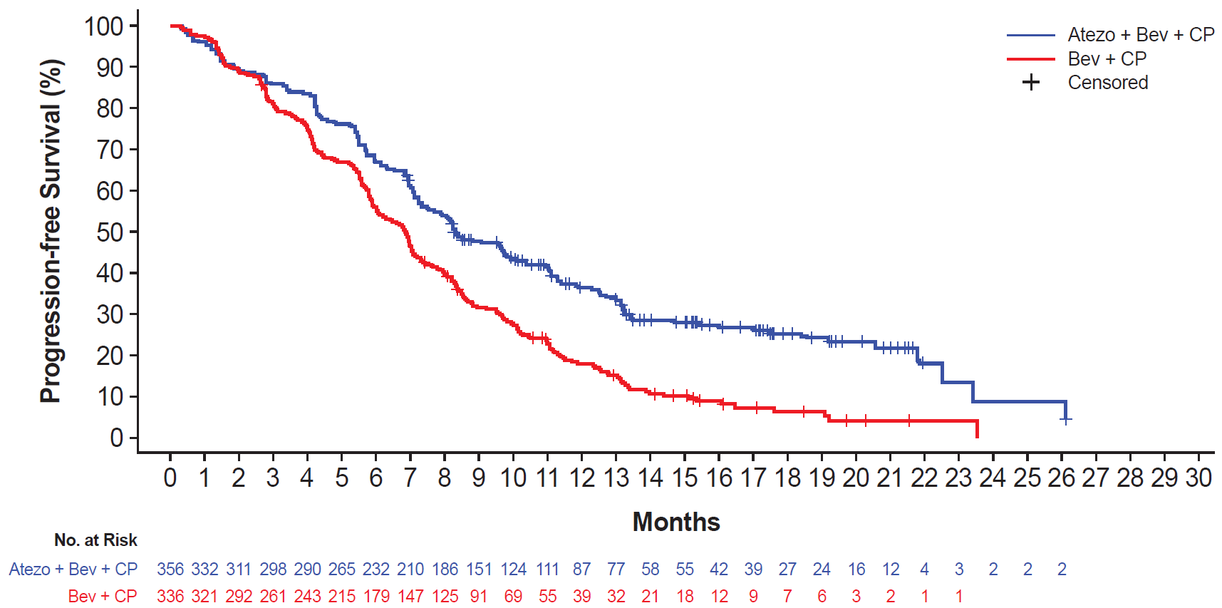
INV-assessed PFS in ITT-WT (Arm B vs Arm C)
Treatment | Median PFS, mos. | HR | 95% CI | P-value
Arm B: atezo + bev + CP | 8.3 (95% CI: 6.0, 7.1) | 0.617 | 0.517, 0.737 | <0.0001
Arm C: bev + CP | 6.8 (95% CI: 7.7, 9.8)
Minimum follow-up: 9.5 mos; Median follow-up: ~15 mos
15
INV, investigator.
Data cutoff: September 15, 2017
Reck M et al ESMO 2017

Slide 16
PFS in key biomarker populations
Median PFS, mo
Population | n (%)ª
ITT (including EGFR/ALK mutant +) | 800 (100%)
EGFR/ALK mutant + only^{b} | 108 (14%)
ITT-WT | 692 (87%)
Teff-high (WT) | 284 (43%)
Teff-low (WT) | 374 (57%)
PD-L1 IHC TC2/3 or IC2/3 (WT) | 244 (35%)
PD-L1 IHC TC1/2/3 or IC1/2/3 (WT) | 354 (51%)
PD-L1 IHC TC0 and IC0 (WT) | 338 (49%)
PD-L1 IHC TC3 or IC3 (WT) | 135 (20%)
PD-L1 IHC TC0/1/2 or IC0/1/2 (WT) | 557 (80%)
0.61
Arm B | Arm C
8.3 | 6.8
9.7 | 6.1
8.3 | 6.8
11.3 | 6.8
7.3 | 7.0
11.1 | 6.8
11.0 | 6.8
7.1 | 6.9
12.6 | 6.8
8.0 | 6.8
0.59
0.62
0.51
0.76
0.48
0.50
0.77
0.39
0.68
1.0
1.25
Hazard Ratio^{c}
In favour of Arm B:
atezo + bev + CP
In favour of Arm C:
bev + CP
ª ITT, EGFR/ALK mutants, and ITT-WT % prevalence out of ITT (n = 800);
Teff % prevalence out those tested in ITT-WT (n = 658); PD-L1 IHC % prevalence out of ITT-WT (n = 692).
^{b} Patients with a sensitising EGFR mutation or ALK translocation must have disease progression
or intolerance of treatment with one or more approved targeted therapies.
^{c} Stratified HRs for ITT, ITT-WT and Teff-high WT populations; unstratified HRs for all other subgroups.
Data cutoff: September 15, 2017
Reck M et al ESMO 2017

Slide 17
ORRª and DOR in ITT-WT and Teff-high WT
ITT-WT
PR
Teff-high WT
PR
ORR: 64%
CR
ORR: 69%
CR
ORR: 48%
ORR: 54%
CR/PR: 4%/60%
CR/PR: 1%/47%
CR/PR: 4%/65%
CR/PR: 2%/51%
Arm B:
atezo + bev + CP
Arm C:
bev + CP
Arm B:
atezo + bev + CP
Arm C:
bev + CP
Median DOR (range), mo
9.0 (0.4-24.9^{b})
5.7 (0.0^{b}-22.1)
Median DOR (range), mo
11.2 (0.5-24.9^{b})
5.7 (0.0^{b}-22.1)
ª Investigator-assessed ORR.
^{b} Censored value.
Data cutoff: September 15, 2017
Reck M et al ESMO 2017

Slide 18
Safety summary
 | Arm A: atezo + CP (n = 400) | Arm B: atezo + bev + CP (n = 393) | Arm C (control): bev + CP (n = 394)
Median doses received (range), n Atezolizumab Bevacizumab | 10 (1-37) NA | 12 (1-38) 10 (1-38) | NA 8 (1-33)
All cause AE, n (%) Grade 3-4 Grade 5 | 389 (97%) 226 (57%) 10 (3%) | 385 (98%) 242 (62%) 23 (6%) | 390 (99%) 230 (58%) 21 (5%)
Treatment-related AE, n (%) Grade 3-4 Grade 5ª | 372 (93%) 170 (43%) 3 (1%) | 371 (94%) 219 (56%) 11 (3%) | 376 (95%) 188 (48%) 9 (2%)
Serious AE, n (%) Treatment-related serious AE | 155 (39%) 77 (19%) | 165 (42%) 100 (25%) | 134 (34%) 76 (19%)
AEs of special interest, n (%)^{b} Grade 3-4 Grade 5 | 184 (46%) 37 (9%) 2 (1%) | 199 (51%) 45 (11%) 0 | 108 (27%) 13 (3%) 0
AE leading to withdrawal from any treatment | 56 (14%) | 128 (33%) | 98 (25%)
AE leading to dose interruption or modification | 203 (51%) | 235 (60%) | 189 (48%)
ª Including fatal haemorrhagic AEs: Arm C: haemoptysis n = 1, pulmonary haemorrhage n = 2; Arm B haemoptysis n = 3,
pulmonary haemorrhage n = 2, haemorrhage intracranial n = 1; Arm A: haemoptysis n = 1, haemorrhage intracranial n = 1.
^{b} Investigator text for AEs encoded using MedDRA v20.1.
Data cutoff: September 15, 2017
Reck M et al ESMO 2017

Slide 19
IMpower150: Overall survival analysis of first-line atezo with chemo ± bevacizumab versus chemo/bev
Patient Subgroup | Arm B: atezo + bev + CP | Arm C (control): bev + CP | HR
ITT (n = 800) | 19.8 mo | 14.9 mo | 0.76
EGFR/ALK⁺ (n = 104) | NE | 17.5 mo | 0.54
Liver metastases (n = 94) | 13.2 mo | 9.1 mo | 0.54
ITT- wildtype (n = 696) | 19.2 mo | 14.7 mo | 0.78
Subgroups in ITT wildtype TC1/2/3 or IC1/2/3 (n = 357) TC0 and IC0 (n = 339) Teff-high (n = 285) Teff-low (n = 377) | 22.5 mo 17.1 mo 25.0 mo 17.6 mo | 16.4 mo 14.1 mo 16.7 mo 14.3 mo | 0.77 0.82 0.83 0.78
Socinski MA et al. ASCO 2018;Abstract 9002.

Slide 20
What may change after ASCO
PD-1/PD-L1 + chemotherapy as first-line for squamous?
PD-1/PD-L1 monotherapy for TPS < 50%?

Slide 21
IMpower131 (Squamous NSCLC)
First line atezolizumab + chemotherapy (carboplatin + paclitaxel/nab-paclitaxel) combination study
Atezolizumab + paclitaxel
+ carboplatin
Paclitaxel 200mg/m²
- Carboplatin AUC6
Atezolizumab
(1,200 mg mg d1-21)
Patients:
Treatment-naïve Stage IV squamous NSCLC
Measurable disease
ECOG PS 0-1
Adequate hematologic and end organ function
IMpower131: Significant PFS benefit for Combination Atezo and Chemo in Sq NSCLC as of 03/18
Atezolizumab
R
Atezolizumab +
nab-paclitaxel + carboplatin
Nab-Paclitaxel 100mg/m²
- Carboplatin AUC6
Atezolizumab
(1,200 mg mg d1-21)
Atezolizumab
Primary Endpoint:
Overall and Progression Free Survival
Nab-paclitaxel + carboplatin
Nab-Paclitaxel 100mg/m²
- Carboplatin AUC6
Best supportive
care

Slide 22
KEYNOTE-407 (Squamous NSCLC)
First line pembrolizumab + chemotherapy (carboplatin + paclitaxel/nab-paclitaxel) combination study
Carboplatin AUC 6
(Q3W x4)
Paclitaxel 200mg/m²
- Or Nab-Pac 100mg/m²
Pembrolizumab
(200 mg Q3W)
Patients: (N = 560)
Metastatic/ recurrent squamous NSCLC
First line metastatic treatment
Measurable disease
ECOG PS 0-1
Stable CNS metastases
KEYNOTE-407: Significant PFS and OS benefit for Combination Pembro and Chemo in Sq NSCLC as of 05/23/18
Pembrolizumab
200 mg Q3W (*)
PD
R
1:1
Off
Study
Carboplatin AUC 6 (Q3W x4)
- Or Paclitaxel 200mg/m²
- Or Nab-Pac 100mg/m² Qw
- And Placebo (Saline Q3W)
Placebo
(Saline Q3W)
PD
Pembrolizumab
Primary Endpoint:
Overall and Progression Free Survival
Secondary Endpoints:
ORR, AE
Exploratory Endpoints: QoL
Stratify:
PD-L1 TPS score: ≥1% vs <1%
Paclitaxel vs nab-paclitaxel
* Up to 2 years

Slide 23
KEYNOTE-042: randomized, open-label, phase III study of pembrolizumab versus platinum-based chemotherapy in PD-L1-positive NSCLC
On April 9, the phase III KEYNOTE-042 trial evaluating pembrolizumab as monotherapy for the first-line treatment of locally advanced or metastatic non–small cell lung cancer (NSCLC, including nonsquamous or squamous histologies) met its primary endpoint of overall survival (OS). An interim analysis conducted by the independent Data Monitoring Committee (DMC) demonstrated that treatment with pembrolizumab resulted in significantly longer OS than platinum-based chemotherapy (carboplatin plus paclitaxel or carboplatin plus pemetrexed) in patients with a programmed cell death ligand 1 (PD-L1) tumor proportion score (TPS) of ≥ 1%.
As part of a prespecified analysis plan, OS was sequentially tested and was significantly improved in patients with a TPS of ≥ 50%, with a TPS of ≥ 20% and then in the entire study population with a TPS of ≥ 1%. The safety profile of pembrolizumab in this trial was consistent with that observed in previously reported monotherapy studies involving patients with advanced NSCLC.
Based on the recommendation of the DMC, the trial will continue to evaluate progression-free survival (PFS), which is a secondary endpoint. Results from KEYNOTE-042 will be presented at an upcoming medical meeting and submitted to regulatory authorities worldwide.
Crucial Question: What about the 1-20% cohort? Any OS benefit?

