Slide 1
Please note, these are the actual
video-recorded proceedings from the
live CME event and may include the use of trade names and other raw, unedited content.

Slide 2
Hodgkin Lymphoma
Anas Younes, M.D.
Chief, Lymphoma Service
Memorial Sloan-Kettering Cancer Center
Research To Practice, ASCO 2018

Slide 3
Disclosures
Consulting Agreements | Bayer HealthCare Pharmaceuticals, Bristol-Myers Squibb Company, Celgene Corporation, Incyte Corporation, Janssen Biotech Inc, Merck, Novartis
Contracted Research | Bristol-Myers Squibb Company, Novartis

Slide 4




In general, what is your usual first-line systemic therapy for an otherwise healthy patient with Stage IV HL?
21
Doxorubicin/bleomycin/
vinblastine/dacarbazine (ABVD)
AVD + brentuximab vedotin
1
ABVD or AVD
— coin toss
1
Other chemotherapy
1
N = 24 investigators
Notes:
4
4
4

Slide 5
What would be your most likely first-line treatment choice for a 53-year-old patient with Stage IV HL with a 25-year smoking history and moderate COPD?
AVD + brentuximab vedotin
16
ABVD
5
AVD
2
eBEACOPP
1
N = 24 investigators
Notes:
5
5
5

Slide 6
A 65-year-old man with advanced-stage HL receives ABVD chemotherapy but experiences recurrent disease in multiple nodes and the liver 8 months later. The patient achieves a complete response to ICE chemotherapy and undergoes autologous stem cell transplant. Would you recommend consolidation brentuximab vedotin?
Yes, for 1 year
19
Yes, for 2 years
1
Yes, until disease progression or toxicity
1
No
3
N = 24 investigators
Notes:
6
6
6

Slide 7
A 65-year-old man with advanced-stage HL receives ABVD chemotherapy but experiences recurrent disease in multiple nodes 18 months later. The patient achieves a complete response to ICE chemotherapy and undergoes autologous stem cell transplant. Would you recommend consolidation brentuximab vedotin?
Yes, for 1 year
6
18
No
N = 24 investigators
Notes:
7
7
7

Slide 8


An 85-year-old frail patient with advanced-stage symptomatic HL is not a candidate for aggressive chemotherapy but is seeking active treatment. Regulatory and reimbursement issues aside, what would you recommend?
Brentuximab
vedotin
9
Brentuximab vedotin/DTIC
6
Brentuximab vedotin +
anti-PD-1/PD-L1 antibody
3
Anti-PD-1/
PD-L1 antibody
3
Other chemotherapy
2
Sequential brentuximab vedotin → AVD
1
N = 24 investigators
Notes:
8
8
8

Slide 9
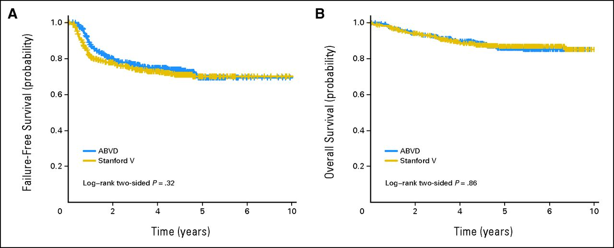
ABVD vs Stanford V
Gordon L I et al. JCO 2013;31:684-691
©2013 by American Society of Clinical Oncology

Slide 10
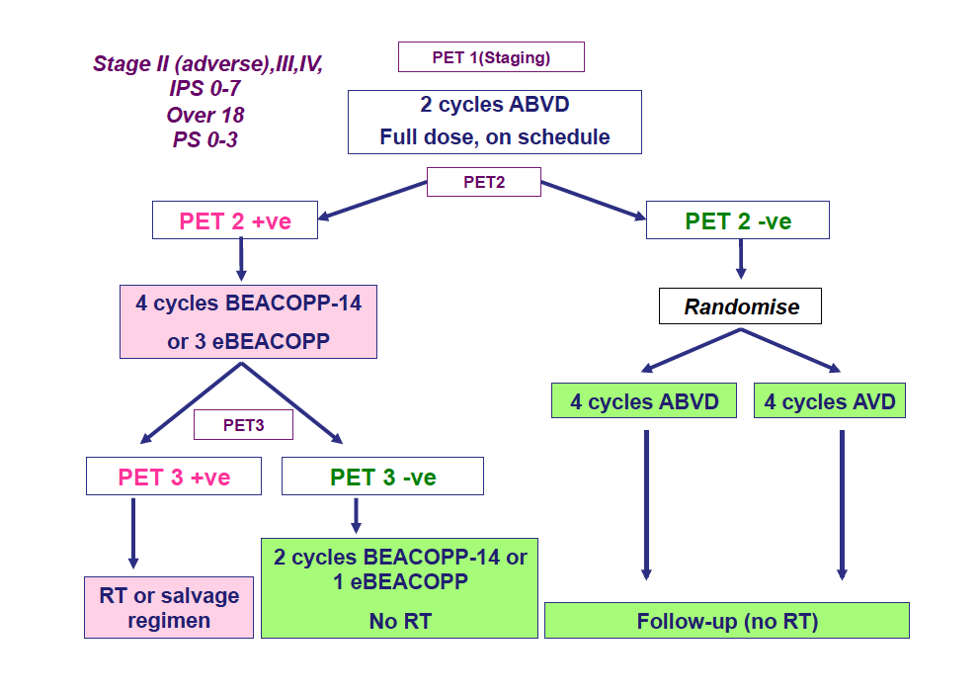
RATHL Trial
Johnson, P ICML 2015

Slide 11
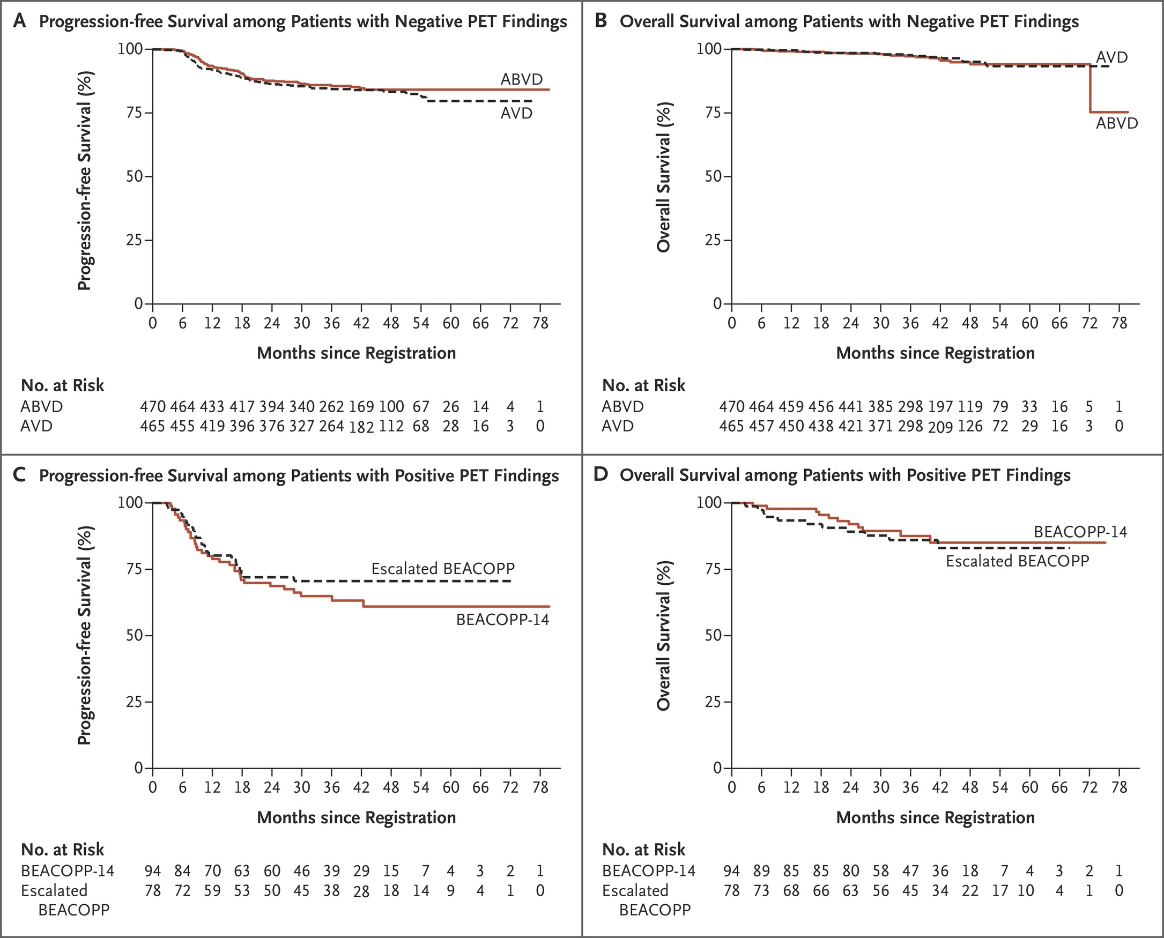
RATHL: PFS and OS
PFS
PET2-
OS
PET2-
PFS
PET2+
OS
PET2+
Johnson P et al. N Engl J Med 2016;374:2419-2429

Slide 12
ECHELON-1: Phase 3 Study of BV+AVD Versus ABVD in Newly Diagnosed, Advanced cHL¹
218 study sites in 21 countries worldwide
Screening
CT/PET scan
EOT
CT/PET scan
Follow-up every 3 months for 36 months, then every 6 months until study closure
ABVD x 6 cycles (n = 670)
R
1:1
BV+AVD x 6 cycles (n = 664)
BV 1.2 mg/kg IV infusion
Days 1 and 15
N =
1,334
Inclusion Criteria
cHL stage III or IV
ECOG PS 0, 1, or 2
Age ≥18 years
Measurable disease
Adequate liver and renal function
End-of-cycle-2 PET scan
Deauville 5; could receive alternate therapy per physician’s choice (not an mPFS event)

Slide 13
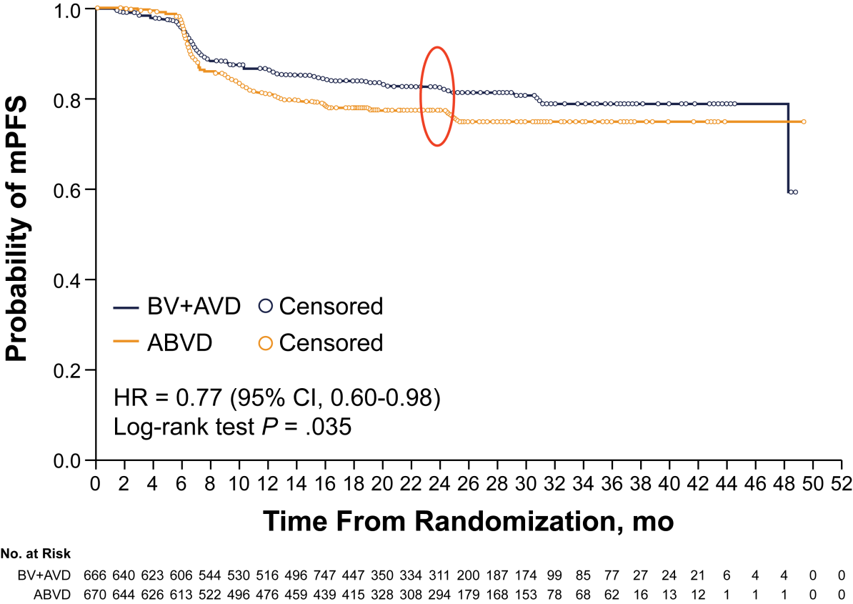
mPFS Per Independent Review
Number of Events
 | BV+AVD (n = 117) | ABVD (n = 146)
Progression | 90 | 102
Death | 18 | 22
Modified progression Chemotherapy Radiotherapy | 9 7 2 | 22 15 7
mPFS Estimates
 | BV+AVD (95% CI) | ABVD (95% CI)
2-year | 82.1 (78.7-85.0) | 77.2 (73.7-80.4)
Median follow-up (range): 24.9 mo (0.0-49.3)

Slide 14
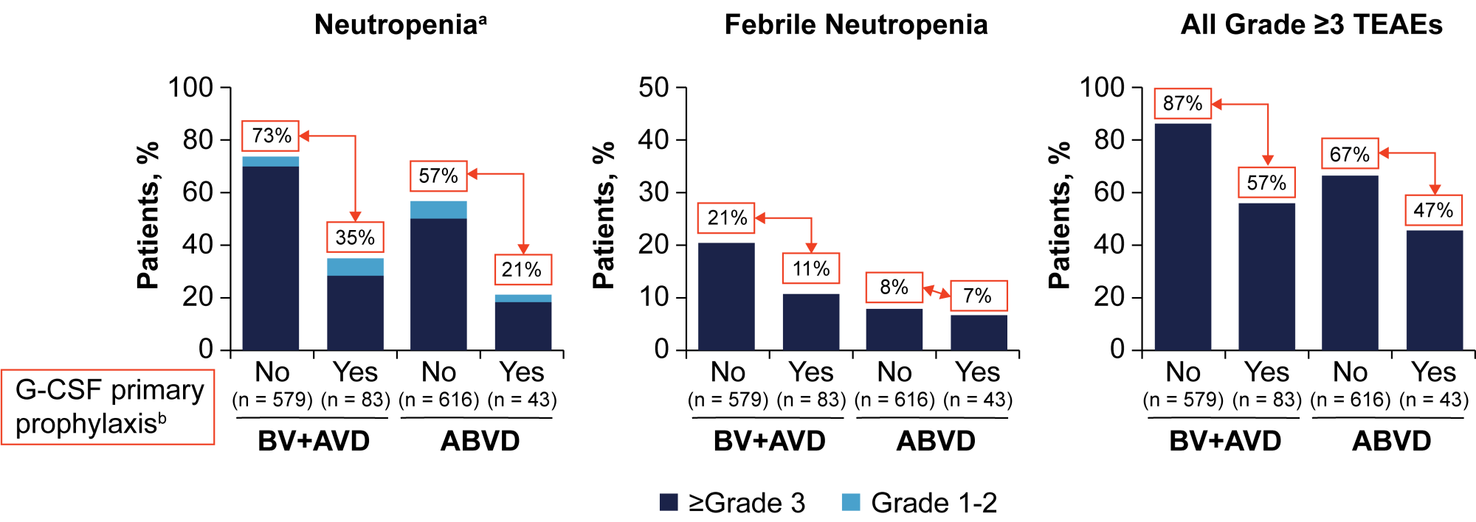
Summary of Treatment-Emergent Febrile Neutropenia and AEs by Primary Prophylaxis With G-CSF
G-CSF primary prophylaxis for BV+AVD resulted in an overall safety profile comparable to ABVD
G-CSF primary prophylaxis is recommended for all BV+AVD patients

Slide 15
Phase 2 CheckMate (Cohort D) 205 Study Design:
Nivolumab in Newly Diagnosed cHL
Monotherapy
(4 doses)
Combotherapy
(6 combo-cycles; 12 doses)
Adults with newly diagnosed, untreated, advanced-stage cHL
(stage IIB, III, IV)
Performance status 0-1
N = 51
Follow-up/ observation
Nivolumab
240 mg IV Q2W
Nivolumab 240 mg IV + AVD
Q2W
~8 weeks
~22 weeks
Max 2 years
FDG-PET plus CT/MRI scans
Primary Endpoints
Safety and tolerability
(Grade 3-5 TRAEs)
Additional Endpoints
Discontinuation rate
CR and ORR by IRC
CR and ORR by investigator
mPFS
OS
Ramshandren et al, ASH 2017

Slide 16
Response per IRC and Investigator: ITT Population¹
ORR: 90%
ORR: 88%
ORR: 84%
ORR: 84%
ORR: 69%
ORR: 67%
End of Monotherapy
After 2 Cycles
End of Therapy
At end of therapy, ORR per investigator for the ITT population was 84%, with 80% of patients achieving CR
Five patients were nonevaluable at end of therapyª

Slide 17
Best Change in Target Lesion Per IRC at
End of Chemoimmunotherapy¹
100
Negative FDG-PET scan at EOT or last prior radiographic assessment
75
Positive FDG-PET scan at EOT or last prior radiographic assessment
Responders
50
25
0
Reduction From Baseline in Target Lesion, %
–25
–50
–75
–100
Patients

Slide 18
HRS Cells Express High Levels of PD-L1
PD-L1
PD-1
T-Cells
T-Cells
Adapted from Stathis & Younes: Ann Oncology 2015
And Younes A & Ansell S: Seminars in Hematology, 2016, 186–189

Slide 19
Brentuximab vedotin in pre-ASCT therapy
 | N | % CR | % CR with BV | Reference
ICE | 97 | 60% | N/A | Moskowitz C, Blood 2012
BV->ICE | 46 | 73% | 27% | Moskowitz A, Lancet Oncol 2015
BV -> chemo | 36 |  | 33% | Chen R, ASH 2014
BV+Benda | 34 | 82% | N/A | LaCasce A, ASH 2014

Slide 20
BV combination regimens
 | BV + bendamustine | BV + ESHAP | BV + ICE
N | 55 | 66 | 16
Dose | -1.8 mg/kg BV on D1 -Bendamustine D1 and D2 | -1.8 mg/kg BV on D1 -ESHAP days 1-4 | -1.5 mg/kg BV on D1 and 8 -ICE days 2-4
Response Rates | 93% ORR 74% CR | 94% ORR 70% CR | 94% ORR 88% CR 69% CR (IR)
Toxicity | 56% infusion reaction | Myelosuppression, infections | Myelosuppression, Peripheral neuropathy
PFS/OS | 12 months PFS 80% | 18 months TTF 74% | N/A
LaCase A et al, ASH 2015
Garcia-Sanz R et al. ASH 2016
Cassaday R et al, ASH 2016

Slide 21
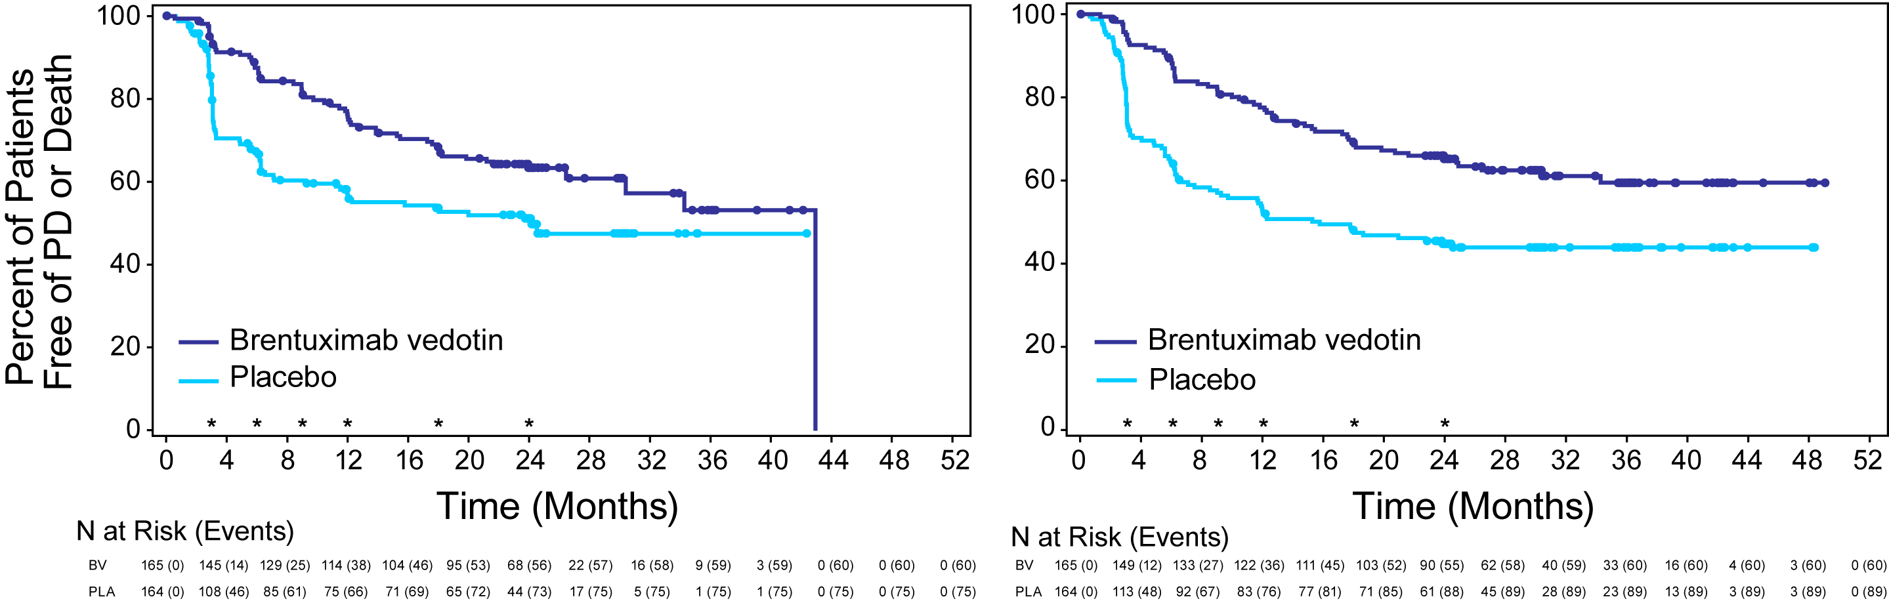

Progression-free survival
PFS per IRF
PFS per Investigator†
 | BV (N=165) | Placebo (N=164)
Hazard Ratio (95% CI) | 0.57 (0.40–0.81, P=0.001)
Events | 60 | 75
Median PFS (months) | 43 | 24
2-year PFS rate | 63% | 51%
 | BV (N=165) | Placebo (N=164)
Hazard Ratio (95% CI) | 0.50 (0.36–0.70)
Events | 60 | 89
Median PFS (months) | -- | 16
2-year PFS rate | 65% | 45%
* Regularly scheduled CT scans
† Includes information from both radiographic assessments and clinical lymphoma assessments
Moskowitz C, et al The Lancet 2015

Slide 22
Results of PD-1 Blocking Antibodies in Relapsed HL
Results of Phase II Studies
Post ASCT and Brentuximab Vedotin
Drug | Dose/Schedule | N | % ORR | % CR | 1st Author/Ref
Pembrolizumab (humanized IgG4) | 200 mg IV Q 3wks | 69 | 72% | 21% | Chen, R & C Moskowitz JCO 2017
Nivolumab (Fully human IgG4) | 3 mg/kg IV Q 2 wks | 80 | 66% | 9% | Younes, A/Lancet Oncology 2016

Slide 23
Results of PD-1 Blocking Antibodies in Relapsed HL
Results of Phase II Studies
Post ASCT but No PRIOR Brentuximab Vedotin
Drug | Dose/Schedule | N | % ORR | % CR | 1st Author/Ref
Pembrolizumab (humanized IgG4) | 200 mg IV Q 3wks | 60 | 67% | 21% | Chen, R & C Moskowitz JCO 2017
Nivolumab (Fully human IgG4) | 3 mg/kg IV Q 2 wks | 63 | 68% | 22% | Fanale, M/ ICML 2017

Slide 24
Progression-Free Survival by Best Overall Response
Nivolumab for Relapsed cHL
1.0
0.9
CR: 22 (19, NE) months
0.8
0.7
0.6
Probability of PFS
PR: 15 (11, 19) months
0.5
0.4
SD: 11 (6, 18) months
0.3
0.2
0.1
0
0
3
6
9
12
15
18
PFS (months)
Number of patients at risk
CR
PR
SD
40
128
47
40
126
44
33
89
25
32
71
19
27
46
11
20
25
8
16
21
8

Slide 25
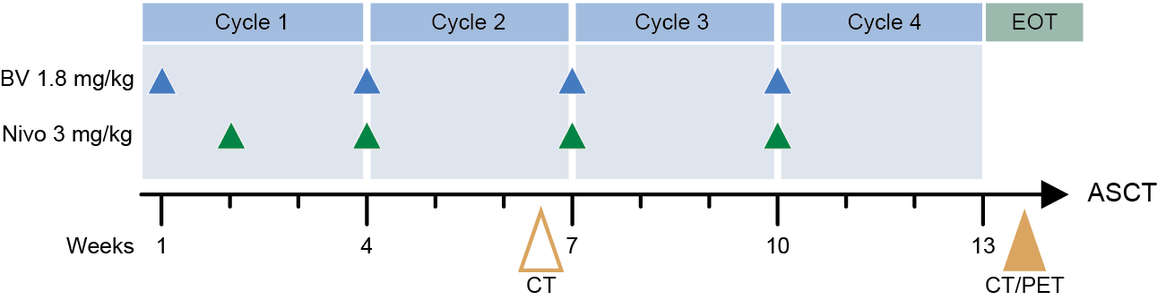
Nivolumab + Brentuximab Salvage Therapy for HL
PR/CR
Stem cell collection
=> BEAM ASCT
Brentuximab Vedotin 1.8mg/kg
Nivolumab 240 mg
Q 3wks x 4
Restage
< PR
Chemo salvage
Stem cell collection
=> BEAM ASCT
Notes:
25

Slide 26
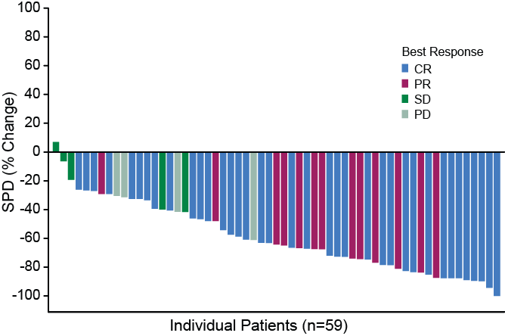
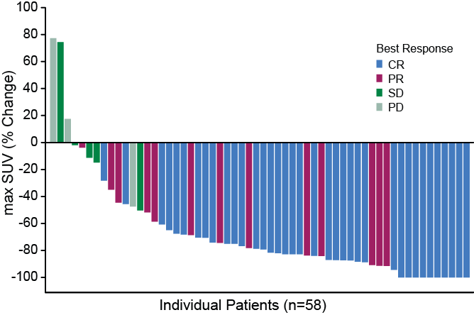
Tumor Response (N=59)
85% objective response rate with 63% complete responses
SPD change from baseline
 | N = 59 n (%)
Complete response (CR) | 37 (63)
Deauville ≤ 2 | 29 (49)
Deauville 3 | 7 (12)
Deauville 5ª | 1 (2)
Partial response (PR) | 13 (22)
Deauville 4 | 7 (12)
Deauville 5 | 6 (10)
No metabolic response (SD) | 5 (8)
Deauville 5 | 5 (8)
Progressive disease (PD) | 3 (5)
Deauville 5 | 2 (3)
Missing | 1 (2)
Clinical Progression (CP) | 1 (2)
Max SUV change from baseline
a. 1 pt had uptake in lymph node, but no evidence of disease was found on biopsy
SPD, sum of the product of the diameters; SUV, standard uptake value

Slide 27
Conclusions
Brentuximab Vedotin is a highly active single agent in relapsed HL
Combination strategies demonstrated variable activity in front-line, second line, and post transplant setting
In the era of highly active new agents, the role of ASCT in second line treatments needs to be re-examined
Immune checkpoint inhibitors are active agents in BV failures
BV + PD-1 antibodies seems to be safe and effective, and may provide a new backbone for future drug development in HL
Standard of care therapy is likely to change in the next few years

