Slide 1
Please note, these are the actual video-recorded proceedings from the live CME event and may include the use of trade names and other raw, unedited content.

Slide 2
Optimal Management Strategies for Patients with Localized HER2-Positive Breast Cancer
Sara A Hurvitz, MD
Associate Professor of Medicine
Director, Breast Oncology Program
University of California, Los Angeles

Slide 3
Disclosures
Contracted Research | Amgen Inc, Bayer HealthCare Pharmaceuticals, BioMarin, Boehringer Ingelheim Pharmaceuticals Inc, Cascadian Therapeutics, Dignitana, Genentech BioOncology, GlaxoSmithKline, Lilly, Medivation Inc, a Pfizer Company, Merrimack Pharmaceuticals Inc, Novartis, OBI Pharma Inc, Pfizer Inc, Puma Biotechnology Inc, Roche Laboratories Inc, Seattle Genetics
Paid Travel | Bayer HealthCare Pharmaceuticals, Lilly, Novartis, OBI Pharma Inc

Slide 4
A 65-year-old woman presents with a 3.4-cm, ER-negative, HER2-positive infiltrating ductal carcinoma (IDC) and receives neoadjuvant docetaxel/carboplatin/trastuzumab/pertuzumab (TCHP). What adjuvant anti-HER2 therapy would you recommend if at surgery she is found to have…?
Pathologic complete response
Significant residual disease
Trastuzumab/pertuzumab
Trastuzumab/pertuzumab
Trastuzumab
Trastuzumab/pertuzumab
Trastuzumab
Trastuzumab/pertuzumab
Trastuzumab/pertuzumab
Trastuzumab/pertuzumab
Trastuzumab
Trastuzumab/pertuzumab
Trastuzumab
Trastuzumab/pertuzumab

Slide 5
What adjuvant systemic therapy would you generally recommend for a 65-year-old woman who at surgery is found to have a 2.5-cm, ER-negative, HER2-positive, node-negative IDC? Would you recommend postadjuvant neratinib?
Adjuvant treatment
Postadjuvant neratinib?
TCHP
No
Paclitaxel/trastuzumab
No
TCHP
No
Anthracycline regimen → HP
No
THP
No
THP
No
H, trastuzumab; P, pertuzumab

Slide 6
What adjuvant systemic therapy would you generally recommend for a 65-year-old woman who at surgery is found to have a 2.5-cm, ER-negative, HER2-positive IDC with 2 of 4 positive sentinel nodes? Would you recommend postadjuvant neratinib?
Adjuvant treatment
Postadjuvant neratinib?
TCHP
No
Anthracycline regimen → HP
No
TCHP
No
Anthracycline regimen → HP
No
TCHP
No
TCHP
No
H, trastuzumab; P, pertuzumab

Slide 7
What adjuvant systemic therapy would you generally recommend for a 65-year-old woman who at surgery is found to have a 2.5-cm, ER-positive, HER2-positive IDC with 2 of 4 positive sentinel nodes? Would you recommend postadjuvant neratinib?
Adjuvant treatment
Postadjuvant neratinib?
TCHP
Yes
Anthracycline regimen → HP
Yes
TCHP
Yes
Anthracycline regimen → HP
No
TCHP
Yes
TCHP
Yes
H, trastuzumab; P, pertuzumab

Slide 8
Contributing Oncologist Case
A 44-year-old woman with a 5-cm, ER-negative, HER2-positive IDC and axillary node involvement but no metastatic disease receives 6 cycles of neoadjuvant docetaxel/carboplatin/trastuzumab/pertuzumab (TCHP), which she tolerates well. Lumpectomy reveals 1.5 cm of residual invasive disease and 3 positive axillary lymph nodes.
Questions
What adjuvant anti-HER2 therapy would you recommend?
Would you recommend postadjuvant neratinib?

Slide 9
Evidence-Based Assumptions
Without HER2-targeted therapy, HER2+ breast cancer has a poor prognosis (similar to triple-negative disease) with 10-year recurrence risk ~30-40% after standard chemotherapy
When treated with trastuzumab, the relative risk of recurrence or death from HER2+ breast cancer is reduced by 30-40%
When treated with trastuzumab, the long-term survival from HER2+ breast cancer is as good as or better than HER2-negative disease

Slide 10
How Do We Apply New Data?
Neratinib and Pertuzumab now approved and available in the curative setting
Both show significant improvements in disease-free survival (relative risk reduction ~19%-27%)
Both are associated with an increase in toxicity
This begs the following question:
How much benefit can be expected for an individual patient by adding pertuzumab or neratinib after standard trastuzumab-based therapy?

Slide 11
Assessing Risk
What is the risk of recurrence after standard chemo vs. chemo plus HER2-targeted therapy?
What is the risk of recurrence for patients with lymph node involvement?
What is the risk of recurrence for patients with tumors co-expressing hormone receptors?
What is the risk of recurrence for patients who achieve a pCR vs non-pCR with neoadjuvant therapy?

Slide 12
DISEASE-FREE SURVIVAL ADJUVANT STUDIES
TRIAL | CHEMO ALONE | CHEMO + TRASTUZUMAB
NCCTG N9831/NSABP B-31 Perez, J Clin Oncol 2014 N=3551 10-year 20% Crossover | 62% | 73%
HERA Goldhirsch, Lancet Oncol, 2013;82:1021 N=5090 8-year 52% crossover | 66% | 72%
BCIRG-006 Slamon, Cancer Res 2016;76(4 Suppl), Abs PD5-01 N=3222 10-year 3% crossover | 68% | 74%*
*(73% TCH, 75% ACTH)

Slide 13
Assessing Risk
What is the risk of recurrence after standard chemo vs. chemo plus HER2-targeted therapy?
What is the risk of recurrence for patients with lymph node involvement?
What is the risk of recurrence for patients with tumors co-expressing hormone receptors?
What is the risk of recurrence for patients who achieve a pCR vs non-pCR with neoadjuvant therapy?

Slide 14
10-YEAR DISEASE-FREE SURVIVAL BASED ON NODE STATUS (BCIRG-006)
Treatment | LN Negative* | 1-3+ LN | >4+ LN
AC-TH | 83% | 77% | 66%
TCH | 82% | 78% | 65%
BCIRG-006, Slamon, Cancer Res 2016
*29% patients had LN negative disease in this study

Slide 15
Assessing Risk
What is the risk of recurrence after standard chemo vs. chemo plus HER2-targeted therapy?
What is the risk of recurrence for patients with lymph node involvement?
What is the risk of recurrence for patients with tumors co-expressing hormone receptors?
What is the risk of recurrence for patients who achieve a pCR vs non-pCR with neoadjuvant therapy?

Slide 16
DFS/EFS for HR+ is as good as or better than that for HR-negative
Study | Treatment | HR positive | HR negative
ALTTO 5-year DFS Moreno-Aspitia et al ASCO 2017 Abs 502 | L+T | 85% | 84%
 | T→L | 85% | 82%
 | T | 83% | 80%
NeoALTTO 6-year EFS Huober, et al ASCO 2017 Abs 512 | L+T | 74% | 74%
 | L | 73% | 61%
 | T | 71% | 63%
BCIRG-006 5-year DFS Slamon, et al NEJM 2011 | AC-TH | 84% | 81%
 | TCH | 80% | 80%
B-31/N9831 10-year DFS Perez E et al. J Clin Oncol 2014:32. | AC-TH | 76% | 71%

Slide 17
Assessing Risk
What is the risk of recurrence after standard chemo vs. chemo plus HER2-targeted therapy?
What is the risk of recurrence for patients with lymph node involvement?
What is the risk of recurrence for patients with tumors co-expressing hormone receptors?
What is the risk of recurrence for patients who achieve a pCR vs non-pCR with neoadjuvant therapy?

Slide 18
DISEASE-FREE SURVIVAL BASED ON RESPONSE TO NEOADJUVANT HER2-TARGETED THERAPY
TRIAL | pCR | Non-pCR
Techno (tpCR) 3-year DFS | 88% | 73%
GeparQuinto GBG-44 (tpCR) 3-year DFS | 90% | 83%
NeoALTTO (in breast pCR only) 3-year EFS | 86% | 72%
NSABP B-41 (in breast pCR only) 5-year RFI | 90% | 81%
Neosphere (tpCR) 5-year PFS | 85% | 76%

Slide 19
Association between pCR and EFS (NeoALTTO) HR negative (Left) vs HR positive (Right)
Similar findings in GeparQuinto and NSABP B41, but not in NeoSphere
De Azambuja E et al. Lancet Oncol. 2014;15

Slide 20
Summary Absolute Risk for Subgroups
10-year DFS Chemo+Trastuzumab
Node Negative 82%
1-3 Nodes 77%
More than 4 nodes 65%
3-5 year DFS
pCR 85-90%
No pCR 75-80%

Slide 21
NERATINIB: ExteNET Study Design
HER2+ breast cancer (local)
Prior adjuvant trastuzumab & chemotherapy
Trastuzumab completed <14m previously
Lymph node + or residual invasive disease after neoadjuvant therapy
ER/PR + or –
Part A
Part B
Part C
Neratinib x 1 year
240mg/day
1:1 randomization
2-year follow-up for iDFS
Overall survival
5-year follow-up for iDFS
Placebo x 1 year
Chan et al, Lancet Oncol Volume 17, Issue 3, 2016, 367–377

Slide 22
ExteNET: Exploratory 5-Year iDFS
Overall population: 2.5% delta
27% relative risk reduction
Holmes MM et al. Lancet Oncol 2017 Dec;18(12):1688-1700

Slide 23
Possible Impact of Neratinib (N) on DFS (Does not take into consideration patients who received pertuzumab where starting DFS likely better)
10-year DFS Chemo+Trastuzumab
Node Negative 82% → 5% benefit with N
1-3 Nodes 77% → 6% benefit with N
More than 4 nodes 65% → 9% benefit with N
3-5 year DFS
pCR 85% → 4% benefit with N
No pCR 75% → 7% benefit with N

Slide 24
ExteNET: Exploratory 5-Year iDFS
HR positive: 4.4% delta
40% relative risk reduction
Holmes MM et al. Lancet Oncol 2017 Dec;18(12):1688-1700

Slide 25
Possible Impact of Neratinib (N) on Absolute Risk for Subgroups: HR POSITIVE??
10-year DFS Chemo+Trastuzumab
Node Negative 82% → 5 7% benefit with N
1-3 Nodes 77% → 6 9% benefit with N
More than 4 nodes 65% → 9 14% benefit with N
3-5 year DFS
pCR 85% → 4 6% benefit with N
No pCR 75% → 7 10% benefit with N

Slide 26
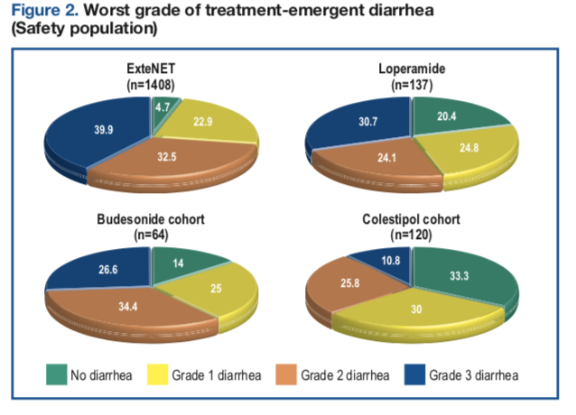
Diarrhea ExteNET vs CONTROL Study
Hurvitz et al. SABCS 2017 P3-14-01

Slide 27
APHINITY: Trial Design
S U R G E R Y
Chemotherapy* + trastuzumab + pertuzumab
F
O
L
L
O
W
-
U
P
10
Y
E
A
R
S
Central confirmation of HER2 status
(N = 4805)
R
Chemotherapy* + trastuzumab + placebo
Randomisation and treatment
within 8 weeks of surgery
Anti-HER2 therapy for a total of 1 year (52 weeks)
(concurrent with start of taxane) Radiotherapy and/or endocrine therapy may be started at the end of adjuvant chemotherapy
*A number of standard anthracycline or non-anthracycline (TCH) regimens were allowed
Von Minckwitz et al. ASCO 2017 Abs LBA500

Slide 28
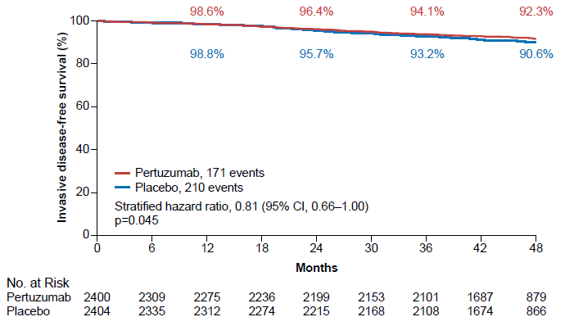
Pertuzumab x 1 year: APHINITY – iDFS Analysis
Von Minckwitz et al. ASCO 2017 Abs LBA500

Slide 29
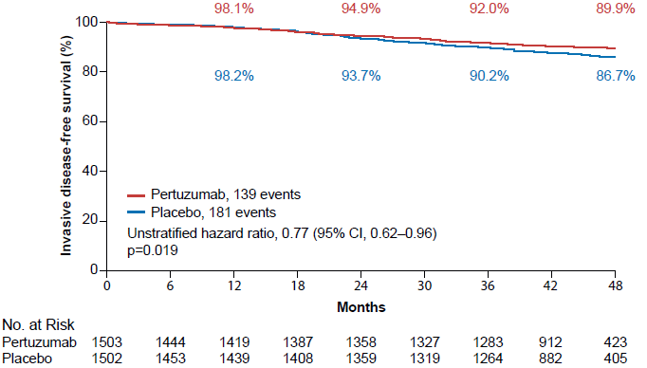
APHINITY: Node-positive Subgroup
Von Minckwitz et al. ASCO 2017 Abs LBA500

Slide 30
Possible Impact of Pertuzumab (P) on DFS
10-year DFS Chemo+Trastuzumab
Node Negative 82% → 3% benefit with P
1-3 Nodes 77% → 5% benefit with P
More than 4 nodes 65% → 8% benefit with P
3-5 year DFS (not accounting for pts who received neo P)
pCR 85% → 3% benefit with P
No pCR 75% → 6% benefit with P

Slide 31
APHINITY: Common Grade ≥ 3 Adverse Events
 | Pertuzumab n=2364 | Placebo n=2405
Neutropenia | 385 (16.3%) | 377 (15.7%)
Febrile Neutropenia | 287 (12.1%) | 266 (11.1%)
Neutrophil count decreased | 228 ( 9.6%) | 230 ( 9.6%)
Diarrhoea | 232 (9.8%) | 90 ( 3.7%)
Anaemia | 163 ( 6.9%) | 113 ( 4.7%)
Von Minckwitz et al. ASCO 2017 Abs LBA500

Slide 32
Conclusions
Trastuzumab-based therapy substantially improves DFS/OS
HR-co-expressing breast cancer has lower pCR rates but similar/better long-term outcomes compared to HR-negative
1-year neratinib after 1-year of trastuzumab improves iDFS by 27% in all comers (40% in HR+), at the expense of significant GI toxicity
Adjuvant pertuzumab significantly improves iDFS by 19% in all comers (23% in LN+), at the expense of increased toxicity
Deciding which patients should have additional systemic therapy for breast cancer depends on the assessment of their absolute risk of recurrence, which is tricky

Slide 33
Contributing Oncologist Case
A 63-year-old woman with a 4-cm, Grade III, ER/PR-positive, HER2-positive IDC and a history of Type 2 diabetes and rheumatoid arthritis receives 1 cycle of neoadjuvant TCHP and develops severe diarrhea requiring hospitalization for dehydration. At the time of hospitalization, her diabetes is uncontrolled and she is in acute renal failure (creatinine = 5.0 mg/dL) and has a bleeding duodenal ulcer. All symptoms resolve with supportive management. The breast mass is no longer palpable, and the patient refuses additional chemotherapy. She undergoes lumpectomy with sentinel lymph node biopsy, which reveals a pathologic complete response.
Questions
What postoperative therapy would you recommend if the patient agreed to further treatment?
In general, have you been administering 6 months of adjuvant anti-HER2 treatment to your patients? In so, in which situations?

