Slide 1
Please note, these are the actual video-recorded proceedings from the live CME event and may include the use of trade names and other raw, unedited content.

Slide 2
Consensus or Controversy? Clinical Investigators Provide Perspectives on Practical Issues and Ongoing Research Related to the Management of Breast Cancer Monday, June 4, 2018
7:00 PM – 9:30 PM Chicago, Illinois
Faculty
Harold J Burstein, MD, PhD
Angelo Di Leo, MD, PhD
Sara A Hurvitz, MD
Mark Robson, MD
Hope S Rugo, MD
George W Sledge Jr, MD
Moderator Neil Love, MD

Slide 3
Disclosures for Moderator Neil Love, MD
Dr Love is president and CEO of Research To Practice, which receives funds in the form of educational grants to develop CME activities from the following commercial interests: AbbVie Inc, Acerta Pharma — A member of the AstraZeneca Group, Adaptive Biotechnologies, Agendia Inc, Agios Pharmaceuticals Inc, Amgen Inc, Ariad Pharmaceuticals Inc, Array BioPharma Inc, Astellas Pharma Global Development Inc, AstraZeneca Pharmaceuticals LP, Baxalta Inc, Bayer HealthCare Pharmaceuticals, Biodesix Inc, bioTheranostics Inc, Boehringer Ingelheim Pharmaceuticals Inc, Boston Biomedical Pharma Inc, Bristol-Myers Squibb Company, Celgene Corporation, Clovis Oncology, CTI BioPharma Corp, Dendreon Pharmaceuticals Inc, Eisai Inc, Exelixis Inc, Foundation Medicine, Genentech BioOncology, Genomic Health Inc, Gilead Sciences Inc, Halozyme Inc, ImmunoGen Inc, Incyte Corporation, Infinity Pharmaceuticals Inc, Ipsen Biopharmaceuticals Inc, Janssen Biotech Inc, administered by Janssen Scientific Affairs LLC, Jazz Pharmaceuticals Inc, Kite Pharma Inc, Lexicon Pharmaceuticals Inc, Lilly, Medivation Inc, a Pfizer Company, Merck, Merrimack Pharmaceuticals Inc, Myriad Genetic Laboratories Inc, NanoString Technologies, Natera Inc, Novartis, Novocure, Onyx Pharmaceuticals, an Amgen subsidiary, Pfizer Inc, Pharmacyclics LLC, an AbbVie Company, Prometheus Laboratories Inc, Puma Biotechnology Inc, Regeneron Pharmaceuticals Inc, Sanofi Genzyme, Seattle Genetics, Sigma-Tau Pharmaceuticals Inc, Sirtex Medical Ltd, Spectrum Pharmaceuticals Inc, Taiho Oncology Inc, Takeda Oncology, Tesaro Inc, Teva Oncology and Tokai Pharmaceuticals Inc.
Notes:
3
3
3

Slide 4
RTP ASCO Symposia

Slide 5
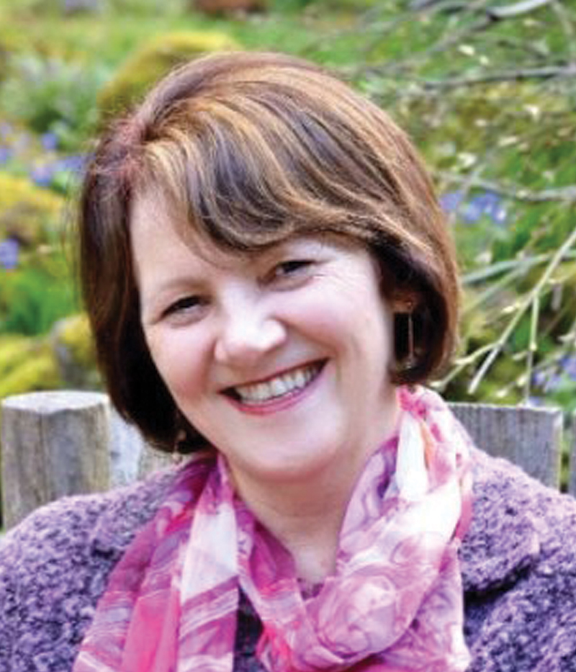
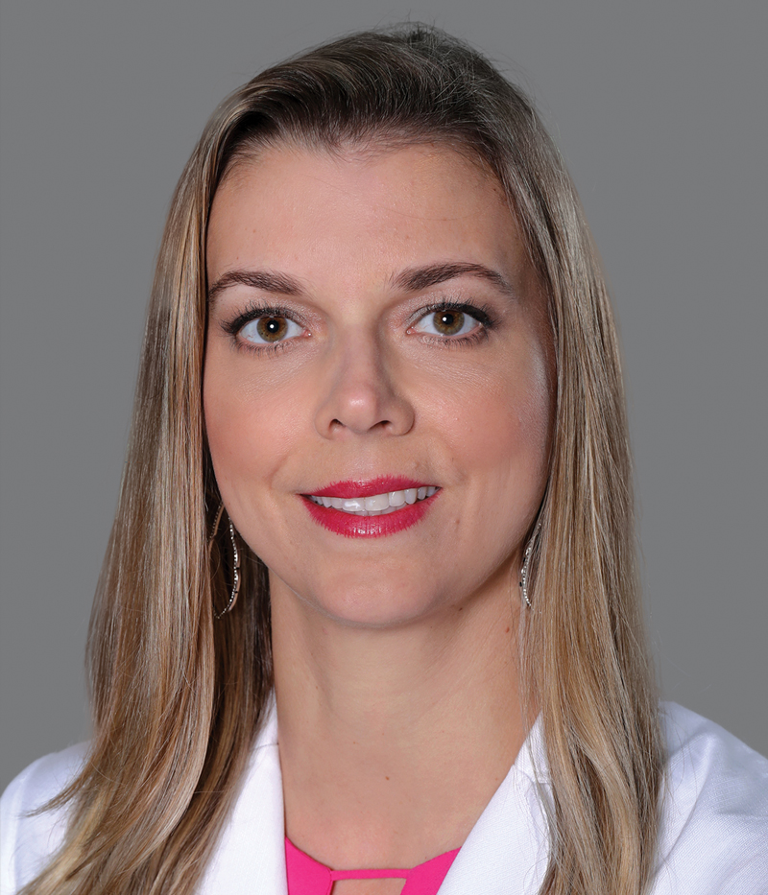
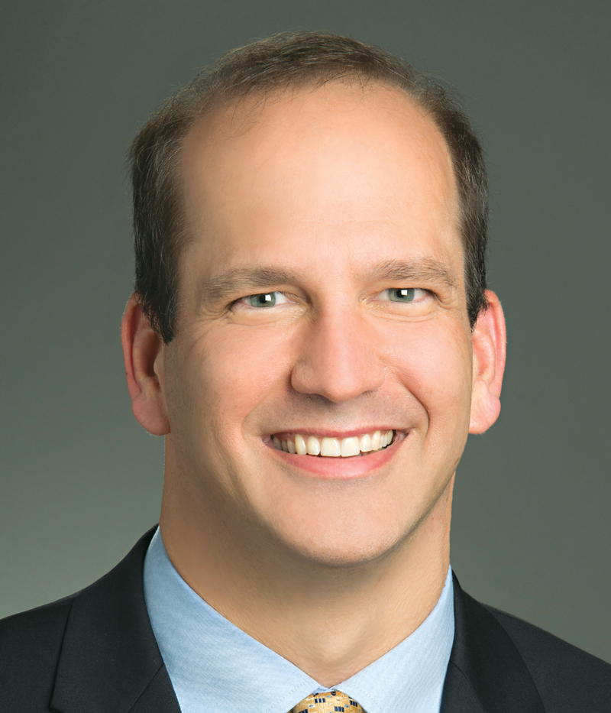
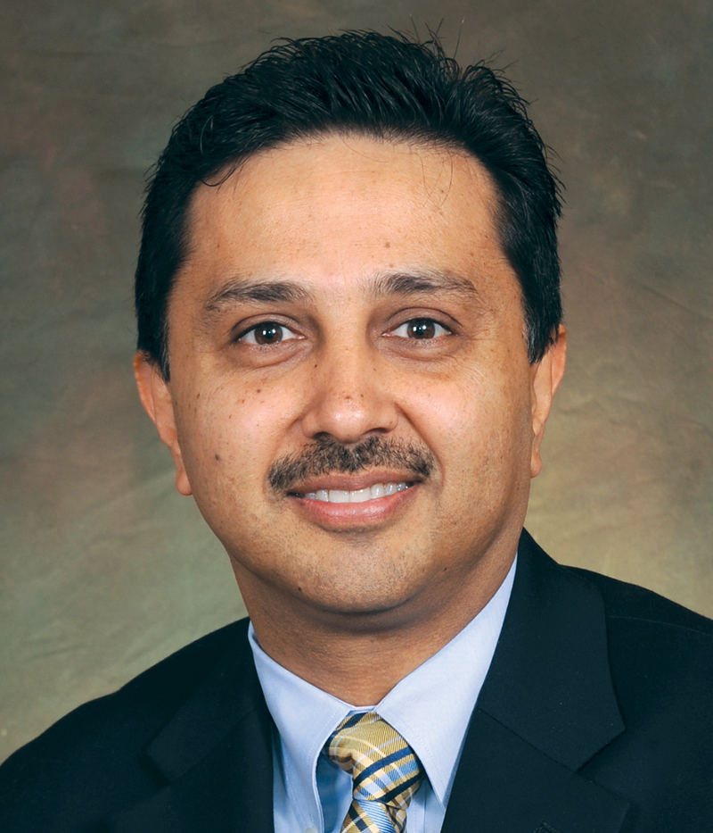
Contributing Community Oncologists
Alan B Astrow, MD
New York, New York
Eveyln Brosnan, MD
Chapel Hill, North Carolina
Lauren Peirce Carcas, MD
Miami, Florida
Justin P Favaro, MD, PhD
Charlotte, North Carolina
Neeraj Mahajan, MD
Cleveland, Ohio

Slide 6
Agenda
Module 1 – Optimal Treatment Strategies for Patients with Localized HER2-Positive Breast Cancer (BC) — Dr Hurvitz
Module 2 – Current Role of Genomic Assays in the Management of ER-Positive Early BC — Dr Burstein
Module 3 – Therapeutic Considerations for Patients with ER-Positive, HER2-Negative Metastatic BC (mBC) — Dr Di Leo
Module 4 – Protocol and Nonresearch Decision-Making for Patients with HER2-Positive mBC — Dr Sledge
Module 5 – Role of PARP Inhibition in the Management of BC — Dr Robson
Module 6 – Immune Checkpoint Inhibitors and Other Emerging Therapeutic Strategies — Dr Rugo

Slide 7
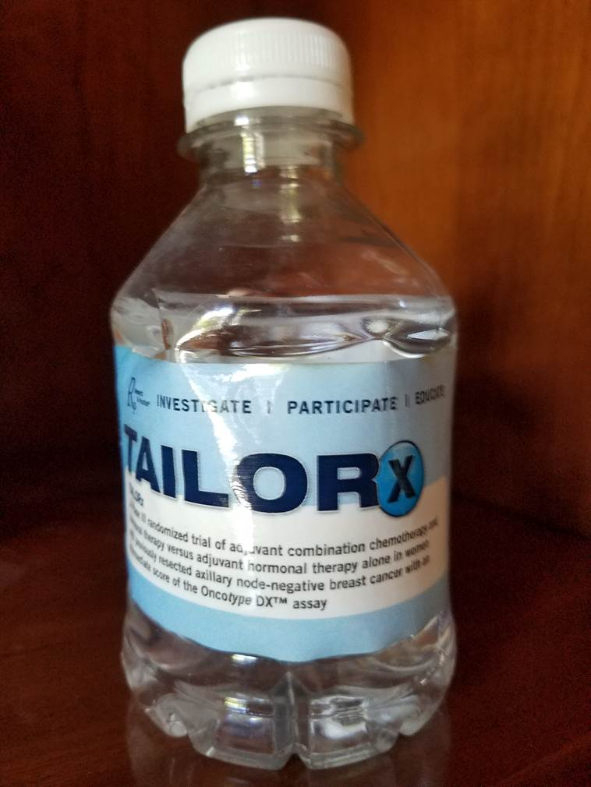
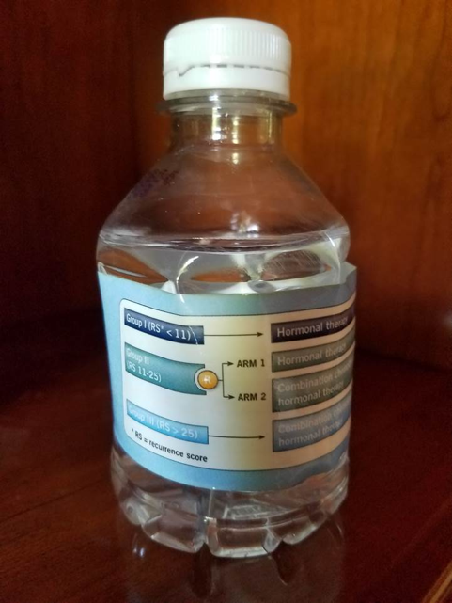
Notes:
7
7

