Slide 1
Please note, these are the actual video-recorded proceedings from the live CME event and may include the use of trade names and other raw, unedited content.

Slide 2
DNA Damage Repair and Breast Cancer Treatment: PARP Inhibitors
2018-06-04
Mark Robson, MD
Breast Medicine and Clinical Genetics Services
robsonm@mskcc.org
@MarkRobsonMD

Slide 3
Disclosures
Advisory Committee, Consulting Agreement and Contracted Research | AstraZeneca Pharmaceuticals LP

Slide 4
In general, for a 65-year-old woman who presents with metastatic breast cancer and no relevant family history, at what point, if any, would you order BRCA testing if the patient’s disease were…
Triple-negative
ER-positive, HER2-negative
HER2-positive
Immediately
After second-line treatment
None
None
None
None
Immediately
None
None
Immediately
None
None
Immediately
None
None
After second-line treatment
None
None

Slide 5
Reimbursement and regulatory issues aside, have you or would you use olaparib for a patient who has a somatic BRCA mutation? A PALB2 germline mutation?
Somatic BRCA mutation
PALB2 germline mutation
No, but would for the right patient
No, but would for the right patient
No, but would for the right patient
No, but would for the right patient
No, but would for the right patient
No, but would for the right patient
No, but would for the right patient
No, but would for the right patient
I have for 1 patient
No, but would for the right patient
No, but would for the right patient
I have

Slide 6
Reimbursement and regulatory issues aside, what would be your preferred treatment approach for a patient with metastatic TNBC and a BRCA germline mutation?
De novo
After adj anthra/tax
After adj anthra/tax → platinum
Platinum chemotherapy
Platinum chemotherapy
Olaparib
Platinum chemotherapy
Platinum chemotherapy
Olaparib
Induction chemo → olaparib maintenance
Olaparib
Olaparib
Olaparib
Olaparib
Nonplatinum chemo
Platinum chemotherapy
Olaparib
Alternate chemotherapy
Platinum chemotherapy
Platinum chemotherapy
Olaparib

Slide 7
Reimbursement and regulatory issues aside, what would be your preferred treatment approach for a patient with metastatic ER-positive, HER2-negative breast cancer and a BRCA germline mutation?
De novo
After adj anastrozole → palbociclib/fulvestrant
Endocrine therapy
Olaparib
CDK4/6 inhibitor + endocrine therapy
Exemestane + everolimus
CDK4/6 inhibitor + endocrine therapy
Exemestane + everolimus
CDK4/6 inhibitor + endocrine therapy
Olaparib
Olaparib + endocrine therapy
Olaparib ± endocrine therapy
CDK4/6 inhibitor + endocrine therapy
Exemestane + everolimus

Slide 8
Have you or would you administer olaparib to an asymptomatic patient with a BRCA germline mutation and ER-negative, HER2-positive metastatic breast cancer presenting with progressive disease who has received all standard anti-HER2 treatments?
No, but would for the right patient
No, but would for the right patient
No, but would for the right patient
No, but would for the right patient
No, but would for the right patient
No, but would for the right patient

Slide 9
In general, in which line of therapy would you generally administer olaparib to a patient with metastatic breast cancer and a BRCA germline mutation?
Triple-negative
ER-positive, HER2-negative
Second line
Third line
Second line
Third line
Second line
Third line
First line
Second line
First- or second-line
First- or second-line
Third line
Third line

Slide 10
Contributing Oncologist Case
A 27-year-old woman with a BRCA2 germline mutation and T2N2M0, ER 80%, PR 20%, HER2-negative IDC receives neoadjuvant chemotherapy, mastectomy and radiation therapy followed by tamoxifen but after 2 years is found to have metastatic disease and receives goserelin and palbociclib/letrozole with response for 14 months but is then found to have pulmonary lymphangitic carcinomatosis.
Question
What therapy would you recommend?

Slide 11
Alternative model (PARP “trapping”)
From CJ Lord, A Ashworth, Science 2017;355(6330):1152-1158.

Slide 12
Phase II studies of olaparib in breast cancer
 | Tutt et al¹ (n=54) | Gelmon et al² (n=26, 10 gBRCAm) | Kaufman et al³ (n=62)
Patient population | Locally advanced/ metastatic BRCAm BC, ≥1 chemotherapy regimen | Advanced metastatic or recurrent BC, triple negative or known BRCAm | Advanced BRCAm BC that progressed despite ≥3 previous lines of chemotherapy for advanced/metastatic
Prior lines of therapy for advanced disease | 3 (median, including adjuvant) | 3 (median, including adjuvant) | 4.6 (mean, metastatic only)
ORR | 41% (400 bid cohort) | 0% (50% unconfirmed in BRCAm) | 13%
Median DoR | 144 days | – | 204 days
1. Tutt A et al. Lancet 2010;376:235–244; 2. Gelmon KA et al. Lancet Oncol 2011;12:852–861; 3. Kaufman B et al. J Clin Oncol 2015;33:244–250

Slide 13
OlympiAD study design
HER2-negative metastatic breast cancer
ER+ and/or PR+ or
TNBC
Deleterious or suspected deleterious gBRCAm
Prior anthracycline and taxane
≤2 prior chemotherapy lines in metastatic setting
HR+ disease progressed on ≥1 endocrine therapy, or not suitable
If prior platinum use
No evidence of progression during treatment in the advanced setting
≥12 months since (neo)adjuvant treatment
Olaparib 300 mg tablets bd
Treat until progression
Primary endpoint
Progression-free survival (RECIST 1.1, BICR)
Secondary endpoints
Secondary endpoints
Time to second progression or death
Overall survival
Objective response rate
Safety and tolerability
Global HRQoL (EORTC-QLQ-C30)
2:1 randomization
Chemotherapy treatment of physician’s choice (TPC)
Capecitabine
Eribulin
Vinorelbine
BICR, blinded independent central review; ER, oestrogen receptor; HRQoL, health-related quality of life; PR, progesterone receptor; RECIST, response evaluation criteria in solid tumours; TNBC, triple negative breast cancer

Slide 14
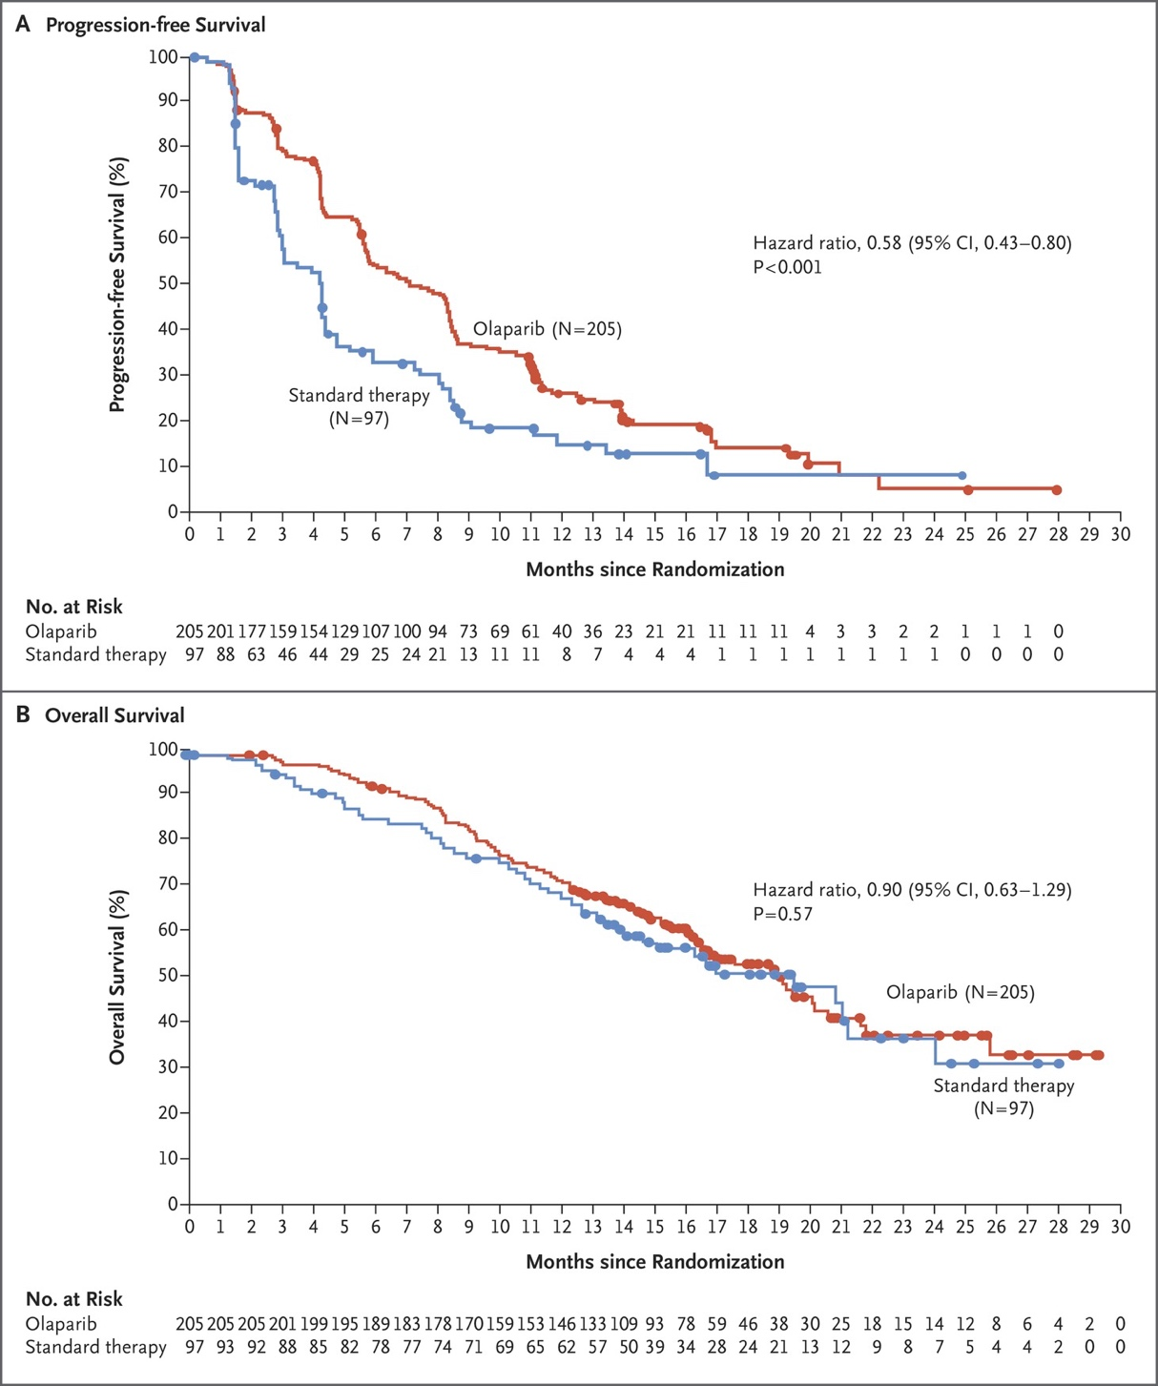
Progression-free Survival
Hazard ratio, 0.58 (95% CI, 0.43-0.80)
P<0.001
Progression-free Survival (%)
Olaparib (N = 205)
Standard therapy
(n = 97)
Months since Randomization
Overall Survival
Hazard ratio, 0.90 (95% CI, 0.63-129)
P=0.57
Overall Survival (%)
Olaparib (N = 205)
Standard therapy
(n = 97)
Months since Randomization
Robson M et al. N Engl J Med 2017;377:523-533

Slide 15
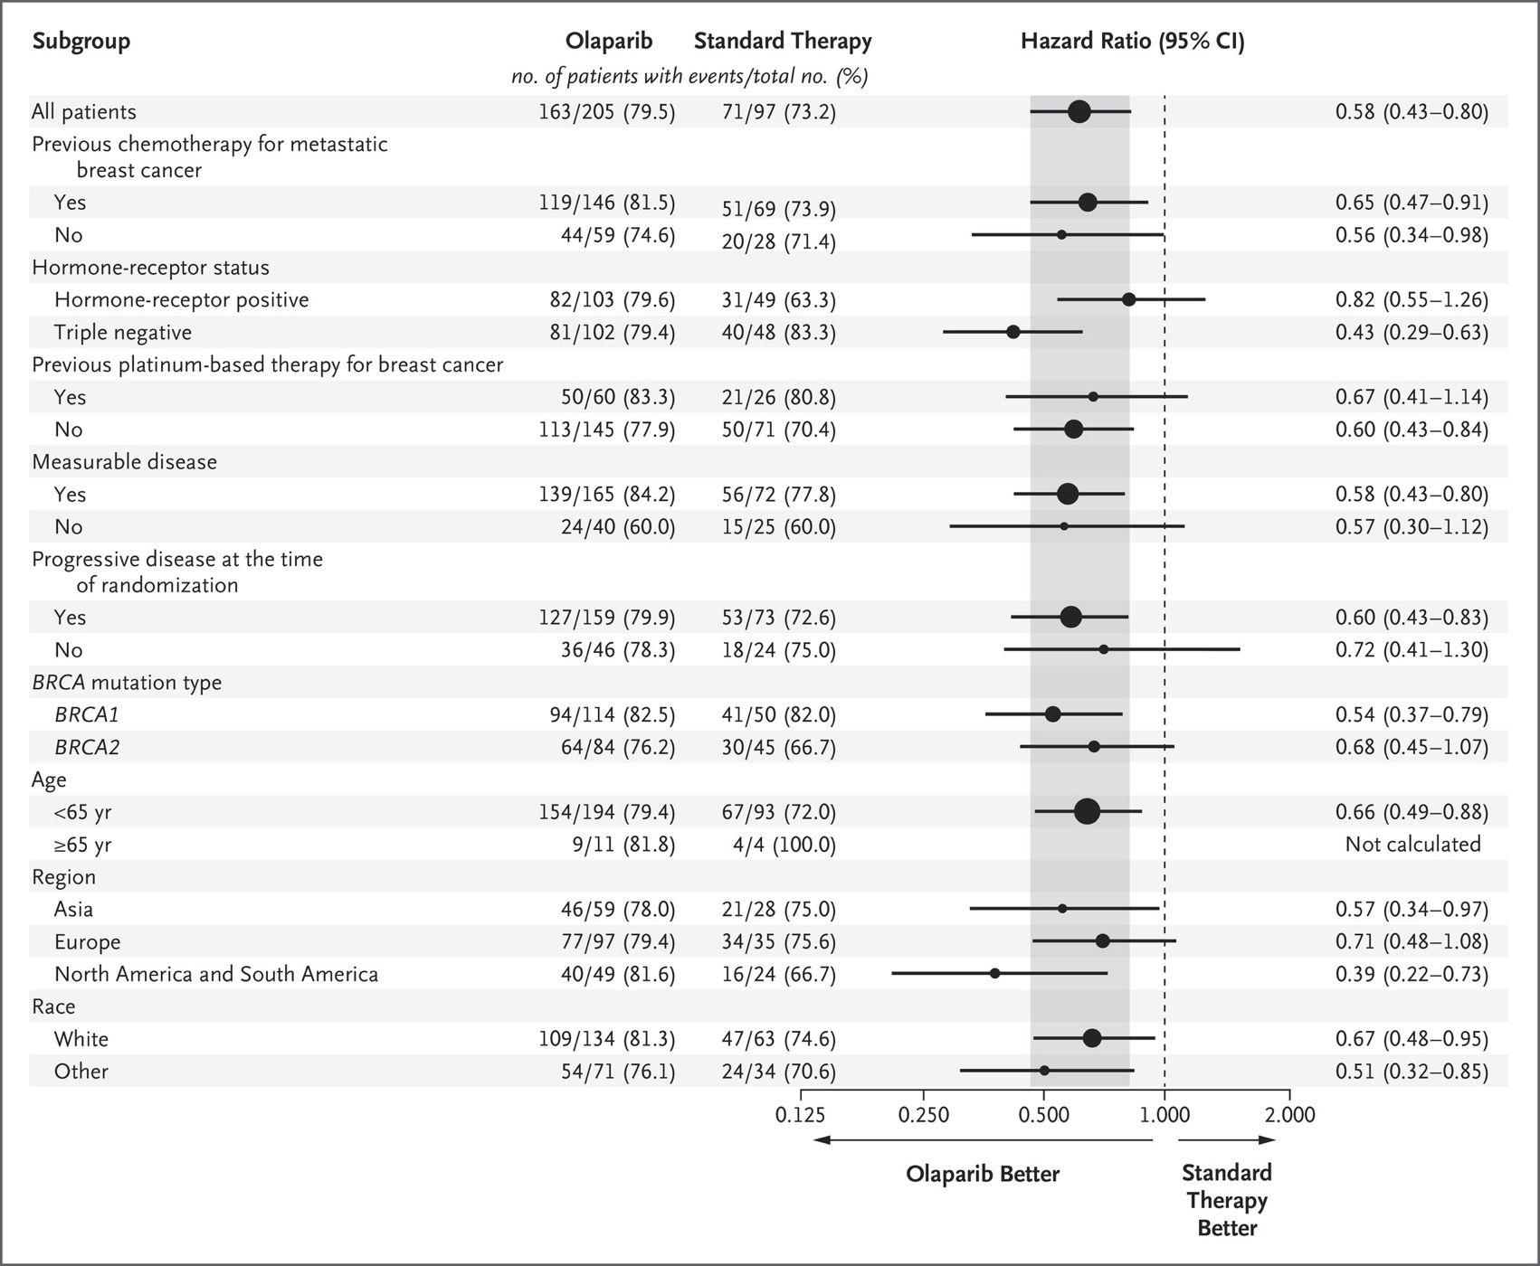
Robson M et al. N Engl J Med 2017;377:523-533

Slide 16
Overall survival
 | Olaparib | TPC
Deaths, n (%) | 130 (63) | 62 (64)
Median OS, months | 19.3 | 17.1
 | HR 0.90
 | 95% CI 0.66–1.23; P=0.513
Alive at 6 months, % | 93.1 | 85.8
Alive at 18 months, % | 54.1 | 48.0
Median follow-up, months | 18.9 | 15.5
1.0
0.9
0.8
0.7
0.6
0.5
Probability of overall survival
0.4
0.3
0.2
0.1
0.0
0
4
8
12
16
20
24
28
32
36
40
Time from randomization (months)
No. at risk
Olaparib
TPC
205
97
199
85
178
74
146
62
124
48
92
40
55
30
23
15
11
5
6
2
0
0

Slide 17
Overall survival in prespecified subgroups
No prior chemotherapy for mBC (1L)
Prior chemotherapy for mBC (2/3L)
 | Olaparib | TPC
Deaths, n (%) | 30 (50.8) | 21 (75.0)
Median OS, mo | 22.6 | 14.7
HR 0.51 (95%CI 0.29–0.90; P=0.02)
Alive at 6 mo, % | 93.2 | 88.5
Alive at 18 mo, % | 62.1 | 46.2
Median follow-up, mo | 25.5 | 26.9
 | Olaparib | TPC
Deaths, n (%) | 100 (68.5) | 41 (59.4)
Median OS, mo | 18.8 | 17.2
HR 1.13 (95%CI 0.79–1.64; P=NS)
Alive at 6 mo, % | 93.1 | 84.9
Alive at 18 mo, % | 50.8 | 48.8
Median follow-up, mo | 25.2 | 26.0
1.0
1.0
0.9
0.9
0.8
0.8
0.7
0.7
0.6
0.6
Probability of overall survival
0.5
0.5
0.4
0.4
0.3
0.3
0.2
0.2
0.1
0.1
0.0
0.0
0
4
8
12
16
20
24
28
32
36
40
0
4
8
12
16
20
24
28
32
36
40
Time from randomization (months)
Time from randomization (months)
Nominal P values calculated using a likelihood ratio test; OS stratification factors were prespecified but not alpha controlled 1L, first line; 2/3L, second or third line; NS, not significant

Slide 18
Adverse events occurring in ≥10% of patients in either arm, with ≥5% difference in frequency between arms
Nausea
Anemia
Vomiting
Fatigue
Neutropenia
Cough
Decreased appetite
Back pain
Increased ALT
Increased AST
Alopecia
Hand–foot syndrome
75
50
25
0
25
50
75
Adverse events (%)
Olaparib 300 mg bid (N=205)
Chemotherapy TPC (N=91)
Irrespective of causality, any grade. MedDRA preferred terms have been combined for 1) anemia and 2) neutropenia ALT, alanine aminotransferase; AST, aspartate aminotransferase; MedDRA, Medical Dictionary for Regulatory Activities

Slide 19
Study Design: EMBRACA
Patients with locally advanced or metastatic HER2-negative breast cancer and a germline BRCA1 or BRCA2 mutation*†
Stratification factors:
Number of prior chemo regimens (0 or ≥ 1)
TNBC or hormone receptor positive (HR+)
History of CNS mets or no CNS mets
Primary endpoint
Progression-free survival by RECIST by blinded central review
Key secondary efficacy endpoints
Overall survival (OS)
ORR by investigator
Safety
Exploratory endpoints
Duration of response (DOR) for objective responders
Quality of life (QoL; EORTC QLQ-C30, QLQ-BR23)
Talazoparib
1 mg PO daily
R
2:1
Treatment (21-day cycles) continues until progression or unacceptable toxicity
Physician's choice of therapy (PCT)‡: capecitabine,
eribulin, gemcitabine,
or vinorelbine
Phase 3, international, open-label study randomized 431 patients in 16 countries and 145 sites
Abbreviations: CNS, central nervous system; EORTC, European Organisation for Research and Treatment of Cancer; HER2, human epidermal growth factor receptor 2; mets, metastases; PO, orally (per os); QLQ-BR23, Quality of Life Questionnaire breast cancer module; QLQ-C30, Quality of Life Questionnaire Core 30; R, randomized; RECIST, Response Evaluation Criteria In Solid Tumors version 1.1; TNBC, triple-negative breast cancer.
*Additional inclusion criteria included: no more than 3 prior cytotoxic chemotherapy regimens for locally advanced or metastatic disease; prior treatment with a taxane and/or anthracycline unless medically contraindicated. †HER2-positive disease is excluded. ‡Physician's choice of therapy must be determined prior to randomization.
www.clinicaltrials.gov (NCT01945775)

Slide 20
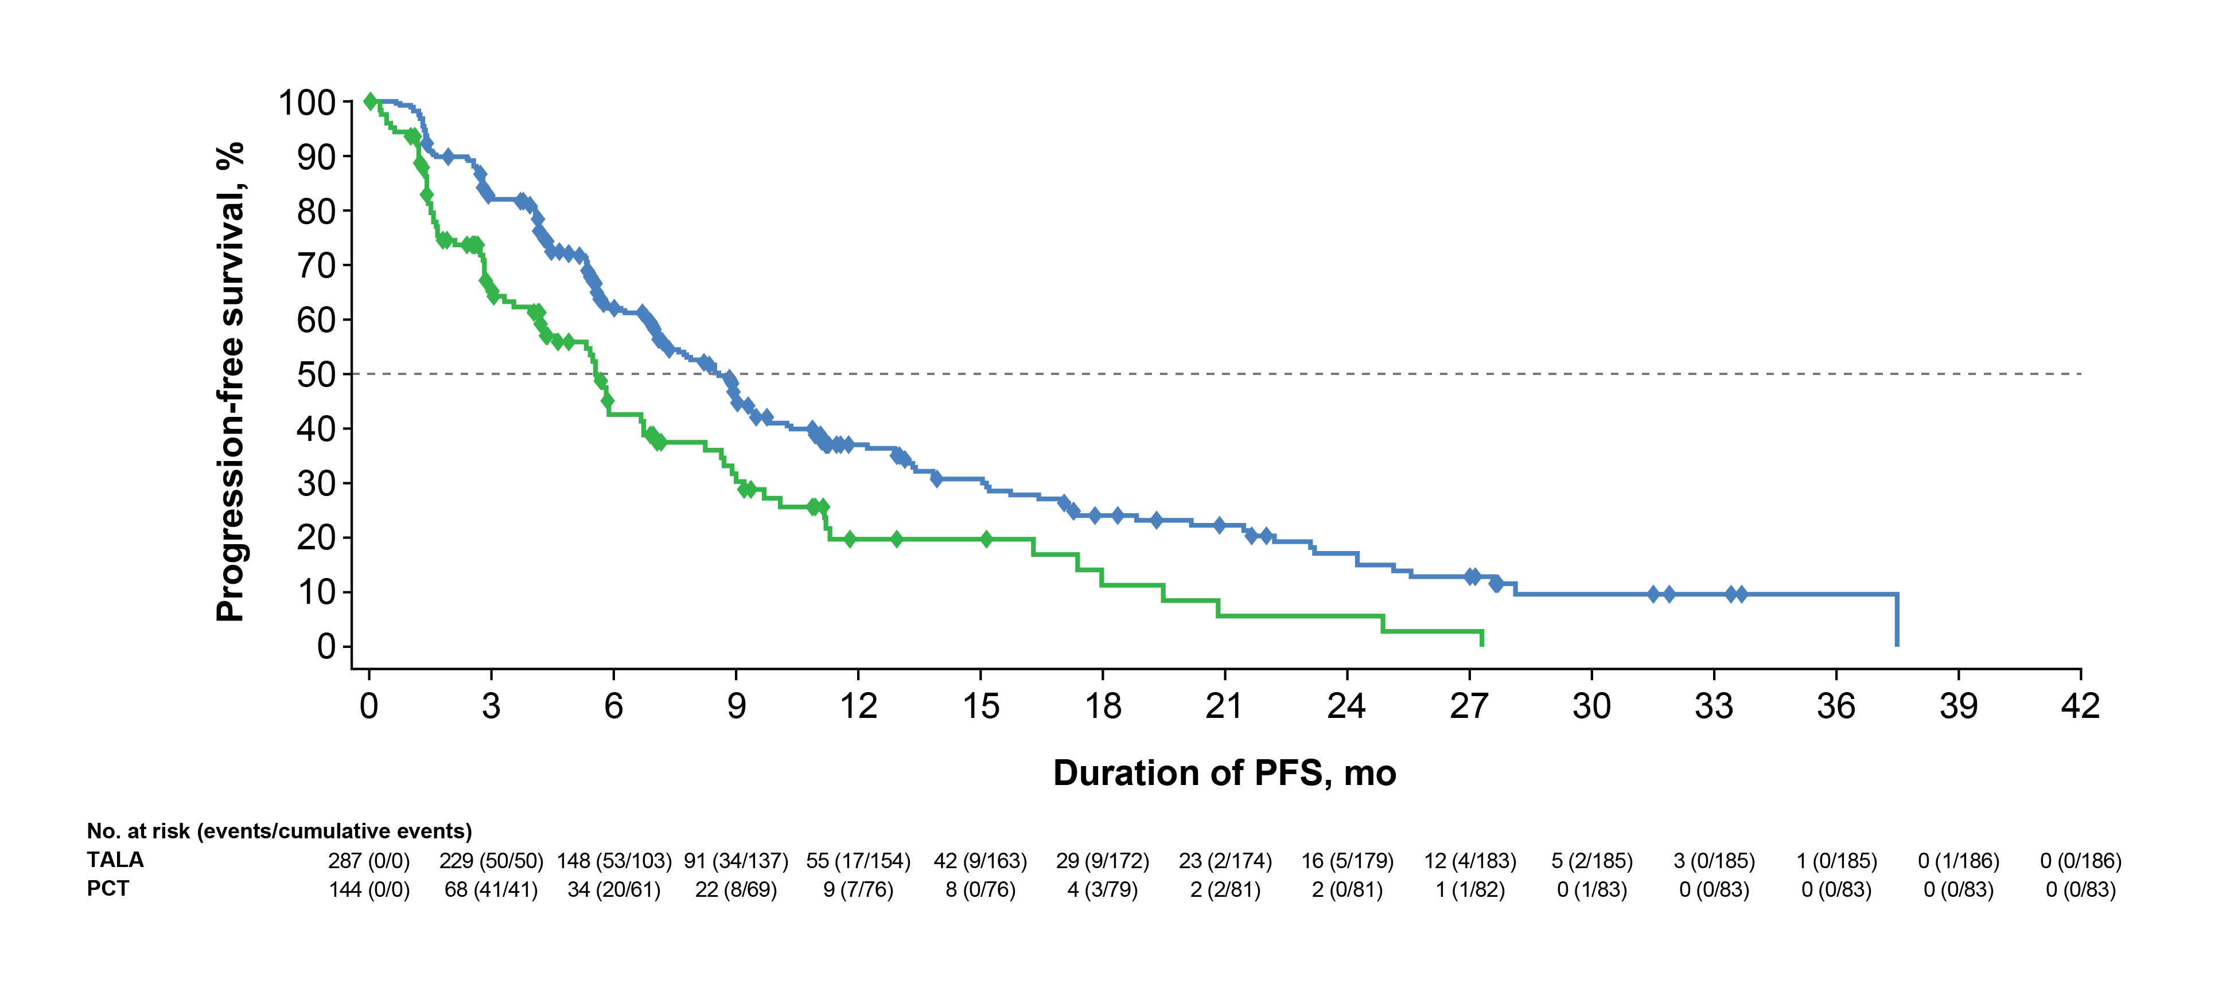
Primary Endpoint: PFS by Blinded Central Review
 | TALA (n = 287) | Overall PCT (n = 144)
Events, no. (%) | 186 (65%) | 83 (58%)
Median, mo (95% CI) | 8.6 (7.2, 9.3) | 5.6 (4.2, 6.7)
 | Hazard ratio, 0.54, 95% CI, 0.41, 0.71 P < 0.0001
TALA
Overall PCT
1-Year PFS 37% vs 20% Median follow-up time: 11.2 months
Notes:
Add comment on PFS by Investigator

Slide 21
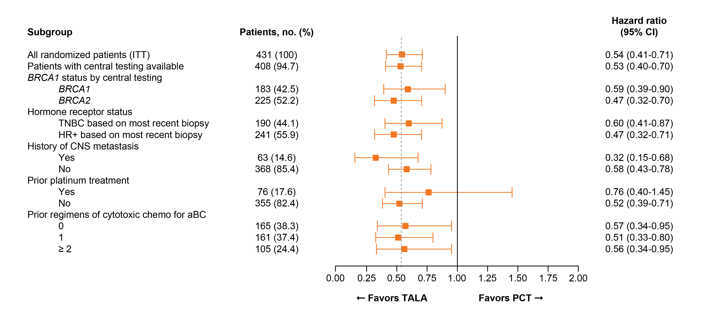
PFS: Subgroup Analysis

Slide 22
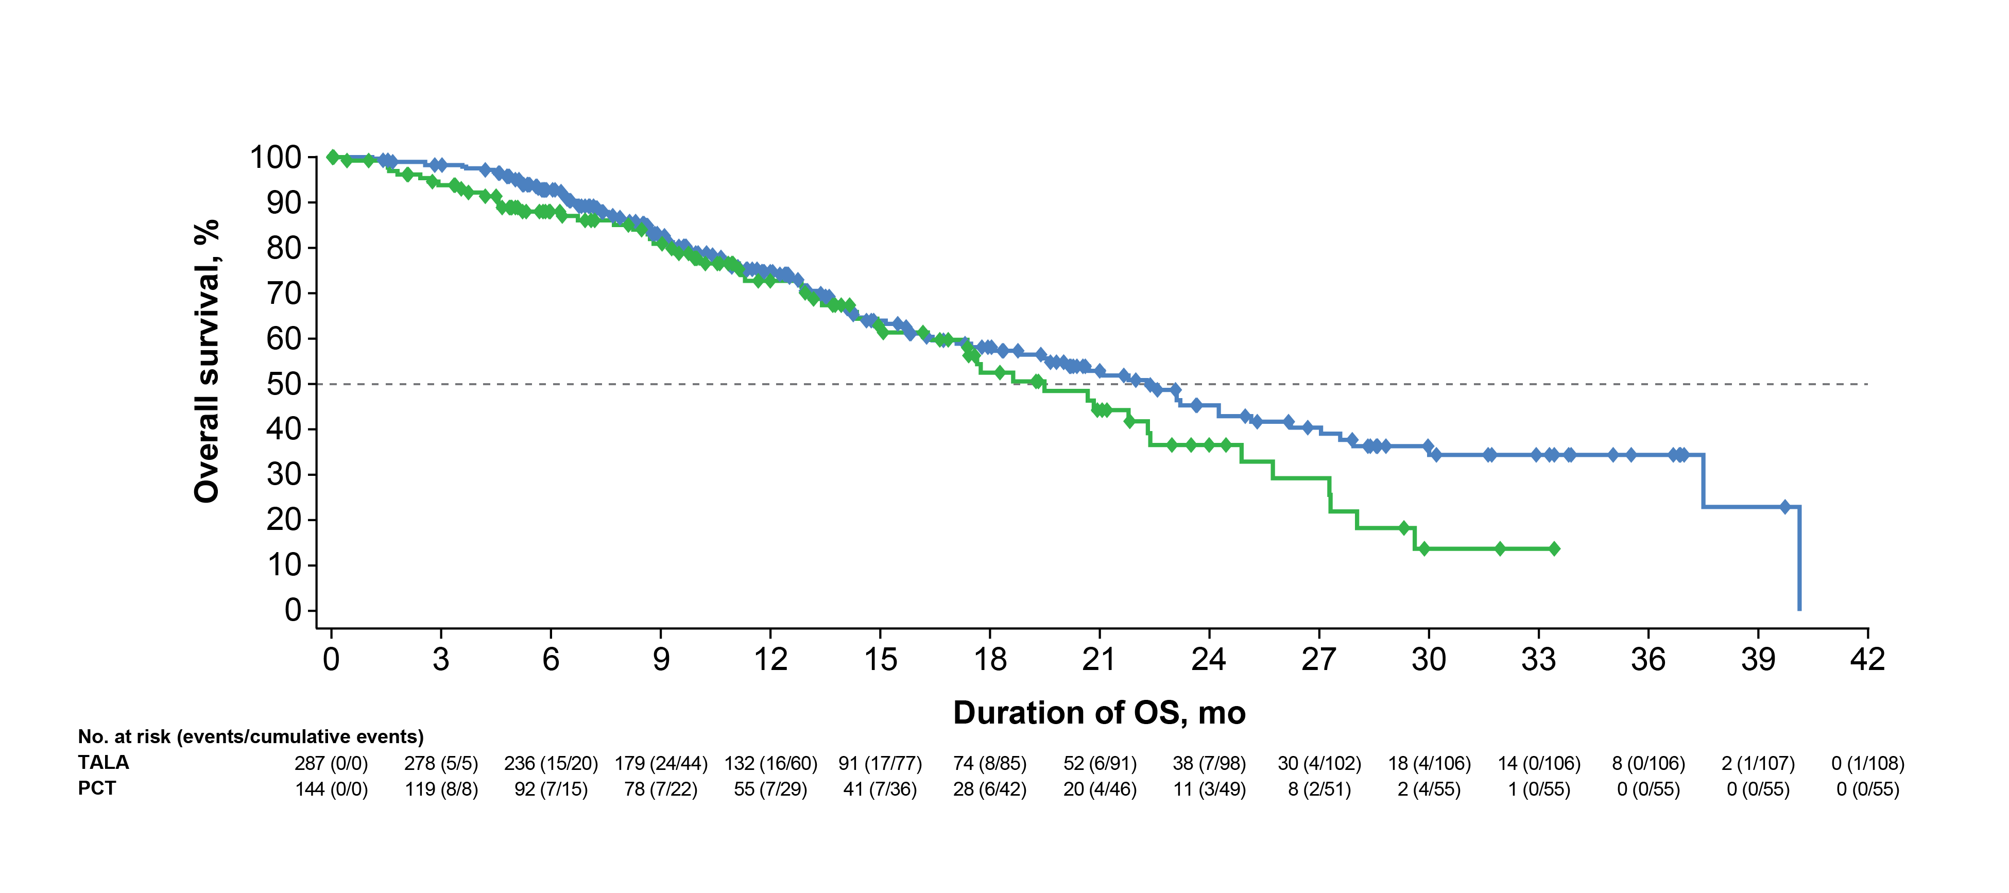
Interim OS Analysis: Secondary Endpoint
 | TALA (n = 287) | Overall PCT (n = 144)
Events, no. (%) | 108 (38%) | 55 (38%)
Median, mo (95% CI) | 22.3 (18.1, 26.2) | 19.5 (16.3, 22.4)
 | Hazard ratio, 0.76, 95% CI, 0.54, 1.06 P = 0.105
TALA
Overall PCT
Survival Probability at: | TALA (n = 287) | Overall PCT (n = 144)
Month 24, % (95% CI) | 45% (36.7-53.5) | 37% (24.1-49.1)
Month 36, % (95% CI) | 34% (25.3-43.7) | 0%

Slide 23
Extending the effectiveness of PARPi
Combinations with conventional cytotoxics
PARPi + PIK3CA inhibitors
PARPi + cediranib (VEGFRi)
PARPi + WEE1 inhibitor, ATRi, ATMi
Increase replication stress
PARPi + BETi
PARPi + SERD + CDK4/6i
PARPi + IO agents

Slide 24
Combination with conventional cytotoxics
Veliparib 120 mg D1–7 BID
+ Carboplatin AUC 6/Paclitaxel 175 mg/m²
Q3W* N = 97
Locally recurrent or metastatic breast cancer with deleterious BRCA1/2 mutation N = 290
(86 sites, 20 countries)
Placebo
+ Carboplatin AUC 6/Paclitaxel 175 mg/m²
Q3W* N = 99
1:1:1
Veliparib 40 mg D1–7 BID
+ TMZ 150 to 200 mg/m² QD, D1–5† N = 94
Stratification factors for randomization
ER and PgR status (positive or negative)
Prior cytotoxic therapy (yes or no)
ECOG status (0–1 or 2)
*Carboplatin/Paclitaxel administered on D3, 21-day cycle.
†28-day cycle.
Patients were treated until progression or unmanageable toxicity.
If both carboplatin and paclitaxel or if TMZ was discontinued, placebo/veliparib was discontinued.
AUC, area under the concentration-time curve; BID, twice daily; D, day; ECOG, Eastern Cooperative Oncology Group; ER, estrogen receptor; PgR, progesterone receptor; Q, every; TMZ, temozolomide.
Han, Dieras, Robson et al, SABCS 2016

Slide 25
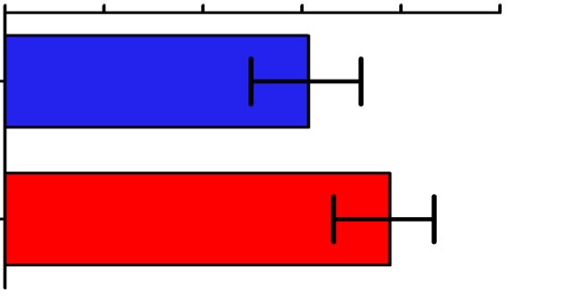
BROCADE: Tumor Response
 | Placebo + C/P N = 98 | Veliparib + C/P N = 95
ORR (CR + PR), n/N, % (95% CI) | 49/80 (61.3%) (49.7–71.9) | 56/72 (77.8%)* (66.4–86.7)
CR, n/N, (%) | 3/80 (3.8%) | 4/72 (5.6%)
PR, n/N, (%) | 46/80 (57.5%) | 52/72 (72.2%)
CBR (week 18 progression-free rate), % (95% CI) | 87.0% (78.3–92.4) | 90.7% (82.2–95.2)
DOR, median months, (95% CI) | 11.1 (9.5–15.7) | 11.7 (8.5–14.1)
Proportion of Patients with ORR, % (95% CI)
0
20
40
60
80
100
Placebo
+ C/P
49/80
(61.3%)
P = 0.027
Veliparib
+ C/P
56/72
(77.8%)
*P < 0.05 for placebo + C/P vs veliparib + C/P.
Tumor assessments were per independent radiology reviewer. ORR, CR, and PR shown represent confirmed responses; these analyses included all patients with measurable disease at baseline. DOR analysis included all patients with an objective response. CBR analysis included all randomized patients who had a deleterious BRCA1/2 mutation per the core lab. DOR, duration of response; PR, partial response.

Slide 26
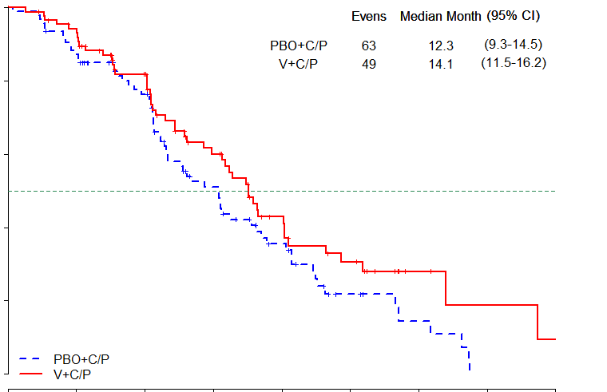
BROCADE: Progression-Free Survival
1.0
 | Placebo + C/P N = 98 | Veliparib + C/P N = 95 | HR | P value*
Median PFS, months (95% CI) | 12.3 (9.3–14.5) | 14.1 (11.5–16.2) | 0.789 (0.536–1.162) | 0.231
0.8
0.6
Probability of
Progression-Free Survival
0.4
0.2
Placebo + C/P
0.0
Veliparib + C/P
0
4
8
12
16
20
24
28
32
Number at risk
Months Since Randomization
Placebo + C/P
98
82
61
35
20
8
4
0
0
Veliparib + C/P
95
80
60
38
22
13
4
2
1
Median (95% CI) PFS, Veliparib + TMZ: 7.4 (5.9–8.5) months; HR = 1.858 (1.278–2.702), P = 0.001. (SABCS program number: P4-22-02)
*From Cox proportional hazard model, stratified by ER/PgR status and prior cytotoxic therapy use.
Efficacy population includes all randomized patients who had a deleterious BRCA1/2 mutation per the core lab.
CI, confidence interval; HR, hazard ratio.

Slide 27
Consensus or Controversy? Clinical Investigators Provide Perspectives on Practical Issues and Ongoing Research Related to the Management of Breast Cancer Monday, June 4, 2018
7:00 PM – 9:30 PM Chicago, Illinois
Faculty
Harold J Burstein, MD, PhD
Angelo Di Leo, MD, PhD
Sara A Hurvitz, MD
Mark Robson, MD
Hope S Rugo, MD
George W Sledge Jr, MD
Moderator Neil Love, MD

Slide 28
Contributing Oncologist Case
A 44-year-old woman with triple-negative metastatic breast cancer and disease progression on several chemotherapeutic regimens is found to have a BRCA1 germline mutation. She is started on olaparib at 300 mg PO BID with clinical improvement, but 6 weeks into therapy her hemoglobin drops from 10.5 g/dL to 8 g/dL with no evidence of hemolysis or bleeding. The only other side effect is mild nausea.
Question
What would be your most likely treatment approach?

