Slide 1
Please note, these are the actual video-recorded proceedings from the live CME event and may include the use of trade names and other raw, unedited content.

Slide 2
Cases from the Community
Clinical Investigators Provide Their Perspectives on Emerging Research and Actual Patients with Ovarian Cancer
Monday, March 26, 2018
12:45 PM – 2:15 PM New Orleans, Louisiana
Moderator
Neil Love, MD
Faculty
Don S Dizon, MD
Lainie P Martin, MD
Bradley J Monk, MD
Angeles Alvarez Secord, MD, MHSc

Slide 3
Disclosures for Moderator Neil Love, MD
Dr Love is president and CEO of Research To Practice, which receives funds in the form of educational grants to develop CME activities from the following commercial interests: AbbVie Inc, Acerta Pharma, Adaptive Biotechnologies, Agendia Inc, Agios Pharmaceuticals Inc, Amgen Inc, Ariad Pharmaceuticals Inc, Array BioPharma Inc, Astellas Pharma Global Development Inc, AstraZeneca Pharmaceuticals LP, Baxalta Inc, Bayer HealthCare Pharmaceuticals, Biodesix Inc, bioTheranostics Inc, Boehringer Ingelheim Pharmaceuticals Inc, Boston Biomedical Pharma Inc, Bristol-Myers Squibb Company, Celgene Corporation, Clovis Oncology, CTI BioPharma Corp, Dendreon Pharmaceuticals Inc, Eisai Inc, Exelixis Inc, Foundation Medicine, Genentech BioOncology, Genomic Health Inc, Gilead Sciences Inc, Halozyme Inc, ImmunoGen Inc, Incyte Corporation, Infinity Pharmaceuticals Inc, Ipsen Biopharmaceuticals Inc, Janssen Biotech Inc, administered by Janssen Scientific Affairs LLC, Jazz Pharmaceuticals Inc, Kite Pharma Inc, Lexicon Pharmaceuticals Inc, Lilly, Medivation Inc, a Pfizer Company, Merck, Merrimack Pharmaceuticals Inc, Myriad Genetic Laboratories Inc, NanoString Technologies, Natera Inc, Novartis, Novocure, Onyx Pharmaceuticals, an Amgen subsidiary, Pfizer Inc, Pharmacyclics LLC, an AbbVie Company, Prometheus Laboratories Inc, Puma Biotechnology Inc, Regeneron Pharmaceuticals Inc, Sanofi Genzyme, Seattle Genetics, Sigma-Tau Pharmaceuticals Inc, Sirtex Medical Ltd, Spectrum Pharmaceuticals Inc, Taiho Oncology Inc, Takeda Oncology, Tesaro Inc, Teva Oncology and Tokai Pharmaceuticals Inc.
Notes:
3
3
3

Slide 4
Agenda
Module 1 – Dr Secord: Local and Systemic Therapeutic Considerations for Patients with Newly Diagnosed Advanced Ovarian Cancer
Module 2 – Dr Monk: Evolving Treatment Paradigms for Patients with Platinum-Sensitive Recurrent Ovarian Cancer
Module 3 – Dr Dizon: Patient- and Disease-Specific Considerations in the Management of Platinum-Resistant Recurrent Ovarian Cancer
Module 4 – Dr Martin: Novel Investigational Agents in Development for Patients with Ovarian Cancer

Slide 5
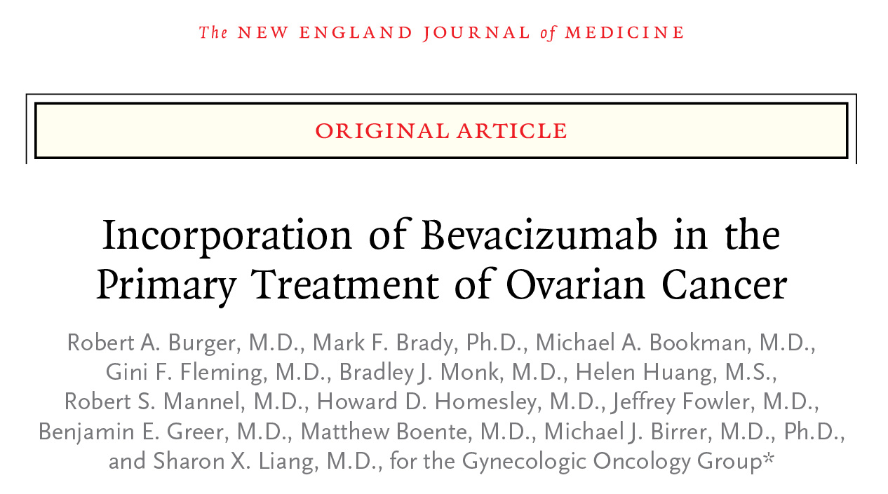
Pending Approval: Bevacizumab ⁽²⁰¹⁸⁾
Front-line (PDUFA Date June 25, 2018)
Final overall survival to be presented at ASCO 2018

