Slide 1
Please note, these are the actual
video-recorded proceedings from the
live CME event and may include the use of trade names and other raw, unedited content.

Slide 2

Existing and Emerging Immunotherapeutic Approaches, Including Combination Strategies, in NSCLC and SCLC
Matthew Hellmann
Memorial Sloan Kettering Cancer Center
RTP Satellite Symposium ASCO –SITC 2018
January 25th 2018

Slide 3
Disclosures
Consulting Agreements | AstraZeneca Pharmaceuticals LP, Bristol-Myers Squibb Company, Genentech BioOncology, Janssen Biotech Inc, Merck, Novartis

Slide 4
Are there any situations in which you would use the combination of an anti-PD-1/PD-L1 antibody and an anti-CTLA-4 antibody for metastatic NSCLC outside of a trial setting?
No
No
No
Yes
No
No
No

Slide 5
Are there any situations in which you would use the combination of an anti-PD-1/PD-L1 antibody and an anti-CTLA-4 antibody for metastatic small cell lung cancer outside of a trial setting?
Yes
Yes: 2nd or 3rd line
Yes: Routine as 2nd-line
Yes: Will discuss as 2nd-line option
Yes
Yes: 2nd line as standard treatment
Yes: Good PS and no contraindications

Slide 6
A 60-year-old patient with metastatic SCLC experiences a response to first-line carboplatin/etoposide but then experiences disease progression after 3 months. What would you recommend?
Nivolumab/ipilimumab
Nivolumab/ipilimumab
Nivolumab/ipilimumab
Nivolumab/ipilimumab
Nivolumab/ipilimumab
Nivolumab/ipilimumab
Nivolumab/ipilimumab

Slide 7
What other strategies combining anti-PD-1/PD-L1 antibodies with other agents do you believe are particularly promising?
PEG-IL-2, adenosine receptor inhibitors, LAG3, IDO
IDO inhibitors; B7H3 MAbs; HEAT vaccine; chemo
Personalized cancer vaccines
Radiation therapy
VEGF inhibitors
IDO and LAG3 as promising targets; DART molecules
Radiation; multikinase inhibitors such as cabozantinib

Slide 8
Topics for discussion
Neoadjuvant approach and progression into early stage lung cancer
PD-1 + CTLA4 and other immunotherapeutic targets in late phase development
Immunotherapy in SCLC

Slide 9
Emerging role for immunotherapy in neoadjuvant setting

Slide 10
Rationale for neoadjuvant nivolumab
Neoadjuvant nivolumab treatment
  May induce immunity against micrometastases
  Allows pathologic response assessment
  Provides tissue for correlative studies
Newly diagnosed resectable stage I (>2cm)/II/IIIA NSCLC
Nivolumab 3mg/kg IV
(Day -14 &
Day -28)
Surgical resection
(Day 0)
Standard of care postoperative treatment
Tumor Biopsy
PBMC & plasma collection
Tumor & Lymph Node Assessment
TILS
PBMC & plasma collection

Slide 11
Pathologic responses to neoadjuvant nivolumab
MPR = 9/21 cases
[43% (95% CI 24-63%)]
Pre-treatment PD-L1 positivity
[≥1% membranous staining (Dako 28-8)] did not correlate with MPR
Pre-treatment PD-L1
*MPR is defined as ≤10% viable tumor cells
(Pataer, et al. JTO, 2012. Hellmann, et al. Lancet Oncol 2014.)

Slide 12
PD-1 + CTLA4 and other immunotherapeutic targets in late phase development

Slide 13
Concept
PD-1 and CTLA-4 have non-redundant, potentially synergistic, effects on effector T cells
  CTLA-4: prevents activation, proliferation
  PD-1: inhibits proliferation, cytokine production
Distinct toxicity in CTLA-4 KO and PD-1 KO mice
Combination of anti-CTLA-4 and PD-1 effective in mice
Curran… Allison, PNAS 2010

Slide 14
In practice:
Nivolumab Plus Ipilimumab in First-line NSCLC:
Safety
Grade 1−2
Grade 3−4
Nivo 3 Q2W
(n = 52)
Nivo 3 Q2W + Ipi 1 Q12W
(n = 38)
Nivo 3 Q2W + Ipi 1 Q6W
(n = 39)
Patients with an event, %
15
Pulmonaryª
Hypersensitivity/
infusion rxn
Pulmonaryª
Hypersensitivity/
infusion rxn
Pulmonaryª
Hypersensitivity/
infusion rxn
Gettinger WCLC 2016
Hellmann Lancet Oncology 2016

Slide 15
In practice:
Nivolumab Plus Ipilimumab in First-line NSCLC:
Efficacy
Nivo 3 Q2W + Ipi 1 Q6/12W
Nivo 3 Q2W
ORR (%)
n
77
52
19
16
46
32
13
12
Overall <1% ≥1% ≥50%
PD-L1 expression
5 CRs (10%) in the nivolumab monotherapy cohort (1 in a patient with tumor PD-L1 expression <1%)
6 CRs (8%) in the nivolumab + ipilimumab cohortsª (3 in patients with tumor PD-L1 expression <1%)
Gettinger WCLC 2016
Hellmann Lancet Oncology 2016

Slide 16
Phase 3 CheckMate 227 (NCT02477826) Study Design
Key eligibility criteria:
Stage IV or recurrent NSCLC
No prior systemic therapy for advanced disease
No EGFR/ALK mutations sensitive to available targeted inhibitor therapy
CNS metastases permitted if adequately treated ≥2 weeks prior to randomization
Stratification factor at randomization:
Histology (squamous vs
non-squamous)
Nivolumab 3 mg/kg Q2W + Ipilimumab 1 mg/kg Q6W
PD-L1+
(≥1%)
Nivolumab monotherapy
240 mg Q2W
Tumor scans Q6W until
week 48 then Q12W
Chemotherapy
Disease progression or unacceptable toxicity
Randomize 1:1:1
Nivolumab 3 mg/kg Q2W + Ipilimumab 1 mg/kg Q6W
PD-L1‒
(<1%)
Nivolumab 360 mg Q3W + Chemotherapy
Chemotherapy

Slide 17
Landscape of Phase 3 trials of 1L PD-(L)1 combos
PD-(L)1 blockade | Combination partner | Trial
Atezo | Chemo | IMPower130 IMPower131 IMPower132 IMPower150
Pembro | Chemo | KEYNOTE-189 KEYNOTE-407
Nivo | Chemo | CheckMate227 CheckMate722
Durva | Treme + Chemo | POSEIDON
Durva | Treme | MYSTIC NEPTUNE
Nivo | Ipi | CheckMate227
Pembro | Epacadostat | NCT03322540

Slide 18
IDO

Slide 19
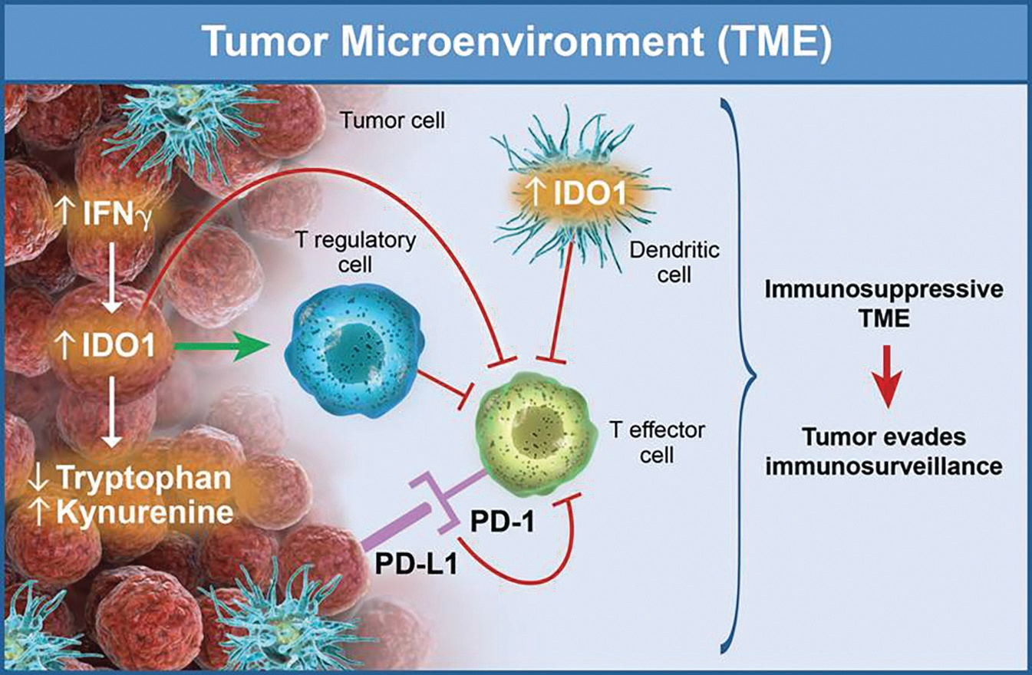
Concept:
IDO

Slide 20
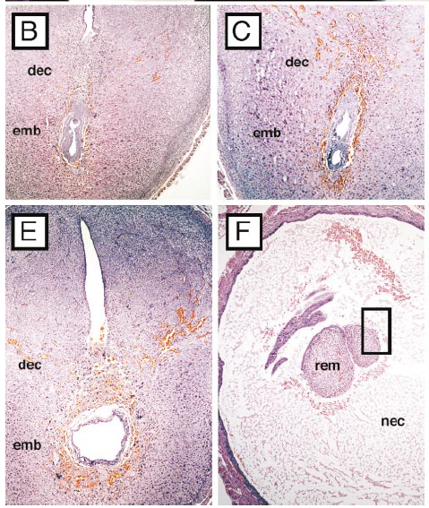
Concept:
IDO
Placenta
Syngeneic fetus
Allogeneic fetus
- IDO inh
+ IDO inh
Munn, Science 1998

Slide 21
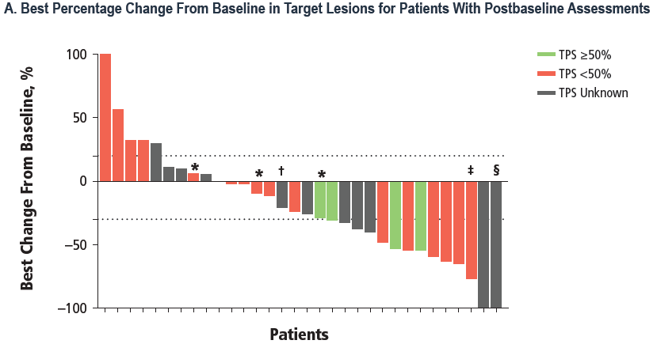
Epacadostat + Pembrolizumab (ECHO-202)
  ORR 10/38 (34%)
    Among PDL1 > 50% - 3/7 (43%)
    Among PDL1 < 50% - 6/18 (33%)
  Minimal excess toxicity. Grade 3-4 events: increased lipase, fatigue, rash
Gangadhar, ASCO 2017

Slide 22
What about SCLC

Slide 23
Immunotherapy can work in SCLC
PD-L1 is uncommon and not predictive
100
CheckMate 032
Nivolumab Monotherapy²
CheckMate 032
Nivolumab-1 + Ipilimumab-3
75
50
25
Best change from baseline in
target lesion volume (%)
0
−25
−50
−75
−100
<1% PD-L1
≥1% PD-L1
PD-L1 not evaluable/missing
Confirmed responders
Truncated to 100%
CheckMate 032:
Tumor PD-L1 expression in
non-randomized cohort (n = 159)^{1a}
≥1%
18%
Best change from baseline in
target lesion volume (%)
<1%
82%
Antonia… Hellmann, WCLC 2017

Slide 24
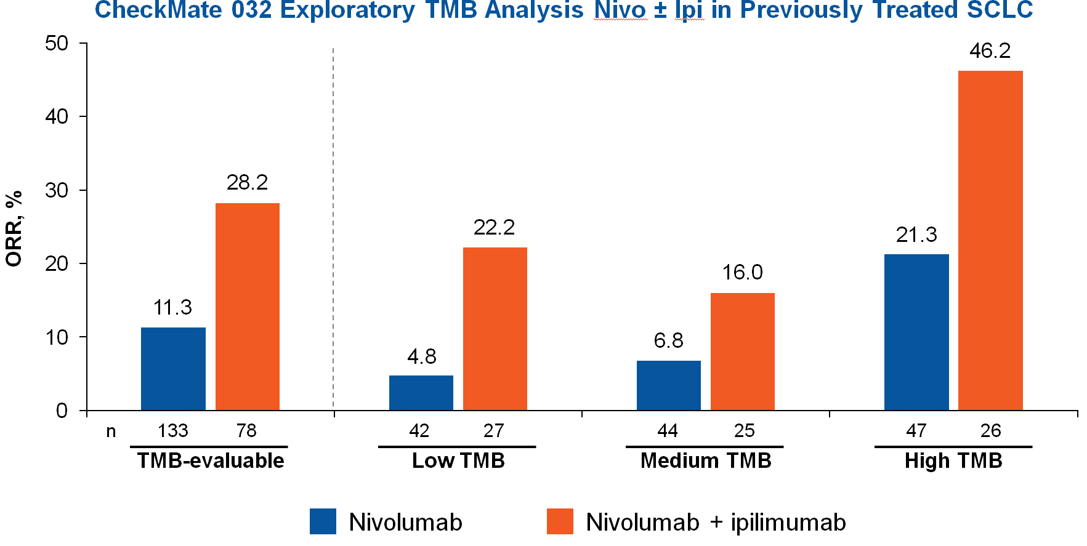
Tumor mutation burden in SCLC
Antonia… Hellmann, WCLC 2017

Slide 25
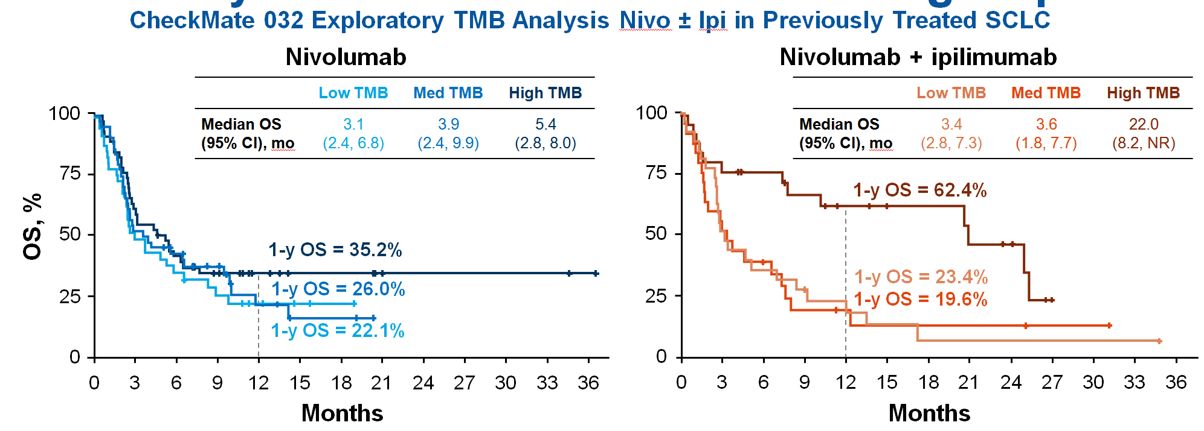
Tumor mutation burden in SCLC
TMB matters for PD-1 treatment across lung cancers… and may be even more important in context of combo therapy
Antonia… Hellmann, WCLC 2017

Slide 26
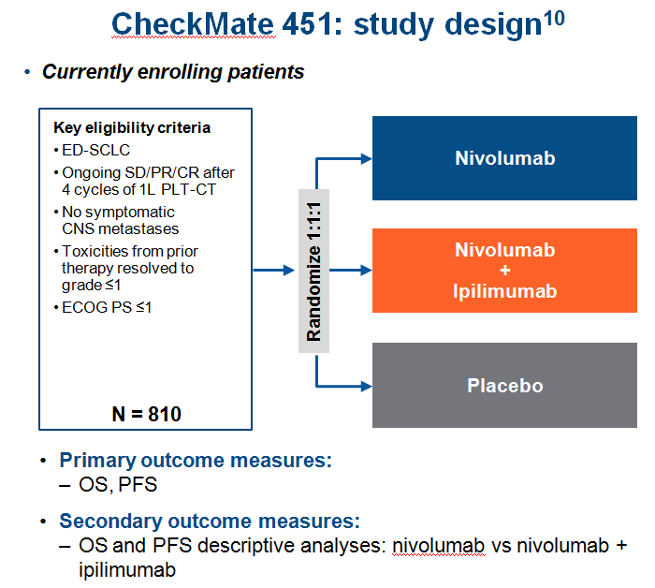

Slide 27
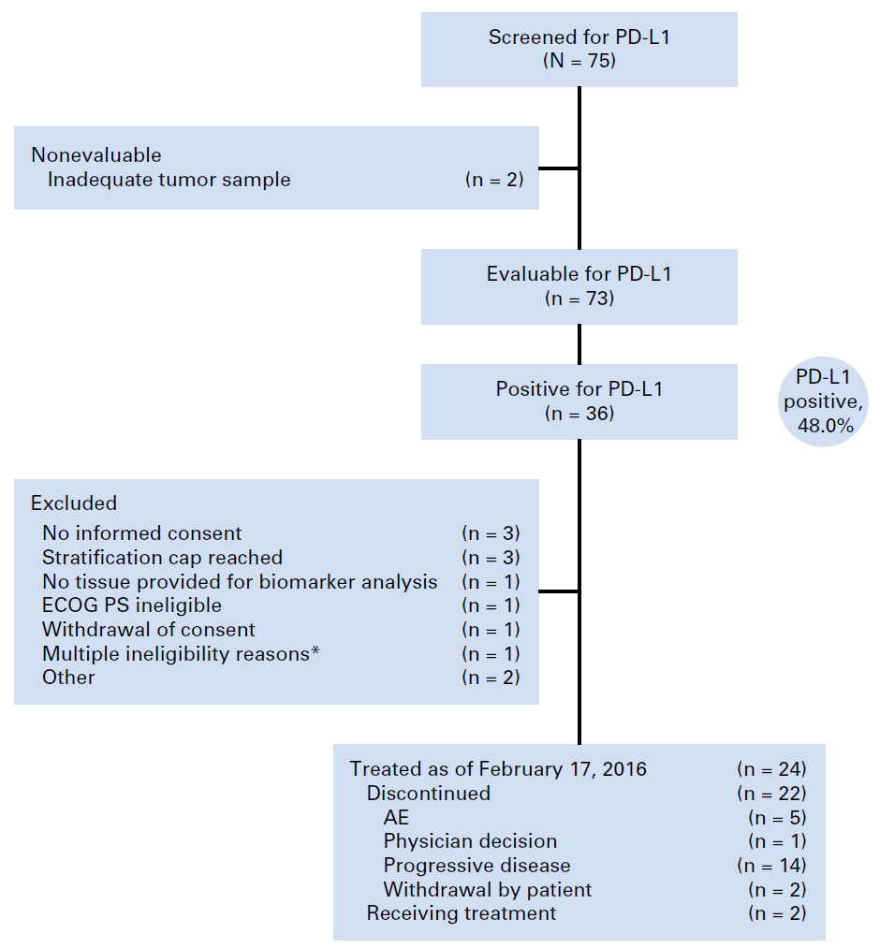
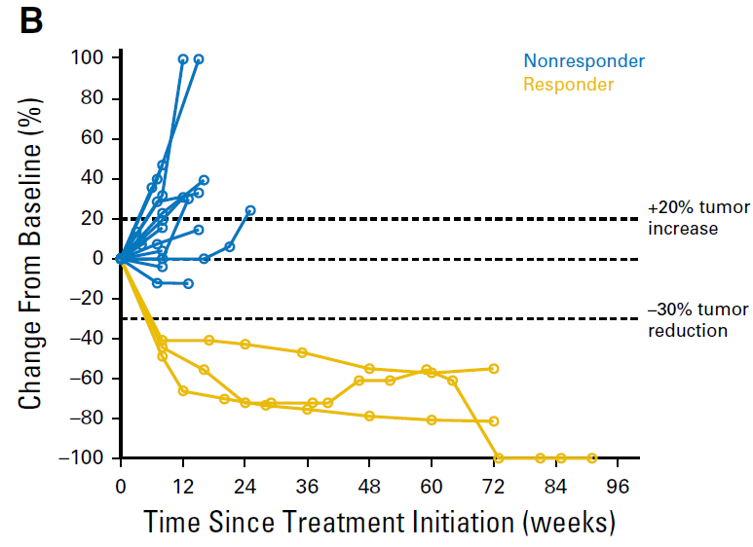
Pembrolizumab in SCLC
Ott, JCO 2017

Slide 28
Summary of discussion
Neoadjuvant approach and progression into early stage lung cancer
  Adjuvant PDL1 is here… neoadjuvant may come!
PD-1 + CTLA4 and other immunotherapeutic targets in late phase development
  Multiple Ph3 trials are enrolled and results awaited
Immunotherapy in SCLC
  PD-1 blockade can work in SCLC (NCCN listed)
  TMB may be a useful biomarker of activity for combination therapy

