Slide 1
Please note, these are the actual video-recorded proceedings from the live CME event and may include the use of trade names and other raw, unedited content.

Slide 2
Chronic Lymphocytic Leukemia: Contemporary management of relapsed and refractory disease
Jonathan W. Friedberg M.D.
Samuel Durand Professor of Medicine

Slide 3
Disclosures
Advisory Committee | Bayer HealthCare Pharmaceuticals
Data and Safety Monitoring Committee | Astellas Pharma Global Development Inc

Slide 4
Which of the following biomarkers do you routinely test for at each relapse of CLL requiring a change in treatment?
Del(17p)
24
TP53 mutation
20
Del(11q)
16
Trisomy 12
13
Del(13q)
12
IGHV mutation
6
Other
11
N = 24 investigators
Notes:
4
4
4
4
4

Slide 5
Reimbursement and regulatory issues aside, what second-line therapy would you recommend for an otherwise healthy 60-year-old patient with CLL without del(17p) or TP53 mutation who responded to FCR and then experienced disease progression 3 years later?
Ibrutinib
18
Venetoclax/rituximab
6
N = 24 investigators
Notes:
5
5
5
5
5

Slide 6
Reimbursement and regulatory issues aside, what second-line therapy would you recommend for an otherwise healthy 80-year-old patient with CLL without del(17p) or TP53 mutation who responded to BR and then experienced disease progression 3 years later?
Ibrutinib
18
Venetoclax/rituximab
3
Acalabrutinib
2
Idelalisib
1
N = 24 investigators
Notes:
6
6
6
6
6

Slide 7
Reimbursement and regulatory issues aside, what second-line therapy would you recommend for an otherwise healthy 60-year-old patient with CLL without del(17p) or TP53 mutation who responded to ibrutinib and then experienced disease progression 3 years later?
Venetoclax/rituximab
16
Venetoclax
4
FCR
2
BR
2
N = 24 investigators
Notes:
7
7
7
7
7

Slide 8
Reimbursement and regulatory issues aside, what second-line therapy would you recommend for an otherwise healthy 60-year-old patient with CLL and del(17p) who responded to ibrutinib and then experienced disease progression 3 years later?
Venetoclax/rituximab
17
Venetoclax
6
FCR
1
N = 24 investigators
Notes:
8
8
8
8
8

Slide 9
Reimbursement and regulatory issues aside, what second-line therapy would you recommend for an otherwise healthy 80-year-old patient with CLL and del(17p) who responded to ibrutinib and then experienced disease progression 3 years later?
Venetoclax/rituximab
17
Venetoclax
6
Obinutuzumab
1
N = 24 investigators
Notes:
9
9
9
9
9

Slide 10
How would you globally compare the antitumor activity of venetoclax/rituximab to that of bendamustine/rituximab in patients with CLL?
Venetoclax/rituximab has greater activity
21
They have approximately equal activity
1
I don’t know
2
N = 24 investigators
Notes:
10
10
10
10
10

Slide 11
Reimbursement and regulatory issues aside, in general, what third-line therapy would you recommend for a 60-year-old patient with CLL without del(17p) or TP53 mutation who responds to BR for 24 months and experiences disease relapse, then receives ibrutinib for 18 months followed by disease progression?
Venetoclax
18
Venetoclax/rituximab
6
N = 24 investigators
Notes:
11
11
11
11
11

Slide 12
Considerations in relapsed/refractory CLL
Is treatment needed?
Rule out Richter Transformation
Prior therapy
Chemoimmunotherapy
Ibrutinib
Response duration to prior therapy
Better or worse than median
Cytogenetics and molecular studies
Del 17p/TP53 mutation
Karyotype
Del 11q

Slide 13
Venetoclax in CLL

Slide 14
Venetoclax in relapsed CLL
Roberts et al, NEJM 374:311 2016

Slide 15
Clinicopathological features and outcomes of CLL on venetoclax
In relapsed/refractory CLL, approximately 80% of patients respond to venetoclax, irrespective of risk factors for chemoimmunotherapy.
67 patients on 3 early phase venetoclax trials:
25 (37%) experienced PD; including 17 with Richter’s transformation
Fludarabine refractoriness and complex karyotype were associated with progression.
Del(17p) and TP53 mutation were not associated with progression
Anderson et al, Blood 129:3362 2017

Slide 16
MURANO Study: Randomized phase 3
Stratified by del(17p), prior tx response,* geographic region
28-d cycles
Venetoclax dose ramp-up;
then 400 mg PO QD
Rituximab 375 mg/m^{2,},
then 500 mg/m²
Venetoclax monotherapy until PD, unacceptable toxicity, or maximum of 2 yrs from Day 1 of C1
Adult pts with R/R CLL, 1-3 prior tx lines (with ≥ 1 CT-containing regimen), prior bendamustine permitted if DoR ≥ 24 mos
(N = 389)
Bendamustine 70 mg/m² on Days 1, 2
Rituximab 375 mg/m²,
Then 500 mg/m²
*High-risk CLL defined as: del(17p); no response to first-line CT-containing tx; or relapsed in ≤ 12 mos after CT or in ≤ 24 mos after chemoimmunotherapy.
Seymour et al. NEJM 378:1107 2018

Slide 17
MURANO Trial: Safety
Grade 3/4 AE With ≥ 2% Diff. Between Arms, n (%) | VEN + R (n = 194) | BR (n = 188)
Neutropenia | 112 (58) | 73 (39)
Anemia | 21 (11) | 26 (14)
Thrombocytopenia | 11 (6) | 19 (10)
Febrile neutropenia | 7 (4) | 18 (10)
Pneumonia | 10 (5) | 15 (8)
Infusion-related reaction | 3 (2) | 10 (5)
TLS | 6 (3) | 2 (1)
Hypotension | 0 | 5 (3)
Hyperglycemia | 4 (2) | 0
Hypogammaglobulinemia | 4 (2) | 0
Seymour et al. NEJM 378:1107 2018

Slide 18
MURANO trial Venetoclax/rituximab vs. bendamustine/rituximab
Seymour et al. NEJM 378:1107 2018

Slide 19
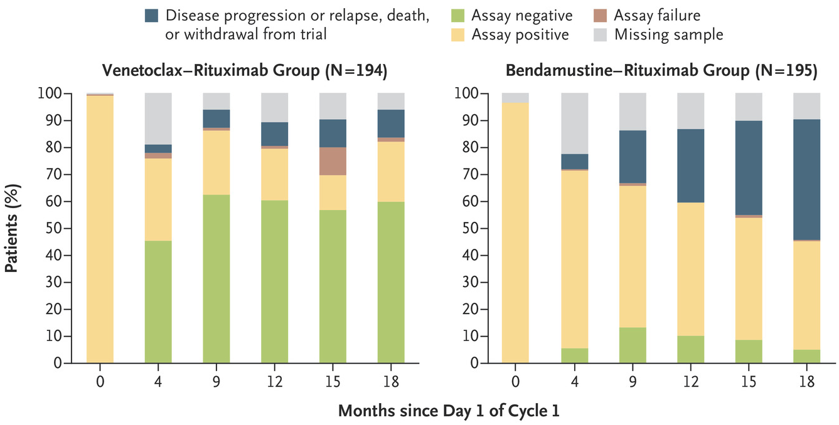
MURANO trial: MRD status
Seymour et al. NEJM 378:1107 2018

Slide 20
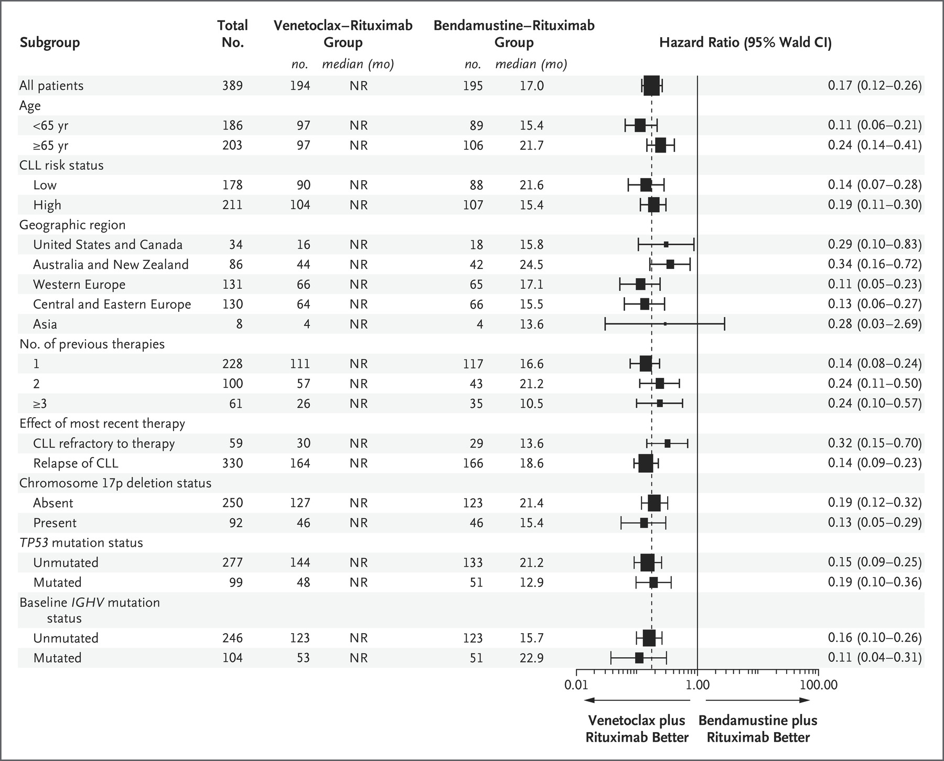
Seymour et al. NEJM 378:1107 2018

Slide 21
MURANO trial: Overall survival (median follow-up 24 months)
Seymour et al. NEJM 378:1107 2018

Slide 22
Issues with the MURANO trial
Bendamustine dosing (70 mg/m² for all patients)
Inclusion of del 17p patients on a BR trial
Previous bendamustine allowed
Duration of therapy not equivalent
More than 20% of patients had not had prior anti-CD20 therapy
No cross-over allowed
Follow-up short; will MRD negativity persist after cessation of venetoclax?

Slide 23
Venetoclax FDA approval in CLL
17p deletion
At least one prior therapy

Slide 24
Venetoclax FDA approval in CLL: June 8, 2018
17p deletion
At least one prior therapy

Slide 25
Acalabrutinib in CLL

Slide 26
Acalabrutinib vs. ibrutinib: kinase activity

Slide 27
ACE-CL-001 Acalabrutinib in CLL
Expansion phase
Acalabrutinib
100 mg bid
or
200 mg qd
Treatment until disease progression or unacceptable toxicity
Primary endpoint:
Safety
Secondary endpoints:
ORR (IWCLL 2008 criteria with modification for lymphocytosis)^{1,2}
DOR
PFS
Ad hoc endpoint:
Time to response
Dose-escalation phase
Acalabrutinib
(PO, 28-day cycles)
100-400 mg qd
or
100-200 mg bid
R/R CLL
Patients with ≥1 prior treatment
N=134
All patients were switched to 100 mg BID
bid = twice daily; CLL = chronic lymphocytic leukemia; bid = twice daily; DOR = duration of response; IWCLL = International Workshop on Chronic Lymphocytic Leukemia; ORR = overall response rate; PFS = progression-free survival; po = orally; qd = once daily; R/R = relapsed/refractory.
¹ Hallek M, et al. Blood. 2008;111(12):5446-5456. ² Cheson BD, et al. J Clin Oncol. 2012;30:2820-2822.

Slide 28
Tumor burden change: acalabrutinib in CLL
Nearly all patients (99%) experienced a reduction in lymphadenopathyª
Best Response:
CR
PR
PRL
SD
n=123^{b}
ª Lymphadenopathy defined as presence of any node with a diameter 1.5 cm; ^{b} Patients without the following were excluded from analysis: lymphadenopathy at baseline, postbaseline lymph node measurements, postbaseline overall response assessment.
CR = complete response; PR = partial response; PRL = partial response with lymphocytosis; SD = stable disease; SPD = sum of product diameters
Byrd et al., ASH annual meeting 2017

Slide 29
Acalabrutinib in CLL: PFS
Median PFS in the overall population was not reached
Median TTR (≥ PR) was 5.3 months (95% CI: 1.7, 22.4), and median DOR was not reached
 | N=134
Median PFS, mos (95% CI)^{b} | NR (35.7, NR)
del(17p) | NR (21.4, NR)
del(11q) | NR (NR, NR)
Complex karyotype | 27.9 (18.4, NR)
No complex karyotype | NR (35.7, NR)
18-month PFS, % (95% CI)^{b} | 90 (83, 94)
del(17p) | 80 (59, 91)
del(11q) | 100 (100, 100)
No complex karyotype | 95 (81, 99)
DOR = duration of response; NR = not reached; PFS = progression-free survival; PR = partial response; TTR = time to response.
Byrd et al., ASH annual meeting 2017

Slide 30
Acalabrutinib: safety
Grade ≥3 AEs occurred in 74 patients (55%)
Grade ≥3 AEs occurring in ≥5% of patients were neutropenia (12%) and pneumonia (11%)
One case of Grade ≥3 bleeding occurred (epistaxis)
Other AEs of interest (any grade/Grade ≥3) included hypertension (13%/4%) and atrial fibrillation or atrial flutter (3%/1%)
Seven patients experienced Grade 5 AEs: pneumonia (n=4), candida sepsis (n=1), congestive cardiac failure (n=1), and plasmablastic lymphoma (n=1)
The most common AEs leading to discontinuation were pneumonia (n=3), anemia, neutropenia, and thrombocytopenia (n=2 each)
Richter transformation occurred in 4 patients (3%)
Byrd et al., ASH annual meeting 2017

Slide 31
Phase III Elevate CLL R/R Trial Design: Acalabrutinib vs. Ibrutinib (ACE-CL-006)
* Treatment will be orally administered until disease progression or unacceptable toxicity.
CLL treatment with acalabrutinib is also being investigated in patients with treatment-naïve (ACE‐CL‐007 [NCT02475681] and R/R CLL ACE‐CL‐309 [NCT02970318]) in ongoing Phase 3 studies.

Slide 32
Conclusions: Acalabrutinib vs. Ibrutinib
Acalabrutinib appears to have similar activity with shorter follow-up compared with ibrutinib in CLL and MCL.
Kinome analyses support increased specificity and decreased off-target effects of acalabrutinib, suggesting potential for decreased toxicities, particularly bleeding and cardiac toxicities.
Ongoing randomized trials will allow direct comparison between these two agents in CLL.
Compliance of oral drugs always an issue, and acalabrutinib is BID.

Slide 33
Thank you!

