Slide 1
Please note, these are the actual
video-recorded proceedings from the
live CME event and may include the use of trade names and other raw, unedited content.

Slide 2
Emerging Research with and Ongoing Evaluation of Venetoclax and Other Novel Agents in Relapsed/Refractory Mantle Cell Lymphoma
Jeremy S. Abramson, MD, MMSc
Massachusetts General Hospital Cancer Center
Harvard Medical School

Slide 3
Disclosures
Consulting Agreements | Amgen Inc, Bayer HealthCare Pharmaceuticals, Celgene Corporation, Gilead Sciences Inc, Humanigen Inc, Juno Therapeutics, Karyopharm Therapeutics, Merck, Novartis, Seattle Genetics, Verastem Inc

Slide 4


Based on available data and reimbursement issues aside, would you attempt to access venetoclax for select patients with relapsed/refractory MCL?
Yes
20
No
3
N = 23 investigators
Notes:
4
4
4
4
4

Slide 5
Please describe a clinical scenario for which you would recommend venetoclax for a patient with MCL.
Ibrutinib and chemo resistance
3rd line in a patient who progressed on chemo and on BTKi therapy
Young pt who has failed chemo-immuno, ASCT and BTK inhibitor
Progress through BTK inhibition and lenalidomide therapy
Combo with ibrutinib is promising but there are not enough data
70 yo who failed prior BR + MR (on E1411), intolerant to len (rash), PD on acalabrutinib
Older patient with MCL who failed ibrutinib
Rapid progression from ibrutinib
Third or fourth line of therapy
Once failed immunochemo and ibrutinib
Ibrutinib failures or blastic transformation in first relapse as a bridge to allo
Failed 2 prior therapies or blastoid variant
Any patient relapsing soon after chemotherapy should be considered for ibrutinib + venetoclax, in my opinion
Progression or intolerance to ibrutinib
Younger patient; post ibrutinib, considering CAR-T cell therapy
Failed BTK inhibitor
Post BTK inhibitor and lenalidomide
Still too risky
Progressed after 2 cycles
Pts failing a BTK inhibitor
Progression after BTK inhibitor
Relapsed after ibrutinib
N = 23 investigators
Notes:
5
5
5
5
5

Slide 6


How would you compare the risk of tumor lysis syndrome in patients with MCL receiving venetoclax to that of patients with CLL receiving venetoclax?
The risk is greater in CLL
11
The risk is about the same
8
There are not enough
available data at this time
3
The risk is greater in MCL
1
N = 23 investigators
Notes:
6
6
6
6
6

Slide 7

A 60-year-old patient with MCL, an absolute lymphocyte count of 7,000 and several involved lymph nodes that are <2 cm is about to receive venetoclax. What preemptive measures, if any, would you take to address tumor lysis syndrome prior to the initiation of therapy?
Encourage oral hydration and allopurinol
15
IV hydration and allopurinol
5
Admit to hospital
1
IV hydration and rasburicase
1
None
1
N = 23 investigators
Notes:
7
7
7
7
7

Slide 8
An 80-year-old patient with MCL, an absolute lymphocyte count of 7,000 and several involved lymph nodes that are <2 cm is about to receive venetoclax. What preemptive measures, if any, would you take to address tumor lysis syndrome prior to the initiation of therapy?
Encourage oral hydration and allopurinol
14
IV hydration and allopurinol
5
Admit to hospital
4
N = 23 investigators
Notes:
8
8
8
8
8

Slide 9
An 80-year-old patient with MCL, an absolute lymphocyte count of 7,000 and several involved lymph nodes that are >5 cm is about to receive venetoclax. What preemptive measures, if any, would you take to address tumor lysis syndrome prior to the initiation of therapy?
Admit to hospital
10
IV hydration and allopurinol
9
Encourage oral hydration and allopurinol
2
Follow package insert
1
IV hydration and rasburicase
1
N = 23 investigators
Notes:
9
9
9
9
9

Slide 10
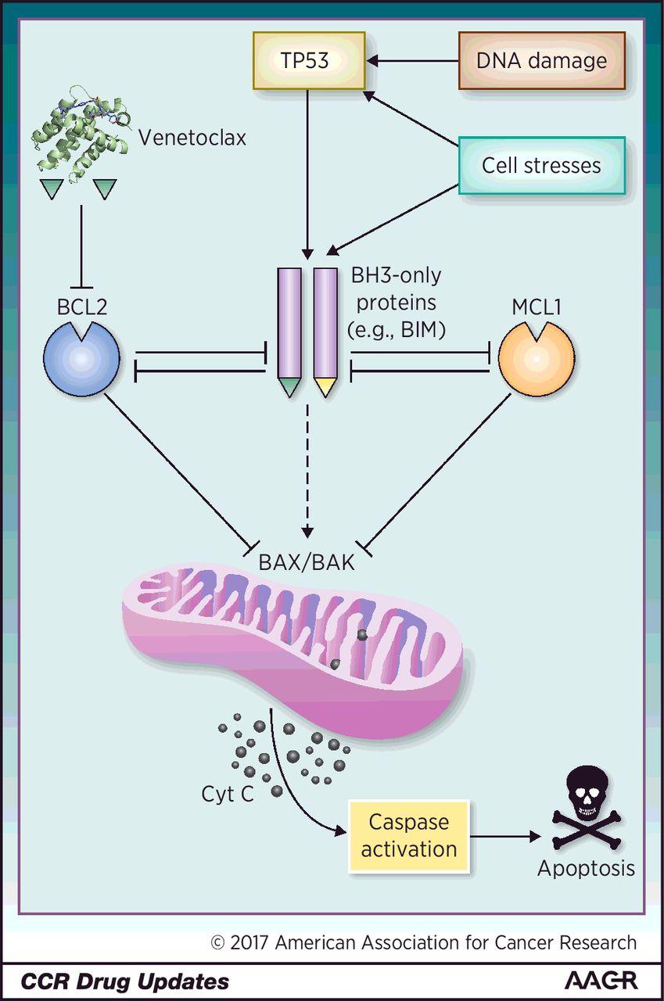
Rationale for venetoclax in MCL
BCL-2 is frequently aberrantly expressed
Amplification of 18q21 (incl BCL-2 locus) is common
Defective protein degradation via reduced FBX010
Transcriptional upregulation through BTK-mediated NFkB activation
Venetoclax is a selective, potent, orally bioavailable
BCL-2 inhibitor that binds BCL-2 with >1000-fold higher affinity than BCL-X_{L}, BCL-W and MCL-1
Venetoclax acts as a BH3-mimetic, displacing the BH3-only protein BIM from BCL-2, thereby inducing apoptosis in BCL-2 dependent cells
Bentz M et al. Genes Chromosomes Cancer 2000
Li et al Oncogene 2016

Slide 11
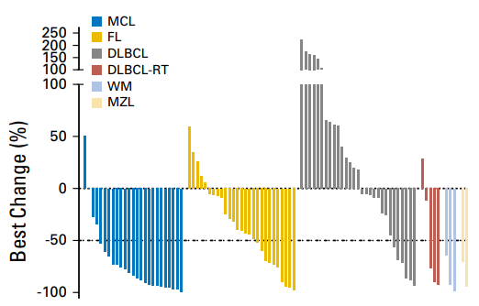
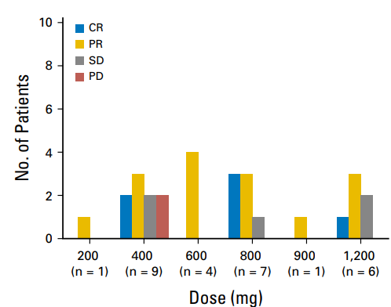
Venetoclax in Relapsed/Refractory MCL
Response
ORR | 21 (75%)
CRR | 6 (21%)
PRR | 15 (54%)
SD | 5 (18%)
Mantle cell lymphoma cohort (N=28)
Age | 72 (35-85)
Prior therapies | 3 (1-10)
Bulky >5cm/>10cm | 14/3
LDH > ULN | 7

Slide 12
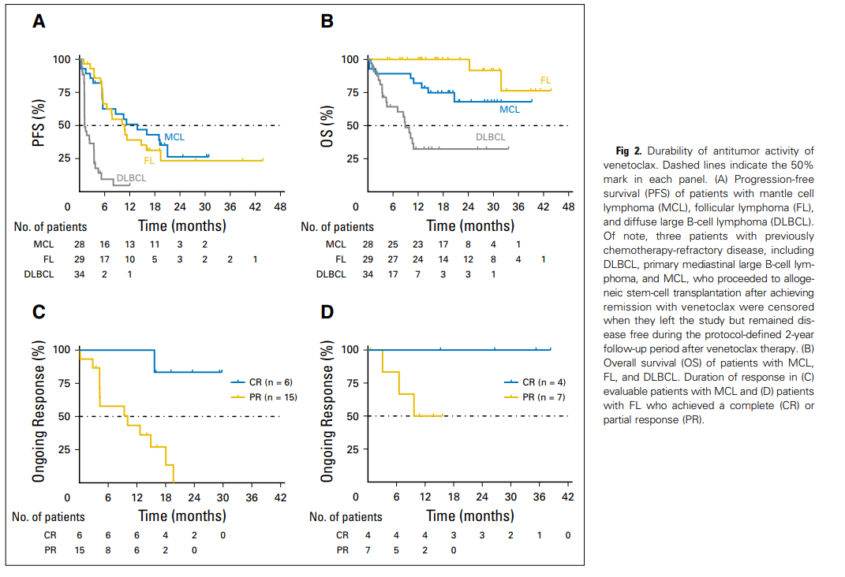
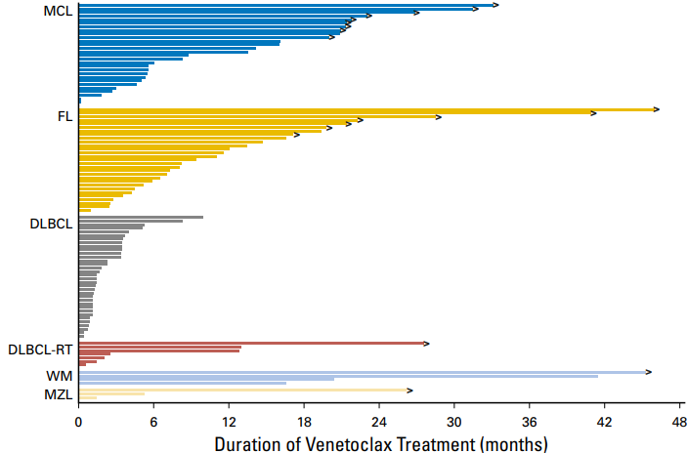
Responses to Venetoclax may be durable
Median PFS 14 m

Slide 13
Venetoclax toxicity
Toxicity | Any grade (%) | Grade 3-4 (%)
Nausea | 48 | 0
Diarrhea | 45 | 3
Fatigue | 42 | 7
Anorexia | 22 | 1
Constipation | 21 | 2
Headache | 18 | 0
Anemia | 17 | 15
Cough | 17 | 1
Neutropenia | 17 | 11

Slide 14
Tumor lysis syndrome (TLS)
Clinical TLS is less common than in CLL, but has been reported, including in “low risk” patients.
My practice:
  All patients should have close observation, hydration and allopurinol.
  Follow CLL algorithm: Begin at 20 mg and escalate weekly to 800 mg.
  More rapid dose escalation strategies are being explored.

Slide 15


Efficacy of venetoclax monotherapy in patients with relapsed, refractory mantle cell lymphoma post Btk inhibition therapy.
T.A. Eyre, H. S. Walter, S. Iyengar, G. Follows, C.P. Fox,
N. Morley, M.J.S. Dyer & G. P. Collins.
Dr Toby A. Eyre
MBChB (Hons), DipMedEd, MRCP(UK), FRCPath, M.D.
Consultant Haematologist
Department of Haematology
Oxford University Hospitals
NHS Foundation Trust
United Kingdom

Slide 16
Efficacy of venetoclax monotherapy in patients with relapsed, refractory mantle cell lymphoma post Btk inhibition therapy
All patients (N=20) | n (%)
Median age | 69 (range 43-84)
Advanced Stage | 95%
Elevated LDH | 75%
ECOG PS 2-4 | 45%
sMIPI 4-9 | 75%
Median prior lines of therapy | 3 (range 2-5)
First line therapy
CHOP+/-R or CHOP-like | 6
Fludarabine-based+/-R | 4
MAXI-CHOP/HDAC+/-R | 8
Other | 2
ASCT Consolidation in 1st remission | 6 (30%)
Rituximab Maintenance in 1st remission | 2 (10%)
Retrospective, multicentre study
20 R/R MCL patients treated with venetoclax at major UK centres (03/2016 -> 05/2018) via the UK-wide compassionate use scheme
All patients had prior ibrutinib exposure
Target dose: 800 mg

Slide 17
Response to prior BTK inhibitor
All patients (N=20) | n (%)
Response rate to prior BTK inhibitor* | ORR 11/20 (55%)
 | CR 3 (15%)
 | PR 8 (40%)
 | PD 5 (25%)
Duration of exposure to BTK inhibitor (months; range) | 4.8 months (range 0.7-34.8)
Reason for BTK inhibitor discontinuation
Progressive disease | 17
Stable disease | 1
Toxicity | 2
median PFS to BTKi f 4.8 m (95% CI 3.1-29.2 m)
*ibrutinib (n=17), ibrutinib with donor lymphocyte infusion (n=1), tirabrutinib (n=2)

Slide 18
Toxicity
All patients (N=20) | n (%)
No adverse effects reported | 12 (60%)
Grade 4 sepsis | 1 (5%)
Grade 3 pneumonia | 3 (15%)
Grade 2 diarrhoea | 2 (10%)
Grade 2 fatigue | 2 (10%)
Grade 2 headache | 2 (10%)
Grade 2 nausea | 1 (5%)
Grade 2 neutropenia | 1 (5%)
Grade 2 raised gamma GT | 1 (5%)
Grade 1 anaemia | 1 (5%)
Grade 1 thrombocytopenia | 1 (5%)
Dose reductions: 800 mg to 600 mg required | 3 (15%)
Reasons: Grade 2 fatigue (n = 1), Grade 2 diarrhoea (n = 2)
Biochemical tumour lysis | 5 (25%)
Clinical tumour lysis syndrome | 0 (0%)

Slide 19
Efficacy
n=20, median f/u 5 m
ORR 60% (CR 20%)
  Primary BTKi resistant (n = 9): 44%
  Initial BTKi response (n = 11): 73%
  Blastoid (n=4): 25%

Slide 20
Mechanisms of resistance to venetoclax in MCL (very limited data)
Upregulation of other BCL-2 family members (BCL-xL, MCL-1)
Post-translational phosphorylation of BCL-2 family members
Downstream BCR, PI3K/AKT signaling

Slide 21
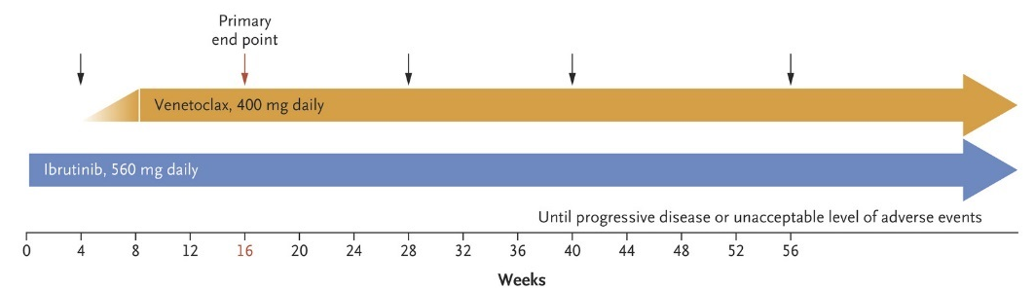
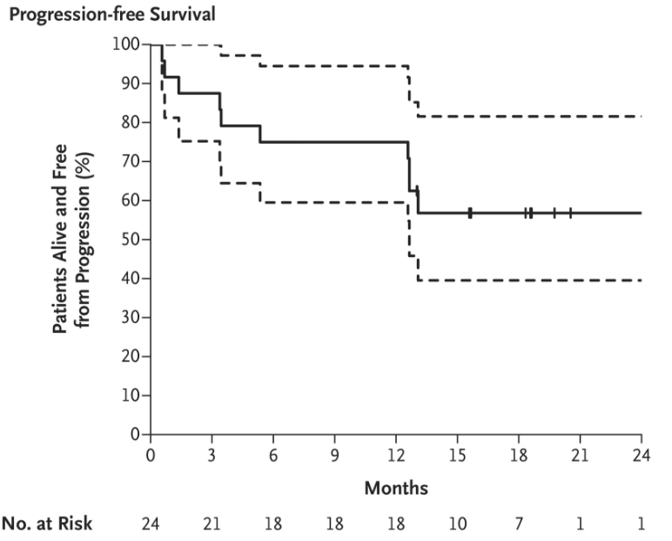
Ibrutinib plus Venetoclax: Single arm phase 2 study
2 cases of TLS, both high burden, began at 50 mg
Characteristic | n=24
Median age (range) | 68 (47-81)
Median prior tx (range) | 2 (1-6)
Refractory to prior tx | 11 (48%)
Prior ASCT | 7 (30%)
Prior HiDAC | 11 (48%)
Prior benda | 4 (17%)
MIPI Int/High | 21%/75%
Best ORR/CRR: 71%/71%
MRD negative: 9/16 (56%)
Tam, et al. NEJM 2018

Slide 22
Ongoing trial: Ibrutinib + venetoclax in relapsed/refractory MCL
Phase 1/1b
R/R MCL
(N=28)*
Ibrutinib (280-560 mg) +
Venetoclax (100-400 mg)
UNTIL
PROGRESSIONOR INTOLERANCE
*Estimated enrollment
INCLUSION CRITERIA
R/R MCL
ECOG score 0-2
Referred for treatment with ibrutinib
Adequate organ function
EXCLUSION CRITERIA
High risk for TLS
OBJECTIVES
Primary: DLT
Secondary: AE, ORR, CR, MRD, PFS, OS, PK
Thus far: n=8, 2 CR, 4 PR. 1 laboratory TLS prompted reduction in starting dose from 100 mg to 20 mg.
Portell CA, et al. Proc ASH 2016.

Slide 23
Ongoing trial:
OAsIS – Phase 1/2 Study of Venetoclax + Ibrutinib + Obinutuzumab
Cohort A (n=9)
Safety of doublet combination
Phase 1/2
R/R MCL
(N=33)
Obinutuzumab + Ibrutinib
Obinutuzumab + Ibrutinib
Cohort B (n=24)
MTD of venetoclax in triplet combination, safety & efficacy
Obinutuzumab + Ibrutinib + Venetoclax
Obinutuzumab maintenance + Ibrutinib + Venetoclax
1L MCL
(N=15)
Cohort C (n=15)
Safety & efficacy
Obinutuzumab + Ibrutinib + Venetoclax
Obinutuzumab maintenance + Ibrutinib + Venetoclax
INCLUSION CRITERIA
For Cohort A & B: ≥1 prior treatment for MCL
For Cohort C: Untreated MCL
ECOG PS of 0-2
EXCLUSION CRITERIA
Clinically significant CVD
ENDPOINTS
Primary: Toxicity of obinutuzumab and ibrutinib; Toxicity of triplet, DLT and RP2D for triplet
Secondary: Response, TTP, OS, safety, TLS

Slide 24
Ongoing trial:
PCYC-1143 - CA (SYMPATICO) – Phase 3 Study of Ibrutinib plus Venetoclax
Ibrutinib + Venetoclax (24 mo)
(n=130)
Discontinue Venetoclax
Continue Ibrutinib
Phase 3
R/R MCL
(N=260)
RANDOMIZE 1:1
Stratified by TLS risk and MIPI
UNTIL
PD OR TOXICITY
Ibrutinib + Placebo (24 mo)
(n=130)
Discontinue Placebo
Continue Ibrutinib
INCLUSION CRITERIA
R/R MCL
Failure to achieve at least PR with, or documented PD after, most recent treatment regimen
EXCLUSION CRITERIA
Prior treatment with venetoclax
ENDPOINTS
Occurrence of TLS and DLT
(~3 mo after last patient enrolled in run-in portion)
PFS

Slide 25
Additional Novel Strategies in MCL
CDK4/6 inhibition
PI3 kinase delta inhibition
Anti-CD19 CAR T-cells

Slide 26
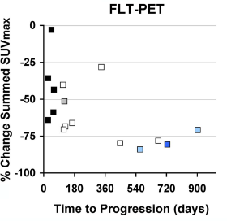
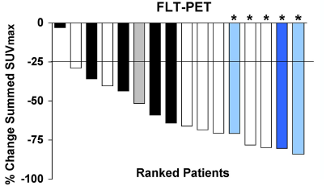
Additional Novel Strategies in MCL: CDK4/6 inhibition
Palbociclib (n=17) ORR 18%, SD 41%
Abemaciclib (n=22) ORR 23%, SD 41%
Palbociclib + ibrutinib (n=18) ORR 67%, CRR 44%
Leonard, et al. Blood 2012
Morschhauser, et al. Proc ASH 2014
Martin, et al. Proc ASH 2016

Slide 27
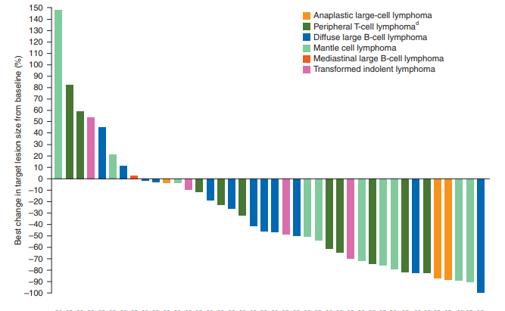
Additional Novel Strategies in MCL: PI3 kinase delta inhibition
Idelalisib ORR 40% (5% CR), but median PFS/DOR of 3.7m/2.7m
Constitutive PI3K alpha signaling may mediate resistance
Copanlisib is a pan PI3K inhibitor with potent delta and alpha inhibition
  N=11, median 3 prior lines of tx,
  8 refractory to last tx
  5 PR/2 CR (ORR 64%)
  Median DOR 5 m. 2 responses >9 m
Gopal, et al. NEJM 2014
Dreyling, et al. Ann Onc 2017
Cunningham Proc ASH 2015

Slide 28
Additional Novel Strategies in MCL: Anti-CD19 CAR T-cells
JCAR014 produced responses in 1 of 4 subjects in a phase I study
Lisocabtagene maraleucel (JCAR017) is an anti-CD19-4-1BB CAR T-cell administered in a precise composition, being studied in the TRANSCEND 001 trial in aggressive B-cell NHL
  Small number of patients treated thus far, but responses are being observed. Accrual is ongoing.
Turtle, et al. Sci Trans Med 2016.
Abramson, et al. Proc ASCO 2018

Slide 29
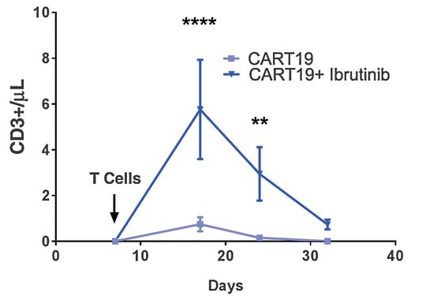
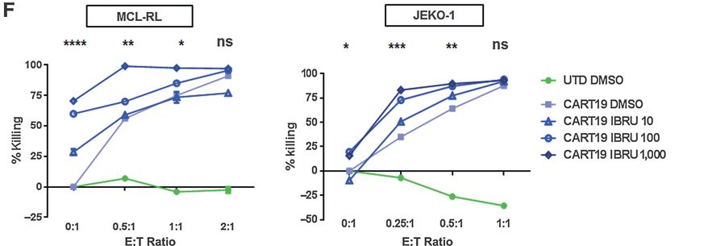
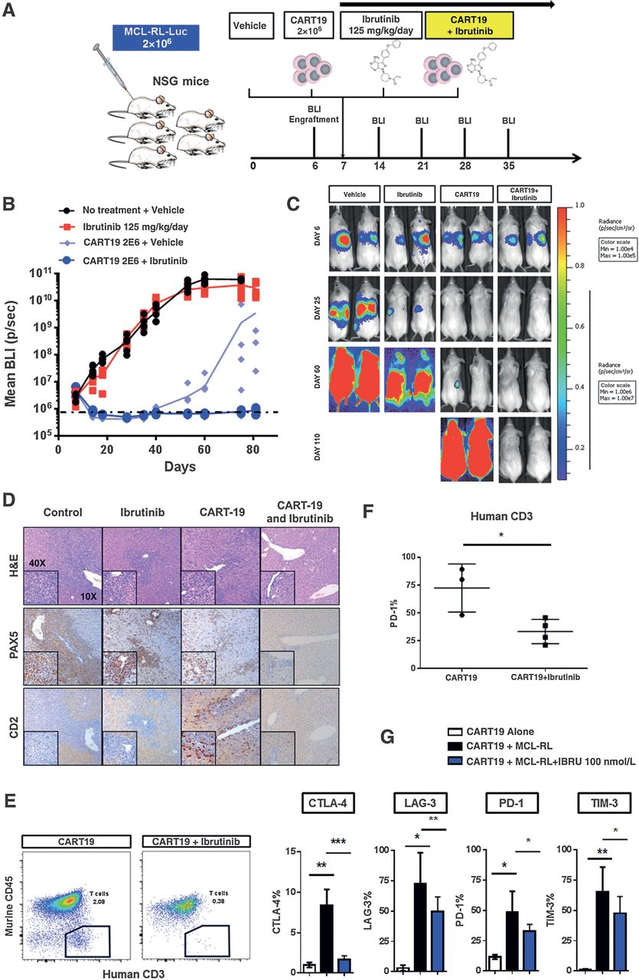
Ibrutinib combined with CAR T-cells in vitro for MCL
Ibrutinib increases CAR expansion
Ibrutinib improves cell lysis in ibrutinib sensitive or resistant MCL lines in vitro
Ibrutinib enhances CAR T-cell MCL activity in MCL xenografts
Ibrutinib downregulates inhibitory immune checkpoints
Ruella et al. Clin Cancer Res 2016

Slide 30
Take home points
The BCL-2 inhibitor venetoclax induces substantial remissions in relapsed/refractory MCL post chemoimmunotherapy
Further studies of venetoclax post ibrutinib are warranted
We need to elucidate mechanisms of resistance to design rational combination strategies with venetoclax
Additional novel agents of interest under investigation include CDK4/6 inhibitors (in combination), PI3K inhibitors (potentially targeting both alpha and delta isoforms), and anti-CD19 CAR T-cells

