Slide 1
Please note, these are the actual
video-recorded proceedings from the
live CME event and may include the use of trade names and other raw, unedited content.

Slide 2
Selection and Sequencing of Therapy for Patients with Relapsed/Refractory
Mantle Cell Lymphoma
John P. Leonard, M.D.
Richard T. Silver Distinguished Professor of Hematology and Medical Oncology
Associate Dean for Clinical Research
Associate Director, Meyer Cancer Center
Executive Vice Chair, Weill Department of Medicine

Slide 3
Disclosures
Consulting advice:
Gilead, Celgene, Sutro, BMS, Genentech/Roche, Pfizer, Bayer, ADC Therapeutics, MEI Pharma, AstraZeneca, Biotest, Novartis

Slide 4



A 60-year-old patient with MCL initially treated with the NORDIC regimen followed by autologous transplant and 2 years of rituximab maintenance relapses 3 years later. What would you recommend?
Ibrutinib
15
Acalabrutinib
7
Modified hyper-CVAD
or R-DHAP
1
N = 23 investigators
Notes:
4
4
4
4
4

Slide 5

The patient in the previous scenario receives ibrutinib and achieves a complete response. What would you do next?
Continue ibrutinib until disease progression
14
Consider allotransplant
8
Switch to acalabrutinib
1
N = 23 investigators
Notes:
5
5
5
5
5

Slide 6
An 80-year-old patient with MCL responds to BR followed by rituximab maintenance but after 3 years develops disease progression. The patient is not a candidate for transplant. In general, what would be your most likely next treatment recommendation?
Ibrutinib
15
Acalabrutinib
7
Bortezomib + rituximab
1
N = 23 investigators
Notes:
6
6
6
6
6

Slide 7



In general, what would be your most likely treatment recommendation for a transplant-ineligible 60-year-old patient with MCL who responds to R-hyper-CVAD and then ibrutinib on relapse but subsequently develops disease progression?
Lenalidomide + rituximab
10
Venetoclax
9
Venetoclax + rituximab
1
Bortezomib + rituximab
1
Lenalidomide
1
N = 22 investigators
Notes:
7
7
7
7
7

Slide 8


In general, what would be your most likely treatment recommendation for an 80-year-old otherwise healthy patient with MCL who responds to BR and then ibrutinib on relapse but then develops rapid tumor progression?
Lenalidomide + rituximab
10
Venetoclax
8
Bortezomib + rituximab
2
No added therapy
1
Modified RBAC
1
Lenalidomide
1
N = 23 investigators
Notes:
8
8
8
8
8

Slide 9
What is the typical outcome from upfront therapy?
In a favorable risk patient population, intensive approaches can have median PFS in the 7 year range and OS in the 7-10 year range
In a “typical risk” patient population, less intensive approaches can have median PFS in the 5+ year range and OS in the 7+ year range
Risk profile (MIPI) has greatest influence on OS
Patient preferences should be a key driver of treatment choice (given similar OS)

Slide 10
Nordic MCL2/3 studies
TP53 mutations associate with poor outcomes w SCT
Eskelund et al, Blood 2017

Slide 11
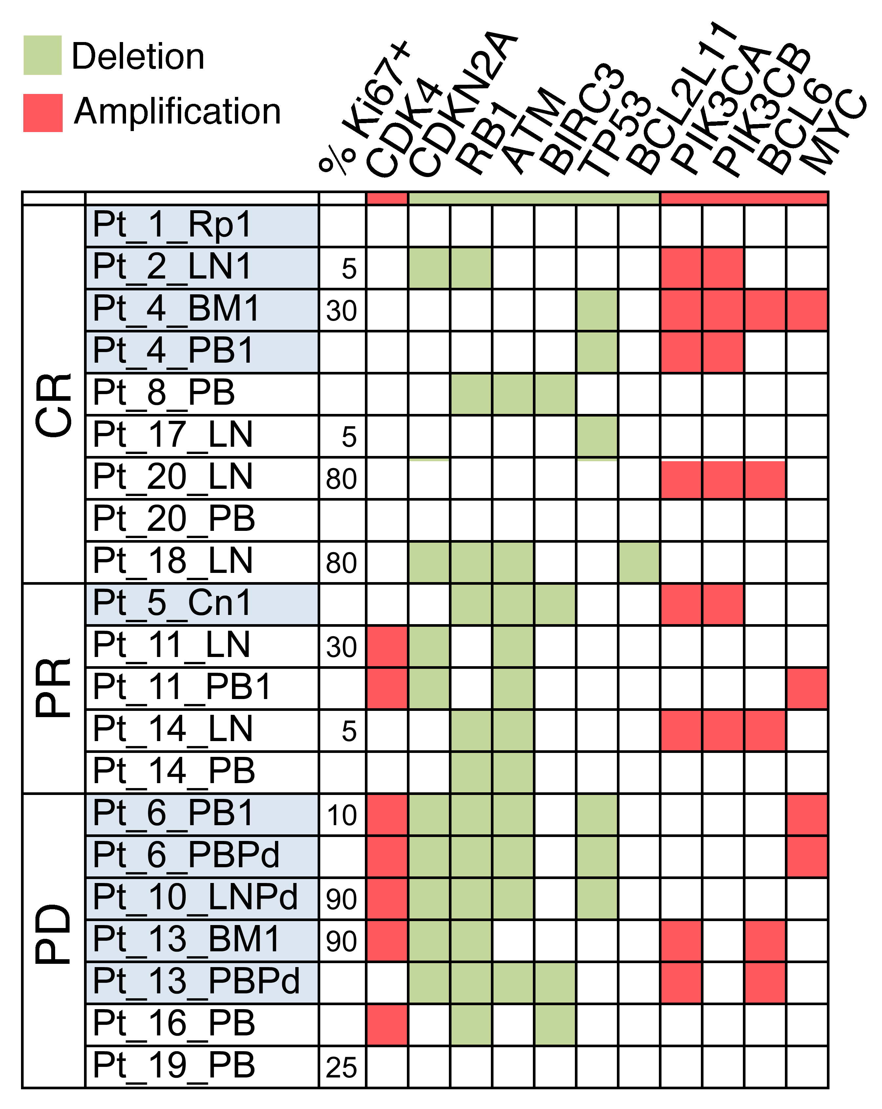
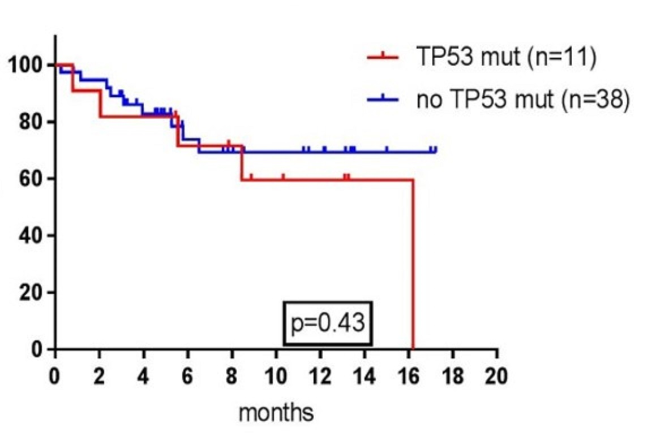
TP53 was not associated with prognosis in studies with novel agents in relapsed/refractory MCL
Ibrutinib-lenalidomide-rituximab
Ibrutinib-palbociclib
PFS by TP53
Jerkman et al. ASH 2016
Martin et al. ASH 2016

Slide 12
What regimens are available for patients with relapsed disease?
B-R (+/- bortezomib) or R-CH(bortezomib)P
  Depending on prior rx and extent of disease
R-HyperCVAD (if blastoid)
Lenalidomide/rituximab
Ibrutinib and acalabrutinib
Venetoclax
SCT approaches
Clinical trials (novel agents/combinations, CAR-T)

Slide 13
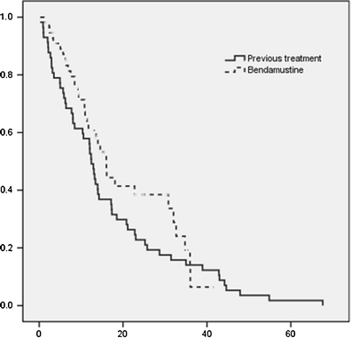
Bendamustine in Relapsed Mantle Cell Lymphoma
58 previously treated patients
Response rate in 57 patients was 86% including 55% CR
Median PFS was 16 months (12m for prior)
Median PFS for patients with CR after bendamustine was 33 months
Median OS was 32.4 months
García-Noblejas A et al. Ann Hematol. 2014;93(9):1551-8

Slide 14
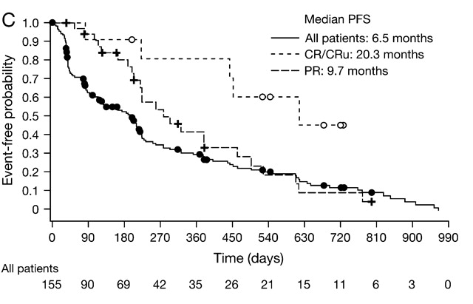
Bortezomib in Relapsed or Refractory MCL (Phase II PINNACLE Study): PFS
Goy A et al. Ann Oncol 2008;20:520-525

Slide 15
Bortezomib Combination Regimens in Relapsed/Refractory MCL
Regimen | N | Median prior treatments | ORR/CR | Median PFS | Median OS
Rituximab-bortezomib¹ | 14 | 2 | 29%/29% | 1.9 mo | NR
Bendamustine-rituximab-bortezomib² | 7 | 4 | 71%/NR | NR | NR
Cyclophosphamide-rituximab-bortezomib³ | 21 | 3 | 74%/42% | 9 mo | 36 mo
CHOP vs CHOP-bortezomib⁴ | 46 | 1 | 48%/22% vs 83%/35% | 8 vs 16 mo | 12 vs 36 mo
¹ Baiocchi RA. Cancer 2011;117:2442-51.
² Friedberg JW. Blood 2011;117:2807-12.
³ Lee HJ et al. Oncologist 2017;22(5):549-53. ⁴ Furtado M et al. Br J Haematol 2015;168(1):55-62.

Slide 16
Lenalidomide in Relapsed/Refractory MCL
Phase II EMERGE trial (n=134)
  Median of four prior therapies, including bortezomib
  Prior SCT in 29%; dose intense therapy in 33%
Lenalidomide 25 mg/day on D1-21 of a 28 day cycle until PD or intolerable adverse events (AEs)
ORR (CR/CRu) | 28% (7.5%)
Med DOR (95% CI) | 16.6 months (7.7-26.7)
Med OS (95% CI) | 19.0 months (12.5-23.9)
Med Time to Response | 2.2 months
Grade 3/4 AEs in >15% | Neutropenia 43% Thrombocytopenia 28%
Goy et al, J Clin Oncol 2013.

Slide 17
Lenalidomide Combination Regimens in Relapsed/Refractory MCL
Regimen | N | Median prior treatments | ORR/CR | Median PFS | Median OS
Lenalidomide-rituximab¹ | 52 | 2 | 57%/36% | 11.1 mo | 24.3 mo
Ibrutinib-lenalidomide-rituximab² | 50 | 2 | 88%/64% | Not reached | —
¹ Wang M. Lancet Oncol 2012;13:716-23.
² Jerkeman M et al. Proc ASH 2016;Abstract 148.

Slide 18
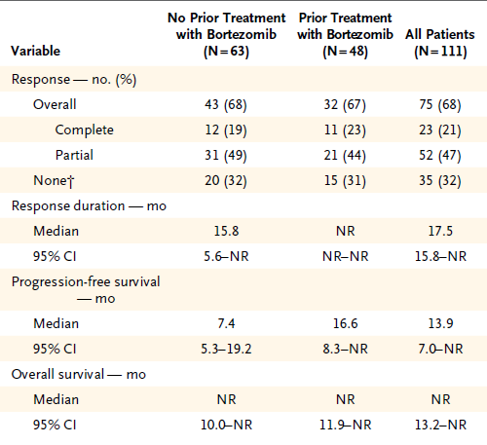
Ibrutinib in Relapsed/Refractory MCL
Wang et al, NEJM 2013

Slide 19
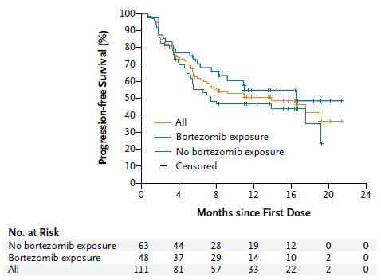
Ibrutinib in Relapsed/Refractory MCL
Wang et al, NEJM 2013

Slide 20
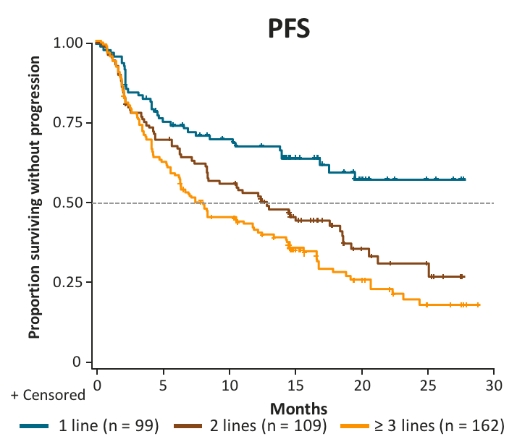
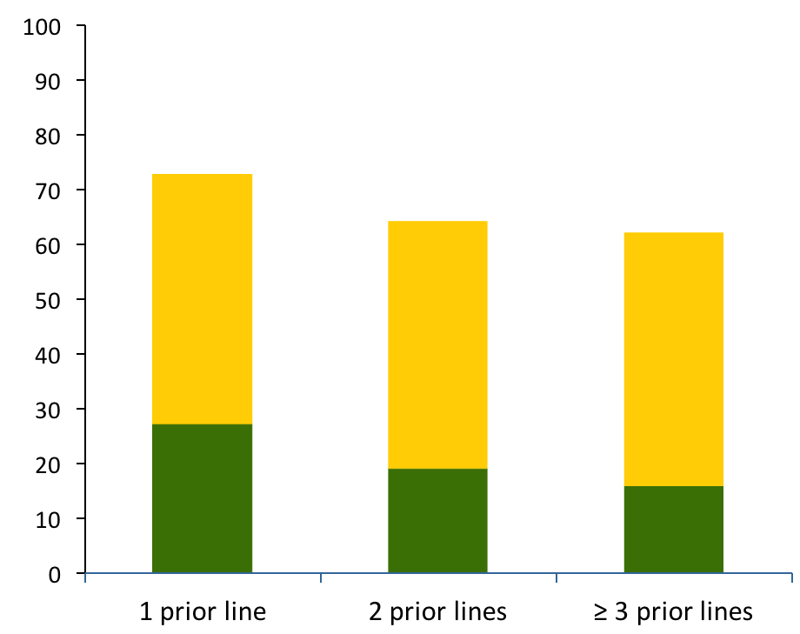
Should we use ibrutinib earlier?
Pooled MCL Analysis: PFS and RR by Lines of Therapy
RR
CR
PR
Rule S et al. EHA 2016

Slide 21
Outcomes post-ibrutinib progression
Characteristic |  | N | %
 | All | 114 | 100%
CR |  | 13 | 11%
PR |  | 45 | 39%
Duration |  | 4.7 mo | 95% CI 3.8-5.7
Post-ibrutinib | All | 104 | 100%
 | Received rx post-ibrutinib | 73 | 70%
 | Time from ibrutinib to next therapy | 0.3 mo | 95% CI 0.2-0.5 mo
MIPI | High risk | 35 | 48%
 | Intermediate risk | 18 | 25%
 | Low risk | 9 | 12%
 | Unknown | 11 | 15%
Subsequent treatment | Rituximab | 39 | 53%
 | Lenalidomide | 19 | 26%
 | Cytarabine | 13 | 18%
 | Bendamustine | 12 | 16%
 | Bortezomib | 7 | 10%
 | Anthracycline | 5 | 7%
 | PI3K inhibitor | 4 | 5%
Whole group median OS: 2.9 mo (95% CI 1.6-4.9)
No treatment OS: 0.8 mo (95% CI 0.3-1.4)
Treated median OS: 5.8 mo (95% CI 3.7-10.4)
TTNT with first subsequent therapy
  N=67; 2.4 mo (95% CI 1.4-3.3)
Univariate Cox regression analysis for OS:
  MIPI prior to ibrutinib (HR 1.81)
  duration of ibrutinib (HR 0.96)
Martin et al Blood 2016

Slide 22
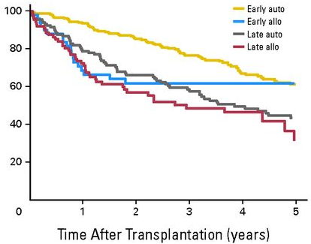
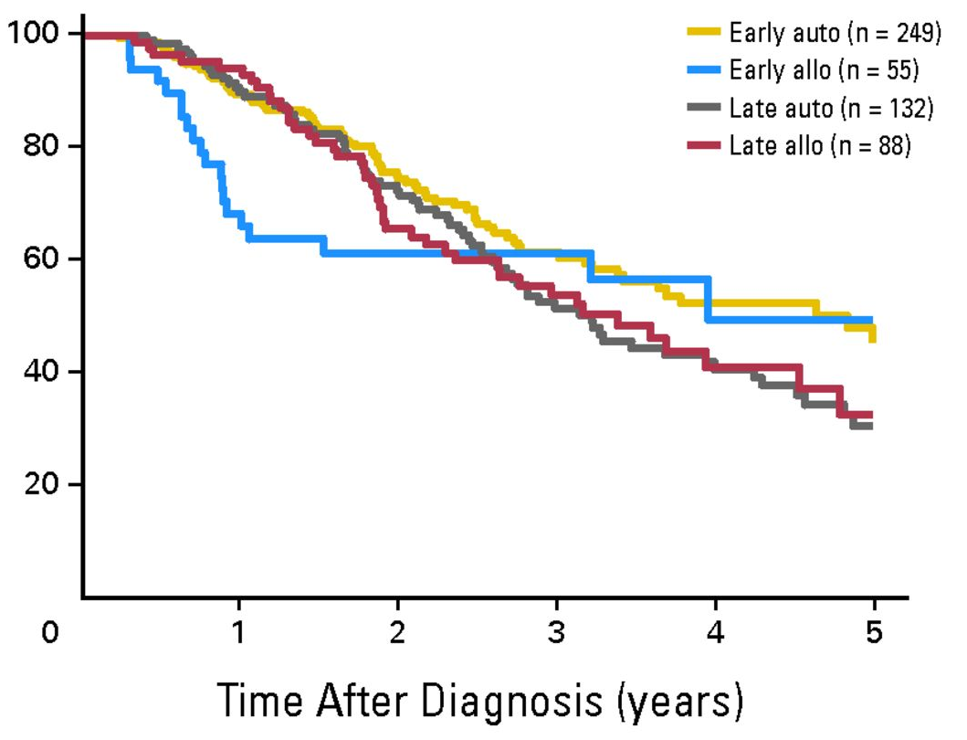
Earlier stem cell transplantation is associated with better survival from time of transplant but not from time of diagnosis
Fenske T S et al. JCO 2014;32:273-281

Slide 23
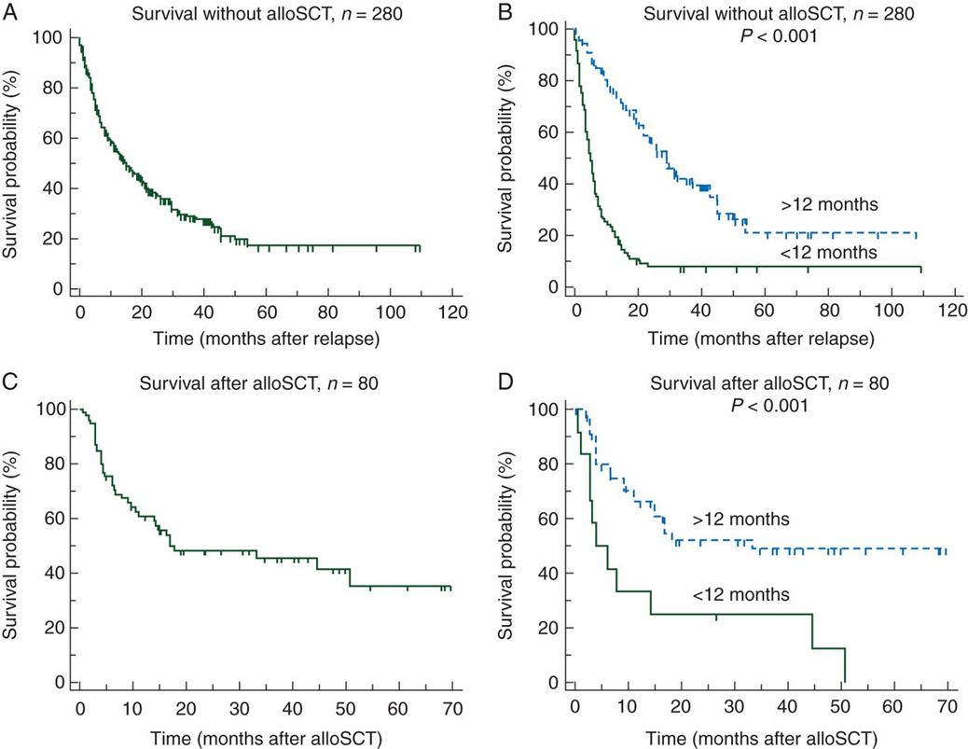
Overall survival with and without allogeneic stem-cell transplantation (relative to prior autoSCT)
Dietrich S et al. Ann Oncol 2014;25:1053-1058

Slide 24
Summary points for relapsed MCL therapy
Watch and wait if asymptomatic/low risk
Consider if SCT (auto or allo) remains an option
Time to relapse and aggressiveness of disease important
Bendamustine or CH(bortezomib)P + rituximab sometimes useful
Bortezomib and lenalidomide usually in combination
Ibrutinib and acalabrutinib being used earlier
Novel combinations and CAR-T under exploration

