Slide 1
Please note, these are the actual video-recorded proceedings from the live CME event and may include the use of trade names and other raw, unedited content.

Slide 2
Oncology Grand Rounds Breast Cancer Nurse and Physician Investigators Discuss New Agents, Novel Therapies and Actual Cases from Practice
Friday, May 18, 2018 12:15 PM – 1:45 PM
Faculty
Lisa A Carey, MD
Lauren Czapla, MSN, WHNP-BC, AOCNP
Sara A Hurvitz, MD
Madelaine C Kuiper, NP
Moderator Neil Love, MD

Slide 3
Oncology Grand Rounds Series

Slide 4
Oncology Grand Rounds: Format
Personalized oncology strategy
New markers and agents
Patient counseling and education as a component of that strategy
Symptom management
Discussion of actual cases from nurse faculty
The bond that heals; trust and integrity
Supporting family and loved ones

Slide 9
Oncology Grand Rounds Breast Cancer Nurse and Physician Investigators Discuss New Agents, Novel Therapies and Actual Cases from Practice
Friday, May 18, 2018 12:15 PM – 1:45 PM
Faculty
Lisa A Carey, MD
Lauren Czapla, MSN, WHNP-BC, AOCNP
Sara A Hurvitz, MD
Madelaine C Kuiper, NP
Moderator Neil Love, MD

Slide 10
Overview of Breast Cancer
Estimated number of new cases and deaths in 2018:
New cases = 268,670
Deaths = 41,400
Stage at diagnosis:
Localized disease = 62%
Regional disease = 31%
Metastatic disease = 6%
Cancer Facts and Figures 2018; American Cancer Society; SEER Stat Fact Sheet.
Notes:
http://www.cancerresearchuk.org/health-professional/cancer-statistics/statistics-by-cancer-type/breast-cancer/incidence-invasive#heading-Three

Slide 11
ER/HER2 Subtypes in Clinical Practice
16%
12%
62%
10%
Visiting Professors Improving The Efficacy of Endocrine Treatment of Metastatic Breast Cancer Survey. Research To Practice 2018.

Slide 12
HER2-Positive: Localized Disease
HER2-Positive Metastatic Disease
ER-Positive/HER2-Negative Metastatic Disease
Triple-Negative Metastatic Disease
Notes:
12
12
12
12
12

Slide 13
Key Considerations in Adjuvant Therapy for HER2-Positive Breast Cancer
Selection of patients: Risk criteria for treatment
Response to neoadjuvant therapy and presence of residual disease
Anthracyclines or not
Current use of adjuvant pertuzumab
Duration and role of extended adjuvant therapy with neratinib
Notes:
http://www.cancerresearchuk.org/health-professional/cancer-statistics/statistics-by-cancer-type/breast-cancer/incidence-invasive#heading-Three

Slide 14
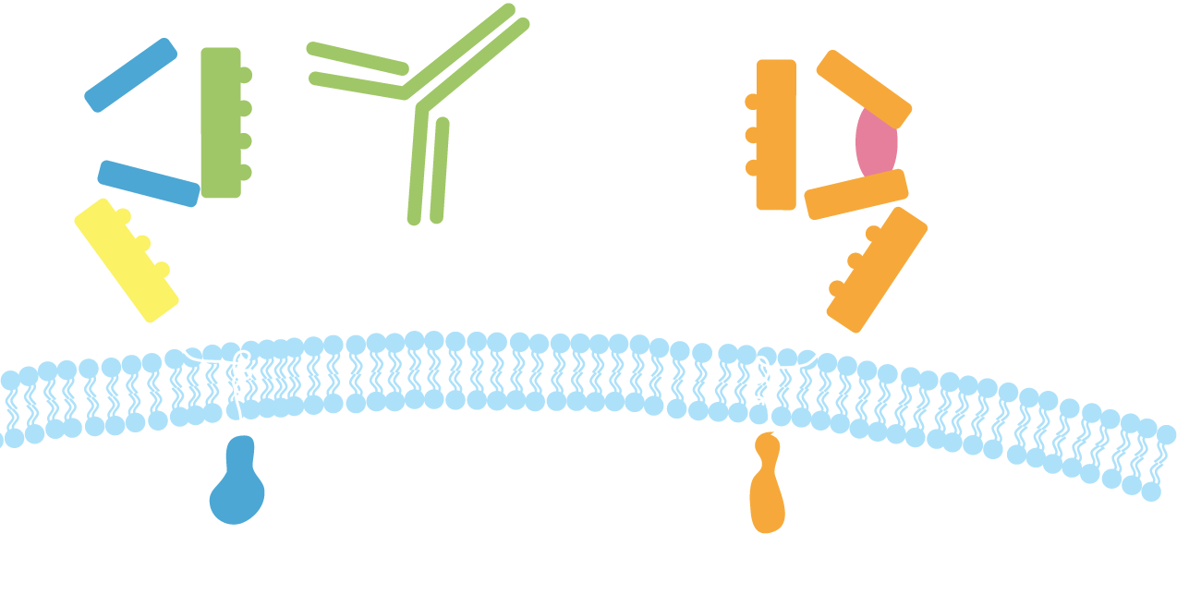
Pertuzumab: Mechanism of Action
Pertuzumab
HER2
HER1/3/4
Dimerization domain
Subdomain IV
Pertuzumab:
Inhibits ligand-dependent HER2 dimerization and signaling
Activates ADCC
ADCC = antibody-dependent cell-mediated cytotoxicity; ECD = extracellular domain
Harbeck N et al. Breast Care (Basel) 2013;8(1):49-55.

Slide 15
Pertuzumab (Neoadjuvant and Adjuvant)
Mechanism of action
Antibody targeted to HER2 receptor that prevents its dimerization with other members of the HER family of receptors
Indications
Neoadjuvant: Patients with HER2-positive, locally advanced, inflammatory or early-stage breast cancer (either greater than 2 cm in diameter or node-positive) as part of a complete treatment regimen
Adjuvant: Patients with HER2-positive early breast cancer at high risk of recurrence
Recommended dose
840 mg IV over 60 min followed q3wk by 420 mg IV over 30 to 60 min
Neoadjuvant — with trastuzumab and chemotherapy q3wk for 3 to 6 cycles
Adjuvant — with trastuzumab and chemotherapy q3wk for 1 year
Pertuzumab package insert, December 2017

Slide 16
APHINITY: A Phase III Adjuvant Study
Target accrual: 4,805
Chemotherapy
Trastuzumab x 1 year
Pertuzumab x 1 year
Resected HER2+ BC
Node+ (except T0)
Baseline LVEF ≥55%
R
Chemotherapy
Trastuzumab x 1 year
Placebo x 1 year
Primary endpoint: Invasive disease-free survival
www.clinicaltrials.gov (NCT01358877); www.ibcsg.org

Slide 17
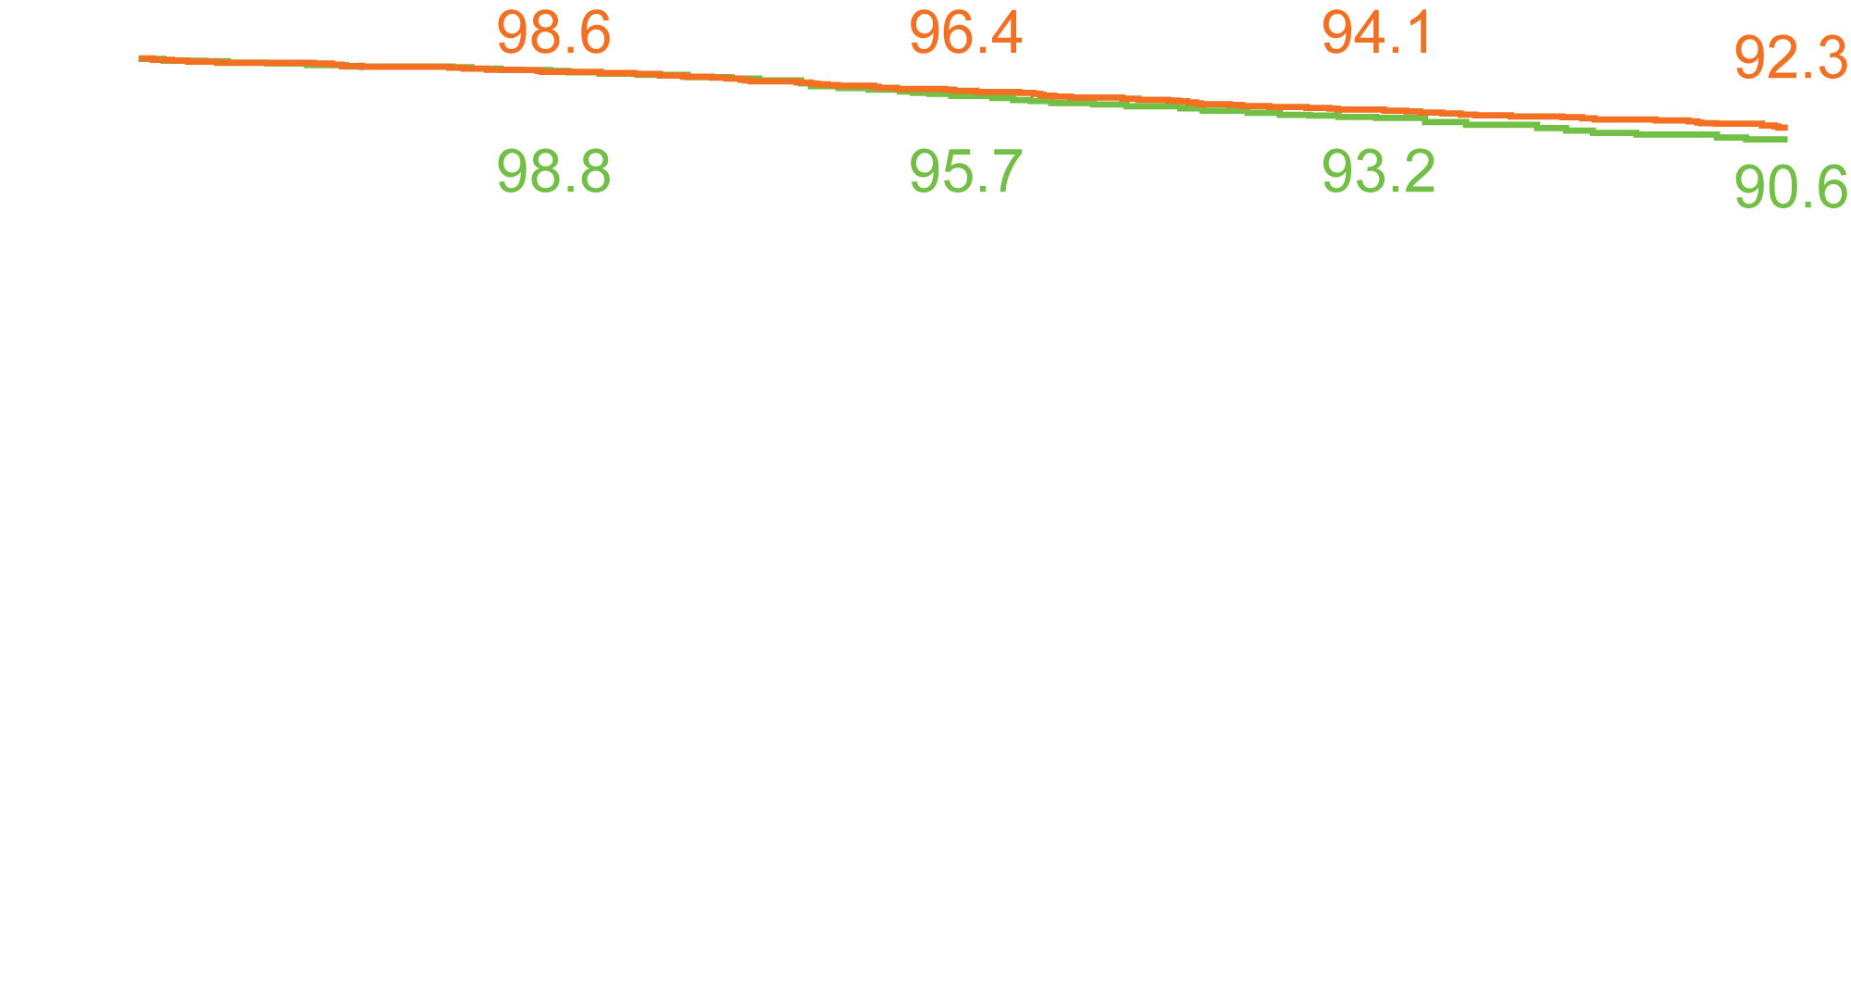
Three-Year Invasive Disease-Free Survival: Intention-to-Treat
Invasive Disease-free Survival Rate (%)
Pertuzumab, 171 events (n = 2,400)
Placebo, 210 events (n = 2,404)
Stratified hazard ratio, 0.81 P = 0.045
Months
von Minckwitz G et al. N Engl J Med 2017;377(2):122-31.

Slide 18
APHINITY: Adverse Events
Grade ≥3 | Pertuzumab (n = 2,364) | Placebo (n = 2,405)
Neutropenia | 16.3% | 15.7%
Febrile neutropenia | 12.1% | 11.1%
Decreased neutrophil count | 9.6% | 9.6%
Diarrhea | 9.8% | 3.7%
Anemia | 6.9% | 4.7%
Heart failure, cardiac death and cardiac dysfunction were infrequent in both arms.
von Minckwitz G et al. N Engl J Med 2017;377(2):122-31.

Slide 19
Patient Education Notes
TCHP
(docetaxel/carboplatin/trastuzumab/pertuzumab)
TP (trastuzumab/paclitaxel)
Notes:
19
19
19
19
19

Slide 20
Case Presentation (Ms Czapla)
35-year-old woman with inflammatory ER/PR-negative, HER2-positive breast cancer
Treatments received
Neoadjuvant THP on protocol
Mastectomy and ALND
AC followed by trastuzumab/pertuzumab (completion of 1 year)
Radiation therapy
Other considerations
Fertility concerns: Unsuccessful egg retrieval
Deep vein thrombosis

Slide 21
Neratinib
Mechanism of action
Tyrosine kinase inhibitor that prevents phosphorylation of HER1, HER2 and HER4 receptors
Indications
For the extended adjuvant treatment of adult patients with early-stage HER2-overexpressing/amplified breast cancer, to follow adjuvant trastuzumab-based therapy
Recommended dose
240 mg (6 tablets, 40 mg each) PO once daily with food, continuously for 1 year
Neratinib package insert, July 2017

Slide 22
ExteNET: A Phase III Study of Neratinib After Trastuzumab-Based Adjuvant Therapy
Stage I-III HER2+ BC
Completion of neoadjuvant and adjuvant trastuzumab up to 2 years prior
Neratinib
(n = 1,420)
R
Placebo
(n = 1,420)
Primary endpoint: Invasive disease-free survival
Chan A et al. Lancet Oncol 2016;17(3):367-77.

Slide 23
ExteNET: 5-Year Invasive Disease-Free Survival by Patient Population
HR = 0.60
Neratinib
Placebo
HR = 0.73
HR = 0.95*
* Not statistically significant
Martin M et al. Lancet Oncol 2017;18(12):1688-700; Martin M et al. Proc ESMO 2017;Abstract 149O.

Slide 24
ExteNET: Adverse Events
Grade ≥3 | Neratinib (n = 1,408) | Placebo (n = 1,408)
Diarrhea | 40% | 2%
Nausea | 2% | 1%
Vomiting | 3% | <1%
Abdominal pain | 2% | <1%
Rash | <1% | 0%
Treatment-emergent serious adverse events: 7% (neratinib) vs 6% (placebo)
No increased risk of long-term toxicity/consequences of neratinib-associated diarrhea
Martin M et al. Lancet Oncol 2017;18(12):1688-700; Martin M et al. Proc ESMO 2017;Abstract 149O.

Slide 25
HER2-Positive: Localized Disease
HER2-Positive Metastatic Disease
ER-Positive/HER2-Negative Metastatic Disease
Triple-Negative Metastatic Disease
Notes:
25
25
25
25
25

Slide 26
Key Considerations in Systemic Therapy for HER2-Positive Metastatic Breast Cancer
Choice of therapy in patients who receive pertuzumab in the (neo)adjuvant setting (time since prior therapy)
Sequencing of therapies
“CLEOPATRA” regimens as first-line treatment
CLEOPATRA versus T-DM1 in patients with early recurrence
Nonchemotherapy regimens
Integration of endocrine treatment for patients with “triple-positive” tumors
Presence of CNS metastases
Notes:
http://www.cancerresearchuk.org/health-professional/cancer-statistics/statistics-by-cancer-type/breast-cancer/incidence-invasive#heading-Three

Slide 27
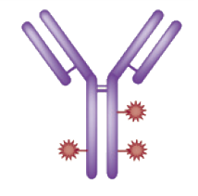
Trastuzumab Emtansine (T-DM1): Mechanisms of Action
Immune effector cell
HER2
T-DM1
HER2
T-DM1
Inhibition of HER2 shedding
Fcγ receptor
Antibody-dependent cellular cytotoxicity (ADCC)
Internalization
Emtansine release
P
P
P
P
P
Inhibition of HER2 signaling
P
Inhibition of microtubule polymerization
Lysosome
PI3K
MAPK
Adapted from LoRusso PM et al. Clin Cancer Res 2011.
Nucleus

Slide 28
Case Presentation (Ms Kuiper)
48-year-old woman with ER-positive, HER2-positive metastatic breast cancer
Treatments received
Neoadjuvant TCH ➞ lumpectomy ➞ TCH and 1 year of trastuzumab | Trastuzumab/lapatinib T-DM1
Adjuvant tamoxifen | Trastuzumab/pertuzumab/vinorelbine
Fulvestrant/trastuzumab | HER2CLIMB trial: Trastuzumab with capecitabine and tucatinib
Other considerations
Advocate for other patients
Patient took lapatinib erroneously with T-DM1

Slide 29
HER2-Positive: Localized Disease
HER2-Positive Metastatic Disease
ER-Positive/HER2-Negative Metastatic Disease
Triple-Negative Metastatic Disease
Notes:
29
29
29
29
29

Slide 30
Endocrine Therapies for HR-Positive Breast Cancer
Agent | Mechanism of action | Main toxicities
Tamoxifen | Antiestrogen | Menopausal symptoms, stroke, DVT
LHRH agonists | Ovarian suppression | Menopausal symptoms, joint and muscle pain
Aromatase inhibitors | Block aromatase | Menopausal symptoms, joint and muscle pain
Fulvestrant | Estrogen receptor antagonist | Hot flashes, bone and muscle pain, GI symptoms
CDK4/6 inhibitors | Block cell cycle progression | GI symptoms, myelosuppression
Everolimus | mTOR inhibitor | Stomatitis, infection, hepatotoxicity
Notes:
http://www.cancerresearchuk.org/health-professional/cancer-statistics/statistics-by-cancer-type/breast-cancer/incidence-invasive#heading-Three

Slide 31
Key Considerations in Systemic Therapy for ER-Positive Metastatic Breast Cancer
Choice of endocrine therapy; implications of menopausal status
Single-modality endocrine therapy with a biologic agent
Chemotherapy versus endocrine therapy: The symptomatic patient who needs an antitumor response
Endocrine therapy in combination with a CDK4/6 inhibitor or everolimus
Notes:
http://www.cancerresearchuk.org/health-professional/cancer-statistics/statistics-by-cancer-type/breast-cancer/incidence-invasive#heading-Three

Slide 32
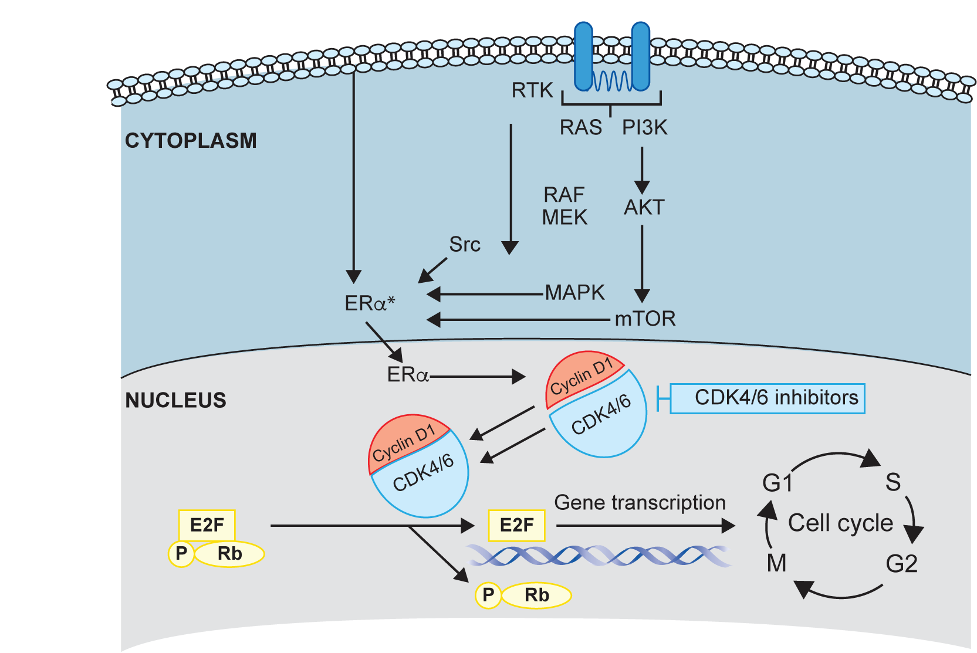
CDK4/6 Inhibitors: Mechanism of Action
Cyclin D1 binds and activates CDK4 and CDK6, and this complex phosphorylates the retinoblastoma protein (Rb).
The phosphorylation of Rb reduces its inhibitory control and promotes the initiation of S-phase, DNA synthesis and ultimately cell division.
CDK4/6 inhibitors interfere with the phosphorylation of Rb and its ability to promote cell division.
Brufsky AM, Dickler MN. Oncologist 2018;[Epub ahead of print]; Brufsky AM. Cancer Treat Rev 2017;59:22-32.

Slide 33
Available CDK4/6 Inhibitors
3 CDK4/6 inhibitors FDA approved since 2/2015 based on 6 Phase III studies with over 3,600 patients
All orally administered, with different dose schedules
Palbociclib: 125 mg/qd 3 weeks on, 1 week off
Ribociclib: 600 mg/qd 3 weeks on, 1 week off
Abemaciclib: 200 mg/BID continuously
Adherence to oral therapies

Slide 34
Randomized Trials of Endocrine Therapy +/- CDK4/6 Inhibition
Line | Trial | Schema | HR compared with endocrine alone
First line | PALOMA-1 | Letrozole ± palbociclib | 0.49
 | PALOMA-2 | Letrozole ± palbociclib | 0.58
 | MONALEESA-2 | Letrozole ± ribociclib | 0.56
 | MONARCH 3 | Letrozole or anastrozole, ± abemaciclib | 0.54
Second line | PALOMA-3 | Fulvestrant ± palbociclib | 0.46
 | MONARCH 2 | Fulvestrant ± abemaciclib | 0.55
Courtesy of Dr Harold Burstein

Slide 35
Indications for CDK4/6 Inhibitors in ER-Positive/HER2-Negative mBC
Palbociclib (Approved February 2015; March 2017)
Postmenopausal women, with an AI as initial endocrine-based therapy
With fulvestrant after disease progression on ET
Ribociclib (Approved March 2017)
Postmenopausal women, with an AI as initial endocrine-based therapy
Abemaciclib (Approved September 2017; February 2018)
Postmenopausal women, with an AI as initial endocrine-based therapy
With fulvestrant after disease progression on or after prior adjuvant ET or first-line ET for metastatic disease
As monotherapy after prior ET and 1 to 2 prior chemotherapy regimens in the metastatic setting

Slide 36
Efficacy of CDK4/6 Inhibitors
Improves time to disease progression by ~10 months when combined with ET as first-line therapy from 15 months to 25 months
No improvement yet observed in overall survival
Improves time to disease progression by ~6 to 8 months when combined with ET after progression on prior AI
No improvement yet observed in overall survival

Slide 37
Warnings and Precautions for CDK4/6 Inhibitors
Adverse event | Warnings and precautions | Palbociclib | Ribociclib | Abemaciclib
Neutropenia | Perform CBC before treatment then monitor q2wk for the first 2 cycles or months (abemaciclib), at the beginning of each subsequent 4 cycles (ribociclib) or monthly for the next 2 months (abemaciclib) and/or as clinically indicated | ✘ | ✘ | ✘
QT interval prolongation | Monitor ECGs and electrolytes prior to treatment. Repeat ECGs at ~day 14 of the first cycle and at the beginning of the second cycle and as clinically indicated. Monitor electrolytes at the beginning of each cycle for 6 cycles and as clinically indicated |  | ✘
Hepatobiliary toxicity | Perform LFTs prior to treatment and monitor q2wk for the first 2 cycles, at the beginning of each subsequent 4 cycles (ribociclib) or monthly for the next 2 months (abemaciclib) and as indicated |  | ✘ | ✘
Diarrhea | Initiate antidiarrheal therapy at the first sign of loose stools, increase oral fluids and notify healthcare provider |  |  | ✘
Venous thromboembolism | Monitor patients for signs and symptoms of thrombosis and pulmonary embolism and treat as medically appropriate |  |  | ✘

Slide 38
Key Clinical Scenarios
De novo metastatic disease
Recurrence during adjuvant ET
Recurrence after adjuvant ET
Disease progression while receiving ET with CDK4/6 inhibitor
Brain metastases
Other Key Factors
Premenopausal versus postmenopausal
Asymptomatic, low-volume versus symptomatic, high-volume disease
Notes:
38
38
38

Slide 39
Case Presentation (Ms Kuiper)
60-year-old woman with de novo ER-positive, HER2-negative metastatic lobular carcinoma
Treatments received
Ribociclib/letrozole
Denosumab
Other considerations
Palliative care referral implications

Slide 40
Case Presentation (Ms Czapla)
36-year-old woman with ER-positive, HER2-negative metastatic breast cancer
Treatments received
Neoadjuvant AC ➞ dose-dense paclitaxel
Abemaciclib/letrozole with ovarian suppression on Phase I protocol
Niraparib and pembrolizumab on Phase I/II KEYNOTE-162 trial
Capecitabine
Other considerations
Diagnosed in 2012 at 28 weeks pregnant
Disease changed from ER-positive, HER2-negative to triple-negative
Married with 3 young children

Slide 41
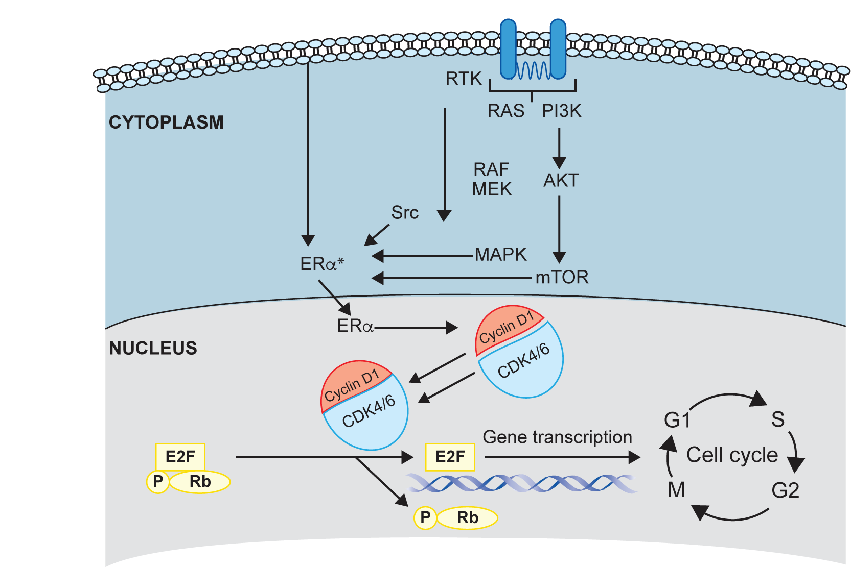
mTOR Inhibitors: Mechanism of Action
mTOR activates ER in a ligand-independent manner
Estradiol suppresses apoptosis induced by mTOR blockade
Hyperactivation of the mTOR pathway is observed in endocrine therapy-resistant breast cancer cells
mTOR is a rational target to enhance the efficacy of hormonal therapy
Brufsky AM, Dickler MN. Oncologist 2018;[Epub ahead of print]; Brufsky AM. Cancer Treat Rev 2017;59:22-32.

Slide 42
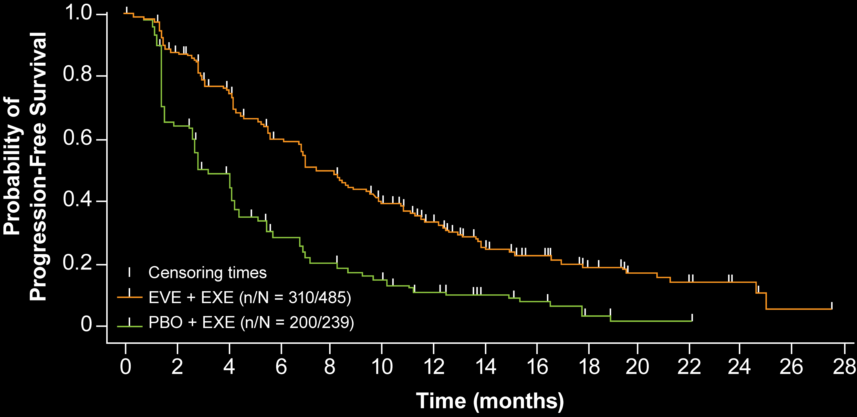
BOLERO-2: Progression-Free Survival — Local and Central Assessment
 | Everolimus + exemestane (n = 485) | Placebo + exemestane (n = 239)
Median (months) | 7.8 | 3.2
 | HR = 0.45; p < 0.0001
Central assessment median (months) | 11.0 | 4.1
 | HR = 0.38; p < 0.0001
At 18-month follow-up, the objective response rate was significantly higher in the everolimus + exemestane group (12.6%) compared to the placebo + exemestane group (1.7%), p < 0.0001.
Yardley DA et al. Adv Ther 2013;30(10):870-84. Burris H et al. SABCS 2014;Abstract P2-16-17.

Slide 43
BOLERO-2: Time Course of Adverse Events of Interest for Patients Receiving Everolimus and Exemestane
Grade ≥2 AE | Time course | Cumulative risk | Proportion resolved from Grade 3/4 to Grade ≤1
Stomatitis | >33% of events reported within first 2 weeks of Tx | 14% | 97%
Hyperglycemia | Approx 50% of events reported within first 6 weeks of Tx | 7% | 46%ª
Fatigue | >33% of events reported within first 6 weeks of Tx | 11% | 72%
Pneumonitis | Approx 25% of events reported within first 12 weeks of Tx | 5% | 80%^{b}
ª Includes new-onset diabetes mellitus; ^{b} Noninfectious pneumonitis only
“Most everolimus-associated adverse events occur soon after initiation of therapy, are typically of mild or moderate severity, and are generally manageable with dose reduction and interruption.”
Rugo HS et al. Ann Oncol 2014;25(4):808-15.

Slide 44
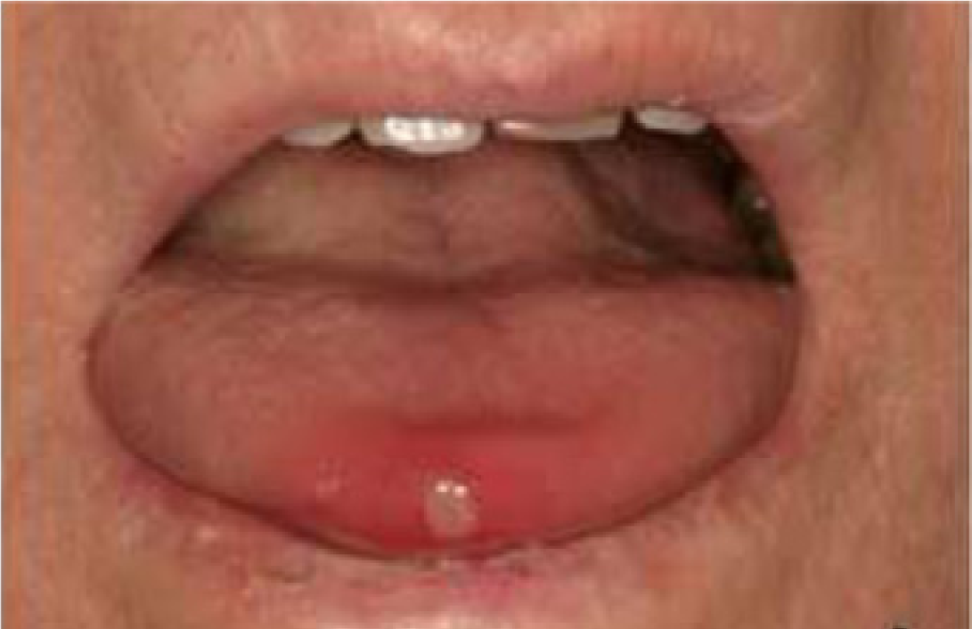
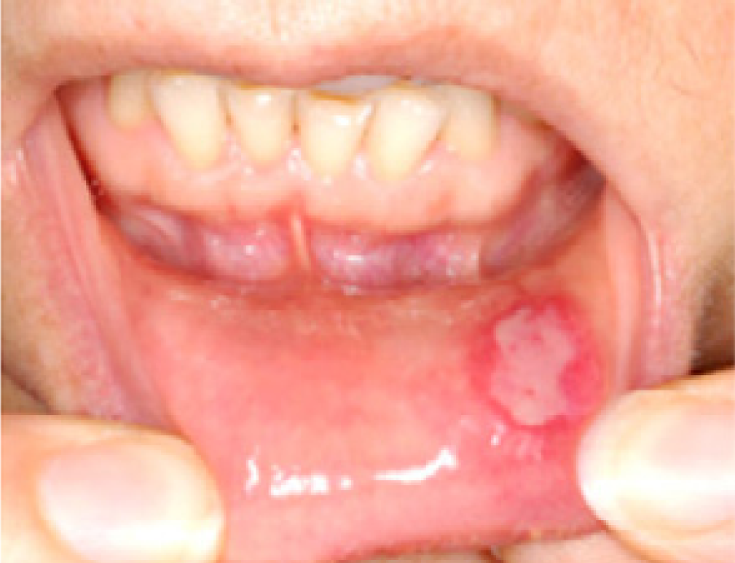
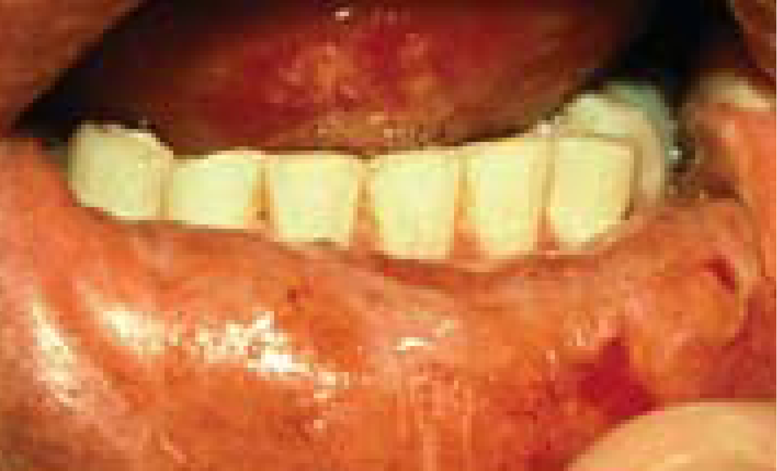
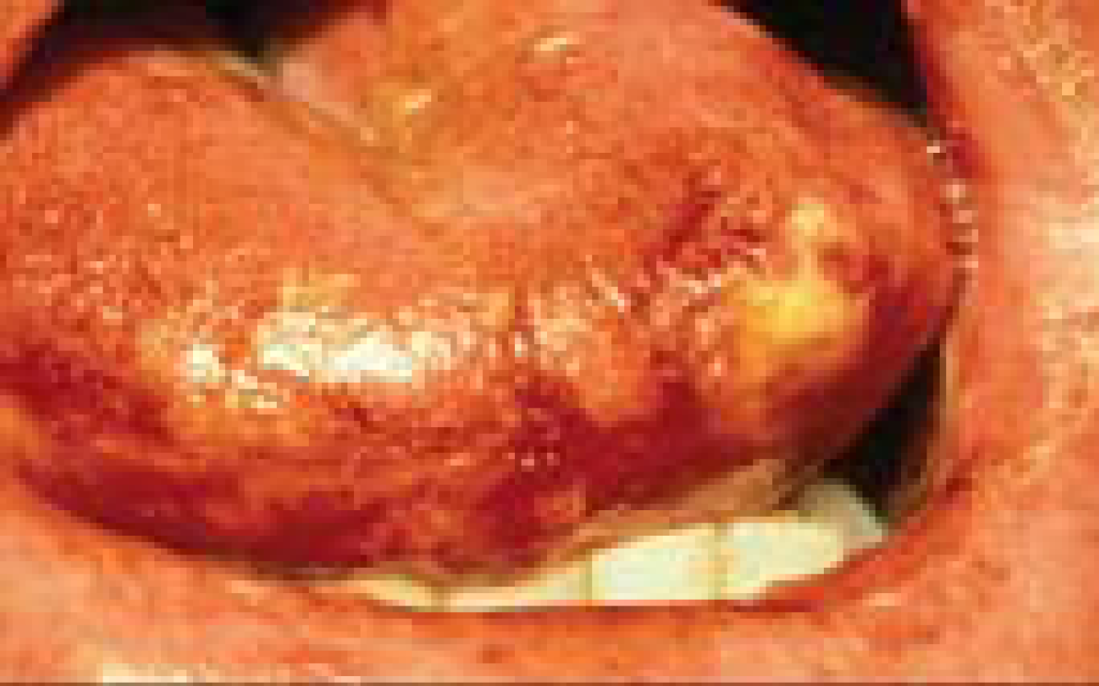
Everolimus-Associated Stomatitis
 | Grade 1 | Grade 2 | Grade 3 | Grade 4
Clinical exam | Erythema of the mucosa | Patchy ulcerations or pseudomembranes | Confluent ulcerations or pseudomembranes, bleeding with minor trauma | Tissue necrosis, significant spontaneous bleeding
Functional symptoms | Minimal symptoms, normal diet | Symptomatic but can eat and swallow modified diet | Symptomatic and unable to adequately aliment or hydrate orally | Symptoms associated with life-threatening consequences
Dose modifications | No dose adjustment | Temporary dose interruption until recovery to Gr 1; initiate at same dose | Temporary dose interruption until recovery to Gr 1; initiate at lower dose | Discontinue and treat with appropriate medical therapy
de Oliveira MA et al. Oral Oncol 2011; Ferte C et al. Eur J Cancer 2011; Cawley M et al. Clin J Oncol Nurs 2005

Slide 45
Case Presentation (Ms Kuiper)
41-year-old woman with ER-positive, HER2-negative metastatic breast cancer
Treatments received
Neoadjuvant docetaxel switched to AC chemo | Fulvestrant and leuprolide Gemcitabine
Adjuvant tamoxifen | Everolimus and tamoxifen
Palbociclib/letrozole with leuprolide
RT and capecitabine
Other considerations
CDK inhibitor trial?
ESR1 mutation
Depression and anxiety

Slide 46
HER2-Positive: Localized Disease
HER2-Positive Metastatic Disease
ER-Positive/HER2-Negative Metastatic Disease
Triple-Negative Metastatic Disease
Notes:
46
46
46
46
46

Slide 47
Key Considerations in Metastatic TNBC
Selection and sequencing of chemotherapeutic agents (eg, capecitabine, eribulin, taxanes)
Ongoing clinical trials and nonresearch role with immune checkpoint inhibitors
Multiplex tumor testing and next-generation sequencing to identify clinical trial opportunities
BRCA mutation status and use of PARP inhibitors
Notes:
http://www.cancerresearchuk.org/health-professional/cancer-statistics/statistics-by-cancer-type/breast-cancer/incidence-invasive#heading-Three

Slide 48
BRCA and PARP Inhibitors
Incidence and clinical significance of BRCA1/2 mutations
Available BRCA mutation testing assays
Current indications for BRCA testing
Preventive implications of positive BRCA results
PARP inhibitors in patients with BRCA mutations

Slide 49
OlympiAD: A Phase III Study of Olaparib for Metastatic Breast Cancer with Germline BRCA1/2 Mutations
Enrollment (N = 302)
Metastatic breast cancer Germline mutation in BRCA1 or BRCA2 No HER2-positive disease Prior therapy with anthracycline and taxane in adjuvant or metastatic setting
Olaparib
300 mg BID PO
R
Physician’s choice of chemo
(capecitabine, vinorelbine or eribulin)
Primary endpoint: Progression-free survival
www.clinicaltrials.gov (NCT02000622). Accessed April 2018.

Slide 50
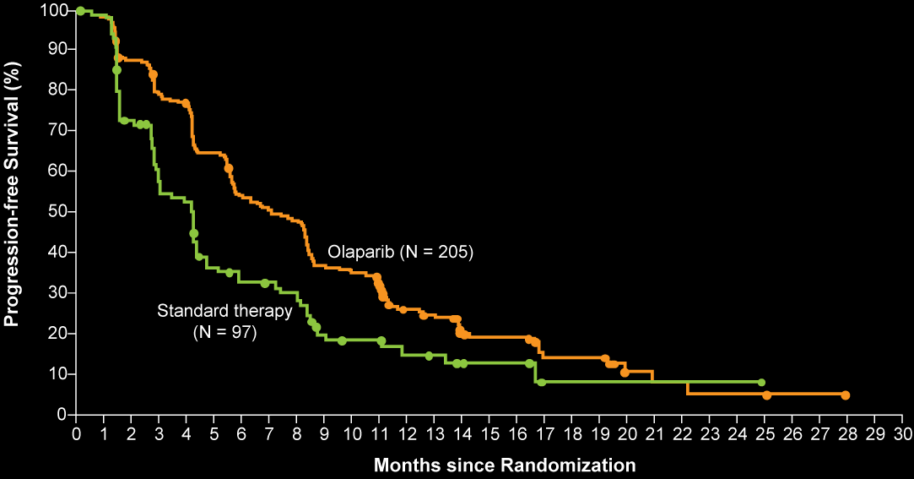
OlympiAD: Survival and Response Rates
Median PFS:
Olaparib = 7.0 mo
Standard therapy = 4.2 mo
HR = 0.58
P < 0.001
Overall survival did not differ significantly between groups
Robson M et al. N Engl J Med 2017;377(6):523-33.
Notes:
http://www.cancerresearchuk.org/health-professional/cancer-statistics/statistics-by-cancer-type/breast-cancer/incidence-invasive#heading-Three

Slide 51
Olaparib
Mechanism of action
Inhibitor of poly(ADP-ribose) polymerase (PARP) enzymes involved in DNA repair
Indications
In patients with HER2-negative metastatic breast cancer with deleterious or suspected deleterious germline BRCA mutation who have received chemotherapy in the neoadjuvant, adjuvant or metastatic setting.
Patients with hormone receptor-positive breast cancer should have received prior endocrine therapy or be considered inappropriate for endocrine therapy
Patients should be selected for olaparib therapy with FDA-approved companion diagnostic assay
Recommended dose
300 mg PO twice daily with or without food (tablet formulation: 150 mg or 100 mg)
Olaparib package insert, January 2018

Slide 52
OlympiA: A Phase III Study of Olaparib as Adjuvant Therapy for High-Risk, HER2-Negative Primary Breast Cancer with Germline BRCA1/2 Mutations
Olaparib
300 mg BID PO
Estimated enrollment (N = 1,800)
TNBC Germline mutation in BRCA1 or BRCA2 Completed neoadjuvant or adjuvant chemotherapy High risk of recurrence
R
Matched placebo
Primary endpoint: Invasive disease-free survival
Tutt A et al. Proc ASCO 2015;Abstract TPS1109; www.clinicaltrials.gov; NCT02032823.

Slide 53
EMBRACA: A Phase III Trial of Talazoparib, a PARP Inhibitor, in Advanced Breast Cancer
Eligibility (N = 431)
Locally advanced or metastatic breast cancer HER2-negative Germline mutation in BRCA1 or BRCA2 ≤3 prior cytotoxic chemotherapy regimens for locally advanced or metastatic disease Prior treatment with a taxane and/or anthracycline unless medically contraindicated
Talazoparib
1 mg PO qd
R
2:1
Physician’s choice (PCT) of:
Capecitabine
Eribulin
Gemcitabine
Vinorelbine
Primary endpoint: PFS by blinded-independent central review (BICR)
Litton JK et al. SABCS 2017;Abstract GS6-07; www.clinicaltrials.gov; NCT01945775.

Slide 54
EMBRACA: Survival and Response
PFS by BICR | Talazoparib (n = 287) | PCT (n = 144)
Median PFS | 8.6 mo | 5.6 mo
HR | 0.54
p-value | <0.0001
Interim overall survival = 22.3 mo (TALA) vs 19.5 mo (PCT); p = 0.105
ORR = 62.6% (TALA) vs 27.2% (PCT)
Litton JK et al. SABCS 2017;Abstract GS6-07.

Slide 55
Anti-PD-1/PD-L1 Antibodies: Mechanism of Action
PD-1 expression on tumor-infiltrating lymphocytes is associated with decreased cytokine production and effector function
3 approved drugs:
Nivolumab/pembrolizumab binds PD-1 receptors on T cells and disrupts negative signaling triggered by PD-L1/PD-L2 to restore T-cell antitumor function
Atezolizumab binds PD-L1 receptors
IFNγ
T-cell receptor
T-cell receptor
IFNγR
MHC
MHC
PI3K
Dendritic cell
Tumor cell
NFκB
CD28
B7
PD-L1
Other
T cell
PD-1
Shp-2
PD-1
PD-L1
PD-L2
Shp-2
PD-1
PD-1
PD-L2
Nivolumab/pembrolizumab: PD-1 receptor blocking Ab
Atezolizumab: PD-L1 receptor blocking Ab

Slide 56
Phase I Trial of Atezolizumab for Metastatic TNBC
 | All patients | Atezo as first line | Atezo after ≥2 lines of therapy
ORR (n = 112, 19, 93) | 10% | 26% | 7%
Median duration of response | 21 mo | 21 mo | Not evaluable
OS rate (n = 113, 19, 94) 1-year 3-year | 41% 22% | 63% Not evaluable | 37% 18%
Durable clinical benefit observed in responders
Schmid P et al. Proc AACR 2017;Abstract 2986; Cancer Discov 2017;7(6):OF10.

Slide 57
Case Presentation (Ms Czapla)
73-year-old woman with triple-negative metastatic breast cancer
Treatments received
Adjuvant AC q3wk ➞ dose-dense paclitaxel
Pembrolizumab on Phase II protocol
Other considerations
Skin eruption with pembrolizumab; also pseudoprogression

