Slide 1
Please note, these are the actual video-recorded proceedings from the live CME event and may include the use of trade names and other raw, unedited content.

Slide 2
Oncology Grand Rounds Acute Leukemia Nurse and Physician Investigators Discuss New Agents, Novel Therapies and Actual Cases from Practice
Friday, May 18, 2018 6:00 AM – 7:30 AM
Faculty
Bernadette Cuello, MSN, NP-C, AOCNP
Eytan M Stein, MD
Wendy Stock, MD
Lauren Ziskind, APN, NP-C, OCN
Moderator Neil Love, MD

Slide 3
Oncology Grand Rounds Series

Slide 4
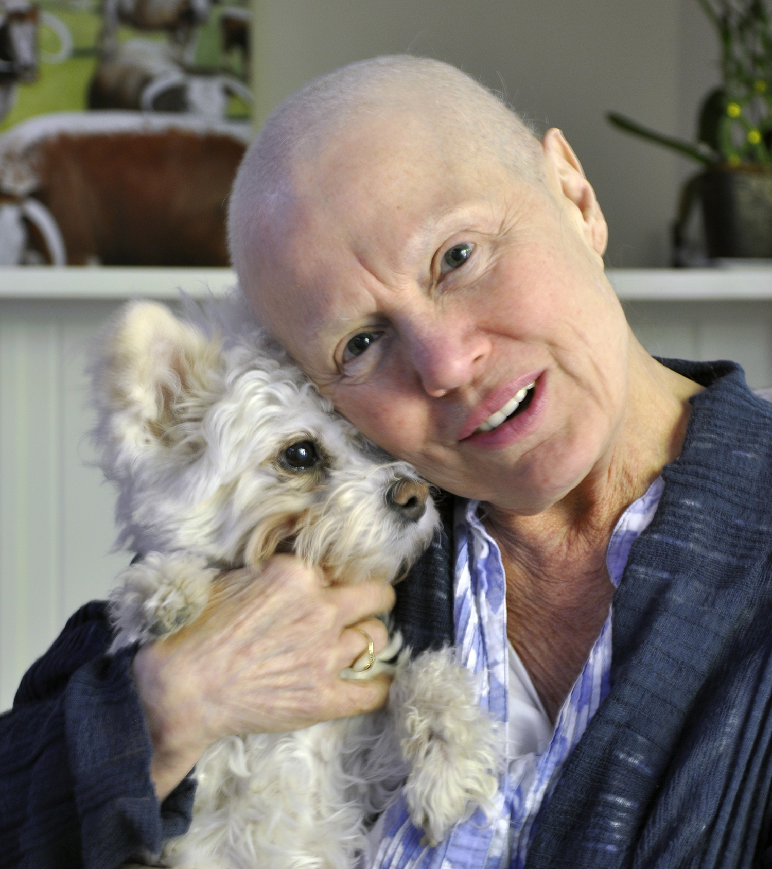
Oncology Grand Rounds: Format
Personalized oncology strategy
New markers and agents
Patient counseling and education as a component of that strategy
Symptom management
Discussion of actual cases from nurse faculty
The bond that heals; trust and integrity
Supporting family and loved ones

Slide 5
Induction Therapy for AML, Including Patient Selection for Midostaurin and Gemtuzumab Ozogamicin
Management of Elderly Patients with AML
Treatment-Related AML or AML with MDS-Related Changes
Management of Patients with R/R AML with FLT3 and IDH 1/2 Mutations
Selection of Initial Therapy for Patients with ALL
Inotuzumab Ozogamicin, Blinatumomab and CAR T-Cell Therapy for R/R ALL
Notes:
5
5
5
5
5

Slide 10
Oncology Grand Rounds Acute Leukemia Nurse and Physician Investigators Discuss New Agents, Novel Therapies and Actual Cases from Practice
Friday, May 18, 2018 6:00 AM – 7:30 AM
Faculty
Bernadette Cuello, MSN, NP-C, AOCNP
Eytan M Stein, MD
Wendy Stock, MD
Lauren Ziskind, APN, NP-C, OCN
Moderator Neil Love, MD

Slide 11
Induction Therapy for AML, Including Patient Selection for Midostaurin and Gemtuzumab Ozogamicin
Management of Elderly Patients with AML
Treatment-Related AML or AML with MDS-Related Changes
Management of Patients with R/R AML with FLT3 and IDH 1/2 Mutations
Selection of Initial Therapy for Patients with ALL
Inotuzumab Ozogamicin, Blinatumomab and CAR T-Cell Therapy for R/R ALL
Notes:
11
11
11
11
11

Slide 12
Case presentation (Ms Cuello)
51-year-old man with AML
Treatments received
Induction 7 + 3
Azacitadine + venetoclax
Allogeneic matched unrelated donor (MUD) transplant
Other considerations
Challenging to “read him”; a person of few words
Missed several appointments for lab checks and transfusions

Slide 13
Four Key Factors for the Selection of Initial Therapy for AML
Simplified Algorithm for First-Line Therapy
Secondary AML?
NO
Candidate for 7 + 3 induction?
YES
FLT3 mutation?
CD33 positivity?
AML
Secondary AML? (MDS or treatment related)
Yes
No
CPX-351
Candidate for 7+3 induction?
Yes
FLT3 mutation?
No
Yes
HMA or GO
or
clinical trial
No
7+3 + midostaurin
CD33+?
Yes
No
7+3 ± GO
7+3
GO = gemtuzumab ozogamicin; HMA = hypomethylating agent

Slide 14
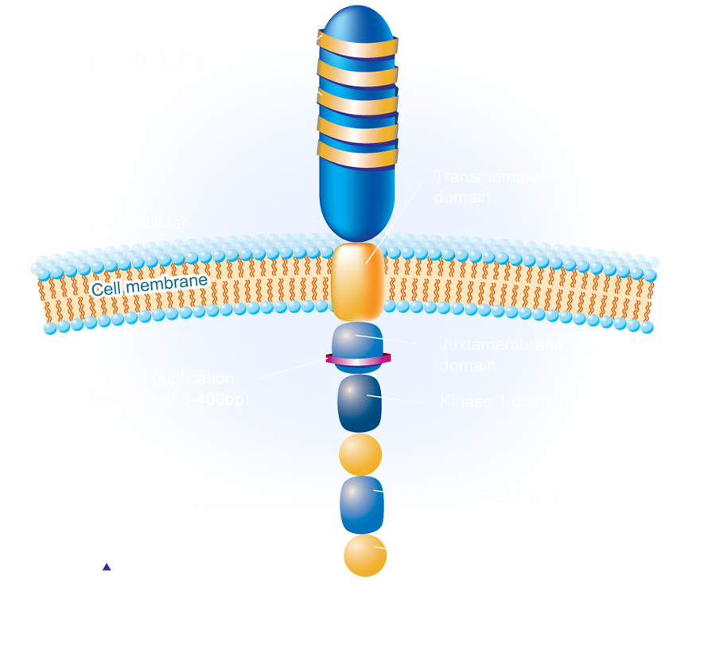
FLT3 Mutations in AML
Approximately 30% of patients with AML have a FLT3 mutation
FLT3 ligand (FL) binding activates downstream pathways (↑ cell proliferation).
FLT3 mutations associated with a poor prognosis
FLT3-ITD: 25% of patients with AML
FLT3-TKD: 5% of patients with AML
Litzow MR. Blood 2005;106:3331-2; Small D. Hematology Am Soc Hematol Educ Program 2006:178-84; Swords R et al. Leukemia 2012;26(10):2176-85; Griffith J et al. Mol Cell 2004;13(2):169-78; Levis M. Hematology Am Soc Hematol Educ Program 2013;2013:220-6.

Slide 15
Midostaurin
Mechanism of action:
A multitargeted inhibitor of FLT3
Indication:
For the treatment of patients with newly diagnosed AML that is FLT3 mutation-positive, as detected by an FDA-approved test, in combination with standard cytarabine and daunorubicin induction and cytarabine consolidation.
Recommended dose:
50 mg twice daily on days 8 to 21 of each cycle of induction and consolidation chemotherapy followed by 50 mg as a single agent for up to 12 months. Administer with food.
https://www.fda.gov/Drugs/InformationOnDrugs/ApprovedDrugs/ucm555756.htm
Midostaurin package insert, April 2017

Slide 16
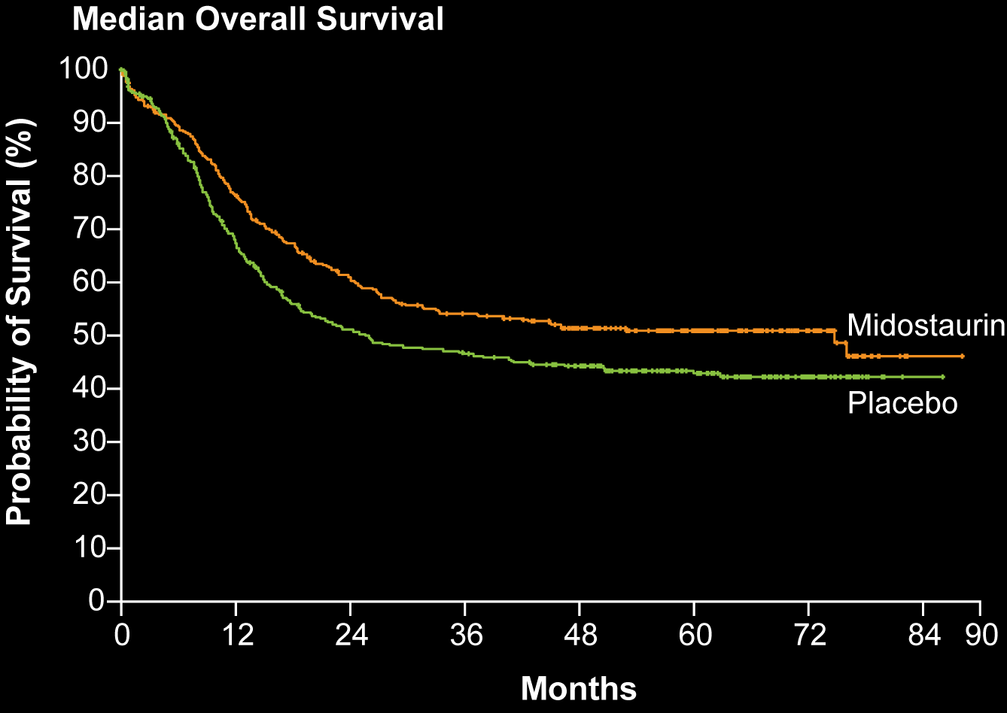
RATIFY: Midostaurin with Chemotherapy for FLT3 Mutation-Positive AML — Primary Endpoint OS
 | Mido n = 360 | Placebo n = 357 | HR, p-value
Median OS | 74.7 mo | 25.6 mo | HR = 0.78, p = 0.009
Median EFS | 8.2 mo | 3.0 mo | HR = 0.78, p = 0.002
Addition of midostaurin led to 22% reduction in risk of death versus placebo
Stone RM et al. N Engl J Med 2017;377(5):454-64.

Slide 17
Mechanism of Action of Venetoclax (ABT-199)
Bcl-2 functions to prevent cell death by apoptosis
Venetoclax is specific for Bcl-2 and inhibits its function, thereby removing the block on apoptosis
Venetoclax has been shown to synergize with HMA
ABT-199
Bcl-2
Bcl-XL
Tumor cell
Platelet
Adapted from Davids MS, Letai A. Cancer Cell 2013;23(2):139-41.

Slide 18
Phase Ib Trial of Venetoclax and Azacitidine for Untreated Elderly Patients: Efficacy Outcomes
Response | n = 33
Overall response rate | 30 (91%)
CR | 20 (61%)
CRi | 8 (24%)
PR | 1 (3%)
MLFS | 1 (3%)
Out of 22 patients monitored by digital droplet PCR:
Achieved MRD negativity and remain in remission: 5 (23%)
Achieved remission, remain MRD-positive but remain in remission: 9 (41%)
Achieved remission and remain MRD-positive, but relapsed: 7 (32%)
Pollyea DA et al. Proc ASH 2017;Abstract 181.

Slide 19
Gemtuzumab Ozogamicin
Mechanism of action:
Antibody-drug conjugate targeted to CD33
Indication:
For the treatment of newly diagnosed CD33-positive acute myeloid leukemia (AML) in adults and for the treatment of relapsed or refractory CD33-positive AML in adults and in pediatric patients 2 years and older
Recommended dose:
Newly diagnosed de novo AML (in combination with daunorubicin and cytarabine): 3 mg/m² on days 1, 4 and 7 for induction and 3 mg/m² on day 1 for consolidation
Newly diagnosed AML (single agent): 6 mg/m² on day 1 and 3 mg/m² on day 8 for induction, followed by up to 8 continuation cycles of 2 mg/m² on day 1 every 4 weeks
Relapsed or refractory AML (single agent): 3 mg/m² on days 1, 4 and 7
https://www.fda.gov/Drugs/InformationOnDrugs/ApprovedDrugs/ucm574518.htm
Gemtuzumab ozogamicin package insert, September 2017

Slide 20
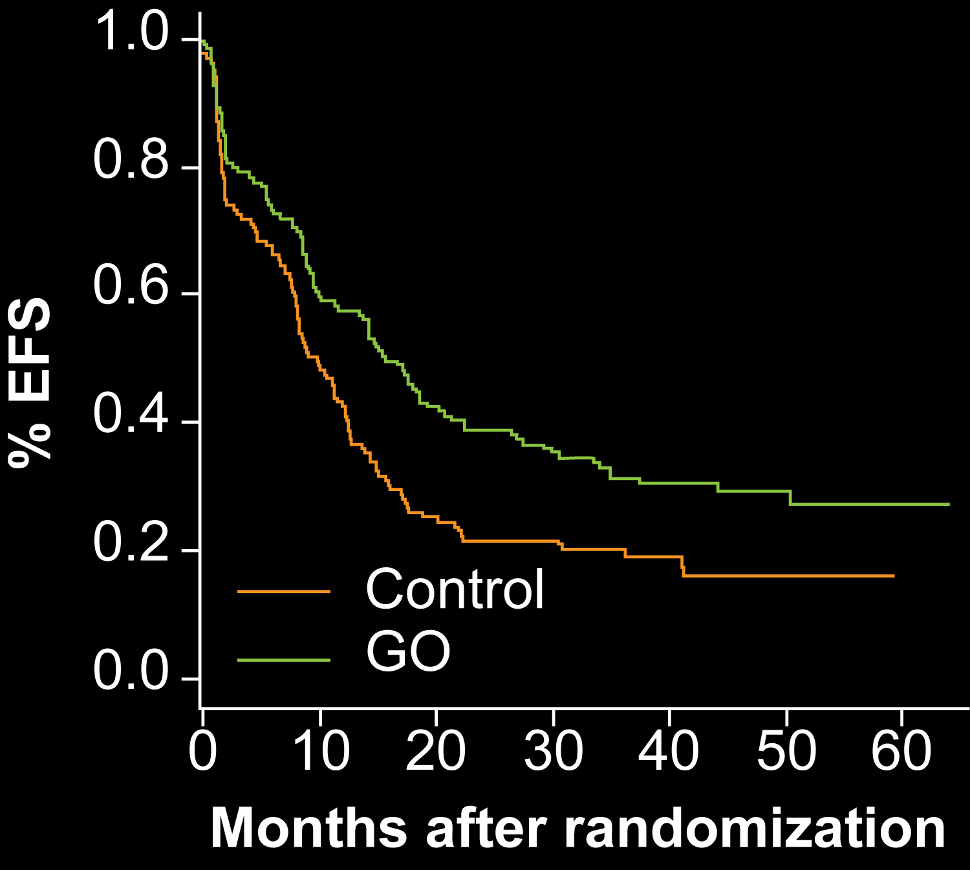
Gemtuzumab Ozogamicin (GO) Antibody-Drug Conjugate: CD33 Antibody Linked to Calicheamicin
History:
2000: Granted FDA accelerated approval
2010: Voluntarily removed from the market when confirmatory trials did not show a clinical benefit but did show higher chance of death and association with veno-occlusive disease of the liver (VOD)
2017: GO received FDA approval in 3 settings, including in combination with induction chemotherapy at a lower dose after review of Phase III results of ALFA 0701 study
ALFA 0701
Median EFS: 9.7 vs 15.6 months; p = 0.0026
No difference in OS
SAEs higher in GO arm
http://www.bloodjournal.org/content/124/21/376?sso-checked=true

Slide 21
Induction Therapy for AML, Including Patient Selection for Midostaurin and Gemtuzumab Ozogamicin
Management of Elderly Patients with AML
Treatment-Related AML or AML with MDS-Related Changes
Management of Patients with R/R AML with FLT3 and IDH 1/2 Mutations
Selection of Initial Therapy for Patients with ALL
Inotuzumab Ozogamicin, Blinatumomab and CAR T-Cell Therapy for R/R ALL
Notes:
21
21
21
21
21

Slide 22
Four Key Factors for the Selection of Initial Therapy for AML
Secondary AML?
NO
Candidate for 7 + 3 induction?
NO
3. FLT3 mutation?
4. CD33 positivity?
Simplified Algorithm for First-Line Therapy
AML
Secondary AML? (MDS or treatment related)
Yes
No
CPX-351
Candidate for 7+3 induction?
Yes
FLT3 mutation?
No
Yes
HMA or GO
or
clinical trial
No
7+3 + midostaurin
CD33+?
Yes
No
7+3 ± GO
7+3
GO = gemtuzumab ozogamicin; HMA = hypomethylating agent

Slide 23
Treatment for Patients Who Are Not Candidates for Standard Induction (Elderly)
What is “elderly?”
Median age at AML diagnosis: 68 years old
No absolute age cutoff for induction
Physiologic vs chronological age
Cancer Facts and Figures 2018; https://www.cancer.org/research/cancer-facts-statistics/all-cancer-facts-figures/cancer-facts-figures-2018.html; https://www.cancer.org/cancer/acute-myeloid-leukemia/about/key-statistics.html; https://seer.cancer.gov/statfacts/html/amyl.html

Slide 24
CC-486 (oral azacitidine) in patients with hematological malignancies who had received prior treatment with injectable hypomethylating agents (HMAs): Results from Phase 1/2 CC-486 studies
Garcia-Manero G et al. Proc ASH 2016;Abstract 905.
AML Response Rate: 36% (4/11)

Slide 25
Case presentation (Ms Ziskind)
87-year-old man with secondary AML (deletion 7)
Treatments received
Clinical trial: azacitidine + venetoclax/placebo
Other considerations
Spanish-speaking only; daughters are very involved in his care
He would like to go back to Mexico; will likely discontinue from the trial and return to Mexico

Slide 26
Induction Therapy for AML, Including Patient Selection for Midostaurin and Gemtuzumab Ozogamicin
Management of Elderly Patients with AML
Treatment-Related AML or AML with MDS-Related Changes
Management of Patients with R/R AML with FLT3 and IDH 1/2 Mutations
Selection of Initial Therapy for Patients with ALL
Inotuzumab Ozogamicin, Blinatumomab and CAR T-Cell Therapy for R/R ALL
Notes:
26
26
26
26
26

Slide 27
Four Key Factors for the Selection of Initial Therapy for AML
Secondary AML?
YES
Candidate for 7 + 3 induction?
FLT3 mutation?
CD33 positivity?
Simplified Algorithm for First-Line Therapy
AML
Secondary AML? (MDS or treatment related)
Yes
No
CPX-351
Candidate for 7+3 induction?
Yes
FLT3 mutation?
No
Yes
HMA or GO
or
clinical trial
No
7+3 + midostaurin
CD33+?
Yes
No
7+3 ± GO
7+3
GO = gemtuzumab ozogamicin; HMA = hypomethylating agent

Slide 28
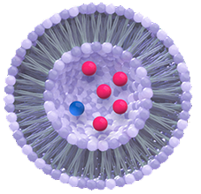
Liposomal Daunorubicin and Cytarabine (CPX-351)
1:5 molar ratio of daunorubicin to cytarabine
Synergistic activity in both in vitro and animal models
100 nm bilamellar liposomes
1 unit = 0.44 mg daunorubicin and 1.0 mg cytarabine (1:5 molar ratio) complexed with copper
Targets bone marrow and preferentially targets leukemic compared to normal marrow progenitors

Slide 29
CPX-351
Mechanism of action:
Liposome-encapsulated fixed ratio of daunorubicin and cytarabine
Indication:
For the treatment of newly diagnosed therapy-related AML or AML with myelodysplasia-related changes
Recommended dose:
Induction: (daunorubicin 44 mg/m² and cytarabine 100 mg/m²) liposome via intravenous infusion over 90 minutes on days 1, 3, and 5 and on days 1 and 3 for subsequent cycles of induction, if needed
Consolidation: (daunorubicin 29 mg/m² and cytarabine 65 mg/m²) liposome via intravenous infusion over 90 minutes on days 1 and 3
https://www.fda.gov/Drugs/InformationOnDrugs/ApprovedDrugs/ucm569950.htm
(Daunorubicin and cytarabine) liposome package insert, April 2017

Slide 30
Overall survival (OS) with CPX-351 versus 7+3 in older adults with newly diagnosed, therapy-related acute myeloid leukemia (tAML): Subgroup analysis of a phase III study Efficacy by consolidation administration site: Subgroup analysis of a phase III study of CPX-351 versus 7+3 in older adults with newly diagnosed, high-risk acute myeloid leukemia (AML)
Lancet JE et al. Proc ASCO 2017;Abstract 7035.
Kolitz JE et al. Proc ASCO 2017;Abstract 7036.

Slide 31
Efficacy of CPX-351 in Older Patients with Therapy-Related AML
Subgroup analysis of patients with therapy-related AML from the Phase III CLTR0310-301 study of CPX-351 compared to standard 7 + 3 regimen for older patients (age 60 to 75 years) with newly diagnosed, secondary AML
 | CPX-351 n = 30 | 7 + 3 n = 32 | HR
Median OS | 12.17 mo | 6.64 mo | 0.49
Median EFS | 2.5 mo | 1.64 mo | 0.66
Remission duration | 10.87 mo | 6.11 mo | 0.50
CR + CRi | 47% | 36% | —
Lancet JE et al. Proc ASCO 2017;Abstract 7035.

Slide 32
CPX-351 in Secondary AML
EFS
OS
100
100
Events, n/N
Median, Mos (Range)
Events, n/N
Median, Mos (Range)
7+3: secondary
14/19
6.1 (1.4-7.5)
80
7+3: secondary
17/19
1.4 (1.1-1.8)
80
CPX-351: secondary
17/32
12.1 (9.1-16.7)
CPX-351: secondary
26/32
3.8 (1.5-6.1)
Log-rank P = .07
60
Log-rank P = .07
60
HR: 0.41
Patients (%)
HR: 0.56
40
40
20
20
0
0
0
3
6
9
12
15
18
0
6
12
18
24
Mos From Randomization
Mos From Randomization
Pts at Risk, n
Pts at Risk, n
7+3:
4
3
2
0
0
0
7+3:
11
9
5
3
1
0
0
0
CPX-351:
17
10
8
3
2
0
CPX-351:
29
23
22
13
6
3
0
0
Lancet JE et al. Proc ASCO 2011;Abstract 6519.
Notes:
AML, acute myeloid leukemia; EFS, event-free survival; HR, hazard ratio; OS, overall survival.
There was no statistically significant difference in survival outcomes between treatment arms for the overall population; however, when the investigators evaluated the subgroup of patients with secondary AML, there was a clear trend toward improved event-free and overall survival for patients who received CPX-351 compared with the 3 plus 7 regimen. In another randomized phase IIb study that enrolled patients with AML in first relapse, CPX-351 significantly improved 1-year survival in patients with unfavorable European Prognostic Index scores.^{[1]} The drug is well tolerated with limited nonhematologic toxicity, including a very low incidence of alopecia.
Reference
1. Goldberg S, Cortes JE, Feldman, EJ, et al. Initial salvage therapy in first relapse AML: a pahse IIb study of CPX-351 versus investigator’s choice – a subset analysis by prognostic group. Program and abstracts of the 2012 American Society of Clinical Oncology Annual Meeting; June 1-5, 2012; Chicago, Illinois. Abstract 6525.

Slide 33
Case presentation (Ms Ziskind)
71-year-old man with de novo AML
Treatments received
CPX-351 on trial
WT1 vaccine on trial
Phase III trial of enasidenib (AG-221)
Other considerations
Distance traveled to receive treatments
Financial limitations
Died from an injury due to a fall

Slide 34
Induction Therapy for AML, Including Patient Selection for Midostaurin and Gemtuzumab Ozogamicin
Management of Elderly Patients with AML
Treatment-Related AML or AML with MDS-Related Changes
Management of Patients with R/R AML with FLT3 and IDH 1/2 Mutations
Selection of Initial Therapy for Patients with ALL
Inotuzumab Ozogamicin, Blinatumomab and CAR T-Cell Therapy for R/R ALL
Notes:
34
34
34
34
34

Slide 35
Targeting FLT3
Inhibitor | Kinase inhibitory profile | Dose | IC50 for FLT3-ITD | FLT3 selectivity | Efficacy against the most frequent FLT3 TKD mutant disease
Sorafenib | RAF/MEK/ERK pathway, CRAF, BRAF, KIT, VEGFR-2, VEGFR-3, PDGFR-β | 400 mg BID | 58 nM | Neg | Neg
Lestaurtinib | JAK2, TRK A, TRK B, TRK C | 80 mg BID | 3 nM | Neg | Pos
Midostaurin | PKC, VEGFR-2, c-KIT, PDGFR | 50 mg BID | <10 nM | Neg | Pos
Crenolanib | PDGFR-α, PDGFR-β | 100 mg TID | 1.3 nM | Pos | Pos
Quizartinib | FLT3/STK1, CSF 1R/FMS, SCFR/KIT, PDGFR | 30 mg QD | 1.3 nM | Pos | Neg
Gilteritinib | FLT3, AXL, ALK | 120 mg QD | 0.29 nM | Pos | Pos
Sunitinib | c-KIT, VEGF, and PDGF receptors | 50 mg daily | <10 nM | Neg | Pos
FLT3 should be rechecked at relapse as may become positive
Warren M et al. Mod Pathol 2012;25(10):1405-12; Pratz KW et al. Blood 2010;115(7):1425-32.

Slide 36
CHRYSALIS: Efficacy of Gilteritinib in Relapsed/Refractory AML
 | All patients (n = 249) | FLT3 WT (n = 58) | FLT3 mutant (n = 191)
Composite complete remission | 30% | 9% | 37%
Overall response | 40% | 12% | 49%
Duration of response | 17 wk | 12 wk | 20 wk
Overall survival | 25 wk | 17 wk | 30 wk
Based on activity data, gilteritinib at 120 mg/day is being tested in Phase III trials
Perl AE et al. Lancet Oncol 2017;18(8):1061-75.

Slide 37
CHRYSALIS: Safety of Gilteritinib in Relapsed/Refractory AML
Grade 3/4 adverse events
Febrile neutropenia | 97/252 (39%)
Anemia | 61/252 (24%)
Thrombocytopenia | 33/252 (13%)
Sepsis | 28/252 (11%)
Pneumonia | 27/252 (11%)
Based on activity data, gilteritinib at 120 mg/day is being tested in Phase III trials
Perl AE et al. Lancet Oncol 2017;18(8):1061-75.

Slide 38
ADMIRAL: A Phase III Study of Gilteritinib in Relapsed or Refractory AML
Target accrual: 371
Eligibility
Gilteritinib
Until lack of clinical benefit or
unacceptable toxicity
Refractory or relapsed after first-line AML therapy
Positive for FLT3-activating mutation
Performance status ≤2
2:1
R
Salvage chemotherapy
Low-dose cytarabine or
Azacitidine or
MEC induction chemotherapy or
FLAG-IDA induction chemotherapy
Primary endpoints: Overall survival, complete remission (CR) and CR with partial hematologic recovery
www.clinicaltrials.gov (NCT02421939)

Slide 39
Clinical Response to Gilteritinib in Combination with 7+3 Induction and HiDAC Consolidation Therapy in Newly Diagnosed AML
Response | All patients (N = 49) | FLT3 mutant (n = 23) | FLT3 wild type (n = 25)
Complete remission (CR) | 57.1% | 82.6% | 36%
CR with incomplete platelet recovery | 2.0% | 4.3% | 0%
CR with incomplete hematologic recovery | 12.2% | 4.3% | 20%
Complete composite remission | 71.4% | 91.3% | 56%
Pratz K et al. Proc ASH 2017;Abstract 722.

Slide 40
Quizartinib Compared to Historical Treatment: Efficacy Results
Primary aim: Compare SCT rates and outcomes for patients with AML with FLT3 mutations treated with quizartinib in a cohort of the AC220-002 study to those of patients who received standard chemotherapy from the UK NCRI database
 | Quizartinib n = 58 | Historic control Standard chemo n = 118 | HR or OR, p-value
CRi | 40% | 3% | OR = 0.05, p < 0.0001
Median OS | 140 d | 54 d | HR = 0.38, p < 0.0001
Proceeded to SCT | 40% | 8% | —
18-month survival
Patients who proceeded to SCT: 29%
Patients who did not proceed to SCT: 7%
}
HR = 0.36
p = 0.0005
Hills R et al. Proc EHA 2017;Abstract S475.

Slide 41
Phase III QuANTUM-R Study of Quizartinib Compared to Chemotherapy in R/R AML with FLT3-ITD Mutations Meets Primary Endpoint of OS Press Release – May 8, 2018
“The pivotal QuANTUM-R phase 3 study of single agent quizartinib met its primary endpoint of significantly prolonging overall survival compared to salvage chemotherapy in patients with relapsed/refractory acute myeloid leukemia (AML) with FLT3-ITD mutations after first-line treatment with or without hematopoietic stem cell transplantation (HSCT). Safety appears consistent with that observed at similar doses in the quizartinib program.”
https://www.prnewswire.com/news-releases/daiichi-sankyo-announces-single-agent-quizartinib-significantly-prolongs-overall-survival-compared-with-chemotherapy-in-patients-with-relapsedrefractory-aml-with-flt3-itd-mutations-quantum-r-study-300643962.html

Slide 42
QuANTUM-First: A Phase III Study of Quizartinib with Standard of Care Chemotherapy and as Maintenance Therapy
Target accrual: 536
Chemotherapy + quizartinib
Induction: Cytarabine and daunorubicin/idarubicin ➞ quizartinib
Consolidation: cytarabine ➞ quizartinib or HSCT
Maintenance: Quizartinib up to 12 cycles
Eligibility
Newly diagnosed primary or secondary AML
FLT3-ITD activating mutation
Receiving 7+3 induction chemo
R
Chemotherapy + placebo
Induction: Cytarabine and daunorubicin/idarubicin ➞ placebo
Consolidation: cytarabine ➞ placebo or HSCT
Maintenance: Placebo up to 12 cycles
Primary endpoint: Event-free survival
www.clinicaltrials.gov (NCT02668653)

Slide 43
Case Presentation (Ms Cuello)
54-year-old woman with AML (NPM1+, FLT3 TKD+, IDH2+)
Treatments received
Induction 7 + 3 ➞ consolidation HIDAC
Clinical trial with gilteritinib ➞ cord blood allogeneic transplant
Other considerations
Challenging patient; very demanding, every appointment had to be negotiated and did not reveal her diagnosis to adult sons until transplant screening
Converted to FLT3 ITD-positive

Slide 44
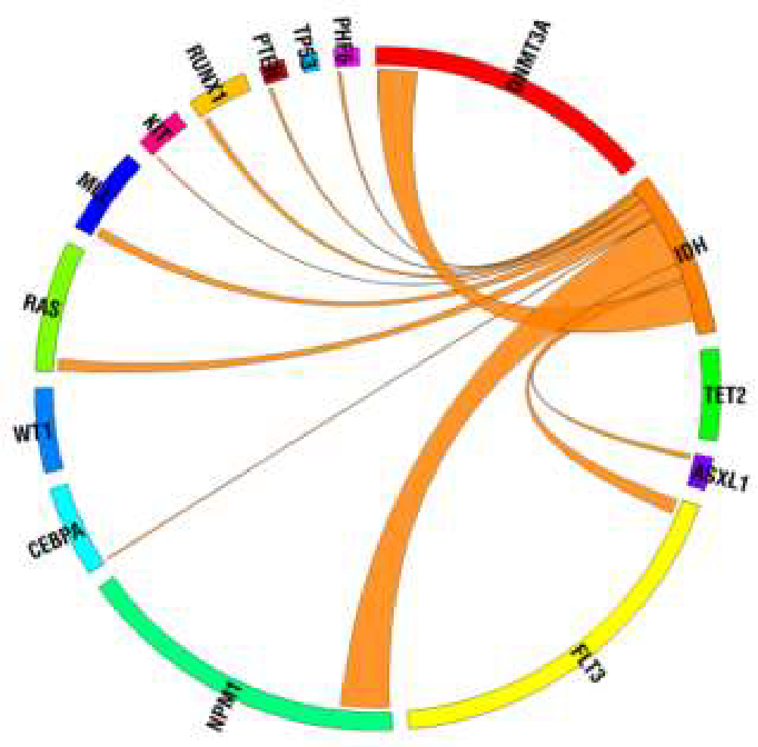
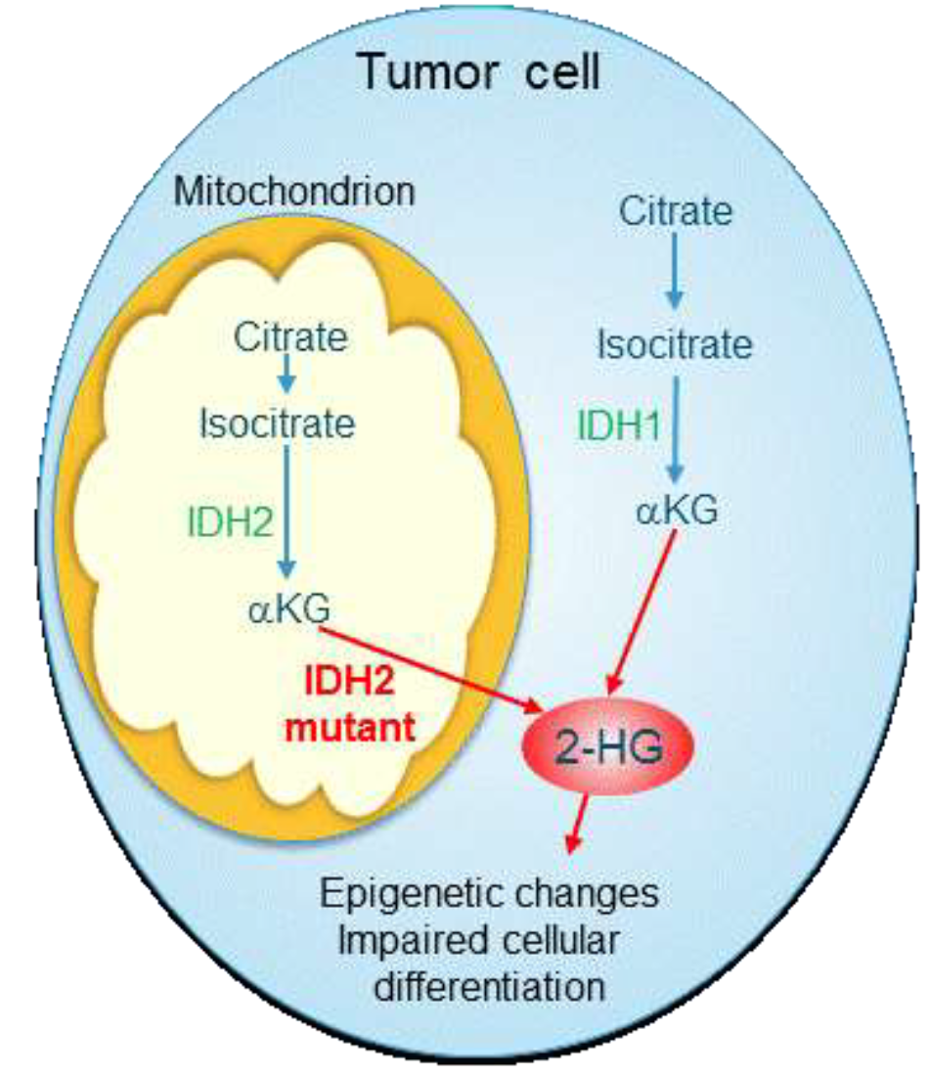
IDH in Leukemia
IDH mutations occur in ~20% of AML
Frequency: 6%-16% IDH1 and 8%-18% IDH2
Majority (85%) with diploid or +8 cytogenetics
↑ prevalence with ↑ patient age
Prognostic effect in AML remains controversial
IDH1 and IDH2 mutations may have different effects on prognosis
Dang L et al. Trends Mol Med 2010;16(9):387-97. Chou WC et al. Leukemia 2011;25(2):246-53. Patel JP et al. N Engl J Med 2012;366(2):1079-89. Medeiros BC et al. Leukemia 2017;31:272-81.

Slide 45
Enasidenib
Mechanism of action:
Selective isocitrate dehydrogenase-2 (IDH2) inhibitor
Indication:
For the treatment of adult patients with relapsed or refractory acute myeloid leukemia with IDH2 mutation as detected by an FDA-approved test
Recommended dose:
100 mg orally once daily until disease progression or unacceptable toxicity
https://www.fda.gov/Drugs/InformationOnDrugs/ApprovedDrugs/ucm569482.htm
Enasidenib package insert, August 2017

Slide 46
Phase I/II Study of Enasidenib for Patients with IDH2-Mutant AML
IDH2 mutations found in ~12% of patients with R/R AML
Response (N = 176)
ORR: 40%
CR: 19%
Median OS
All patients with R/R AML: 9.3 mo
Patients who attained complete remission: 19.7 mo
IDH inhibitor-associated differentiation syndrome: 6%
Stein EM et al. Blood 2017;130(6):722-31.

Slide 47
Phase I Trial of Ivosidenib for Patients with IDH1-Mutant AML
IDH1 mutations found in ~10% of patients with R/R AML
Response (N = 125)
ORR: 42%
CR + CRh: 30%
Median duration of response: 6.5 mo
Median OS
All patients with R/R AML: 8.8 mo
IDH inhibitor-associated differentiation syndrome (all grades): 9.6%
DiNardo CD et al. Proc ASH 2017;Abstract 725.

Slide 48
Induction Therapy for AML, Including Patient Selection for Midostaurin and Gemtuzumab Ozogamicin
Management of Elderly Patients with AML
Treatment-Related AML or AML with MDS-Related Changes
Management of Patients with R/R AML with FLT3 and IDH 1/2 Mutations
Selection of Initial Therapy for Patients with ALL
Inotuzumab Ozogamicin, Blinatumomab and CAR T-Cell Therapy for R/R ALL
Notes:
48
48
48
48
48

Slide 49
Case Presentation (Ms Cuello)
63-year-old woman with Ph-negative B-ALL
Treatments received
Hyper-CVAD
Blinatumomab
Scheduled for allogeneic stem cell transplant in May 2018
Other considerations
Loss of her elderly mother
Blinatumomab-associated rash
Whipple resection for pancreatic NET

Slide 50
Acute lymphoblastic leukemia
Ph-negative
AYA (18-39?)
adolescent young adult
Adult (40-60?)
Older adult (>60?)
Pediatric inspired
Adult regimens
Low intensity
Ph-positive: add TKI; CD20+: consider rituximab; T-ALL: consider nelarabine

Slide 51
ALL Diagnosis and Risk Assessment
ALL diagnosis (1-2 days)
• Morphology
• Immunophenotype
• RT-PCR (BCR-ABL 1)
• Biology/risk assessment
• Cytogenetics/genetics/new genetics/genomics/MRD study (molecular probe/LAIP)
Clinical risk factors (age/WBC…)
Targeted therapy/monoclonals
• BCR-ABL+: add TKI
• CD20+: consider rituximab
TLS prophylaxis
Prephase (5-7 days)
• Supportive measures
MRD study/ immunobiologic subsets
CR induction/CNS prophylaxis (4-8 weeks)
Allogenic SCT
• HR and/or MRD+
Final risk assessment
Consolidation (0.5-1 year)
• SR and/or MRD-
Maintenance (2 years)
Adapted from: http://www.esmo.org/Guidelines/Haematological-Malignancies/Acute-Lymphoblastic-Leukaemia

Slide 52
Pediatric-Inspired Regimen: US Intergroup Study for AYAs 16 to 39 Years Old: C10403
Accrual completed on 9/15/12 (n = 300)
I
C
IM
DI
M
*
DNR
VCR
Pred
Peg-Asp
IT-MTX
IT-AraC
Cyclo
VCR
Dex
Peg-Asp
Ara-C
6MP
IT-MTX
MTX
VCR
Peg-ASP
IT-MTX
DOX
Cyclo
Dex
Peg-Asp
Ara-C
6-TG
IT-MTX
DEX
VCR
6MP
MTX
IT-MTX
* 5 phases: induction, consolidation, interim maintenance, delayed intensification and prolonged maintenance
Stock W et al. Proc ASH 2014;Abstract 796.

Slide 53
Minimal Residual Disease (MRD) Assessment
Should be done after induction and at follow-up (time points guided by regimen used)
Should be sent from first pull of bone marrow aspirate
Methods (commercial tests available)
6-color flow cytometry
Real-time quantitative PCR
NGS
Detects:
Fusion genes (eg, BCR-ABL)
B-ALL: Ig heavy chain gene rearrangements
T-ALL: T-cell receptor (TCR) rearrangements

Slide 54
Induction Therapy for AML, Including Patient Selection for Midostaurin and Gemtuzumab Ozogamicin
Management of Elderly Patients with AML
Treatment-Related AML or AML with MDS-Related Changes
Management of Patients with R/R AML with FLT3 and IDH 1/2 Mutations
Selection of Initial Therapy for Patients with ALL
Inotuzumab Ozogamicin, Blinatumomab and CAR T-Cell Therapy for R/R ALL
Notes:
54
54
54
54
54

Slide 55
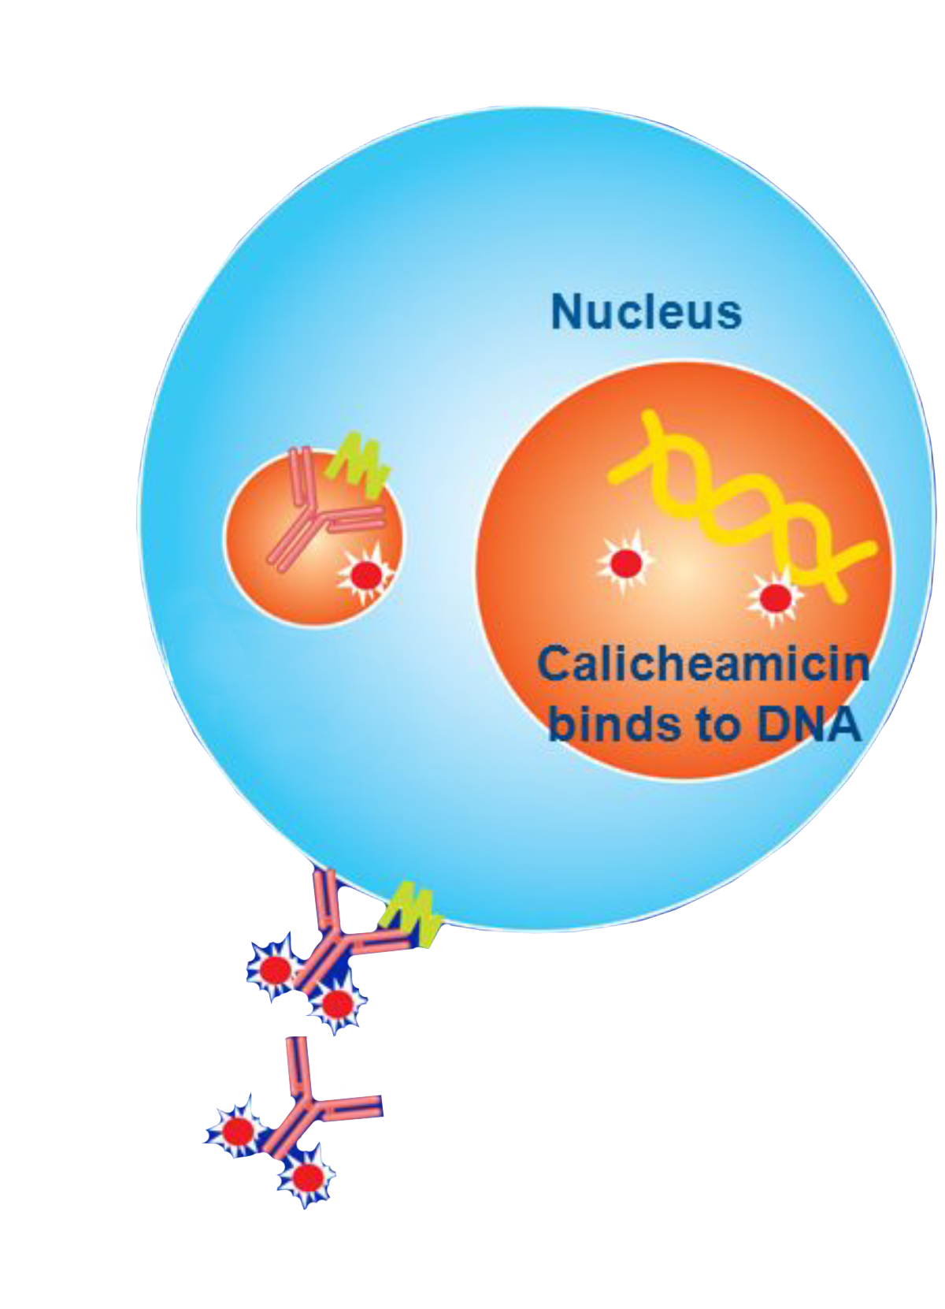
Inotuzumab Ozogamicin in ALL: Mechanisms of Action
The antibody-antigen complex is rapidly internalized upon binding to CD22
Calicheamicin is released inside the tumor cell
Calicheamicin is more potent than other cytotoxic chemotherapeutic agents
Calicheamicin binds to DNA, inducing double-stranded DNA breaks
Development of DNA breaks is followed by apoptosis of the tumor cell
Tumor cell
Internalization
CD22
Inotuzumab ozogamicin
With permission from Jabbour E et al. Proc ASCO 2012;Abstract 6501.

Slide 56
Inotuzumab Ozogamicin (InO)
Mechanism of action:
Antibody-drug conjugate targeted to CD22
Indication:
For the treatment of adults with relapsed or refractory B-cell precursor acute lymphoblastic leukemia (ALL).
Recommended dose:
Premedicate with a corticosteroid, antipyretic and antihistamine prior to all infusions.
For the first cycle: 21-day cycle; 0.8 mg/m² on day 1, 0.5 mg/m² on days 8 and 15
CR/CRi: 28-day cycle; 0.5 mg/m² on days 1, 8 and 15
No CR/CRi: 28-day cycle; 0.8 mg/m² on day 1, 0.5 mg/m² on days 8 and 15
https://www.fda.gov/Drugs/InformationOnDrugs/ApprovedDrugs/ucm572133.htm
Inotuzumab ozogamicin package insert, August 2017

Slide 57
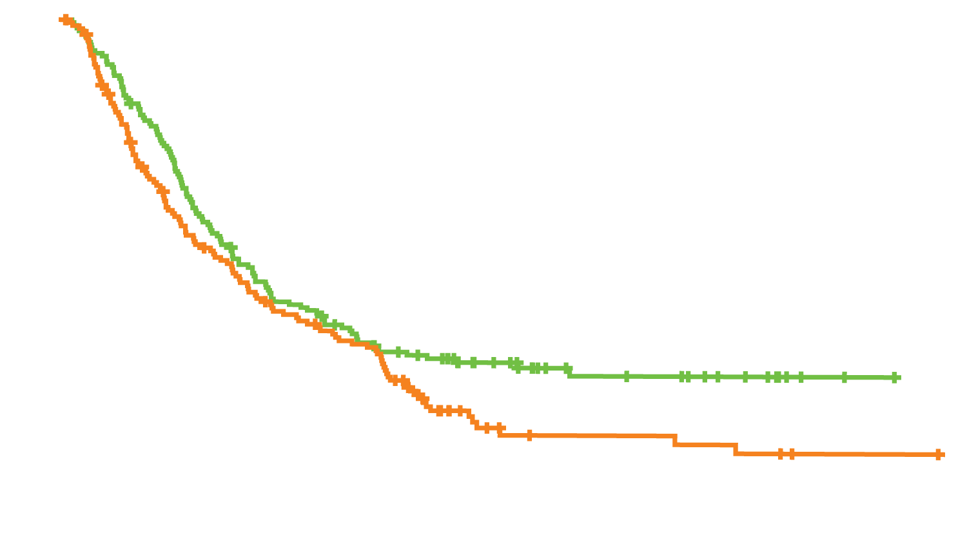
Phase III INO-VATE ALL Trial: OS and Response
Response | Inotuzumab (n = 109) | Standard (n = 109) | p-value
CR | 35.8% | 17.4% | 0.002
CR with incomplete hematologic recovery | 45.0% | 11.9% | <0.001
OS
Hazard ratio, 0.77
p = 0.04
Probability of Overall Survival
Median OS = 7.7 mo
Inotuzumab ozogamicin group
Median OS = 6.7 mo
(n = 164)
Standard-therapy group
(n = 162)
Months
Kantarjian HM et al. N Engl J Med 2016;375(8):740-53.

Slide 58
Phase III INO-VATE ALL Trial: Select Adverse Events
 | Inotuzumab (n = 139) |  | Standard (n = 120)
 | Any grade | ≥Grade 3 | Any grade | ≥Grade 3
Febrile neutropenia | 16 (12%) | 15 (11%) | 22 (18%) | 21 (18%)
Veno-occlusive disease | 15 (11%) | 13 (9%) | 1 (1%) | 1 (1%)
Pneumonia | 5 (4%) | 5 (4%) | 1 (1%) | 0
Sepsis | 3 (2%) | 3 (2%) | 6 (5%) | 6 (5%)
Respiratory failure | 1 (1%) | 1 (1%) | 4 (3%) | 4 (3%)
Tumor lysis syndrome | 2 (1%) | 1 (1%) | 0 | 0
Acute renal failure | 2 (1%) | 1 (1%) | 0 | 0
Kantarjian HM et al. N Engl J Med 2016;375(8):740-53.

Slide 59
CD19: An Ideal Tumor Target in B-Cell Malignancies
CD19 expression is generally restricted to B cells and B-cell precursors¹
CD19 is not expressed on hematopoietic stem cells¹
CD19 is expressed by most B-cell malignancies¹
CLL, B-ALL, DLBCL, FL, MCL¹
Antibodies against CD19 inhibit tumor cell growth
preB-ALL
B cell lymphomas and leukemias
CD19 expression
Hematopoietic
stem cell
Pro-B
Pre-B
Immature
(IgM)
Mature
(IgM, IgD)
Activated
B cell
Memory
B cell
(IgG, IgA)
Plasma
cell
(IgG)
¹ Scheuermann RH, Racila E. Leuk Lymphoma 1995;18(5-6):385-97; Image adapted from Janeway CA et al. Immunobiology 2001:221-93; Scheuermann RH, Racila E. Leuk Lymphoma 1995;18(5-6):385-97; Feldman M, Marini JC. Cell cooperation in the antibody response. In: Roitt I, Brostoff J, Male D, eds. Immunology 2001:131-46.
Notes:
CD19 is an ideal tumor target in B-cell malignancies because it is generally restricted to B cells and B cell precursors, and is expressed on the surface of most B-cell malignancies¹
Furthermore, antibodies against CD19 inhibit tumor cell growth indicating that CD19 is an appropriate anti-cancer target¹
Importantly, CD19 is not expressed on pluripotent bone marrow stem cells. Therefore, CD19 targeted agents should not affect a patient’s ability to regenerate hematopoietic stem cells and produce normal blood cells from other (ie non-B) hematopoietic lineages. This reduces the risk of developing autoimmune disease or irreversible myelotoxicity¹
References
Scheuermann RH, et al. CD19 antigen in leukemia and lymphoma diagnosis and immunotherapy. Leuk Lymphoma. 1995;18:385-397.

Slide 60
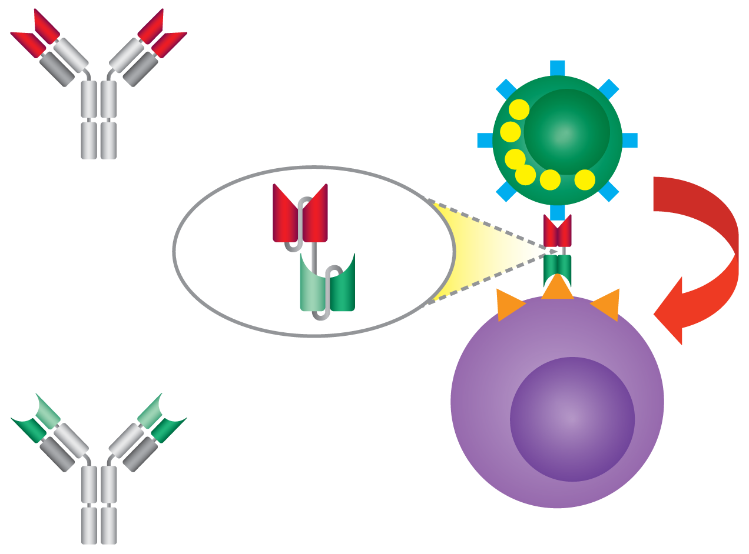
Mode of Action of BiTE Antibody Blinatumomab
V_{H}
V_{L}
α-CD3 antibody
CD3
T Cell
Blinatumomab BiTE
Redirected lysis
Target antigen
CD19
Blinatumomab: A BiTE antibody designed to direct cytotoxic T cells to CD19-expressing cancer cells
V_{H}
Tumor cell
V_{L}
α-CD19 antibody
Notes:
No redraw, fix font

Slide 61
Blinatumomab
Mechanism of action:
Bispecific CD19-directed CD3 T-cell engager
Indication:
For the treatment of patients with relapsed or refractory B-cell precursor acute lymphoblastic leukemia (ALL)
Recommended dose:
For patients ≥ 45 kg, fixed dose (shown below). For patients < 45 kg, BSA (body surface area)-based dose
Induction cycle 1: 9 mcg/day days 1-7, 28 mcg/day days 8-28, 14-day treatment-free interval
Cycles 2-5: 28 mcg/day days 1-28, 14-day treatment-free interval
Cycles 6-9: 28 mcg/day days 1-28, 56-day treatment-free interval
Hospitalization recommended for days 1-9 of cycle 1 and days 1-2 of cycle 2
Premedicate with dexamethasone before first dose of each cycle
https://www.fda.gov/Drugs/InformationOnDrugs/ApprovedDrugs/ucm566708.htm
Blinatumomab package insert, March 2018

Slide 62
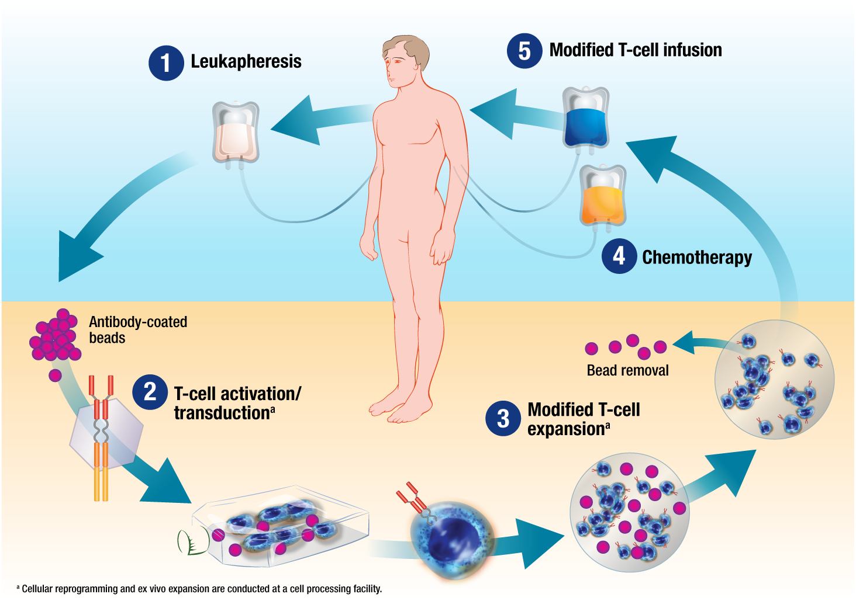
Overview of CAR T-Cell Therapy

Slide 63
Tisagenlecleucel
Mechanism of action:
CD19-targeted chimeric antigen receptor (CAR) T-cell immunotherapy
Indication:
For the treatment of patients up to age 25 years with B-cell precursor ALL that is refractory or in second or later relapse
Recommended dose:
One infusion of 0.2 to 5.0 x 10⁶ (CAR)-positive viable T cells per kg body weight intravenously for patients who are ≤50 kg, and 0.1 to 2.5 x 10⁸ total CAR-positive viable T cells intravenously for patients who are >50 kg, administered 2 to 14 days after lymphodepleting chemotherapy
https://www.fda.gov/Drugs/InformationOnDrugs/ApprovedDrugs/ucm603171.htm
Blinatumomab package insert, March 2018

Slide 64
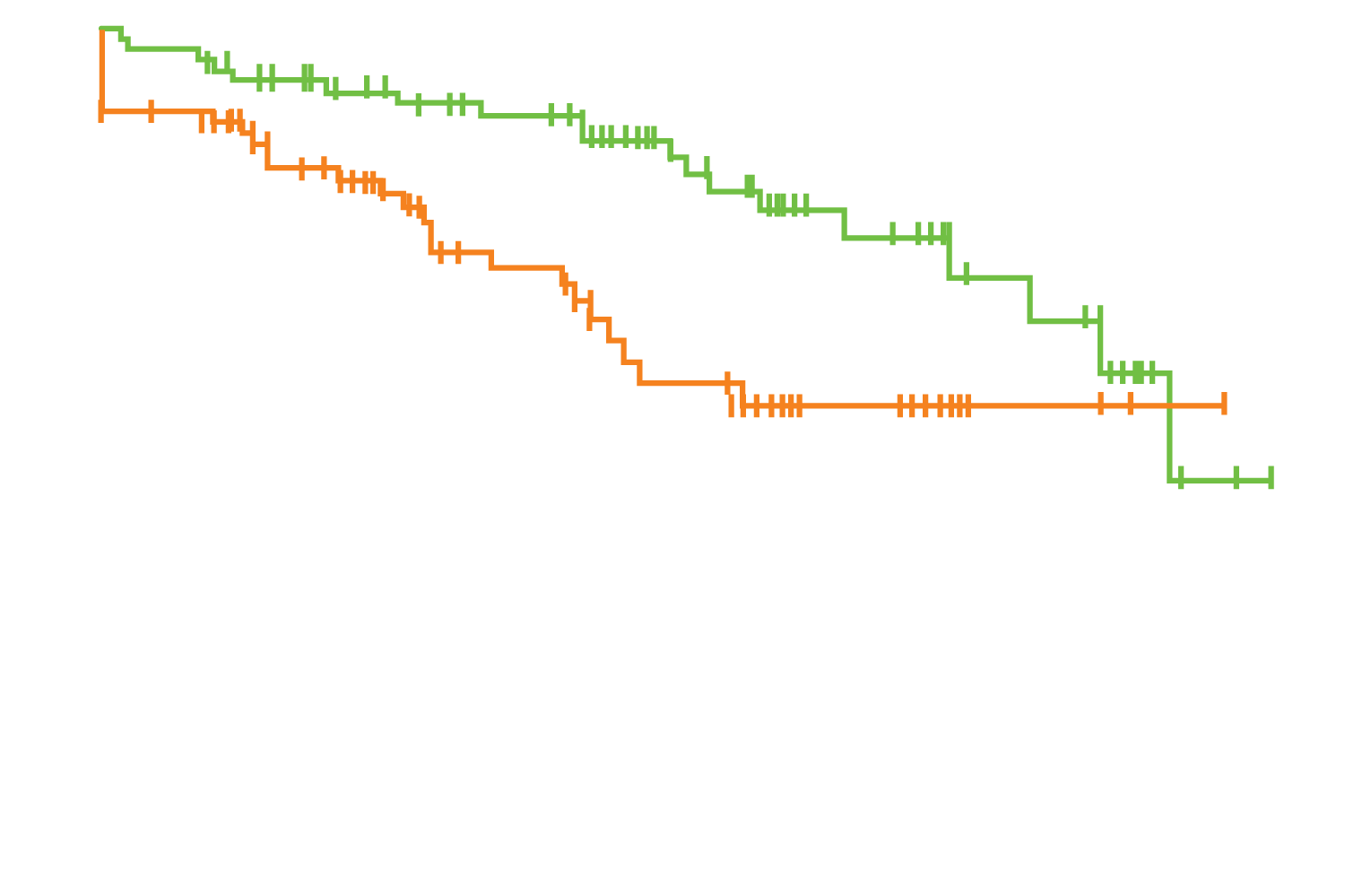
Phase II ELIANA Trial: Survival and Response
Response | n = 75
Overall remission rate | 81%
CR | 45 (60%)
CR with incomplete hematologic recovery | 16 (21%)
Overall survival
Probability
Event-free survival
 | No. of patients | No. of events | Median survival (months) | Rate at 6 months
Overall survival | 75 | 19 | 19.1 | 90%
Event-free survival | 75 | 27 | Not reached | 73%
Months since tisagenlecleucel infusion
Maude SL et al. N Engl J Med 2018;378(5):439-48.

Slide 65
Phase II ELIANA Trial: Select AEs within 8 Weeks After Infusion
AE of special interest (n = 75) | Any grade | Grade 3 | Grade 4
Any | 67 (89%) | 26 (35%) | 30 (40%)
Cytokine release syndrome | 58 (77%) | 16 (21%) | 19 (25%)
Neurologic event | 30 (40%) | 10 (13%) | 0
Infection | 32 (43%) | 16 (21%) | 2 (3%)
Febrile neutropenia | 26 (35%) | 24 (32%) | 2 (3%)
Unresolved cytopenia by day 28 | 28 (37%) | 12 (16%) | 12 (16%)
Tumor lysis syndrome | 3 (4%) | 3 (4%) | 0
Maude SL et al. N Engl J Med 2018;378(5):439-48.

Slide 66
Cytokine Release Syndrome (CRS): Common Symptoms
CRS
High fevers
Rigors
Myalgia/
arthralgias
Nausea/vomiting/anorexia
Hypotension
Dyspnea/ tachypnea/ hypoxia
Fatigue
Headache
Escalating fevers
Based on CAR T-cell experience
Diagnosis based on clinical symptoms and events
Management: tocilizumab and glucocorticoids

Slide 67
CAR T-Cell-Related Encephalopathy Syndrome (CRES)
Symptom or sign | Grade 1 | Grade 2 | Grade 3 | Grade 4
Neurological assessment score (by CARTOX-10) | 7-9 (mild impairment) | 3-6 (moderate impairment) | 0-2 (severe impairment) | Patient in critical condition, and/or obtunded and cannot perform assessment of tasks
Raised intracranial pressure | NA | NA | Stage 1-2 papilloedema, or CSF opening pressure <20 mmHg | Stage 3-5 papilloedema, or CSF opening pressure ≥20 mmHg, or cerebral oedema
Seizures or motor weakness | NA | NA | Partial seizure, or non-convulsive seizures on EEG with response to benzodiazepine | Generalized seizures, or convulsive or nonconvulsive status epilepticus, or new motor weakness
Signs and symptoms include:
diminished attention
language disturbance
impaired handwriting
confusion
disorientation
Typically lasts 2-4 days but can range from hours to weeks
Severity can fluctuate rapidly
Neelapu SS et al. Nat Rev Clin Oncol 2018;15(1):47-62.

Slide 68
CRES: Timeline of Events
CAR T therapy administered
Day 5
3 weeks
5 weeks
Phase 1 (days 0-5)
Concurrent with high fever and other CRS symptoms
Typically shorter duration and lower grade (Grade 1-2)
Anti-IL-6 therapy is effective
Phase 2 (day 5 onward)
CRS and fever have subsided
Typically longer duration and higher grade (Grade 3+)
Anti-IL-6 therapy is not effective; corticosteroids recommended
Delayed events
10% of patients experienced delayed neurotoxic events, including seizures and episodes of confusion, during the 3rd or 4th week after treatment
Neelapu SS et al. Nat Rev Clin Oncol 2018;15(1):47-62.

Slide 69
Case Presentation (Ms Ziskind)
26-year-old woman with high-risk precursor B-ALL
Treatments received
CAR T-cell therapy
Matched unrelated donor allotransplant
Other considerations
Borderline personality disorder; tumultuous relationship with abusive boyfriend
Supportive adoptive parents and an incredibly kind and patient mother/ primary caregiver during this past year

