Slide 1
Please note, these are the actual
video-recorded proceedings from the
live CME event and may include the use of trade names and other raw, unedited content.

Slide 2
Module 4:
Current and Future Treatment of Gastric and Gastroesophageal Junction (GEJ) Cancer
Peter C. Enzinger, MD

Slide 3
Disclosures
Advisory Committee | Merck
Consulting Agreements | Astellas Pharma Global Development Inc, Five Prime Therapeutics Inc, Merck, Taiho Oncology Inc

Slide 4
Case presentation 6
38-year-old woman with a history of GERD and treated H pylori presents with epigastric pain and weight loss
  EGD: ulcer in gastric cardia
  Biopsy: poorly differentiated adenocarcinoma
  CT scan CAP: no signs of metastasis
  EUS: large mass in the gastric cardia without lymphadenopathy
  Staging: T2N0M0
  Neoadjuvant FLOT complicated by neutropenia
  Declined surgery in favor of holistic approaches

Slide 5
Case presentation 7
45-year-old man with difficulty swallowing solids
  EGD: mass in GEJ
  Biopsy: moderately differentiated adenocarcinoma, HER2-, MSS
  PET/CT scan: metastases in L rib and abdominal lymph node
Started on EOX → CR lasting for 1 year
  Presented with liver and pelvic metastases
Currently stable on paclitaxel/ramucirumab

Slide 6
Case presentation 8
50-year-old woman with a history of Hep B presents with dysphagia
  Barium swallow: GEJ stenosis with circumferential lobulated mass
  Upper endoscopy: GEJ mass
  Biopsy: moderately differentiated adenocarcinoma, HER2+
  EUS: T3 tumor with perigastric enlarged LNs
  PET scan: hypermetabolic uptake in abdominal LNs
Started on 5-FU, cisplatin and trastuzumab for 6 months → continued on 5-FU and trastuzumab only (best response with stable disease)
  Disease progression after 4 months
Started on weekly paclitaxel with ramucirumab for 1 year with PR

Slide 7
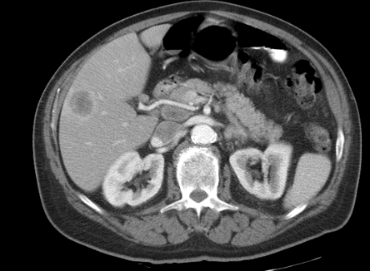
CT scan showing lesions in liver and abdominal LN

Slide 8
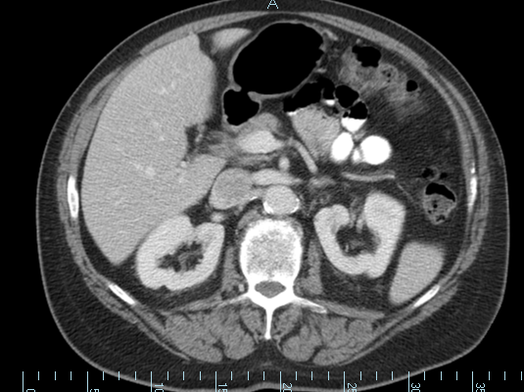
Resolved liver lesion and LN after paclitaxel + ramucirumab

Slide 9
What is the current standard of care?

Slide 11
IntelliDose chemotherapy order entry (COE) platform:
Trends in metastatic gastric cancer chemotherapy treatment* (2005-2016 )
 | Year of initiation of first-line therapy N=4,333 |  |  |  |  | Year of initiation of second-line therapy N=1,822
 | 2005-09 | 2010-12 | 2013-14 | 2015-16 |  | 2005-09 | 2010-12 | 2013-14 | 2015-16
N | 1,073 | 1,357 | 948 | 883 | N | 465 | 604 | 424 | 329
FOLFOX (%) | 12.0 | 21.2 | 35.1 | 41.0 | FOLFOX (%) | 13.3 | 13.1 | 17.2 | 16.4
ECF/EOX (%) | 13.8 | 23.0 | 11.6 | 10.2 | ECF/EOX (%) | 11.2 | 7.9 | 5.4 | 3.0
DCF (%) | 22.9 | 14.3 | 11.8 | 8.4 | DCF (%) | 15.7 | 9.3 | 7.3 | 2.1
CF (%) | 12.6 | 10.8 | 7.9 | 7.2 | CF (%) | 4.3 | 4.6 | 3.3 | 3.3
TAX (%) | 4.8 | 4.1 | 3.8 | 6.3 | TAX (%) | 11.8 | 11.4 | 21.0 | 22.8
C+Irinotecan (%) | 9.0 | 2.8 | 1.1 | 1.5 | FOLFIRI (%) | 11.2 | 9.1 | 12.0 | 9.7
C+TAX (%) | 9.8 | 12.2 | 15.6 | 14.6 | C+TAX (%) | 7.1 | 19.7 | 7.5 | 7.6
FU mono (%) | 9.2 | 7.5 | 8.1 | 6.5 | FU mono (%) | 9.2 | 112.1 | 13.0 | 22.2
Other (%) | 5.9 | 4.1 | 5.0 | 4.3 | Other (%) | 14.8 | 11.9 | 13.0 | 11.9
FOLFOX=fluoropyrimidine (FU) + oxaliplatin ; ECF/EOX=epirubicin + platinum + FU ; DCF=docetaxel (D) + cis/carboplatin (C) + FU ; CF=C + FU; TAX=taxane; DF = D + FU
* With or without biologic agents
Abrams T et al. GI Cancers Symposium 2018

Slide 12
Trends in biologic/targeted agent use in 1st and 2nd line therapy (2005-2016)
N=4,322 | Year of initiation of first-line biologic/targeted agent
 | 2005-09 | 2010-12 | 2013-14 | 2015-16
Number of patients | 1,106 | 1,371 | 959 | 886
HER2 agents | 0.3% | 6.7% | 11.4% | 13.9%
Antiangiogenic agents | 1.7% | 0.4% | 1.9% | 4.9%
EGFR agents | 1.4% | 1.3% | 0.5% | 0.3%
PD-1/PD-L1 agents | 0% | 0% | 0% | 0.3%
No biologic/ targeted agent use | 96.7% | 91.5% | 86.4% | 80.5%
N = 1,946 | Year of initiation of second-line biologic/targeted agent
 | 2005-09 | 2010-12 | 2013-14 | 2015-16
Number of patients | 444 | 535 | 495 | 472
EGFR agents | 2.5% | 2.4% | 0.6% | 0.8%
HER2 agents | 0.5% | 12.7% | 14.7% | 21.4%
PD-1/PD-L1 agents | 0% | 0% | 0% | 0.8%
Antiangiogenic agents
Bevacizumab | 6.5% | 1.3% | 1.2% | 0.4%
Ramucirumab | 0% | 0% | 4.8% | 24.4%
No biologic/ targeted agent use | 90.5% | 83.6% | 78.6% | 52.1%
EGFR=epidermal growth factor receptor; HER2=human epidermal growth factor receptor 2; PD-1=programmed cell death protein 1; PD-L1=programmed cell death ligand 1
Modified from Abrams et al. GI Cancers Symposium 2018

Slide 13
Are we moving from CROSS and MAGIC to FLOT 4?

Slide 14


FLOT4 Study Design
Randomized, multicenter, investigator-initiated, phase II/III study
S
T
RA
T
I
F
I
CA
T
I
ON
Gastric cancer or adenocarcinoma of the gastro-esophageal junction type I-III
Medically and technically operable
cT2-4/cN-any/cM0 or cT-any/cN+/cM0
FLOT x4 - RESECTION - FLOT x4
FLOT: docetaxel 50 mg/m², d1; 5-FU 2600 mg/m², d1; leucovorin 200 mg/m², d1; oxaliplatin 85 mg/m², d1, every two weeks
R
ECF/ECX x3 - RESECTION - ECF/ECX x3
n=716
ECF/ECX: Epirubicin 50 mg/m², d1; cisplatin 60 mg/m², d1; 5-FU 200 mg/m² (or capecitabine 1250 mg/m² p.o. divided into two doses d1-d21), every three weeks
Stratification: ECOG (0 or 1 vs. 2), location of primary (GEJ type I vs. type II/III vs. stomach), age (< 60 vs. 60-69 vs. ≥70 years) and nodal status (cN+ vs. cN-).

Slide 15
FLOT4: Progression-Free Survival
ECF/ECX FLOT
mPFS 18 months 30 months
[15-22] [21-41]
HR 0.75 [0.62-0.91]
p=0.004 (log rank)
PFS rate* ECF/ECX FLOT
2y 43% 53%
3y 37% 46%
5y 31% 41%
*projected PFS rates

Slide 16
FLOT4: Overall Survival
ECF/ECX FLOT
mOS 35 months 50 months
[27-46] [38-na]
HR 0.77 [0.63 - 0.94]
p=0.012 (log rank)
OS rate* ECF/ECX FLOT
2y 59% 68%
3y 48% 57%
5y 36% 45%
*projected OS rates

Slide 17
FLOT 4: Toxicity
Toxic event | ECF/ECX (N=354) | FLOT (N=354) | P-value (Chi-Square)
SAE any | 220 (62%) | 215 (61%)
SAE w/ relation to treatment | 137 (34%) | 139 (35%)
toxic death | 2 (<1%) | 2 (<1%)
Grade 3-4 >5% | ECF/ECX (N=354) | FLOT (N=354) | P-value (Chi-Square)
Diarrhea | 13 (4%) | 34 (10%) | 0.002
Vomiting | 27 (8%) | 7 (2%) | <0.001
Nausea | 55 (16%) | 26 (7%) | 0.001
Fatigue | 38 (11%) | 25 (7%)
Infections | 30 (9%) | 63 (18%) | <0.001
Leukopenia | 75 (21%) | 94 (27%)
Neutropenia | 139 (39%) | 181 (51%) | 0.002
Sensory | 7 (2%) | 24 (7%) | 0.002
Thromboembolic | 22 (6%) | 9 (3%) | 0.03
Anemia | 20 (6%) | 9 (3%) | 0.04
Modified from Al-Batran et al. ASCO 2017

Slide 18
What could be the near-future treatment of gastric cancer?

Slide 19
Phase III Gastric/GEJ Studies in Progress:*
Name | Agent | MOA | Line | Randomization | Country | 1º Outcome | N=?
SOLAR | TAS-118 | 5-FU inhibitor | 1st | TAS-118+Oxaliplatin vs. S-1 + Cisplatin | East Asia | OS | 686
NCT02500043 | TAS-102 | 5-FU inhibitor | 3rd+ | TAS-102 + BSC vs. BSC | Global | OS | 506
NCT01813253 | Nimotuzumab | EGFR inhibitor | 2nd | Irinotecan + Nimotuzumab vs. Irinotecan | East Asia | OS | 400
GAMMA-1 | GS-5745 (Andecaliximab) | MMP-9 antibody | 1st | FOLFOX + GS-5745 vs. FOLFOX + placebo | Global | OS | 432
ANGEL | Apatinib | VEGFR2 TKI | 3rd + | Apatinib vs. Placebo | Global | OS | 459
INTEGRATE II | Regorafenib | Multi-target TKI | 3rd | Regorafenib +BSC vs. Placebo + BSC | Global | OS | 350
CheckMate 649 | Nivolumab Ipilumumab | PD-1 AB CTLA-4 AB | 1st | Nivo/Ipi vs. Nivo/FOLFOX vs. FOLFOX | Global | OS | 1266
Keynote 585 | Pembrolizumab | PD-1 AB | 1st | Cisplatin/5-FU + Pembro vs. Cisplatin/5-FU + Placebo | Global | OS | 800
FPA 144 004 | FPA 144 | FGFR2b Ab |  | Confidential
Astellas | Claudiximab (IMAB 362) | Claudin -18 Ab |  | Confidential
*https://clinicaltrials.gov accessed Jan 8th, 2018

Slide 20
A Multicenter Phase II Study of TAS-102 Monotherapy in Patients with Pre-Treated Advanced Gastric Cancer (EPOC1201)
Trifluridine/tipiracil (TAS-102) 35mg/m² bid
29 patients
  PFS: 2.9mo (95% CI 1.1-5.3mo)
  OS: 8.7mo (95% CI 5.7-14.9mo)
  DCR: 65.5% (95% CI 45.7-82.1%)
  Grade III/IV AE: ANC 69%; Anorexia 10%
Bando H et al. Eur J Cancer 2016; 46-53

Slide 21
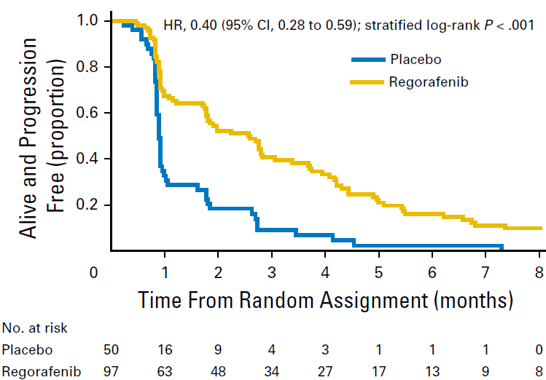
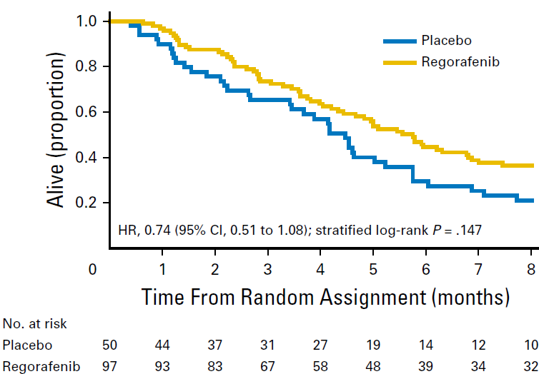
INTEGRATE:
Randomized Phase 2 of Regorafenib in Multi-Refractory Gastric Ca
2.6mo
0.9mo
5.8mo
4.5mo
Pavlakis N et al. J Clin Oncol 2016; 34(23): 2728-35

Slide 22
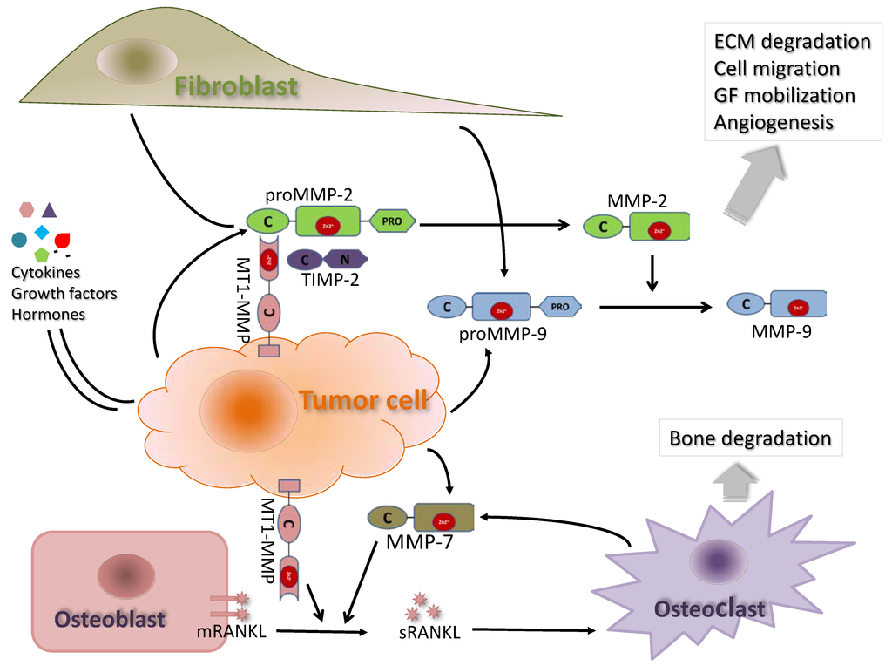
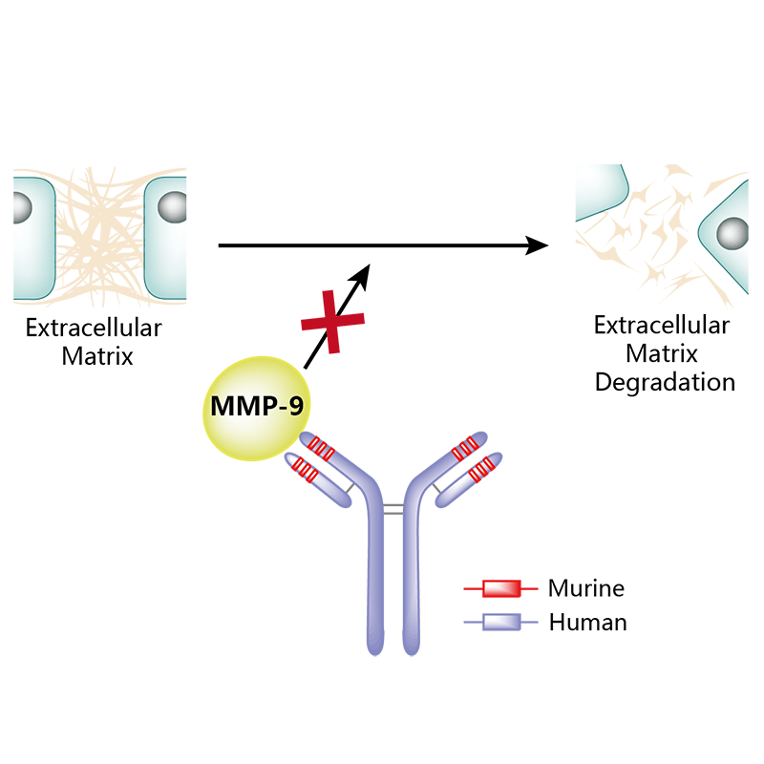
GS-5745
Humanized monoclonal antibody against matrix metalloproteinase 9 (MMP-9).
Causes inhibition of extracellular matrix protein degradation and, potentially, the inhibition of angiogenesis, tumor growth, invasion, and metastasis.
Increased activity of MMP-9 has been associated with increased invasion and metastasis of cancer.

Slide 23
Phase 1: FOLFOX + GS-5745 in Advanced Unresectable Gastric Ca
mFOLFOX 6 + GS-5745 800mg IV q 2 weeks
ORR: 55% chemo-naïve; 36% prior treatment
PFS: 12 mos chemo-naïve; 4.8 mos prior treatment
Grade >3 Adverse events:
  Any 70%, ANC 20%, nausea 10%, fatigue 7.5%, diarrhea 5%, PN 2.5%
Shah M et al. ASCO 2016

Slide 24
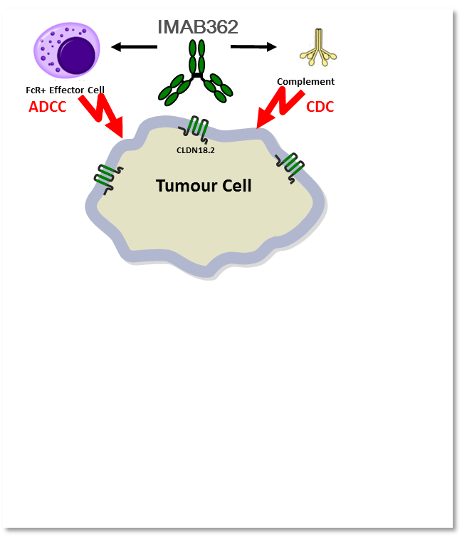
Claudiximab (IMAB362)
Claudins are a major structural component of tight junctions
IMAB362 is a chimeric antibody highly specific for CLDN18.2
Broadly expressed in various cancer types
  ~80-90% biliary duct, gastric, and mucinous ovarian cancer
  But not most normal tissues
Modes of action:
  Antibody-dependent cellular cytotoxicity (ADCC)
  Complement-dependent cytotoxicity (CDC)
  Immunomodulation of tumor-microenvironment
+ EOX Chemotherapy *
(immunogenic cell death)
IMAB362-coated Tumour Cell Debris
Pro-Inflammatory, Chemoattractant Environment
Cross-presentation by APCs**
T Cell Infiltration
Induction of Adaptive T cell immunity***
EOX: Epirubicin, Oxaliplatin, Capecitabine
*Kroemer et al, 2013
**Rogers, Veeramani and Weiner, 2014
***Biachini and Gianni, 2014

Slide 25
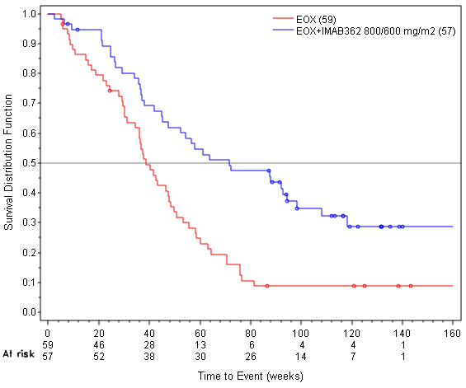
FAST - Overall Survival
Total Population*
High Expressors#
HR 0.51
P=0.0001
HR 0.45
p=<0.0005
13.2mo
16.7mo
8.4mo
9.0mo
*in patients with 2+/3+ CLDN18.2 staining in ≥ 40% of tumor cells
#in patients with 2+/3+ CLDN18.2 staining in ≥ 70% of tumor cells

Slide 26
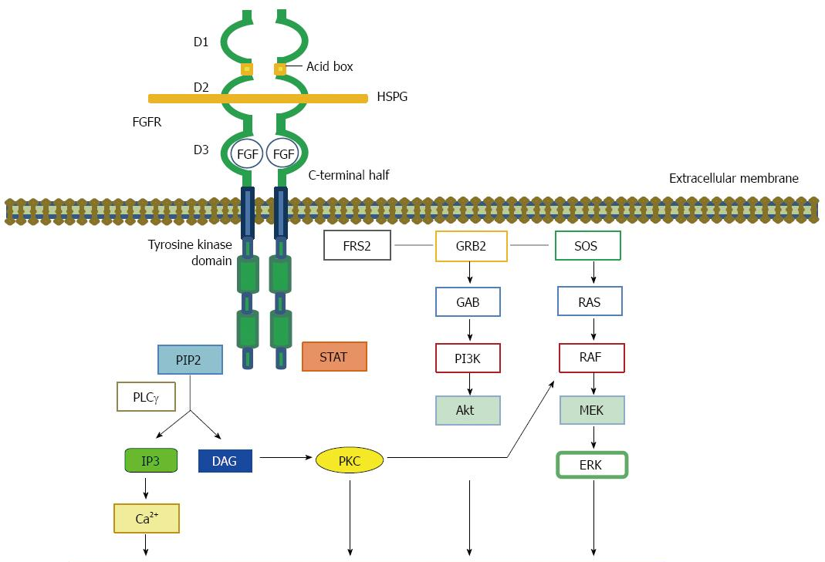
FPA144
Humanized monoclonal antibody
Binds to fibroblast growth factor receptor 2b
Also activates ADCC by recruiting NK cells
Only 2-9% of gastric cancers are FGFR2 amplified
Embriogenesis, tissue homeostasis, mitogenesis, differentiation, proliferation, angiogenesis, survival, invasion
Matsuoka YM et al, World J Gastroenterol 2016; 22(8): 2415-2423

Slide 27
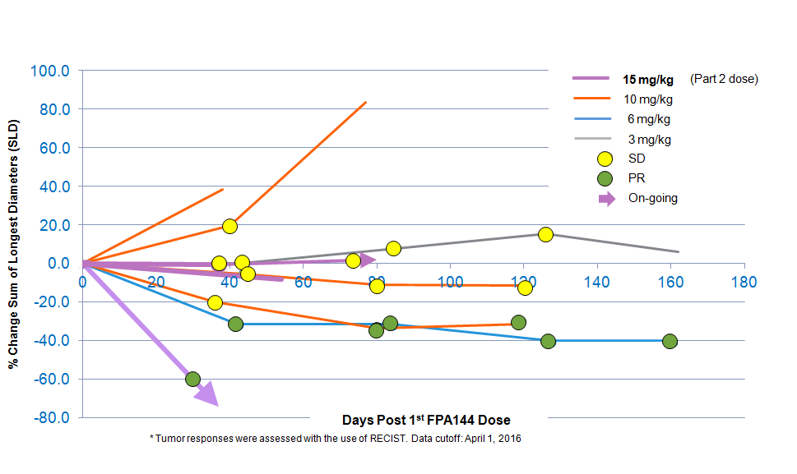
Phase I: Response to FPA144 in Multi-Refractory FGFR2b+ Gastric Ca

