Slide 1
Please note, these are the actual
video-recorded proceedings from the
live CME event and may include the use of trade names and other raw, unedited content.

Slide 2

Existing, Recently Approved and Investigational Approaches for Patients with Resectable and Unresectable PDAC
01-18-2018
Eileen M. O’Reilly, M.D.
Associate Director
David M. Rubenstein Center for Pancreatic Cancer Research
Attending Physician, Member
Memorial Sloan Kettering Cancer Center
Professor of Medicine
Weill Cornell Medical College

Slide 3
Disclosures
Consulting Agreements | Agios Pharmaceuticals Inc, Amgen Inc, Aptus Clinical, ASLAN Pharmaceuticals, Astellas Pharma Global Development Inc, AstraZeneca Pharmaceuticals LP, Bayer HealthCare Pharmaceuticals, Boston Scientific Corporation, Bristol-Myers Squibb Company, CARsgen, CASI Pharmaceuticals Inc, Celgene Corporation, CytomX Therapeutics, Daiichi Sankyo Inc, Debiopharm Group, Delcath Systems Inc, Eisai Inc, Gilead Sciences Inc, Halozyme Inc, Incyte Corporation, Inovio Pharmaceuticals Inc, Ipsen Biopharmaceuticals Inc, Lilly, MabVax Therapeutics, MedImmune Inc, Merck, Onxeo, PCI Biotech, Roche Laboratories Inc, Sanofi Genzyme, Servier, Silenseed Ltd, SillaJen, Sirtex Medical Ltd, Yakult Honsha Co Ltd
Contracted Research | Agios Pharmaceuticals Inc, Array BioPharma Inc, AstraZeneca Pharmaceuticals LP, Bayer HealthCare Pharmaceuticals, Boehringer Ingelheim Pharmaceuticals Inc, Bristol-Myers Squibb Company, CASI Pharmaceuticals Inc, Celgene Corporation, Exelixis Inc, Genentech BioOncology, Incyte Corporation, Lilly, MabVax Therapeutics, MedImmune Inc, Momenta Pharmaceuticals Inc, Novartis, OncoMed Pharmaceuticals Inc, Roche Laboratories Inc

Slide 4
Case presentation 4
75-year-old woman with RUQ and epigastric pain
  Endoscopy: gastritis → treated with ranitidine + sucralfate
  CT: pancreatic head mass abutting the SMV and SMA
  EUS/biopsy: 2.5-cm adenocarcinoma, 1 local LN
Whipple procedure: duodenal wall invasion; 2/13 LNs, T3N1M0
Received adjuvant gemcitabine and capecitabine
  Four months after completion: recurrent disease in liver
Gemcitabine + nab paclitaxel → disease progression 2 months later
Nal-IRI + 5-FU/LV → disease progression 6 months later
Phase I Clinical Trial
Massive CVA 2 months into treatment and subsequently passed away

Slide 5
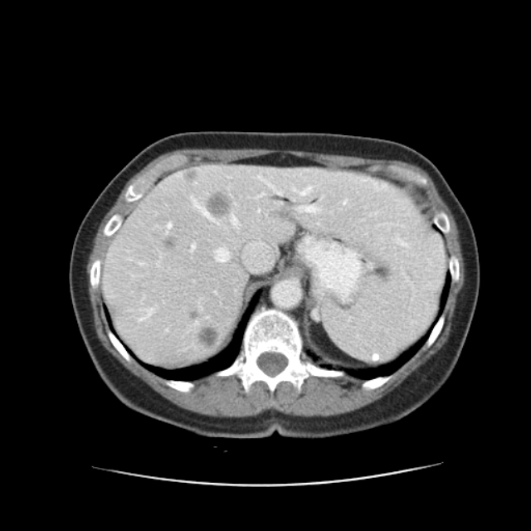
CT scan showing metastatic liver lesions developed after adjuvant therapy

Slide 6
Case presentation 5
59-year-old man with weight loss and pancreatitis and no family history of cancer
  CT scan: 4-cm lesion in pancreas and 3 liver lesions
  Liver biopsy: adenocarcinoma c/w pancreatic primary
FOLFIRINOX → 6 months later changed to FOLFIRI 2/2
neuropathy → PR
Chemo holiday after 13 months
Disease progression 5 months later → restarted on FOLFIRI
  Tumor mutation profile: MMS, TP53, APC, KRAS and BRCA2
Started on clinical trial of WEE1 inhibitor + PARP inhibitor
PR on this treatment and continues on therapy for 6 months

Slide 7
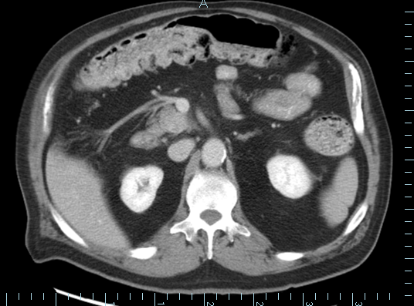
CT scan showing pancreatic lesion at the uncinate process

Slide 8
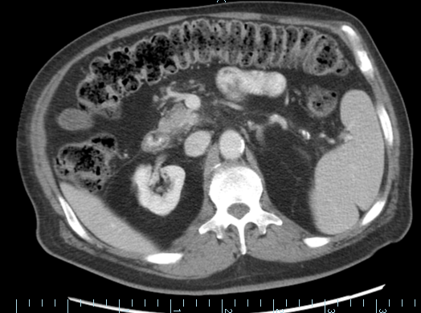
CT scan showing pancreatic lesion after WEE1 inhibitor + PARP inhibitor

Slide 9
Beyond Front-Line Therapy

Slide 10
NAPOLI-1: Phase III Design nal-IRI (nano-liposomal irinotecan)
nal-IRI 100 mg/m² q3 wks
(n = 151)
R
A
N
D
O
M
I
Z
E
Met PDAC
Prior Gemcitabine
KPS 70- 100%
n = 417
Infusional 5-FU/LV
wkly x 4 q6w (n = 149)
nal-IRI +Inf. 5-FU/LV q2 wks (n = 117)*
Stratification
Albumin, KPS, Ethnicity
Primary Endpoint: Overall Survival
Secondary Endpoints: PFS, RR, Ca 19-9, Safety, QoL
*Trial amended after n = 63 to include 3rd arm nal-IRI+5-FU/LV

Slide 11
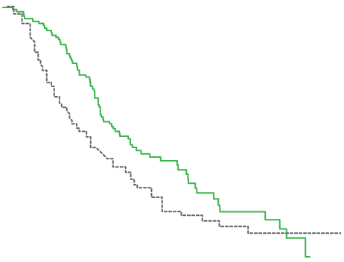
NAPOLI-1 Overall Survival: nal-IRI+5-FU/LV vs 5-FU/LV
Log-Rank p = 0.014, HR = 0.68 (95% CI: 0.50 - 0.93)
nal-IRI+5-FU/LV
6.1 mths (4.8, 8.5)
5-FU/LV
4.2 mths (3.3, 5.3)

Slide 12
Second-Line Treatment in PDAC
Oxaliplatin: Mixed Data
 | CONKO-003 |  | PANCREOX
 | 5-FU/LV | OFF | 5-FU/LV | mFOLFOX
Med OS | 3.3 m | 5.9 m | 9.9 m | 6.1m
 | HR 0.068 |  | HR 1.78
Med TTP | 2 m | 2.9 m
Med PFS |  |  | 2.9 |  | 3.1
Oettle, H. J Clin Oncol 2014. Gill, S. J Clin Oncol 2016.

Slide 13
Second-Line Therapy: Meta-Analysis
N = 5 randomized trials, 895 patients
Fluoropyrimidine + irinotecan or fluoropyrimidine + oxaliplatin vs fluoropyrimidine monotherapy
  Improved PFS
Fluoropyrimidine + irinotecan vs fluoropyrimidine monotherapy
  Improved PFS (HR 0.64; 0.47 - 0.87, p = 0.005)
  Improved OS (HR 0.7; 0.55 - 0.89, p = 0.004)
Data more compelling for irinotecan vs oxaliplatin-based therapy following gemcitabine

Slide 14
Microenvironment Targeting

Slide 15
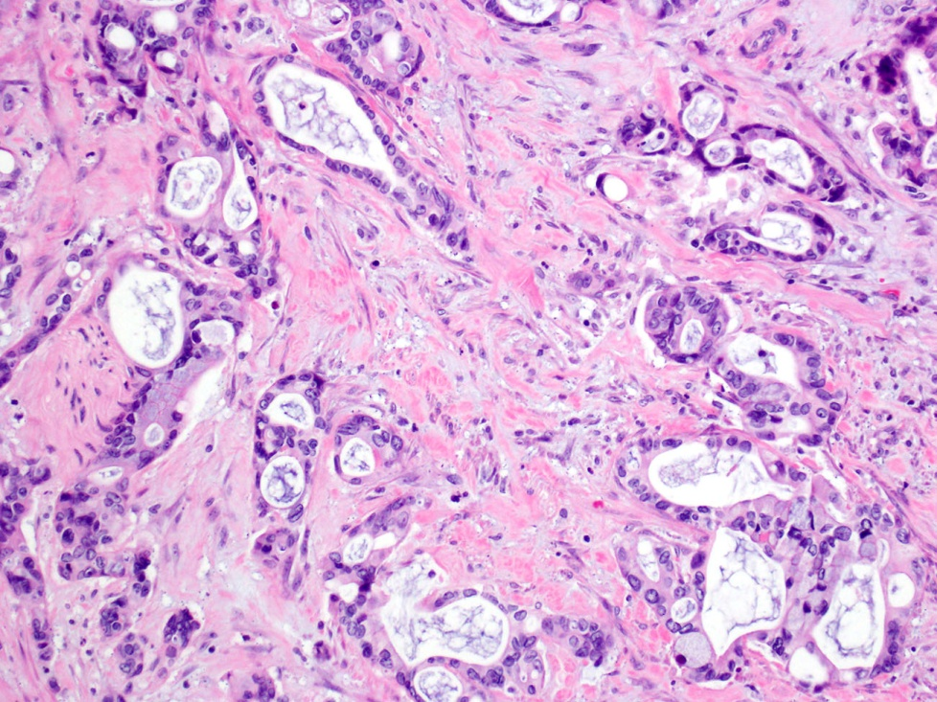
Microenvironment in PDAC
Hypovascular, hypoxic
Physical stromal barrier
  Hyaluronan (HA) glycosaminoglycans
  Increased EMT, chemoresistance
PEGPH20 rhuman hyaluronidase
  Depletes HA in stroma
  Improves drug delivery

Slide 16
Randomized Phase II: nab-P + Gem
+/-PEGHPH20 (HALO 202)
nab-P + Gem + PEGPH20
3ug/kg IV x 2 wk (C1)➔wkly
n = 166
R
A
N
D
O
M
I
Z
E
Untreated Met Panc Adenoca
KPS 70-100%
n = 279
nab-P + Gem
n = 113
Primary endpoint: Progression-free survival, rate of thromboembolic events (TE)
Secondary: PFS by HA level, ORR, OS, Safety
Exploratory: OS by HA level, duration of response, DCR

Slide 17
Results: Randomized Phase II (2017)
Outcome | All Pts |  | HA-High
 | PAG n = 166 | AG n = 113 | PAG n = 49 | AG n = 35
Stage 1, 2
Overall Response | 40% | 33% | 45% | 31%
Median OS | - | - | 11.5 mths | 8.5 mths
 |  |  | 0.96 (0.57 - 1.61)
Stage 2 only
Median PFS | - | - | 8.6 mths | 4.5 mths
 |  |  | 0.63 (0.21 - 1.93)
Median OS | - | - | 11.7 mths | 7.8 mths
 |  |  | 0.52 (0.22 - 1.23)

Slide 18
Thromboembolic Events
TE Rate, % (n/N) | All Pts
 | PAG n = 166 | AG n = 113
Stage 1 (pre-prophylaxis) | 43% (32/74) | 25% (15/61)
Stage 2 40 mg/day enoxaparin 1 mg/kg/day enoxaparin | 14% (12/86) 28% (5/18) 10% (7/68) | 10% (4/39) 29% (2/7) 6% (2/32)
No difference in TE rate by treatment arm or tumor HA level

Slide 19
Tumor Microenvironment/ Stroma: PEGPH20
Randomized phase II trials
  FOLFIRINOX ± PEGPH20 (SWOG-NCI)
  Stopped due to futility by DSMB
  Data GI ASCO, 2018
Phase III trial underway
  Nab-P + gemcitabine ± PEGPH20 (HALO-301)
  Biomarker selected: Hyaluronan-high
  Primary endpoints: PFS, OS
  N = 420

Slide 20
Somatic and Germline Profiling & Targeted Genetic Approaches

Slide 21
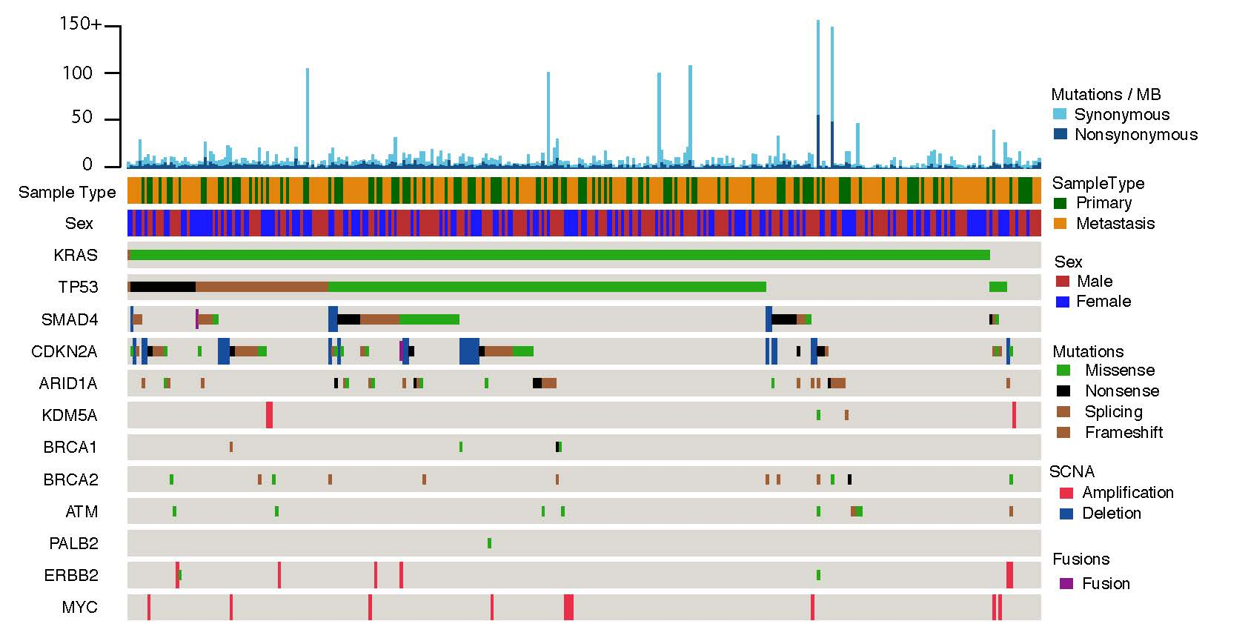
MSK-IMPACT: PDAC Somatic Profiling
Mean/Median #Mutations = 4 (n= 324)
95%
72%
22%
18%
11%

Slide 22
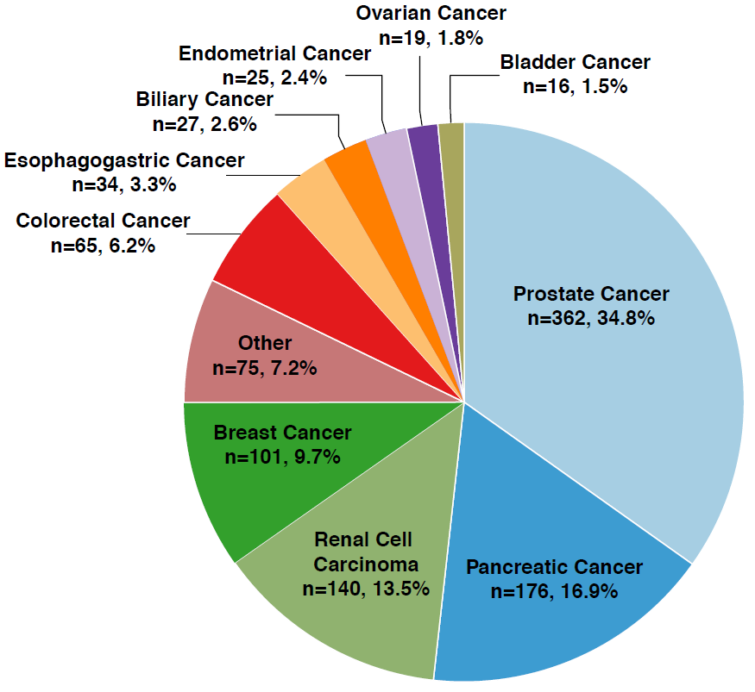
MSK IMPACT: Germline Testing: N= 1,040
PDAC n = 176 (16.9%)
BRCA 1
BRCA 2
CDKN2A
PALB2
ATM
CHEK2
APC
MUYTH

Slide 23
Phase IB: Cisplatin, Gem, Veliparib
RECIST: gBRCA(+) vs gBRCA(-)
Germline BRCA(-):
OS 11 months
(95% CI: 1.5 - 12.1)
Germline BRCA(+):
OS 23.3 months
(95% CI: 3.8 - 30.2)
Predictive vs Prognostic effect

Slide 24
Single-Agent PARPi Trials PDAC: Completed
 | Olaparib | Veliparib | Rucaparib
N | 23 | 16 | 19
BRCA Type | Germline | Germline | Germline (15)/ Somatic (4)
Lines of Therapy | Mean = 2 | Mean = 2 | 1-2
Prior platinum | 15/23 (65%) | 13/16 (82%)
Response Rate | 5/23 (22%) | - | 3/19 (15%)
Stable Disease | 8/22 (35%) | 4/16 (25%) 4, 4, 10, 11 m | 4/19 (21%) 1 CR: 14 m+
Kaufmann, B. J Clin Oncol 2014. Lowery, M. Eur J Cancer 2017. Domchek, S. J Clin Oncol 2016 (34):4110 [abstr].

Slide 25
Randomized Phase II
Cisplatin, Gemcitabine +/- Veliparib
Germline BRCA/PALB2
R
A
N
D
O
M
I
Z
E
Arm A:
Cisplatin,Gemcitabine
+ Veliparib
Untreated Stage III- IV PDAC
ECOG 0-1
n = 50- 70
Arm B:
Cisplatin, Gemcitabine
Randomization 1: 1
Primary Endpoint: Response Rate

Slide 26
Phase III POLO:
Maintenance Platinum ➔ Olaparib/Placebo
R
A
N
D
O
M
I
Z
E
Olaparib
300 mg PO BID
Metastatic PDAC
Germline BRCAm
Prior Platinum
ECOG 0-1
n = 145
Placebo
300 mg PO BID
Randomization 3: 2
Primary Endpoint: PFS (central review mRECIST 1.1)
80% power HR 0.54

Slide 27
Molecular/Genomic Profiling in PDAC
Germline testing
  Selected targeting vs limited germline panel for all?
    Age, personal/family hx ca, clinical hx guided (pancreatitis, etc)
  Identification of MSI-H/dMMR, DNA repair, at risk family
Consider somatic testing for all
  Feasible for majority; substantial scientific interest
  KRAS wild-type subgroup (4-5%), BRCA (5-7%), others, e.g., BRAF, ERBB2, MSI
  Clinical value 2017 modest: Trial, off-label use
  Bioinformatics programs: NGS info + MSI status

