Slide 1
Please note, these are the actual video-recorded proceedings from the live CME event and may include the use of trade names and other raw, unedited content.

Slide 2
Immune Checkpoint Inhibitors in the Management of mCRC
Michael Overman, MD
Associate Professor
Gastrointestinal Medical Oncology
MD Anderson Cancer Center
moverman@mdanderson.org

Slide 3
Agenda/Disclosures
Agenda
Deficient Mismatch Repair (dMMR) Colorectal Cancer
Deficient Mismatch Repair (dMMR) non-Colorectal Cancer
Proficient Mismatch Repair (pMMR) Colorectal Cancer
Disclosures
Consulting:
Merrimack Pharmaceuticals Inc, Bristol-Myers Squibb Company, Roche Laboratories Inc, Karyopharm Therapeutics
Research Funding:
Roche Laboratories Inc, Merck, Celgene Corporation, MedImmune Inc, Bristol-Myers Squibb Company, Amgen Inc

Slide 4
Case presentation 3
31-year-old woman with anemia
CT: mass in ascending colon
Colonoscopy: tumor completely obstructing the ascending colon
Biopsy: moderately differentiated adenocarcinoma
Right laparoscopic hemicolectomy: poorly differentiated mucinous T4bN2bMx BRAF wild-type, MSI-high adenocarcinoma
No family history of colorectal cancer
Adjuvant FOLFOX
Two years later, recurrent peritoneal disease
Pembrolizumab → PR and continues 2 years later

Slide 5
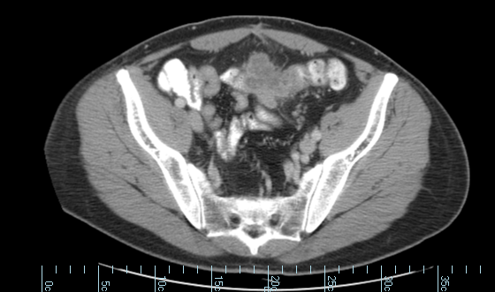
Abdominal CT scan showing postadjuvant recurrent peritoneal disease

Slide 6
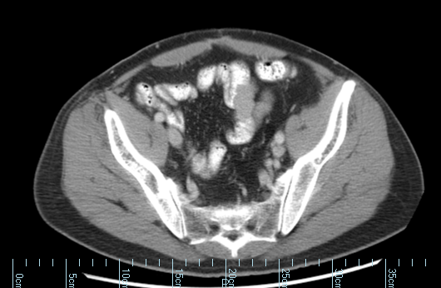
CT showing mostly resolved peritoneal mass after PR from pembrolizumab

Slide 7
Guidelines and FDA Indications
Testing for Microsatellite Instability or Mismatch Repair (NCCN):
Treatment Recommendations:
FDA label Nivolumab
Microsatellite instability-high (MSI-H) or mismatch repair deficient (dMMR) metastatic colorectal cancer (CRC) that has progressed following treatment with a fluoropyrimidine, oxaliplatin, and irinotecan
FDA label for Pembrolizumab:
For the treatment of adult and pediatric patients with unresectable or metastatic, microsatellite instability-high (MSI-H) or mismatch repair deficient”
“solid tumors that have progressed following prior treatment and who have no satisfactory alternative treatment options”
“colorectal cancer that has progressed following treatment with a fluoropyrimidine, oxaliplatin, and irinotecan
NCCN:
Recommends nivolumab or prembrolizumab as treatment options in patients with metastatic MMR-deficient colorectal cancer in second- or third-line therapy or for pts ”not appropriate for intensive therapy”
NCCN update 3/13/2017; FDA labels 2017

Slide 8
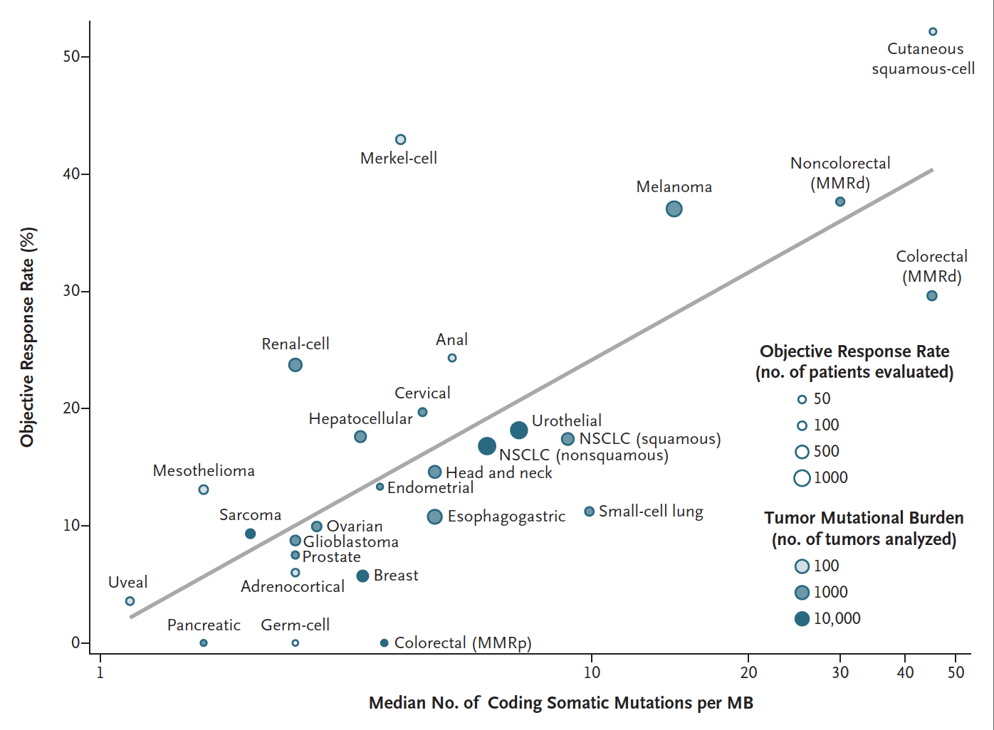
Tumor Mutation Burden and Response Rate to PD-1 Inhibition
Chalmers et al. Genome Medicine 2017; Yarchoan et al. NEJM 2017

Slide 9
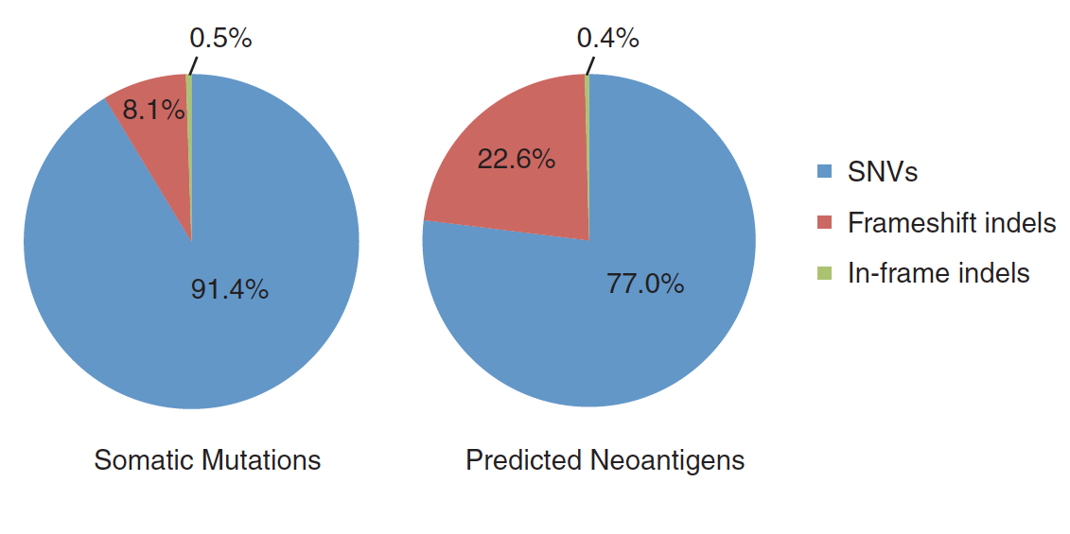
dMMR/MSI-H and Neoantigens
Tumor Antigens:
Differentiation (melanocyte differentiation antigens…)
Overexpressed (HER-2…)
Viral (HPV proteins…)
Cancer/testis (MAGE, NY-ESO-1…)
Mutational (p53…)
Frameshift Antigens
N=619 CRC
Giannakis et al. Cell Report 2016; Kloor et al. Trends in Cancer 2016; Chalmers et al. Genomic Medicine 2017

Slide 10
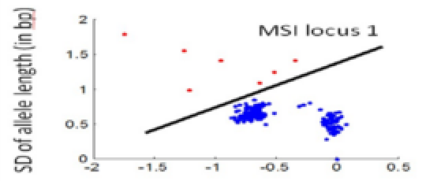
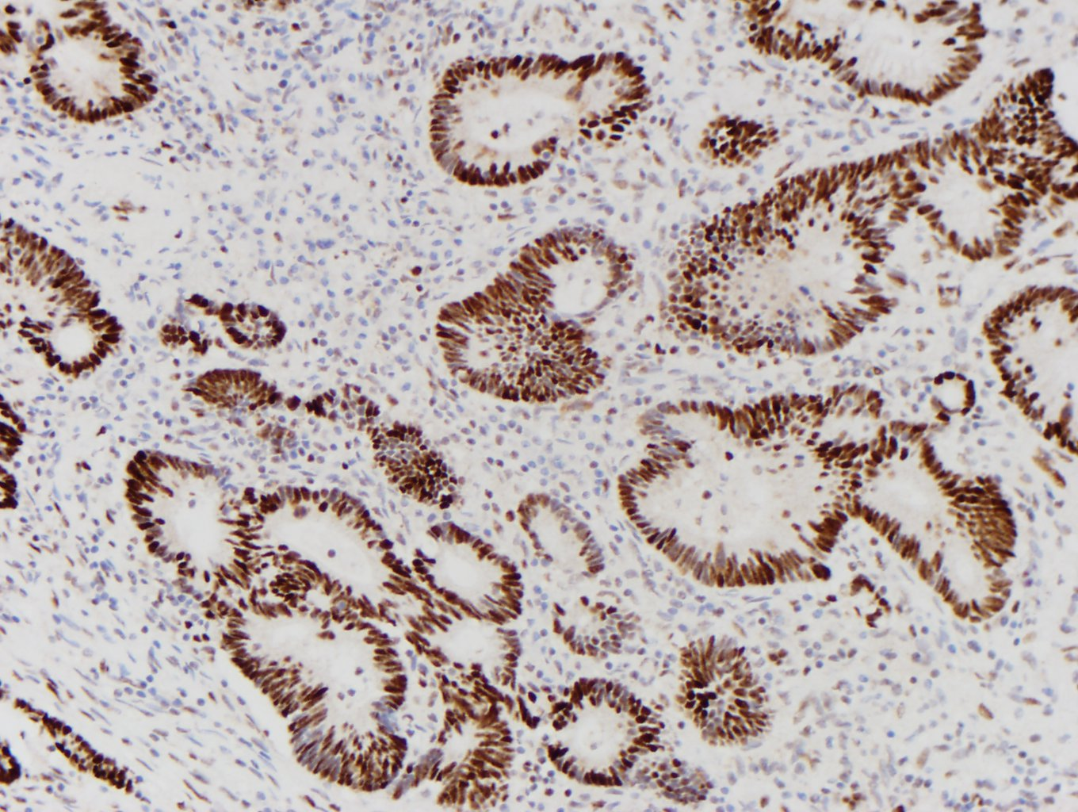
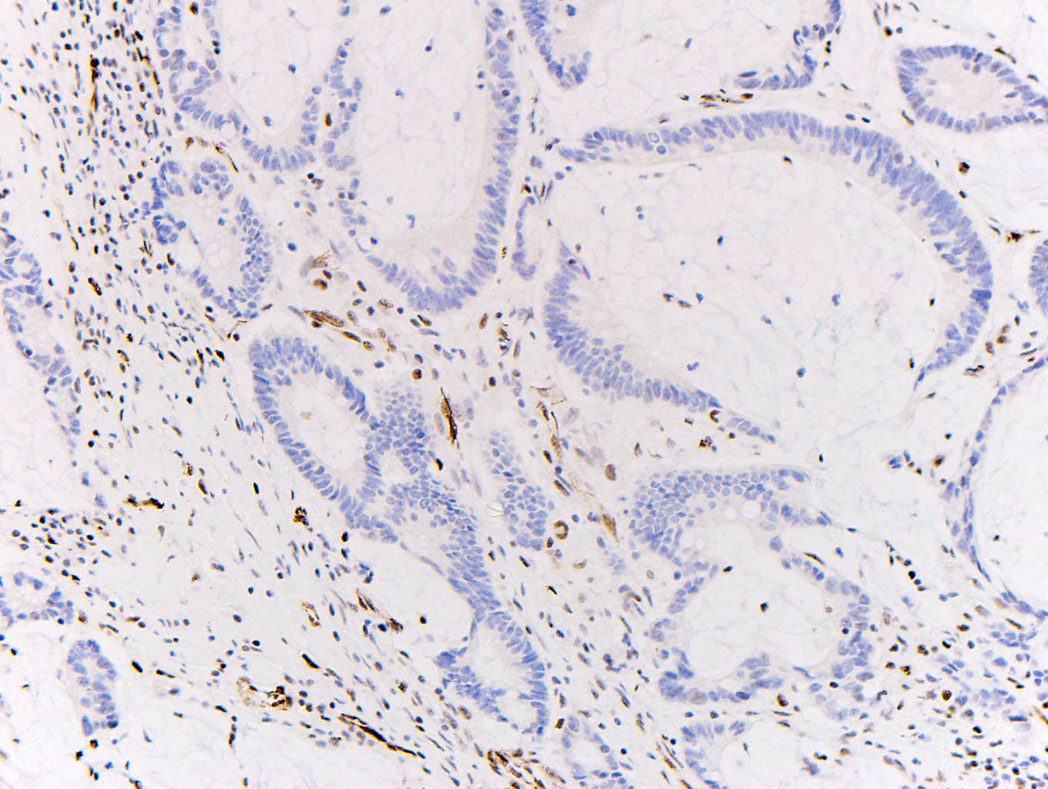
dMMR/MSI-H
592-gene panel: MSI-high defined as ≥43 altered microsatellite loci (compared to MSI PCR from 2100 case)
Sensitivity 95.8% and Specificity 99.4%
Assay for 114 microsatellite loci (compared to MSI PCR or IHC in 69 cases)
Sensitivity 95% and Specificity 98%
Stage | MSI-H
II | 22%
III | 12%
IV | 4%
Variance at 114 msi loci
Next-generation Sequencing
≈1/3 Inherited mutations in MMR (HNPCC or Lynch).
≈2/3 Sporadic loss of MMR by MLH-1 methylation or biallelic somatic genomic alteration.
Immunohisto-chemistry
Polymerase Chain Reaction
Complete loss of expression in one of the MMR proteins = MSI-high
Panel of 5 or more microsatellites with allelic shift in 2 (>30%) or more markers = MSI-high
Intact expression
Loss of expression

Slide 11
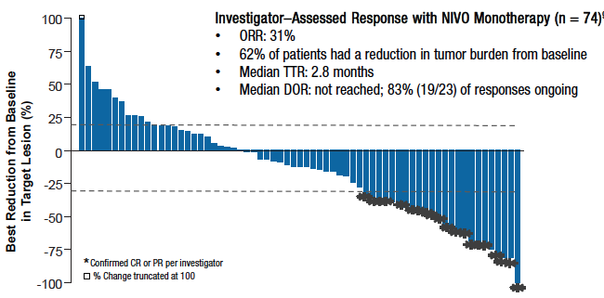
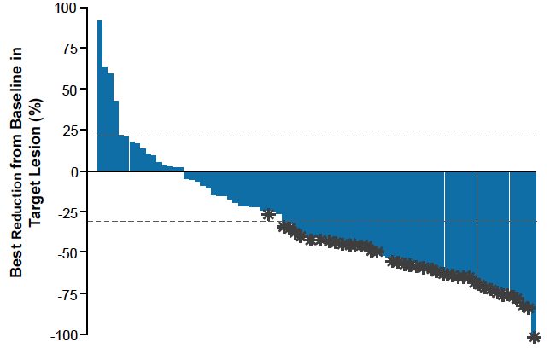
dMMR Anti-PD-1 Response
Pembrolizumab
Nivolumab
Nivolumab and
Ipilimumab
Overman Lancet Onc 2017; Andre et al. ASCO 2017 a3531; Le et al. Science 2017

Slide 12
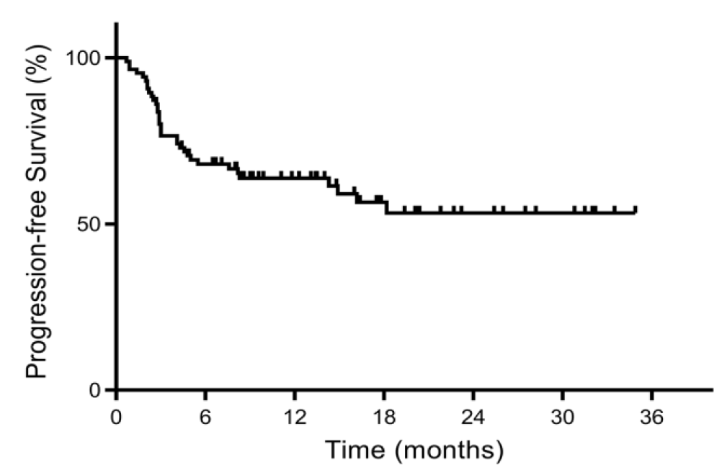
dMMR Anti-PD-1 and Durability
Nivolumab; Nivolumab + Ipilimumab
Pembrolizumab
1.0
0.8
12m PFS 77%
0.6
≈12m PFS 65%
Probability of
Progression-free Survival
12m PFS 48%
0.4
NIVO 3 mg/kg Q2W
0.2
NIVO 3 mg/kg + IPI 1 mg/kg Q3W
N=86, MSI-high Cancers
0.0
0
3
6
9
12
15
18
21
24
Time (Months)
No.at Risk
74
48
22
14
12
10
7
3
0
NIVO
NIVO + IPI
84
65
35
17
13
8
1
0
0
Oral Presentations
Saturday 10am Session
A554 Long-term Follow-up for Nivolumab
A553 Nivolumab/Ipilimumab
Pembrolizumab (mandatory stop at 2 years)
18 pts ( 11 with CR and 7 with residual disease)
Median time off 8months
None have recurred
Overman Lancet Onc 2017; Andre et al. ASCO 2017 a3531; Le et al. Science 2017

Slide 13
Reduction in Target Lesions Regardless of PD-L1 Expression, BRAF or Lynch History
Tumor PD-L1 Expression
BRAF Mutation Status
Clinical History of Lynch Syndrome
100
100
100
≥ 1%
< 1%
+ Confirmed CR/PR
Mutant
Wild type
+ Confirmed CR/PR
Yes
No
+ Confirmed CR/PR
50
50
50
Investigator-Assessed Best Change in Target Lesion Size (%)
Investigator-Assessed Best Change in Target Lesion Size (%)
Investigator-Assessed Best Change in Target Lesion Size (%)
0
0
0
-50
-50
-50
-100
-100
-100
Overman et al. Lancet Onc 2017

Slide 14
MSI-H/dMMR Phase III CRC Trials
Frontline Metastatic
KEYNOTE 177
MSI-high mCRC
R
mFOLFOX6/Bevacizumab
Pembrolizumab
N=270
PI: Luis Diaz
mFOLFOX6/Bevacizumab
NRG-CR1556/SWOG-1610
MSI-high mCRC
R
Atezolizumab
N=311
mFOLFOX6/Bevacizumab
+ Atezolizumab
PI: James Lee and Michael Overman
Stage III Adjuvant
mFOLFOX6 + Atezolizumab (12 cycles)
then Atezolizumab x 6 months
Alliance 021502
Resected Stage III
R
mFOLFOX6 (12 cycles)
N=700
PI: Frank Sinicrope

Slide 15
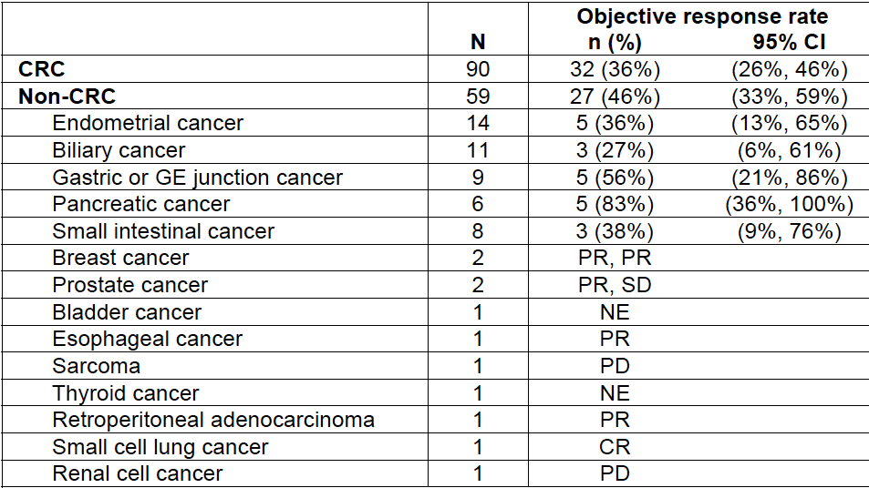
Pembrolizumab: Non-CRC
Lee et al Science 2017, Pembrolizumab FDA label

Slide 16
dMMR Rates Across Platforms (Metastatic Pts)
Cancer |  | Match | Foundation | Caris
Gastroesophageal |  | 7/142 (4.9%) | 6/400 (1.5%)
 | Esophageal SCC | 1/19 (5.3%)
 | Gastric/GEJ Adenoca | 4/79 (5.1%) |  | 6/91 (6.2%)*
 | Esophageal Adenoca | 2/44 (4.5%) |  | 9/91 (0%)**
CRC |  | 20/723 (2.8%) | 42/1185 (3.5%) | 38/888 (4.1%)
 | Rectal Adenoca | 1/205 (0.5%)
 | Colon Adenoca | 19/518 (3.7%)
Small bowel Adenoca |  | 1/27 (3.7%) | 6/70 (8.6%) | 1/35 (2.8%)***
Panceatic Adenoca |  | 1/267 (0.4%) | 1/459 (0.2%) | 7/316 (2.2%)
Uterine |  | 34/237 (14.3%) | 39/277 (14.1%) | 62/365 (14.5%)
Prostate |  | 7/122 (5.7%) | 11/178 (6.2%) | 3/128 (2.3%)
Breast |  | 8/566 (1.4%) | 2/1459 (0.1%) | 2/705 (0.3%)
NSCLC |  | 2/244 (0.8%) | 5/2112 (0.2%) | 9/1042 (0.9%)
SCLC |  | 2/65 (3.1%) |  | 1/52 (0.9%)
Hepatobiliary |  | 4/166 (2.4%) | 9/389 (2.3%)
 | Gallbladder | 1/37 (2.7%)
 | Cholangiocarcinoma | 3/129 (2.3%) |  | 3/89 (3.3%)
 | HCC |  |  | 0/30 (0%)
GBM |  | 1/47 (2.1%) |  | 2/431 (0.5%)
Neuroendocrine NOS |  | 1/99 (1%) | 1/431 (0.2%) | 3/124 (2.4%)
Panc Neuroendocrine |  | 2/28 (7.1%)
CUP |  |  | 22/815 (2.7%) | 6/421 (1.4%)
CARIS groupings of *gastric cancer; **esophagel/GEJ; *** "small intestinal malignancies"
Le et al. Science 2017; Conley et al. abstract A53 AACR Molecular Targets; Chalmers et al. Genome Medicine 2017

Slide 17
KEYNOTE-028 for PD-L1+ CRC
Pembrolizumab 10mg/kg IV q2wks
PD-L1+: “membranous PD-L1 expression in ≥1% of cells in tumor and stroma”
33/137 (24.1%) PD-L1+ with 23 enrolled
ORR 4.3%
SD 17.4%
(Only MSI-high pt was the one responder)
O’Neil et al. ESMO 2015

Slide 18
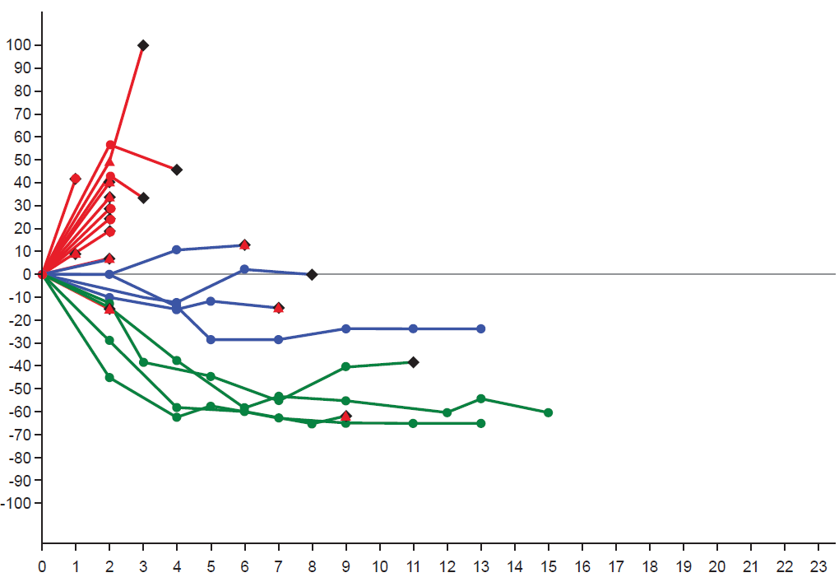
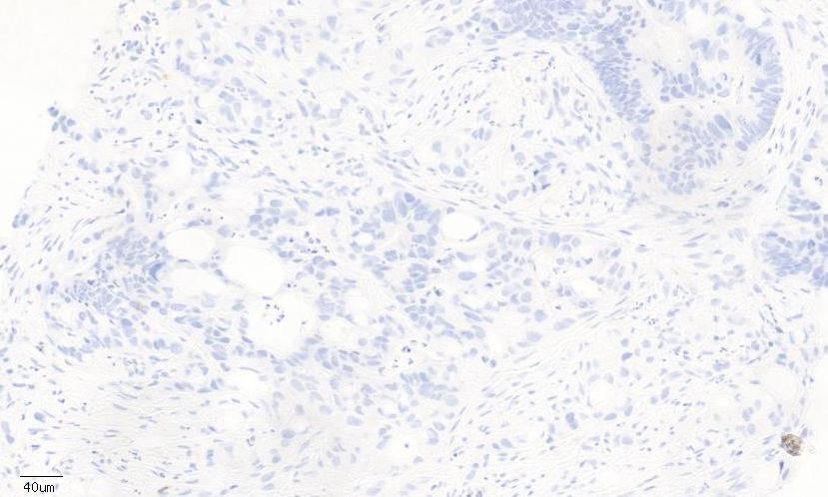
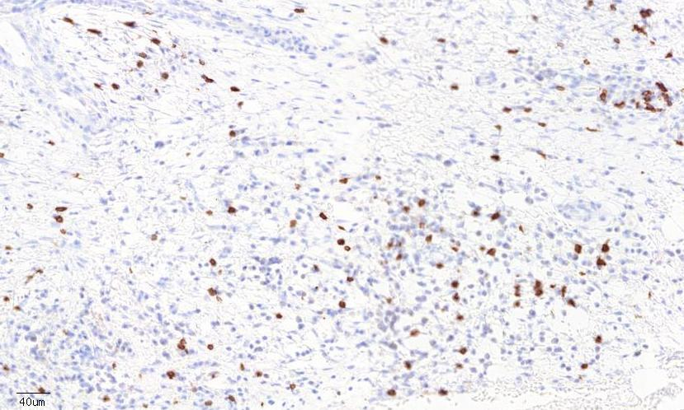
Clinical activity and safety of cobimetinib and atezolizumab in colorectal cancer
23 CRC
22 KRAS mutant
1 KRAS wt
60 mg cobi PO QD 21/28d
800 mg atezo IV q2w
PD
RR 17%
SD 22%
PD 52%
SD
PR/CRª
Discontinued atezolizumab
New lesion
Oral Presentation A560
Saturday 7am session
Results from expansion enrollment
Change in Sum of Longest Diameters from Baseline, %
3 of 4 responders MSS (4th MSI-high)
3 of 4 responders PDL-1 negative (<1%)
Median duration of response not reached (range: 5.4 to 11.1+ mo)
Baseline
Cobi+Atezo
Time on Study (mo)
CD8
KRAS mutant responder:
Bendell et al. ASCO 2016
0.03%
1.72%

Slide 19
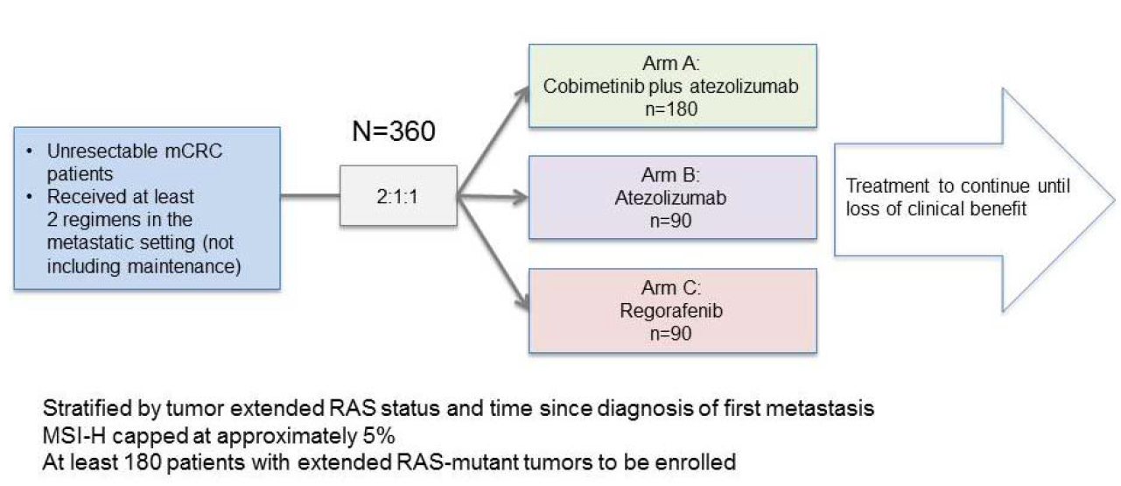
IMblaze370 Phase III study Completed enrollment with expected results 2018

Slide 20
Study 2: CEA-TCB + atezolizumab (n = 25, 5-160 mg of CEA-TCB)
CEA-TCB (T-Cell Bispecific Antibody) + Atezolizumab Demonstrated Clinical Activity in mCRC
100
5 mg
10 mg
20 mg
Best change in target
lesions from baseline, %
40 mg
80 mg
160 mg
^
50
^ MSI
0
-50
^
Binds simultaneously with 1 arm to CD3 on T cells and with 2 arms to CEA on tumor cells
Silent Fc results in reduced risk of FcγR-related cytokine release/IRRs
CEA-TCB + Atezolizumab (N=25)
-100
100
5 mg 40 mg
10 mg 80 mg
20 mg 160 mg
^ MSI
* Withdrawal
p Progression
Ongoing
First new lesion
Change in target lesions from baseline, %
p
p^
p p
100
50
p
p
Best change in target lesions from baseline, %
60 mg 200 mg
90 mg 300 mg
p
p p
p
p
p
p
100 mg 400 mg
50
135 mg 600 mg
0
p
*
p
* MMR unknown
*
0
*
a
^
*
*
-50
-50
0 1 2 3 4 5 6 7 8 9 10 11 12 13 14 15 16 17 18 19 20 21 22 23 24
Weeks after treatment start
CEA-TCB Monotherapy (N=31)
-100
Tabernero et al. ASCO 2017; Bacac M, et al. AACR 2017

Slide 21
Conclusions
Employ universal testing of all CRC (NCCN recommendation)
Anti-PD-1 therapy is standard of care for metastatic MSI-high cancers
FDA approvals for Pembrolizumab/Nivolumab after fluoropyrimidine/oxaliplatin/irinotecan
NCCN recommends Pembrolizumab/Nivolumab for ≥2nd line or poor PS frontline
Phase III Trials for adjuvant and front-line metastatic MSI-H CRC are ongoing
PD-L1 expression is not predictive in MSS CRC
Combination therapies of anti-PD-1 combined with MEK or CEA-TCB are showing promise in MSS CRC

