Slide 1
Please note, these are the actual video-recorded proceedings from the live CME event and may include the use of trade names and other raw, unedited content.

Slide 2
Selection and Sequencing of FDA-Approved Therapies for Patients with Previously Treated Advanced HCC
Andrew X. Zhu, MD, PhD
Professor of Medicine, Harvard Medical School
Director, Liver Cancer Research, MGH Cancer Center

Slide 3
Disclosures
Advisory Committee | AstraZeneca Pharmaceuticals LP, Bayer HealthCare Pharmaceuticals, Bristol-Myers Squibb Company, Eisai Inc, Lilly, Merck, Novartis, Sanofi Genzyme
Contracted Research | Bayer HealthCare Pharmaceuticals, Lilly, Merck, Novartis

Slide 4
What would be your most likely second-line systemic therapy for a 60-year-old patient with HCC, a Child-Pugh A score and a PS of 0 who responded to standard-dose sorafenib for 6 months with minimal toxicity and then experienced disease progression?
17
Nivolumab
Regorafenib
8
N = 25 investigators

Slide 5
A patient with HCC has been receiving standard-dose sorafenib but is now experiencing disease progression and is about to start regorafenib. What starting dose of regorafenib would you use?
160 mg
12
120 mg
7
80 mg
5
I would not use regorafenib for this patient
1
N = 25 investigators

Slide 6
What would be your most likely second-line systemic therapy for a 60-year-old patient with HCC, a Child-Pugh A score and a PS of 0 who responded to standard-dose lenvatinib for 6 months with minimal toxicity and then experienced disease progression?
Nivolumab
18
Regorafenib
5
Sorafenib
1
N = 24 investigators

Slide 7
Consider the last patient in your practice who received second-line systemic treatment for HCC. What systemic treatment did the patient receive?
Nivolumab
16
Regorafenib
7
Pembrolizumab
1
N = 24 investigators
Notes:
7
7
7

Slide 8
Consider the last patient in your practice who received regorafenib as second-line systemic treatment for HCC. What tolerability issues, if any, did the patient experience? (Please select all that apply.)
None
3
Hand-foot syndrome
11
Fatigue/muscle aches
13
GI adverse events/diarrhea
5
LFT increase
2
Hypertension
1
N = 19 investigators
Notes:
8
8
8

Slide 9
Consider the last patient in your practice who received regorafenib as second-line systemic treatment for HCC. What was the clinical response/benefit?
Partial response
1
Stable disease
12
Disease progression
5
Not assessable
1
N = 19 investigators
Notes:
9
9
9

Slide 10
Consider the last patient in your practice who received regorafenib as second-line systemic treatment for HCC. If the patient is no longer receiving this treatment, what was the reason for discontinuation?
Patient is still receiving regorafenib
3
Progressive disease
15
Toxicity
1
N = 19 investigators
Notes:
10
10
10

Slide 11
Consider the last patient in your practice who received nivolumab as second-line systemic treatment for HCC. What tolerability issues, if any, did the patient experience? (Please select all that apply.)
None
14
Fatigue/muscle aches
4
GI adverse events/diarrhea
2
LFT increase
2
Skin toxicity
1
Hypothyroidism
1
N = 22 investigators
Notes:
11
11
11

Slide 12
Consider the last patient in your practice who received nivolumab as second-line systemic treatment for HCC. What was the clinical response/benefit?
Partial response
8
Stable disease
11
Disease progression
2
Not assessable
1
N = 22 investigators
Notes:
12
12
12

Slide 13
Consider the last patient in your practice who received nivolumab as second-line systemic treatment for HCC. Is the patient still receiving treatment? If not, what was the reason for discontinuation?
Patient is still receiving nivolumab
10
Progressive disease
9
Toxicity
1
Death
1
Patient decision
1
N = 22 investigators
Notes:
13
13
13

Slide 14
Outside of a protocol setting, have you or would you offer an anti-PD-1/ PD-L1 antibody to a patient with HCC in the following situation? A patient who has undergone a liver transplant
I have
3
I have not, but I would for the right patient
3
I have not, and I would not
18
N = 24 investigators

Slide 15
Current and Emerging Treatments for HCC
HCC
PS 0, Child–Pugh A
Okuda 3, PS > 2, Child–Pugh C
Okuda 1-2, PS 0-2,
Child–Pugh A-B
Very early stage (0)
Single <2 cm
Carcinoma in situ
Early stage (A)
Single or 3 nodules
<3 cm, PS 0
Intermediate stage (B)
Multinodular, PS 0
Advanced stage (C)
Portal invasion, N1, M1, PS 1-2
Terminal stage (D)
Single
3 nodules ≤ 3 cm
Portal pressure/bilirubin
Increased
Associated diseases
Checkpoint inhibitors?
Normal
No
Yes
Resection
Liver transplantation
RFA/PEI
TACE
Lenvatinib
Sorafenib
BSC
Curative treatments (30%); 5-yr survival: 40% to 70%
Regorafenib
Nivolumab
Cabozantinib

Slide 16
Current landscape for second line HCC
Regorafenib-approved based on improved OS
Nivolumab-approved based on durable RR
Cabozantinib-positive OS benefits
Brivanib-failed
Everolimus-failed
Ramucirumab-failed in REACH and pending in REACH-2
ADI-PEG 20-failed
Tivantinib-failed
Pembrolizumab-pending

Slide 17
Multi-Kinase Inhibitors and Novel Anti-Angiogenic Agents in HCC
Regorafenib
Oral TKI targeting VEGFR1-3, TIE2, PDGFRb, KIT, RET, RAF
Cabozantinib
Oral TKI targeting MET, AXL, and VEGFR
Ramucirumab
Human IgG1 Monoclonal antibody against VEGFR2

Slide 18
Regorafenib vs Placebo in the Second-Line (RESORCE)
HCC patients with documented radiologic progression during sorafenib treatment
Stratified by
Geographic region (Asia vs rest of the world)
Macrovascular invasion
Extrahepatic disease
ECOG PS (0 vs 1)
AFP (< or ≥ 400 ng/mL)
N = 573
Regorafenib
160 mg orally;
3 wk on, 1 wk off (4 wk cycle)
n = 379
R
2:1
Placebo
n = 194
All patients received best supportive care
Patients were treated until disease progression, death, or unacceptable toxicity
Primary endpoint: OS in ITT population
Secondary endpoints: PFS, TTP, RR, DCR

Slide 19
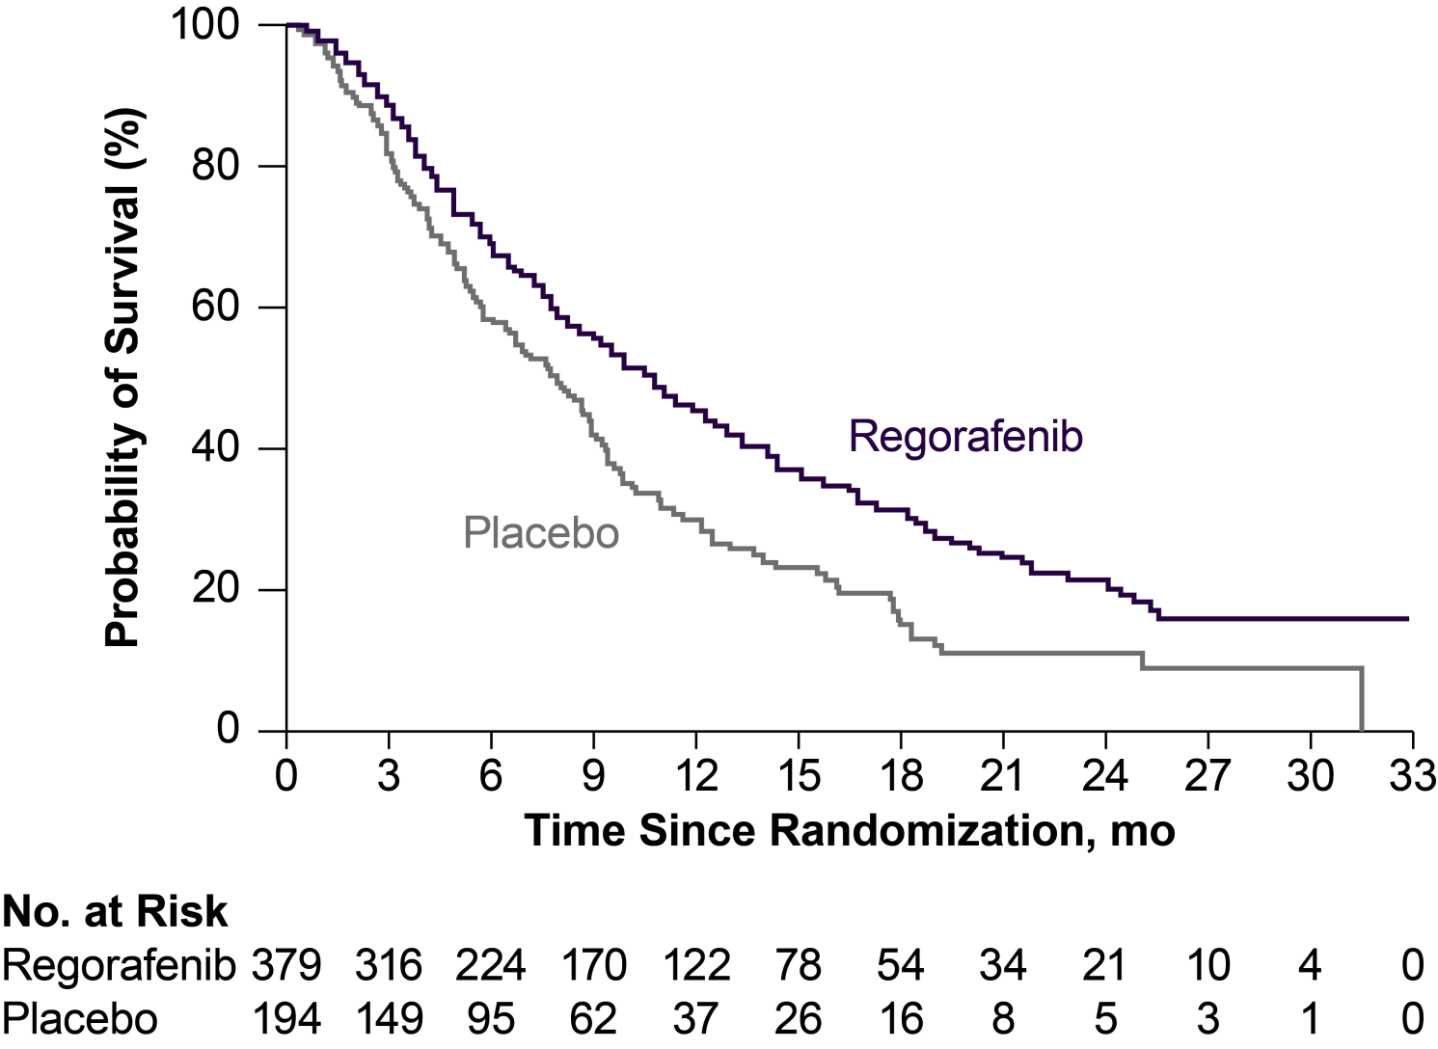
RESORCE Trial: Overall Survival¹
 | Regorafenib (n = 379) | Placebo (n = 194)
Events | 232 (61%) | 140 (72%)
Censored | 147 (39%) | 54 (28%)
Median OS, mo (95% CI) | 10.6 (9.1-12.1) | 7.8 (6.3-8.8)
HR (95% CI) | 0.63 (0.50-0.79); P < .0001 (2-sided)
Probability of Overall Survival,ª %

Slide 20
RESORCE Trial: Efficacy¹
Endpointª | Regorafenib (n = 379) | Placebo (n = 194) | Statistic
Median OS, mo | 10.6 | 7.8 | HR = 0.63 P < .0001
Median PFS, mo | 3.1 | 1.5 | HR = 0.46 P < .001
Median TTP, mo | 3.2 | 1.5 | HR = 0.44 P < .001
ORR, % | 10.6 | 4.1 | P = .005
DCR, % | 65.2 | 36.1 | P < .001

Slide 21
RESORCE Trial: Safety¹
AE, % | Regorafenib (n = 379) | Placebo (n = 193)
Any ≥grade 3 AE | 68 | 39
Hypertension | 15.2 | 4.7
HFSR | 12.6 | 0.5
Fatigue | 9.1 | 4.7
Diarrhea | 3.2 | 0
Dose modifications due to AEs | 68.2 | 31.1
Drug discontinuations due to AEs | 25 | 19
Deaths occurring ≤30 days after last dose | 13.4 | 19.7

Slide 22
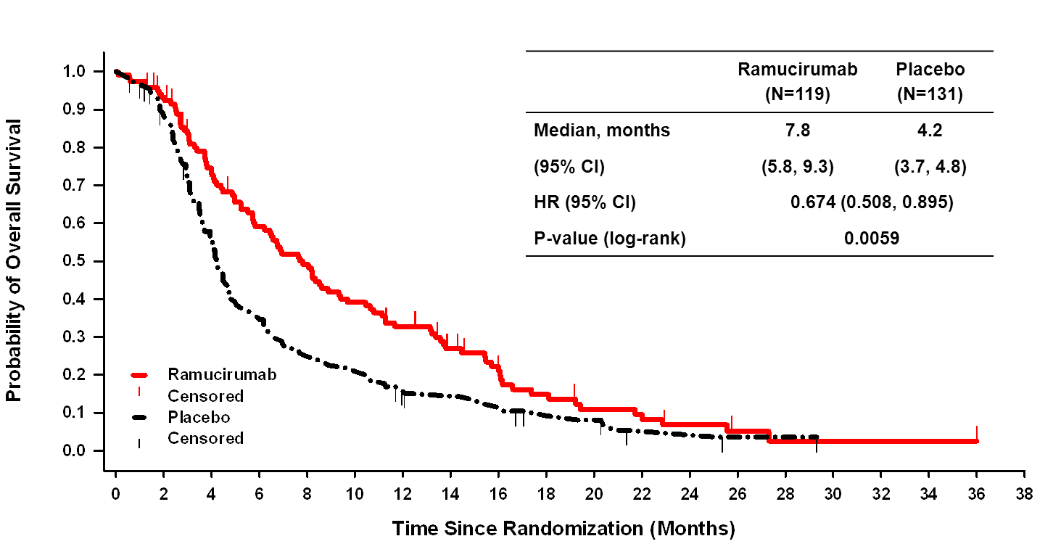
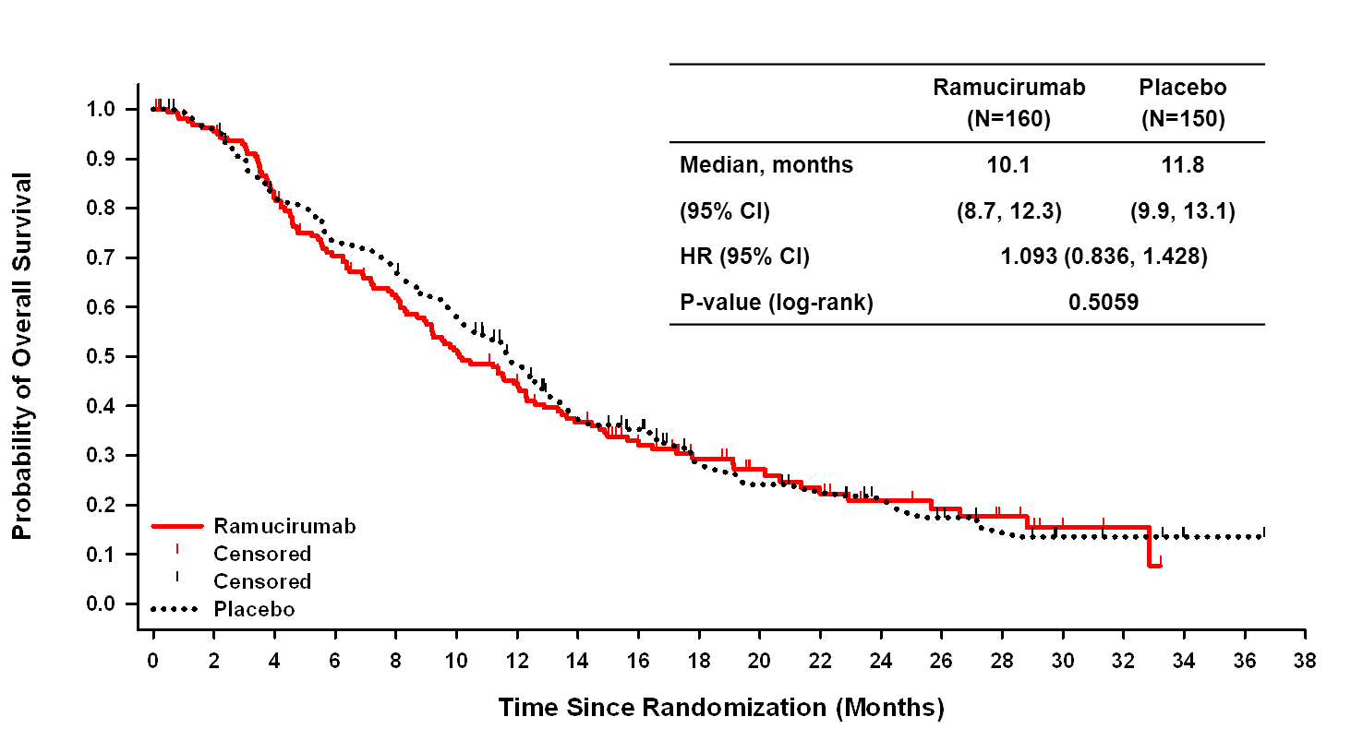
AFP ≥400 ng/mL
REACH: Overall Survival in Patients With Baseline Alpha‑Fetoprotein ≥ or < 400 ng/mL
AFP <400 ng/mL
Zhu AX et al, Lancet Oncology, 2015

Slide 23
CheckMate 040 Study Design
Study Endpoints
Primary
Safety and tolerability (escalation)
Objective response rateª (expansion)
Secondary
Objective response rateª (escalation)
Disease control rate
Time to response
Duration of response
Overall survival
Other
Biomarker assessments
Patient-reported outcomes^{b}
Dose Escalation
0.1–10 mg/kg
N = 48
Uninfected (n = 23)
Sorafenib Experienced (2L)
(n = 37)
HCV infected (n = 10)
Sorafenib Naive (1L)
(n = 11)
HBV infected (n = 15)
All Patients (N = 262)
Dose Expansion
3 mg/kg
N = 214
Sorafenib Experienced (2L)
(n = 145)
Sorafenib Experienced (2L)
(n = 145)
Uninfected (n = 113)
Sorafenib Experienced (2L)
(n = 145)
HCV infected (n = 50)
Sorafenib Naive (1L)
(n = 69)
Sorafenib Naive (1L)
(n = 69)
Sorafenib Naive (1L)
(n = 69)
HBV infected (n = 51)
Disease assessment imaging (CT or MRI) every 6 weeks
Interim analysis data cutoff date: August 8, 2016
Median follow-up was 13.3 months in the dose-escalation phase and 10.5 months in the dose-expansion phase
ª RECIST v1.1; ^{b} Baseline and every 6 weeks through week 25 using the EQ-5D utility index and visual analog scale (VAS).
Melero I et al, 2017 GI Symposium

Slide 24
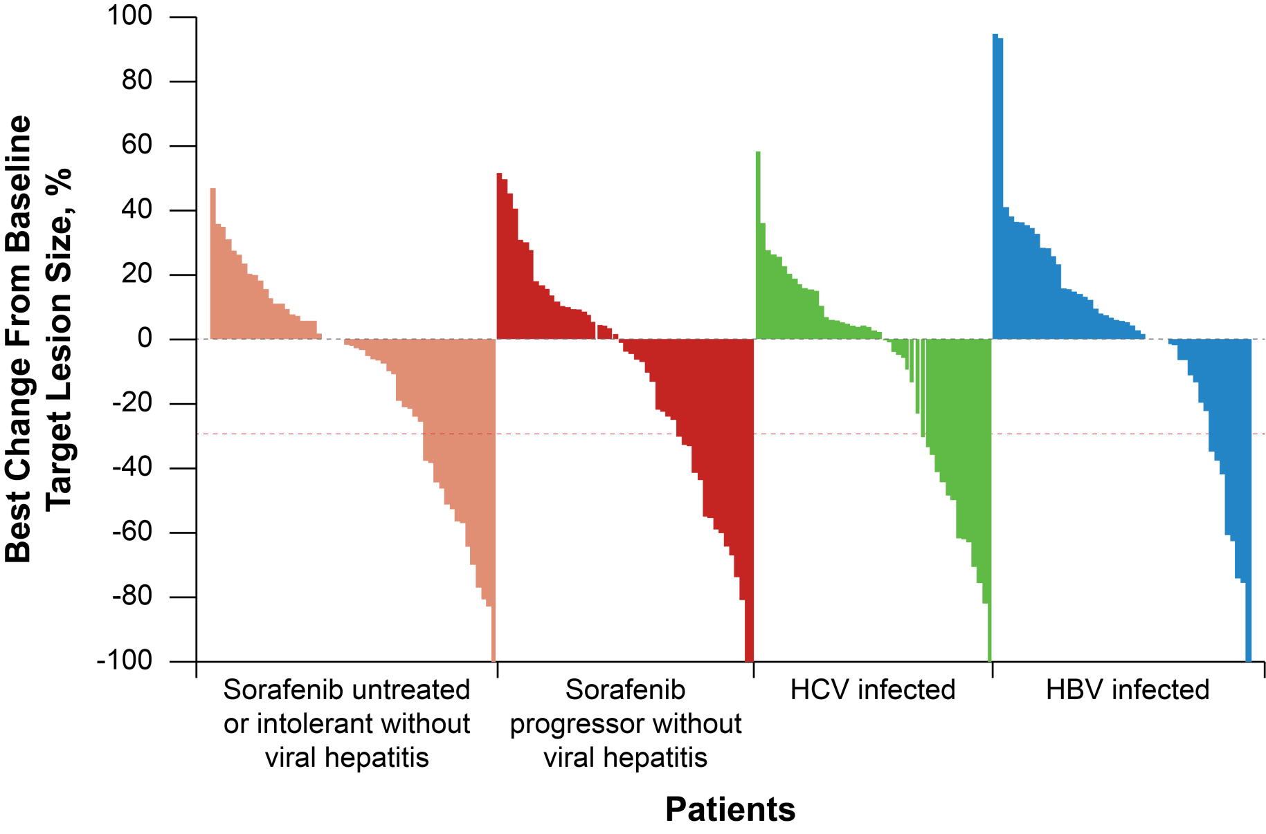
Nivolumab (Anti–PD-1) in HCC

Slide 25
Overall Survival: Sorafenib-Experienced Patients in the Dose-Expansion Phase
 | HCV Infected (n = 30) | HBV Infected (n = 43) | Uninfected (n = 72) | All Patients (N = 145)
Median OS (95% CI) | NR | NR | 16.7 (11.3-NE) | 16.7 (13.2-NE)
12-mo OS rate (95% CI), % | 67.1 (46.2-81.4) | 55.6 (39.6-69.0) | 59.7 (47.4-70.0) | 59.9 (51.3-67.4)
Probability of Survival
1.0
HCV infected
HBV infected
Uninfected
All patients
0.9
0.8
0.7
0.6
0.5
0.4
0.3
0.2
0.1
0.0
0
3
6
9
12
15
18
21
24
Time, mo

Slide 26
Response by PD-L1 Expression
Sorafenib Experienced (2L)
Investigator Assessment
Dose Escalation
Dose Expansion
100
100
PD-L1: < 1%
≥ 1% NA
PD-L1: < 1%
≥ 1% NA
50
50
Size From Baseline (%)
Change in Target Lesion
0
0
-50
 | PD-L1 < 1% | PD-L1 ≥ 1%
ORR, n/N (%) 95% CI, % | 4/26 (15.4), 4.4–34.9 | 2/9 (22.2), 2.8–60
-50
 | PD-L1 < 1% | PD-L1 ≥ 1%
ORR, n/N (%) 95% CI, % | 17/99 (17.2) 10.3–26.1 | 8/25 (32.0), 14.9–53.5
-100
-100
Patients
Patients
Responses were observed irrespective of PD-L1 expression on tumor cells

Slide 27
Safety: Dose-Expansion Phase
Patients, n (%) | Uninfected (n = 113) |  |  | HCV Infected (n = 50) |  | HBV Infected (n = 51) |  | All Dose Expansion (N = 214)
 | Any Grade | Grade 3/4 |  | Any Grade | Grade 3/4 | Any Grade | Grade 3/4 | Any Grade | Grade 3/4
Any treatment-related AE (TRAE) | 84 (74) | 22 (19) |  | 40 (80) | 15 (30) | 35 (69) | 3 (6) | 159 (74) | 40 (19)
TRAEs (≥ 5%)
Fatigue | 34 (30) | 2 (2) |  | 8 (16) | 1 (2) | 7 (14) | 0 | 49 (23) | 3 (1)
Pruritus | 18 (16) | 0 |  | 14 (28) | 1 (2) | 13 (25) | 0 | 45 (21) | 1 (<1)
Rash | 16 (14) | 2 (2) |  | 9 (18) | 0 | 8 (16) | 0 | 33 (15) | 2 (1)
Diarrhea | 19 (17) | 2 (2) |  | 5 (10) | 0 | 3 (6) | 1 (2) | 27 (13) | 3 (1)
Nausea | 10 (9) | 0 |  | 6 (12) | 0 | 1 (2) | 0 | 17 (8) | 0
Dry mouth | 9 (8) | 0 |  | 2 (4) | 0 | 2 (4) | 0 | 13 (6) | 0
Decreased appetite | 6 (5) | 0 |  | 2 (4) | 1 (2) | 3 (6) | 0 | 11 (5) | 1 (<1)
Laboratory TRAEs (≥ 5%)
AST increase | 9 (8) |  | 4 (4) | 6 (12) | 5 (10) | 1 (2) | 0 | 16 (7) | 9 (4)
ALT increase | 7 (6) |  | 2 (2) | 7 (14) | 3 (6) | 3 (6) | 0 | 17 (8) | 5 (2)

Slide 28
How to select and sequence each agent in clinical decision
No level 1 evidence
Survival benefits with sorafenib-regorafenib sequencing
Safety profiles of each agent
Sorafenib intolerance
Tumor burden and aggressiveness
Predictive biomarkers:
Nivolumab: PD-L1 status, MSI status, tumor mutation
burden and immune signature
TKIs: angiogenesis signatures

Slide 29
Conclusions
Regorafenib, nivolumab are the currently approved second line agents for advanced HCC
Angiogenesis pathway is important in hepatocarcinogenesis. Despite the negative data of several VEGFR TKI, phase III trials with regorafenib, lenvatinib, cabozantinib showed positive survival benefits and ramucirumab is under further development
Anti–CTLA-4 and anti–PD-1/PD-L1 preliminary data confirmed safety and response and ongoing trials will help to define the role of immune checkpoint inhibitors in HCC
Potential synergistic effect of immune checkpoint inhibitors with local-regional therapy and other systemic therapies under investigation
Identification of relevant predictive markers and applying molecular classification are important in predicting response and enriching the population in future HCC trial design-proof of concept trials needed

