Slide 1
Please note, these are the actual
video-recorded proceedings from the
live CME event and may include the use of trade names and other raw, unedited content.

Slide 2
Bone Targeted Therapies and Other Emerging Radiopharmaceuticals
Oliver Sartor, M.D.
Laborde Professor for Cancer Research
Depts. of Medicine and Urology
Medical Director, Tulane Cancer Center
Assistant Dean for Oncology
Tulane Medical School
New Orleans, LA

Slide 3
Disclosures
Consulting Agreements | Advanced Accelerator Applications, AstraZeneca Pharmaceuticals LP, Bayer HealthCare Pharmaceuticals, Bellicum Pharmaceuticals Inc, Bristol-Myers Squibb Company, Celgene Corporation, Constellation Pharmaceuticals, Dendreon Pharmaceuticals Inc, EMD Serono Inc, Endocyte Inc, Johnson & Johnson Pharmaceuticals, OncoGenex Pharmaceuticals Inc, Pfizer Inc, Sanofi Genzyme
Contracted Research | Bayer HealthCare Pharmaceuticals, Endocyte Inc, Innocrin Pharmaceuticals Inc, Johnson & Johnson Pharmaceuticals, Sanofi Genzyme

Slide 4



For a patient presenting with hormone-sensitive metastatic prostate cancer and bone metastases for whom you are about to initiate ADT with or without docetaxel or abiraterone, do you generally administer either denosumab or zoledronic acid?
Yes, denosumab
4
Yes, either denosumab or zoledronic acid
1
20
No
N = 25
Notes:
4
4
4
4
4

Slide 5

For a patient with metastatic prostate cancer to the bone who is receiving a secondary hormonal therapy, would you add bone-targeted treatment?
Yes, denosumab
14
Yes, zoledronic acid
4
Yes, radium-223
1
No
6
N = 25
Notes:
5
5
5
5
5

Slide 6
A 68-year-old man who is receiving abiraterone for metastatic prostate cancer to the bone responds for 6 months and then begins experiencing subtle bone discomfort along with weight loss and fatigue. Imaging reveals new bone metastases. What would be your treatment approach?
Radium-223
7
16
Docetaxel
Continue abiraterone and
add radium-223
2
N = 25
Notes:
6
6
6
6
6

Slide 7
Approximately how many times in the past year have you sent a patient for treatment with radium-223?
MEDIAN: 15 times
Months
N = 25
Notes:
7
7
7
7
7

Slide 8
Based on available data and your own clinical experience, do you believe that radium-223 relieves pain?
19
Yes
No
6
N = 25
Notes:
8
8
8
8
8

Slide 9
Have you observed an improvement in bone pain in any patient receiving radium-223? Please describe:
Dramatic response in pain in a 70-year-old man with multiple bone metastases
mCRPC patient on abiraterone with new painful bone met that improved soon after the first dose of radium-223
Many such patients
Elderly male, extensive bone mets, was able to reduce narcotic dose, but still required narcotics
Patient whose pain subsided after first dose… however the majority do not get dramatic pain improvement
Multiple patients having decreasing pain while on therapy. Generally it occurs 2-3 months later. Some may experience pain flare before improving
A patient whose pain responded after 2nd injection of radium-223
Notes:
9
9
9
9
9

Slide 10
How frequently does treatment with radium-223 lead to clinically relevant cytopenias?
Very frequently
1
Somewhat frequently
3
17
Occasionally
Rarely if ever
4
N = 25
Notes:
10
10
10
10
10

Slide 11
Challenges: Advanced prostate cancer is a heterogeneous group of diseases filled with targets, many of which are undruggable
Robinson et al. Cell 161:1215, 2015

Slide 12
Key Challenges in Treating Advanced Prostate Cancer
How do we target cancers that are highly heterogeneous in genotype?
How do we target cancers driven by multiple undruggable targets?

Slide 13
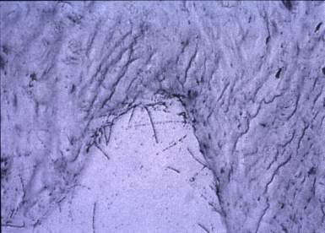
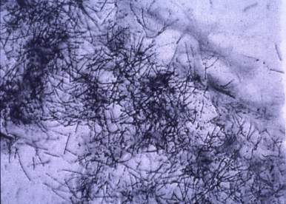
Radium-223: An Alpha-Emitter with Preferential Uptake in the Stroma of Osteoblastic Lesions
Normal bone Osteoblastic lesion
marrow
Track length <100 microns
Studies in Dog
Bruland et al. Clin Cancer Res. 2006;12:6250s-6257s.
Notes:
13

Slide 14
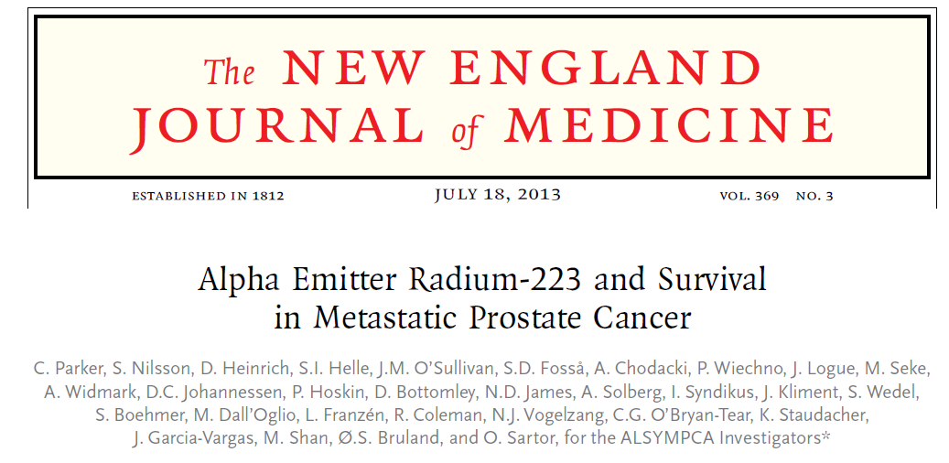

Slide 15
What we learned and did not learn with ALSYMPCA
Radium-223 was safer than expected and associated with better survival
We learned concomitant therapies were fine
  External beam radiation or bisphosphonates
  Any “old” hormonal agent can be combined
    Bicalutamide, dexamethasone, DES, etc.
However…no abi, no enza, no denosumab, no imaging, no analysis of chemotherapy after radium
Radium dosing arbitrarily limited to 6 cycles
So……after a successful phase III, there was much more to learn

Slide 16
Can Radium add value to Abiraterone or Enzalutamide in Bone-Metastatic CRPC?
Two trials initiated……
Abiraterone +/- radium phase III (ERA 223)
Enzalutamide +/-radium phase III (PEACE III)

Slide 17
ERA 223 trial stopped early and unblinded by IDMC for safety reasons
Fractures higher in Abi + radium-223 arm
Death higher in Abi + radium-223 arm
How does adding abiraterone + radium-223 yield a deleterious effect?

Slide 18
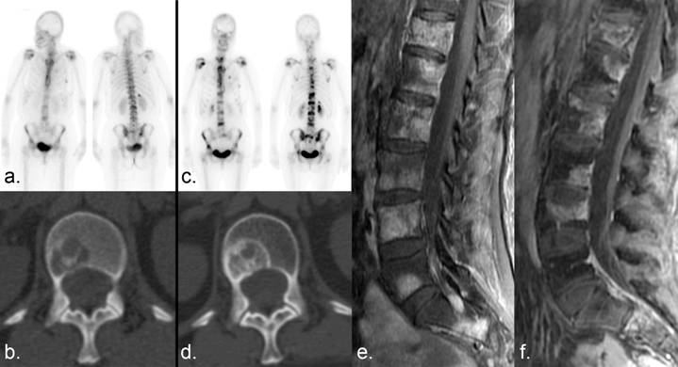
Did “flare” induced by hormonal agents lead to deleterious radium-223 effects on healing bone?

Slide 19
If ‘concomitant” hormonal therapy is used, when should radium-223 be added?
Tumor
Size
At the start or with responding patients?
Best Response?
Overt progression?
Induction of sclerosis
Early Progression?
Time

Slide 20
Radium-223 Only Goes to Bone!
……..but tumors in other locations cannot be neglected

Slide 21
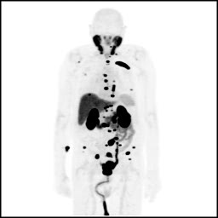
PSMA, highly expressed in prostate cancer, can be targeted with small molecules, antibodies, diabodies, minibodies, etc.
Image Courtesy of Steve Y. Cho (UW) and Martin G. Pomper (JHU)

Slide 22
PSMA binding molecules can be chelated to therapeutic agents, such as Lu-177, Bi-213, Ac-225, etc.
Chelator
Chelator
Chatolic et al. Theragnostics 6:849, 2016

Slide 23
Phase III
in near term planning
First cycle Second Cycle

Slide 24
Alphas may be better than betas….. so we need tumor targeted alpha emitters

Slide 25
Radio-conjugates: PSMA targeted alpha emitters (Actinium-225) as 9th line treatment
Kratochwil et a. J Nuc Med 57: 1-4, 2016

Slide 26
Explorations with Targeted Radiation
Small molecules, antibodies, more…..
Radiation with alphas and betas and combos
Radiation and various hormones (abi/enza/apa/daro)
Radiation and patients with DNA repair defects
Radiation and inhibitors of DNA repair (PARP and ATR)
Radiation and high dose testosterone
Radiation and various old/new radiosensitizers
Radiation and immunotherapy (anti-PD-1, etc.)

Slide 27
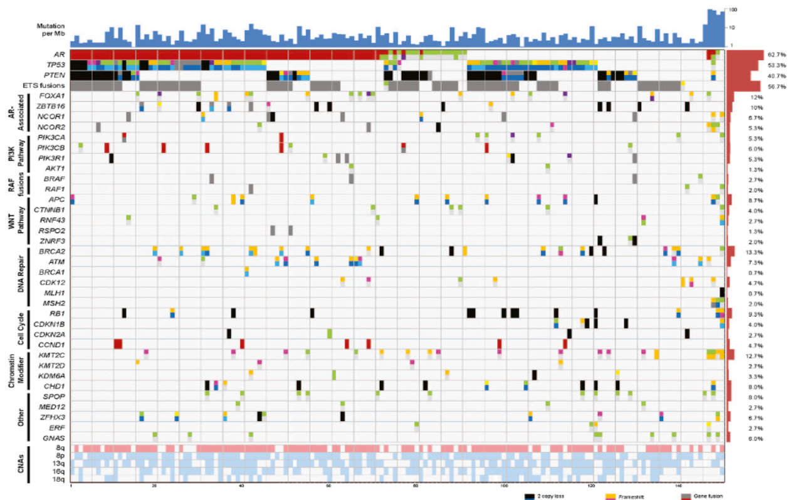
Genetically Heterogeneous Cancers a Challenge for “Molecularly Targeted” Therapy but Radiation Kills Them All!
Berger et al. Nature 470:214-220, 2011
Notes:
27

