Slide 1
Please note, these are the actual video-recorded proceedings from the live CME event and may include the use of trade names and other raw, unedited content.

Slide 2
MODULE 5: Incidence and Management of Toxicities Associated with Immune Checkpoint Inhibitors; Autoimmune Contraindications to Treatment
Elizabeth R. Plimack MD MS
Chief, Division of Genitourinary Medical Oncology
Director, Genitourinary Clinical Research
Associate Professor, Hematology/Oncology
Fox Chase Cancer Center, Temple Health

Slide 3
Disclosures
Advisory Committee | AstraZeneca Pharmaceuticals LP, Bristol-Myers Squibb Company, Exelixis Inc, Genentech BioOncology, Horizon Pharma, Inovio Pharmaceuticals Inc, Lilly, Novartis, Pfizer Inc, Roche Laboratories Inc
Contracted Research | Acceleron Pharma, Agensys Inc, a subsidiary of Astellas Pharma US, AstraZeneca Pharmaceuticals LP, Bristol-Myers Squibb Company, Merck, Peloton Therapeutics Inc, Pfizer Inc

Slide 4
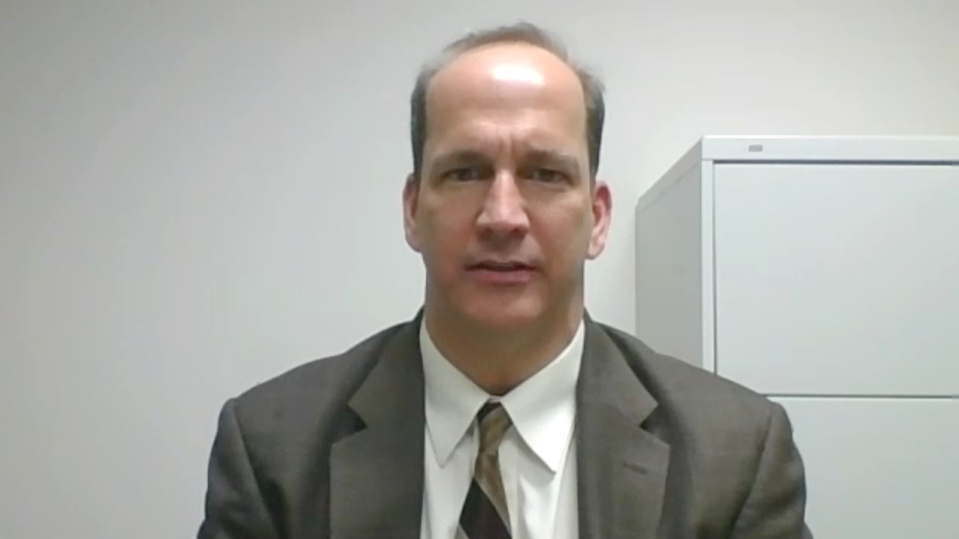
Case presentation 9: Dr Favaro
77-year-old man
Papillary carcinoma of the kidney: PDGFR-beta, VEGFA amplification
Extensive retroperitoneal lymphadenopathy
Obese (280 lbs)
Sunitinib → progression
Checkpoint inhibitor → response

Slide 5
PET/CT prior to treatment

Slide 6
PET/CT after treatment

Slide 7
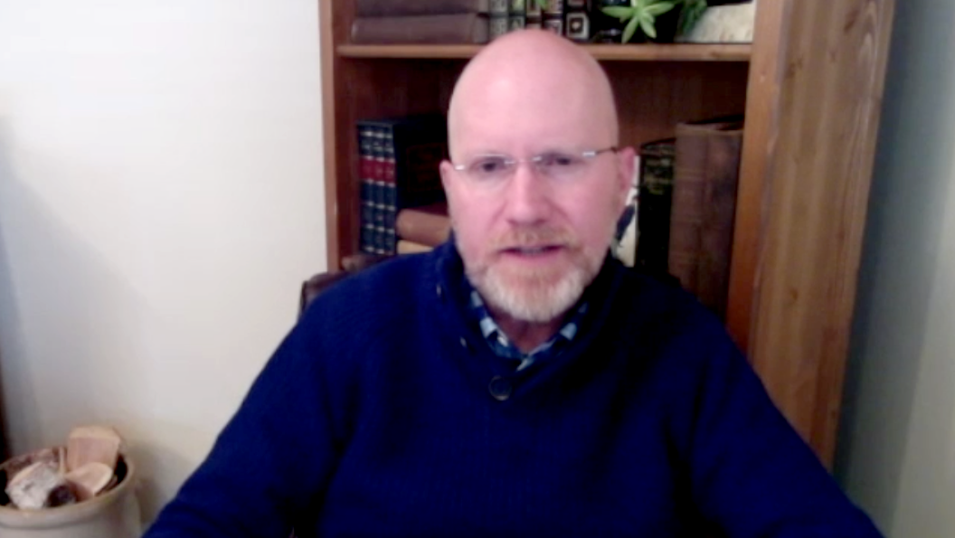
Case presentation 10: Dr Rupard
65-year-old woman
7/2016: RCC, liver and lung metastases
pazopanib
9/2016: L nephrectomy
12/2016: progression on imaging
Checkpoint inhibitor started

Slide 8
Name an -itis, Any -itis
Organ System | Reported Toxicities
Integumentary | Hives, Eczema, Vitiligo, Pemphigus, Lichenoid Reactions
Gastrointestinal | Enterocolitis, Pancreatitis, Gastritis, Celiac Disease
Hepatic | Autoimmune Hepatitis, Sclerosing Cholangitis, Primary Biliary Cirrhosis
Renal | Interstitial Nephritis, Nephrotic Syndrome, Autoimmune Nephropathy
Pulmonary | Pneumonitis, Interstitial Lung Disease, Pleuritis
Cardiac | Myocarditis, Pericarditis, Cardiomyopathy
Endocrine | Hypo/Hyperthyroidism, Hypophysitis, Adrenal Insufficiency
Neurologic | Encephalitis, Guillain-Barre Syndrome, Myasthenia Gravis, Mononeuritis, Autoimmune inner ear disease
Hematologic | Hemolytic Anemia, Immune Thrombocytopenic Purpura, Thrombotic Thrombocytopenic Purpura, Hemophilia, Evans Syndrome
Rheumatologic | Polyarthritis, Systemic Lupus Erythematosus, Antiphospholipid Syndrome
Slide: Matt Zibelman MD

Slide 9
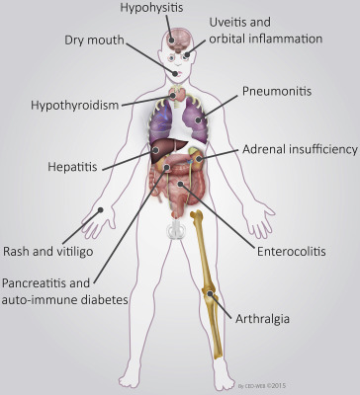
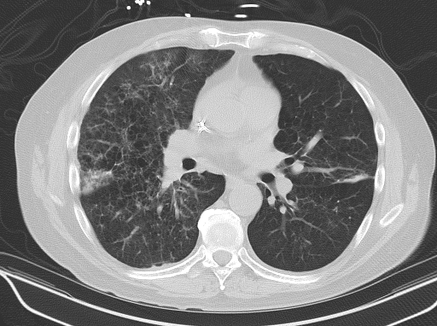
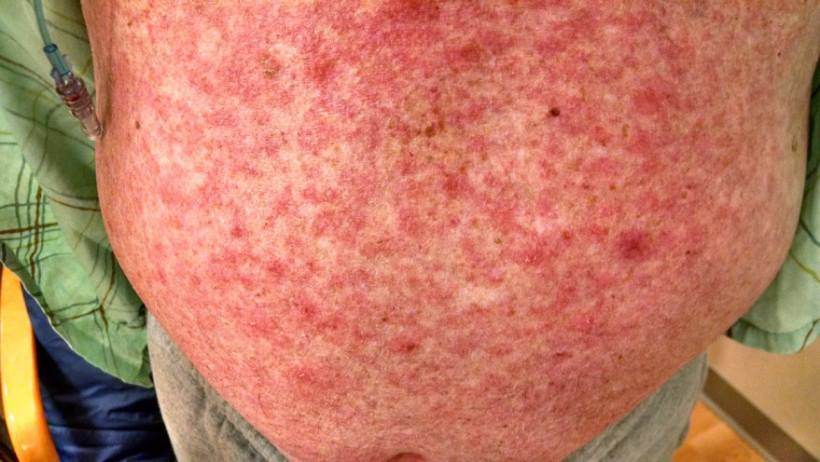
Hypophysitis
Minchot JM, et al. Eur J Cancer. 2016;54:139-148.
Photos: E Plimack

Slide 10
Kinetics of onset and resolution of skin and GI treatment related toxicity
Weber, Jeffrey S., et al. "Safety Profile of Nivolumab Monotherapy: A Pooled Analysis of Patients With Advanced Melanoma." Journal of Clinical Oncology (2016)

Slide 11
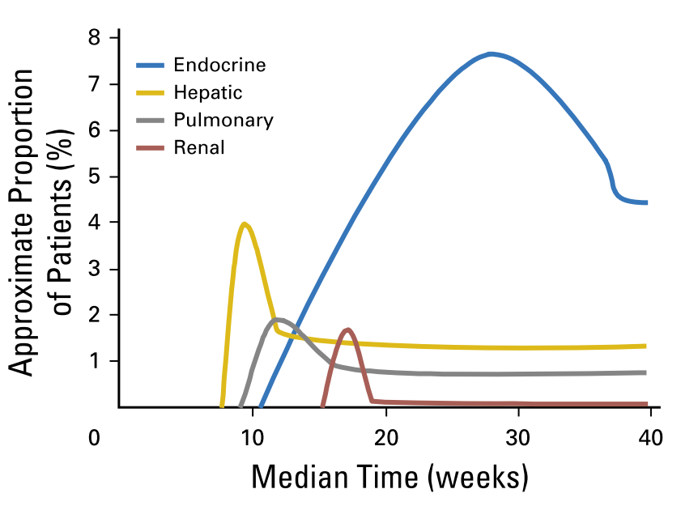
Kinetics of onset and resolution of endocrine, hepatic, pulmonary and renal treatment related toxicity
It is usually appropriate to initiate replacement therapy and continue the checkpoint inhibitor
Weber, Jeffrey S., et al. "Safety Profile of Nivolumab Monotherapy: A Pooled Analysis of Patients With Advanced Melanoma." Journal of Clinical Oncology (2016)

Slide 12
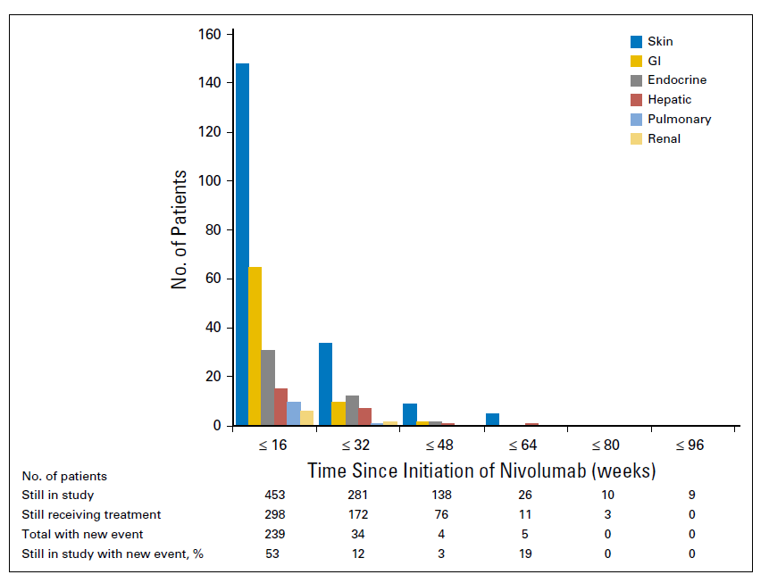
Occurrence of new treatment-related select adverse events of any grade over time
Weber, Jeffrey S., et al. "Safety Profile of Nivolumab Monotherapy: A Pooled Analysis of Patients With Advanced Melanoma." Journal of Clinical Oncology (2016)

Slide 13
576 patients with melanoma treated with single agent nivolumab
10% had severe (grade 3/4) treatment-related adverse effects
24% received systemic immunomodulatory drugs (i.e. steroids)
Receipt of IMs had no effect on response rate
29.8% for those who received IMs versus 31.8 % who did not
Adjusting for number of doses, response rate was higher in pts who experienced treatment related AEs
Do Treatment related AEs predict efficacy?
Do responding patients get more drug and are more prone to AEs?
Weber, Jeffrey S., et al. "Safety Profile of Nivolumab Monotherapy: A Pooled Analysis of Patients With Advanced Melanoma." Journal of Clinical Oncology (2017)

Slide 14
Immune-mediated adverse events on Checkmate 214: Ipi + Nivo in RCC
 | NIVO + IPI N = 547
Category, % | Any grade | Grade 3–4
Rash | 17 | 3
Diarrhea/colitis | 10 | 5
Hepatitis | 7 | 6
Nephritis and renal dysfunction | 5 | 2
Pneumonitis | 4 | 2
Hypersensitivity/infusion reaction | 1 | 0
Hypothyroidism | 19 | <1
Hyperthyroidism | 12 | <1
Adrenal insufficiency | 8 | 3
Hypophysitis | 5 | 3
Thyroiditis | 3 | <1
Diabetes mellitus | 3 | 1
60% of patients treated with NIVO + IPI required systemic corticosteroids for an adverse event
Secondary immunosuppression with infliximab (3%) and mycophenolic acid (1%) was reported

Slide 15
Experience with checkpoint inhibitors in patients with history of autoimmune disease is limited
Trials exclude patients with a history of autoimmune disease
Retrospective/Registry data:
Mayo experience: 6/12 (50%) of patients with pre-existing rheumatological disease treated with ICB experienced irAEs
The French Experience: 20/45 patients (44%) presented with at least one irAE: eleven of these were associated with a pre-existing AID (‘AID flare’). Treatment with anti-PD-1 antibodies was maintained in 15 of the 20 patients with an irAE.
Careful risk/benefit discussion with patients is important
Richter, et al. Cancer immunotherapy in patients with preexisting rheumatologic disease: the Mayo Clinic experience. Arthritis Rheumatol. (2018)
Danlos., et al. "Safety and efficacy of anti-programmed death 1 antibodies in patients with cancer and pre-existing autoimmune or inflammatory disease." Eur J Cancer (2017)

Slide 16
Work-up of a Suspected irAE
Patients with new or worsening toxicities should be evaluated for an irAE, particularly once other causes such as disease progression have been excluded
Work-up should be tailored to the signs or symptoms in question, and when possible, performed in conjunction with specialists in the relevant field
Do not delay potentially life-saving immunosuppressive treatment while a work-up is being pursued
Patients with signs or symptoms warranting hospital admission or that are potentially life threatening should be treated with corticosteroids at 1-2 mg/kg while the work-up is still under way, if necessary, to minimize treatment-related morbidity

Slide 17
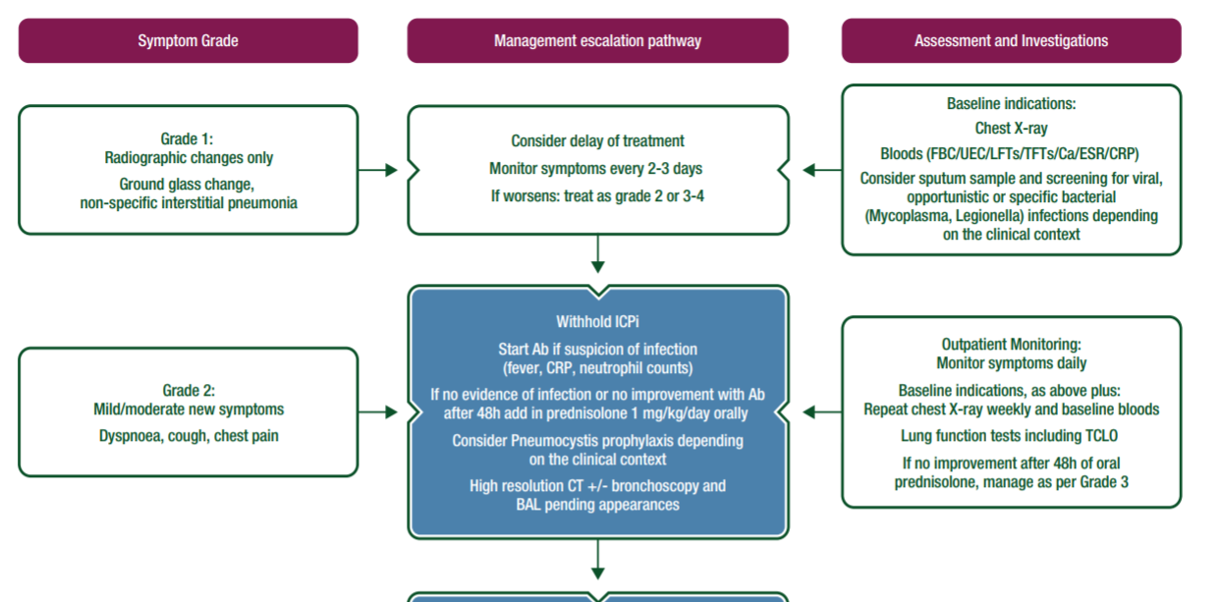
Immune related adverse event management algorithms are available through ESMO and planned through NCCN/ASCO
Excerpt of pneumonitis guidelines from ESMO
Management of toxicities from immunotherapy: ESMO Clinical Practice Guidelines for diagnosis, treatment and follow-up. Annals of Oncology, 2017
http://www.esmo.org/Guidelines/Supportive-and-Palliative-Care/Management-of-Toxicities-from-Immunotherapy

Slide 18
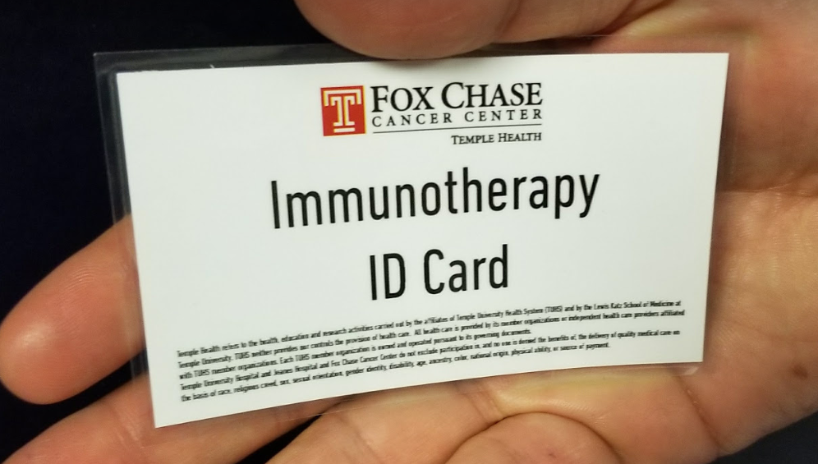
Patient and community education is key

Slide 19
Managing autoimmune AEs: Key Points
Early detection is key
It can be tricky to attribute symptoms to immunotherapy
Most are reversible with immunosuppression (steroids)
Typically start at high dose IV and then taper over 1-3 months
Exception: Adrenal insufficiency and hypothyroid need replacement hydrocortisone/levothyroxine, not immune suppressive doses of steroids.
No evidence that intervening with steroids curtails the antitumor efficacy of the agent
Autoimmune history predicts higher rate of immune related AEs on checkpoint inhibitors

