Slide 1
Please note, these are the actual
video-recorded proceedings from the
live CME event and may include the use of trade names and other raw, unedited content.

Slide 2

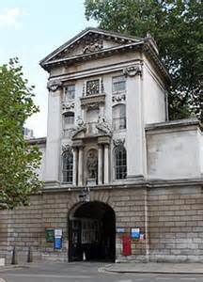
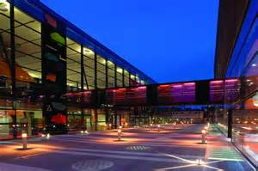

Existing and emerging roles for anti PD-1/PD-L1 antibodies in renal cell carcinoma
Professor Thomas Powles
Director of Barts Cancer Centre,
Renal Cancer Lead for London Cancer

Slide 3
Disclosures
Consulting Agreements | AstraZeneca Pharmaceuticals LP, Bristol-Myers Squibb Company, Merck, Novartis, Pfizer Inc, Roche Laboratories Inc
Contracted Research | AstraZeneca Pharmaceuticals LP, Roche Laboratories Inc

Slide 4
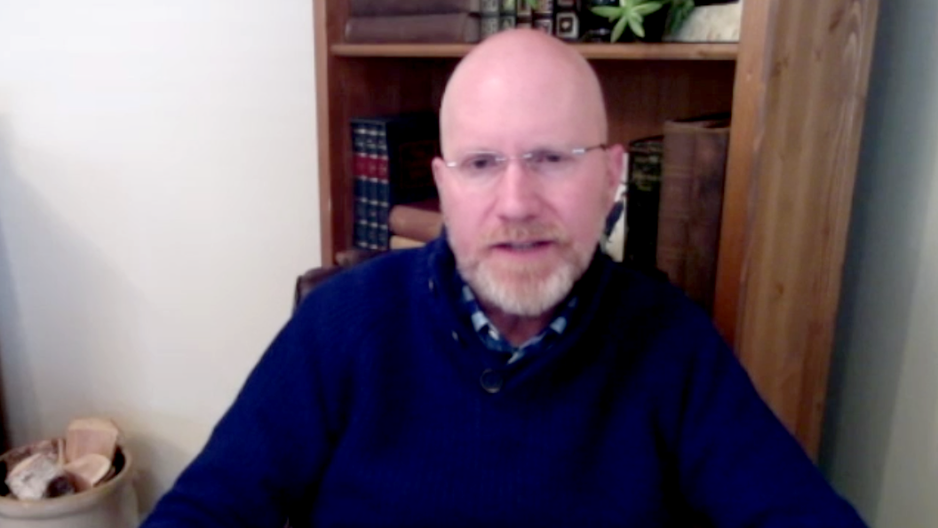
Case presentation 4: Dr Rupard
59-year-old man
10/2017: scapular pain: 13 cm renal mass,
bone, lung and brain mets
Biopsy: clear cell RCC
Radiotherapy to brain and scapula
Pazopanib → pulmonary embolus (placed on rivaroxaban)
1/2018: Evidence of progression on imaging

Slide 5
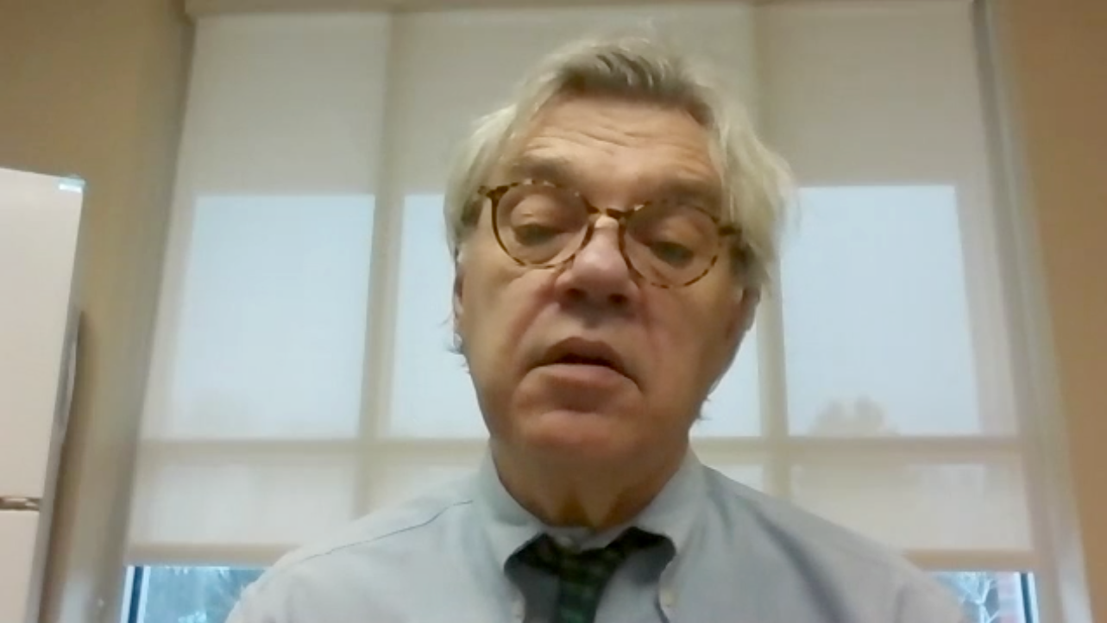
Case presentation 5: Dr Glynn
85-year-old man
11/2005: left nephrectomy for clear cell
renal cell carcinoma
2014: routine follow-up found to have liver
mass: clear cell cancer
Sunitinib: fatigue, hypothyroidism, then progression
10/2016: pazopanib → severe fatigue, anorexia, then progression
7/2017: nivolumab → dramatic improvement in PS
12/2017: progression on imaging

Slide 6
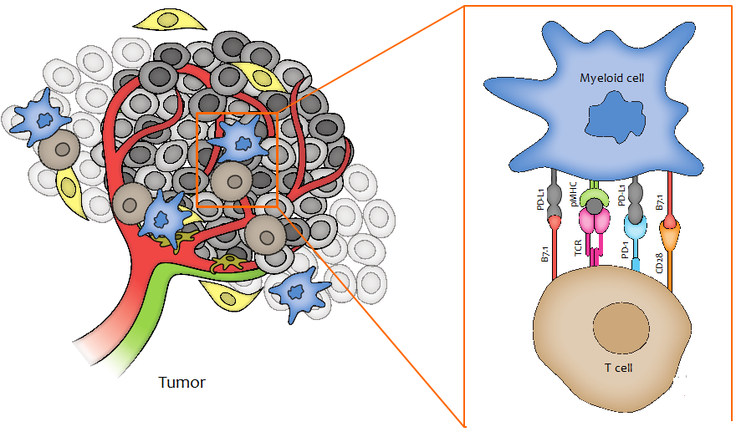
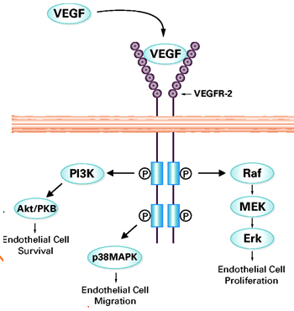
Both VEGF and immune checkpoints are established targets in RCC.
High VEGF levels
via VHL mutations
Prominent immune
infiltration with distinct properties.

Slide 7
CheckMate 214: Study design
CheckMate 214, Motzer et al.
Randomize 1:1
Patients
Treatment
Arm A
3 mg/kg nivolumab IV +
1 mg/kg ipilimumab Q3W for four doses, then
3 mg/kg nivolumab Q2W
Treatment-naïve advanced or metastatic clear-cell RCC
Measurable disease
KPS ≥70%
Tumor tissue available for PD-L1 testing
Stratified by
IMDC prognostic score (favorable vs intermediate vs poor risk)
Region (US vs Canada/ Europe vs rest of world)
Arm B
50 mg sunitinib orally
once daily for 4 weeks
(6-week cycles)
Co-primary endpoints of Response, PFS and OS.
Escudier B et al. ESMO 2017;Abstract LBA5

Slide 8
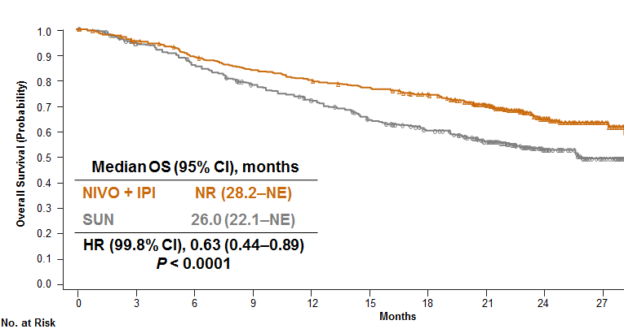
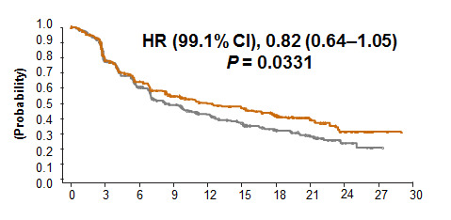
Outcomes in IMDC intermediate/poor risk
 | Response rates
Outcome | NIVO + IPI N = 425 | SUN N = 422
ORRª (95% CI), % | 42 (37–47) | 27 (22–31)
 | P < 0.0001
Progression free survival.
Overall survival.
Months
Escudier B et al. ESMO 2017;Abstract LBA5

Slide 9
Outcomes in Intention to treat population
Median OS (95% CI), months
NIVO + IPI | NR (NE–NE)
SUN | 32.9 (NE–NE)
 | N = 1,096ª
Outcome | NIVO + IPI N = 550 | SUN N = 546
ORR^{b} (95% CI), % | 39 (35–43) | 32 (28–36)
 | P = 0.0191
PFS,^{c} median (95% CI), months | 12.4 (9.9–16.5) | 12.3 (9.8–15.2)
 | HR (99.1% CI), 0.98 (0.79–1.23) P = 0.8498
1
.
0
HR (99.8% CI), 0.68 (0.49–0.95)
P = 0.0003
0
.
9
0
.
8
0
.
7
0
.
6
Overall Survival (Probability)
0
.
5
0
.
4
0
.
3
0
.
2
0
.
1
ª23% of patients in the NIVO + IPI arm and 25% of patients in the SUN arm had tumor PD-L1 expression ≥1%
^{b}IRRC-assessed confirmed ORR by RECIST v1.1
^{c}IRRC-assessed
0
.
0
0
3
6
9
1
2
1
5
1
8
2
1
2
4
2
7
3
0
3
3
No. at Risk
Months
NIVO + IPI
550 |  | 492 |  | 443 |  | 404 |  | 197 |  | 4
546 |  | 471 |  | 402 |  | 334 |  | 173 |  | 6

Slide 10
OS by PD-L1 expression
PD-L1 <1% (n = 562)
PD-L1 ≥1% (n = 214)
1
.
0
1
.
0
0
.
9
0
.
9
0
.
8
0
.
8
0
.
7
0
.
7
0
.
6
0
.
6
Overall Survival (Probability)
0
.
5
0
.
5
0
.
4
0
.
4
0
.
3
Median OS (95% CI), months
NIVO + IPI | NR (28.2–NE)
SUN | NR (24.0–NE)
0
.
3
Median OS (95% CI), months
NIVO + IPI | NR (NE–NE)
SUN | 19.6 (14.8–NE)
0
.
2
0
.
2
Intermediate
and poor risk
0
.
1
HR (95% CI), 0.73 (0.56–0.96)
P = 0.0249
0
.
1
HR (95% CI), 0.45 (0.29–0.71)
P <0.001
0
.
0
0
.
0
0
3
6
9
1
2
1
5
1
8
2
1
2
4
2
7
3
0
3
3
0
3
6
9
1
2
1
5
1
8
2
1
2
4
2
7
3
0
3
3
NIVO + IPI
SUN
No. at Risk
Months
Months
284 |  | 251 |  | 223 |  | 200 |  | 76 |  | 0
278 |  | 239 |  | 198 |  | 157 |  | 61 |  | 1
100 |  | 87 |  | 83 |  | 76 |  | 33 |  | 2
114 |  | 90 |  | 72 |  | 55 |  | 21 |  | 2

Slide 11
VEGF targeted therapies effect tumour immunity via all 3 components.
Effects on cancer cell.
activate
suppress
Hypoxia and effects on vasculature.
activate
suppress
activate
suppress
Effects on the stroma
Manzo A et al JMC 2017

Slide 12
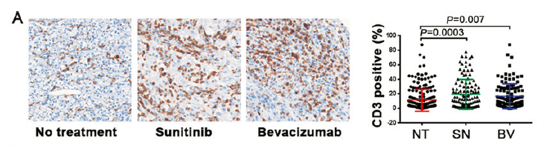
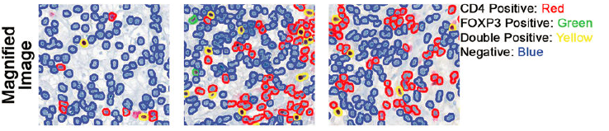
The intratumoral effects of VEGF targeted therapy are complex in vitro.
Liu et al JIC 2015

Slide 13
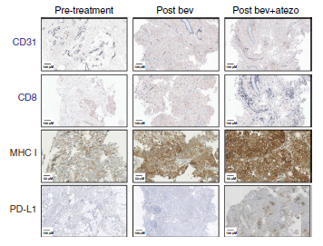
Effects of bevacizumab and atezolizumab on key VEGF and immune parameters
10 patients with metastatic RCC
Biopsy at 3 time points
bev
atezo
Wallin et al Nat Comm 2016

Slide 14
IMmotion150 (Phase II) Trial Design
First-line treatment
Crossover treatment permittedª
Stratification:
Prior nephrectomy
PD-L1 IHC expression
(≥ 5% IC level)
MSKCC risk category
Atezolizumab 1200 mg IV + bevacizumab 15 mg/kg q3w
Treatment naive, locally advanced or metastatic RCC
N = 305
R 1:1:1
Atezolizumab 1200 mg IV q3w
Atezolizumab + bevacizumab
PD
Sunitinib 50 mg (4 wk on, 2 wk off)
Atezolizumab + bevacizumab
IC, tumor-infiltrating immune cells; IRF, independent review facility. Powles et al ESMO 2017. ª Crossover from atezolizumab monotherapy not allowed in Europe.

Slide 15
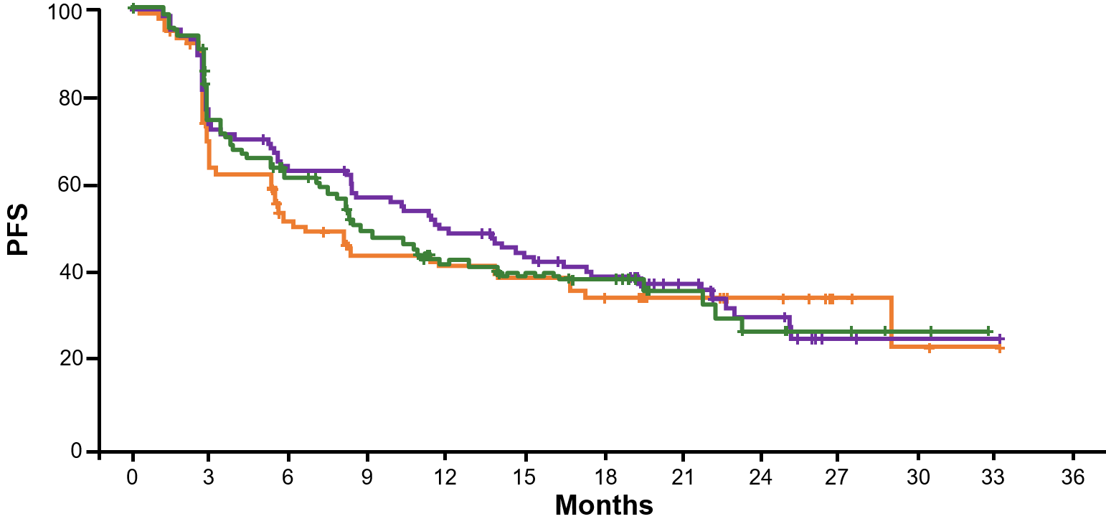
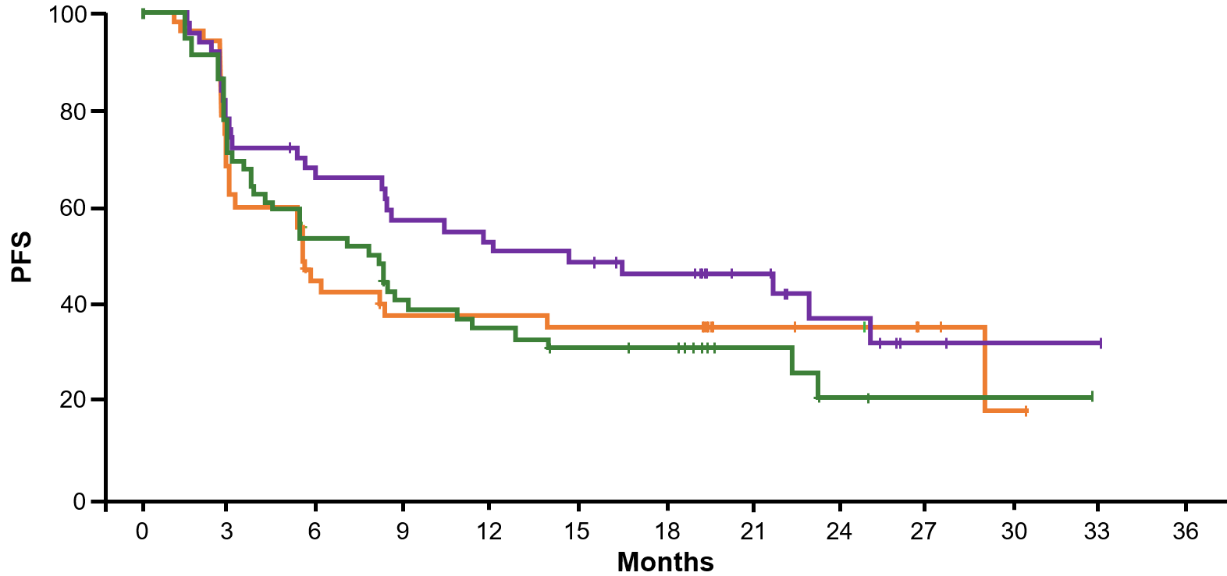
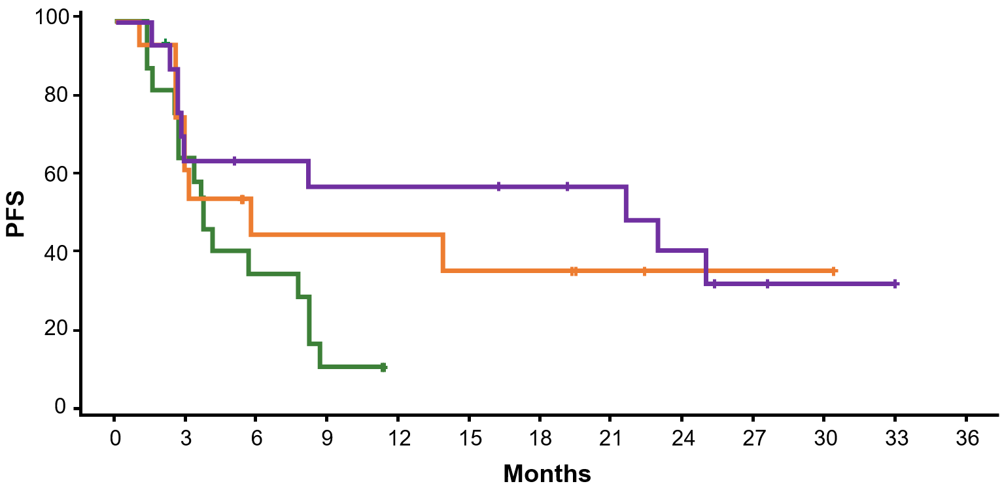
Encouraging Efficacy by PFS of Atezolizumab + Bevacizumab vs Sunitinib in Patients With IC PD-L1 Expression
PFS in ITT
PFS in ≥ 1% PD-L1 IC
Atezo + bev (n = 101)
Atezo + bev (n = 50)
Atezo (n = 103)
Atezo (n = 54)
Sunitinib (n = 101)
Sunitinib (n = 60)
PFS in ≥ 5% PD-L1 IC
Stratified HR (95% CI)
 | ITT | ≥ 1% PD-L1 IC | ≥ 5% PD-L1 IC
Atezo + bev vs sunitinib | 1.00 (0.69, 1.45) | 0.64 (0.38, 1.08) | 0.34 (0.13, 0.91)
Atezo vs sunitinib | 1.19 (0.82, 1.71) | 1.03 (0.63, 1.67) | 0.64 (0.27, 1.54)
Atezo + bev (n = 17)
Atezo (n = 17)
Sunitinib (n = 17)
Responses were observed in both patients with tumors expressing < 1% PD-L1 on IC and ≥ 1% PD-L1 on IC
Atezo, atezolizumab; bev, bevacizumab. IRF-assessed PFS.
McDermott, ASCO GU 2017.

Slide 16
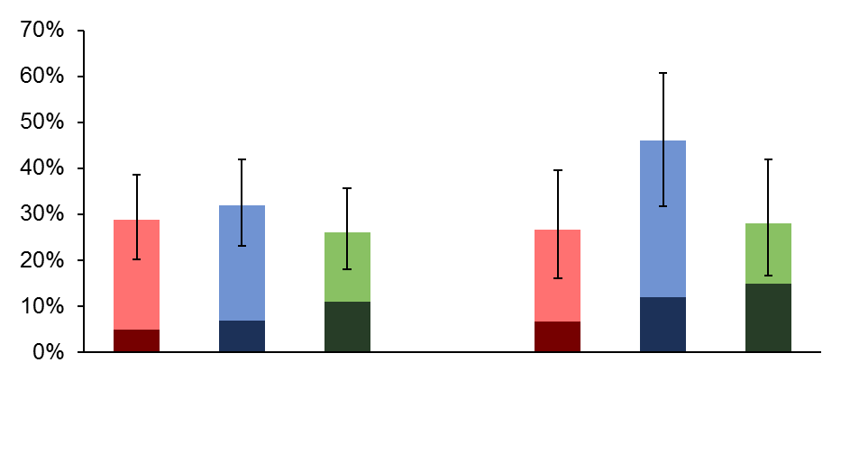
Confirmed IRF-Assessed ORR
ITT
≥ 1% of IC expressing PD-L1
46%
32%
27%
28%
29%
25%
PR
CR
5%
7%
11%
7%
12%
15%
Sunitinib
Atezo
+ bev
Atezo
Sunitinib
Atezo
+ bev
Atezo
75% of responses are ongoing across treatment arms, and the median DOR is not
estimable due to an insufficient number of PFS events in responders
Clinical cut-off, Oct 17, 2016. Median duration of follow-up, 20.7 mo.

Slide 17
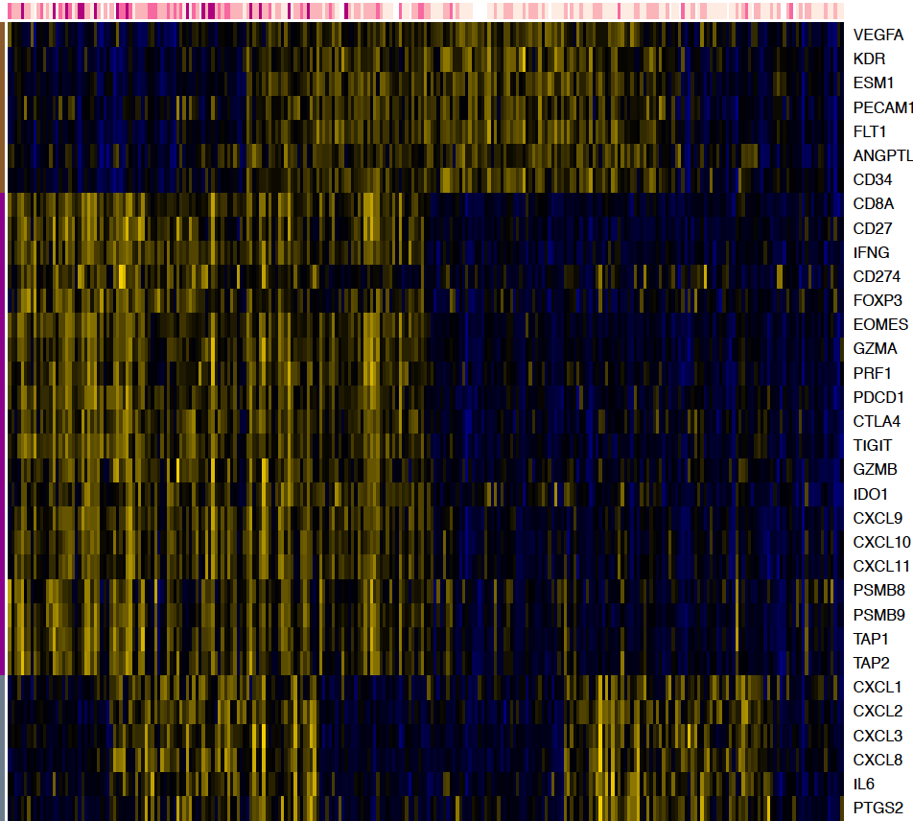

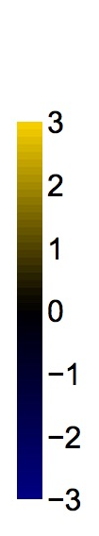
Transcriptome Map of Angiogenesis and Immune-Associated Genes in RCC Tumors
PD-L1 IHC
Angiogenesis
PD-L1 IHCª
IC0
IC1
IC2
IC3
Immune,
Antigen Presentation
3
2
1
0
-1
-2
Myeloid Inflammation
-3
Brauer, Clin Cancer Res. 2012; Herbst, Nature 2014; Powles, SITC 2015; Fehrenbacher, Lancet 2016.
ª PD-L1 expression scored as IC3 (≥ 10%), IC2 (≥ 5% and < 10%), IC1 (≥ 1% and < 5%) or IC0 (< 1%).

Slide 18
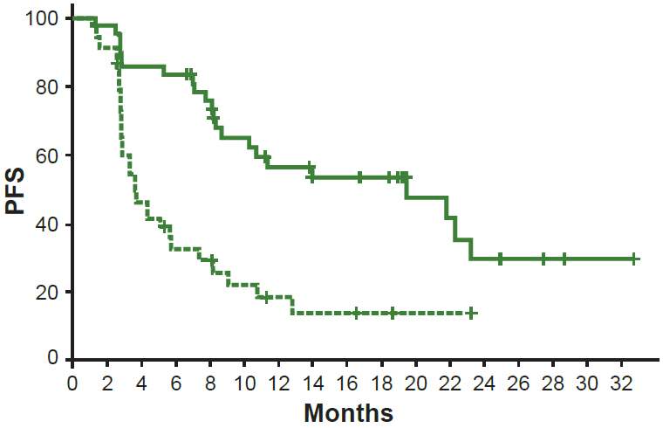
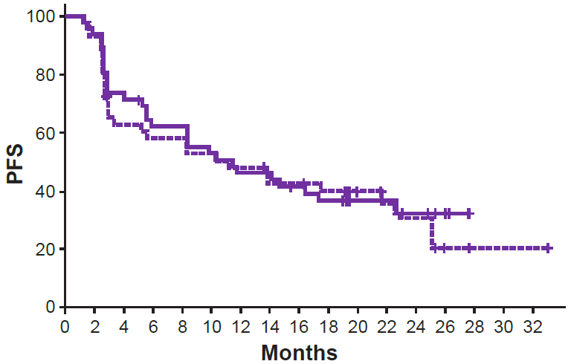
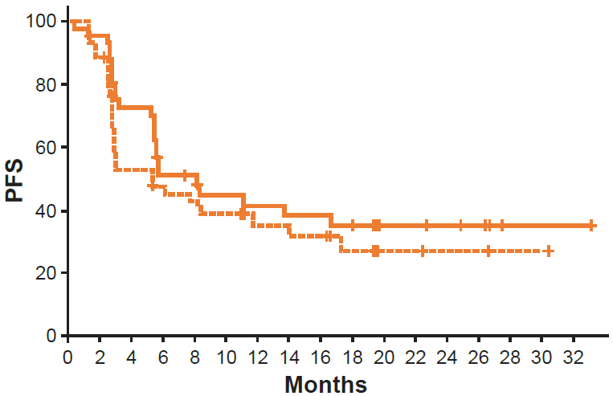
Sunitinib Demonstrated Improved PFS in Angiogenesis^{High} Subset vs Angiogenesis^{Low} Subset
Angiogenesis
Sunitinib
Atezolizumab + Bevacizumab
Atezolizumab
High (n = 44)
Low (n = 45)
High (n = 45)
Low (n = 43)
High (n = 42)
Low (n = 44)
Sunitinib
 | HR | 95% CI
Angiogenesis (High vs Low) | 0.31 | (0.18, 0.55)
Atezolizumab + Bevacizumab
 | HR | 95% CI
Angiogenesis (High vs Low) | 0.90 | (0.54, 1.51)
Atezolizumab
 | HR | 95% CI
Angiogenesis (High vs Low) | 0.74 | (0.42, 1.28)
Angiogenesis gene signature: VEGFA, KDR, ESM1, PECAM1, ANGPTL4, CD34.
Angiogenesis High: ≥ median expression, Angiogenesis Low: < median expression.

Slide 19
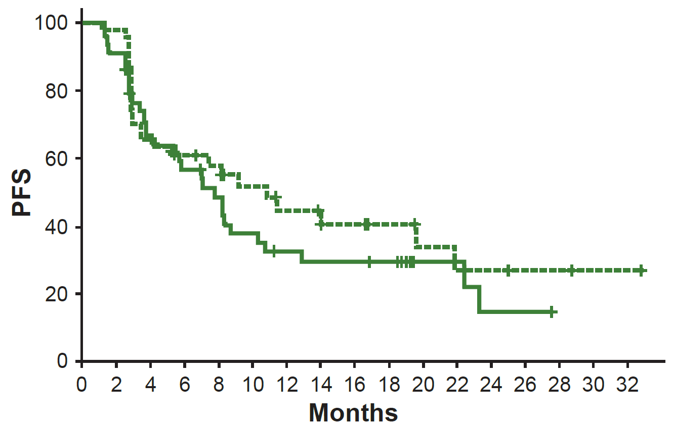
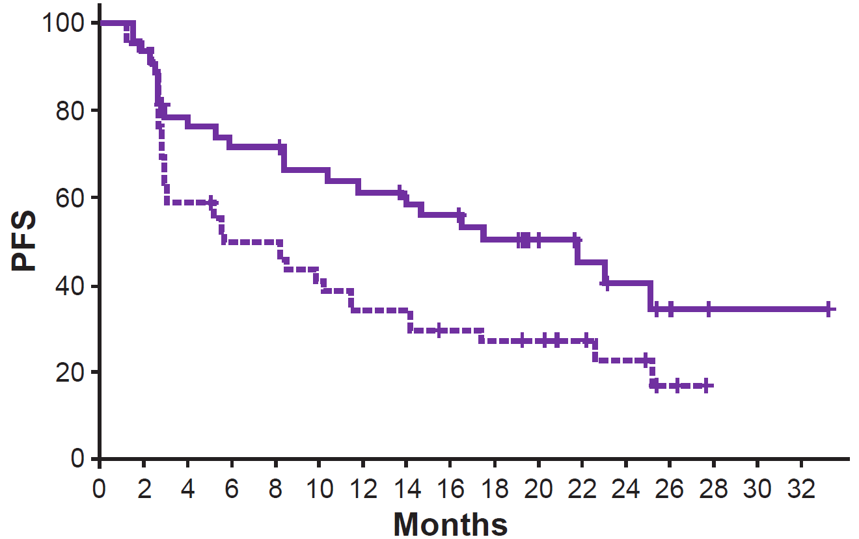
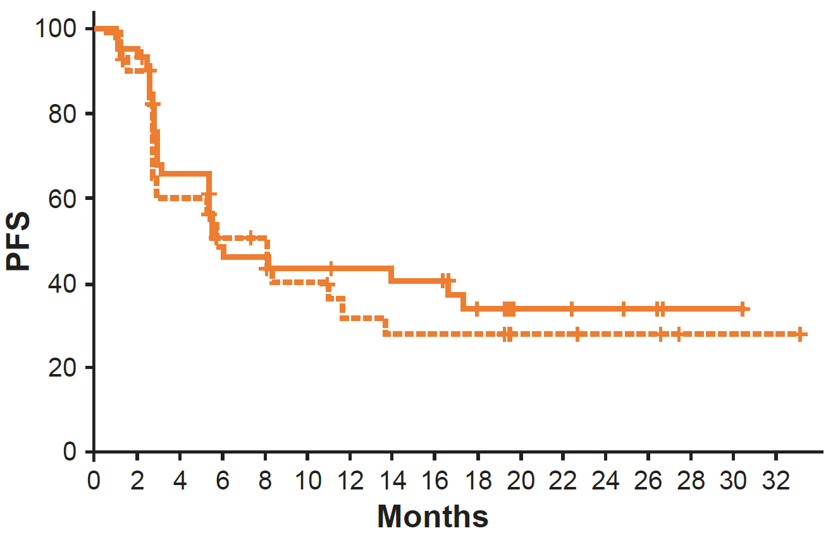
Atezolizumab and Bevacizumab Demonstrated Improved PFS in T-Effector^{High} Subset vs T-Effector^{Low} Subset
Immune
Sunitinib
Atezolizumab + Bevacizumab
Atezolizumab
High (n = 43)
Low (n = 46)
High (n = 42)
Low (n = 46)
High (n = 46)
Low (n = 40)
Sunitinib
 | HR | 95% CI
T-effector (High vs Low) | 1.31 | (0.77, 2.23)
Atezolizumab + Bevacizumab
 | HR | 95% CI
T-effector (High vs Low) | 0.50 | (0.30, 0.86)
Atezolizumab
 | HR | 95% CI
T-effector (High vs Low) | 0.83 | (0.48, 1.45)
T-effector gene signature: CD8A, EOMES, PRF1, IFNG, CD274.
T-effector High: ≥ median expression, T-effector Low: < median expression.

Slide 20
The runners and riders
KEYNOTE-426 (NCT02853331)
axitinib + prembolizumab
1L advanced/metastatic
N=880
R
sunitinib
Co-primary endpoints: PFS and OS
Javelin100 (NCT02516241)
axitinib + avelumab
1L advanced/metastatic
N=680
R
Primary endpoint: PFS and OS
sunitinib
lenvatinib + pembrolizumab
CLEAR trial
1L metastatic
N=850
lenvatinib + everolimus
R
Co-primary endpoints: PFS and OS
sunitinib

Slide 21
Summary
Single agent data shows significant activity with OS in the VEGF refractory setting and responses in the front line setting
The combination of ipilimumab and nivolumab show significant efficacy advantage over sunitinib (RR and OS). Its also showed good safety and quality of life data. This appears limited to the IMDC intermediate and good risk population.
The PD-L1 biomarker is inconsistent but appears more discriminatory in the front line setting with the CTLA-4/PD-L1 combination.
Atezolizumab and bevacizumab is active, especially in the PD-L1 biomarker in exploratory phase II studies. This is being formally tested in IMmotion 151.
Other combinations of VEGF TKI and PD-1/PD-L1 therapies are in randomised phase III studies. PFS results are expected to be good.
The degree to which VEGF targeted therapy has immunogenic effects will be important in long term durable remission results.

