Slide 1
Please note, these are the actual video-recorded proceedings from the live CME event and may include the use of trade names and other raw, unedited content.

Slide 2
RTP at GU ASCO 2018: Prostate Cancer: San Francisco Friday, February 9th, 2018 MODULE 3: Immune Checkpoint Inhibition in Prostate Cancer
David I. Quinn
MBBS (Hons) PhD FRACP FACP
Associate Professor of Medicine
Chief, Section of GU Medical Oncology
Division of Medical Oncology
Medical Director, Norris Cancer Hospital and Clinics
Kenneth J. Norris Comprehensive Cancer Center
Keck School of Medicine at
University of Southern California
diquinn@med.usc.edu

Slide 3
Disclosures
Advisory Committee | Astellas Pharma Global Development Inc, AstraZeneca Pharmaceuticals LP, Bayer HealthCare Pharmaceuticals, Bristol-Myers Squibb Company, Dendreon Pharmaceuticals Inc, Exelixis Inc, Genentech BioOncology, Janssen Biotech Inc, Merck, Pfizer Inc, Sanofi Genzyme
Consulting Agreements | Astellas Pharma Global Development Inc, AstraZeneca Pharmaceuticals LP, Bayer HealthCare Pharmaceuticals, Bristol-Myers Squibb Company, Celgene Corporation, Dendreon Pharmaceuticals Inc, Exelixis Inc, Genentech BioOncology, Janssen Biotech Inc, Merck, Pfizer Inc, Sanofi Genzyme

Slide 4
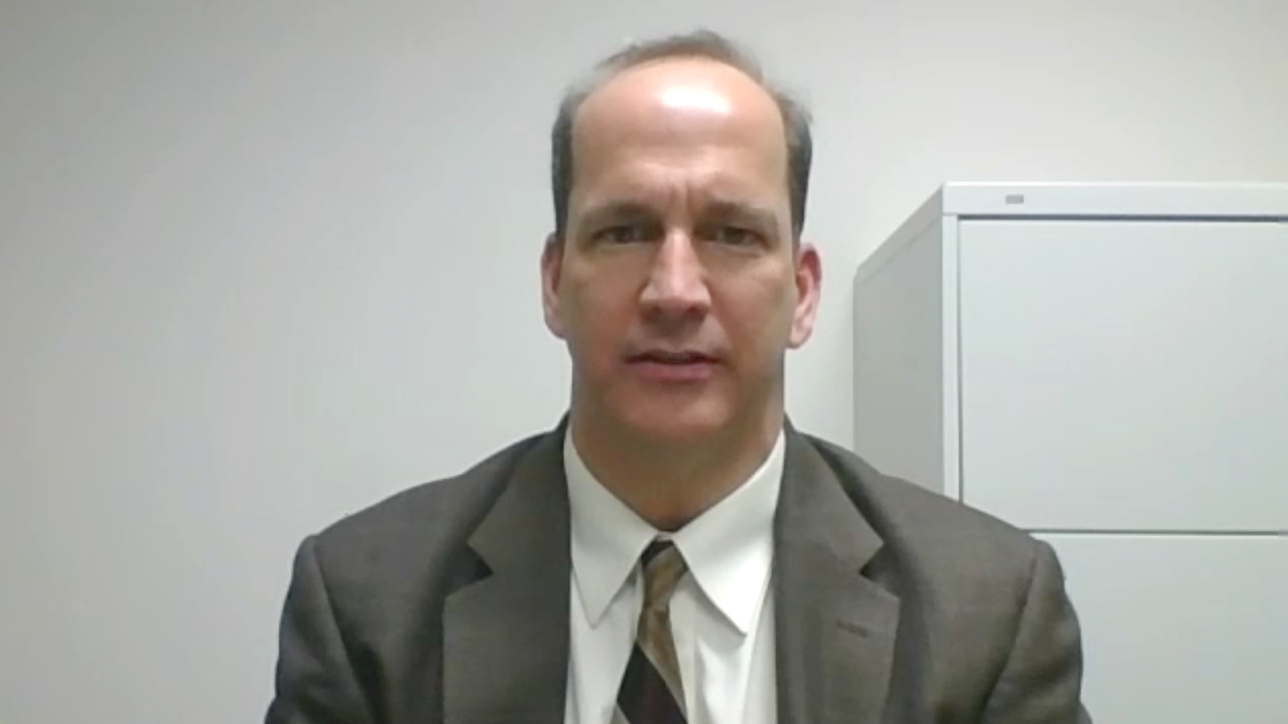
Case presentation 6: Dr Favaro
59-year-old man
2012: locally advanced Gleason 9 prostate cancer: radiotherapy and ADT
2014: metastatic disease
Treated sequentially with multiple lines of therapy, including abiraterone, sipuleucel-T, docetaxel, cabazitaxel
2017: disease progression and lymph node biopsy performed

Slide 5
MSI-high prostate cancer
Pembrolizumab Approval
Localized at about 2%
mCRPC 5-6%
Do we test every prostate cancer patient?
Johns Hopkins study
screened by MSH2 immunohistochemistry with confirmation by next-generation sequencing
8% in Gleason grade 5/5
0.4% in others
NEPC 5%
Lemery S et al. N Engl J Med 2017;377:1409-1412
Pritchard C et al Nature Comm 2014
GuEdes LB Clin Cancer research 23; 6863-74 2017.

Slide 6
High prevalence of mismatch repair deficiency in prostate cancers diagnosed in mismatch repair gene mutation carriers from the colon cancer family registry
whether prostate cancer is part of the Lynch syndrome spectrum of tumors is unresolved.
Prostate cancers (mean age 62 yrs) from 32 MMR mutation carriers (23 MSH2, 5 MLH1 and 4 MSH6) from Australasian, Mayo Clinic and Ontario sites of Colon Cancer Family Registry
immunohistochemical loss of MMR protein expression and high levels of microsatellite instability; MSI-H.
Tumor MMR-deficiency was observed for 22 cases [69 %; 95 % CI 50-83 %],
highest prevalence of MMR-deficiency in tumors from MSH2 mutation carriers (19/23, 83 %)
compared with MLH1 and MSH6 carriers combined (3/9, 33 %; p = 0.01)
mutation carriers are at 3.2-fold (95 % CI 2.0-6.3) increased risk of prostate cancer, and when assessed by gene, the relative risk was greatest for MSH2 carriers (5.8, 95 % CI 2.6-20.9). Prostate cancer was the first or only diagnosed tumor in 37 % of carriers
Rosty C et al. Fam Cancer 13(4):573-82 2014

Slide 7
Quinn’s current approach
Lynch family or with suggestive history – early prostate screening and include in pedigree
Prostate cancer patients with Gleason grade adenocarcinoma or small cell / NEPC – screen
IHC methods are adequate for screening, confirm with NGS and Genetics consult for pedigree and germline

Slide 8
Why don’t prostate cancers seem to respond to PD-1/PD-L1 blockade like other cancers?
Theories:
Lower mutational burden
Slower growing - respond to vaccine type therapy like sipuleucel-T or PROSTVAC but not CPIs
Androgen receptor blockade produces an anergic state (perhaps until late in the disease when mutational burden does rise)
Only special populations respond: MSI-H, DDR germline, ?high PD-L1, Other immunological characteristics

Slide 9
Slide 2
Presented By Emma Reilly at 2018 ASCO-SITC Clinical Immuno-Oncology Symposium

Slide 10
DNA damage repair deficiency and activation of cGAS-STING
Presented By Emma Reilly at 2018 ASCO-SITC Clinical Immuno-Oncology Symposium

Slide 11
The Prostate Cancer Metastatic Assay
PCM assay characterizes a set of early prostate cancers that express genes associated with CRPC and that have poor outcomes: cluster 4 is associated with the worst outcome
Presented By Emma Reilly at 2018 ASCO-SITC Clinical Immuno-Oncology Symposium

Slide 12
Metastatic Biology <br />Group and Immune <br />Response
Presented By Emma Reilly at 2018 ASCO-SITC Clinical Immuno-Oncology Symposium

Slide 13
Metastatic Immune Subgroup associated with poor prognosis
Presented By Emma Reilly at 2018 ASCO-SITC Clinical Immuno-Oncology Symposium

Slide 14
Slide 10
PCM assay may represent a way for early identification of patients that may respond to immune and DNA damaging agents
Presented By Emma Reilly at 2018 ASCO-SITC Clinical Immuno-Oncology Symposium

Slide 15
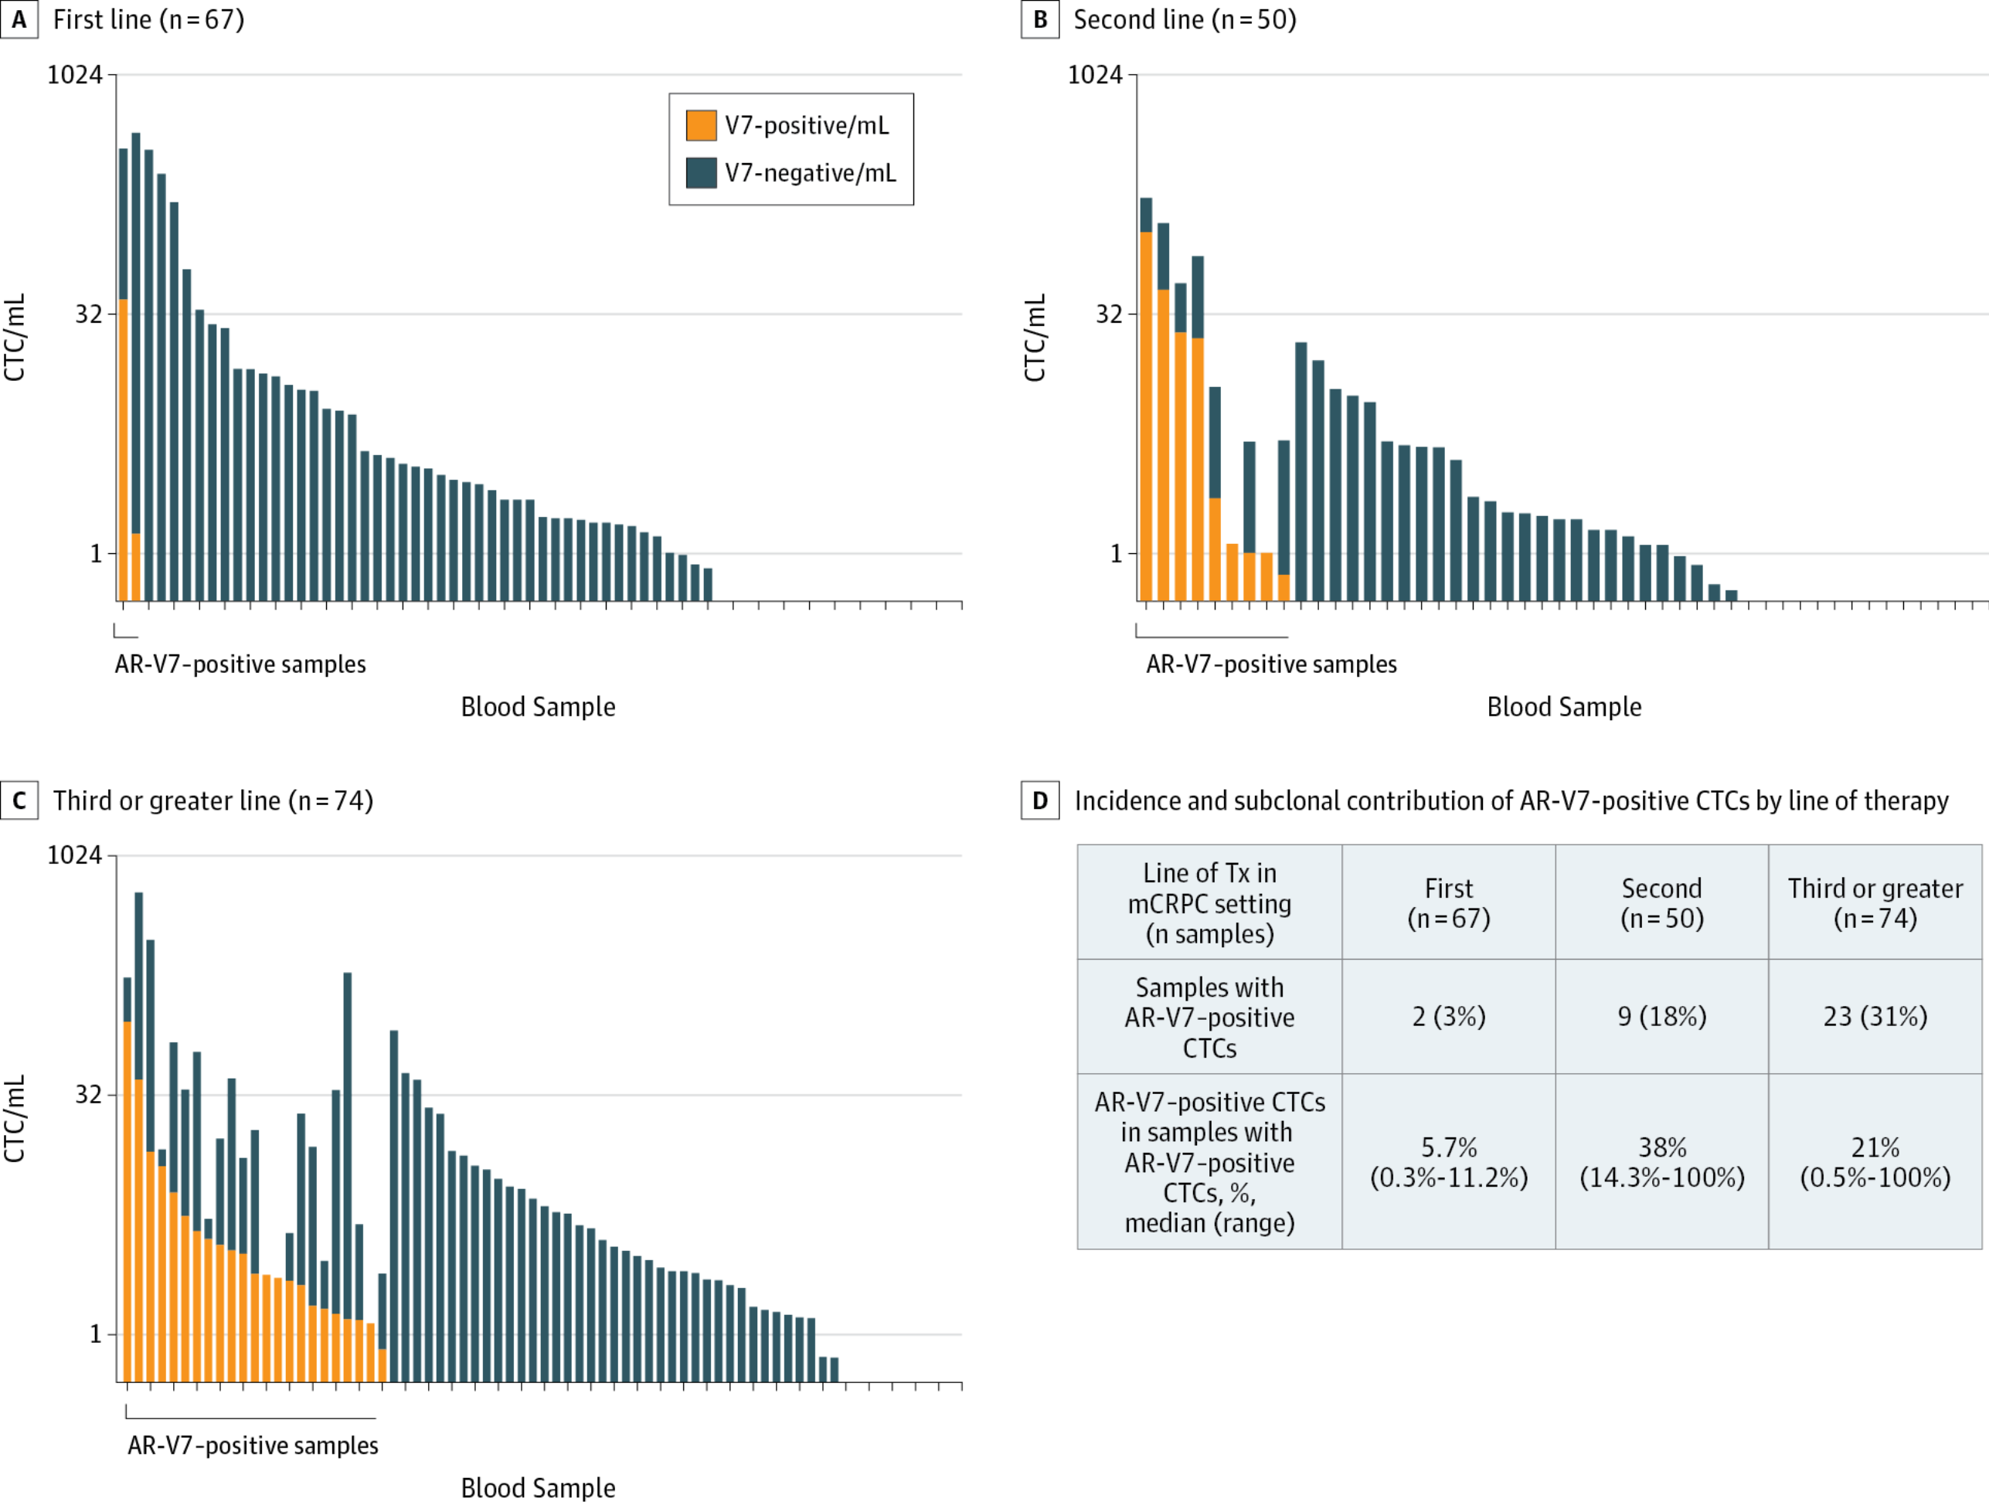
Prevalence and Frequency of AR-V7 CTC Positivity by Line of Therapy: The burden of intact, non-apoptotic CTCs
Association of AR-V7 on Circulating Tumor Cells as a Treatment-Specific Biomarker With Outcomes and Survival in Castration-Resistant Prostate Cancer. JAMA Oncol. 2016;2(11):1441-1449. doi:10.1001/jamaoncol.2016.1828
Copyright © 2017 American Medical Association. All rights reserved.

Slide 16
Overall Survival
Presented By John Silberstein at 2017 Genitourinary Cancers Symposium

Slide 17
Addition of Pembrolizumab Upon Progression on Enzalutamide in Men with mCRPC
Julie Graff, MD
Assistant Professor Knight Cancer Institute
Oregon Health & Science University
Staff Oncologist VA Portland Health Care System

Slide 18
Clinical Factors: PSA (every 3-6 weeks), Imaging every 12 weeks (T99 Nuclear Bone Scan, CT scan chest/abdomen/pelvis.
Tumor Microenvironment: Tumor at baseline, at 12 weeks and at progression.
ENROLLMENT
Genetic Factors: Tumor and normal sequencing at baseline and at progression.
Host Immunological System Fitness: PBMCs, cytokines at baseline, every 3 weeks on pembrolizumab and progression.

Slide 19
Responder Details
Responder | Cycle 1 | PSA (ng/ml) every 3-weeks and nadir | Measurable Disease at Baseline | Best Radiologic Response | MSI
1 | April 2015 | 70.65 → 11.11 → 1.18 → 0.11 → 0.08 | Yes (lymph) | PR | present
2 | October 2015 | 46.09 → 41.22 → 12.99 → 9.89 → 0.02 | No | n/a | n/a
3 | January 2016 | 2502.75 → 1.26 → 0.07 →0.01 → <0.01 | Yes (liver) | PR | absent
4 | March 2016 | 82.43 → 17.34 → 0.3 → 0.01 | No | n/a | n/a
5 | June 2016 | 250 → 88.69 → 5.1 → 0.43 → 0.18 | Yes (liver) | PR | absent
None of the responders has required additional therapy.

Slide 20
Progress?
Expanded the study with another 30 patients (58 total).
tumor biopsies on all of the 30 additional patients.
sequencing tumors, monitoring peripheral immune response, examining tumor infiltrating lymphocytes, monitoring cytokines and checking changes in antibody levels and targets.
Report submitted and being considered for publication at this time
Possible Phase III study to come.

Slide 21
Questions and comments?
Is ongoing AR blockade important?
Increasing AR splicing and amplification are associated with rising mutation number and TMB
What is occurring immunologically in parallel?
Are responses driven by “special populations” harboring altered BRCA, ATM, mismatch etc?

Slide 22
Select Ongoing Trials of Checkpoint Inhibitors in mCRPC
Trial | Phase | Setting | No. of Patients | Treatment Arms
CheckMate 650 | II | mCRPC | 90 | Nivolumab + Ipilimumab
NCT02499835 | I/II | mCRPC | 32 | pTVG-HP + Pembrolizumab pTVG-HP → Pembrolizumab
IMbassador250 | III | mCRPC | 730 | Atezolizumab + Enzalutamide Enzalutamide
KeyNote-028 | I | Adv solid cancers | 477 | Pembrolizumab
KeyNote-199 | II | mCRPC | 370 | Cohort 1-3: Docetaxel-treated: Pembrolizumab Cohort 4-5: Progressing on Enza: Pembrolizumab + Enzalutamide
KeyNote-365 | I | mCRPC | 210 | Cohort 1: Pembrolizumab + Olaparib Cohort 2: Pembrolizumab + Docetaxel Cohort 3: Pembrolizumab + Enzalutamide
www.clinicaltrials.gov, Accessed February 9, 2018

