Slide 1
Please note, these are the actual
video-recorded proceedings from the
live CME event and may include the use of trade names and other raw, unedited content.

Slide 2

Molecular testing in clinical practice:
CAP, IASLC and AMP Updated Molecular
Testing Guideline for the Selection of Lung
Cancer Patients for Treatment with Targeted Tyrosine Kinase Inhibitors
Anne S Tsao, MD
Professor
Director, Mesothelioma Program
Director, Thoracic Chemo-Radiation Program
Department of Thoracic/Head and Neck Medical Oncology
The University of Texas
MD Anderson Cancer Center
Houston, Texas

Slide 3
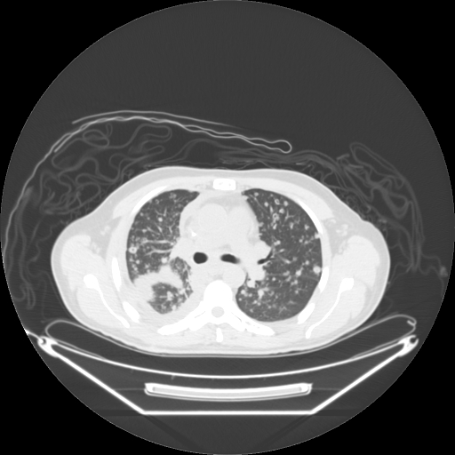
Case: 54 year old Hispanic male never-smoker
Labs: Hgb 12
Vitals: normal
Physical exam: normal
ECOG PS 1
Clinical: Received a pre-op knee surgery CxR which showed a right lung abnormality. Has a mild cough and slight DOE but otherwise no symptoms.
PET/CT demonstrates bilateral diffuse pulmonary nodules, liver mets, adrenal mets, diffuse wide-spread bone mets, right pleural effusion.
Thoracentesis of right lung shows adenocarcinoma.
Pathology: NSCLC - adenocarcinoma
Immunohistochemistry: PD-L1 IHC 60%
Molecular profiling: Pending

Slide 4
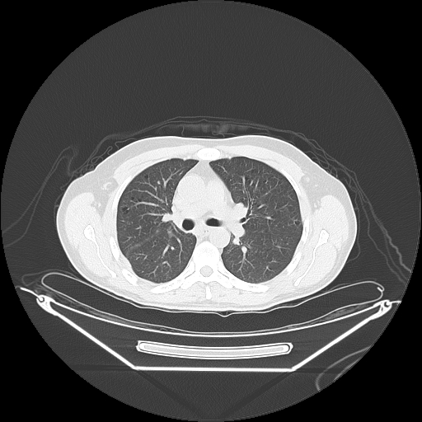
Case: 54 year old Hispanic male Never-smoker Outcome
Pathology: NSCLC - adenocarcinoma
Immunohistochemistry: PD-L1 IHC 75%
Molecular profiling: EGFR exon 21 L858R mutation
After 3 months of erlotinib, he has a near CR
After 1.8 years of erlotinib, he has new liver lesions. He is asymptomatic and has no LFT elevation.

Slide 5


Molecular Testing in Clinical Practice:
CAP-IASLC-AMP Updated Guidelines for Molecular Testing and Targeted Therapies in NSCLC
Anne S. Tsao, M.D.
Professor
Director, Mesothelioma Program
Director, Thoracic Chemo-XRT Program
March 2018
The University of Texas
MD ANDERSON
Department of Thoracic/Head & Neck
Medical Oncology
CANCER CENTER

Slide 6
Disclosures
Advisory Committee | Boehringer Ingelheim Pharmaceuticals Inc, Bristol-Myers Squibb Company, EMD Serono Inc, Genentech BioOncology, Lilly, Merck, Novartis, Roche Laboratories Inc, Takeda Oncology
Contracted Research | Boehringer Ingelheim Pharmaceuticals Inc, Bristol-Myers Squibb Company, Genentech BioOncology, Lilly, Merck

Slide 7
Outline
Frontline NSCLC Treatment Algorithm 2018
Background
CAP-IASLC-AMP Guidelines for Testing
2013 Continued Recommendations
2017 Update
Case
Frontline NSCLC

Slide 8
Frontline Histology and Molecular Profiling 2018
NSCLC PATIENT
PD-L1 IHC (-) or < 50%
SCC
Any histology but no actionable mutation
PD-L1 IHC (+) > 50%
Non-SCC
No actionable
Mutations and PD-L1 < 50%
Avoid pemetrexed or bevacizumab, consider necitumumab + cis/gem
Pembrolizumab
Platinum-pemetrexed-pembrolizumab
MET Exon 14 skip mutation
Adenocarcinoma
EGFR
Crizotinib
RET
ROS1
BRAF V600E
EML 4 ALK
Osimertinib, Erlotinib,
Gefitinib, Afatinib
Cabozantinib, Vandetanib
Crizotinib
Dabrafenib + Trametinib
Crizotinib, Alectinib
If T790M Osimertinib
Platinum-pemetrexed-pembrolizumab
Platinum-paclitaxel-bevacizumab-atezolizumab
Platinum-doublet + bevacizumab
Non-platinum or platinum based doublet
Ceritinib
Ceritinib, Alectinib, Brigatinib

Slide 9
College of American Pathologists (CAP), IASLC, Association for Molecular Pathology (AMP) Working Group Guidelines for NSCLC Testing - Update 2018
Which new genes should routinely be tested for alterations in lung cancer?
What methods are appropriate for lung cancer testing?
Is there a need to test patients with SCC, SCLC, or non-adeno lung cancers?
What testing should be performed for patients with a targetable alteration who have progressed following initial response to appropriately targeted therapy?
What is the role of testing circulating cell-free DNA (cfDNA) in lung cancer management?
Lindeman et al. Updated Molecular Testing Guideline for the Selection of Lung Cancer Patients for Treatment with Targeted Tyrosine Kinase Inhibitors, JTO 2018

Slide 10
Testing
Gene mutation testing (panels or NGS), PD-L1 IHC, ALK IHC, FISH
Tumor Tissue
Circulating cell-free tumor DNA (cfDNA)
Blood
Urine
CAP-IASLC-AMP 3 categories of Biomarkers:
Must-test (standard of care)
Should-test (direct to clinical trials)
Investigational and not for clinical use at this time
Experimental and Not Validated
Sputum

Slide 11
2013 Summary Recommendations that were Upheld
Universal testing for all adenocarcinoma lung cancers for EGFR (exons 18-21) and ALK FISH.
Do not use clinical factors to select which adenocarcinoma to test (i.e. tobacco use, age, gender, ethnicity)
Do not recommend testing SCC (unless clinical predictors present)
Do not recommend using KRAS negativity to determine anti-EGFR therapy
Do not use EGFR IHC nor FISH for mutation testing
Any cytology specimen with adequate cellularity may be tested
Analytic methods must be able to detect mutation in sample with 20% or more malignant cell content

Slide 12
2017 CAP-IASLC-AMP Update Frontline Testing
Which new genes should routinely be tested for alterations in lung cancer?
Biomarker gene testing
  Mandatory Must-Test Minimum: EGFR, ALK, ROS1
  Should-Test: BRAF, MET, RET, ERBB2 (HER2), KRAS
  Investigational: all other genes
Recommend all institutions offer 1 of the below options:
  1) Offer comprehensive cancer panel including (EGFR, ALK, ROS1, BRAF, MET, ERBB2, RET, KRAS)
  2) Offer targeted testing (EGFR, ALK, ROS1) then check KRAS single gene test and if negative, then offer a second test with an expanded panel (BRAF, MET, ERBB2, RET)

Slide 13
2017 CAP-IASLC-AMP Guidelines
What methods are appropriate for lung cancer testing?
Is there a need to test patients with SCC, SCLC, or non-adeno lung cancers?
ALK – IHC can be used instead of FISH
ROS1 – IHC can be used to screen, but positive results should be confirmed by molecular or cytogenetic studies
Multiplexed genetic sequencing panels are preferred over multiple single-gene tests beyond EGFR, ALK, ROS1
Molecular biomarker testing in tumors with non-adenocarcinoma histologies can be done when clinical features indicate a higher likelihood of an oncogenic driver.
  Young age
  Never or minimal smoking history
  Mixed histology (adeno-SCC)

Slide 14
2017 CAP-IASLC-AMP Guidelines
What testing should be performed for patients with a targetable alteration who have progressed following initial response to appropriately targeted therapy?
In lung adenocarcinomas with EGFR mutations who have progressed on EGFR TKI (1st or 2nd generation), EGFR T790M mutation testing must be done when selecting patients for 3rd generation EGFR TKI.
For ALK patients, there is currently insufficient evidence for routine testing after progression.

Slide 15
2017 CAP-IASLC-AMP Guidelines
What is the role of testing circulating cell-free DNA (cfDNA) in lung cancer management?
Currently, insufficient evidence to support cfDNA as the primary diagnostic tool in newly diagnosed adenocarcinoma
In cases where tissue is limited and/or insufficient for molecular testing, cfDNA assay can be used to identify EGFR mutations
cfDNA assays can identify EGFR T790M in EGFR mutated patients who progressed on EGFR TKI; if negative, tumor tissue should be evaluated
Note: sensitivity of cfDNA analysis is lower (60-70%) so a negative mutation finding does not exclude the possibility of a mutation.
  Specificity is high – low (<5-20% false positive rate)

Slide 16
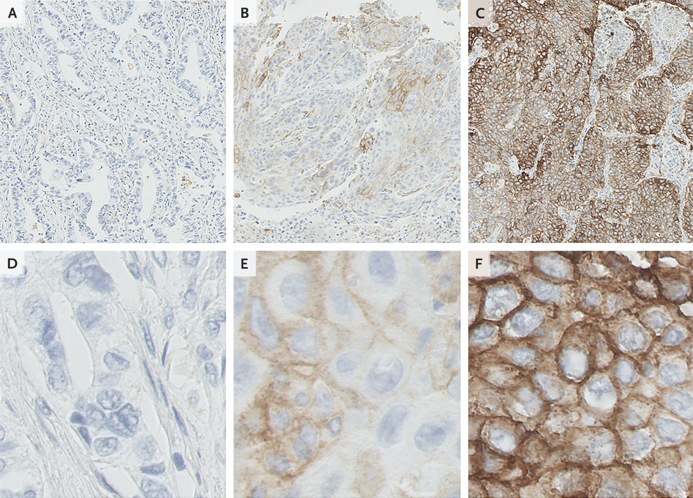
What is the role of testing to select patients for treatment with immunomodulatory therapies?
CAP-IASLC-AMP will be providing future guidelines.
PD-L1 IHC in first and second-line therapies is being done.
  The optimal antibody, IHC cut-off remains unclear.
Emerging role of tumor mutation burden (TMB) from NGS, whole exome sequencing (WES) neoantigen prediction algorithms, microbiome.
Garon EB et al. N Engl J Med 2015;372:2018-2028

