Slide 1
Please note, these are the actual video-recorded proceedings from the live CME event and may include the use of trade names and other raw, unedited content.

Slide 2
Identification of and treatment for patients with BRAF V600E mutations and MET mutations/amplifications
Leena Gandhi, MD, PhD
Director, Perlmutter Cancer Center
Langone Health
New York University
New York, New York

Slide 3
Patient Case
46 yo man, 15 pk year smoker
Diagnosed with NSCLC, poorly differentiated in late 2010
Disease included R lung mass (small), R pleural effusion, mediastinal adenopathy and large R chest wall mass
Initial stabilization with chemotherapy with rapid progression of chest wall mass
De novo MET amplification identified on next-gen sequencing from initial biopsy

Slide 4
CRIZOTINIB RESPONSE IN A PATIENT WITH DE NOVO MET AMPLIFICATION
46 yo man with de novo MET amplification
August 16, 2011
October 14, 2011
Response continuing as of 2016

Slide 5
Oncogene-Driven Non-Small Cell Lung Cancer: BRAF and c-MET Leena Gandhi MD PhD NYU Perlmutter Cancer Center March 3, 2018

Slide 6
Disclosures
Advisory Committee | AstraZeneca Pharmaceuticals LP, Genentech BioOncology, Ignyta Inc, Merck, Syndax Pharmaceuticals Inc

Slide 7
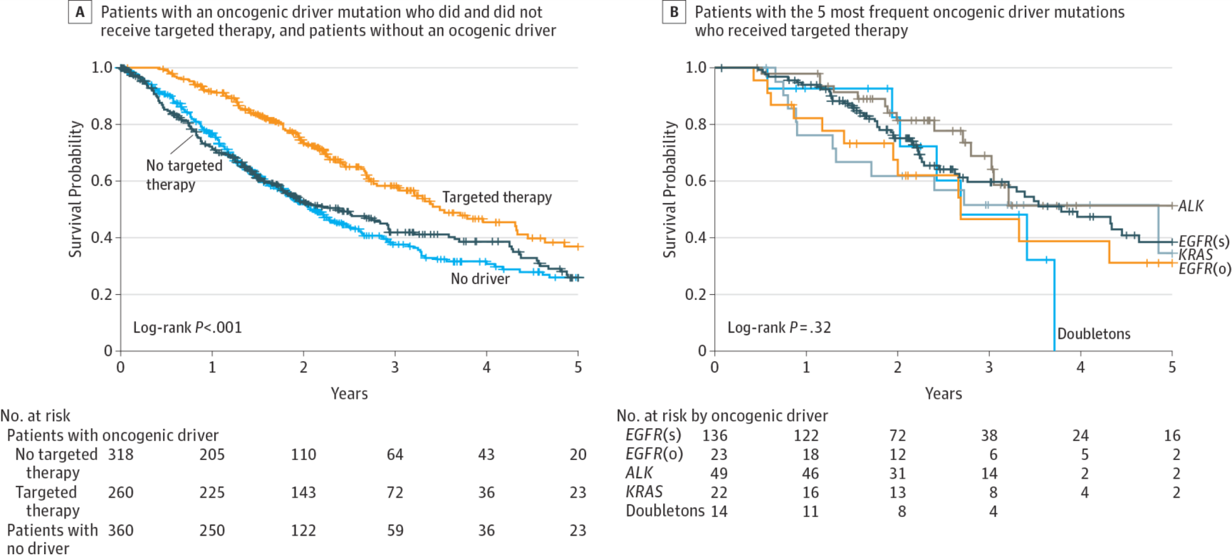
TARGETED THERAPY FOR ONCOGENIC DRIVER ALTERATIONS
Kris MG, et al. JAMA. 2014 May 21;311(19):1998-2006
Kris MG, et al. JAMA 311:1998 [2014])

Slide 8
BRAF mutations in NSCLC
Found in 2-4% of NSCLC
Primarily found in adenocarcinoma, but unlike other drivers, a majority of these mutations occur in smokers
Approximately 50% are V600E mutations in Exon 15 as are commonly found in melanoma
40-50% are non-V600 mutations found in exons 11 and 15

Slide 9
BRAF mutations result in downstream activation of MEK-ERK signaling
Nguyen-Nuc, T et al., J Thorac Oncol 2015
Cardarella S et al., Clin Cancer Res 2013

Slide 10
DABRAFENIB IN A PATIENT WITH BRAF MUTATION
64 yo man with BRAF V600E mutated NSCLC
August 10, 2012
September 19, 2012

Slide 11
Dabrafenib as monotherapy in BRAF V600E NSCLC has some benefit
Overall response rate (ORR) 33%
4/6 previously untreated patients with response
Median PFS 5.5 months
Median duration of response 9.4 months
Planchard DE et al, Lancet Oncol 2016

Slide 12
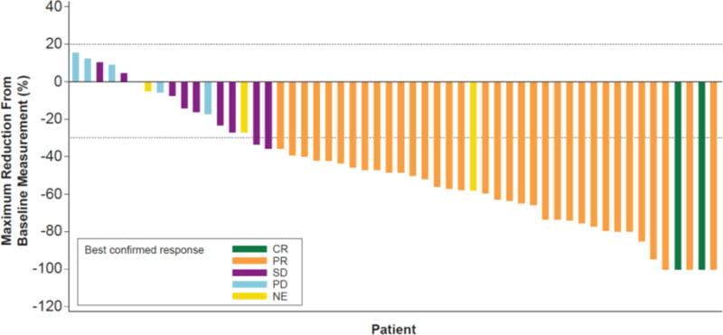
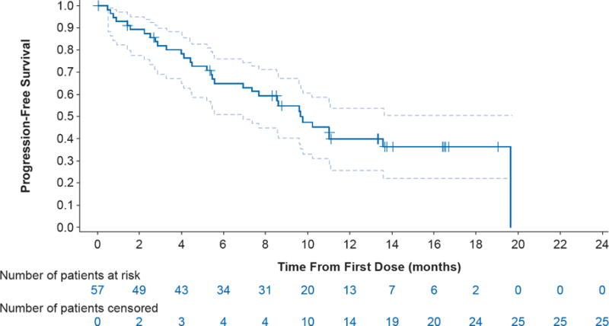
Dabrafenib +trametinib in BRAF mutant NSCLC after platinum-based chemotherapy
Median PFS 9.7 months
Median DOR 9 months
ORR 63.2%
Planchard D et al., Lancet Oncol 2016

Slide 13
Dabrafenib + trametinib in untreated BRAF V600E-mutant NSCLC
Median PFS 10.9 months
Median DOR 10.4 months
ORR 64%
Planchard, DE et al, Lancet Oncol 2017

Slide 14
Dabrafenib + trametinib standard of care for BRAF V600E mutant NSCLC
Combination therapy approved by the FDA in June 2017
NCCN guidelines now recommend 1st line use of combination
Newer non-V600 pan-RAF inhibitors are currently in clinical trial
Data suggests combination can also be effective in non-V600 BRAF mutations (as ERK signaling is downregulated) Neoparast A et al, Oncotarget 2017

Slide 15
MET in NSCLC
Overexpression
Activating mutations (1%)
Amplification (2-3%)
Exon 14 skip mutations (2-4%)
Higher frequency in pulmonary sarcomatoid carcinomas (reported rates of 7-20%)
May occur more frequently in older, smoking patient
Frequently co-occur with MET amplification
Frequently co-occur with CDK4 and/or MDM2 amplification exclusive of MET amplification

Slide 16
MET splice site mutations resulting in Exon 14 “skipping”
Paik P et al. Cancer Discov 2015;5:842-849

Slide 17
MET Exon 14 skipping results in activation of downstream signaling
Decreased MET ubiquitination
delayed receptor downregulation after stimulation with HGF.
Downstream ligand-dependent signaling through MAPK was also prolonged in cells transfected with a MET exon 14 splice variant.
Kong-Beltram M et al., Cancer Res 2006

Slide 18
Treatment of MET alterations in NSCLC
Both MET amplified tumors and MET Exon 14 skip mutated tumors have reported response to crizotinib (Frampton GM et al., Cancer Discovery 2015; Paik P et al Cancer Discovery 2015; Caparica R et al., J Thorac Oncol 2017; Jorge SE et al, Lung Cancer 2015)
Retrospective analysis suggests potential prolongation of survival with MET TKIs (Awad MM et al., J Clin Oncol (abstr) 2017)

Slide 19
Ongoing studies of MET-targeted therapy
TKI: crizotinib, cabozantinib, savolitinib, capmatinib, glesatinib, tepotinib, merestinib
Antibodies: Emibetuzumab, Sym 015
Antibody-drug conjugates: Abbv399

Slide 20
With effective therapy comes resistance….
Y1230C mutation associated with resistance to crizotinib (Ou, SH et al, J Thorac Oncol. 2017)
D1228V, Y1248H, D1246N mutation associated with resistance to type I inhibitors (i.e. crizotinib) but not type II inhibitors (those that bind outside of the active site, i.e. cabozantinib, glesatinib) (Li A-N et al, Clin Cancer Res 2017; Bahcall M et al., Cancer Discovery 2016)

Slide 21
Patient Case
46 yo man, 15 pk year smoker
Diagnosed with NSCLC, poorly differentiated in late 2010
Disease included R lung mass (small), R pleural effusion, mediastinal adenopathy and large R chest wall mass
Initial stabilization with chemotherapy with rapid progression of chest wall mass
De novo MET amplification identified on next-gen sequencing from initial biopsy

Slide 22
CRIZOTINIB RESPONSE IN A PATIENT WITH DE NOVO MET AMPLIFICATION
46 yo man with de novo MET amplification
August 16, 2011
October 14, 2011
Response continuing as of 2016

Slide 23
Question 1. Targeted combination therapy against BRAF should be used:
Only in patients who have been previously treated with platinum-doublet chemotherapy
May be used together with immunotherapy
Only in patients with V600E mutations as it has no activity against other mutations
In patients with V600E mutations who are untreated or previously treated with other agents

Slide 24
Question 2. Patients with MET exon 14 skip mutations:
respond to crizotinib and ceritinib
can respond to a type II inhibitor if they develop a Y1248H mutation
Will still respond to crizotinib if they develop a Y1248 mutation
Are a distinct population from those with MET amplification

