Slide 1
Please note, these are the actual video-recorded proceedings from the live CME event and may include the use of trade names and other raw, unedited content.

Slide 2
PD-L1, tumor mutation burden and other potential predictors of response to immune checkpoint inhibition in NSCLC
Matthew Gubens, MD, MS
Associate Professor Thoracic Medical Oncology
University of California, San Francisco
San Francisco, California

Slide 3
Case
67yo F, former smoker (60PY, quit 2 years ago)
Lung cancer screening CT (non-con, low dose protocol) reveals LUL 2.3cm mass and mediastinal fullness
PET/CT: LUL 2.4cm mass with SUV 10, hypermetabolic mediastinal LAD, hepatic lesion, spinal and rib lesions
MRI brain: No evidence of metastatic disease
Biopsy performed of liver mass
Pathology: Pulmonary adenocarcinoma, TTF1+, PD-L1 35%
NGS: TP53, but no actionable mutations; TMB high, 28 Muts/Mb

Slide 4
PD-L1, Tumor Mutation Burden, and Other Biomarkers for Immunotherapy
15th Annual Winter Lung Cancer Conference
Miami, Florida
March 3, 2018
Matthew Gubens, MD, MS
Associate Professor of Medicine
Chair, Thoracic Oncology Site Committee
UCSF Helen Diller Family Comprehensive Cancer Center

Slide 5
Disclosures
Advisory Committee | AbbVie Inc, AstraZeneca Pharmaceuticals LP, Bristol-Myers Squibb Company, Genentech BioOncology, Mersana Therapeutics, Novartis
Contracted Research | Celgene Corporation, Merck, OncoMed Pharmaceuticals Inc, Roche Laboratories Inc

Slide 6
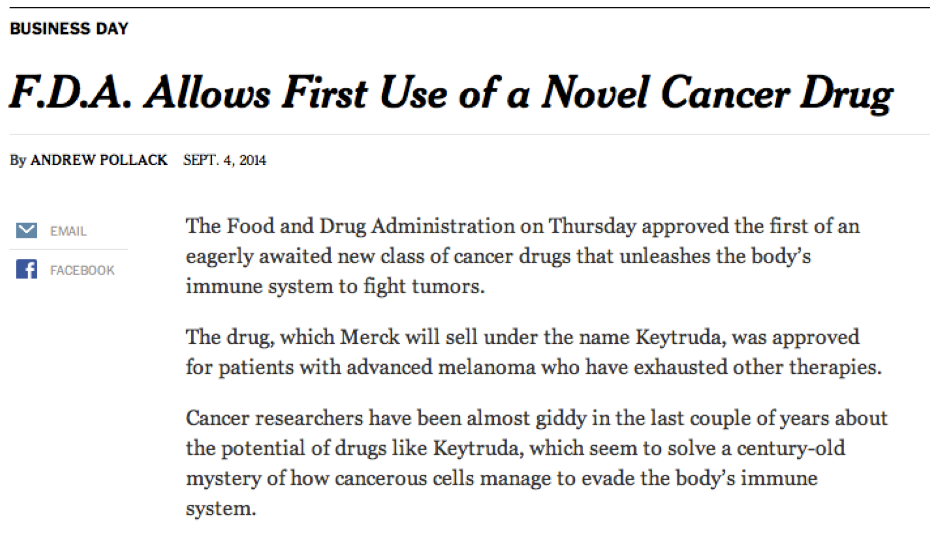
*
*
*Pembrolizumab

Slide 7
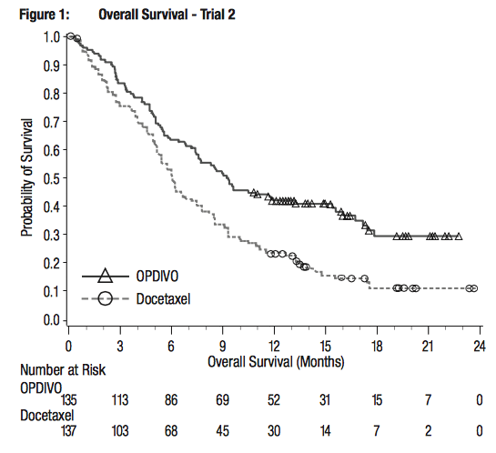
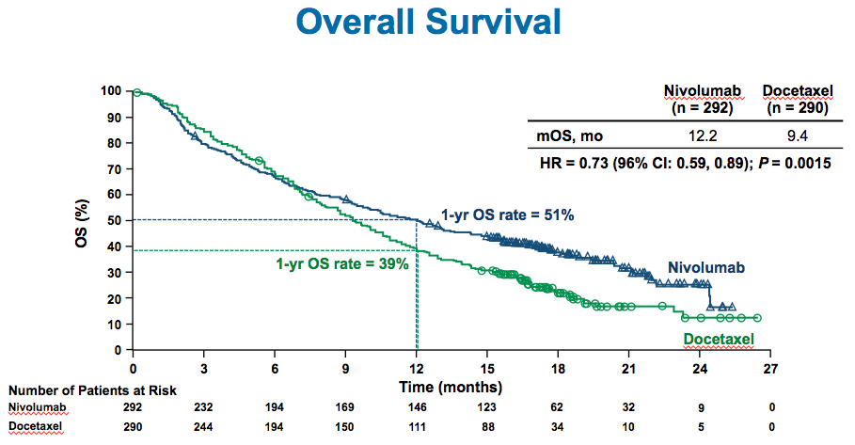
Squamous Non-squamous
Nivolumab vs docetaxel: Checkmate 017/057
Response rate
Nivo 20% vs doce 9%
Median duration of response
Nivo NR vs doce 8.4 mo
Response rate
Nivo 19% vs doce 12%
Median duration of response
Nivo 17.2 vs doce 5.6 mo
Brahmer J, et al. NEJM 2015
Borghaei H, et al. NEJM 2015

Slide 8
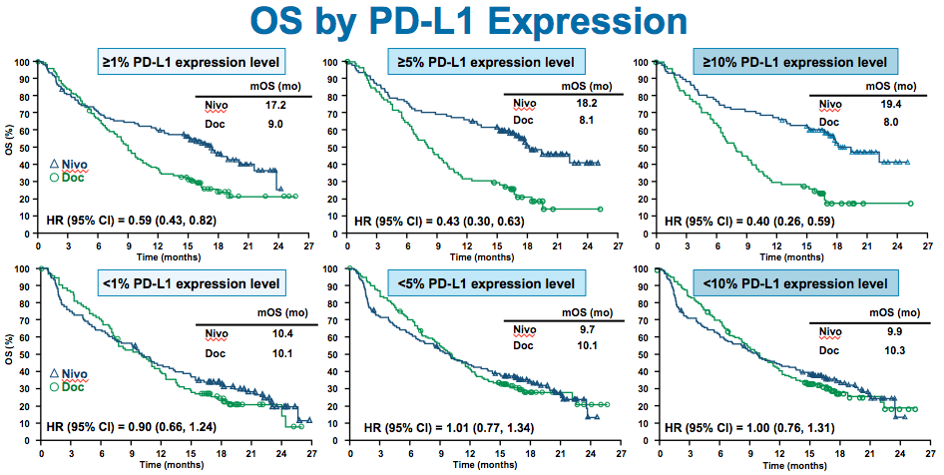
Nivolumab vs docetaxel: Checkmate 057 (non-squamous)
Borghaei H, et al. NEJM 2015

Slide 9
PD-1 inhibition in the 1st line?
1st line trials presented at ESMO 2016
Pembrolizumab vs chemo in PD-L1>50%
Nivolumab vs chemo in PD-L1>5%
POSITIVE
NEGATIVE

Slide 10
How to test PD-L1?
FDA label
NSCLC >50% 1st line
NSCLC >1% 2nd line
Any PD-L1
N/A for lung indication
Any PD-L1
Hansen, JAMA Onc 2016

Slide 11
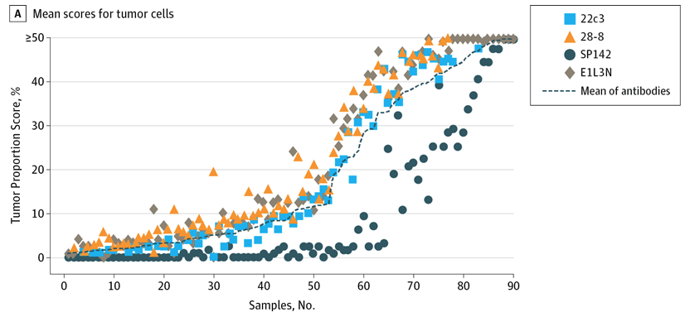
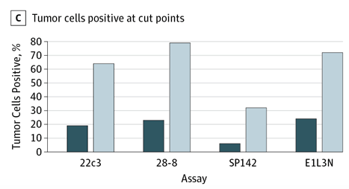
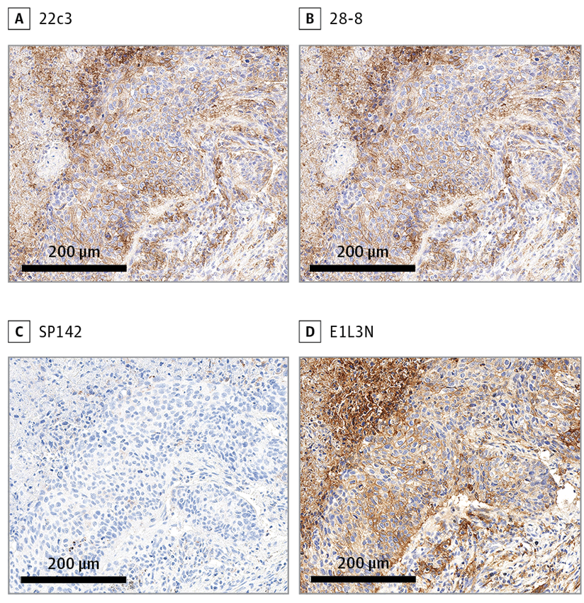
Which PD-L1 assay to choose?
Prospective evaluation of 90 samples by 4 IHC techniques
Good correlation… with one exception, SP142
Rimm, JAMA Onc 2017

Slide 12
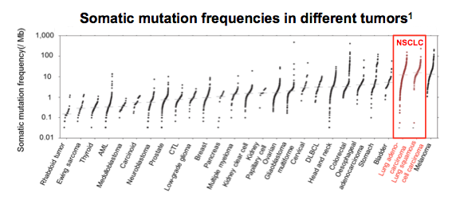
Beyond PD-L1 as a biomarker
0
Higher rates of somatic mutations in lung cancer may contribute to increased immunogenicity
Tumor mutation burden as a predictive biomarker, eg by WES or NGS
Lawrence, Nature, 2013

Slide 13
CheckMate 026: Nivolumab 1st line (PD-L1≥5%)
Socinski, ESMO 2016

Slide 14
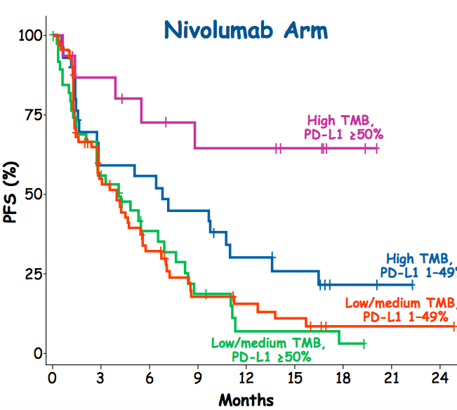
Exploratory TMB analysis of CM-026
By TMB tertile
By TMB tertile and PD-L1
Peters, AACR 2017. Carbone, NEJM 2017

Slide 15
Blood-based TMB in POPLAR and OAK
211 of 273 samples from POPLAR, and 583 of 797 samples from OAK were biomarker-evaluable and constitute the BEP for the study
Gandara, ESMO 2017

Slide 16
Blood-based TMB in POPLAR and OAK
Gandara, ESMO 2017

Slide 17
Blood-based TMB in POPLAR and OAK
Gandara, ESMO 2017

Slide 18
What about TMB prospectively?
CM-227: Nivolumab + ipilimumab vs chemo

Slide 19
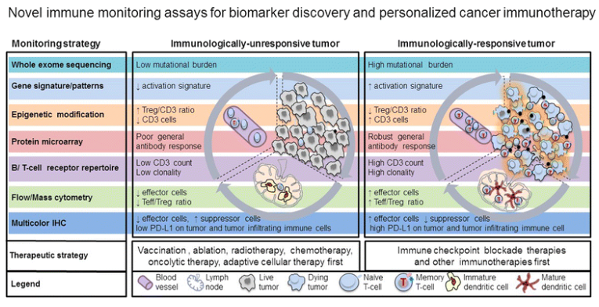
Beyond PD-L1 and TMB
Yuan, ImmunoTherapy Cancer 2015

Slide 20
Immunotherapy biomarkers
PD-L1
Needed to choose pembro alone in the first line
22C3 preferred
Tumor mutation burden
First prospective phase 3 to be reported out soon
Look out for blood-based assays
Be careful about definition and methods
Other biomarkers to come
Some of them dynamic

