Slide 1
Please note, these are the actual
video-recorded proceedings from the
live CME event and may include the use of trade names and other raw, unedited content.

Slide 2

Update on clinical research on
the management of psychiatric/psychologic issues in lung cancer management;
case discussions
Jesse R Fann, MD, MPH
Director, Psychiatry and Psychology Service
Seattle Cancer Care Alliance
Clinical Research Division
Fred Hutchinson Cancer Research Center
Professor, Department of Psychiatry and Behavioral Sciences
University of Washington
Seattle, Washington

Slide 3
Case #1
Medical
58 y.o. woman with metastatic (duodenum) adenocarcinoma of lung
Past Tx: cisplatin + etoposide + XRT
Current Tx: carboplatin/pembrolizumab + pemetrexed
Psychiatric
Referred to SW due to lability (crying, laughing, angry)
Very anxious (GAD-7=16), described by some providers as ‘histrionic’
Calls frequently about pain, multiple somatic sxs. (some unexplained)
Poor social support, multiple stressors at home (daughter’s ‘allergies’, caregiver for disabled husband)
Dx: Adjustment Disorder with Anxiety, R/O PTSD from past traumas

Slide 4
Case #2
Medical
38 y.o. man with metastatic (CNS, incl. L frontal) adenocarcinoma of lung
Past Tx: crizotinib, alectinib, carboplatin/pemetrexed, whole brain XRT, gamma knife
Current Tx: lorlatinib
Psychiatric
Cognitive impairment (memory, verbal fluency, executive function), impulsivity, irritability/anger (kicking objects), depression, insomnia
Married, 2 young kids at home
Followed by SW, Psychiatry, Psychology
Dx: Mild neurocognitive disorder due to brain lesions & XRT, Depressive disorder due to medical condition

Slide 5
Psychiatric Issues in Lung Cancer Management
Jesse Fann, MD, MPH
Professor, Psychiatry & Behavioral Sci, University of Washington
Clinical Research Division, Fred Hutchinson Cancer Research Center
Director, Psychiatry & Psychology Service, Seattle Cancer Care Alliance

Slide 6
Disclosures
Consulting Agreement | Quartet Health
Stock Ownership | Pfizer Inc

Slide 7
Objectives
Identify the common psychological issues and symptoms associated with lung cancer
Know pharmacological and psychotherapeutic strategies to manage these issues and symptoms

Slide 8
Types of Distress
(occurs on a continuum)
Practical
Distress
Spiritual
Family
Anxiety/PTSD
Social
Depression
Emotional
Physical
Notes:
8

Slide 9
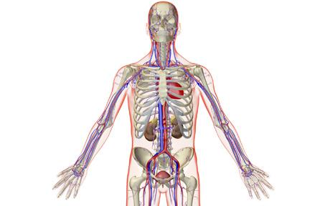
Distress by tumor site
N=4,496 patients
Brief Symptom Inventory (BSI)
Caseness by site:
  Lung 43%
  Brain 42%
  Pancreas 36%
  Head & Neck 35%
  Liver 35%
  Colon 32%
        Zabora et al, PsychoOncology 2001
Photo: www.telegraph.co.uk
Notes:
9

Slide 10
Impact of Distress in Cancer
Associated with:
Poor tolerance of aversive symptoms (e.g., nausea)
Poor adherence/receipt of definitive cancer Tx, health behaviors, and satisfaction with medical care
Decreased functioning, family cohesion and QOL
More cognitive and somatic complaints (e.g., pain, fatigue, sexual dysfunction)
Longer hospital lengths of stay, higher health care utilization
Frequent requests for hastened death
Increased risk of suicide
Likely impaired immune function and higher mortality

Slide 11
Mental Health Conditions
Before & After Cancer Dx
Lu et al. JAMA Oncol 2016

Slide 12
Association between Schizophrenia and Cancer
Relative to Persons w/o Schizophrenia
Crump et al, Am J Psychiatry 2013

Slide 13
Suicide rates by tumor site
Group | Rate¹ | SMR²
US General Population | 15.8 | 1
SEER | 32.4 | 2.06
Lung & Bronchus | 81.7 | 5.74
Stomach | 71.7 | 4.68
Oral cavity & Oropharynx | 53.1 | 3.66
Larynx | 46.8 | 2.83
¹Per 100,000 person-years ²SMR=Standardized Mortality Ratio
Misono, Weiss, Fann, et al, J Clin Oncol 2008
Notes:
13

Slide 14
Suicide rates after cancer diagnosis
Gen Pop
16.7
Misono, Weiss, Fann, et al, J Clin Oncol 2008

Slide 15
Transitions that may bring increased vulnerability to distress
Diagnosis Completion Recurrence, Advancing
of of Progression of Disease,
Cancer Treatment Disease Hospice
High Initial Surveillance, Palliative End of Life
Risk Treatment Survivorship Treatment
(e.g., BRCA) course
Adapted from McCormick & Conley 1995

Slide 16
Distress in Lung Cancer
Lung cancer patients have more unmet supportive care needs than other cancer patients (16 vs. 11) (Li & Girgis, 2006)
>90% wanted supportive care (Sanders et al, 2010)
Distress strongly associated with HRQOL (Sarna et al, 2002)
Strong stigma & blame associated with lung cancer
  Leading to anxiety & depression
Anxiety associated with decreased survival in stage III NSCLC (Vodermaier et al, 2017)

Slide 17
Depression in Lung Cancer
Prevalence 13-50% in various studies
  More prevalent in advanced stages
  Risk factors
    Functional impairment - Advanced stage
    Symptom burden / fatigue - Lower social support
    Lower education - Female sex
Increased rates with chemotherapy, interferon, menopause
  Effects of proinflammatory cytokines (IL-1, IL-6), estrogen
Differentiate from ‘Demoralization’ - Characterized by “various degrees of helplessness, confusion and subjective incompetence” to adversity
Depression is under-recognized in cancer patients
Hopwwod & Stephens, 2000; Uchitomi et al, 2003; Walker et al, 2014

Slide 18
Components of Anxiety
Anxiety
Physical
Cognitive
Behavioral
Emotional

Slide 19
Cancer Worry During Survivorship
Vulnerability
  Risk of recurrence
Controllability
  Future risk and preventive measures
Threat/Interference
  Anticipated dangerousness of outcome
Coping
  Ability to cope with recurrence
Predictability
Controllability
Uncontrollability
Unpredictability

Slide 20
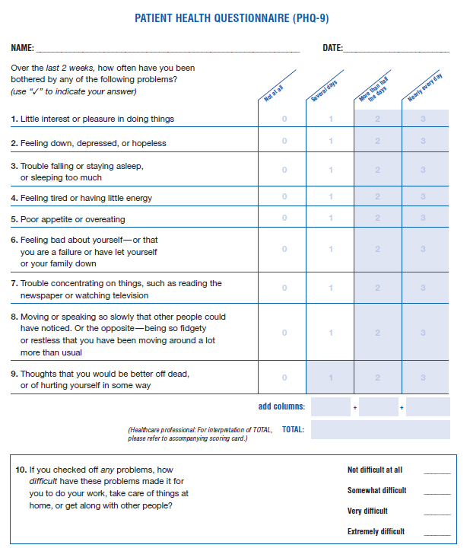
Screening for Depression & Anxiety
Depression: PHQ-2 → PHQ-9
Anxiety: GAD-2 → GAD-7
  Good sensitivity for Generalized Anxiety Disorder, Panic Disorder, Social Anxiety, PTSD
Primary Care PTSD screen (PC-PTSD): 4 items
  Follow positive screens with PCL-5 (PTSD Checklist)
Available in multiple languages
Andersen et al, 2014; Kroenke et al, 2007

Slide 21
Treatment Approaches that we know Don’t Work
Screening without a system to ensure access to evidence-based treatment
Referral to specialty care without close coordination and follow-up
Co-location of behavioral health specialists without a system for tracking outcomes and treatment adjustments
Patients ‘fall through the cracks’ or stay on ineffective treatments for too long
Carlson et al, J Clin Oncol 2010; Hollingworth et al, J Clin Oncol 2013

Slide 22
Meta-Analysis of Pharmacological Therapy in Cancer
SMD = -0.58
Li et al, Psycho-Oncology 2017
Li et al, Psycho-Oncology 2017

Slide 23
Meta-Analysis of Psychological Therapy in Cancer
SMD = -1.40
SMD = -0.27, NS
Li et al, Psycho-Oncology 2017
Li et al, Psycho-Oncology 2017

Slide 24
Psychosocial Interventions that show promise in Lung Cancer
Cognitive behavioral therapy, Problem Solving Therapy – depression, anxiety, dyspnea, stigma, QOL
Psycho-education, Supportive Therapy – self-confidence, managing symptoms & side effects, depression
Mind-body interventions (e.g., mindfulness-based stress reduction, yoga, tai-chi) – anxiety, depression, distress
Exercise Training – anxiety, depression, well-being, physical symptoms,
Including caregivers may strengthen effectiveness, small sample sizes
Lehto 2017; Rueda et al, 2011; Wlaker et al, 2013

Slide 25
Traditional Referral Model
Psycho-social Oncology Service
CRISIS
Oncology
Team
Oncologist
APP
Nurse Case Mgr

Slide 26
Distress & Cancer
Referral
Derogatis et al, JAMA 1983

Slide 27
Meta-Analysis of Collaborative Care in Cancer
SMD = -0.58
SMD = -0.53
SMD = -0.49
Li et al, Psycho-Oncology 2017

Slide 28
Collaborative Care Model
Psycho-social Oncology
Service
Evidence-Based Treatment
Oncology
Team
Oncologist
APP
Nurse Case Mgr
Care Manager
(Social Worker)
Distress Screening
Education & Triage
OutcomeMonitoring

Slide 29
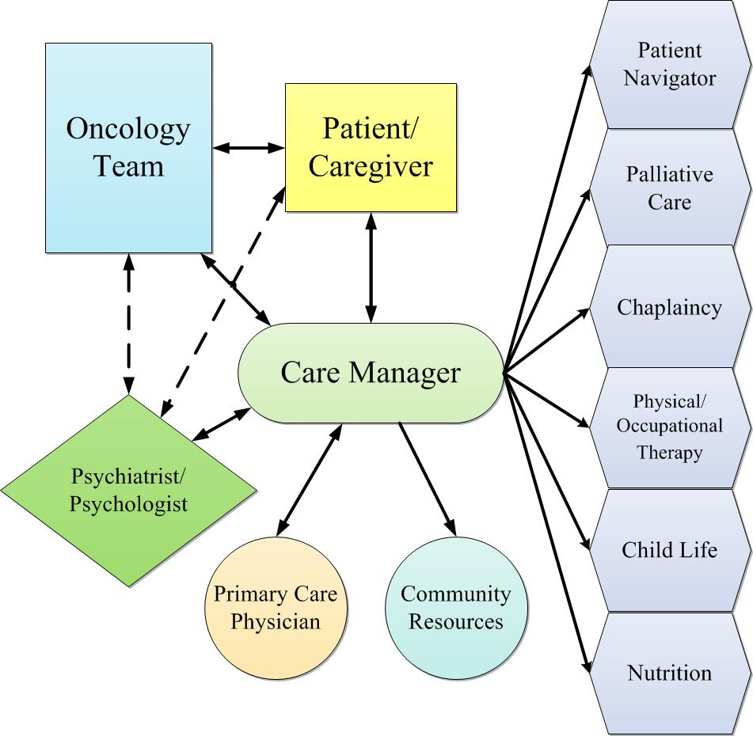


Collaborative Care Model
On-Site Care Coordinator
Electronic Patient Registry
Weekly Caseload Review
Fann et al, JCO 2012; Fann & Sexton, Psycho-Oncology Textbook, 2015

Slide 30
Collaborative Care in Patients with Lung Cancer
Walker et al, Lancet Oncol 2014

Slide 31
Neuropsychiatric effects of medications
Corticosteroids – mood, cognitive, behavioral
Dopamine-blocking anti-emetics – restlessness
Methotrexate (intrathecal), cisplatin, cyclosporine, tacrolimus - leukoencephalopathy
Interferon-alpha, interleukin-2 – mood, cognition, leukoencephalopathy
Leuprolide acetate, androgen blockers – mood, cognition
Immunotherapies – encephalopathy, headache, neuropathy
TKAs – depression, insomnia, fatigue, headache
Limbic encephalitis – psychiatric symptoms, memory deficits

Slide 32
Preventing Polypharmacy
Comorbidity Management Opportunities
 | Anxiety | Depress | Insomnia | Pain | Hot Flash | Nausea
Benzodiazepine | X |  | X | X |  | X
Antidepressant | X | X | X | X | X | X
Anticonvulsant (e.g., pregabalin) | X |  | X | X | X
Antipsychotic (e.g., olanzapine) | X | X | X |  |  | X
Antihistamine | X |  | X |  |  | X
Non-benzodiaz sedative |  |  | X

Slide 33
Choosing a Psychotropic Medication
Few RCTs – often not targeting specific psychiatric condition
What was effective & tolerated before cancer?
Pay attention to medical comorbidity / drug interactions
  For Pts with depression/anxiety - treat insomnia, sleep apnea, pain, anemia, hypoxia, hypothyroid
  Potential hematopoietic dysfunction*, esp. due to TCAs, antipsychotics, lithium, anticonvulsants, SSRIs (platelet dysfunction)
  Avoid sedation, anticholinergics in fatigued or cognitively impaired
  Anti-neoplastic procarbazine and the antibiotic linezolid are weak monoamine oxidase inhibitors (MAOIs) → avoid SSRIs
  Prolonged QTc with citalopram & antipsychotics and ondansetron, antifungals, tacrolimus, prochlorperazine, promethazine
  Extrapyramidal sxs. with SSRIs and metoclopramide, prochlorperazine
*Flanagan RJ, Dunk L. Haematological toxicity of drugs used in psychiatry. Hum Psychopharmacol. 2008 Jan;23 Suppl 1:27–41

Slide 34
Antidepressants
Selective serotonin re-uptake inhibitors (SSRIs)
  sertraline* citalopram* escitalopram*
  paroxetine fluoxetine fluvoxamine
  Can help with anxiety, pain, hot flashes
venlafaxine*, desvenlafaxine – helps w/ anxiety, pain (neuropathic), hot flashes; may cause HTN
duloxetine* – helps w/ anxiety, pain (neuropathic), incontinence; may cause HTN
bupropion* – helps w/ fatigue, smoking cessation; low sexual SEs
mirtazapine* – helps w/ nausea, anorexia, weight loss, anxiety, insomnia; may cause neutropenia rarely, antihistamine effects; low sexual SEs
tricyclic antidepressants (TCAs) – e.g., nortriptyline, desipramine – helps w/ anxiety, neuropathic pain; monitor serum levels; more SEs (sedation, anticholinergic)
levomilnacipran - SNRI, vortioxetine – 5-HT modulator, vilazodone – 5-HT inhibitor & partial agonist: newer agents
* Most experience in cancer patients Ostuzzi et al, 2015

Slide 35
Sedation and Activation Profiles
fluvoxamine
mirtazapine paroxetine
trazodone nefazodone
(des)venlafaxine duloxetine
(es)citalopram sertraline
fluoxetine
bupropion
-2
-1
0
+1
+2
sedation
activation

Slide 36
Psychostimulants
(methylphenidate, dexmethylphenidate, dextroamphetamine, modafinil)
Can help in:
  Fatigue
  Depression
  Cognitive deficits
  Adjuvant analgesia
  Opioid-related sedation
  Appetite / sense of well-being
  (rapid onset)
Side Effects
  Tachycardia
  Anxiety / jitteriness
  Insomnia (rare)
  Abuse (rare)

Slide 37
Panic Disorder
Acute: Benzodiazepine (taper when possible)
Maintenance & prevention (1+ year, taper gradually), combine w/ psychotherapy (e.g., CBT)
  Selective serotonin reuptake inhibitors (SSRI)
  Serotonin-norepinephrine reuptake inhibitor (SNRI)
  Tricyclic antidepressant (TCA)
  Monoamine oxidase inhibitors (MAOI) - phenelzine
  Others – mirtazapine, trazodone, anticonvulsant – esp w/ mood lability (valproate, gabapentin, pregabalin, vigabatrin, tiagabine) moclobemide, olanzapine, quetiapine, verapamil, clonidine, rTMS

Slide 38
Generalized Anxiety Disorder
Combine meds w/ psychotherapy
Onset of effect may take 4-6 wks
Continue treatment for 12-18 months
SSRIs – citalopram, escitalopram, sertraline, paroxetine
SNRIs – venlafaxine, duloxetine
TCAs - imipramine
Buspirone – monotherapy or augment SSRI/SNRI
Benzodiazepines – use scheduled, longer-acting, taper when possible
Pregabalin - 50-300 mg, watch for sedation, dizziness, tolerance
Others - mirtazapine, hydroxyzine, quetiapine, beta-blockers (for anticipatory/ performance anxiety, physically-focused pts)

Slide 39
Posttraumatic Stress Disorder (PTSD)
CBT & benzos for Acute Stress Disorder, prevention of PTSD
Treat PTSD for 6-12 months
SSRIs/SNRIs (esp. sertraline, paroxetine, venlafaxine) – treats core sxs & comorbid depression
  SNRIs particularly helpful for re-experiencing, avoidance
Benzodiazepines - Use short-term only to address early (e.g., Acute Stress Disorder) or residual symptoms
TCAs – esp for insomnia, depression
MAOIs - phenelzine
Others
Atypical Antipsychotics – augment SSRI/SNRI - comorbid psychosis, bipolar
Prazosin – trauma-related arousal (dreams, insomnia)
Mirtazapine - Effective for core PTSD sxs,
Nefazodone (100 to 600mg) - hepatotoxicity risk, sedating
Trazodone – esp for insomnia, watch for priapism
Antihistamines – esp for insomnia (diphenhydramine, hydroxyzine), anticholinergic SEs

Slide 40
Somatic Symptom Disorder
Excessive thoughts, feelings, or behaviors related to distressing somatic symptoms
General treatment issues:
  Schedule regular follow-up visits
  Perform brief physical exam focused on the area of discomfort on each visit
  Look closely for objective signs of disease rather than taking the patient’s symptoms at “face value”
  Avoid unnecessary tests, invasive treatments, referrals, hospitalizations.
  Avoid explanations such as “the symptoms are all in your head”
    Explain that stress can cause physical symptoms
  Set limits on contacts outside of scheduled visits
Hatcher & Arroll, BMJ 2008

Slide 41

Thank You

