Slide 1
Please note, these are the actual video-recorded proceedings from the live CME event and may include the use of trade names and other raw, unedited content.

Slide 2
Management of toxicities associated with immune checkpoint inhibitors in the locally advanced and metastatic settings
Naiyer Rizvi, MD
Professor of Medicine
Director of Thoracic Oncology and Phase I Immunotherapeutics
Price Chair in Clinical Translational Research
Columbia University Medical Center
New York, New York

Slide 3
Disclosures
Advisory Committee | AstraZeneca Pharmaceuticals LP, Bristol-Myers Squibb Company, EMD Serono Inc, Genentech BioOncology, GlaxoSmithKline, Janssen Biotech Inc, Lilly, Merck, Novartis, Pfizer Inc, Roche Laboratories Inc

Slide 4
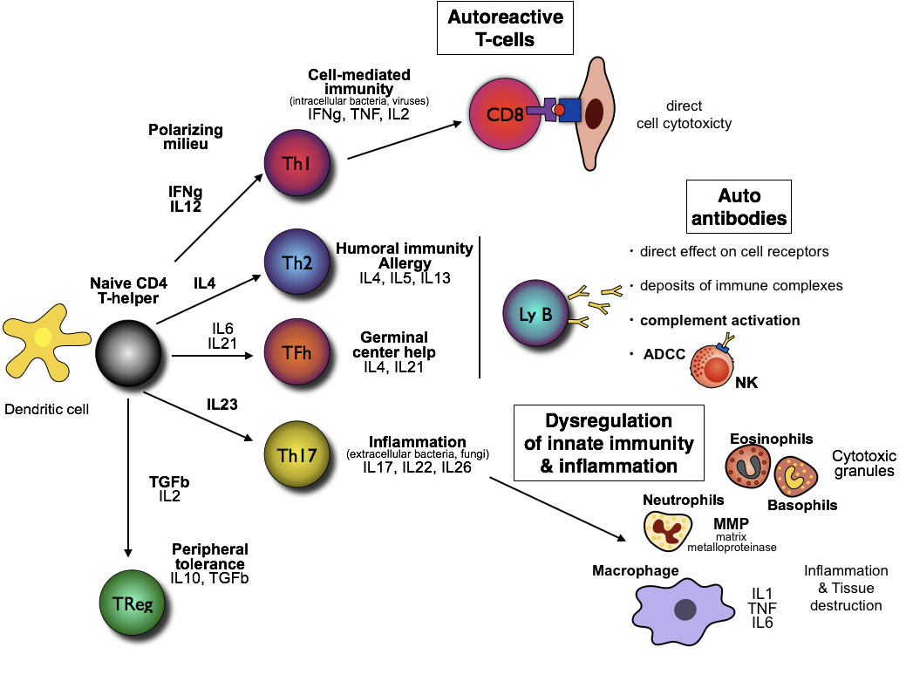
Immuno-pathogenesis
Courtesy JC Soria

Slide 5
Spectrum of toxicity of checkpoint inhibitors
Neuropathy
Guillain-Barré
Myelopathy
Meningitis
Encephalitis
Myasthenia
Uveitis
Conjunctivitis
(Epi)scleritis
Neurological
Eye
Blepharitis
Retinitis
Myocarditis
Pericarditis
Vasculitis
Cardiovascular
Hyper-/hypothyroidism
Hypophysitis
Adrenal insufficiency
Diabetes
Endocrine
Liver
Hepatitis
Pneumonitis
Pleuritis
Sarcoid-like granulomatosis
Respiratory
Colitis
Ileitis
Pancreatitis
Gastritis
Gastrointestinal
Renal
Nephritis
Arthritis
Dermatomyositis
Musculoskeletal
Rash
Pruritus
Psoriasis
Vitiligo
DRESS
Stevens Johnson
Skin
Blood
Haemolytic anaemia
Thrombocytopenia
Neutropenia
Haemophilia
Champiat, et al. Ann Oncol 2016

Slide 6
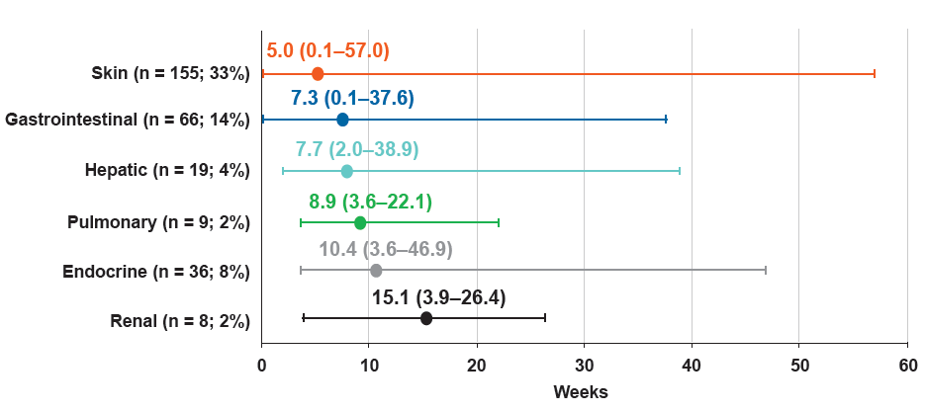
Anti-PD1 Nivolumab Pooled Safety Analysis Time to Onset of Select Treatment-related AEs (Any Grade; N = 474)
Weber J et al JCO 2017

Slide 7
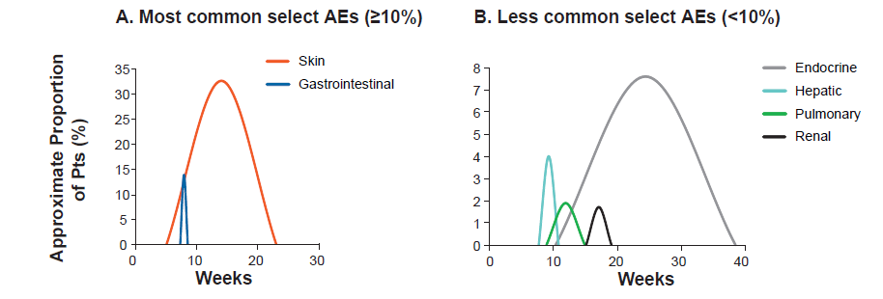
Anti-PD1 Nivolumab Pooled Safety Analysis
Kinetics of Onset and Resolution of Immune-related AEs
Incidence
Weber J et al JCO 2017

Slide 8
Checkmate 067: Safety
Onset Grade 3–4 Treatment-Related Select AEs
Skin (n=18)
Skin (n=5)
Gastrointestinal (n=46)
Gastrointestinal (n=7)
Endocrine (n=15)
Endocrine (n=2)
Hepatic (n=60)
Hepatic (n=8)
Pulmonary (n=3)
Pulmonary (n=1)
Renal (n=6)
Renal (n=1)
5.6 (0.1 – 55.0)
19.4 (1.3 – 50.9)
7.4 (1.0 – 48.9)
26.3 (13.1 – 57.0)
12.1 (2.9 – 17.0)
28.6 (19.1 – 38.1)
7.4 (2.1 – 48.0)
14.1 (1.9 – 25.1)
3.7 (3.7 – 9.4)
NIVO+IPI
6.7 (6.7 – 6.7)
NIVO
11.3 (3.3 – 23.7)
50.9 (50.9 – 50.9)
Weeks
0
10
20
30
40
50
60
Larkin J et al ECC 2015

Slide 9
Checkmate 067 Safety Number of organs involved
Number of organ categories impacted, n (%)* | All treated patients
 | NIVO+IPI (N=313) | NIVO (N=313) | IPI (N=311)
0 | 91 (29) | 236 (75) | 171 (55)
1 | 125 (40) | 61 (20) | 112 (36)
2 | 77 (25) | 14 (5) | 24 (8)
3 | 15 (5) | 2 (1) | 4 (1)
>3 | 5 (2) | 0 (0) | 0 (0)
*Organ categories: Skin, gastrointestinal, endocrine, hepatic, pulmonary, renal
Larkin J et al ECC 2015

Slide 10
Management of Immune-Related Adverse Events (irAE) with CPI
Grade | Steroids | Study Treatment | Persistent/Recurring
1 | Treat symptomatically; No systemic steroids | Can continue
2 | Steroids for selected irAEs and for recurrent irAEs | Continue Hold for selected AEs* | Systemic steroids; Consider withholding; discontinue if ≥12 weeks
3 | Systemic Steroids, prolonged tapers | Withhold or discontinue | Systemic steroids and discontinue
4 | Systemic steroids | Discontinue (unless endocrine irAE) | Add other immune suppressants
Selected AEs: colitis, pneumonitis, liver/renal toxicity, hypophysitis, neurologic
Systemic steroids (PO or IV): 1–2 mg/kg/d prednisone or equivalent
Slow taper over ≥4 weeks is recommended.
Several courses may be necessary if symptoms worsen when dose decreased.
*Discontinue for G3/4 irAEs renal toxicity, pneumonitis and infusion reactions; question for liver grade 3.
Courtesy Jeff Weber

Slide 11
Beyond steroid treatment?
Infliximab: chimeric monoclonal antibody directed against tumor necrosis factor-α (TNF-α)
Mycophenolate mofetil (MMF): prodrug of mycophenolic acid, an inhibitor of inosine monophosphate dehydrogenase (IMPDH). This is the rate-limiting enzyme in de novo synthesis of guanosine nucleotides. T- and B-lymphocytes are more dependent on this pathway than other cell types are.
Tocilizumab: humanized MoAb against the IL-6R.
Rituximab: antibody binds to the cell surface protein CD20 (widely expressed on B cells)

Slide 12
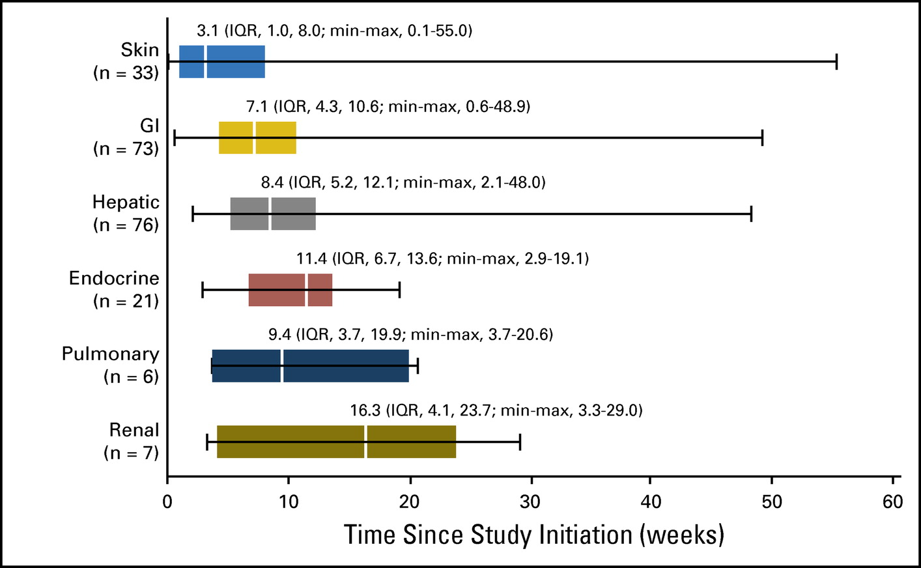
Kinetics of resolution of irAEs with combination checkpoint inhibition
Sznol et al; JCO 2016

Slide 13
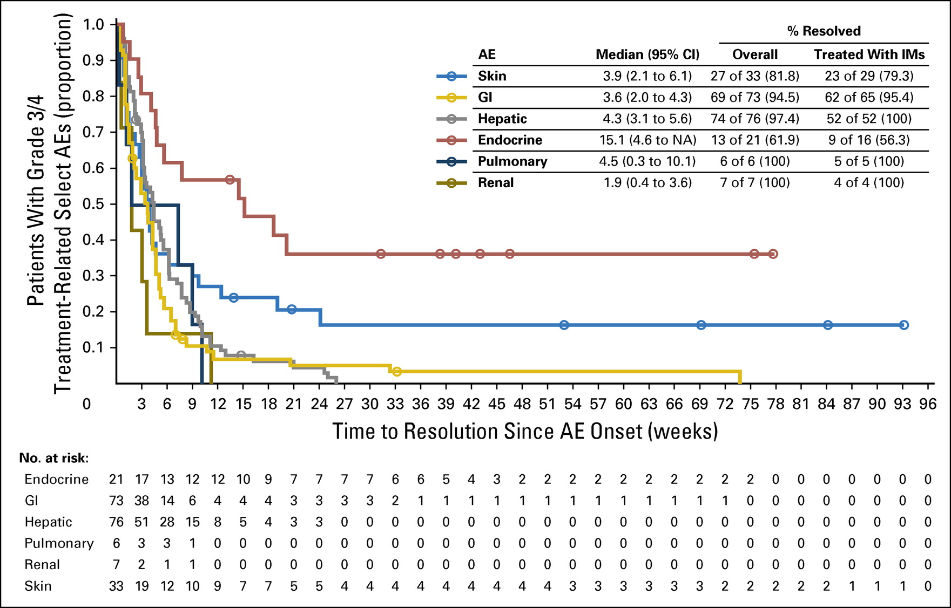
Most irAEs resolve except for endocrine and skin
Sznol et al; JCO 2016

Slide 14
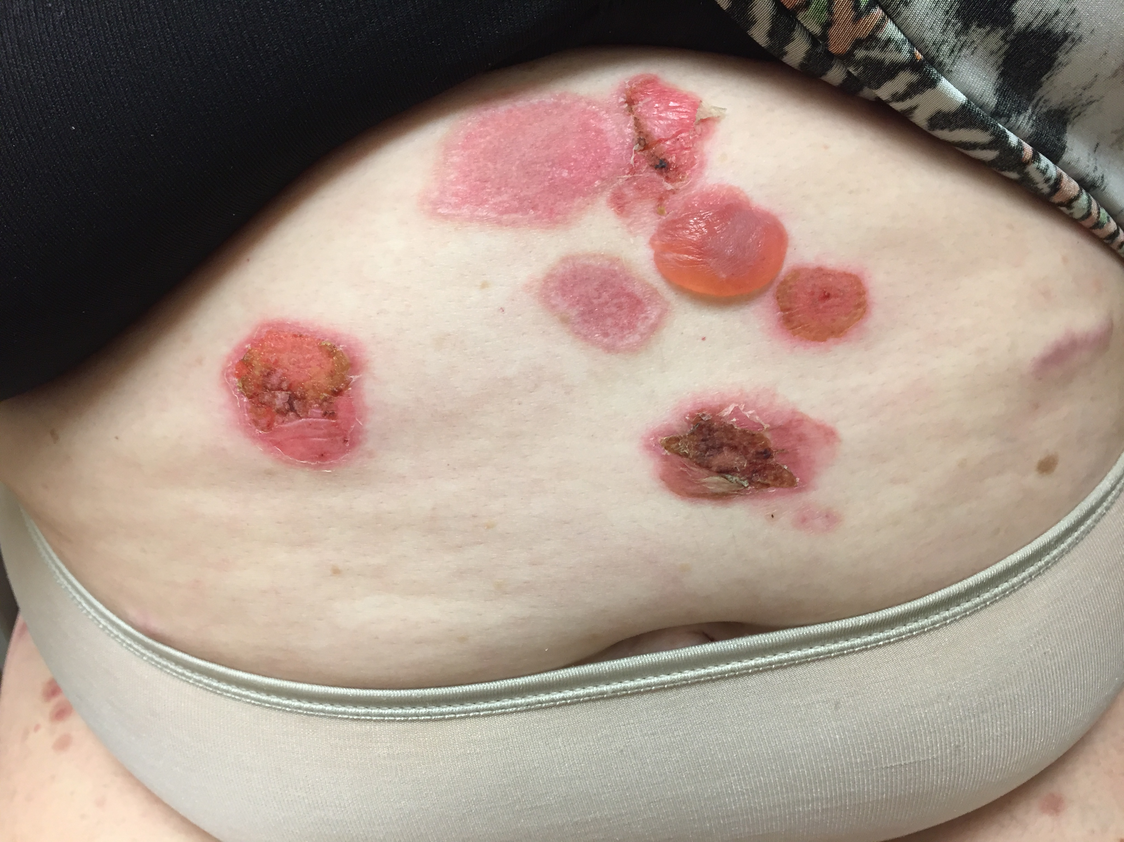
Bullous Pemphigus after 1 year of immune checkpoint blockade

Slide 16
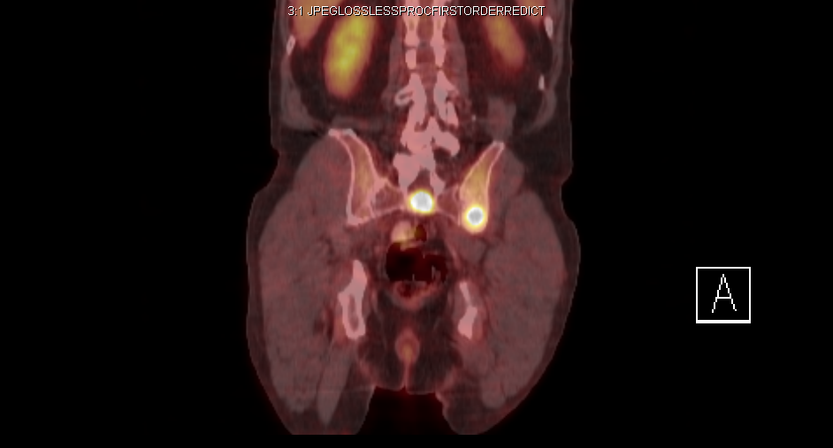
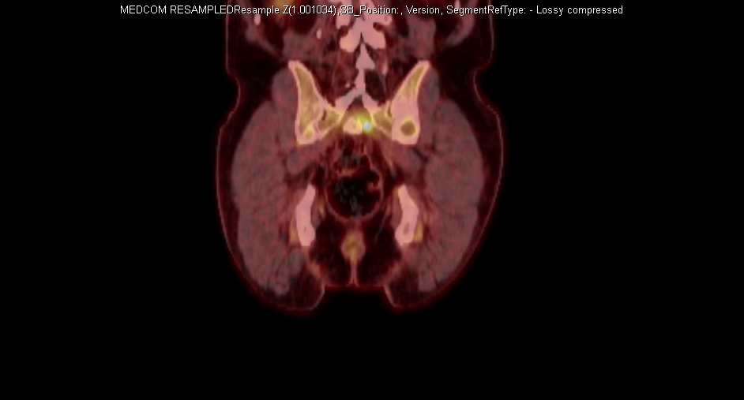
Type I Diabetes and near CR after 1 dose of anti-PD-1: association of irAEs and benefit; need to continue treatment?
Notes:
Fuji, T Invest New Drugs 2017
Ninety-eight of 290 patients (34%) experienced any grade irAEs among those receiving PD-1 antibodies at MD Anderson.
Among the 15 (5.2%) patients with grade ≥ 3 irAEs, the most common irAEs were dermatitis and enterocolitis. Although 80% of the patients with grade ≥ 3 irAEs required systemic corticosteroids, all 15 patients recovered from the irAEs.
On re-challenge, 4 of the 5 patients who had received systemic corticosteroids for irAE continued to respond. There were no irAE-related deaths.
Patients with grade ≥ 3 irAEs had improved overall response rate (25 vs. 6%; p = 0.039) and longer median time to progression (30 weeks vs. 10 weeks; p = 0.0040) when compared to those without grade ≥ 3 irAEs.
Kostine A et al Ann Rheum Dis 2017
A 6.6% rate (35/524) of rheumatic irAEs occurred with anti-programmed cell death protein 1(PD-1)/PD-1 ligand 1(PD-L1) antibodies, with a median exposure time of 70 days.
There were two distinct clinical presentations: (1) inflammatory arthritis (3.8%) mimicking either rheumatoid arthritis (n=7), polymyalgia rheumatica (n=11) or psoriatic arthritis (n=2) and (2) non-inflammatory musculoskeletal conditions (2.8%; n=15).
Nineteen patients required glucocorticoids, and methotrexate was started in two patients. Non-inflammatory disorders were managed with non-steroidal anti-inflammatory drugs, analgesics and/or physiotherapy. ICI treatment was pursued in all but one patient.
Patients with rheumatic irAEs had a higher ORR compared with patients without irAEs (85.7% vs 35.3%; P<0.0001).

Slide 17
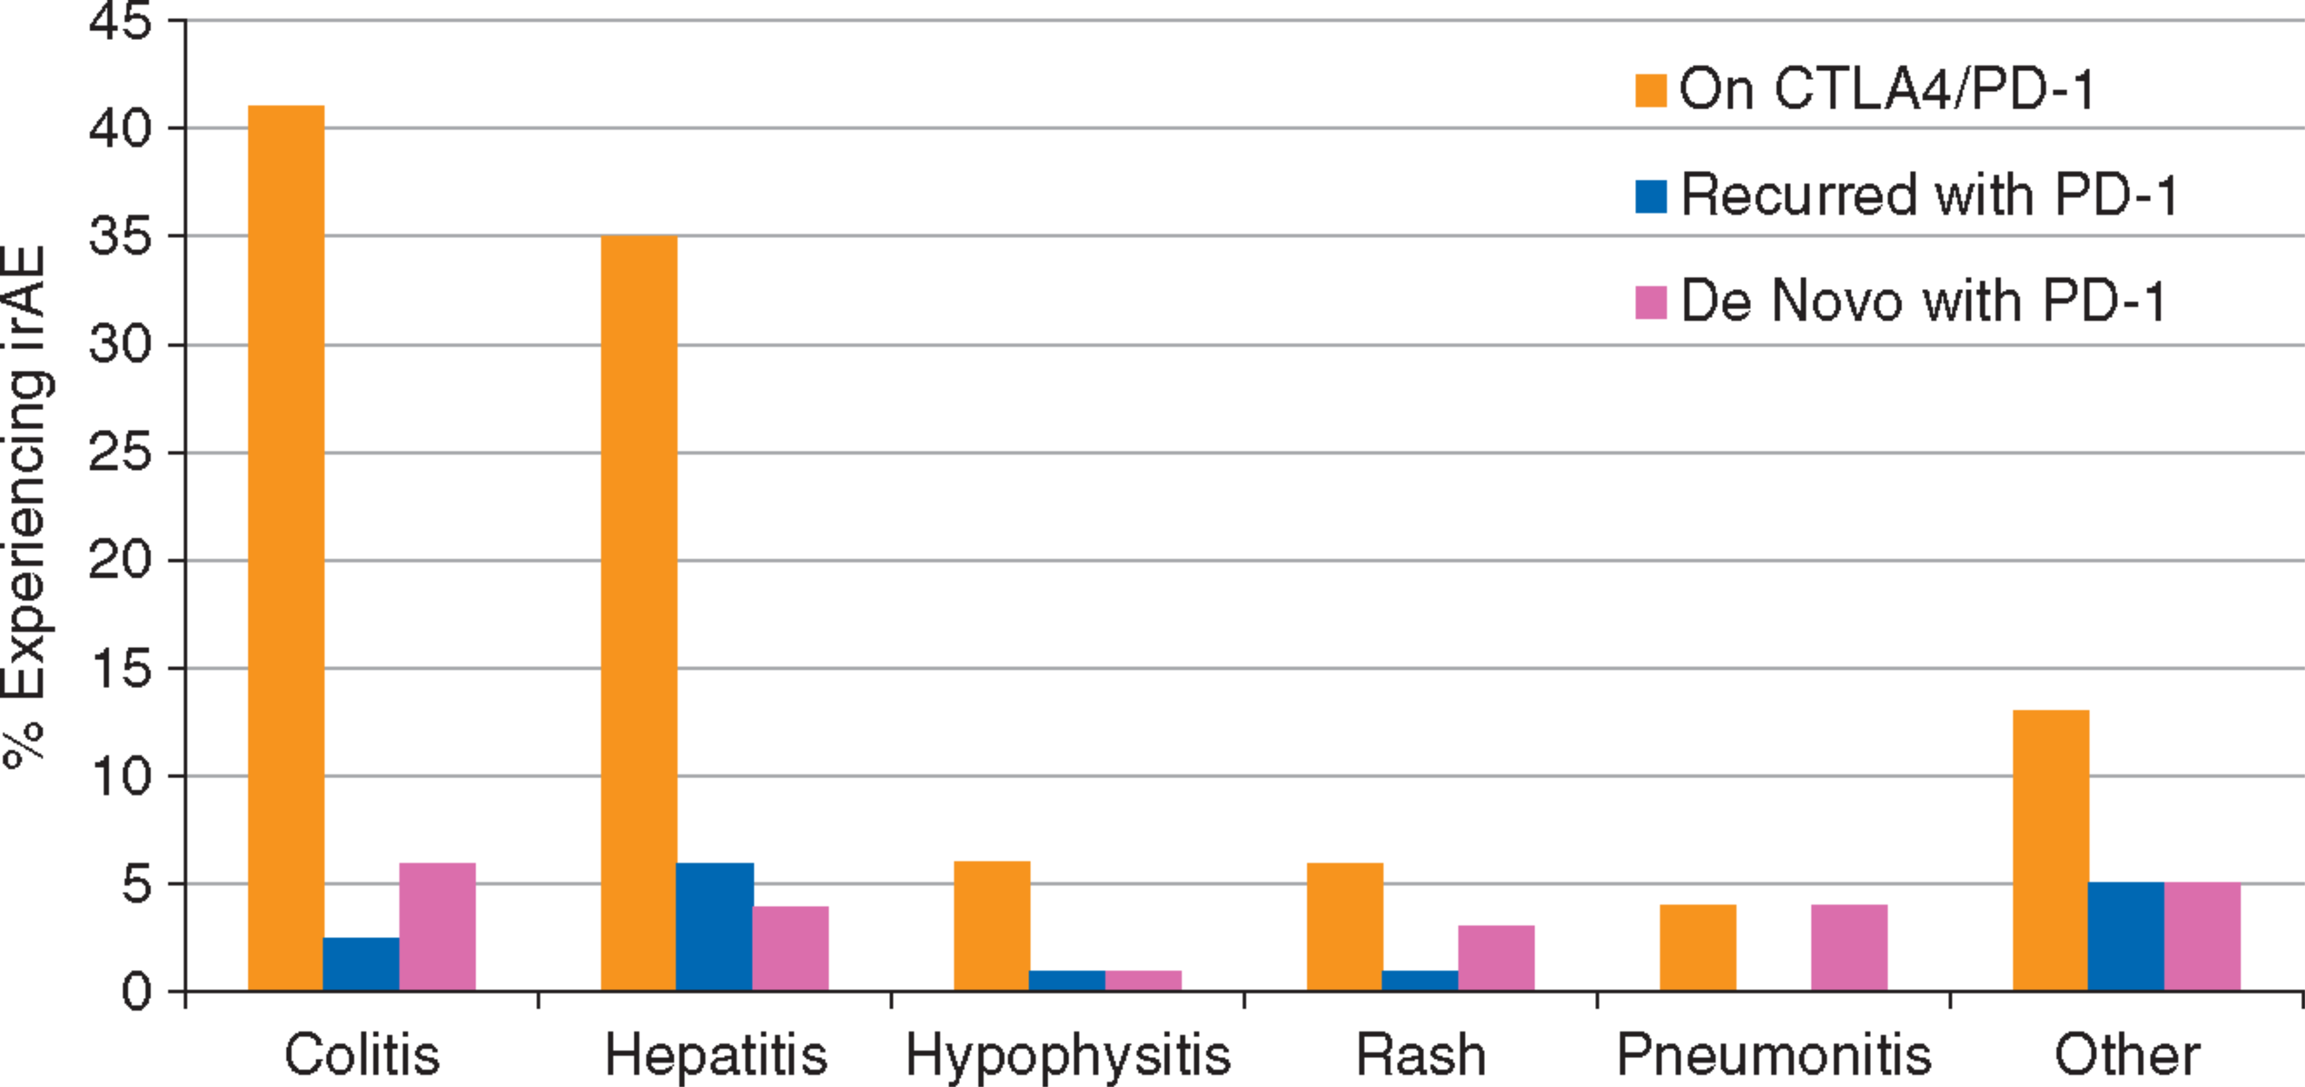
Safety of resuming anti-PD-1 in patients with immune-related adverse events (irAEs) during combined anti-CTLA-4 and anti-PD1 in metastatic melanoma
Pollack et al, Ann Oncol. 2017
Notes:
17

Slide 18
Summary
T cell mediated vs. cytokine vs. autoantibody related toxicities
Dose and duration of therapy
Retreatment ?
Dose and duration of therapy
Toxicity and correlation with outcomes

