Slide 1
Please note, these are the actual video-recorded proceedings from the live CME event and may include the use of trade names and other raw, unedited content.

Slide 2
Immunotherapy in patients with a history of autoimmune disease or paraneoplastic syndromes in the locally advanced and metastatic settings
Jeffrey Crawford, MD
George Barth Geller Professor for Research in Cancer
Co-Director, Solid Tumor Therapeutics Program
Duke Cancer Institute
Durham, North Carolina

Slide 3
Case 2
74 year old retired cardiologist from Little Rock, Arkansas
Cough for 2 months, mild right sided chest discomfort
15 lb weight loss over 6 months
– Medical history:
CAD, atrial flutter, hypertension, gout and psoriasis, and 50 pack yr, (quit 2002)
– PE:
well appearing, PS1
decreased breath sounds RUL, minimal psoriatic patches on right elbow
– CT/PET:
10 cm RUL mass, no distant disease
Bx – squamous cell ca, 90% PDL-1 +
EBUS – level 7 – negative
– Enrolled on protocol with 2 cycles of preoperative pembrolizumab

Slide 4
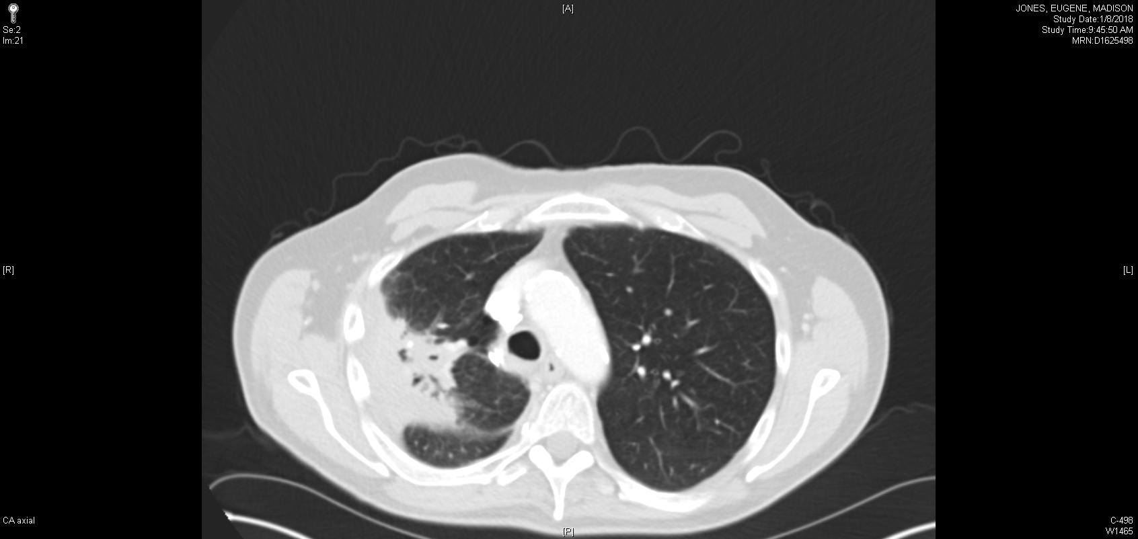
Pretreatment Post 2 cycles of Pembrolizumab

Slide 5
After 2nd cycle of Pembro:
Flare in psoriasis – plaques over trunk and extremities, diffuse erythematous patches over palmar / plantar surfaces of hands and feet
Painful bilateral knee effusions, both required arthrocentesis
Ongoing tenosynovitis, making walking painful
Follow up CT:
-reduction in mass from 10 to 7 cm
Surgery:
Plan:
Adjuvant platinum based chemotherapy per protocol
Subsequent adjuvant Pembrolizumab
RUL/RML bilobectomy 7.5 cm tumor 10% residual viable tumor Marked lymphoid infiltration | One 12 R lobar node + 18 other N1/N2 nodes – Stage IIIA (T4N1M0)

Slide 6
Questions
In a cancer patient with a history of autoimmune disease, what is the likelihood of exacerbation of the disease with immune checkpoint therapy?
a) 10%
b) 25%
c) 50%
d) 75%
What factor is associated with a lower risk of autoimmune disease exacerbation with checkpoint therapy (CPI)?
a) History of inactive disease
b) Being on immunosuppressive treatment at start of CPI
c) Receiving PDL-1 agent rather than CTLA-4
d) We don’t really know

Slide 7
Use of Immune Checkpoint Inhibitors in Cancer Patients with Autoimmune Disease, Paraneoplastic Syndromes, and the Elderly

Slide 8
Disclosures — Jeffrey Crawford, MD
Scientific Advisor | AstraZeneca, Dova, Merck, Pfizer
DSMB Member | Beyond Spring, Celgene, G1 Therapeutics, Janssen, Merrimack, Mylan, Roche
Principal Investigator/Institutional Research Funding | Amgen, AstraZeneca, Bayer, Genentech

Slide 9
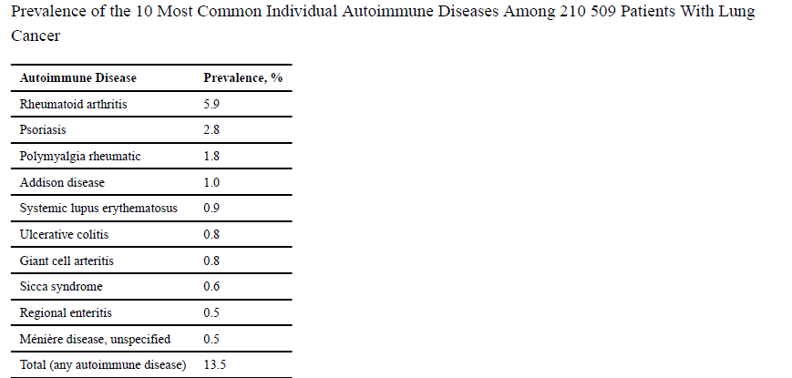
Medicare data linked to SEER database (1992-2009)
Increased incidence in early stage, female sex, and older cohorts
Khan, Pruitt, Kuran, Gerber. JAMA Oncol. 2016 2(11):1507-1508.

Slide 10
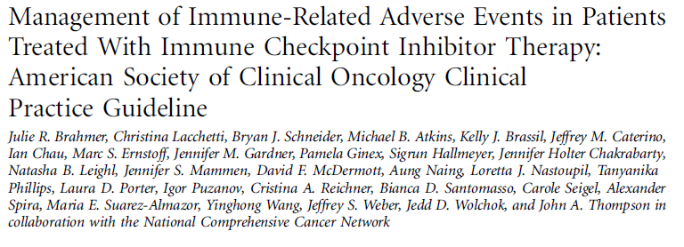
J Clin Oncol 2018:1-55

Slide 11
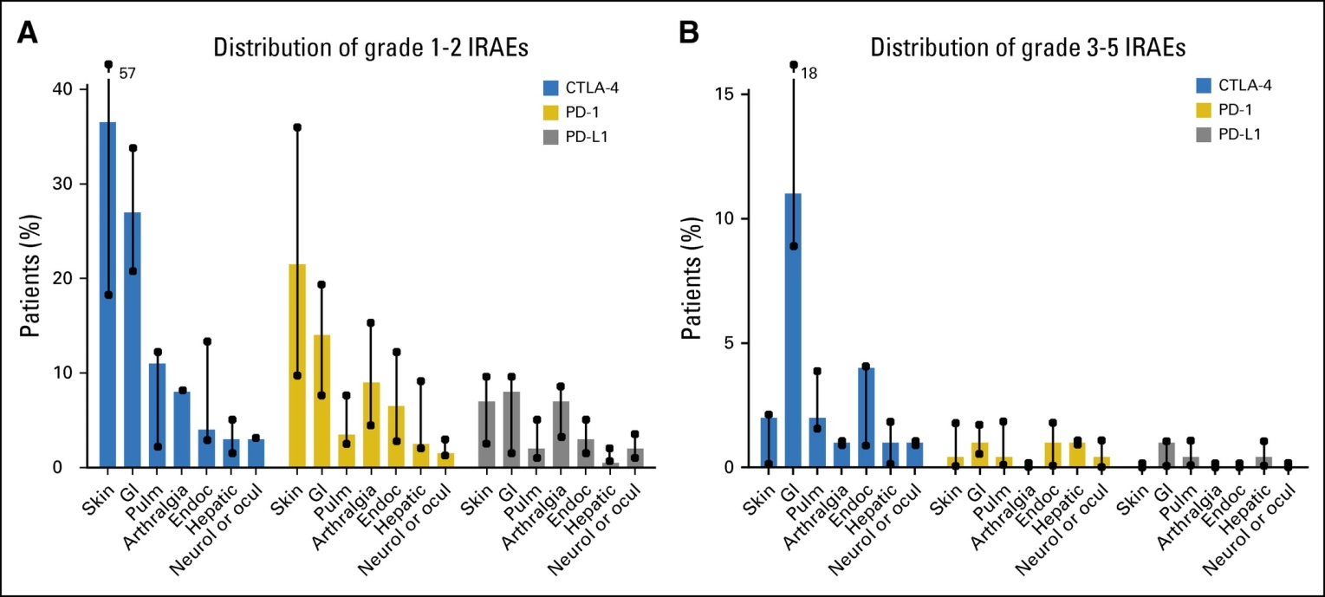
Brahmer, et al. J Clin Oncol 2018:1-55

Slide 12
Immune Checkpoint Inhibitors (CPI) in Treatment of Patients with Cancer and Pre-existing Autoimmune Disease
Systematic review of case reports, case series, and observational studies
123 patients / 49 publications
92 (75%) had adverse event
61 (50%) exacerbation of autoimmune disease
42 (34%) de novo AE
Abdel-Wahab, et al. Ann Intern Med 2018:168:121-130

Slide 13
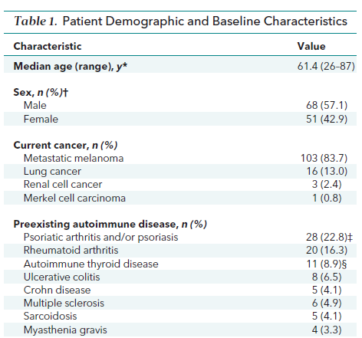
Immune Checkpoint Inhibitors in Cancer and Preexisting Autoimmune Disease
Abdel-Wahab, et al. Ann Intern Med 2018:168:121-130

Slide 14
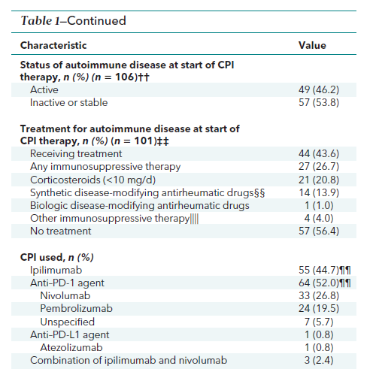
Abdel-Wahab, et al. Ann Intern Med 2018:168:121-130

Slide 15
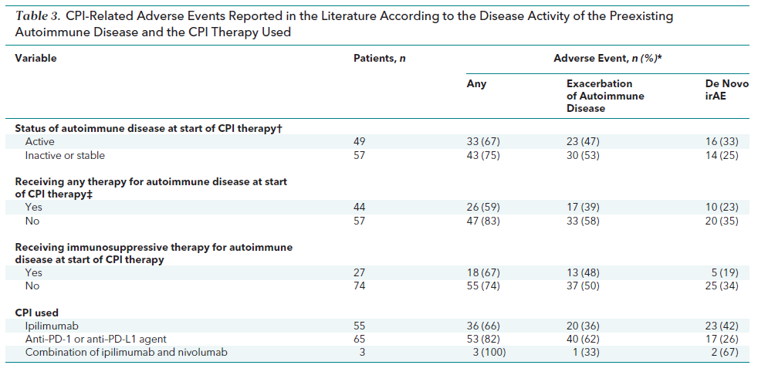
Abdel-Wahab, et al. Ann Intern Med 2018:168:121-130

Slide 16
Summary
Exacerbation of Autoimmune Disease as well as De Novo iRAE with immune checkpoint inhibitor therapy are common.
AEs were at least as frequent in patients with inactive compared to active disease.
AEs improved in more than half of patients without discontinuation of CPI, but there were 3 deaths reported.
It is unknown if patients with autoimmune disease on or off immunosuppression therapy derive the same benefit as patients without autoimmune disease.

Slide 17
AFT-42 (In Development) Safety, Activity, and Pharmacology of Nivolumab in Patients with Advanced Non-Small Cell Lung Cancer and Pre-existing Autoimmune Disease

Slide 18
Cohorts of Autoimmune Conditions
Cohort 1 | Rheumatoid arthritis, psoriasis, giant cell arteritis/polymyalgia rheumatica, Sjogren’s, systemic lupus erythematosis
Cohort 2 | Other autoimmune diseases (ulcerative colitis, Crohn’s disease, multiple sclerosis). Patients must be discussed with PI prior to enrollment.
Use of validated instruments for assessing and scoring disease activity
Rheumatoid arthritis DAS28
Psoriasis PASI
Polymyalgia rheumatica PMR-AS Sjogrens ESSDAI
SLE SLEDAI-2000
Ulcerative Colitis SSCAI
Crohn’s CDAI
Multiple Sclerosis EDSS

Slide 19
Immune Checkpoint Inhibitor (ICI) Impact on Survival in Older Patients
Meta-analysis of 9 randomized trials (n=5265 patients)
Subgroup analysis with
Age cutoff 65-70
Hazard Ratios
Conclusion: a benefit in OS with ICIs was significant in both younger and older patients (safety differences not formally evaluated)
 | PFS | OS
Younger | .58 (.40-.84) | .75 (.68-.82)
Older | .77 (.58-1.02) | .73 (.62-.87)
Nishijima, Muss, Shachar, Moschos. Cancer Treatment Reviews, Vol. 45, p30–37

Slide 20
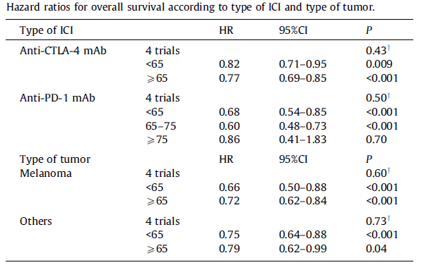
Overall Survival by Type of Immune Checkpoint Inhibitor and Tumor
† p-value for differences in HR
Nishijima, Muss, Shachar, Moschos. Cancer Treatment Reviews, Vol. 45, p30–37

Slide 21
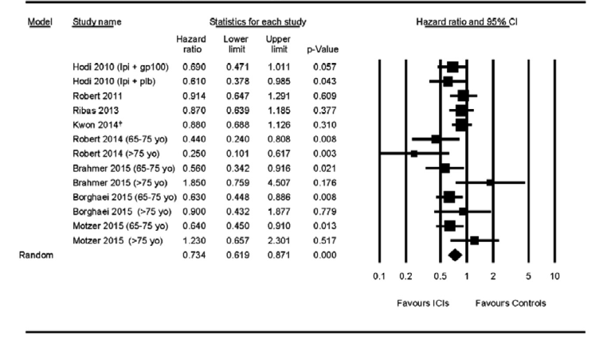
Overall Survival for Older Group by Study Hazard Ratios
Nishijima, Muss, Shachar, Moschos. Cancer Treatment Reviews, Vol. 45, p30–37

Slide 22
Immune Checkpoint Inhibitors in Cancer Patients with Immune Disorders: Commentary
Immune checkpoint inhibitors have been given to cancer patients with a wide range of autoimmune disorders.
The majority of patients experienced exacerbation of their underlying autoimmune disorder and/or de novo immune related adverse events.
The risk/benefit ratio will require prospective longitudinal studies in larger populations.
In the interim, providers should proceed with caution, particularly in high risk settings where exacerbation of underlying disorders may not be readily reversed (inflammatory CNS disease, transplant, etc).

