Slide 1
Please note, these are the actual video-recorded
proceedings from the live CME event and may include
the use of trade names and other raw, unedited content.

Slide 2
Emergence of Immune Checkpoint Inhibition as a Therapeutic Consideration for Patients with Locally Advanced Non-Small Cell Lung Cancer (NSCLC)
Corey J Langer, MD, FACP
Director of Thoracic Oncology
Abramson Cancer Center
Professor of Medicine
University of Pennsylvania
Philadelphia, PA

Slide 3
Disclosures
Advisory Committee | Abbott Laboratories, AstraZeneca Pharmaceuticals LP, Boehringer Ingelheim Pharmaceuticals Inc, Celgene Corporation, Genentech BioOncology, Lilly, Merck, Pfizer Inc, Roche Laboratories Inc, Takeda Oncology
Consulting Agreements | AstraZeneca Pharmaceuticals LP, Bayer HealthCare Pharmaceuticals, Boehringer Ingelheim Pharmaceuticals Inc, Bristol-Myers Squibb Company, Celgene Corporation, Eisai Inc, Genentech BioOncology, Lilly, Merck, Novartis, Pfizer Inc, Roche Laboratories Inc, Takeda Oncology
Contracted Research | Advantagene Inc, Ariad Pharmaceuticals Inc, GlaxoSmithKline, Inovio Pharmaceuticals Inc, Merck, Takeda Oncology
Data and Safety Monitoring Board | Amgen Inc, Lilly, Peregrine, Synta, SWOG

Slide 4
LA-NSCLC Chemoradiation:
Positive Trials: OS through 2018
INDUCTION: 4 (CALGB; RTOG, French, UK)
CONCURRENT: 4 (EORTC; Jeremic [2], Japan)
CONCURRENT v SEQUENTIAL: 3 (Furuse; RTOG; Czech)
IMMUNOTHERAPY 1 (PACIFIC)
ADJUVANT/CONSOLIDATION: 0 (HOG)
TARGETED TX 0 (SWOG 0023)
DOSE ESCALATION of RT 0 (RTOG 0617)

Slide 5
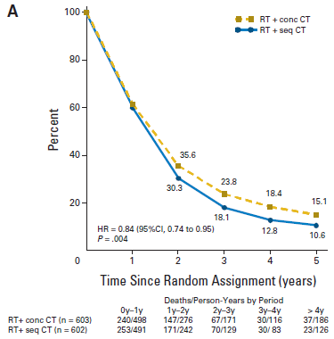
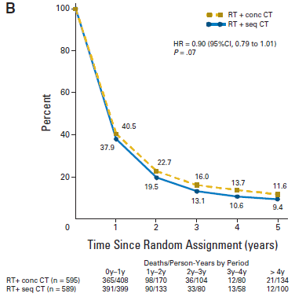
Survival Comparison between Sequential and Concurrent Chemoradiation Therapy
OS
PFS
Auperin, LePechoux et al Seoul, Abstract 1-05, S310, JTO Vol 2, Suppl 4, August 2007

Slide 6
Where Have We Failed in Recent Years in LA-NSCLC?
EGFR TKIs: SWOG
  Reduced Survival with Gefitinib in Unselected pts (p = 0.01)
XRT Dose Escalation: RTOG 0617
  Deleterious effect on OS for 74 Gy vs 60 Gy (p = 0.0007)
EGFR MAb: RTOG 0617
  No benefit to the addition of C225 (p = 0.48)
Vaccines: START
  No benefit for the addition of L -BLP-25 (liposomal vaccine targeting mucinous glycoprotein) (p= 0. 123)

Slide 7
Primacy of Immunotherapy in LA-NSCLC
PACIFIC (Durvalumab)
HOG LUN 14-179 (Pembrolizumab)

Slide 8
Rationale for PD(L)1 Inhibition after Chemoradiation in LA-NSCLC
Checkpoint Inhibitors (CPIs) have demonstrated activity in lung cancer with OS advantage vs Docetaxel in 2nd Line NSCLC and now as single agent (PDL1 > 50%) and in combination with chemo in 1st line
Potentially enhanced efficacy when used in minimal disease states, therefore well suited as “consolidation” therapy after definitive chemoradiation
XRT can upregulate PDL1 and cause release of tumor antigen and pro-inflammatory cytokines potentially enhancing immune response, as well as recruit T cells to the tumor bed
Preclinical studies in mice show that anti-PD1 therapy enhances the efficacy of radiation therapy via
T cell dependent cytotoxic mechanisms
  Mouse GBM model: increased OS with concurrent PD1 inhibition and XRT with anti tumor memory response: Zeng et al, IJROP 86:343-349, 2013
  Synergy observed with XRT and PD1 MAb in Breast and CRC xenografts, with abscopal effect (Deng et al, JCI 124; 687-695, 2014
  Melanoma model: addition of PDL1 blockade reverses T cell exhaustion and mitigates depression in CD8/Treg ratio; with expansion
  of oligoclonal Tcell population (CT-S Victor et al, Nature 1-5 (2015) doi:10 1038/nature 14292)

Slide 9
Select Immunotherapy Trials
LA-NSCLC
Trial name | NCT trial number | Drug name | Outcome | Phase | n | Duration | Trial status
NICOLAS | 02434081 | Nivolumab* | Safety (pneumonitis) | II | 43 | 1 year | Recruiting
RTOG 3505 |  | Nivolumab | OS | III | 660 | 1 year | Cx
Rutgers/ Penn/Yale | 02621398 | Pembrolizumab* | MTD | I | 30+ | 1 year | Recruiting
Hoosier | 02343952 | Pembrolizumab (c) | Time to distant relapse | II | 93 | 1 year | Completed
DETERRED | 02525757 | Atezolizumab# | Safety | II | 40 | 1 year | Recruiting
PACIFIC | 02125461 | Durvalumab (c) | OS | III | 702 | 1 year | Completed (+)
START2 | 02049151 | Tecemotide (L-BLP25) | OS | III | 1,000 | Until progression | Terminated (-)
ECOG | 00828009 | Tecemotide (L-BLP25) + bevacizumab | Safety | II | 55 | Up to 34 courses | Completed
* Concurrent
(c) Consolidation
# Both

Slide 10
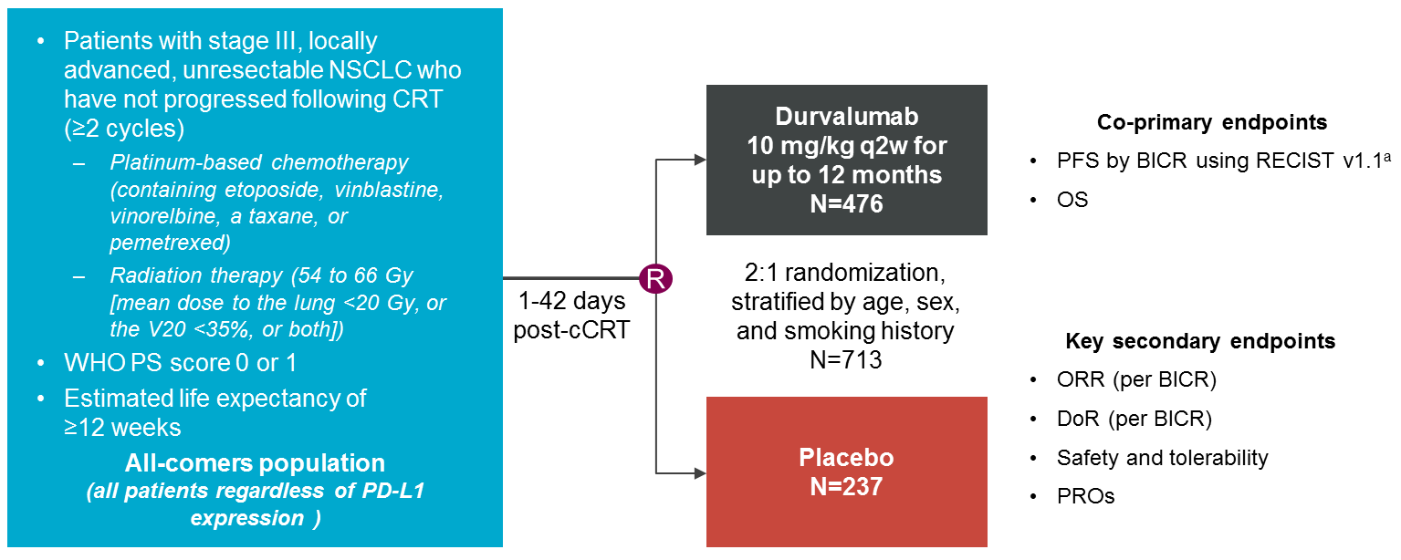
PACIFIC: Consolidation immunotherapy (durvalumab) after CRT is the current standard of care for unresectable LA-NSCLC
Antonia SJ et al., NEJM 2017

Slide 11
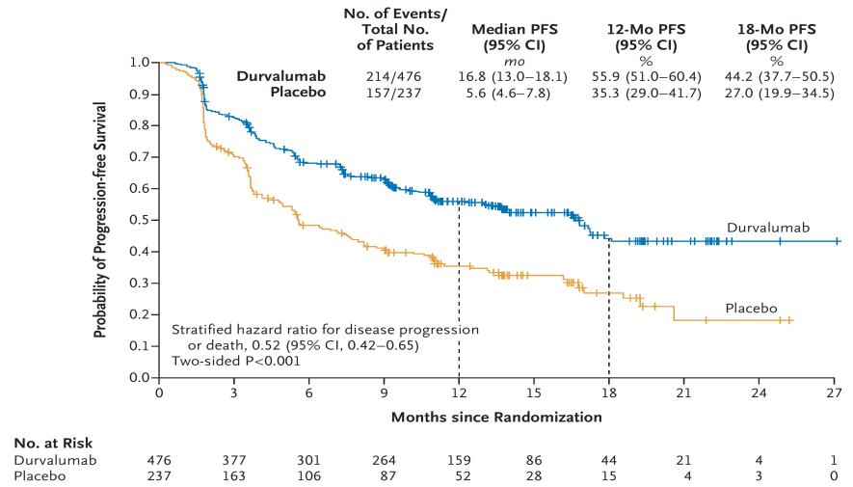
PACIFIC: Consolidation immunotherapy (durvalumab) after CRT is the current standard of care for unresectable LA-NSCLC
Antonia SJ et al., NEJM 2017

Slide 12
PFS Subgroup Analysis by BICR (ITT)
 |  | Durvalumab | Placebo |  | Unstratified HR*
 |  | No. of patients |  |  | (95% CI)
 | All patients | 476 | 237 |  | 0.55 (0.45–0.68)
Sex | Male | 334 | 166 |  | 0.56 (0.44–0.71)
 | Female | 142 | 71 |  | 0.54 (0.37–0.79)
Age at randomization | <65 years | 261 | 130 |  | 0.43 (0.32–0.57)
 | ≥65 years | 215 | 107 |  | 0.74 (0.54–1.01)
Smoking status | Smoker | 433 | 216 |  | 0.59 (0.47–0.73)
 | Non-smoker | 43 | 21 |  | 0.29 (0.15–0.57)
Disease stage | Stage IIIA | 252 | 125 |  | 0.53 (0.40–0.71)
 | Stage IIIB | 212 | 107 |  | 0.59 (0.44–0.80)
Histology | Squamous | 224 | 102 |  | 0.68 (0.50–0.92)
 | Non-squamous | 252 | 135 |  | 0.45 (0.33–0.59)
Best response to cCRT | CR | 9 | 7 |  | –
 | PR | 232 | 111 |  | 0.55 (0.41–0.75)
 | SD | 222 | 114 |  | 0.55 (0.41–0.74)
PD-L1 status | ≥25% | 115 | 44 |  | 0.41 (0.26–0.65)
 | <25% | 187 | 105 |  | 0.59 (0.43–0.82)
 | Unknown | 174 | 88 |  | 0.59 (0.42–0.83)
EGFR status | Mutant | 29 | 14 |  | 0.76 (0.35–1.64)
 | Wild-type | 315 | 165 |  | 0.47 (0.36–0.60)
 | Unknown | 132 | 58 |  | 0.79 (0.52–1.20)
0.25
0.5
1
2
Favors durvalumab
Favors placebo
*Hazard ratio and 95% CI not calculated if the subgroup has less than 20 events.
BICR, blinded independent central review; CI, confidence interval; CR, complete response; HR, hazard ratio; ITT, intention-to-treat; EGFR, epidermal growth factor receptor
¹Antonia et al. NEJM. 2017. Nov 16. 1919-1929.

Slide 13
PACIFIC: Overall Survival* (ITT)
 | No. of events / No. of patients | Median OS (95% CI) months | 12-mo OS (95% CI) % | 24-mo OS (95% CI) %
Durvalumab | 183/476 | NR (34.7–NR) | 83.1 (79.4–86.2) | 66.3 (61.7–70.4)
Placebo | 116/237 | 28.7 (22.9–NR) | 75.3 (69.2–80.4) | 55.6 (48.9–61.8)
1.0
0.9
0.8
0.7
0.6
Durvalumab
0.5
Probability of Overall Survival
0.4
Placebo
0.3
0.2
0.1
Stratified hazard ratio for death, 0.68 (99.73% CI, 0.469–0.997)
Two-sided P=0.00251
0.0
1
3
6
9
12
15
18
21
24
27
30
33
36
39
42
45
Time from Randomization (months)
No. at Risk
Durvalumab
476
464
431
415
385
364
343
319
274
210
115
57
23
2
0
0
Placebo
237
220
198
178
170
155
141
130
117
78
42
21
9
3
1
0
*Median duration of follow-up for OS was 25.2 months (range 0.2–43.1)
¹Antonia et al. NEJM. 2018

Slide 14
Overall Survival by Subgroup (ITT)
 |  | Durvalumab | Placebo |  | Unstratified HR*
 |  | No. of events / No. of patients (%) |  |  | (95% CI)
 | All patients | 183/476 (38.4) | 116/237 (48.9) |  | 0.68 (0.54–0.86)
Sex | Male | 141/334 (42.2) | 80/166 (48.2) |  | 0.78 (0.59–1.03)
 | Female | 42/142 (29.6) | 36/71 (50.7) |  | 0.46 (0.30–0.73)
Age at randomization | <65 years | 89/261 (34.1) | 58/130 (44.6) |  | 0.62 (0.44–0.86)
 | ≥65 years | 94/215 (43.7) | 58/107 (54.2) |  | 0.76 (0.55–1.06)
Smoking status | Smoker | 169/433 (39.0) | 103/216 (47.7) |  | 0.72 (0.56–0.92)
 | Non-smoker | 14/43 (32.6) | 13/21 (61.9) |  | 0.35 (0.16–0.76)
Disease stage | Stage IIIA | 101/252 (40.1) | 70/125 (56.0) |  | 0.63 (0.46–0.85)
 | Stage IIIB | 79/212 (37.3) | 44/107 (41.1) |  | 0.77 (0.53–1.11)
Tumor histologic type | Squamous | 103/224 (46.0) | 56/102 (54.9) |  | 0.72 (0.52–0.99)
 | Non-squamous | 80/252 (31.7) | 60/135 (44.4) |  | 0.61 (0.44–0.86)
Best response to prior treatment | CR | 2/9 (22.2) | 3/7 (42.9) |  | –
 | PR | 83/237 (35.0) | 50/112 (44.6) |  | 0.69 (0.49–0.99)
 | SD | 93/223 (41.7) | 61/115 (53.0) |  | 0.66 (0.48–0.91)
PD-L1 status | ≥25% | 37/115 (32.2) | 23/44 (52.3) |  | 0.46 (0.27–0.78)
 | <25% | 74/187 (39.6) | 41/105 (39.0) |  | 0.92 (0.63–1.34)
 | Unknown | 72/174 (41.4) | 52/88 (59.1) |  | 0.62 (0.43–0.89)
 | ≥1%† | 70/212 (33.0) | 45/91 (49.5) |  | 0.53 (0.36–0.77)
 | 1–24%† | 33/97 (34.0) | 22/47 (46.8) |  | 0.60 (0.35–1.03)
 | <1%† | 41/90 (45.6) | 19/58 (32.8) |  | 1.36 (0.79–2.34)
EGFR status | Positive | 10/29 (34.5) | 6/14 (42.9) |  | –
 | Negative | 117/317 (36.9) | 80/165 (48.5) |  | 0.64 (0.48–0.86)
 | Unknown | 56/130 (43.1) | 30/58 (51.7) |  | 0.77 (0.49–1.20)
0.00
0.20
0.40
0.60
0.80
1.00
1.20
1.40
1.60
1.80
2.00
2.20
2.40
*Not calculated if the subgroup has less than 20 events
†Assessed as part of exploratory post-hoc analyses
Durvalumab better
Placebo better
¹Antonia et al. NEJM. 2018

Slide 15
Langer’s Concerns 2018
PACIFIC
Study Remains Blinded to OS: since addressed by press release and WCLC 2018 presentation – Data on PDL1 < 1% give us pause
Control Group Underperformed wrt PFS: still unexplained
Significant Percentage of Pts (?Majority) did not Undergo Pre-Tx PET: need to see these data
Some Imbalance in Percentage of Pts with > 25% PDL1 Expression Favoring Durvalumab: Lucky break
No data on Percentage who Received < 60 Gy or Nature of Subsequent or Concurrent Chemo: latter addressed by supplemental tables in NEJM paper; still need information on the former and on f/u Tx

Slide 16
Phase II Trial of Concurrent Chemoradiation with Consolidation Pembrolizumab in Patients with Unresectable Stage III NSCLC
Hoosier Cancer Research Network LUN 14-179
Greg Durm¹, Sandra Althouse², Ahad Sadiq³, Shadia Jalal¹, Salma Jabbour⁴, Robin Zon⁵, Goetz Kloecker⁶, William Fisher⁷, Karen Reckamp⁸, Ebenezer Kio⁹, Robert Langdon¹⁰, Bamidele Adesunloye¹¹, Ryan Gentzler¹², and Nasser Hanna¹
¹ Indiana University Simon Cancer Center, ² Indiana University Department of Biostatistics, ³ Fort Wayne Medical Oncology and Hematology, ⁴ Rutgers Cancer Institute of New Jersey, ⁵ Michiana Hematology/Oncology, ⁶ University of Louisville James Graham Brown Cancer Center, ⁷ IU Health Ball Memorial Hospital, ⁸ City of Hope Comprehensive Cancer Center, ⁹ Goshen Center for Cancer Care, ¹⁰ Nebraska Methodist Hospital, ¹¹ IU Health Arnett Cancer Center, ¹² University of Virginia Cancer Health System

Slide 17
Consolidation Pembrolizumab Following CCRT for Unresectable Stage III NSCLC: LUN 14-179
Concurrent Chemoradiation
Cis/Etop
OR
Carbo/Pac
OR
Cis/Pemetrexed
+
59.4-66.6 Gy
Repeat imaging (CT or PET) 28-56 days later
PD
SD or Response
Patient Enrolled
Not Eligible
Pembrolizumab 200mg IV every 3 weeks for up to 12 months
Subjects can receive up to 2 cycles of consolidation chemotherapy at the discretion of treating physician
Greg Durm, WCLC 2018

Slide 18
Treatment Administration: LUN 14-179
Median number of cycles of Pembrolizumab – 13.5 (1-19)
40 (43.5%) pts were able to complete 1 year of treatment
  Disease progression- 23 (25%)
  Adverse events- 18 (19.6%)
  Patient withdrawal- 7 (7.6%)
  Death on study- 3 (3.3%)
  Other complicating disease- 1 (1.1%)
Greg Durm, WCLC 2018

Slide 19
Efficacy of Consolidation
Pembrolizumab vs Durvalumab
Endpoint | LUN 14-179² (Pembrolizumab) | PACIFIC¹ (Durvalumab) | PACIFIC¹ (Placebo)
Median Follow-up | 23.9 months | 14.5 months | 14.5 months
Progression Free Survival
Median | 15 months | 16.8 months | 5.6 months
12-month | 60.8% | 55.9% | 35.3%
18-month | 46.9% | 44.2% | 27.0%
Overall Survival
Median | NR | NR | 28.7
12-month | 81.0% | 83.1% | 75.3%
24-month | 61.9% | 66.3% | 55.6%
Time to Metastatic Disease or Death
Median | 30.7 months | 23.2 months | 14.6 months
12-month | 76.3% | - | -
18-month | 60.0% | - | -
¹Antonia et al. NEJM. 2017. Nov 16. 1919-1929; ²Durm et al. WCLC ‘18

Slide 20
Efficacy of Consolidation
Pembrolizumab vs Durvalumab
Endpoints | LUN 14-179² (Pembrolizumab) | PACIFIC¹ (Durvalumab) | PACIFIC¹ (Placebo) | START³ (Placebo) | START³ BLP-25
Median Follow-up | 18.6 months | 14.5 months | 14.5 months | 39.9 months | 37.7 months
Progression Free Survival
Median | 15.0 months | 16.8 months | 5.6 months | 8.4 months | 10.0 months
12-month | 60.8% | 55.9% | 35.3% | NA | NA
18-month | 46.9% | 44.2% | 27.0% | NA | NA
Overall Survival
Median (mos) | NR | NA | 28.7 | 22.3 | 25.6
12-month (%) | 81.0% | 83.1 | 75.3 | NA | NA
24-month (%) | 61.9% | 66.3 | 56.7 | NA | NA
Time to Metastatic Disease or Death
Median | 30.7 months | 23.2 months | 14.6 months | - | -
12-month | 76.3% | - | - | - | -
18-month | 50.0% | - | - | - | -
¹Antonia et al. NEJM. 2017. Nov 16. 1919-1929; ²Durm et al. ASCO ’18, ³Butts et al. Lancet 2014
¹Antonia et al. NEJM. 2017. Nov 16. 1919-1929
²Durm et al, ASCO 2018.

Slide 21
DETERRED: Phase II trial combining atezolizumab concurrently with chemoradiation therapy in locally advanced non-small cell lung cancer
Steven H. Lin, Yan Lin, Debora Clay, Luyang Yao, Isabel Mok, Daniel R. Gomez, Jonathan M. Kurie, George R. Simon, George R. Blumenschein, Jr., Jeanean Young, See Phan, Alan Sandler, Vali Papadimitrakopoulou, John V. Heymach, Anne S. Tsao
Departments of Radiation Oncology and Thoracic Head & Neck Medical Oncology, The University of Texas MD Anderson Cancer Center, Houston, Texas; Genentech, San Francisco, CA
Presenter: Steven H. Lin, MD Anderson Cancer Center, Houston, Texas, USA

Slide 22
DETERRED* (PD-L1 BlockadE To Evaluate the safety of Lung CanceR Therapy using Carboplatin, Paclitaxel, and Radiation combinEd with MPDL3280A (Atezolizumab))
Part 1 (N=10)
Schema
Part 2 (N=30)
*Clinicaltrials.gov NCT02525757

Slide 23
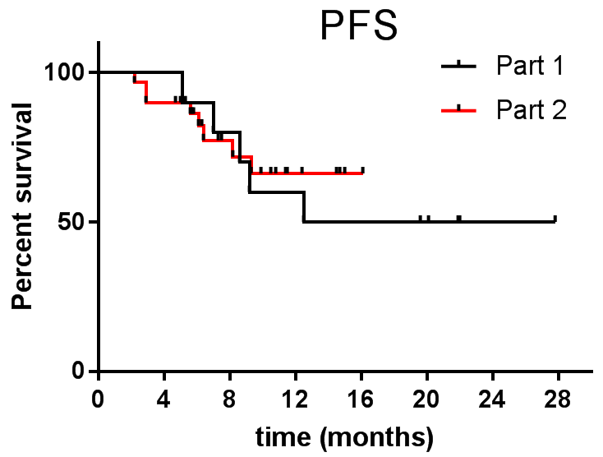
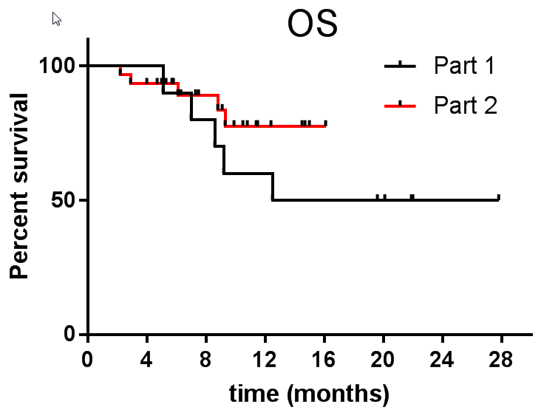
DETERRED: Early preliminary efficacy results (as of 8/15/18)
Cohort | Median PFS | 1 yr PFS | Median OS | 1 yr OS
Part 1 | 20.1 mos | 60% | 20.1 mos | 60%
Part 2 | NR | 66% | NR | 77%
Median F/U 1.3 years for part 1
0.75 years for part 2
Suggestion that Concurrent and Consolidation may be Superior to Consolidation Alone
Lin SH et al. WCLC 2018

Slide 24
Efficacy of Consolidation +/- Concurrent IO
Pembrolizumab vs Durvalumab vs Atezolizumab
Endpoints | LUN 14-179² (Pembrolizumab) | PACIFIC¹ (Durvalumab) | PACIFIC¹ (Placebo) | DETERRED⁴ (Atezolizumab) | START³ (Placebo) | START³ BLP-25
Median Follow-up | 23.9months | 14.5 months | 14.5 months | 9 mos | 39.9 months | 37.7 months
No | 92 | 476 | 237 | 30 | 829 | 410
Time to Metastatic Disease or Death
Median | 30.7 months | 23.2 months | 14.6 months |  | - | -
12-month | 76.3% | - | - |  | - | -
18-month | 60.0% | - | - |  | - | -
Progression Free Survival
Median | 15.0 months | 16.8 months | 5.6 months | NR | 8.4 months | 10.0 months
12-month | 60.8% | 55.9% | 35.3% | 66% | NA | NA
18-month | 46.9% | 44.2% | 27.0% |  | NA | NA
Overall Survival
Median (mos) | NR | NR | 28.7 | NR | 22.3 | 25.6
12-month (%) | 81.0% | 83.1 | 75.3 | 77 | NA | NA
24-month (%) | 61.9% | 66.3 | 56.7 |  | NA | NA
¹Antonia et al. NEJM. 2017. Nov 16. 1919-1929
²Durm et al, ASCO 2018.
¹Antonia et al. NEJM. 2017. Nov 16. 1919-1929; ²Durm et al. WCLC ’18, ³Butts et al. Lancet 2014 ⁴Lin et al WCLC 2018 – phase II cohort

Slide 25
Moving PD-1 Blockade with Pembrolizumab into Concurrent CRT for Locally Advanced NSCLC,
Phase I Study
Trial in Progress
CINJ 031507
PI: Salma Jabbour
Multicenter Study: Rutgers, Penn, Yale

Slide 26
Langer’s Conclusions and Future Directions:
IO Tx in LA-NSCLC
Vaccines, EGFR MABs and TKIs have “failed” in this space (so far)
Based on (+) PFS and OS results, durvalumab “consolidation” X 1 yr is now the standard of care in LA-NSCLC who have completed definitive chemoradiation
Pembrolizumab consolidation performs on par with durvalumab albeit with slightly higher pulmonary toxicity; OS data exceed historic controls
Atezolizumab concurrently with CT/RT appears safe; efficacy data VERY preliminary
Open questions:
  Do all PD-1/PD-L1 inhibitors have similar efficacy and toxicity?
  What is the optimal duration of consolidation immunotherapy?
  Role of concurrent chemo/RT/IO followed by Consolidation IO vs Consolidation IO only?
  Consolidation with combination IO agents ?
  Role, if any, of biomarkers. Critically, should we consider an alternative strategy in those with no PDL1 expression?

