Slide 1
Please note, these are the actual video-recorded
proceedings from the live CME event and may include
the use of trade names and other raw, unedited content.

Slide 2
DNA Repair Deficiency in Advanced Prostate Cancer and the Potential Role of PARP Inhibition
Emmanuel S Antonarakis, M.D.
Associate Professor
Departments of Oncology and Urology
Johns Hopkins University
Sidney Kimmel Comprehensive Cancer Center
Baltimore, Maryland

Slide 3
Faculty Disclosures
Emmanuel S. Antonarakis, MD, has disclosed that he has received consulting fees and funds for research from Janssen, J&J, AstraZeneca, Bayer, Astellas, Pfizer, Sanofi, Merck and Clovis; and royalties and intellectual property rights from Qiagen.

Slide 4
PARP Inhibition in Four Common Cancers:
Biology, Clinical Research Database and
Therapeutic Strategy
Pan-Tumor Considerations:
Short- and long-term toxicity based on genomic profile?

Slide 5
Outline
Prevalence of DNA repair gene mutations in prostate cancer
Inherited DNA repair mutations and indications for germline BRCA testing
Clinical data with Olaparib in mCRPC (phase 2 and 3)
Clinical data with Rucaparib in mCRPC (phase 2 and 3)
PARP inhibitor combinations (w/ hormonal agents, checkpoint inhibitors)
Conclusions and unanswered questions

Slide 6
Frequency of DNA repair mutations in prostate cancer

Slide 7
DNA Repair Defects in Localized Prostate Ca
DNA Sequencing analysis of localized prostate tumors (N = 477)
  200 whole-genome sequences, 277 whole-exome sequences
47/477 (9.9%) tumors had DNA repair mutations
  FANCA (n = 9) 1.9%
  ATM (n = 8) 1.7%
  RAD51 (n = 7) 1.5%
  CDK12 (n = 6) 1.3%
  BRCA2 (n = 5) 1.0%
Fraser M, et al. Nature 2017; 541: 359-364.

Slide 8
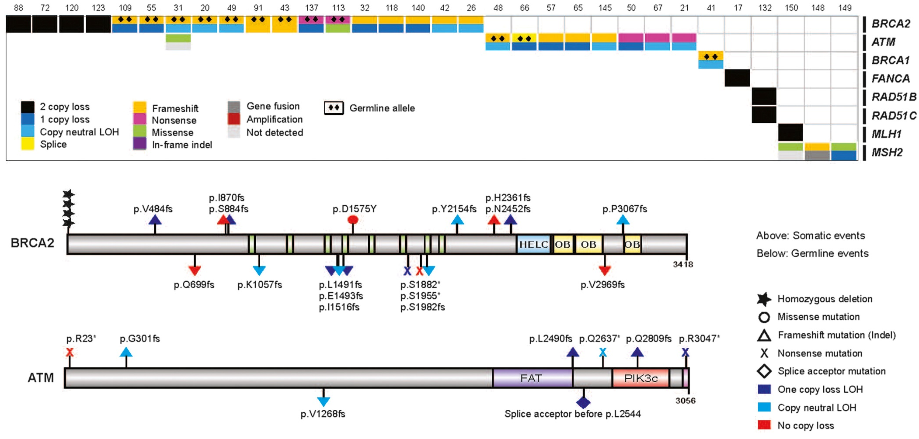
DNA Repair Defects in Metastatic CRPC
32/150 (21.3%) mCRPC pts had bi-allelic DNA repair mutations
All DNA Repair
Defects
Mutations in BRCA2, ATM
Robinson D, et al. Cell. 2015; 5: 1215-1228.

Slide 9
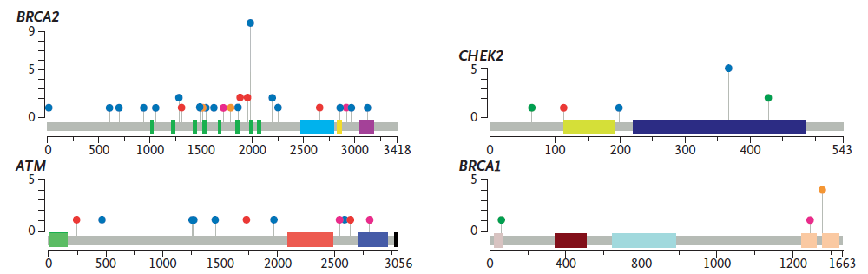
Germline Mutations in Advanced Prostate Cancer
Pathogenic Germline Mutations
11.8% (82/692) of men with metastatic prostate cancer inherited a germline DNA repair mutation vs 4.6% in localized PCa
RAD51C, 1%
MSH6, 1%
MRE11A, 1%
MSH2, 1%
BRIP1, 1%
GEN1, 2%
FAM175A, 1%
CHEK2
PMS2, 2%
BRCA2
NBN, 2%
n = 37 (5.3%)
n = 10 (1.9%)
ATR, 2%
RAD51D, 4%
PALB2, 4%
BRCA2,
44%
BRCA1,
7%
ATM
BRCA1
CHEK2,
12%
n = 11 (1.6%)
n = 6 (0.9%)
ATM,
13%
Pritchard CC, et al. N Engl J Med. 2016;375:443-453.

Slide 10
Germline DNA-Repair Defects and Intraductal Cancer
Distribution of Germline Mutations
Germline mutations in 14% (21/150) of men with recurrent/ advanced prostate cancer
Men with intraductal histology more likely to have germline mutations
Incidence of Germline Mutations
Intraductal Histology | No Intraductal Histology | P Value*
40% (10/25) | 9% (11/125) | P = .003
*Fisher’s test
Isaacsson Velho P, et al. The Prostate. 2018; 78: 401-407.

Slide 11
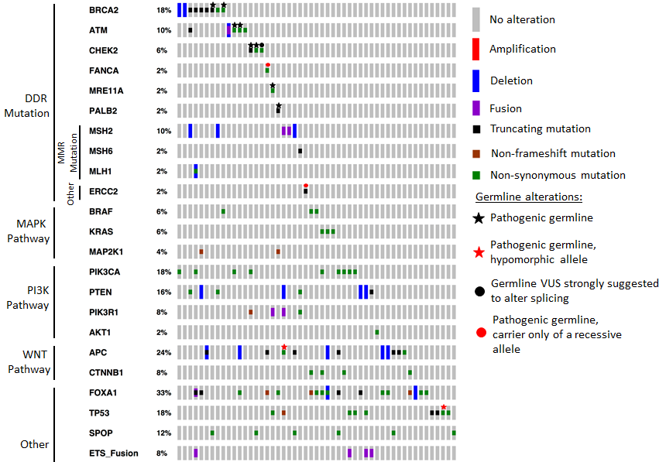
DNA Repair Defects and Prostatic Ductal Cancer
Overall, 49% had DNA repair gene mutations:
  MMR mutations 14%
  HRD mutations 31%
Schweizer MT, et al. ASCO 2018; abstract 5030.

Slide 12
Indications for germline genetic testing

Slide 13
Germline testing:
2019 NCCN Prostate vs. NCCN High-Risk Breast/Ovarian
Prostate Cancer Risk Group | NCCN 1.2019 Prostate (“Consider germline testing”) | NCCN 2.2019 High-Risk Breast/Ovarian (BRCA1/2 Testing Criteria)
Gleason score 7, any age | If brother or father with PCa ≤60 OR If ≥1 relative with breast, ovarian, pancreas Ca OR If ≥1 relative with CRC, endometrial, gastric, ovarian, pancreas, small bowel, urothelial, kidney, bile duct | Ashkenazi Jewish ancestry If ≥1 close blood relative with ovarian or breast Ca ≤50 OR If 2 relatives with breast, pancreas, prostate Ca (Gleason ≥7 or metastatic)
Gleason score ≥8, any age | Consider germline testing for all men | Ashkenazi Jewish ancestry If ≥1 close blood relative with ovarian or breast Ca ≤50 OR If 2 relatives with breast, pancreas, prostate Ca (Gleason ≥7 or metastatic)
Metastatic (radiographic) | Consider germline testing for all men | Germline testing for all men
Any age, and: ≥T3a OR PSA>20 at diagnosis | Consider germline testing for all men | No recommendations
Any man with prostate Ca (any grade/stage, PSA level) | If brother or father with PCa ≤ 60 OR If ≥1 relative with breast, ovarian, pancreas Ca OR If ≥1 relative with CRC, endometrial, gastric, ovarian, pancreas, small bowel, urothelial, kidney, bile duct | No recommendations

Slide 14
Germline testing: Merged referral criteria
Metastatic prostate cancer (both NCCN guidelines agree on this)
Men with high-risk or locally-advanced disease
For very-low to unfavorable-intermediate risk disease:
  Brother, father, or multiple male relatives diagnosed with prostate cancer <60 yrs
  FH suggestive of HBOC: >1 relative with breast, ovarian, or pancreatic cancers
  FH suggestive of Lynch Syndrome: >1 relative with colorectal, endometrial, ovarian, gastric, small bowel, UTUC, bile duct cancers
If Gleason ≥ 7:
  FH: ≥ 1 close blood relative with ovarian, pancreatic, met prostate or breast
  cancer <50
  FH: ≥ 2 close blood relatives with breast or prostate cancer (any grade) at any age
  Ashkenazi Jewish ancestry
BRCA1/2 mutations detected on somatic tumor profiling
Courtesy of Veda Giri MD, Thomas Jefferson University.

Slide 15
Clinical data with Olaparib in mCRPC
28 January 2016 – Olaparib granted Breakthrough Therapy designation by the FDA for treatment of BRCA1/2- or ATM-mutated metastatic CRPC

Slide 16
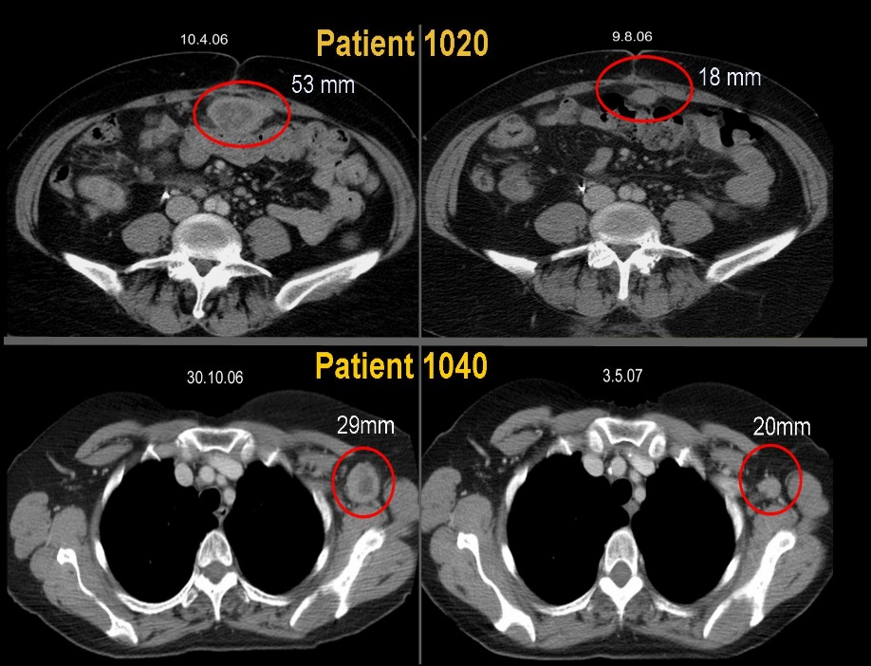
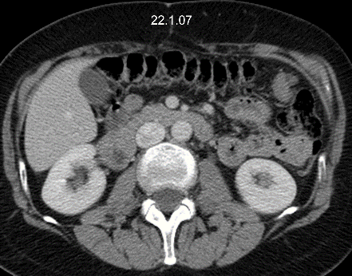
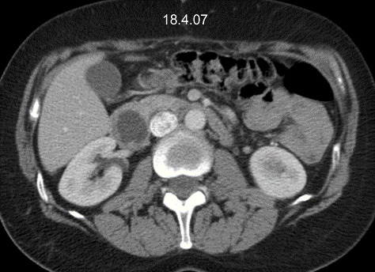
PARPi in germline BRCA1/2 mutation carriers
Baseline CT
Month 4
Phase I study of olaparib in patients (N=60) with solid tumors, including prostate cancer
  22 BRCA1/2 mutation carriers
  3 prostate cancer pts, 1 with mCRPC and BRCA2 mutation
Fong PC, et al. N Engl J Med. 2009; 361: 123-134.

Slide 17
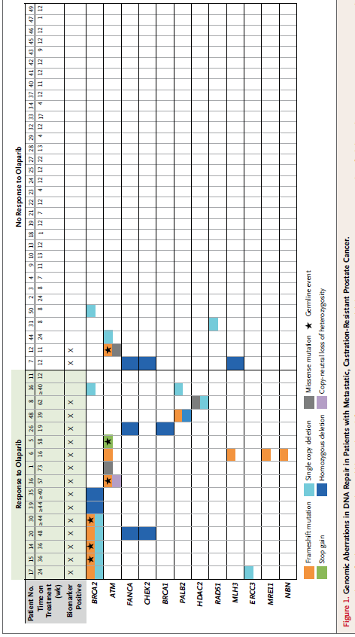
TOPARP-A: Unselected phase 2 trial in mCRPC
16 of 49 pts responded to olaparib
  14 of 16 (88%) biomarker-positive pts
  2 of 33 (6%) biomarker-negative pts
Mateo J, et al. N Engl J Med. 2015; 373: 1697-1708.

Slide 18
TOPARP-A: Survival with Olaparib by HR Deficiency
P < 0.001 by log-rank test
P < 0.05 by log-rank test
Mateo J, et al. N Engl J Med. 2015; 373: 1697-1708.

Slide 19
PROfound: Olaparib vs Enza or Abi in mCRPC with somatic HRD mutations
Open-label, randomized, phase 3 study with rPFS primary endpoint
Men with mCRPC and somatic HRD mutations who progressed on abiraterone and/or enzalutamide;
and up to 1 prior taxane
(Planned N = 340)
Olaparib 300 mg BID
Randomized 2:1
Investigator’s Choice:
Enzalutamide or
Abiraterone/prednisone
Optional
post-PD switch:
Olaparib 300 mg BID
Cohort A: BRCA1, BRCA2, or ATM
Cohort B: One of 12 other HRD mutations
Secondary endpoints: ORR (Cohort A), rPFS (Cohorts A & B), time to pain progression (Cohort A), OS (Cohort A)
Primary endpoint: rPFS (Cohort A)
ClinicalTrials.gov. NCT02987543

Slide 20
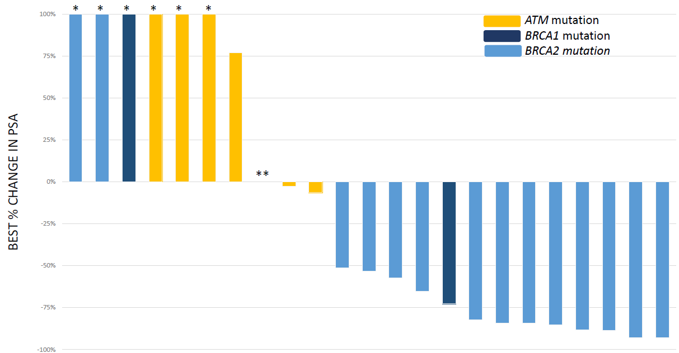
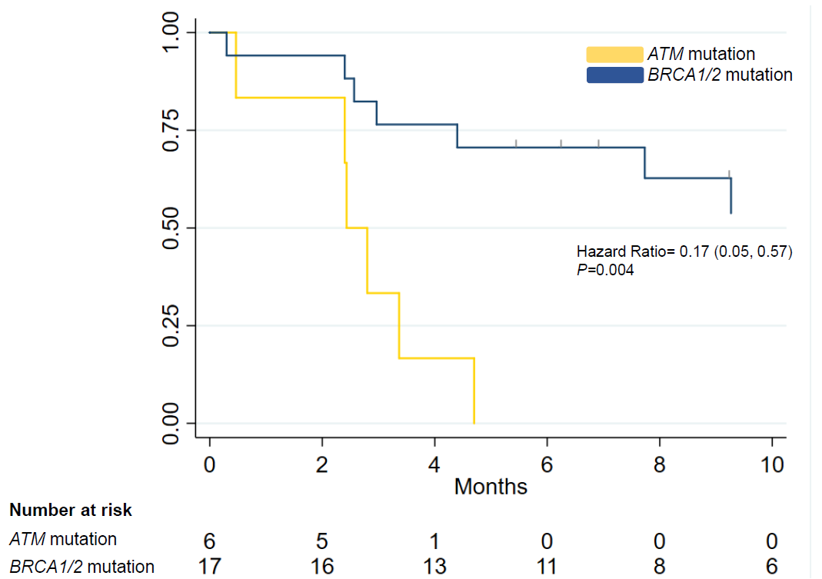
Olaparib sensitivity and BRCA1/2 vs. ATM
Best PSA Response
Radiologic PFS
Marshall CH, et al. European Urology 2019 (epub ahead of print).
Notes:
20
20

Slide 21
Clinical data with Rucaparib in mCRPC
2 October 2018 – Rucaparib granted Breakthrough Therapy designation by the FDA for treatment of BRCA1/2-mutated mCRPC with at least one prior AR-directed therapy and taxane-based chemotherapy

Slide 22
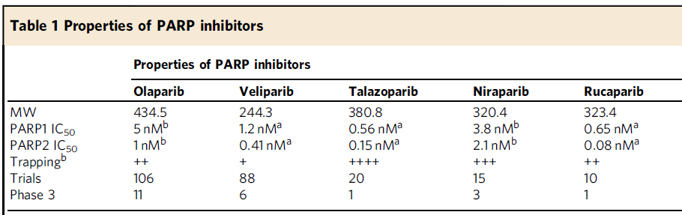
Properties of different PARP inhibitors
Carney B, et al. Nat Commun. 2018; 9: 176.
Notes:
22
22

Slide 23
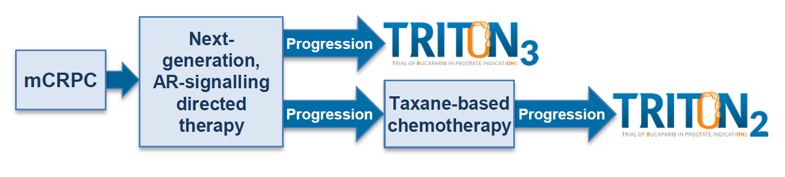
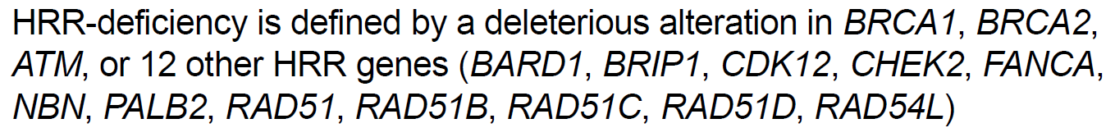
Rucaparib (TRITON2 and TRITON3)
Chowdhury S, et al. ESMO 2018; abstract 795PD.
Notes:
23
23

Slide 24
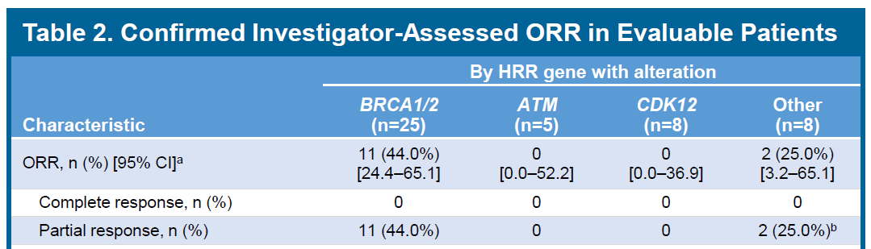
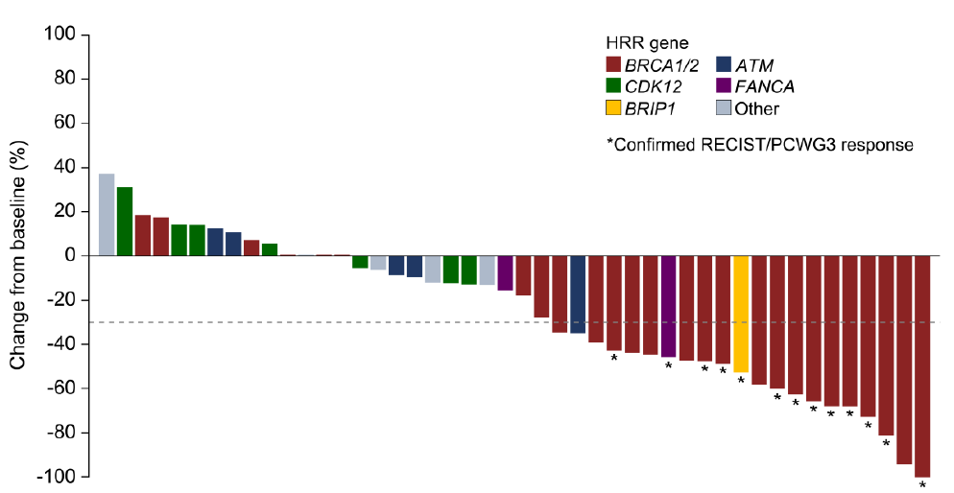
Rucaparib: TRITON2 interim results
Abida W, et al. ESMO 2018; abstract 793PD.
Notes:
24
24

Slide 25
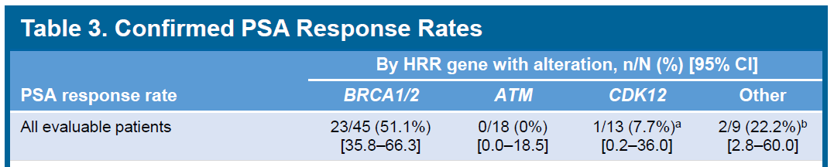
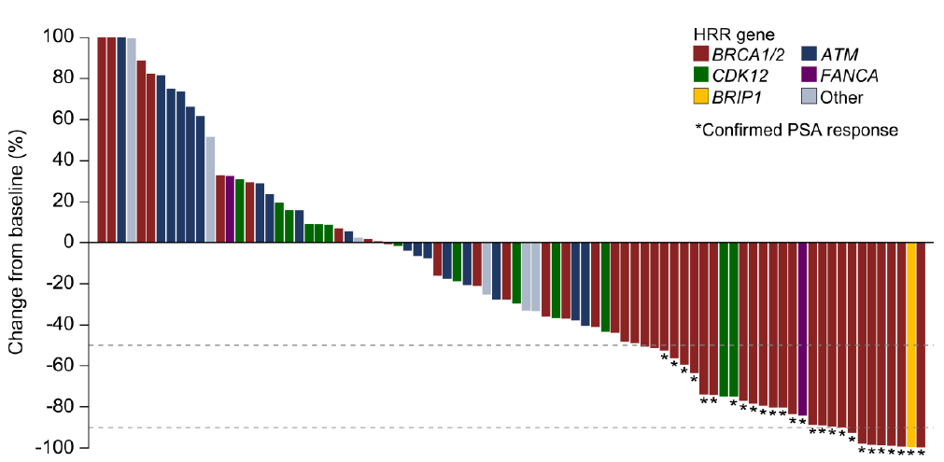
Rucaparib: TRITON2 interim results
Abida W, et al. ESMO 2018; abstract 793PD.
Notes:
25
25

Slide 26
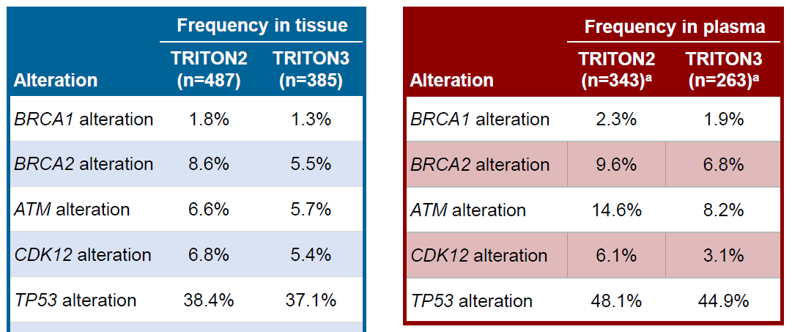
Rucaparib (TRITON2 and TRITON3)
Chowdhury S, et al. ESMO 2018; abstract 795PD.
Notes:
26
26

Slide 27
Clinical data with Niraparib in mCRPC

Slide 28
Properties of different PARP inhibitors
Carney B, et al. Nat Commun. 2018; 9: 176.
Notes:
28
28

Slide 29
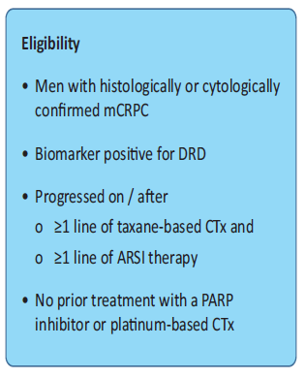
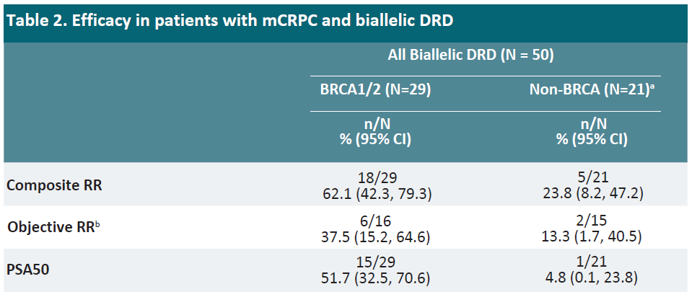
Niraparib: GALAHAD interim results
Patients plasma samples were evaluated for DRD (defined as pathogenic mutation in BRCA1/2, ATM, FANCA, PALB2, CHEK2, BRIP1 or HDAC2) using plasma circulating tumor DNA.
ª ATM, FANCA, PALB2, CHEK2, BRIP1, or HDAC2 assayed, not all represented in non-BRCA pts.
^{b} Investigator assessed
DRD = DNA repair gene defects;
ARSI = androgen receptor signaling inhibitor
Smith MR, et al. Genitourinary Cancers Symposium 2019; abstract 202.
Notes:
29
29

Slide 30
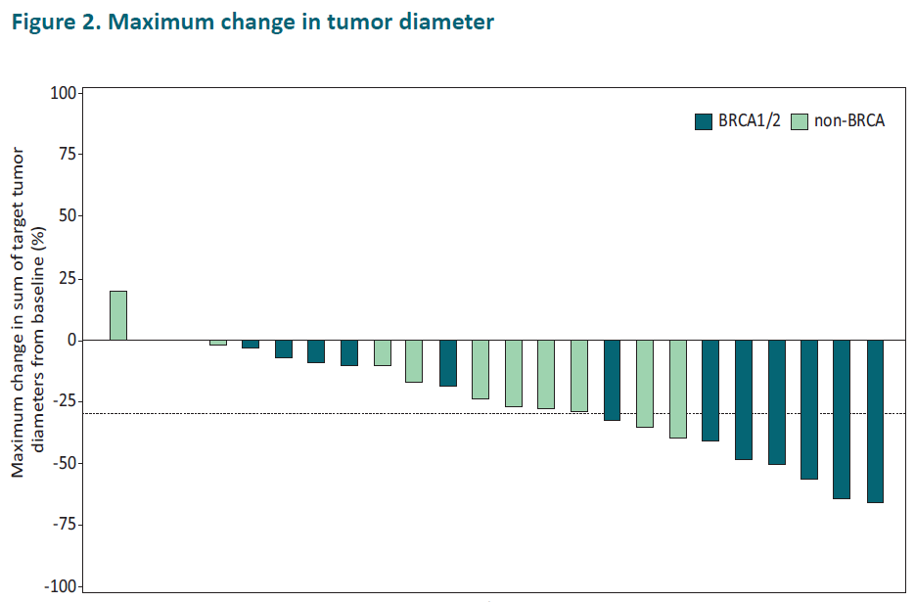
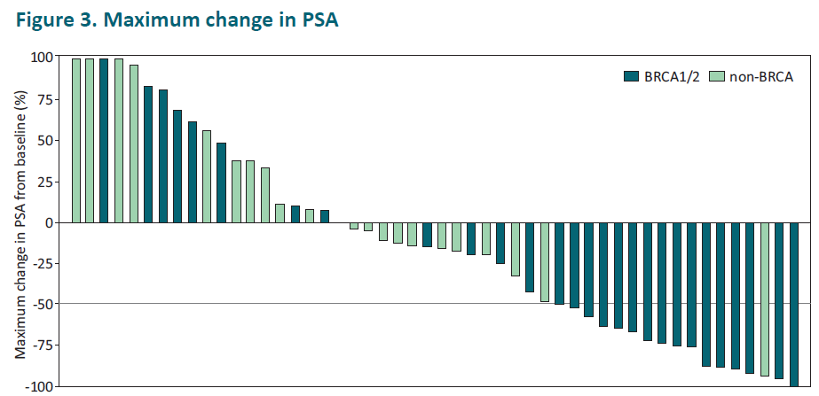
Niraparib: GALAHAD interim results
Maximum change in tumor diameter
Maximum change in PSA
Smith MR, et al. Genitourinary Cancers Symposium 2019; abstract 202.
Notes:
30
30

Slide 31
PARP inhibitor combinations
(with hormonal agents, immune checkpoint inhibitors)

Slide 32
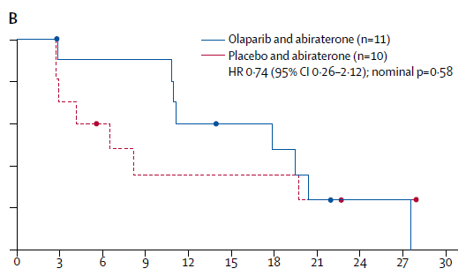
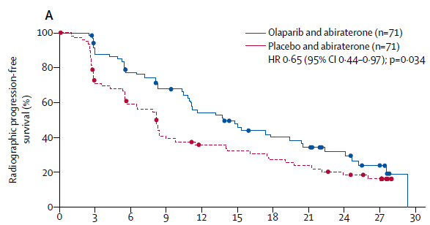
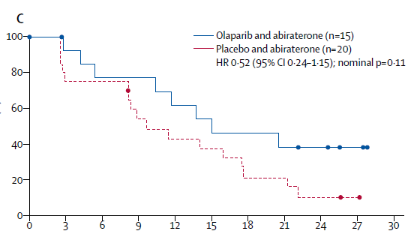
Olaparib plus Abi in unselected mCRPC
HRR mutation-positive subgroup
Intention-to-treat population
Wild-type HRR subgroup
Clark N, et al. Lancet Oncol. 2018; 19: 975-986.
Notes:
32
32

Slide 33
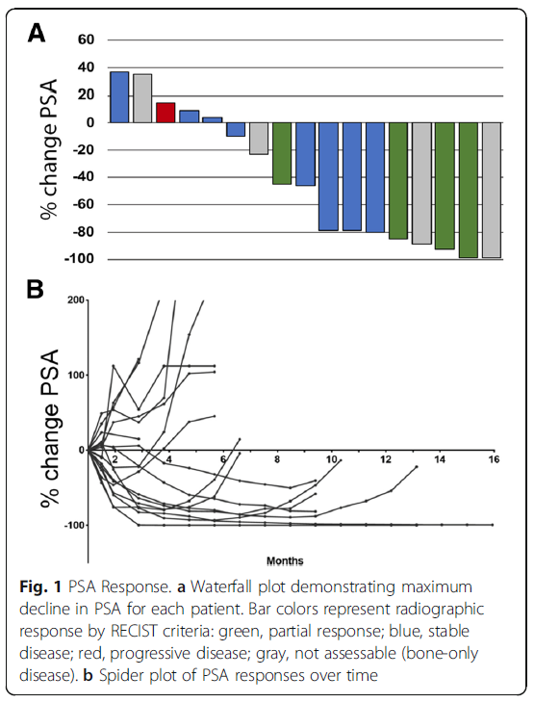
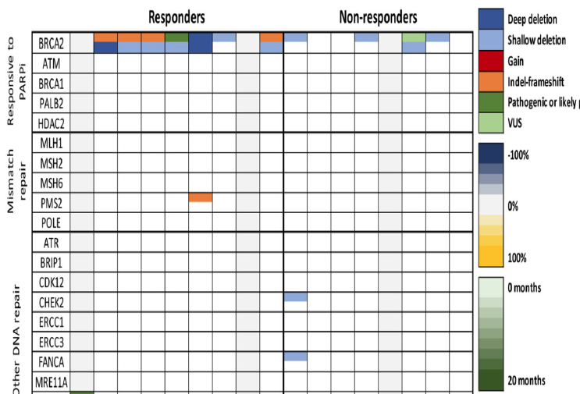
Olaparib plus Durvalumab (anti-PD-L1) in mCRPC
Karzai F, et al. J Immunother Cancer. 2018; 6: 141.
Notes:
33
33

Slide 34
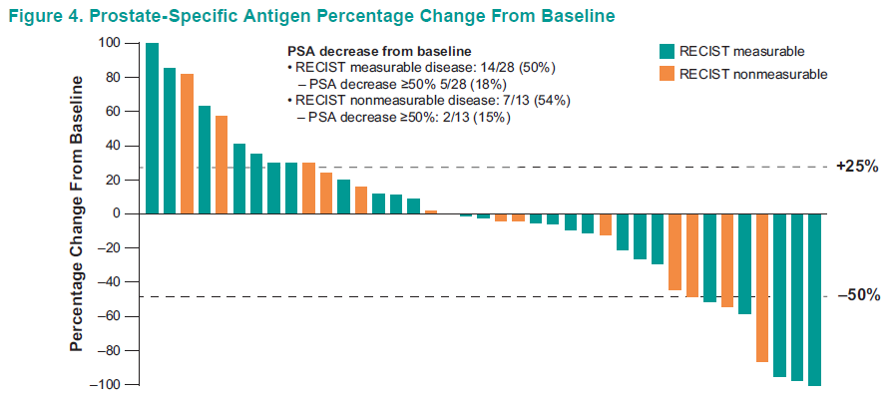
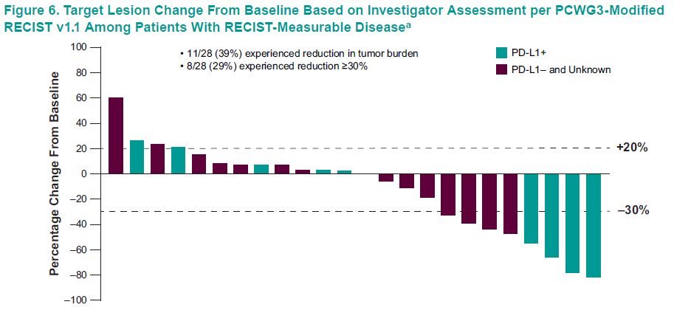
Olaparib plus Pembro (anti-PD-1) in mCRPC
Prostate-Specific Antigen Percentage Change From Baseline
Target Lesion Change From Baseline Based on Investigator Assessment per PCWG3-Modified RECIST v1.1 Among Patients With RECIST-Measurable Diseaseª
ª Based on investigator assessment. Includes confirmed and unconfirmed responses.
Yu EY, et al. Genitourinary Cancers Symposium 2019; abstract 145.
Notes:
34
34

Slide 35
Conclusions
DNA repair mutations are common in PCa, esp. in mCRPC
Germline genetic testing is indicated for many PCa patients
There may be enrichment for HRD mutations in high-grade PCa and in certain histological subtypes
Not all DNA repair mutations are created equal: BRCA1/2 mutations (but not ATM or CDK12) may sensitize to PARPi
Olaparib and Rucaparib may be the first PARPi to receive FDA approval, and combination studies are now underway
The role of germline vs. somatic, and mono- vs. bi-allelic mutations, remains unclear

