Slide 1
Please note, these are the actual video-recorded
proceedings from the live CME event and may include
the use of trade names and other raw, unedited content.

Slide 2
Management of NSCLC with ALK rearrangements or other targetable abnormalities*
D. Ross Camidge, MD PhD
Professor of Medicine/Oncology
Joyce Zeff Chair in Lung Cancer Research
University of Colorado Cancer Center
* (ROS1, RET, NTRK)

Slide 3
Disclosures (DRC)
Most recent contact (last 3 years):
Advisory role: Ad hoc advisory boards/consultations
  2019: Takeda, CBT Pharmaceuticals, Daiichi-Sankyo (ILD adjudication committee), G1 Therapeutics (DSMB), Bio-Thera (DSMB), Blueprint
  2018: AstraZeneca, Takeda, Arrys/Kyn, Regeneron, Hengrui, G1 Therapeutics (DSMB), Daichii Sankyo (ILD adjudication committee), Hansoh (SRC), Bio-Thera (DSMB), Ribon, BMS, Blueprint, Roche/Genentech, Inivata
  2017: Genoptix, G1 Therapeutics (DSMB), Mersana Therapeutics, Roche/Genentech, Takeda, Ignyta, Daichii Sankyo (ILD adjudication committee), Hansoh SRC, Bio-Thera DSMB, Lycera, Revolution Med
Research funding:
  2017: Takeda Investigator-initiated Trial
Company sponsored trials at institution (PI roles):
  2018/9: Abbvie, AstraZeneca, BMS, Hansoh, Lycera, Medimmune, Merck, Pfizer, Phosplatin, Roche/Genentech, Seattle Genetics, Symphogen, Takeda

Slide 4


Regulatory and reimbursement issues aside, which first-line therapy would you generally recommend for an asymptomatic patient with metastatic nonsquamous NSCLC with an ALK rearrangement and a PD-L1 TPS of 60%?
23
Alectinib
Brigatinib
1

Slide 5



In general, what would be your preferred choice of second-line therapy for a patient with metastatic nonsquamous NSCLC with an ALK rearrangement and a TPS of 60% who experiences disease progression on alectinib?
Lorlatinib
13
Brigatinib
6
Order NGS and decide
3
Chemotherapy +/- bevacizumab
1
Atezolizumab/carboplatin/
paclitaxel + bevacizumab
1

Slide 6
Regulatory and reimbursement issues aside, which first-line therapy would you generally recommend for an asymptomatic patient with metastatic nonsquamous NSCLC with a ROS1 rearrangement and a PD-L1 TPS of 60%?
22
Crizotinib
Lorlatinib
1
Chemotherapy +/- bevacizumab
1

Slide 7

A 65-year-old patient with metastatic adenocarcinoma of the lung with a ROS1 rearrangement and a PD-L1 TPS of 60% experiences a 1-year response to crizotinib but then develops progressive disease. Regulatory and reimbursement issues aside, what in general would be your most likely next systemic treatment?
Lorlatinib
10
Chemotherapy +/- bevacizumab
6
Pembrolizumab/carboplatin/
pemetrexed
6
Atezolizumab/carboplatin/
paclitaxel +/- bevacizumab
1
Ceritinib
1
Brigatinib
1

Slide 8
Do you typically administer targeted therapy for your patients with metastatic NSCLC and a RET rearrangement?
22
Yes
No
2

Slide 9
In what line of therapy do you typically administer targeted therapy for your patients with metastatic NSCLC and a RET rearrangement?
First line
11
Second line
12

Slide 10
Which targeted therapy do you typical offer for your patients with metastatic NSCLC and a MET exon 14 mutation?
24
Crizotinib

Slide 11
In what line of therapy do you typically administer targeted therapy for your patients with metastatic NSCLC and a MET exon 14 mutation?
First line
18
Second line
6

Slide 12
ALK
1st line licenses: crizotinib, ceritinib, alectinib
+ 1st line NCCN: brigatinib
+ ongoing, not yet presented 1st line trials: ensartinib, lorlatinib
Post crizotinib licenses: ceritinib, alectinib, brigatinib
Post next generation ALK TKI (ie post ceritinib, alectinib, brigatinib +/- prior crizotinib): lorlatinib (+ ASCO 2019 brigatinib data)
Elephants in the room

Slide 13
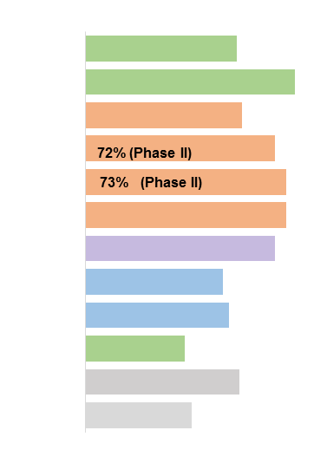
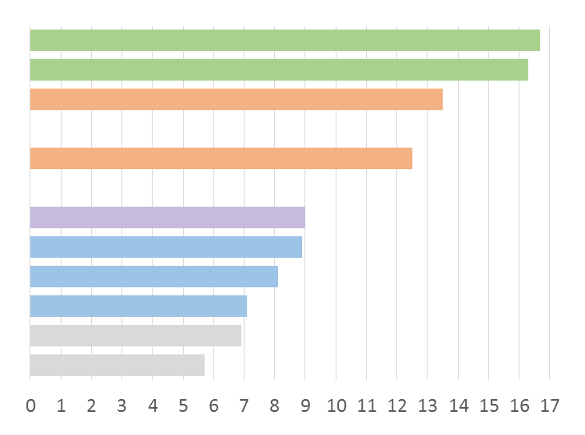
Next-generation ALK TKI efficacy: Indirect comparison* post-crizotinib (+/- prior chemo) including experimental agents
*Cross-trial comparisons are potentially confounded by differences in trial design and study populations.
ORR %
mPFS (months)
PFS REMARKABLY
consistent across
trials for same drug
but differs by drug,
despite ‘similar’ ORR
Brigatinib
Brigatinib
Lorlatinib
Lorlatinib
Lorlatinib
Lorlatinib
Ensartinib
Alectinib
Alectinib
Alectinib
Ceritinib
Ceritinib
55% (Phase II)
16.7 months per IRC (90→180mg) (n=110)⁵
76% (Phase I/II)
16.3 months (90→180mg) (n=25)⁴
57% (Phase I)
13.5 months (heterogeneous populations at varying doses; n=14)⁶
11.1 months Pre/post chemo (n=59)¹⁰
Overlapping
subgroup
data points
in ph II
12.5 months (NO ALK mutant detected pre/post chemo) (n=45)⁹
73% (Phase II)
95% CI 1.7-NR ALK mutant+ pre/post chemo (n=11)⁹
69% (Phase II)
9 months¹¹
50% (Phase II)
8.9 months (n=138)³
52% (Phase II)
8.1 months (n=87)²
36% (Phase III)
7.1 months (IRC) (9.6 by Inv) (n=72)⁸
56% (Phase I)
6.9 months (n=163)¹
38.6% (Phase II)
5.7 months (n=140)⁷
Median not reached

Slide 14
 |  |  |  |  |  |  | IRC data
J-ALEX IRC Hida et al, Lancet 2017 | N=207 pts (1:1) 103 alec 104 criz | ALK+ Centrally confirmed by IHC and FISH or RT-PCR | Prior chemo allowed | CNS mets: 14% alec 28% criz | CNS Rx: 43% Rx alec, 55% Rx criz (No details) | Median follow up 12 m alec 12.2 m criz | PFS HR 0.34 (0.17-71), p<0.0001 Median NR and 10.2 mo
ALEX IRC Peters et al, NEJM 2017 | N=152 alec, 151 criz | ALK+ Centrally confirmed by IHC | No prior chemo allowed | CNS mets: 42% alec 38% criz | CNS Rx: 31% Rx alec, 40% Rx criz (WBRT/SRS balanced) | Median follow up 18.6 m alec 17.6 m criz | PFS HR 0.50 (0.36-7), p<0.0001 Median 25.7 and 10.4 mo
ALTA-1L IRC Camidge et al, NEJM 18; Popat et al, ESMO 18 | N=137 brig, 138 criz | Local ALK Testing allowed | Prior chemo allowed | CNS mets: 29% brig 30% criz | CNS Rx: 45% Rx brig, 46% Rx criz (WBRT/SRS balanced -esmo) | Median follow up 11 m brig 9.3 m criz | PFS HR 0.49 (0.33-74), p=0.0007 Median NR and 9.8 mo
Inv data
PFS HR 0.34 (0.21-0.54)
PFS HR 0.47 (0.34 to 0.65); p<0.001 Median NR and 11.1 mo
PFS HR 0.45 (0.3 to 0.68)
ASCO ‘19 Ab9092
JALEX | IRC data
Median follow up 42.2 m alec 42.4 m criz | PFS HR 0.37 (0.26-52), Median 34.1 and 10.2 mo
Inv assessed updated ALEX Camidge et al, JTO 2019
Median follow up 27.8 m alec 22.8 m criz | PFS HR 0.43 (0.32-0.58), Median 34.8 and 10.9 mo
ALTA-1L Longer follow up awaited

Slide 15
Potential
Differentiators:
Efficacy
Convenience
(dosing and
Drug-drug
interaction
potential)
Toxicity/
Tolerability
Cost
Medication | Substrates | Enzymes Induced by Medication | Enzymes Inhibited by Medication | Other Interactions
Alectinib 600mg BID (8 pills/day) | CYP3A4 (minor) | None | None
Brigatinib 90mg QD 7 days, then 180mg QD thereafter (1 pill/day) | CYP3A4 (major), CYP2C8 (minor), P-glycoprotein | None | None
Ceritinib 450mg QD with food (3 pills/day) | CYP3A4 (major), P-glycoprotein |  | CYP2C9 | QT Prolongation
Crizotinib 250mg BID (2 pills/day) | CYP3A4 (major), P-glycoprotein |  | CYP3A4 (moderate), OCT1, OCT2 | QT Prolongation
Lorlatinib 100mg QD (1 pill/day) | CYP3A4 (major) | CYP2B6 & CYP3A4 | CYP2C9 & P-glycoprotein | QT Prolongation
1. alectinib product information, 2. brigatinib product information, 3. ceritinib product information, 4. crizotinib product information

Slide 16
Toxicity/Tolerability
 | Crizotinib¹⁻³ | Ceritinib^{4,5} | Alectinib^{6,7} | Brigatinib (IA1)⁸
Grade 3/4 AEs ≥4% | Increased ALT (15%), increased AST (8%), neutropenia (11%), hypophosphatemia (10%), lymphopenia (7%) | Increased gamma-GGT (49%), increased ALT (34%), increased AST (21%), increased alkaline phosphatase (12%), hyperglycemia (10%), increased amylase (8%), fatigue (7%) | Anemia (7%), increased AST (6%), increased ALT (6%), hyponatremia (6%) | Increased CPK (16%), increased lipase (13%), hypertension (10%), increased amylase (5%), ILD/pneumonitis (4%)
AE-related discontinuation | 12% | 5% | 11% | 12%
AE-related dose reductions | 6% | 45% @ 5-pill dose 10% @ 3-pill dose | 16% | 29%
Trial protocol mandated dose reductions
For example, in ALTA-1L: For brigatinib, reduction rate 29% but 63% of these are lab
values: increased CPK (10.3%), increased lipase (5.1%); increased amylase (2.9%)
Dose reduction rate of these drugs in real world??
Symptomatic events causing dose reduction brig ALTA-1L : pneumonitis, pruritic rash (1.5% each)
1. Solomon BJ, et al. N Engl J Med. 2014;371(23):2167-2177. 2. Solomon BJ, et al. J Clin Oncol. 2016;34(24):2858-2865. 3. XALKORI [package insert]. New York, NY: Pfizer Inc; 2018. 4. Soria JC, et al. Lancet. 2017;389(10072):917-929. 5. ZYKADIA [package insert]. East Hanover, NJ: Novartis Pharmaceuticals Corporation; 2017. 6. ALECENSA [package insert]. South San Francisco, CA: Genentech, Inc; 2018. 7. Camidge DR, et al. Poster presented at: the 54th Annual Meeting of the American Society of Clinical Oncology; June 1-5, 2018; Chicago, IL. Poster 366. 8. Camidge DR, et al.
N Engl J Med. 2018;379(21):2027-2039.

Slide 17
Transient Early Onset Pulmonary Events (TEOPEs)
Normal dosing regimen 90mg 7 days then 180mg thereafter minimizes risk
Onset in first week, usually first day, dyspnea, hypoxia (not subtle)
With this regimen, hypoxic events occur in 3% of trial cases
Can tolerize completely if continue dosing with supportive care (eg O2) usually by Day 5
NOT classical pneumonitis ?vascular spasm = short term drop in DLCO
If have to hold, or if poor baseline resp function consider 30mg for 4 days, 60mg for 3 days, 90mg for 3 days, then 180mg
‘Sneak up’ on this event if proven or suspected susceptibility (ie poor baseline resp function, recent PE, pneumonia, etc)
Camidge et al, TLO 2019

Slide 18
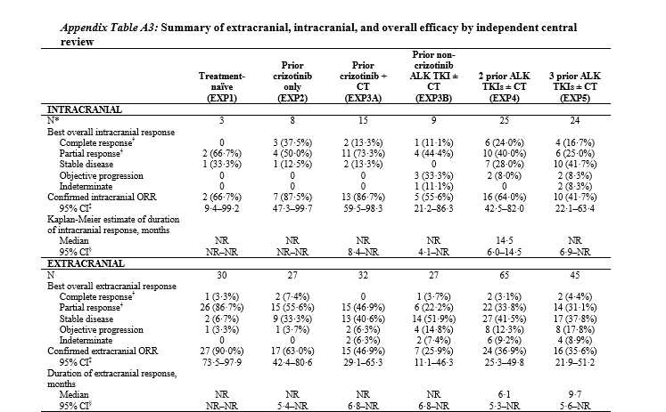
Lorlatinib phase II
80% hypercholesterolemia/triglyceridemia needing rx
54% any grade higher cognitive function change
Grade 1-2 edema (41%), neuropathy (28%), weight gain (16%)
FDA label is only post
a next generation inhibitor and quotes a 48% response rate
Yet this rate is based on 215 pretreated patients and includes data from 64 who only had prior crizotinib
What is the chance of a lorlatinib response in MY patient post a next-generation TKI? Calculate as 37-38%
BUT IT DEPENDS!
CNS=42-64%
eCNS=26-37%
Median PFS post next gen TKI:
5.5 (1st line next gen, cohort 3B) - 6.9 months (≥2 lines, cohort 4-5)
CNS vs eCNS
88 vs 63%
CNS vs eCNS
87 vs 47%
CNS vs eCNS
56 vs 26%
CNS vs eCNS
64 vs 37%
CNS vs eCNS
42 vs 36%
Solomon et al Lancet Oncol 2018

Slide 19
Brigatinib post-next generation TKI? Inc ASCO 2019
Lin et al, JTO 2019. 22 patients. 17% ORR, median PFS 4.4 months. No data on DoR, target lesion location (CNS or eCNS), or detailed molecular information.
Hochmair et al, WCLC 2018. 18 patients. 77% ORR, median PFS 7.5 months. No data on dose, DoR, target lesion location (CNS or eCNS) or detailed molecular information.
Descourt et al, ASCO 2019 Ab 9045. 104 patients. 50% ORR, median PFS 6.6 months. No data on dose, DoR, target lesion location (CNS or eCNS) or detailed molecular information but site of progression CNS in 29% cases
Stinchcombe et al, ASCO 2019 Ab 9027. 20 patients. 40% ORR, median PFS 6.4 months. Prospective. Data on dose, DoR, target lesion location (CNS or eCNS) and detailed molecular information should be captured

Slide 20
Progression Free Survival with Lorlatinib in Patients with Prior 2nd-gen ALK TKI(s) – Tumor Tissueª
ELEPHANTS!
Non-ALK driven resistance
-Local ablative therapy
-Pemetrexed-based chemo
(prob with TKI and without
IO)
-Actionable second drivers
EXP3B,4–5 (n=135)
 | No Mutation (n=81) | ≥1 Mutation (n=29)
Number with event, n (%) | 57 (70.4) | 17 (58.6)
Median PFS, months (95% CI) | 5.4 (3.9, 6.9) | 11.0 (6.9, 22.9)
100
80
60
ªDetected in archival or de novo tumor tissue.
Progression-free survival (%)
40
20
 | EXP3B,4–5: Prior 2nd-gen TKI (N=139)ª
 | No Mutation^{b} (n=87) | ≥1 Mutation^{b} (n=49)
BOR, n (%) CR PR SD PD IND | 2 (2.3) 21 (24.1) 36 (41.4) 21 (24.1) 7 (8.0) | 1 (2.0) 29 (59.2) 10 (20.4) 5 (10.2) 4 (8.2)
ORR, n (%) 95% CI | 23 (26.4) 17.6, 37.0 | 30 (61.2) 46.2, 74.8
0
0
1
2
3
4
5
6
7
8
9
10
11
12
13
14
15
16
17
18
19
20
21
22
23
Time (months)
81
76
56
44
37
34
30
25
23
22
20
20
14
12
8
6
3
3
2
2
2
0
0
0
29
29
26
24
24
23
20
18
17
15
14
14
10
8
7
4
3
3
3
3
3
2
2
0

Slide 21
ROS1
Crizotinib is licensed but has CNS liability, presence/absence of CNS disease may explain variable median PFS of crizotinib across PFS trials
Entrectinib (seeking a license) has similar spectrum of activity as crizotinib but CNS penetration. ASCO 2019 Abstract 3017. CNS ORR 55%
Repotrectinib (AKA ropotrectinib and TPX-0005) has CNS penetration and activity against G2032R reported in 2/4 cases previously (Drilon et al, ASCO 2018). ASCO 2019 abstract 9011. 18 TKI-pretreated ROS1 pts, ORR 28%, DOR of 10.2 mos. cORR 44% in 9 such pts at dose levels of ≥160 mg QD. Intracranial ORR was 3/3 (100%). LOOK for G2032R response rate!
Lorlatinib (being used off label) has excellent CNS penetration and possibly additional activity in some ROS1 resistance mutations (but not G2032R)

Slide 22
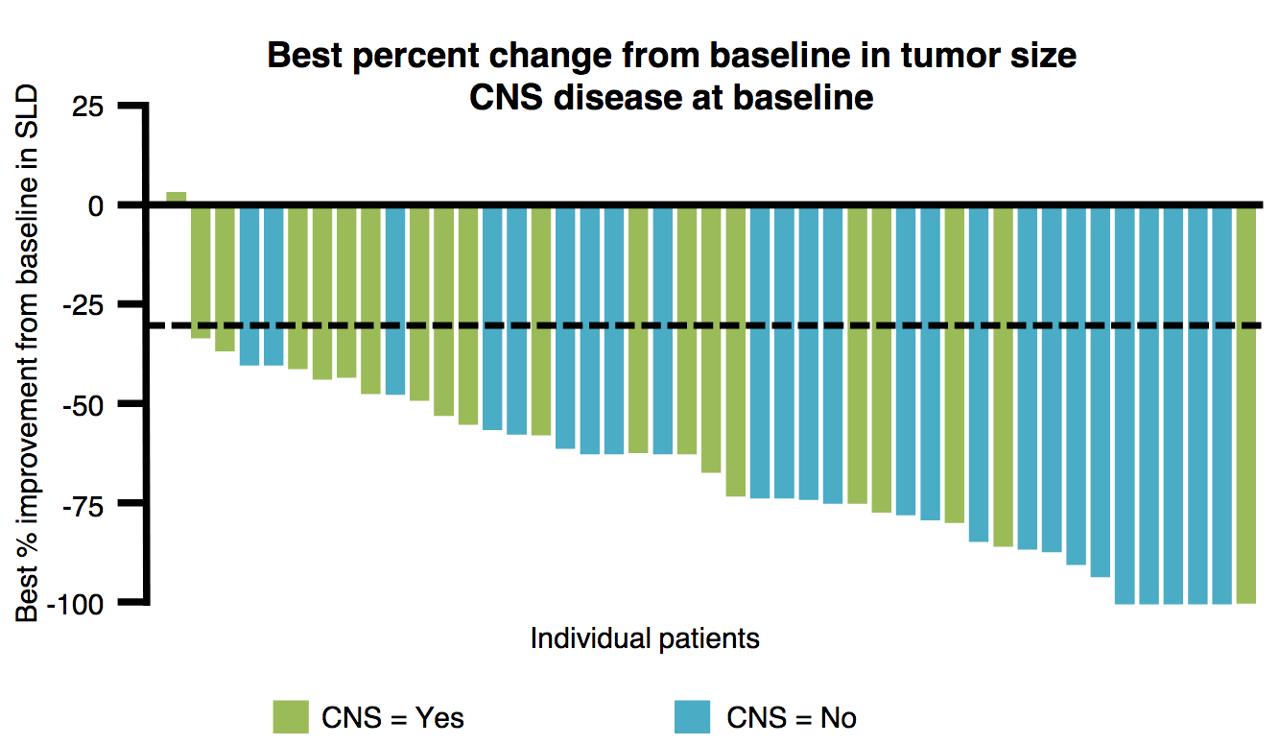
Entrectinib for Locally Advanced or Metastatic ROS1 Fusion-Positive NSCLC
Change in tumor size: ROS1+ NSCLC population (n = 53) (BICR assessment)
n (%) | Total N = 53 | CNS disease at baseline N = 23 | No CNS disease at baseline N = 30
ORR | 41.7 (77.4) | 17 (73.9) | 24 (80.0)
CR | 3 (5.7) | 0 | 3 (10.0)
PR | 38 (71.7) | 17 (73.9) | 21 (70.0)
SD | 1 (1.9) | 0 | 1 (3.3)
Clinical benefit rate | 41 (77.4) | — | —
In patients with CNS disease at baseline, intracranial ORR and DoR were 55% and 12.9 mo, respectively.
Most adverse events were Grade 1-2 and reversible.
Grade 3 adverse events included anemia (4.5%), fatigue (2.8%) and increased weight (5.1%).
Doebele RC et al. Proc WCLC 2018;Abstract OA02.01.

Slide 23
Lorlatinib in ROS1 positive non-small cell lung cancer (mostly post-crizotinib)
Overall (contains potentially
body and brain information)
Brain only dataset
70
70
60
#
60
50
50
40
40
30
#
30
20
#
20
10
#
10
0
0
‒10
#
‒10
#
#
#
‒20
#
#
#
Best Change From Baseline (%)
#
‒20
‒30
#
‒30
#
#
‒40
#
#
‒40
‒50
#
#
‒50
#
‒60
#
‒60
‒70
#
#
‒70
#
‒80
#
‒80
#
#
‒90
#
‒90
#
‒100
#
‒100
#
#
Previously received crizotinib
36% people have significant shrinkage
56% people have significant shrinkage
Solomon et al, WCLC 2017

Slide 24
RET
The 5’ fusion partner in RET rearrangements (KIF5B or non-KIF5B) matters for earlier RET inhibitors and MAY STILL matter for next generation inhibitors (LOXO-292 and BLU-667)

Slide 25
RET
KIF5B = upstream partner of RET
Approx 2/3rds time
?Stronger promoter?
?Co-driver engagement?
Drilon et al, ESMO 2017

Slide 26
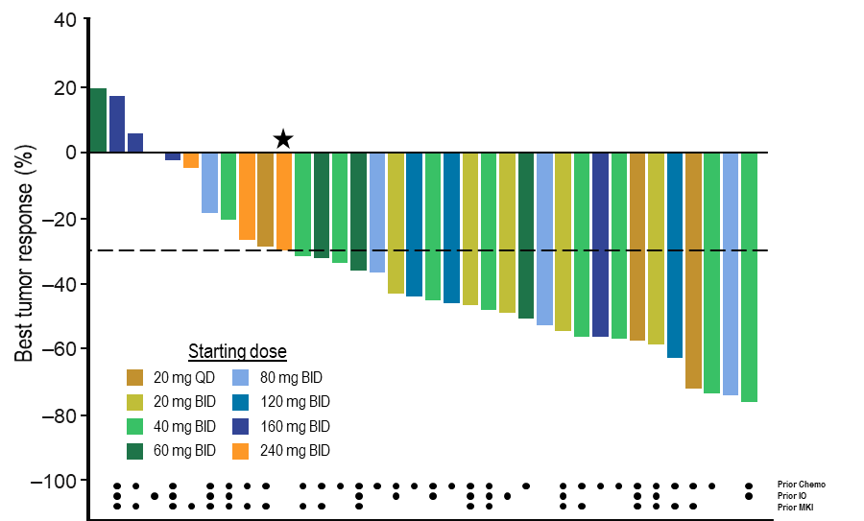
Efficacy of LOXO-292 in RET fusion-positive NSCLC (RECIST 1.1)
One CNS response in KIF5B RET shown.
ORR in KIF5B and non-KIF5B not yet shown nor percent of KIF5b in dataset (relevant if ORR different by partner)
ORR (95% CI) | 68% (n=26/38) (51–83%)
Confirmed ORR* (95% CI) | 68% (n=25/37) (50–82%)
CR | –
PR** | 26
SD | 8
PD | 2
NE | 2
All unconfirmed responses reported at ASCO have since been confirmed
RECIST 1.1 responses were seen at all starting dose levels, prior to any intrapatient dose escalation, and in 18/26 (69%) responding patients at each patient’s starting dose
Activity independent of prior therapy
4/4 confirmed intracranial responses (1 CR, 3 PR) in patients with measurable CNS lesions
ASCO 2019 Ab 9008
79 pts with advanced RET fusion+ NSCLC (44 KIF5B, 16 CCDC6, 19 other/pending)
57 response evaluable ORR 56%
Brain metastasis ‘shrinkage was seen’
pending confirmation; * Excludes one patient with unconfirmed PR pending confirmation at time of data cut-off; ** 25 confirmed PR, 1 unconfirmed PR pending confirmation
NSCLC patients enrolled as of April 2, 2018. Follow-up as of July 19, 2018.

Slide 27
NTRK
Rare gene rearrangements – should tip anyone over into doing panel based testing as now 5 FDA approved treatments for molecular subtypes of NSCLC (EGFR, ALK, ROS1, BRAF and NTRK)
Larotrectinib licensed
Entrectinib seeking a license

Slide 28
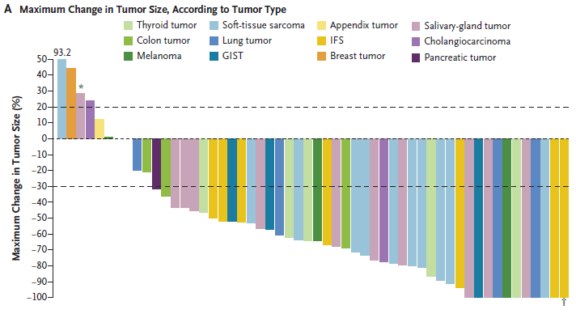
Results of a “Basket” Study on Larotrectinib
ORR Inv 80%
IRC 75%
8.3 months median
follow up
Median DoR NR
Median PFS NR
3 of 4 lung tumors
Efficacy regardless of tumor type
Drilon A, et al. N Engl J Med. 2018;378(8):731-739.

Slide 29
Entrectinib activity in NTRK fusion-positive solid tumours: individual patient responses by tumour type
 | NTRK+ patients (n=54)
ORR (95% CI) | 57.4% (43.2–70.8)
SD | 9 (16.7)
PD | 4 (7.4)
Non-CR/PD, missing or unevaluable | 10 (18.5)
50
7/9 NSCLC responses?
40
30
20
15
0
-10
-20
Best % change from baseline
-30
-40
-50
-60
-70
-80
-90
-100
Sarcoma
NSCLC
MASC
Breast
Thyroid
CRC
Pancreatic
Neuroendocrine tumours
Gynaecological
Cholangiocarcinoma
Results per Blinded Independent Central Review (BICR)
Cut-off date: 31 May 2018
Note: Patients (n=6) without matched pre/post therapy scans were excluded from the plot
CI: confidence interval; CRC: colorectal cancer; MASC: mammary analogue secretory carcinoma; NSCLC: non-small cell lung cancer

