Slide 1
Please note, these are the actual video-recorded
proceedings from the live CME event and may include
the use of trade names and other raw, unedited content.

Slide 2
Optimal Therapeutic Approaches for Patients with Metastatic Non-Small Cell Lung Cancer (NSCLC) and EGFR Tumor Mutations
Gregory J. Riely
May 31, 2019

Slide 3
Disclosures
Contracted Research | Merck, Mirati Therapeutics, Novartis, Pfizer Inc, Roche Laboratories Inc, Takeda Oncology

Slide 4




Do you order liquid multiplex assay testing (ie, NGS) for your patients with newly diagnosed metastatic NSCLC?
Yes
17
No
7
About how long does it take to obtain results for this liquid multiplex assay?
Less than 1 week
2
1 to 2 weeks
13
2 to 3 weeks
2

Slide 5
Regulatory and reimbursement issues aside, which first-line therapy would you generally recommend for an asymptomatic patient with metastatic nonsquamous NSCLC with an EGFR exon 19 deletion and a PD-L1 tumor proportion score (TPS) of 60%?
23
Osimertinib
Afatinib
1

Slide 6

Regulatory and reimbursement issues aside, what would you generally recommend as first-line therapy for an asymptomatic patient with metastatic nonsquamous NSCLC with an EGFR L861Q mutation and a PD-L1 TPS of 60%?
Osimertinib
16
Afatinib
6
Pembrolizumab
1
Carboplatin/pemetrexed
1

Slide 7
Which initial treatment approach would you generally recommend for a patient with asymptomatic nonsquamous NSCLC with an EGFR exon 19 mutation, systemic metastases and multiple, bilateral small brain metastases that would require whole-brain radiation therapy?
24
Osimertinib

Slide 8
If a patient with asymptomatic metastatic nonsquamous NSCLC with an EGFR exon 19 deletion and a PD-L1 TPS of 60% responded to first-line osimertinib and then experienced disease progression, in general would you order some type of mutation testing?
Yes, both a liquid and a tissue assay
12
Yes, a liquid assay
4
Yes, a tissue assay
4
No
4

Slide 9
Should community-based medical oncologists order mutation testing for patients whose disease progresses on osimertinib?
Yes
18
No
6

Slide 10

In general, what would be your most likely treatment approach for a patient with disease progression on osimertinib who is found to have no further actionable mutations?
Pembrolizumab/
carboplatin/pemetrexed
9
Atezolizumab/carboplatin/
paclitaxel + bevacizumab
5
Carboplatin/pemetrexed/
bevacizumab
4
Carboplatin/pemetrexed
3
Carboplatin/pemetrexed/
osimertinib
2
Chemotherapy +/- bevacizumab
1

Slide 11



In general, what would be your most likely treatment approach for a patient with disease progression on osimertinib who is found to have an EGFR C797S mutation?
Pembrolizumab/
carboplatin/pemetrexed
6
Erlotinib
4
Carboplatin/pemetrexed/
bevacizumab
3
Atezolizumab/carboplatin/
paclitaxel/bevacizumab
3
Carboplatin/pemetrexed
3
Chemotherapy +/- bevacizumab
2
1
Carboplatin/
pemetrexed/osimertinib
1
Gefitinib
Osimertinib/gefitinib
1

Slide 12
Oncogenic Drivers in NSCLC
Subtypes of NSCLC Can be Defined by Somatic Oncogenic Drivers
MSK-IMPACT data

Slide 13
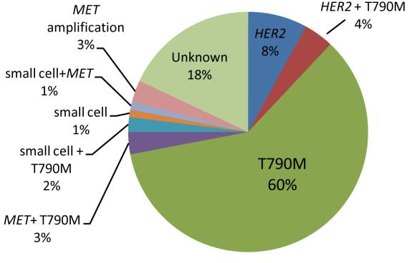
What causes acquired resistance?
Diagnosed with EGFR mutant NSCLC
1st/2nd Generation
EGFR TKI
Development of Clinical Resistance to EGFR TKI
Biopsy to understand mechanism of resistance
Yu et al, CCR 2013

Slide 14
Spectrum of Activity of EGFR TKIs
 | Drug | EGFR L858R | EGFR Exon 19 del | EGFR T790M | EGFR (WT) | HER2
1st gen | gefitinib | + | + | - | + | -
 | erlotinib | + | + | - | + | -
2nd gen | afatinib dacomitinib | + + | + + | - - | + + | + +
3rd gen | osimertinib | + | + | + | - | -

Slide 15
How we treat patients with EGFR mutant lung cancer?
~10 months Median PFS with osimertinib (T790M +)
Diagnosis
9-11 month
Median PFS
1st Gen
~4 months Median PFS with Chemotherapy
Diagnosis
?
Start with osimertinib?

Slide 16
Osimertinib vs Gefitinib/Erlotinib
Randomized Trial (FLAURA)
Osimertinib
(80 mg p.o. qd)
(n=279)
Patients with locally advanced or metastatic NSCLC
Stratification by mutation status
(Exon 19 deletion / L858R)
and race
(Asian /
non-Asian)
Key inclusion criteria
WHO performance status 0 / 1
Exon 19 deletion / L858R
No prior systemic anti-cancer /
EGFR-TKI therapy
Stable CNS metastases allowed
EGFR-TKI SoC;
Gefitinib (250 mg p.o. qd) or Erlotinib (150 mg p.o. qd)
(n=277)
Primary endpoint: PFS
Secondary endpoints: response rate, duration of response, disease control rate, depth of response, overall survival, patient reported outcomes, safety
Soria et al, NEJM 2017

Slide 17
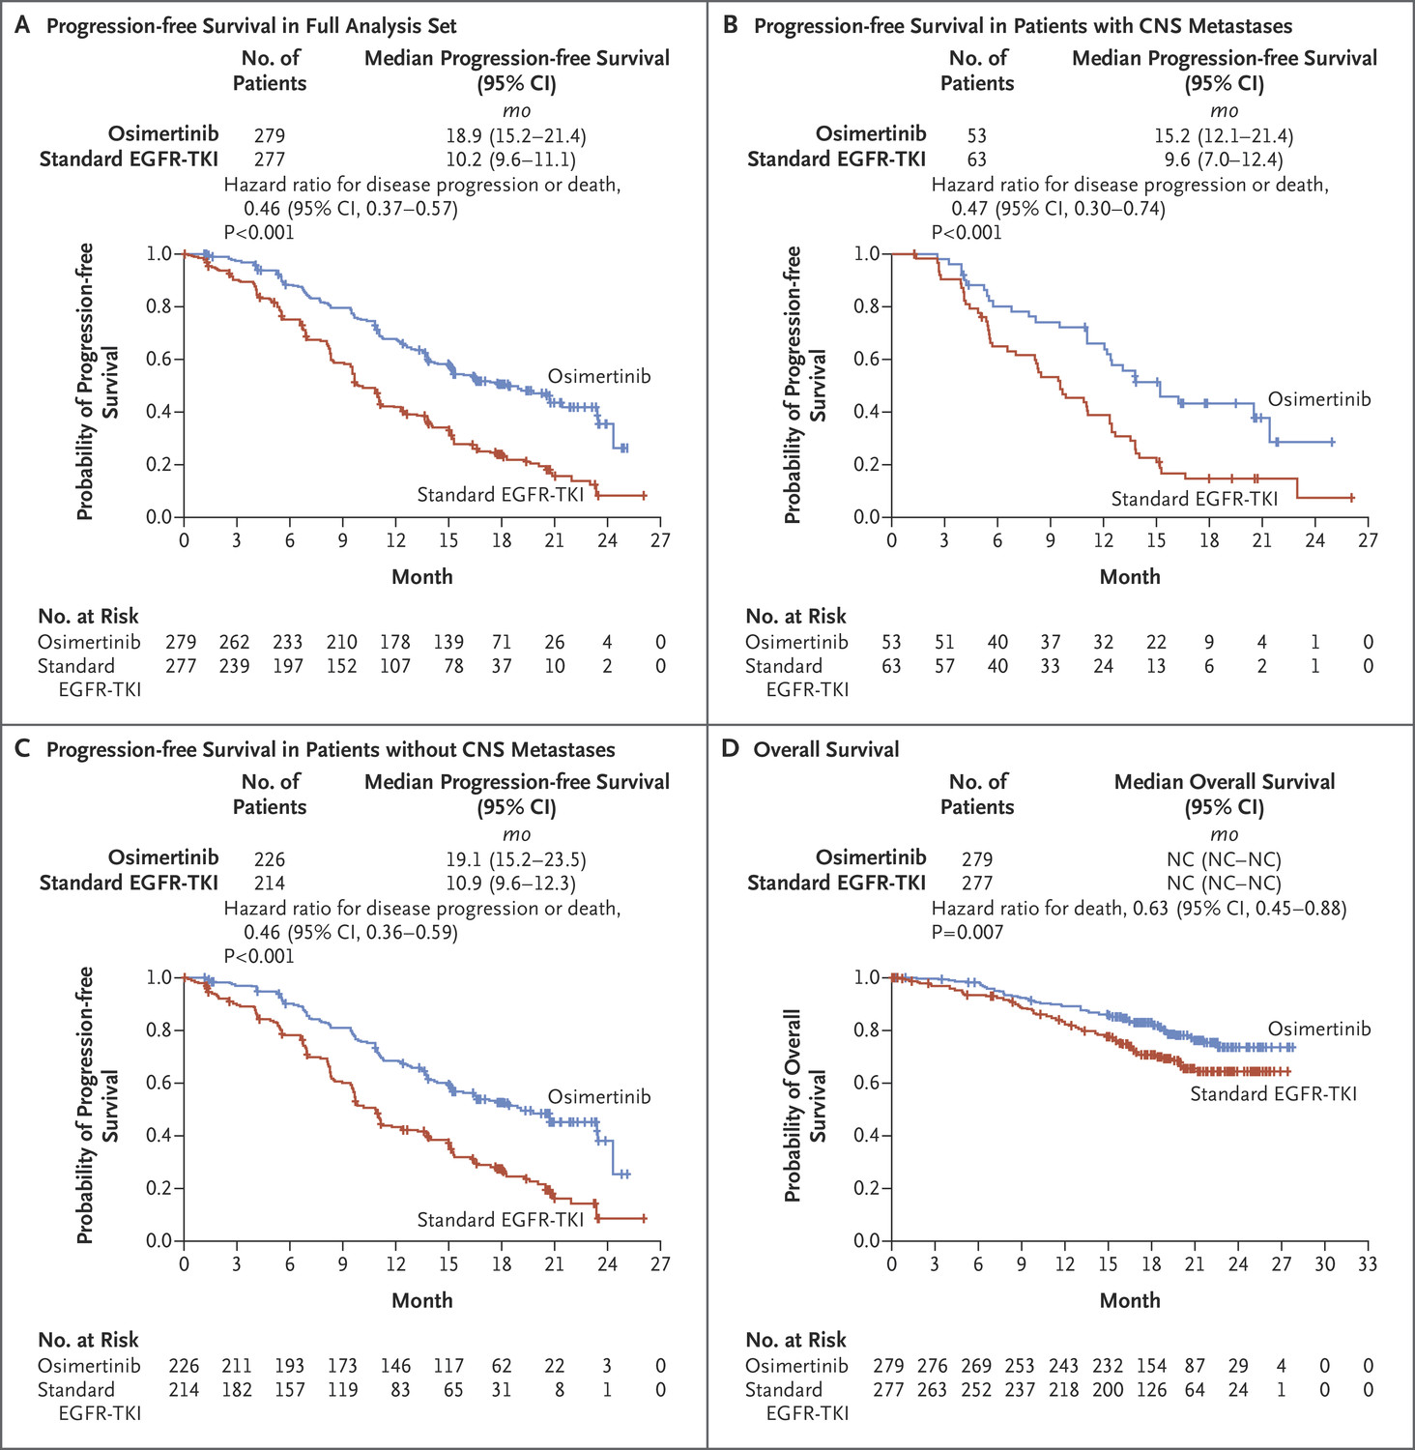
Osimertinib vs Gefitinib/Erlotinib as first treatment for NSCLC Progression-Free Survival
Soria et al, NEJM 2017

Slide 18
Osimertinib vs Gefitinib/Erlotinib as first treatment for NSCLC
CNS responses
Osimertinib
Gefitinib/Erlotinib
Reungwetwattana et al, JCO 2018

Slide 19
Osimertinib vs Gefitinib/Erlotinib as first treatment for NSCLC
CNS Progression
Reungwetwattana et al, JCO 2018

Slide 20
Osimertinib vs Gefitinib/Erlotinib as first treatment for NSCLC
Overall Survival
Hazard ratio – 0.63 (95% CI, 0.45-0.88)
p=0.007
Soria et al, NEJM 2017

Slide 21
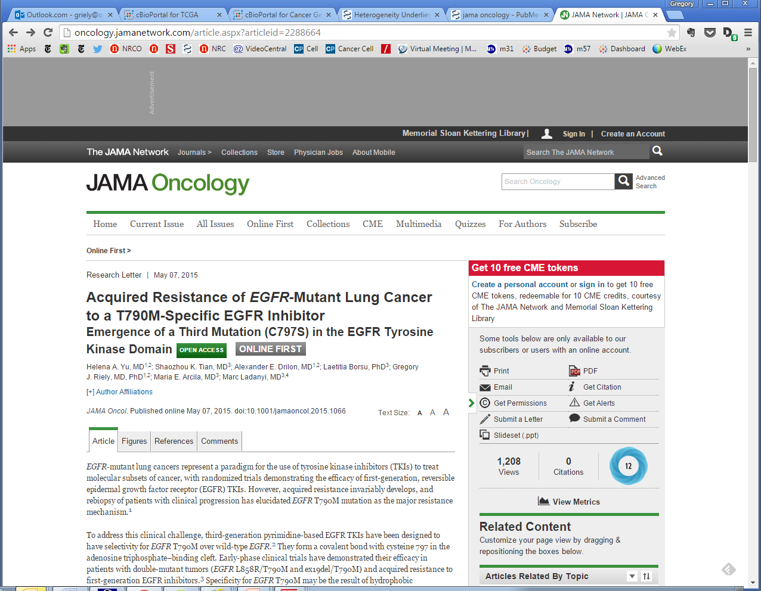
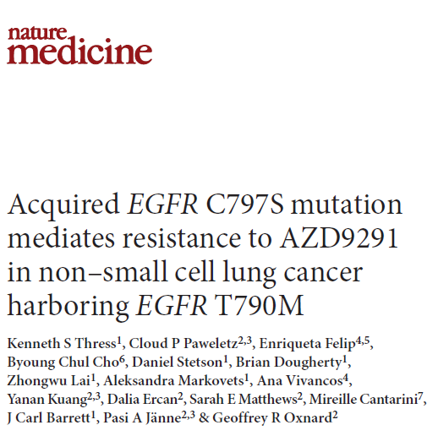
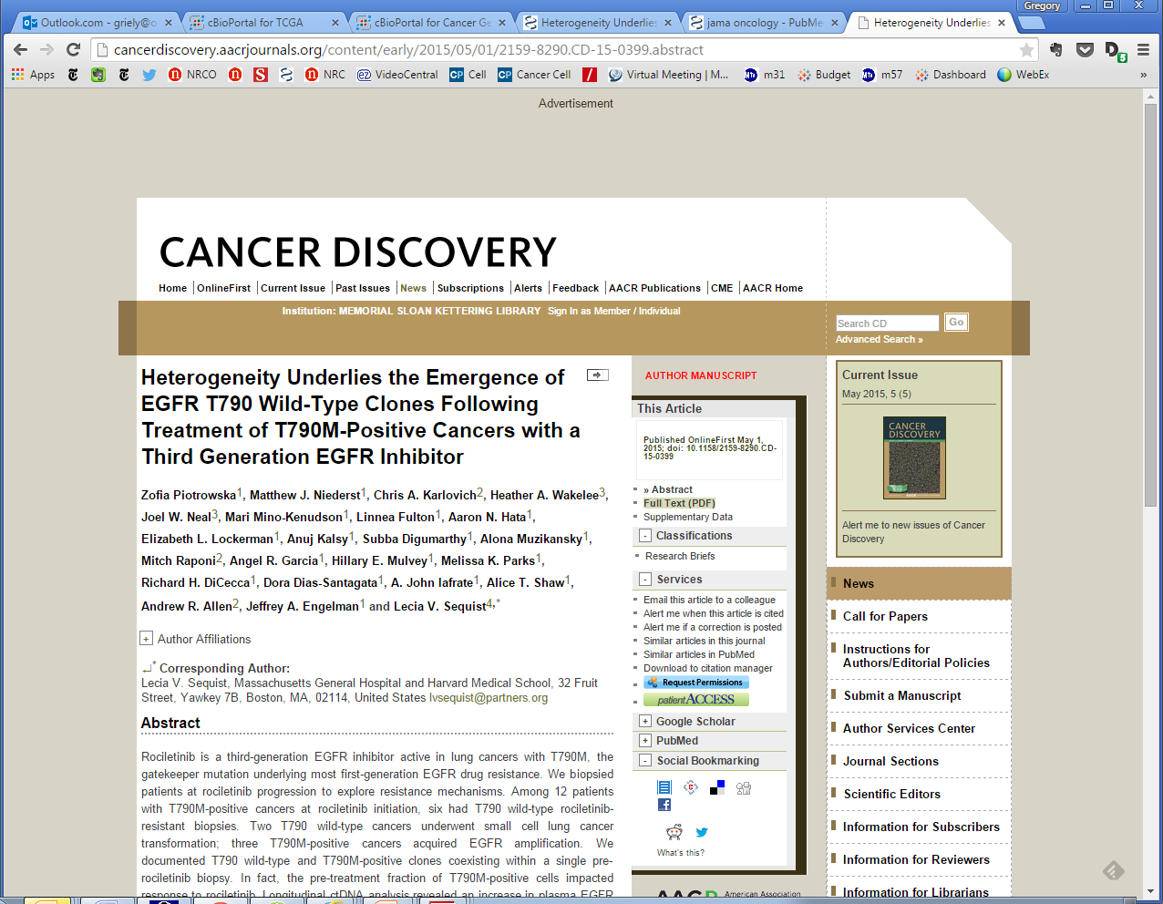
Published online 7 May 2015
Published online 4 May 2015
Published online 1 May 2015

Slide 22
Resistance to Osimertinib…it’s not so easy
 | FLAURA | AURA3 | Le et al. | Piotrowska et al.
N | 91 | 83 | 42 | 41
First line | 91 | N/A | 6 | 1
Paired tissue (1st line) | N/A | N/A | 6 (0) | N/A
Acquired changes
SCLC/SqCC | N/A | N/A | 2%/0% | 5%/2%
MET amp | 15% | 19% | 15% | 19%
HER2 amp | 2% | 5% | 2% | 5%
PIK3CA mut | 7% | 1% | 5% | 12%
BRAF mut | 3% | 3% | 0% | 0%
KRAS mut | 3% | 0% | 2% | 0%
Fusions | 1% | 3% | 5% | 10%
EGFR mut | 9% | 17% | 26% | 24%
Other | 60% | 52% | 40% | 23%
Caveat…
Most information is from plasma, which misses some events, including histologic transformation
Adapted from Ramalingam FLAURA Update and Rudin ESMO 2018 presentation.
Piotrowska et al. Cancer Discov 2018, Le et al. Clin Cancer Research 2018

Slide 23
Summary
Initial treatment with a 3rd generation EGFR TKI (with ability to inhibit not only T790M, but also the underlying EGFR mutation) leads to significantly longer progression-free survival
Understanding mechanisms of resistance for osimertinib is still early

Slide 24
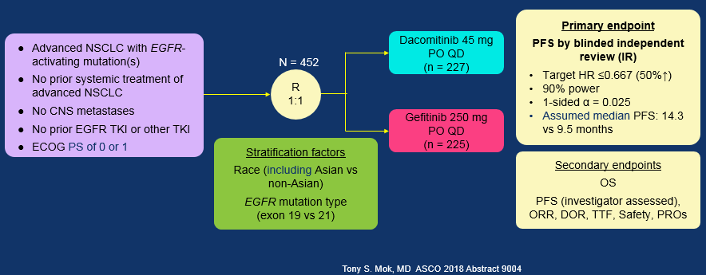
Can using a 2nd Generation EGFR TKI (with HER2 activity) improve outcomes?

Slide 25
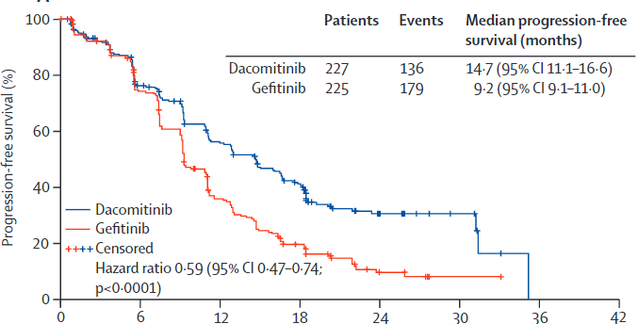
Dacomitinib Treatment Leads to Longer PFS
Wu et al, Lancet Onc 2017

Slide 26
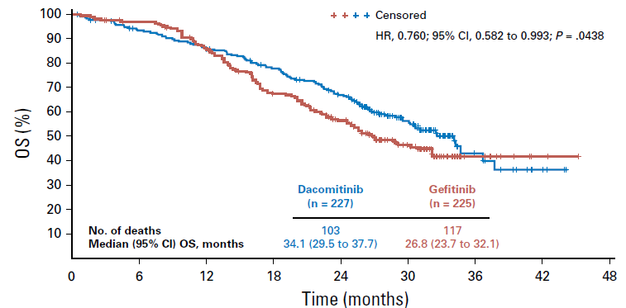
Dacomitinib Improves OS Compared to Gefitinib
Mok et al, JCO 2018

Slide 27
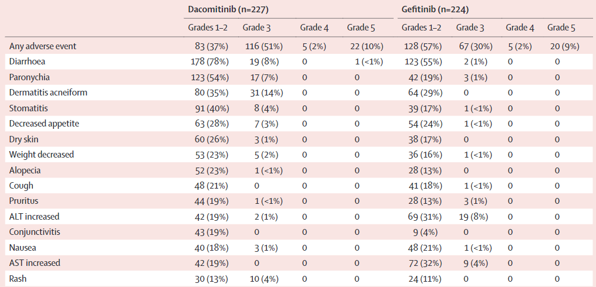
Dacomitinib Treatment is Associated with Greater Toxicity
Wu et al, Lancet Onc 2017

Slide 28
Dacomitinib Treatment is Associated with Greater Toxicity
Dose Reductions
Dacomitinib | Gefitinib
66% | 8%
38% - 30 mg/day 28% - 15 mg/day | 8% - 250 mg qod
Wu et al, Lancet Onc 2017

