Slide 1
Please note, these are the actual video-recorded
proceedings from the live CME event and may include
the use of trade names and other raw, unedited content.

Slide 2
Addressing Current Questions and
Controversies in the Management
of Gastrointestinal Cancers
Saturday, June 1, 2019
7:00 PM – 9:30 PM
Chicago, Illinois
Faculty
Professor Dirk Arnold, MD, PhD
Tanios Bekaii-Saab, MD
Joseph Chao, MD
Anthony El-Khoueiry, MD
Richard S Finn, MD
Yelena Y Janjigian, MD
Scott Kopetz, MD, PhD
Eileen M O’Reilly, MD
Moderator
Neil Love, MD

Slide 3
Module 2 – Pancreatic Adenocarcinoma (PAD)

Slide 4

Tanios Bekaii-Saab, MD
Professor, Mayo Clinic College of Medicine
and Science
Program Leader, Gastrointestinal Cancer
Mayo Clinic Cancer Center
Vice-Chair and Section Lead
Division of Medical Oncology
Medical Director, Cancer Clinical Research Office
Senior Associate Consultant
Mayo Clinic
Phoenix, Arizona

Slide 5
Disclosures for Tanios Bekaii-Saab, MD
Advisory Committee | Amgen Inc, Immuneering Corporation, Imugene
Consulting Agreements | AbbVie Inc, Array BioPharma Inc, Bayer HealthCare Pharmaceuticals
Contracted Research | Arrys Therapeutics, a wholly owned subsidiary of Kyn Therapeutics, Astellas Pharma Global Development Inc, Bayer HealthCare Pharmaceuticals, Boston Biomedical Inc, Bristol-Myers Squibb Company, Genentech, Ipsen Biopharmaceuticals Inc, Novartis
Data and Safety Monitoring Board/Committee | ARMO BioSciences, AstraZeneca Pharmaceuticals LP, Exelixis Inc, Merck, SillaJen

Slide 6

Eileen M O’Reilly, MD
Winthrop Rockefeller Chair in Medical Oncology
Section Head, Hepatopancreaticobiliary/
Neuroendocrine Cancers, Gastrointestinal Oncology Service
Associate Director, David M Rubenstein Center for Pancreatic Cancer; Attending Physician, Member
Memorial Sloan Kettering Cancer Center
Professor of Medicine
Weill Cornell Medical College
New York, New York

Slide 7
Disclosures for Eileen M O’Reilly, MD
Consulting Agreements | Aptus Pharma, BioLineRx, Bristol-Myers Squibb Company, Celgene Corporation, CytomX Therapeutics, Gilead Sciences Inc, Halozyme Inc, Janssen Biotech Inc, Loxo Oncology Inc, a wholly owned subsidiary of Eli Lilly & Company, NewLink Genetics, Pfizer Inc, PharmaCyte Biotech, Pharmacyclics LLC, an AbbVie Company, Pieris Pharmaceuticals Inc, Sanofi Genzyme, Silenseed Ltd, Sobi, Targovax, twoXAR
Contracted Research | Acta Biológica, AstraZeneca Pharmaceuticals LP, Bristol-Myers Squibb Company, Celgene Corporation, Genentech, Halozyme Inc, MabVax Therapeutics Inc, OncoQuest Inc, Roche Laboratories Inc

Slide 8

A man in his late 50s with symptomatic metastatic pancreatic adenocarcinoma to the liver
Modified FOLFIRINOX and paricalcitol
  Dramatic improvement with complete resolution of
  pancreatic mass and all but 1 liver met
  Resolution of clinical symptoms; patient returns to work
  within 1 month
  FOLFIRINOX-associated neuropathy, diarrhea
Scheduled to undergo radioembolization to solitary liver lesion
Dr Ibrahim

Slide 9
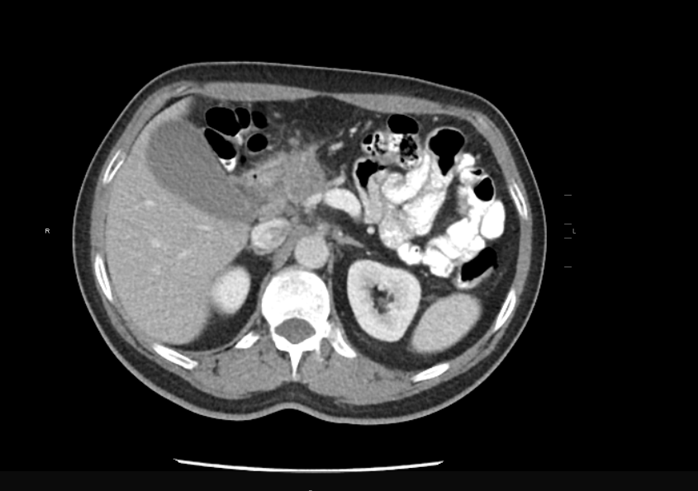
11/2018: Mass in the head of the pancreas

Slide 10
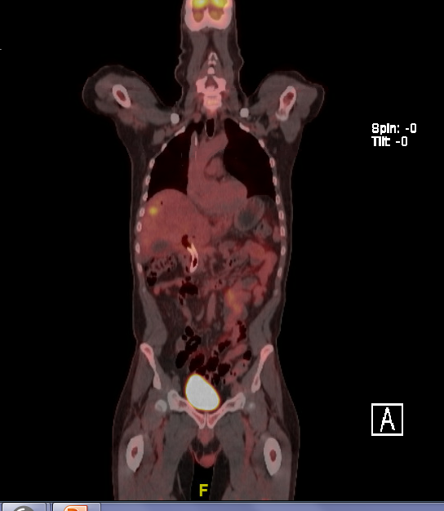

4/2019: After treatment with FOLFIRINOX

Slide 11
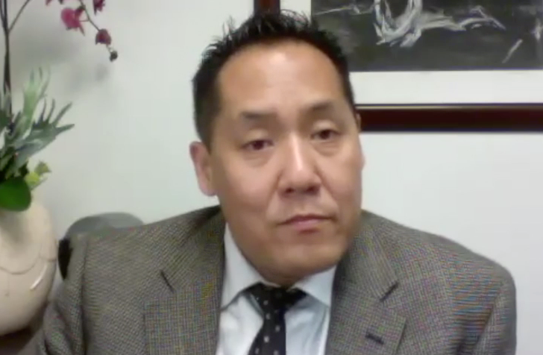
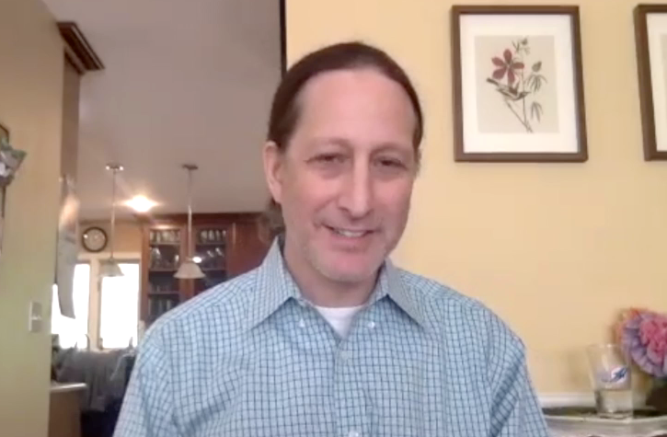
Elderly Patients with Metastatic Pancreatic Cancer, Poor PS and Disease Progression on Nab Paclitaxel/Gemcitabine
A man in his mid-70s
PS = 2 with peripheral edema and peripheral neuropathy
A man in his early 80s
Previously healthy with well-controlled hypertension
and hyperlipidemia
Dr Park
Dr Morganstein

Slide 12

A woman in her late 60s with metastatic pancreatic adenocarcinoma (PS = 0) and prior history of breast cancer (BRCA2 mutation)
Biopsy-confirmed pancreatic adenocarcinoma with multiple
liver lesions
  Rapid clinical deterioration
  CA 19-9: 30,000 → 70,000 in 2 to 3 weeks
  Benign leukemoid reaction (WBC > 50,000)
  Pulmonary embolism, leg swelling
  Albumin = 2.7
  Bilirubin = 1.1
  INR = 1.5
Dr Gujja

Slide 13
Module 2 – Pancreatic Adenocarcinoma (PAD)

Slide 14
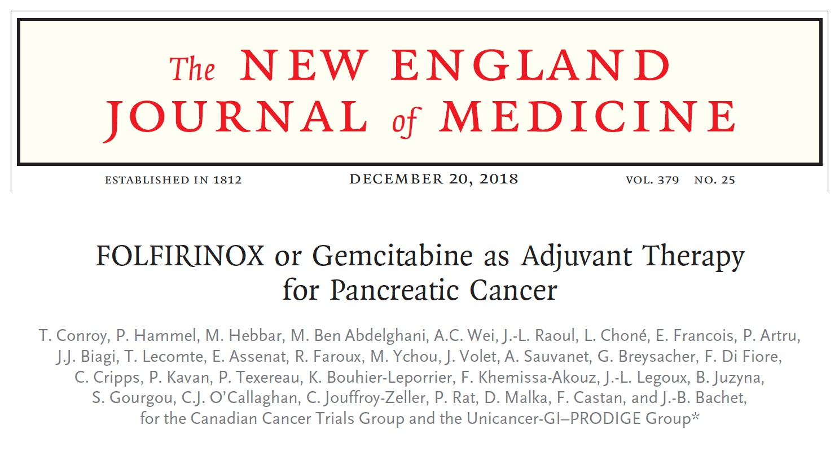

Slide 15
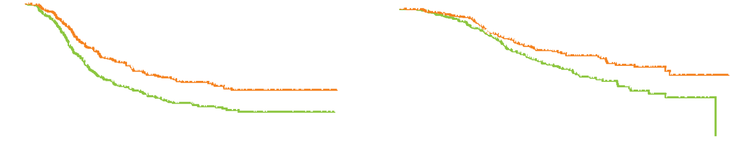
PRODIGE 24/CCTG PA.6: Survival Outcomes
Disease-free Survival
Overall Survival
Stratified hazard ratio for cancer-related event, second cancer or death, 0.58
p < 0.001
No. of events, 314
Modified FOLFIRINOX
Patients without event (%)
Modified FOLFIRINOX
Patients who were alive (%)
Stratified hazard ratio for death, 0.64
p = 0.003
No. of deaths, 192
Gemcitabine
Gemcitabine
Months
Months
Outcome | mFOLFIRINOX (n = 247) | Gem (n = 246) | HR | p-value
Median DFS | 21.6 mo | 12.8 mo | 0.58 | <0.001
Median OS | 54.4 mo | 35.0 mo | 0.64 | 0.003
Conroy T et al. N Engl J Med 2018;379(25):2395-406.

Slide 16
Press Release: The Phase III APACT Trial of Adjuvant Gemcitabine/ Nab Paclitaxel Fails to Meet Primary DFS Endpoint — March 12, 2019
The Phase 3 APACT study evaluating the investigational use of nab paclitaxel in combination with gemcitabine following surgical resection (adjuvant treatment) in patients with pancreatic cancer did not achieve the primary endpoint of improvement in disease-free survival, as confirmed by independent radiological review, compared to gemcitabine alone.
Overall survival, a secondary endpoint of the study, was improved, reaching nominal statistical significance, with nab paclitaxel in combination with gemcitabine compared to gemcitabine alone. The safety profile observed in the APACT study was consistent with previously reported studies of nab paclitaxel.
https://www.businesswire.com/news/home/20190312005846/en/Celgene-Update-ABRAXANE%C2%AE-Combination-Therapy-Treatment-Metastatic

Slide 17
SWOG-1505 Randomized Phase II Schema
Resectable pancreatic cancer
N = 112
FOLFIRINOX
(6 cycles)
Surgery
Gemcitabine/ nab paclitaxel
(3 cycles)
Surgery
FOLFIRINOX
(6 cycles)
Gemcitabine/ nab paclitaxel
(3 cycles)
Sohal D et al. SWOG S1505: Initial findings on eligibility and neoadjuvant chemotherapy experience with mFOLFIRINOX versus gemcitabine/nab-paclitaxel for resectable pancreatic adenocarcinoma. ASCO 2019;Abstract 4137. Poster Session, Monday, June 3rd, 8:00 AM – 11:00 AM, Hall A
www.clinicaltrials.gov. NCT02562716.

Slide 18
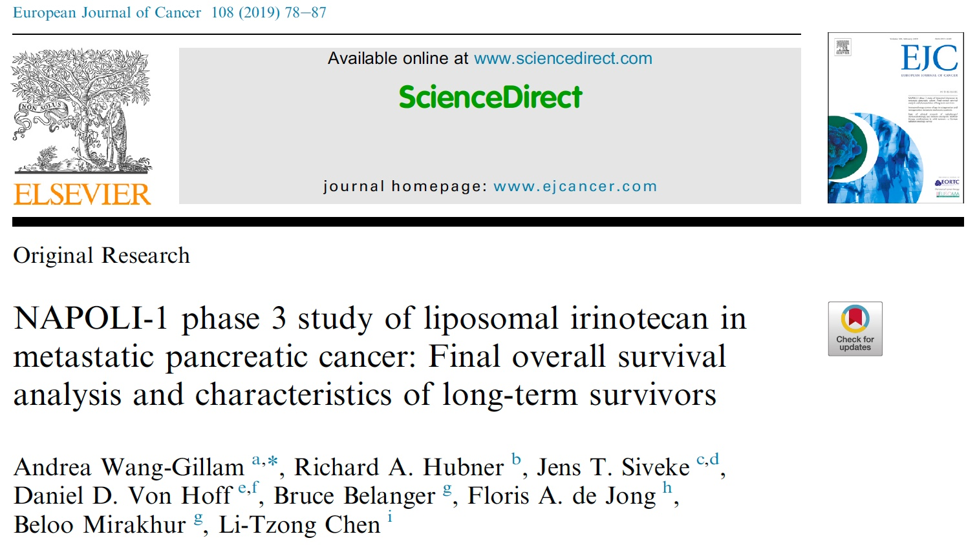

Slide 19
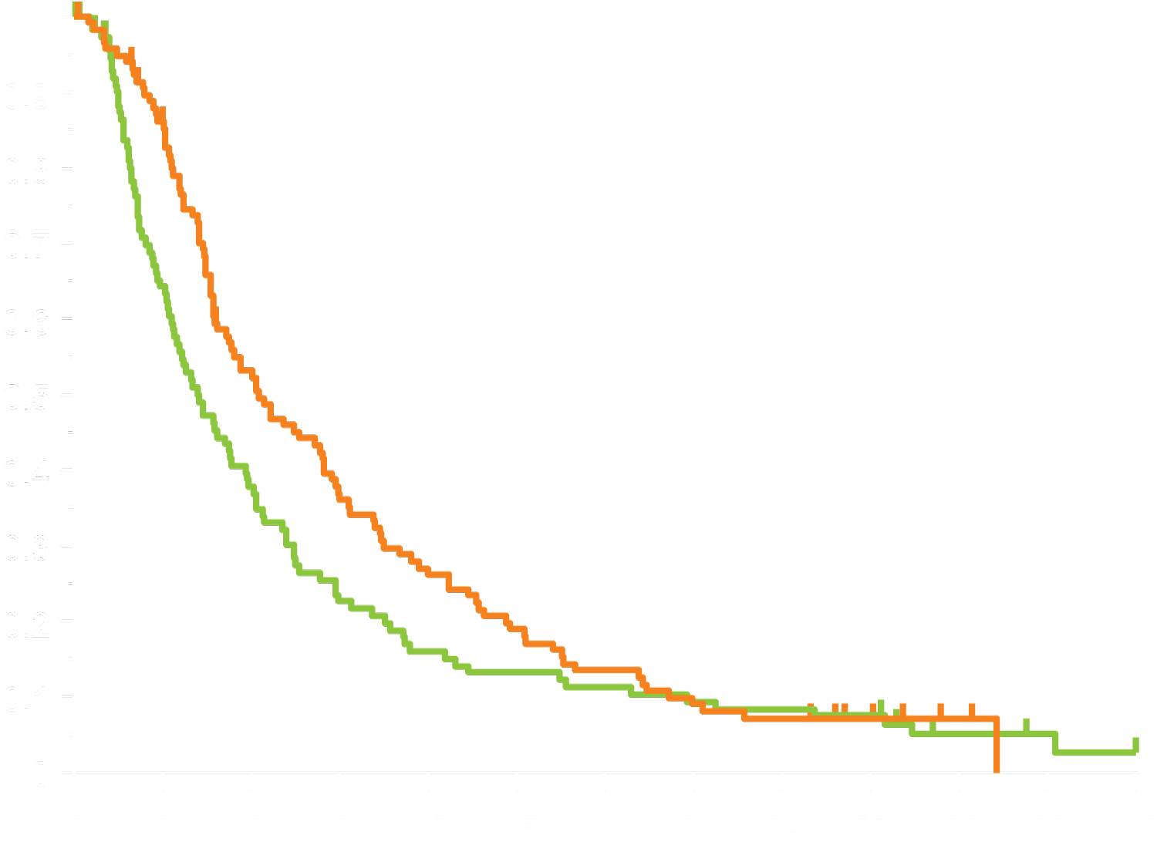
NAPOLI-1: Final Overall Survival with Nal-IRI/5-FU/LV vs 5-FU/LV as Second-Line Therapy
N = 117
N = 119
nal-IRI + 5-FU/LV 6.24
5-FU/LV 4.24
HR: 0.75 (0.57–0.99)
 | 6-month survival (%) | 1-year survival (%)
nal-IRI + 5-FU/LV | 53 | 26
5-FU/LV | 38 | 16
Overall survival
Time from randomization, months
Wang-Gillam A et al. Eur J Cancer 2019;108:78-87.

Slide 20
Dose Modifications of Liposomal Irinotecan
(Nal-IRI) + 5-Fluorouracil/Leucovorin (5-FU/LV) in NAPOLI-1: Impact on Efficacy
Wang-Gillam A et al.
Gastrointestinal Cancers Symposium 2018;Abstract 388.

Slide 21
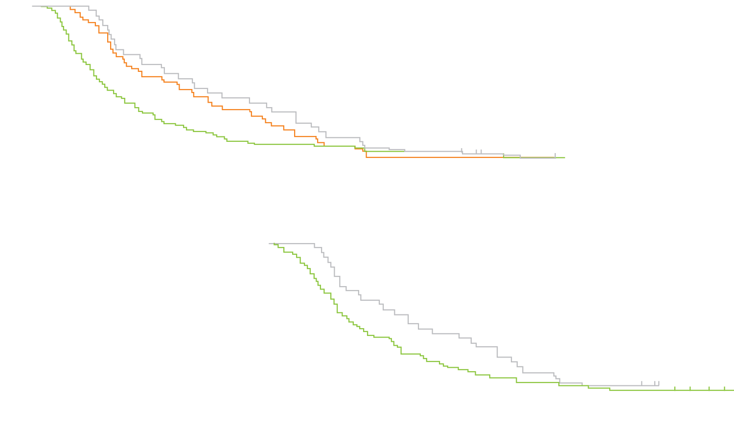
NAPOLI-1: Impact on OS of Dose Modifications or Dose Delays of Nal-IRI + 5-FU/LV
nal-IRI + 5-FU/LV, dose reduction (n = 34)
nal-IRI + 5-FU/LV, dose delay (n = 49)
OS was greater with nal-IRI/5-FU/LV vs 5-FU/LV only
5-FU/LV (n = 105)
Overall survival (%)
Impact of nal-IRI Dose Delay or Dose Reduction on OS by Treatment Arm
Time from randomization (months)
nal-IRI + 5-FU/LV, dose reduction (n = 34)
No significant impact of dose reduction or dose delay on OS in the nal-IRI/5-FU/LV arm
nal-IRI + 5-FU/LV, no dose reduction (n = 83)
Impact of nal-IRI Dose Reduction vs No Dose Reduction on OS in the nal-IRI/5-FU/LV Arm
Overall survival (%)
Time from randomization (months)
Wang-Gillam A et al. Gastrointestinal Cancers Symposium 2018;Abstract 388.

Slide 22
Phase II Study of Nal-IRI, 5-FU/LV and Oxaliplatin (NAPOX): Moving Nal-IRI to the Front Line for Metastatic Pancreatic Cancer
Nal-IRI/5-FU/Oxaliplatin
Cohort A
80/2400/400/60
Cohort B
60/2400/400/60
Cohort B
60/2400/400/60
Part 1A
Dose exploration
Part 1B
Dose expansion
 | Cohort A | Cohort B | Cohort C
 | N = 7 | N = 7 | N = 10
ORR | — | 4 of 7 | 3 of 10
DCR | 3 of 7 | 6 of 7 | 4 of 10
Cohort C
60/2400/400/85
Most tolerable
Cohort D
65/2400/400/70
Future potential for NAPOX versus gem/nab paclitaxel
Dean A et al. Proc ASCO 2018;Abstract 4111.

Slide 23
DNA Damage Response (DDR) Mutations in Pancreatic Cancer
17%-25% of pancreatic adenocarcinomas harbor mutations in the DDR genes
  Homologous recombination DNA damage response (HR-DDR) mutations
  BRCA1, BRCA2, ATM, PALB2, ATRX, RAD51 and others
Gene | N (616 total)
ATM | 28 (4.5%)
BRCA2 | 18 (2.9%)
SMARCA4 | 10 (1.6%)
BAP1 | 8 (1.3%)
BRCA1 | 8 (1.3%)
BRIP1 | 6 (1.0%)
PALB2 | 5 (0.8%)
CHEK2 | 4 (0.6%)
FANCA | 4 (0.6%)
FANCC | 3 (0.5%)
RAD50 | 3 (0.5%)
STAG2 | 2 (0.3%)
BARD1 | 1 (0.2%)
CHEK1 | 1 (0.2%)
FANCG | 1 (0.2%)
Know Your Tumor® (KYT) DataSet
  16.5% HR-DDR
Caris Database Review
  16.9% HR-DDR
Pancreas | Total N = 833
OVERALL HR-DDR | 16.9%
95% CI | (14.4~19.6)
ATM | 3.60%
BRCA2 | 3.33%
BRCA1 | 1.41%
PALB2 | 1.20%
CHEK2 | 0.60%
BAP1 | 0.48%
BRIP1 | 0.48%
NBN | 0.12%
WRN | 0.12%
ATRX | 0%
BLM | 0%
FANCC | 0%
MRE11A | 0%
RAD50 | 0%
ARID1A | 5.54%
Pishvaian, et al, Clinical Cancer Research, 2018
Heeke, et al, JCO Precision Oncology, 2018
Aguirre, et al, Cancer Discovery, 2018
Witkiewicz, et al, Nat Commun, 2015
Lowery, et al, Clinical Cancer Research, 2017
Waddell, et al, Nature, 2015
Bailey, et al, Nature, 2016
Biankin, et al, Nature, 2012
Collisson, et al, Nat Med, 2011
Courtesy of Michael Pishvaian, MD, PhD

Slide 24
POLO: A Phase III Trial of Maintenance Olaparib for Metastatic Adenocarcinoma of the Pancreas
Eligibility (N = 154)
Patients with metastatic pancreatic cancer Deleterious or suspected deleterious germline BRCA mutation-positive disease No disease progression on first-line platinum-based chemotherapy
Olaparib
(300 mg BID)
R
Placebo
3:2
Primary endpoint: Progression-free survival
Key secondary endpoints include: Overall survival, time to second disease progression, response rate and health-related quality of life
www.clinicaltrials.gov (NCT02184195); https://www.astrazeneca.com/media-centre/press-releases/2019/lynparza-significantly-delayed-disease-progression-as-1st-line-maintenance-treatment-in-germline-brca-mutated-metastatic-pancreatic-cancer-26022019.html

Slide 25
Phase III POLO Trial Met Its Primary Endpoint of Progression-Free Survival
Press Release – February 26, 2019
“Results from the trial showed a statistically-significant and clinically-meaningful improvement in progression-free survival (PFS) with olaparib vs placebo. The safety and tolerability profile of olaparib was consistent with previous trials.
POLO is a randomised, double-blinded, placebo-controlled trial exploring the efficacy of olaparib tablets as 1st-line maintenance monotherapy in patients with germline BRCA-mutated (gBRCAm) metastatic adenocarcinoma of the pancreas (pancreatic cancer) whose disease has not progressed on platinum-based chemotherapy.”
https://www.astrazeneca.com/content/astraz/media-centre/press-releases/2019/lynparza-significantly-delayed-disease-progression-as-1st-line-maintenance-treatment-in-germline-brca-mutated-metastatic-pancreatic-cancer-26022019.html

Slide 26
Olaparib as Maintenance Treatment Following First-Line Platinum-Based Chemotherapy (PBC) in Patients (pts) with a Germline BRCA Mutation and Metastatic Pancreatic Cancer (mPC): Phase III POLO Trial
Kindler HL et al.
ASCO 2019;Abstract LBA4.
Plenary Session, 3:15-3:30 PM, Hall B1

Slide 27
A Phase II, Single Arm Study of Maintenance Rucaparib in Patients with Platinum-Sensitive Advanced Pancreatic Cancer and a Pathogenic Germline or Somatic Mutation in BRCA1, BRCA2 or PALB2
Binder KAR et al.
Proc AACR 2019;Abstract CT234.

Slide 28
Napabucasin: First-in-Class Cancer Stemness Inhibitor
Cancer
stem cells
Cancer stemness inhibitor
Why target cancer cell stemness?
Cancer Stem Cells & Cancer Stemness
Highly tumorigenic
Fundamentally responsible for continued malignant growth
Initiators (seeds) of metastases
Resistant to chemotherapy and current targeted therapies
Heterogeneous cancer cells
Cancer stem cells
Chemotherapy
Radiotherapy
Targeted therapy
Relapse with
resistance
Cancer cells with
stemness
Bulk
cancer cells
Bekaii-Saab T et al. Proc ESMO World Congress GI 2017;Abstract LBA-002.

Slide 29
Phase 1b/2 Trial of Cancer Stemness Inhibitor Napabucasin (NAPA) + Nab-Paclitaxel (nPTX) and Gemcitabine (Gem) in Metastatic Pancreatic Adenocarcinoma (mPDAC)
Bekaii-Saab TS et al.
Proc ASCO 2018;Abstract 4110.

Slide 30
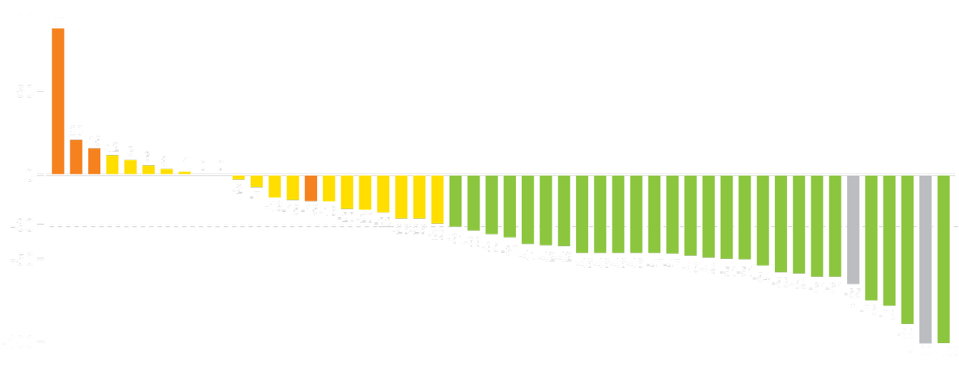
Phase Ib/II Trial: Response, Survival and Safety Outcomes
CR
PR
SD
PD
All patients (n = 59)
Best overall response rate (all pts) = 47.5%
Disease control rate (all pts) = 78%
Complete response = 2 (3.4%)
Partial response = 26 (44.1%)
Change from baseline (%)
Partial response
* Lymph nodes decreased to <10 mm in short axis. ** Some nontarget lesions remain
Survival | Phase I/IIb trial (n = 59) | Pts meeting CanStem111P criteria (n = 29)
Median OS | 9.59 mo | 12.62 mo
Median PFS | 7.06 mo | 7.10 mo
Napabucasin at 240 mg BID can be safely combined with nab paclitaxel and gemcitabine at full dose.
GI AEs seen with napabucasin were mainly Grade 1 or 2 and were manageable with supportive measures.
Grade 3 GI AEs were low and resolved upon withholding napabucasin.
Bekaii-Saab TS et al. Proc ASCO 2018;Abstract 4110.

Slide 31
CanStem111P Phase III Trial Schema
Trial identifier: NCT02993731
Estimated enrollment: 1,134
Napabucasin orally, twice daily
+ nab paclitaxel 125 mg/m² IV
3 out of 4 weeks
+ gemcitabine 1,000 mg/m² IV
3 out of 4 weeks
Eligibility
Treatment-naïve, metastatic pancreatic adenocarcinoma No prior cytotoxic or investigational therapy for metastatic disease ECOG PS 0-1
Disease progression
based on RECIST
or unacceptable toxicity
R
Nab paclitaxel 125 mg/m² IV
3 out of 4 weeks
+ gemcitabine 1,000 mg/m² IV
3 out of 4 weeks
Primary endpoint: Overall survival
www.clinicaltrials.gov. Accessed May 2019.

Slide 32
PEGPH20 Targets Hyaluronan in the Tumor Microenvironment
Removal of hyaluronan (HA) by PEGPH20
in HA-high tumor animal models was shown to:
Cancer cell
Decrease intratumoral
pressure
Decompress
vasculature
Increase
perfusion
Increase
access for therapeutics
Increase
access for
immune cells
Vasculature
HA
Collagen
Macrophage
T cell
PEGPH20
Treg
MDSC
Fibroblast
Adenosine
Molecular
receptors
Notes:
\

Slide 33

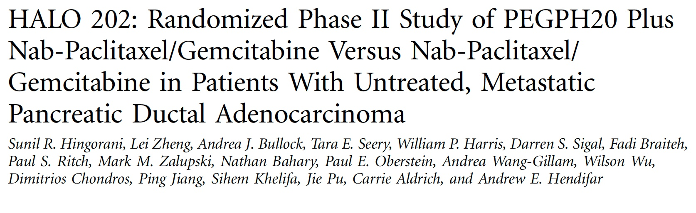

Slide 34
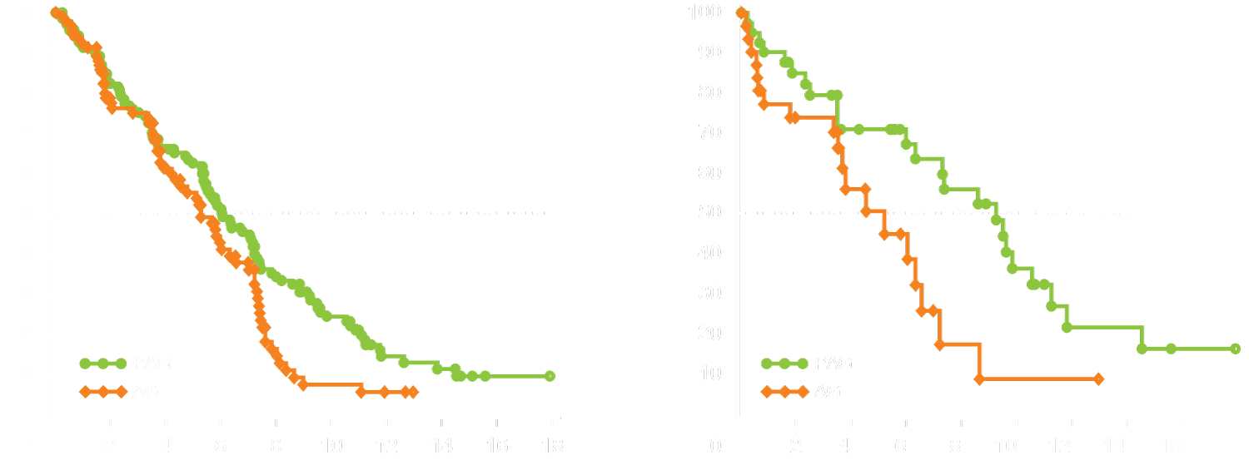
HALO 202: Progression-Free Survival (All and HA-High Patients)
Stage 1 + 2 | PAG (n = 166) | AG (n = 1,113)
Events | 102 | 67
Median PFS, mo | 6.0 | 5.3
HR (95% CI) | 0.73 (0.53 to 0.99)
p-value | 0.045
Stage 1 + 2 (HA-high) | PAG (n = 49) | AG (n = 35)
Events | 24 | 19
Median PFS, mo | 9.2 | 5.2
HR (95% CI) | 0.51 (0.26 to 1.00)
p-value | 0.048
K-M Estimate of PFS (%)
K-M Estimate of PFS (%)
Study duration (months)
Study duration (months)
TE events were comparable after enoxaparin initiation (14% PAG v 10% AG)
Hingorani SR et al. J Clin Oncol 2018;36(4):359-66.

Slide 35
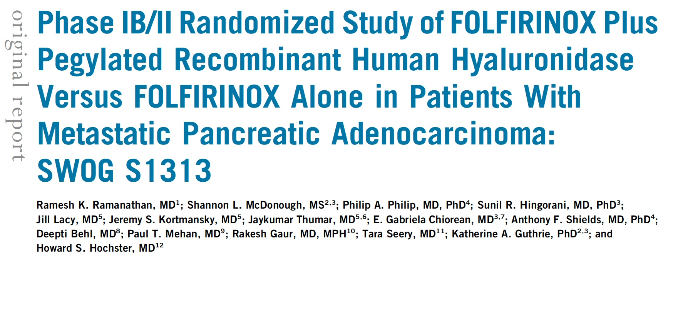
J Clin Oncol 2019;37:1062-9.

Slide 36
HALO-301 Phase III Trial Schema
Trial identifier: NCT02715804
Estimated enrollment: 500
PEGPH20 (P) +
nab paclitaxel/gemcitabine (AG)
Eligibility
Hyaluronan-high Stage IV, previously untreated pancreatic ductal adenocarcinoma
2:1
R
AG + placebo
Primary endpoint: Overall survival

Slide 37
A Phase Ib Study of CD40 Agonistic Monoclonal Antibody APX005M Together with Gemcitabine and Nab Paclitaxel with or without Nivolumab in Untreated Metastatic Pancreatic Ductal Adenocarcinoma (PDAC) Patients: PICI0002 (PRINCE)
O’Hara MH et al.
Proc AACR 2019;Abstract CT004.

Slide 38
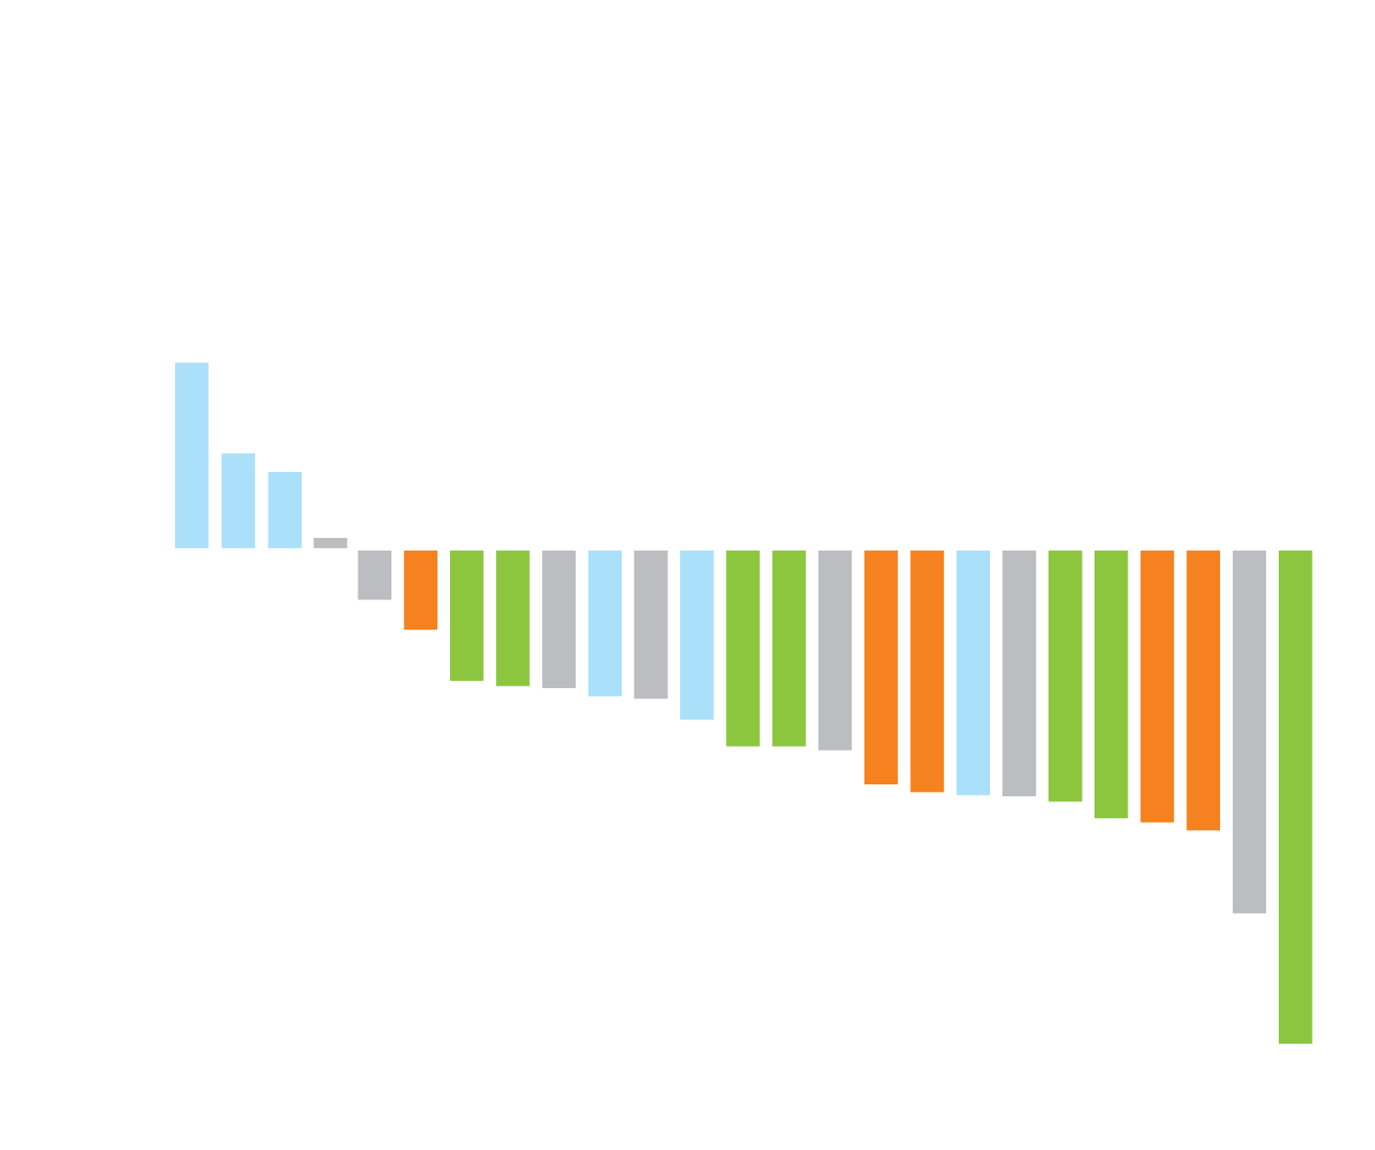
PRINCE (PICI0002): Response
Cohort B1: Gem/NP/APX005M 0.1 mg/kg
Cohort B2: Gem/NP/APX005M 0.3 mg/kg
Cohort C1: Gem/NP/APX005M 0.1 mg/kg + nivo
Cohort C2: Gem/NP/APX005M 0.3 mg/kg + nivo
*
= confirmed PR
ORR (DLT-evaluable population, n = 24): 54.2%
ORR (Safety-evaluable population, n = 30): 46.7%
Maximum change from baseline (%)
O’Hara MH et al. Proc AACR 2019;Abstract CT004.

Slide 39
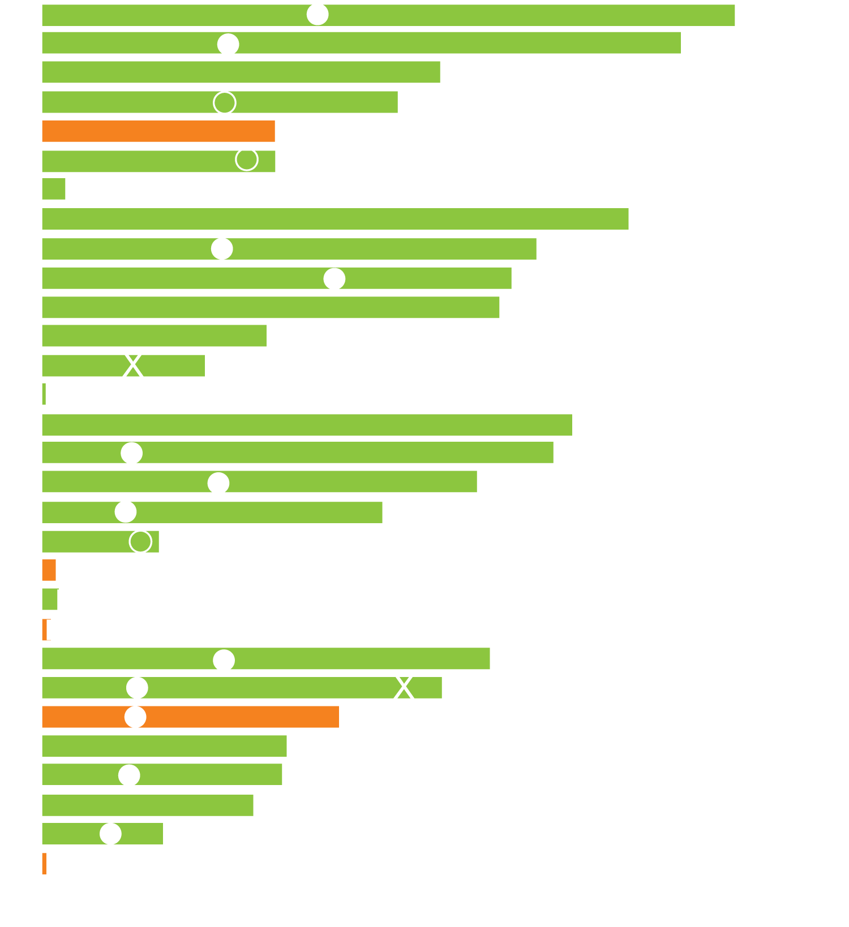
PRINCE (PICI0002): Time on Treatment and Time to First Response
Cohort B1: Gem/NP/APX005M 0.1 mg/kg
Cohort B2: Gem/NP/APX005M 0.3 mg/kg
Cohort C1: Gem/NP/APX005M 0.1 mg/kg + nivo
Cohort C2: Gem/NP/APX005M 0.3 mg/kg + nivo
Cohort B1
DLT-evaluable
Cohort B2
•
No
Subject
•
Yes
Event
Confirmed PR
Cohort C1
Unconfirmed PR
Death
X
Radiologic PD
Cohort C2
Treatment ongoing
Study month
O’Hara MH et al. Proc AACR 2019;Abstract CT004.

Slide 40

Currently, what is the optimal first-line systemic treatment for a patient with metastatic pancreatic cancer and a germline BRCA mutation?
Chemotherapy
PARP inhibitor
Chemotherapy followed by PARP inhibitor maintenance
Chemotherapy combined with a PARP inhibitor
Other

