Slide 1
Please note, these are the actual video-recorded proceedings from the live CME event and may include the use of trade names and other raw, unedited content.

Slide 2
Breakfast with the Investigators Exploring the Role of PARP Inhibition in the Management of Ovarian Cancer Sunday, June 2, 2019 6:45 AM – 7:45 AM Chicago, Illinois
Faculty
Professor Jonathan A Ledermann
Joyce F Liu, MD, MPH
David M O’Malley, MD
Moderator Neil Love, MD

Slide 3
Disclosures for Moderator Neil Love, MD
Dr Love is president and CEO of Research To Practice. Research To Practice receives funds in the form of educational grants to develop CME activities from the following commercial interests: AbbVie Inc, Acerta Pharma — A member of the AstraZeneca Group, Adaptive Biotechnologies, Agendia Inc, Agios Pharmaceuticals Inc, Amgen Inc, Ariad Pharmaceuticals Inc, Array BioPharma Inc, Astellas Pharma Global Development Inc, AstraZeneca Pharmaceuticals LP, Bayer HealthCare Pharmaceuticals, Biodesix Inc, bioTheranostics Inc, Boehringer Ingelheim Pharmaceuticals Inc, Boston Biomedical Inc, Bristol-Myers Squibb Company, Celgene Corporation, Clovis Oncology, Daiichi Sankyo Inc, Dendreon Pharmaceuticals Inc, Eisai Inc, Exelixis Inc, Foundation Medicine, Genentech, Genmab, Genomic Health Inc, Gilead Sciences Inc, Guardant Health, Halozyme Inc, ImmunoGen Inc, Incyte Corporation, Infinity Pharmaceuticals Inc, Ipsen Biopharmaceuticals Inc, Janssen Biotech Inc, administered by Janssen Scientific Affairs LLC, Jazz Pharmaceuticals Inc, Kite Pharma Inc, Lexicon Pharmaceuticals Inc, Lilly, Loxo Oncology Inc, a wholly owned subsidiary of Eli Lilly & Company, Merck, Merrimack Pharmaceuticals Inc, Myriad Genetic Laboratories Inc, Natera Inc, Novartis, Oncopeptides, Pfizer Inc, Pharmacyclics LLC, an AbbVie Company, Prometheus Laboratories Inc, Puma Biotechnology Inc, Regeneron Pharmaceuticals Inc, Sandoz Inc, a Novartis Division, Sanofi Genzyme, Seattle Genetics, Sirtex Medical Ltd, Spectrum Pharmaceuticals Inc, Taiho Oncology Inc, Takeda Oncology, Tesaro, Teva Oncology, Tokai Pharmaceuticals Inc and Tolero Pharmaceuticals.
Notes:
3
3
3

Slide 4
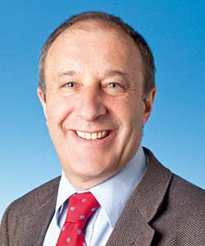
Professor Jonathan A Ledermann Professor of Medical Oncology Clinical Director University College London Cancer Institute Director, Cancer Research UK and UCL Cancer Trials Centre London, United Kingdom

Slide 5
Disclosures for Professor Jonathan A Ledermann
Advisory Committee | Artios Pharma, AstraZeneca Pharmaceuticals LP, Clovis Oncology, Cristal Therapeutics, Merck Sharp & Dohme Corp, Pfizer Inc, Roche Laboratories Inc, Seattle Genetics
Contracted Research | AstraZeneca Pharmaceuticals LP, Merck Sharp & Dohme Corp
Data and Safety Monitoring Board/Committee | Regeneron Pharmaceuticals Inc
Speakers Bureau | AstraZeneca Pharmaceuticals LP, Clovis Oncology

Slide 6
Joyce F Liu, MD, MPH Assistant Professor of Medicine Harvard Medical School Director of Clinical Research, Division of Gynecologic Oncology Dana-Farber Cancer Institute Boston, Massachusetts

Slide 7
Disclosures for Joyce F Liu, MD, MPH
Advisory Committee | AstraZeneca Pharmaceuticals LP, Clovis Oncology, Mersana Therapeutics, Tesaro

Slide 8
David M O’Malley, MD Professor Medical Director, Gynecologic Oncology Director, Clinical Research, Gynecologic Oncology Co-Director, Gynecologic Oncology Phase I Program ORIEN Physician Liaison for OSUCCC – James The Ohio State University and The James Cancer Center Columbus, Ohio

Slide 9
Disclosures for David M O’Malley, MD
Advisory Committee | AstraZeneca Pharmaceuticals LP, Clovis Oncology, GOG Foundation Inc, Janssen Biotech Inc, Myriad Genetic Laboratories Inc, Tesaro
Consulting Agreements | AbbVie Inc, Ambry Genetics, Amgen Inc, AstraZeneca Pharmaceuticals LP, Clovis Oncology, ImmunoGen Inc, Partnership for Health Analytic Research LLC, Tesaro
Contracted Research | Agenus Inc, Ajinomoto, Array BioPharma Inc, AstraZeneca Pharmaceuticals LP, Bristol-Myers Squibb Company, Clovis Oncology, EMD Serono Inc, Ergomed PLC, Exelixis Inc, Genentech, GlaxoSmithKline, GOG Foundation Inc, ImmunoGen Inc, Janssen Biotech Inc, Ludwig Institute for Cancer Research Ltd, Novartis, PRA Health Sciences, Regeneron Pharmaceuticals Inc, Stemcentrx, Syneos Health, Tesaro, TRACON Pharmaceuticals Inc
Data and Safety Monitoring Board/Committee | Marker Therapeutics Inc

Slide 10
RTP ASCO Symposia

Slide 11
The patients I saw today…
79 | M | CLL (serial monitoring of counts) and carcinoid tumor of the lung (active surveillance imaging)
55 | F | Stage 1 node-negative TNBC - Adjuvant chemo
64 | M | AML - Admitted for new onset severe pancytopenia; >50% blasts in marrow. Initiation of Induction chemo
79 | F | Metastatic NSCLC, completed carbo, nab-P, pembrolizumab, now on maintenance pembro
82 | M | Metastatic bladder cancer receiving 1st-line atezolizumab; Tolerating well, with stable disease
50 | M | Metastatic GIST on sunitinib since 2015
71 | F | Ovarian cancer - bevacizumab gemcitabine
75 | F | Myelodysplastic Syndrome 5q-, receiving lenalidomide but tolerating very poorly
74 | M | Locally advanced, distal esophageal cancer on concurrent chemoRT
55 | M | Pancytopenia secondary to liver cirrhosis
77 | M | Metastatic NSCLC post carbo, nab-P, pembrolizumab due to start pembro maintenance
81 | F | Locally advanced NSCLCa-N2, refused chemo. Definitive XRT, refused durvalumab consolidation
88 | F | DLBCL dx May 2018, refused chemo. Rituximab + prednisone ~8wks, complete remission. Now, relapsed disease in CNS but refuses WBRT; hospice
55 | M | Gastric cancer receiving FOLFOX
44 | F | Ovarian cancer - Carbo-paclitaxel
57 | M | CLL previously monitored, now with constitutional symptoms, weight loss and increasing WBC
73 | F | Extensive stage SCLC diagnosed 2014, Relapsed in 2017, XRT with CDDP/VP-16. Remains in remission
45 | M | Sokal high risk CML on dasatinib 75mg due to severe thrombocytopenia, tolerating much better, in CcyR
81 | F | S/p lobectomy for incidentally diagnosed Stage 1A NSCLCa. No adjuvant treatment required
55 | F | Newly diagnosed ER/PR-pos, HER2-neg locally advanced, node+ lobular carcinoma s/p bilat mastectomy. Plan: Adjuvant chemo, XRT, hormonal rx

Slide 12
The patients I saw today…
57 | F | Low grade gastric NET - octreotide
64 | M | MM - Post ASCT on lenalidomide maintenance
66 | M | Castrate-resistant metastatic prostate cancer - PD on enzalutamide, to start docetaxel
42 | F | Breast cancer, refused adjuvant chemotherapy, now with metastatic disease in the right axilla and bone.
66 | F | CML – CR to imatinib
98 | F | MDS – receiving ESAs
58 | F | Glioblastoma multiforme - Maintenance temozolomide and optune device
62 | F | Adjuvant Olaparib maintenance
60 | F | Metastatic ER + HER2 - breast cancer - almost complete response in the breast after 4 months
82 | M | Breast cancer 8 years ago - followup
48 | M | CML – considering third line bosutinib
61 | M | Primary appendyceal low grade cancer - surgery
62 | F | IgM MGUS for years, now with pancytopenia, bone marrow biopsy showing low grade NHL (possibly WM)
38 | F | mCRC – 2L FOLFIRI/Bevacizumab
59 | M | Lupus anticoagulant/Pulmonary embolism - rivaroxaban
70 | M | Metastatic melanoma - in remission on nivolumab for almost 3 years
67 | M | Melanoma – PD on ipi/nivo, pt not doing well
67 | F | Metastatic RCC – cape/bev maintenance
68 | M | Metastatic lung adenocarcinoma, PD-L1 70% - 1L pembro, SD for 3 months
59 | M | Stage IIIB Lung adenocarcinoma - Consolidation durvalumab post XRT/Chemo
59 | F | Breast cancer 11 years ago – follow up
86 | M | Anemia secondary to chronic kidney disease - ESA
48 | F | Recurrent cervical SCC – CR to cis/pac/bev, on bev maint 18 months later

Slide 13
Agenda
Module 1: Genetic Drivers of Ovarian Cancer Development and Current Testing Algorithms; PARP Inhibitors in the Management of Newly Diagnosed Disease
Module 2: Role of PARP Inhibition in the Management of Relapsed Ovarian Cancer Platinum-sensitive relapse Multiply relapsed disease
Module 3: Investigational Applications of Approved PARP Inhibitors; Other PARP Inhibitors in Clinical Development

Slide 14
Module 1: Genetic Drivers of Ovarian Cancer Development and Current Testing Algorithms; PARP Inhibitors in the Management of Newly Diagnosed Disease
Notes:
14
14
14

Slide 15
A woman in her early 60s with HGSC and a BRCA1 mutation (deletion exons 20-23) who presents with dry gangrene of her fingers (Dr Liu)
Workup for finger gangrene consistent with paraneoplastic inflammatory/vasculitis phenomenon
Neoadjuvant carboplatin/paclitaxel x 4
CA125 decrease: 122 to 13 units/ml
Resolution of gangrene
Interval cytoreductive surgery with extensive treatment effect
2 additional cycles of carboplatin/paclitaxel
Olaparib maintenance therapy
No evidence of recurrence to date
Notes:
Gujja Cut 02

Slide 16
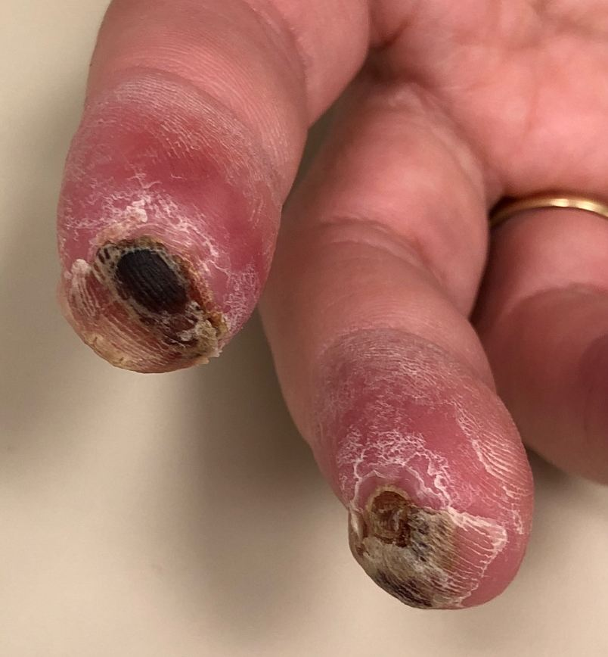
A woman in her early 60s (Dr Liu)

Slide 17
A woman in her early 70s with Stage IV tubo-ovarian cancer and a germline BRCA1 mutation who is a Jehovah’s Witness (Dr Ledermann)
2/2014: Presents with umbilical nodule and intra-abdominal disease
Completes carboplatin and paclitaxel x 6
3/2014: SOLO1 trial of maintenance olaparib versus placebo
Cycle 3: Dose reduction to 250 mg (Grade 2 transaminase changes and gamma-glutamyl transferase)
3/2016: Continues on drug due to minor persistent abnormalities on CT
3/2019: Continues on drug

Slide 18
DNA-Repair Deficiency (DRD) Impacts Up to Two Thirds of Tumors
A subset of ovarian tumors may exhibit DRD in the absence of BRCA1/2 mutations
OTHER
Some may be DRD positive via upregulation of miRNAs or other mechanisms
BRCA1 germline mutations 8%
DRD
DRD positive may be sensitive to PARP inhibition
BRCA1 somatic mutations 3%
BRCA sensitive to PARP inhibition
Other 21%
BRCA2 germline mutations 6%
BRCA2 somatic mutations 3%
NER mutations 4-8%
BRCA1 promoter methylation 10%
MMR mutations 3%
DR PROFICIENT
DRD
DRD positive may be sensitive to PARP inhibition
Not sensitive to PARP inhibition
CDK12 mutations 3%
RAD51C promoter methylation 2%
Cyclin E1 amplification 15%
FA gene mutations 2%
Core RAD gene mutations 1.5%
HR DNA damage gene mutations 2%
PTEN homozygous loss 7%
EMSY amplification
6%
POSSIBLY DRD
CDK12, cyclin dependent kinase 12; EMSY, BRCA2-interacting transcriptional repressor; FA, Fanconi anemia; MMR, mismatch repair; miRNA, micro messenger ribonucleic acid; NER, nucleotide excision repair; PTEN, phosphatase and tensin homolog.
Konstantinopoulos PA et al. Cancer Discov 2015;5:1137-54.

Slide 19
Impact of Family History of Breast or Ovarian Cancer
Proportion of patients with germline mutation
N
ALL PATIENTS 360
Family history
Breast or ovarian cancer 157
Neither breast nor ovarian cancer 203
BRCA1
BRCA2
Other*
BRCA1
BRCA2
Other*
BRCA1
BRCA2
Other*
0
0.10
0.20
0.30
Frequency
* BARD1, BRIP1, CHEK2, MRE11, NBN, PALB2, RAD50, RAD51C and TP53
Walsh T et al. PNAS 2011;108(44):18032-7.

Slide 20
BRCA Testing (Germline or Tumor): Standard of Care¹⁻⁵
A patient with ovarian cancer who is BRCA
wild type on germline testing would need subsequent tumor testing to establish whether or not she has a somatic BRCA mutation to access olaparib
Germline test
Tumor test
A patient with ovarian cancer who has a BRCA mutation identified from tumor testing would need subsequent germline testing to determine whether there are implications for her relatives
Negative
Positive
Tumor test
Germline test
Beginning with a tumor test rather than a germline test:
Fewer patients will require 2 rounds of BRCA testing (a greater number of women with ovarian cancer will test negative on germline testing than will test positive on tumor testing). More cost effective?
Consent may be perceived as more straightforward
Potential risk of not obtaining an accurate result (technical issues): missing a BRCA mutation
. 1. Vergote I et al. Eur J Cancer. 2016;69:127-134. 2. NCCN Guidelines. https://www.nccn.org/professionals/physician_gls/PDF/genetics_screening.pdf. Accessed 24 September 2018. 3. SGO. https://www.sgo.org/clinical-practice/guidelines/genetic-testing-for-ovarian-cancer/. Accessed 24 September 2018. 4. ASCO. https://www.asco.org/practice-guidelines/cancer-care-initiatives/genetics-toolkit/assessing-your-patient%E2%80%99s-hereditary. Accessed 24 September 2018. 5. Ledermann JA et al. https://www.esmo.org/Guidelines/Gynaecological-Cancers/Newly-Diagnosed-and-Relapsed-Epithelial-Ovarian-Carcinoma/eUpdate-Treatment-Recommendations. Accessed 24 September 2018.

Slide 21
Clinical Utility of Multigene Panel Testing
Additional mutations (besides BRCA1/2) create risk for ovarian cancer
PALB2, BARD1, BRIP1, RAD51C, RAD51D, MSH2, MLH1, PMS2 and MSH6
Advantages
Decreases:
Resource use (efficient use of funds and time)
Number of patient visits
Number of tests sent
Limitations
Increases:
Complexity of results
Likelihood of identifying results of uncertain clinical significance
Potential for misinterpretation of results
Norquist BM et al. JAMA Oncol 2016;2(4):482-90; SGO Clinical Practice Statement: Next Generation Cancer Gene Panels Versus Gene by Gene Testing. Available at: https://www.sgo.org/clinical-practice/guidelines/next-generation-cancer-gene-panels-versus-gene-by-gene-testing/.

Slide 22
Simultaneous clinical testing for germline and somatic mutations in ovarian carcinoma (OC): Mutation rate and impact on therapeutic decisions
Jorge S et al.
Proc SGO 2019;Abstract 6.

Slide 23
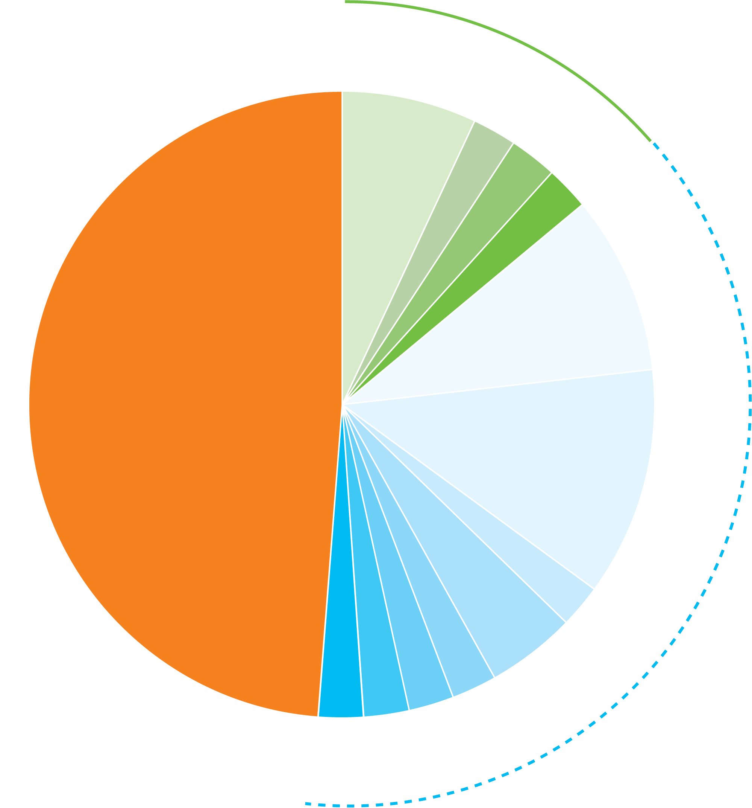
Simultaneous Clinical Testing for Germline and Somatic Mutations in Ovarian Carcinoma (N = 43)
Negative = neither germline nor somatic mutation identified
Germline = germline mutation identified with corresponding somatic mutation
Somatic = somatic mutation identified but not germline mutation
BRCA1 (3, 7%)
BRCA2 (1, 2.3%)
Germline (6, 14%)
In 18 cases (41.9%), somatic testing provided additional information on actionable mutations when germline testing was negative or inconclusive
Genetic testing had an impact on clinical decision making in 10 cases (23.3%)
7 based on somatic mutations (3 BRCA1, 2 BRCA2, 1 RAD51B, 1 BRIP1)
and 3 on germline mutations (1 BRCA1, 1 BRCA2, 1 PMS2)
PMS2 (1, 2.3%)
CHEK2 (1, 2.3%)
BRCA1 (4, 9.3%)
Negative (21, 48.8%)
BRCA2 (5, 11.6%)
PMS2 (1, 2.3%)
BRP1 (2, 4.7%)
Somatic (16, 37.2%)
RAD51C (1, 2.3%)
ATM (1, 2.3%)
BRAF (1, 2.3%)
RAD51B (1, 2.3%)
Jorge S et al. Proc SGO 2019;Abstract 6.

Slide 24
SOLO-1: A Phase III Trial of Maintenance Olaparib in OC with BRCA Mutation
NCT01844986
Eligibility
Newly diagnosed ovarian, fallopian tube or primary peritoneal cancer FIGO Stage III-IV High-grade serous or endometrioid histology Deleterious or suspected deleterious BRCA1 or BRCA2 mutation-positive
Maintenance olaparib
300 mg BID
(n = 260)
CR or PR and no clinical evidence of PD after completing first-line platinum-based therapy
R
Placebo
(n = 131)
(2:1)
Primary endpoint: Investigator-assessed progression-free survival
www.clinicaltrials.gov; Moore KN et al. Proc ASCO 2014;Abstract TPS5616; Moore K et al. N Engl J Med 2018 Dec 27;379(26):2495-505.

Slide 25
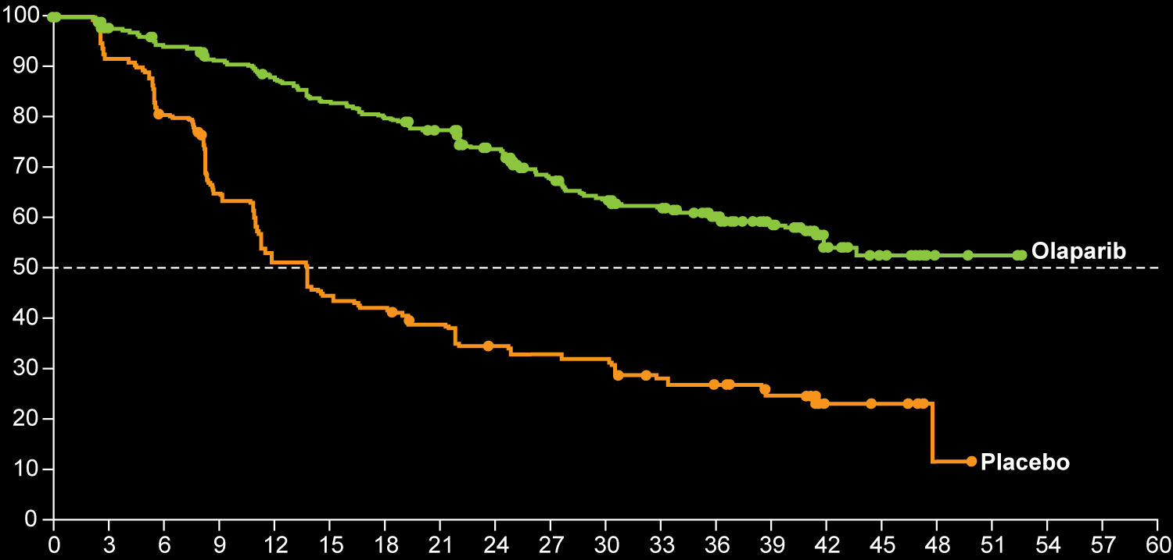
SOLO-1: Primary Endpoint Progression-Free Survival (Investigator Assessed)
 | Olaparib (N = 260) | Placebo (N = 131)
3-year PFS | 60% | 27%
Patients free from disease progression and death (%)
Hazard ratio for disease progression or death, 0.30
P < 0.001
Months since randomization
Moore K et al. N Engl J Med 2018 Dec 27;379(26):2495-505.

Slide 26
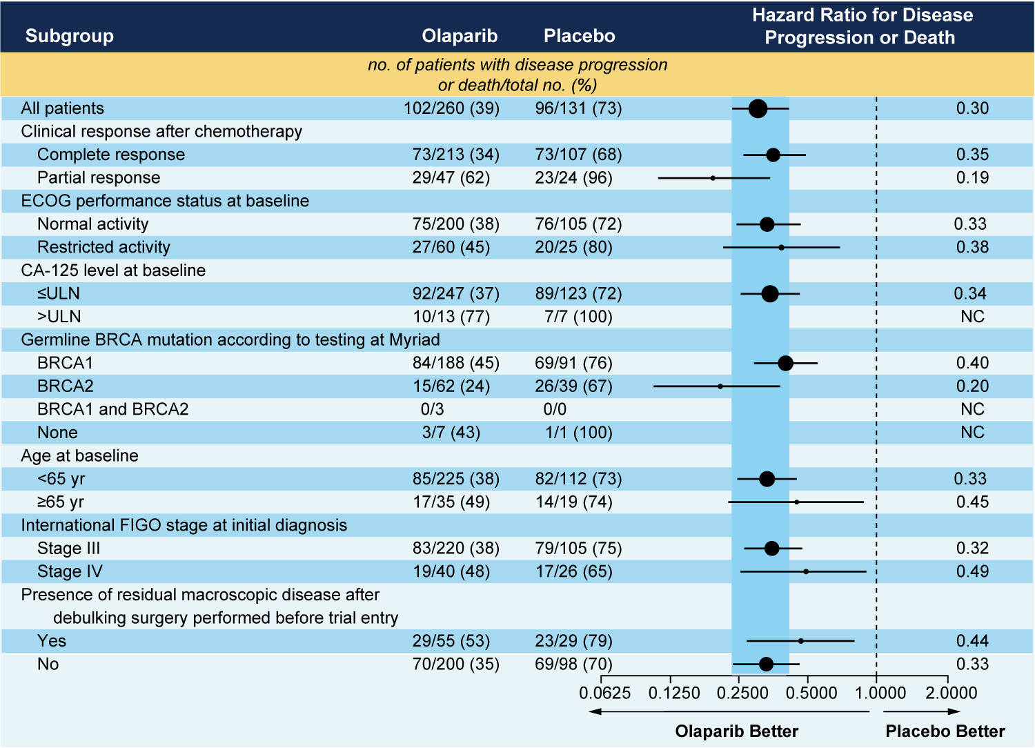
SOLO-1: PFS Subgroup Analyses
Moore K et al. N Engl J Med 2018 Dec 27;379(26):2495-505.

Slide 27
SOLO-1: Select Adverse Events
Event | Olaparib (n = 260) |  | Placebo (n = 130)
 | All grades | Grade ≥3 | All grades | Grade ≥3
Any | 98% | 39% | 92% | 18%
Nausea | 77% | 1% | 38% | 0
Anemia | 39% | 22% | 10% | 2%
Diarrhea | 34% | 3% | 25% | 0
Abdominal pain | 25% | 2% | 19% | 1%
Neutropenia | 23% | 9% | 12% | 5%
Moore K et al. N Engl J Med 2018 Dec 27;379(26):2495-505.

Slide 28
FDA Approval of Olaparib as First-Line Maintenance Therapy for Advanced Ovarian Cancer with BRCA Mutations
“On December 19, 2018, the FDA approved olaparib for the maintenance treatment of adult patients with deleterious or suspected deleterious germline or somatic BRCA-mutated (gBRCAm or sBRCAm) advanced epithelial ovarian, fallopian tube or primary peritoneal cancer who are in complete or partial response to first-line platinum-based chemotherapy. Patients with gBRCAm advanced epithelial ovarian, fallopian tube or primary peritoneal cancer should be selected for therapy based on an FDA-approved companion diagnostic.”
The FDA also approved the ­­­­BRACAnalysis CDx test to identify patients with gBRCAm advanced epithelial ovarian, fallopian tube or primary peritoneal cancer who are eligible for olaparib, based on the effectiveness of the test in the SOLO-1 trial population.
https://www.fda.gov/Drugs/InformationOnDrugs/ApprovedDrugs/ucm628876.htm

Slide 29
PRIMA Trial: Maintenance Niraparib for Advanced Ovarian Cancer After Response to Front-Line Platinum-Based Chemotherapy
Maintenance
Eligibility (N = 620)
Newly diagnosed ovarian cancer Advanced-stage (FIGO III or IV) disease Completion of first-line platinum-based therapy CR or PR to most recent platinum chemotherapy
Niraparib
R
Placebo
(2:1)
Primary endpoint: Progression-free survival
Gonzalez-Martin A et al. Proc ESMO 2018;Abstract 941PD.

Slide 30
Grade ≥3 Hematologic Toxicities Decreased with Individualized Dosing Regimen A Prospective Evaluation of Tolerability of Niraparib Dosing Based Upon Baseline Body Weight and Platelet Count: Pooled Interim Safety Data From the PRIMA Study
Fixed 300-mg dose
Individualized 200- or 300-mg dose
~60% decrease in Grade ≥3 thrombocytopenia
~40% decrease in Grade ≥3 neutropenia and anemia
Patients (%)
Anemiaª
Neutropenia^{b}
Thrombocytopenia
ª Anemia events included anemia and hemoglobin decrease.
^{b} Neutropenia events included neutropenia, febrile neutropenia, and neutrophil count decrease.
Monk BJ et al. Proc SGO 2019;Abstract 3 (Plenary).

Slide 31
ATHENA Phase III Trial Schema
Rucaparib + nivolumab
Target accrual: N = 1,012
Eligibility
Newly diagnosed advanced (FIGO Stage III-IV) epithelial ovarian, fallopian tube or primary peritoneal cancer Completed cytoreductive surgery Completed first-line platinum-based chemotherapy and surgery with a response ECOG PS 0-1
Rucaparib + placebo
R
Placebo + nivolumab
Placebo + placebo
Primary endpoint: Investigator-assessed PFS
www.clinicaltrials.gov. Accessed June 1, 2019 (NCT03522246).

Slide 32
Select Ongoing Phase III Clinical Trials of PARP Inhibitors as Maintenance After First-Line Therapy
Trial name (trial identifier) | N | Eligibility | First-line treatment | Maintenance treatment arms
PAOLA-1 (NCT02477644) | 612 | BRCA mut or wt Stage IIIB-IV Prior surgery | Platinum/taxane-based chemotherapy ≥3 cycles of bevacizumab | Bevacizumab + olaparib Bevacizumab + placebo
FIRST (NCT03602859) | 912 | BRCA mut or wt Stage III or IV Surgery or inoperable | Platinum-based chemo Platinum-based chemo + TSR-042 | Niraparib + TSR-042 Niraparib + placebo Placebo + placebo
GOG-3005 (NCT02470585) | 1,140 | BRCA mut or wt Stage III or IV Prior surgery | Carboplatin/paclitaxel +/- veliparib | Veliparib Placebo
DUO-O (NCT03737643) | 1,056 | BRCA mut or wt Stage III or IV Candidates for upfront surgery | Non-tBRCAm cohort Chemo + bev +/- durvalumab Open-label tBRCAm cohort Chemo + durvalumab +/- bev | Non-tBRCAm cohort Bev + placebo Bev + durvalumab Bev + durvalumab + olaparib Open-label tBRCAm cohort Durvalumab + olaparib +/- bev
www.clinicaltrials.gov. Accessed May 2019.

Slide 33
A woman in her 60s with Stage IIIC high-grade serous ovarian cancer (Dr O’Malley)
Complete cytoreductive surgery (no gross residual disease)
Modified GOG 172 IP chemo regimen (cisplatin IP, with IP and IV taxane) x 6 cycles
CR with normalization of her CA125 (9), normal CT
Genetic counseling: Underwent extended germline testing and NGS somatic testing
BRCA2 somatic mutation
Olaparib maintenance
Continues on treatment, NED

Slide 34
A woman in her 60s (Dr O’Malley)

Slide 35
Module 2A: Role of PARP Inhibition in the Management of Relapsed Ovarian Cancer
Platinum-sensitive relapse
Notes:
35
35
35

Slide 36
A nurse in her late 50s with BRCA wild-type ovarian cancer (Dr Ledermann)
3/2016: TAH/BSO, supracolic omentectomy and removal of pararectal deposit
9/2016: Completes carboplatin and paclitaxel x 6
Normal CA125 and CT
8/2017: CA125 137 units/ml, CT: sigmoid mass
Resection of HGSC, with no residual disease
3/2018: Completes carboplatin and liposomal doxorubicin x 6
Niraparib maintenance therapy 200 mg
Persistent Grade 1 elevation of ALT and Alk phosphatase
Minor Grade 1 fatigue and insomnia
5/2019: Remains free of recurrence

Slide 37
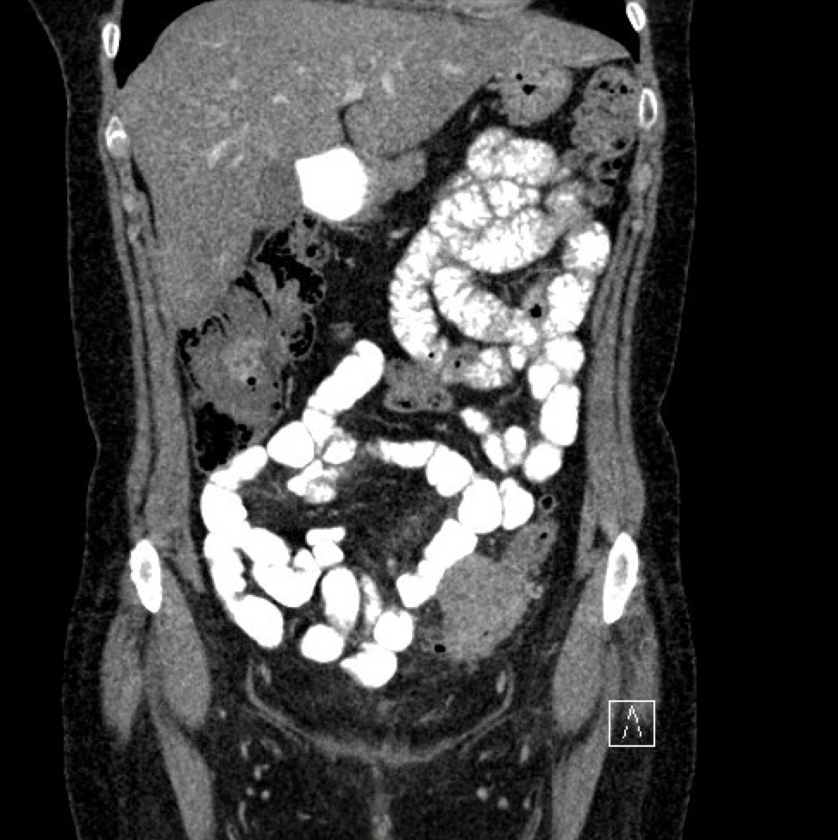
A nurse in her late 50s with BRCA wild-type ovarian cancer (Dr Ledermann)

Slide 38
A woman in her 80s with platinum-sensitive recurrent ovarian cancer (Dr O’Malley)
Stage IIIC HGSOC (neoadjuvant chemo → interval TRS → 3 additional cycles chemo)
18 months after completing chemo: Elevated CA125, peritoneal disease
IV carboplatin and PLD every 4 weeks: PR
Normal CA125 but persistent 8-mm RUQ disease
Previously underwent extended germline testing
Sent original tissue for somatic NGS testing: RAD51C mutation
Maintenance rucaparib: CR
Continues on therapy today (13+ months)

Slide 39
FDA-Approved PARP Inhibitors as Maintenance Therapy for Recurrent, Platinum-Sensitive Disease
Niraparib
Rucaparib
Olaparib
Indications:
Maintenance following response to platinum-based therapy
Irrespective of BRCA status
Pivotal study: ENGOT-OV16/NOVA
Approved: 3/2017
Indications:
Maintenance following response to platinum-based therapy
Irrespective of BRCA status
Pivotal study: ARIEL3
Approved: 4/2018
Indications:
Maintenance following response to platinum-based therapy
Irrespective of BRCA status
Pivotal studies: SOLO-2, Study 19
Approved: 8/2017
Niraparib FDA insert, revised 3/2017; Rucaparib FDA insert, revised 4/2018; Olaparib FDA insert, revised 1/2018;
Pujade-Lauraine E et al. Lancet 2017;18(9):1274-84; Mirza MR et al. N Engl J Med 2016;375(22):2154-64; Coleman RL et al. Lancet 2017;390(10106):1949-61; Ledermann J et al. N Engl J Med 2012;366:1382-92.

Slide 40
Eligibility and Dosing in Pivotal Studies of PARP Inhibitors for Recurrent, Platinum-Sensitive OC
 | NOVA¹ (Niraparib) | SOLO-2² (Olaparib) | ARIEL3³ (Rucaparib)
BRCA status | With or without gBRCA mutation | gBRCA mutation (Study 19: +/- gBRCA mutation) | With or without gBRCA mutation
HRD testing | Yes | No | Yes
Tumor assessment schedule | Every 8 wk to C14 → every 12 wk | Every 12 wk until wk 72 → every 24 wk | Every 8 wk to C14 → every 12 wk
Dosing | 300 mg qd | 300 mg BID | 600 mg BID
No. of prior lines of chemo | 2 or more | 2 or more | 2 or more
¹ Mirza MR et al. N Engl J Med 2016;375(22):2154-64; ² Pujade-Lauraine E et al. Lancet 2017;18(9):1274-84; ³ Coleman RL et al. Lancet 2017;390(10106):1949-61.

Slide 41
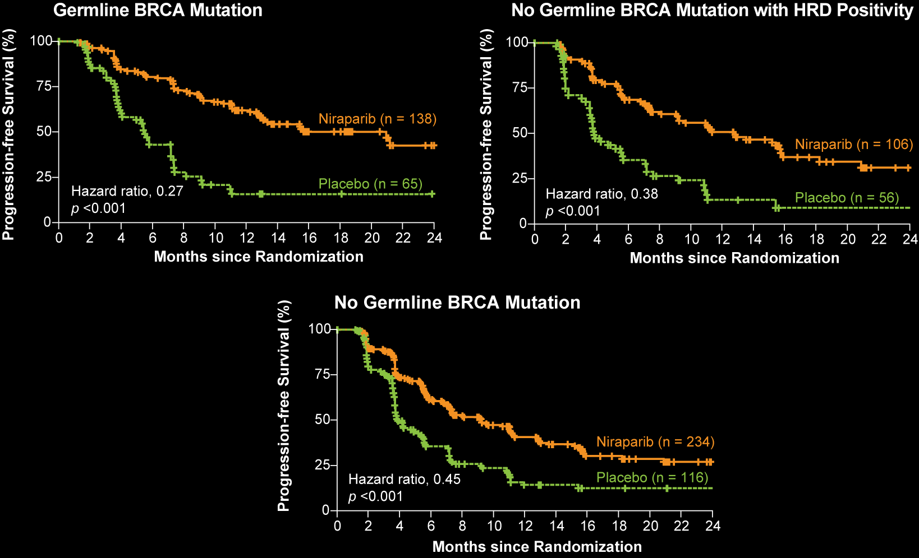
ENGOT-OV16/NOVA: PFS Results
21.0 mo
12.9 mo
5.5 mo
3.8 mo
9.3 mo
3.9 mo
Mirza MR et al. N Engl J Med 2016;375(22):2154-64.

Slide 42
Effect of BRCA Status on Outcomes with Niraparib Maintenance Therapy: ENGOT-OV16/NOVA
Median PFS | Niraparib | Placebo | Hazard ratio | p-value
Germline BRCA mutation (n = 138; 65) | 21.0 mo | 5.5 mo | 0.27 | <0.001
No germline BRCA mutation with HRD positivity (n = 106; 56) | 12.9 mo | 3.8 mo | 0.38 | <0.001
No germline BRCA mutation with HRD negativity (n = 92; 42) | 6.9 mo | 3.8 mo | 0.58 | 0.02
No germline BRCA mutation (n = 234; 116) | 9.3 mo | 3.9 mo | 0.45 | <0.001
Mirza MR et al. N Engl J Med 2016;375(22):2154-64.

Slide 43
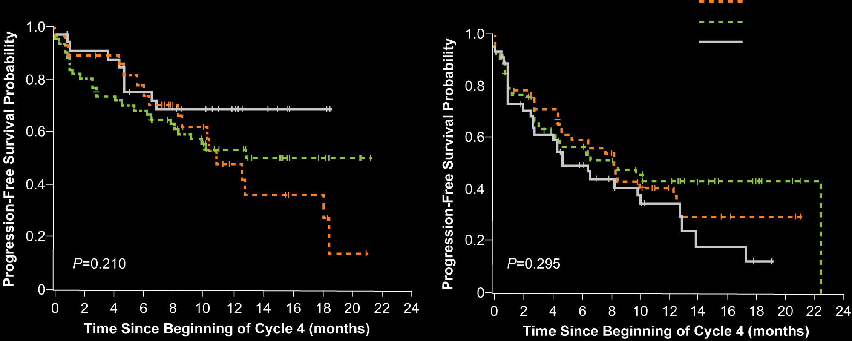
ENGOT-OV16/NOVA: PFS Probability by Dose
gBRCA^{mut}
non-gBRCA^{mut}
300 mg
200 mg
100 mg
Berek JS et al. Ann Oncol 2018;29(8):1784-92.
Notes:
43

Slide 44
ENGOT-OV16/NOVA: Safety and Dose Modification for Patients Receiving Niraparib
Retrospective analysis of ENGOT-OV16/NOVA to identify clinical parameters that predict dose reductions
After dose modification, 200 mg was the most commonly administered dose
Patients with a baseline body weight <77 kg or platelet count <150,000/μL
Had higher rates of Grade ≥3 thrombocytopenia (35% vs 12%)
Received an average daily dose of 200 mg due to dose interruption/reduction
Progression-free survival with dose reduction to 200 mg or 100 mg was consistent with PFS with continuation of the 300 mg starting dose
Patients with baseline body weight of <77 kg or baseline platelets of <150,000/μL may benefit from a starting dose of 200 mg/day
Berek JS et al. Ann Oncol 2018;29(8):1784-92; Lord R et al. Proc SGO 2018;Abstract 20.

Slide 45
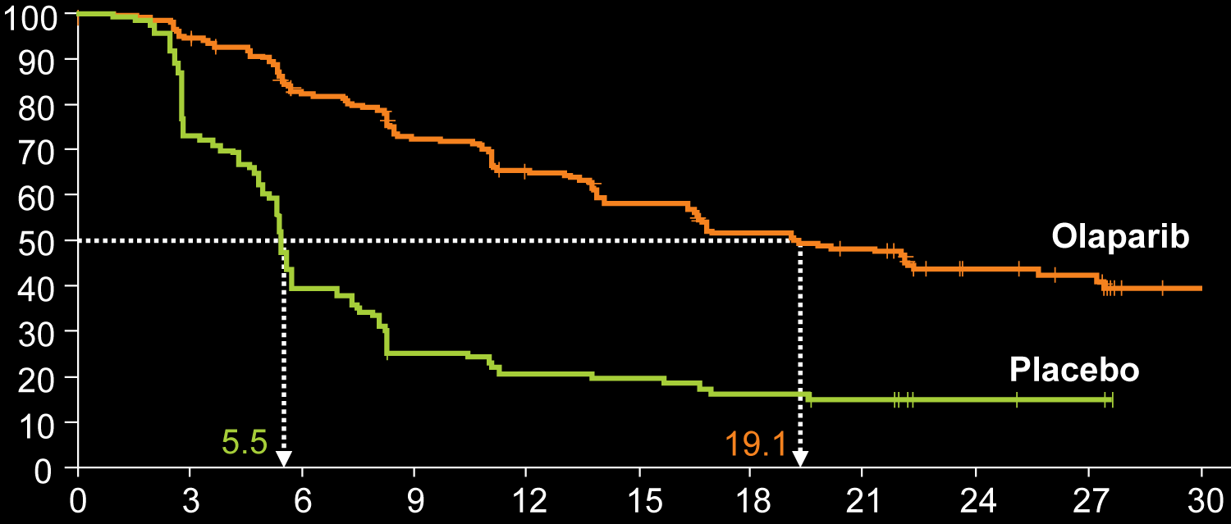
SOLO-2: PFS by Investigator Review
PFS by Investigator Assessment
Clinical endpoint | Olaparib (n = 196) | Placebo (n = 99) | HR (p-value)
Median PFS | 19.1 mo | 5.5 mo | 0.30 (<0.0001)
Progression-free survival (%)
Months since randomization
Pujade-Lauraine E et al. Lancet 2017;18(9):1274-84.

Slide 46
Effect of BRCA Status on Outcomes with Olaparib Maintenance Therapy: SOLO-2, Study 19
Median PFS | Olaparib | Placebo | Hazard ratio | p-value
SOLO-2: BRCA mutation (n = 196, 99) | 19.1 mo | 5.5 mo | 0.30 | <0.0001
Study 19: BRCA mutation (n = 74, 62) | 11.2 mo | 4.3 mo | 0.18 | <0.0001
Study 19: BRCA wild type (n = 57, 61) | 7.4 mo | 5.5 mo | 0.54 | 0.0075
Pujade-Lauraine E et al. Lancet 2017;18(9):1274-84. Ledermann JA et al. Lancet Oncol 2014;15:852-61.

Slide 47
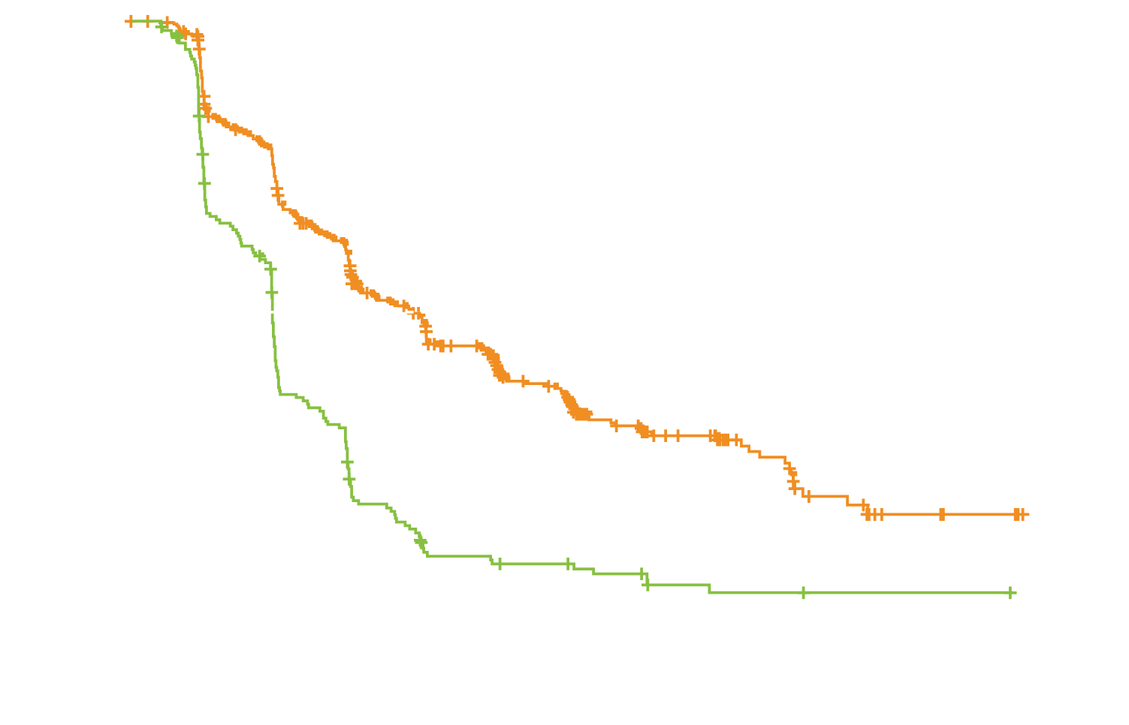
ARIEL3: PFS by Investigator Assessment (INV)
ITT
Rucaparib (n = 375) = 10.8 mo
Placebo (n = 189) = 5.4 mo
Subgroup analysis of PFS by INV | Rucaparib | Placebo | HR | p-value
Pts with BRCAm dx (n = 130, 66) | 16.6 mo | 5.4 mo | 0.23 | <0.0001
Pts with HRD dx (n = 236, 118) | 13.6 mo | 5.4 mo | 0.32 | <0.0001
HRD = homologous recombination deficient carcinoma; dx = disease
Coleman RL et al. Lancet 2017;390(10106):1949-61.

Slide 48
Effect of BRCA and DNA Repair Deficiency Status on Outcomes with Rucaparib Maintenance Therapy: ARIEL3
Median PFS | Rucaparib | Placebo | Hazard ratio | p-value
Tumor BRCA mutation (n = 130, 66) | 16.6 mo | 5.4 mo | 0.23 | <0.0001
HRD-positive (n = 236, 118) | 13.6 mo | 5.4 mo | 0.32 | <0.0001
BRCA^{wt}/High LOH (n = 106, 52) | 9.7 mo | 5.4 mo | 0.44 | <0.0001
BRCA^{wt}/Low LOH (n = 107, 54) | 6.7 mo | 5.4 mo | 0.58 | 0.0049
HRD = homologous recombination deficiency; BRCA^{wt} = BRCA wild type; LOH = loss of heterozygosity
Coleman RL et al. Lancet 2017;390(10106):1949-61; Ledermann JA et al. Proc ESMO 2017;Abstract LBA40_PR; Coleman RL. Proc AACR 2017 (Addressing Critical Questions in Ovarian Cancer Research and Treatment).

Slide 49
ARIEL3: Rucaparib in Patients With or Without Bulky Disease
Cohort | Rucaparib, n | Placebo, n | PFS (Per BICR)
 |  |  | HR (p-value) | Median PFS, mo
Bulky disease at baseline (per BICR)
BRCA mutation | 21 | 10 | 0.13 (0.0028) | 17.1 vs 2.9
HRD | 39 | 18 | 0.58 (0.1994) | 8.3 vs 2.9
ITT | 71 | 29 | 0.46 (0.0057) | 8.3 vs 3.0
No bulky disease at baseline (per BICR)
BRCA mutation | 109 | 56 | 0.22 (<0.0001) | 26.8 vs 5.5
HRD | 197 | 100 | 0.32 (<0.0001) | 24.7 vs 5.6
ITT | 304 | 160 | 0.34 (<0.0001) | 16.2 vs 5.4
Aghajanian C et al. ASCO 2018;Abstract 5537.

Slide 50
Side Effects of PARP Inhibitors
Common side effects with all PARP inhibitors
Gastrointestinal: nausea, vomiting, constipation
Hematologic: anemia, thrombocytopenia*, neutropenia
Fatigue, insomnia
Other adverse events of special interest
Pneumonitis: <1% of patients on olaparib
MDS, AML: olaparib <1.5%, rucaparib 0.5%, niraparib 1.4%
Creatinine increase: rucaparib 92%, olaparib 44%
Cardiovascular side effects: niraparib
Embryo-fetal toxicity
* Occurs more frequently with niraparib
Niraparib FDA insert revised 3/2017; Rucaparib FDA insert revised 12/2016; Olaparib FDA insert revised 1/2018
Notes:
50

Slide 51
Module 2B: Role of PARP Inhibition in the Management of Relapsed Ovarian Cancer
Multiply relapsed disease
Notes:
51
51
51

Slide 52
Combination of Niraparib and Bevacizumab versus Niraparib Alone as Treatment of Recurrent Platinum-Sensitive Ovarian Cancer. A Randomized Controlled Chemotherapy-Free Study — NSGO-AVANOVA2/ ENGOT-OV24
Mirza M et al.
ASCO 2019;Abstract 5505.
Oral Abstract Session, Monday, June 3, 3:03-3:15 PM, S406

Slide 53
A woman in her early 60s with recurrent ovarian cancer and a BRCA2 mutation (Dr Liu)
Stage II ovarian cancer, declined adjuvant chemotherapy
7 months later: Recurrence
Carboplatin/paclitaxel x 6 → partial response
Chemo holiday per patient request
7 months later: Progressive disease
Liposomal doxorubicin (patient declined carboplatin-based therapy)
Response followed by progression after 7 cycles
Rucaparib
Baseline Cr 0.88 → 1.4 after 1 week on treatment (stable at 1.3-1.4 subsequently)
Robust response after 2 cycles, rapid disease progression after 4 cycles

Slide 54
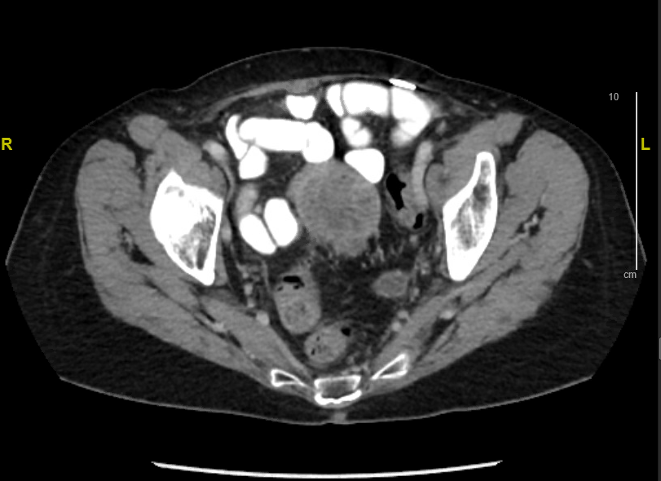
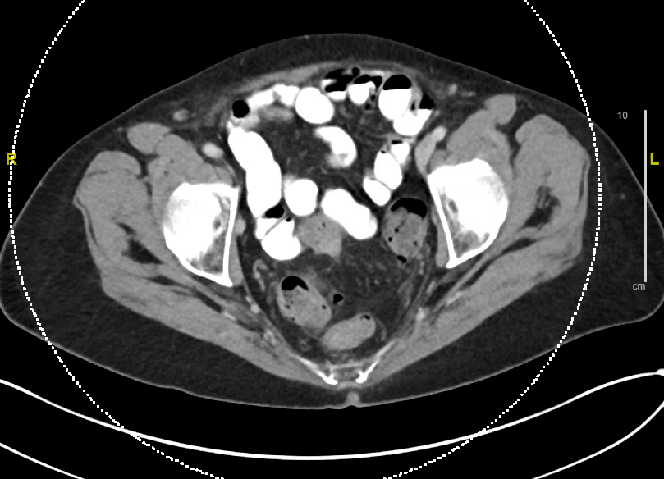
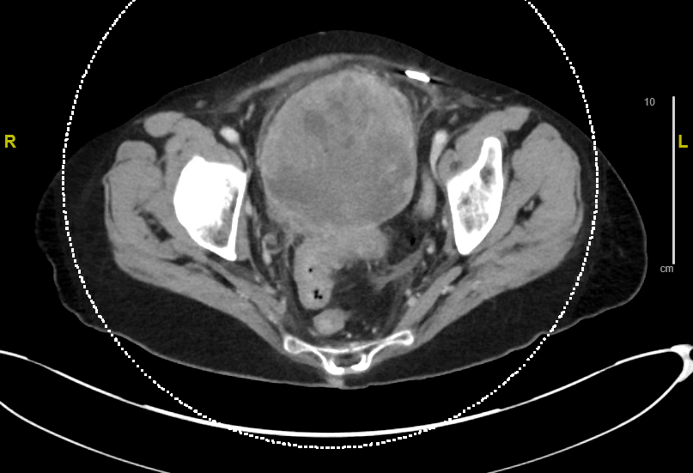
A woman in her early 60s (Dr Liu)
Pre-Treatment
2 Months After Initiating
Treatment
4 Months After Initiating
Treatment

Slide 55
FDA-Approved PARP Inhibitors as Monotherapy for Multiply Relapsed Disease
Olaparib
Rucaparib
Indications:
4th-line therapy and beyond
Germline BRCA mutation
Dosing:
300 mg BID
Outcome of pivotal study: ORR: 34%,
Median duration of response: 7.9 mos
Approved: 12/2014
Indications:
3rd-line therapy and beyond
Germline and/or somatic BRCA mutation
Dosing:
600 mg BID
Outcome of pivotal study: ORR: 54%,
Median duration of response: 9.2 mos
Approved: 12/2016
Olaparib prescribing information, revised 12/2018; Rucaparib prescribing information, revised 4/2018. Kaufman B et al. J Clin Oncol 2015;33:244-250; Swisher E et al. Lancet Oncol 2017;75-87; Kristeleit R et al. Clin Cancer Res 2017;23(15):4095-106; Oza A et al. Gynecol Oncol 2017;147:267-75.

Slide 56
Study 42: Olaparib Monotherapy in Patients with Advanced OC and gBRCA Mutations Who Received 3 or More Lines of Prior Chemo
Platinum sensitivity | No. of responders | ORR | Median DoR
Total (N = 137) | 46 | 34% | 7.9 mo
Platinum sensitive (n = 39) | 18 | 46% | 8.2 mo
Platinum resistant (n = 81) | 24 | 30% | 8.0 mo
Platinum refractory (n = 14) | 2 | 14% | 6.4 mo
Unknown (n = 3) | 2 | 67% | 6.3 mo
Domchek SM et al. Gynecol Oncol 2016;140(2):199-203.

Slide 57
Olaparib Meets Primary Endpoint in the Phase III SOLO-3 Trial for Patients with Relapsed Advanced Ovarian Cancer with BRCA Mutations
On December 20, 2018, positive results were announced from the randomized Phase III SOLO-3 trial of olaparib tablets in patients with relapsed ovarian cancer after two or more lines of treatment. The trial was conducted as a post-approval commitment in agreement with the FDA.
In the trial, patients with advanced ovarian cancer with BRCA mutations who received olaparib after 2 or more lines of chemotherapy demonstrated a statistically significant and clinically meaningful improvement in the primary endpoint of objective response rate (ORR) and the key secondary endpoint of progression-free survival (PFS) compared to chemotherapy. The safety and tolerability profile of olaparib was consistent with previous trials.
Trial results will be presented at an upcoming medical meeting.
https://www.astrazeneca.com/media-centre/press-releases/2018/lynparza-meets-primary-endpoint-in-phase-iii-solo-3-trial-for-the-treatment-of-relapsed-brca-mutated-advanced-ovarian-cancer20122018.html

Slide 58
Olaparib Monotherapy versus (vs) Chemotherapy for Germline BRCA-mutated (gBRCAm) Platinum-sensitive Relapsed Ovarian Cancer (PSR OC) Patients (pts): Phase III SOLO3 Trial
Penson RT et al.
ASCO 2019;Abstract 5506.
Oral Abstract Session, Monday, June 3, 3:15-3:27 PM, S406

Slide 59
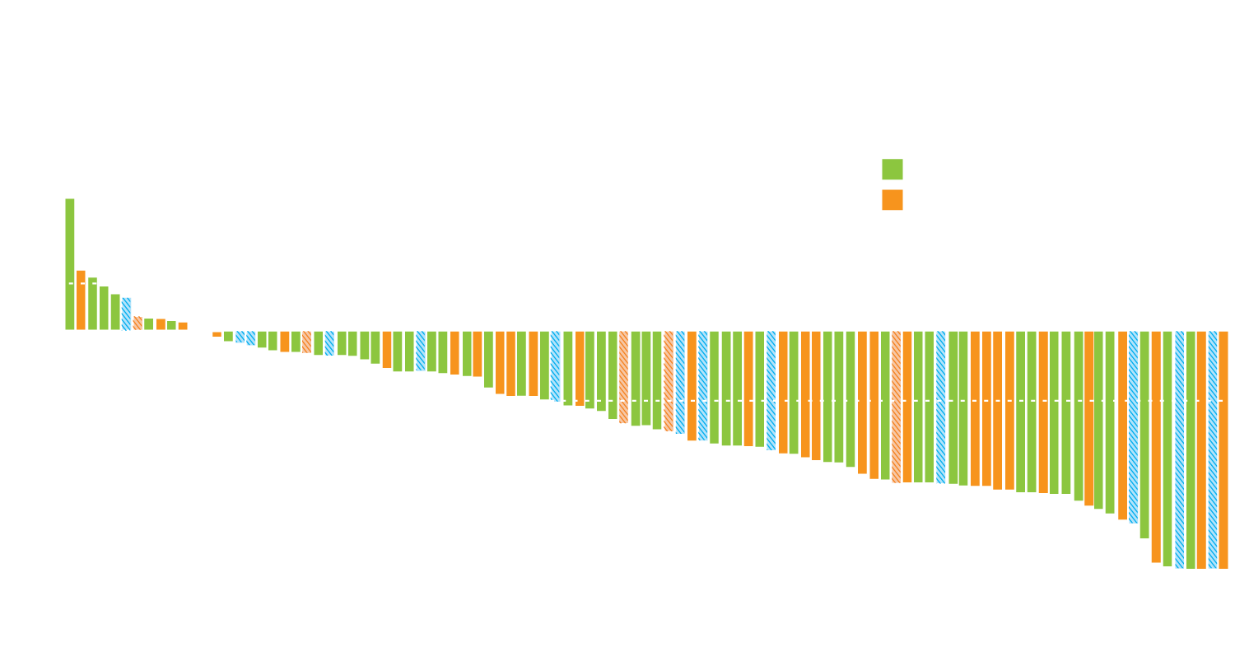
Study 10/ARIEL2: Rucaparib in Patients with Relapsed OC with Germline or Somatic BRCA Mutations Who Received 2 or More Lines of Prior Chemo
N = 103 patients
+
Ongoing
BRCA1
BRCA2
Germline BRCA1/2 mutation
Somatic BRCA1/2 mutation
ORR: 53.8%
Change from baseline in sum of the diameter of target lesions (%)
Oza AM et al. Gynecol Oncol 2017;147(2):267-75.

Slide 60
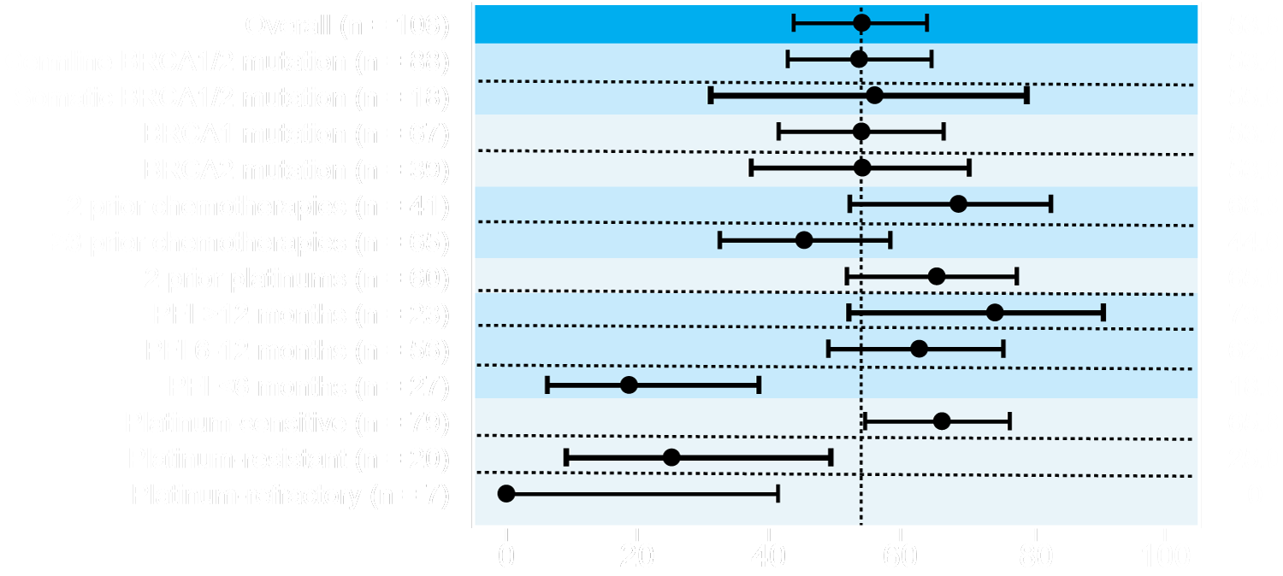
Study 10/ARIEL2: Rucaparib in Relapsed OC with Germline or Somatic BRCA Mutations
Confirmed response rate by investigator
ORR
ORR (95% CI)
Oza AM et al. Gynecol Oncol 2017;147(2):267-75.

Slide 61
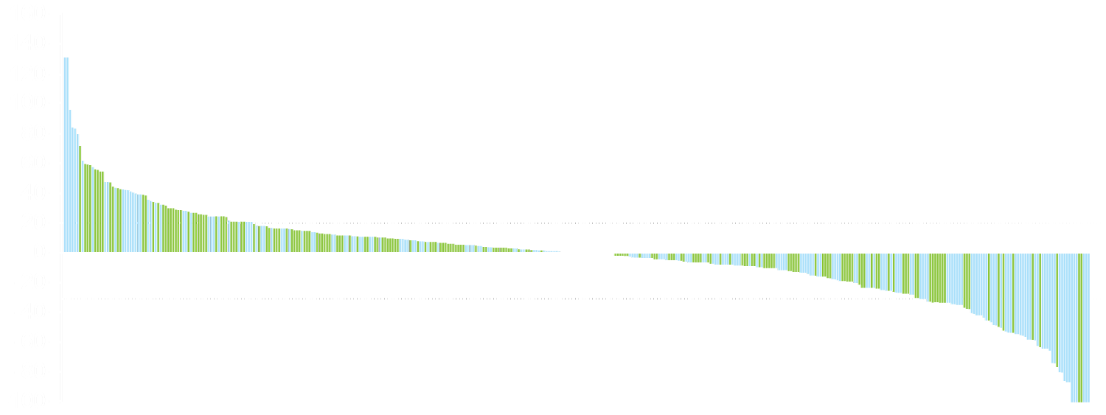
QUADRA: Tumor Response to Niraparib Monotherapy in All Patients Who Had Received at Least 3 Previous Chemotherapy Regimens
In all response-evaluable patients:
ORR = 38/387 (10%)
mDOR = 9.4 months
HRDpos
Benefit observed across all patient populations
HRDneg/unknown
Best percentage change from baseline (%)
+20%
-30%
Patient
Patients with at least 1 follow-up scan with an evaluable target lesion in fourth or later line (n = 380) are included on the waterfall plot.
Patients previously treated with PARP inhibitors are included.
Moore KN et al. Lancet Oncol 2019;20(5):636-48.

Slide 62
QUADRA: Subgroup Analysis of Response in Patients with Platinum-Sensitive Disease
Biomarker defined population of patients | BRCA mutation-positive |  | HRD-positive
 | ORR | CBR24 | ORR | CBR24
Sensitive to last line of platinum therapy | 39% (7/18) | 56% (10/18) | 26% (14/53) | 40% (21/53)
Platinum resistant or refractory | 27% (10/37) | 32% (12/37) | 10% (12/120) | 20% (24/120)
Three or 4 prior lines of therapy, platinum-sensitive, PARP inhibitor-naïve, HRD-positive population | n = 47
ORR | 28%
DCR | 68%
Median duration of response | 9.2 mo
Median duration of PFS | 5.5 mo
CBR24 = clinical benefit rate (CR + PR + SD ≥24 weeks)
Median OS for patients with measurable disease at baseline, excluding those who had received only 2 prior lines of therapy (n = 456): 17.2 months
Moore KN et al. Lancet Oncol 2019;20(5):636-48.

Slide 63
Module 3: Investigational Applications of Approved PARP Inhibitors; Other PARP Inhibitors in Clinical Development
Notes:
63
63
63

Slide 64
PARPi After PARPi: A Multi-institutional, Retrospective Review of Patients with EOC Who Received at Least 2 Lines of PARPi Therapy
N = 21
Response to initial PARP inhibitor (PARPi1)
CR: 10, PR: 3, SD: 4, PD: 2
Response to second PARP inhibitor (PARPi2)
PR: 3, SD: 13, PD: 2
The 3 patients who experienced a PR to PARPi2 had a BRCA mutation and all experienced a CR to PARPi1
Prior PARPi did not predict toxicity to a second PARPi
Essel KG et al. Proc SGO 2019;Abstract 7.

Slide 65
OReO Trial: PARPi After PARPi (Olaparib Maintenance Re-treatment)
Two cohorts independently powered for PFS, one for BRCAm and one for BRCAwt (HRD pos and HRD neg)
All epithelial ovarian cancer*
1 prior PARP inhibitor maintenance period
Known BRCA status
PLUS
Response ≥PR to most recent platinum CT (not bevacizumab)
Entry based on length of first PARP inhibitor exposure
BRCAm →
PARP inhibitor ≥18 mo (after first-line CT)
PARP inhibitor ≥12 mo (after second-line CT)
BRCAwt →
PARP inhibitor ≥12 mo (after first-line CT)
PARP inhibitor ≥6 mo after second- or later-line CT
Cohorts
Olaparib
300mg** po bid
gBRCAm or sBRCAm
N≈136
R
Primary outcome
PFS
Secondary outcomes
TFST
TSST
FACT-O
Safety and AEs
OS
Placebo
2:1
Stratification factors:
Prior bevacizumab
3 vs ≥4 chemotherapy lines
Olaparib
300mg** po bid
BRCAwt all-comers
N≈280
R
FSI 2Q 2017
PFS readout: BRCAm 4Q 2020
BRCAwt 2Q 2021
CSR 3Q 2022
Placebo
2:1
*Not restricted to high-grade serous ovarian cancer
**Tablet formulation
AEs=adverse events; bid=twice daily; CSR=clinical study report; CT=chemotherapy; FACT-O=Functional Assessment of Cancer Therapy-Ovarian; FSI=first subject in; HRD=homologous recombination deficiency; mo=months; OS=overall survival; PARP=poly ADP ribose polymerase; PFS=progression-free survival; po=by mouth; PR=partial response; TFST=time to first subsequent therapy; TSST=time to second subsequent therapy; wt=wild type
Powered 80% for PFS primary endpoint (BRCAm HR=0.5 [74 events]; BRCAwt HR=0.65 [191 events]), Patients followed to OS for long-term safety

Slide 66
Current FDA-Approved and Investigational PARP Inhibitors: Differences
PARP inhibitor | IC₅₀ | PARP trapping potency | PARPi target selectivity (strength of binding) | Half life | Dose
Olaparib | 6 nM | 1 | Potent PARP1 inhibitor, less selective | 11.9 hours | 300 mg BID
Rucaparib | 21 nM | 1 | Potent PARP1 inhibitor, less selective | 18 hours | 600 mg BID
Niraparib | 60 nM | ~2 | Selective inhibitor of PARP1 and 2 | 36 hours | 300 mg qd
Veliparib | 30 nM | <0.2 | Potent PARP1 inhibitor, less selective | 5 hours | 400 mg BID
Talazoparib | 4 nM | ~100 | Potent PARP1 inhibitor, less selective | 50 hours | 1 mg qd
Lim JSJ, Tan DSP. Cancers Rev 2017;9(8):pii:E109. Olaparib package insert, rev 12/2018; Rucaparib package insert, rev 04/2018; Niraparib package insert, rev 2/2019

Slide 67
Efficacy and Safety of Veliparib Monotherapy for Platinum-Resistant or Partially Platinum-Sensitive OC Positive for gBRCA Mutation
Outcome | n = 32
CA-125 response | 65%
Complete response | 6%
Partial response | 59%
Median PFS | 5.6 mo
Median OS | 13.7 mo
Phase I: MTD for veliparib = 300 mg BID
Phase II: The most common treatment-related Grade 2 toxicities included fatigue (22%), nausea (22%) and vomiting (9%)
Steffensen KD et al. Int J Gynecol Cancer 2017;27(9):1842-9.

Slide 68
VELIA Phase III Trial Schema
Accrual: N = 1,140
Carboplatin/paclitaxel + veliparib
→ veliparib maintenance
Eligibility
FIGO Stage III or IV epithelial ovarian, fallopian tube or primary peritoneal carcinoma High-grade serous adenocarcinoma Willing to undergo testing for gBRCA ECOG PS 0-2
R
Carboplatin/paclitaxel + veliparib
→ placebo maintenance
Carboplatin/paclitaxel + placebo
→ placebo maintenance
Primary endpoint: Progression-free survival
www.clinicaltrials.gov. Accessed June 1, 2019 (NCT02470585).

Slide 69
Efficacy and Safety of Talazoparib in a Phase I First-in-Human Trial for Advanced OC with gBRCA Mutation
Outcome | n = 12
ORR | 41.7%
Complete response | 8.3%
Partial response | 33.3%
Clinical benefit rate | 66.7%
Median PFS | 36.4 weeks
MTD for talazoparib = 1.0 mg/day
The most common treatment-related Grade 3-4 toxicities included
Anemia (23%), thrombocytopenia (18%) and neutropenia (10%)
De Bono J et al. Cancer Discov 2017;7(6):620-9.

Slide 70
Mechanism of Resistance to PARP Inhibitors
PARP inhibitor resistance mechanisms
Decreased intracellular PARP concentration by activated drug efflux
Recovery of HR
Decreased PARP-1 expression
Increased PTEN
Decreased Aurora A
Secondary mutations in BRCA1/BRCA2 restoring BRCA protein functionality
Loss of 53BP1
Increased RAD51
Ohmoto A, S Yachida S. Onco Targets Ther 2017;10:5195-208.

Slide 71
Extending PARP-Inhibitor Use in HR-Proficient Tumors
PARPi + anti-angiogenic
PARPi + CDKi
PARPi + PI3Ki
PARPi + PD1 blockade
HR-PROFICIENT HR-DEFICIENT
PARPi + HSP90i
PARPi + Checkpoint Inhibitor
PARP - Inhibitor
Another agent that inhibits HR
Courtesy Ursula Matulonis, MD.

Slide 72
Combination of Niraparib and Bevacizumab versus Niraparib Alone as Treatment of Recurrent Platinum-Sensitive Ovarian Cancer. A Randomized Controlled Chemotherapy-Free Study — NSGO-AVANOVA2/ ENGOT-OV24
Mirza M et al.
ASCO 2019;Abstract 5505.
Oral Abstract Session, Monday, June 3, 3:03-3:15 PM, S406

Slide 73
Biologic Rationale for the Combination of a PARP Inhibitor with an Immune Checkpoint Inhibitor
PARP inhibitors
Preclinical models indicate synergy between PARPi + anti-PD-1 agents regardless of BRCA mutation status or PD-L1 status
DSB processing (EXO1, BLM1, etc)
DSB checkpoint activation (ATM, ATR, CHK1)
Error-prone repair
Cytosolic DNA
ATM/ATR/CHK1 activation
Point mutations
STING pathway activation
STAT1/3 activation IRF1 activation
Neoantigens
Type I IFN response
PD-L1 upregulation
Immune activating
Immune suppressing
Preclinical data demonstrate synergy with PARPi and anti-PD-1 combinations
Konstantinopoulos PA et al. Proc ASCO 2018;Abstract 106.
Notes:
73

Slide 74
TOPACIO (KEYNOTE-162): A Phase I/II Study of Niraparib with Pembrolizumab in Recurrent, Platinum-Resistant OC
Percentage change in lesion size
tBRCAmut
HRDpos
HRDneg/Unknown
Ongoing
PD-L1pos
*
Best percent change in target lesion dimensions from baseline (%)
-30%
Subject
Response | All patients | tBRCAmut | HRD-pos | tBRCAwt | HRD-neg
ORR | 11/47 (23%) | 2/8 (25%) | 4/16 (25%) | 9/37 (24%) | 7/26 (27%)
DCR | 30/47 (64%) | 5/8 (63%) | 11/16 (69%) | 24/37 (65%) | 15/26 (58%)
Konstantinopoulos PA et al. Proc ASCO 2018;Abstract 106.
Notes:
74

Slide 75
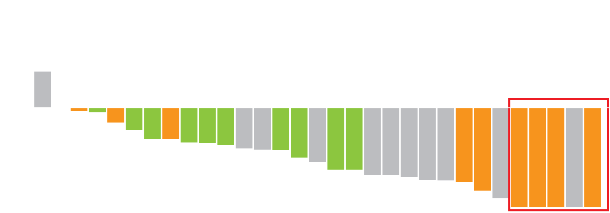
MEDIOLA: A Phase I/II Study of Olaparib and Durvalumab in Recurrent, Platinum-Sensitive OC with gBRCA Mutation
Best percentage change in target lesion size
1 prior line of chemotherapy
2 prior lines of chemotherapy
3 or more prior lines of chemotherapy
Best change (%)
 | Second line | Third line | Fourth line | All lines
ORR | 10/13 (77%) | 6/9 (67%) | 7/10 (70%) | 23/32 (72%)
Drew Y et al. Proc SGO 2018;Abstract LBA4.

Slide 76
Select Ongoing Phase III Trials of PARP Inhibitors in Combination with Immune Checkpoint Inhibitor Therapy
Trial name (Trial identifier) | N | Setting | Treatment arms
ATHENA (NCT03522246) | 1,012 | Maintenance therapy after 1L platinum-based chemo | Rucaparib + Nivolumab Rucaparib + Placebo | Nivolumab + Placebo Placebo
DUO-O (NCT03737643) | 1,056 | Maintenance therapy after 1L platinum-based chemo/Bev ± Durvalumab | Bev Bev + Durvalumab | Bev + Durvalumab + Olaparib
ANITA (NCT03598270) | 414 | Recurrent, platinum-sensitive | Placebo + Platinum-based chemo → Niraparib ATEZO + Platinum-based chemo → Niraparib + ATEZO
Bev = bevacizumab; ATEZO = atezolizumab
www.clinicaltrials.gov. Accessed May 2019.

Slide 77
In general, what is the optimal approach to mutation testing for possible use of a PARP inhibitor for a patient with newly diagnosed ovarian cancer?
Germline BRCA
Germline BRCA; if negative, multigene somatic (eg, next-generation sequencing [NGS])
Multigene germline panel
Multigene somatic/NGS
Multigene germline and somatic/NGS
Other

