Slide 1
Please note, these are the actual video-recorded proceedings from the live CME event and may include the use of trade names and other raw, unedited content.

Slide 2
Meet The Professors Clinical Investigator Perspectives on Key Questions and Emerging Research in the Management of Lymphoma, Chronic Lymphocytic Leukemia and Multiple Myeloma Sunday, June 2, 2019 7:00 PM - 9:30 PM Chicago, Illinois
Faculty
Jeremy Abramson, MD
Bruce D Cheson, MD
Ann S LaCasce, MD, MMSc
Noopur Raje, MD
Paul G Richardson, MD
Sonali M Smith, MD
Moderator Neil Love, MD

Slide 3
Module 2: Chronic Lymphocytic Leukemia and Follicular Lymphoma

Slide 4
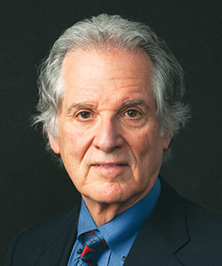
Bruce D Cheson, MD Frank M Ewing Foundation Chair in Hematology-Oncology Professor of Medicine Head of Hematology and Cellular Therapy Deputy Chief, Division of Hematology-Oncology Georgetown University Hospital Lombardi Comprehensive Cancer Center Washington, DC

Slide 5
Disclosures for Bruce D Cheson, MD
Advisory Committee and Consulting Agreements | AbbVie Inc, AstraZeneca Pharmaceuticals LP, Celgene Corporation, Genentech, Gilead Sciences Inc
Contracted Research | AbbVie Inc, AstraZeneca Pharmaceuticals LP, Bristol-Myers Squibb Company, Genentech, Seattle Genetics

Slide 6
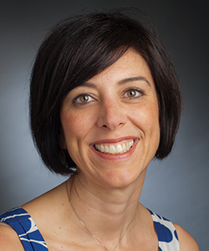
Ann S LaCasce, MD, MMSc
Program Director, Dana-Farber/Partners Fellowship in Hematology/Oncology Associate Professor of Medicine Institute Physician Dana-Farber Cancer Institute Harvard Medical School Boston, Massachusetts

Slide 7
Disclosures for Ann S LaCasce, MD, MMSc
Advisory Committee | Humanigen Inc
Consulting Agreement | Seattle Genetics
Data and Safety Monitoring Board/Committee | Bristol-Myers Squibb Company
Institutional Research Funding | Celgene Corporation, Forty Seven Inc, Seattle Genetics

Slide 8
Biomarker-Based Algorithm for First-Line Treatment of Chronic Lymphocytic Leukemia
Del(17p)/TP53 mutation
+
-
IGHV
Mutation
No mutation
Younger
Older

Slide 9
A man in his early 90s with progressive CLL (Dr LaCasce)
Prior therapies for CLL: FR x 6 (2006), BR x 6 (2011)
2015: Hypogammaglobulinemia, recurrent bacterial pneumonias
IVIG
6/2016: Progressive anemia, thrombocytopenia and splenomegaly
Ibrutinib
Persistent gross hematuria → therapy discontinued
10/2016: Venetoclax
Hospitalized for initiation of therapy due to borderline renal insufficiency, WBC (124)
Remains on therapy

Slide 10
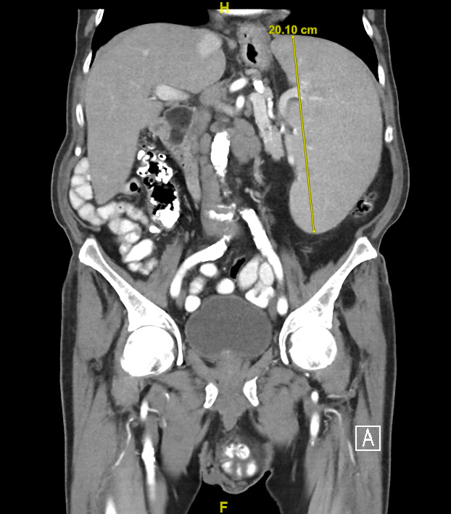
A man in his early 90s (Dr LaCasce)

Slide 11
A man in his mid-60s with CLL (unmutated IGHV, trisomy 12) (Dr Cheson)
2012: BR x 6 → complete response
2016: Recurrence of fatigue, shortness of breath on exertion and adenopathy
Trial: Lenalidomide/rituximab (R²) + ibrutinib → excellent response
Diarrhea, neutropenia → dose interruptions required
Pneumonitis → treatment discontinued
Declined venetoclax (preferred to keep it “in reserve”)
Trial: Umbralisib for patients with ibrutinib-intolerant disease
Initially well tolerated but developed ITP, anemia, severe fatigue, SOB
Intolerance and poor response to steroids
Taken off study and tapered off steroids
Venetoclax and rituximab
4/24/2019: No adverse effects and feels great

Slide 12
A Randomized Phase III Study of Ibrutinib (PCI-32765)-Based Therapy vs Standard Fludarabine, Cyclophosphamide, and Rituximab (FCR) Chemoimmunotherapy in Untreated Younger Patients with Chronic Lymphocytic Leukemia (CLL): A Trial of the ECOG-ACRIN Cancer Research Group (E1912)
Shanafelt TD et al. Proc ASH 2018;Abstract LBA-4.

Slide 13
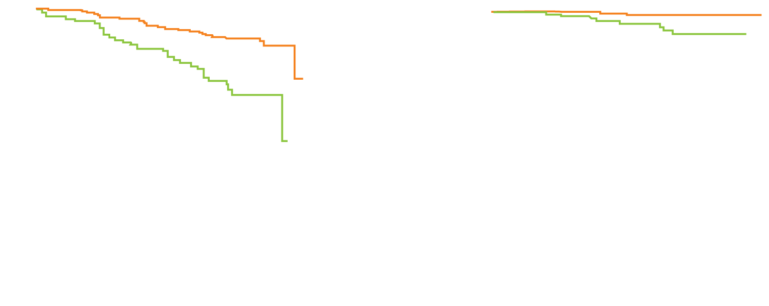
ECOG-ACRIN-E1912: Up-Front Ibrutinib and Rituximab (IR) Compared to FCR in Younger Patients with CLL
Progression-free survival
Overall survival
Probability
Probability
P = 1.62 x 10⁻⁶
HR = 0.352
P = 3.22 x 10⁻⁴
HR = 0.168
Arm A: Ibrutinib (37 events/354 cases)
Arm B: FCR (40 events/175 cases)
Arm A: Ibrutinib (4 deaths/354 cases)
Arm B: FCR (10 deaths/175 cases)
Years
Years
IR was also superior to FCR for patients without IGHV mutations (HR = 0.262; p < 0.0001) but not for those with IGHV mutations (HR = 0.435; p = 0.07).
FCR was more frequently associated with Grade 3/4 neutropenia (FCR: 44% vs IR: 23%; p < 0.0001) and infectious complications (FCR: 17.7% vs IR: 7.1%; p < 0.0001).
Shanafelt TD et al. Proc ASH 2018;Abstract LBA-4.

Slide 14
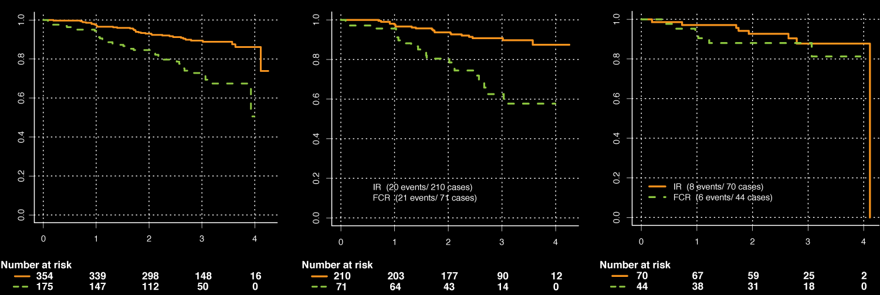
ECOG-E1912: Progression-Free Survival
All comers (ITT analysis)
No IGHV mutation
IGHV mutation
Probability
Probability
Probability
HR = 0.35 (95% CI 0.22-0.56)
One-sided p = 1.62 x 10⁻⁶
IR (37 events/354 cases)
FCR (40 events/175 cases)
HR = 0.26 (95% CI 0.14-0.50)
One-sided p = 7.51 x 10⁻⁶
IR (20 events/210 cases)
FCR (21 events/71 cases)
HR = 0.44 (95% CI 0.14-1.36) One-sided p = 7.08 x 10⁻²
IR (8 events/70 cases)
FCR (6 events/44 cases)
Years
Years
Years
HR = 0.35 (95% CI 0.22-0.5)
One-sided p < 0.00001
HR = 0.26 (95% CI 0.14-0.50) One-sided p < 0.00001
HR = 0.44 (95% CI 0.14-1.36) One-sided p = 0.07
Shanafelt TD et al. Proc ASH 2018;Abstract LBA-4.

Slide 15
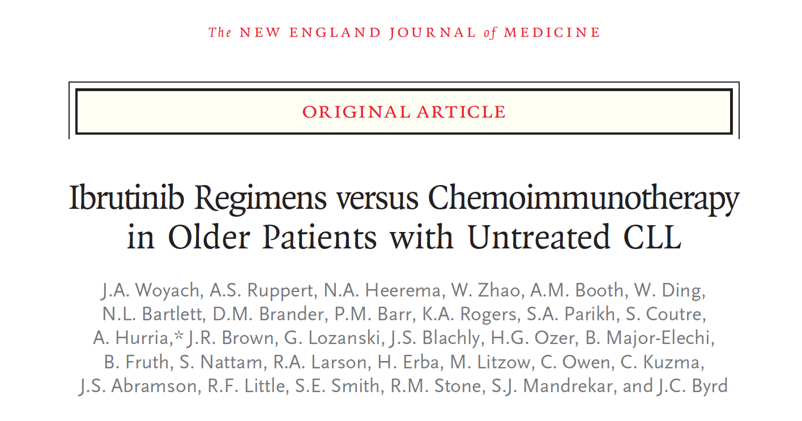
N Engl J Med 2018;379(26):2517-28.

Slide 16
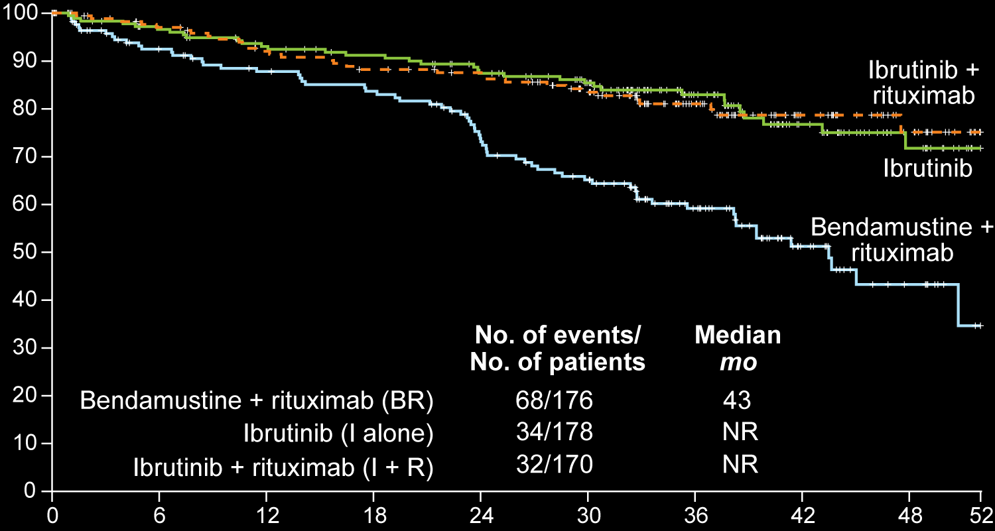
ALLIANCE A041202: Efficacy with Ibrutinib Alone or in Combination with Rituximab Compared to Bendamustine/Rituximab (BR)
Patients who were alive and free from disease progression (%)
Months
Woyach JA et al. N Engl J Med 2018;379(26):2517-28.

Slide 17
ALLIANCE A041202: Safety Results with Ibrutinib Alone or in Combination with Rituximab Compared to Bendamustine/Rituximab (BR)
Adverse events | BR (n = 176) | I alone (n = 180) | I + R (n = 181)
Grade ≥3 hematologic, any | 61% | 41% | 39%
Grade ≥3 nonhematologic, any | 63% | 74% | 74%
Grade ≥3 hypertension | 14% | 29% | 34%
Atrial fibrillation (any grade) | 3% | 9% | 6%
Woyach JA et al. N Engl J Med 2018;379(26):2517-28.

Slide 18
Lancet Oncol 2019;20(1):43-56.

Slide 19
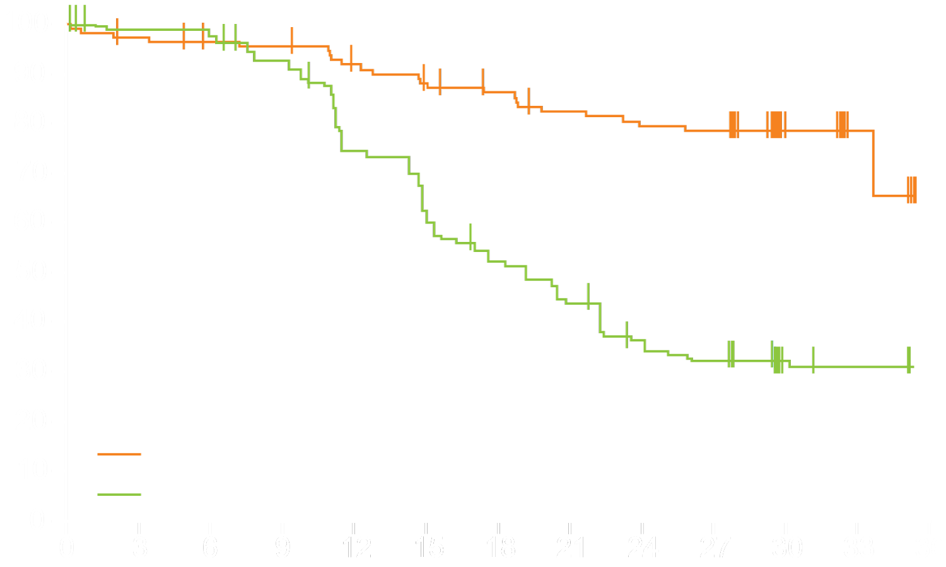
iLLUMINATE: A Phase III Trial of Ibrutinib and Obinutuzumab as First-Line Therapy for CLL
The most common Grade 3 or 4 adverse events in both groups were neutropenia and thrombocytopenia
Serious adverse events occurred in 65 (58%) of 113 patients who received ibrutinib/obinutuzumab and 40 (35%) of 115 patients who received chlorambucil/obinutuzumab.
Progression-free survival (%)
Hazard ratio 0.23
p < 0.0001
Median PFS
Ibrutinib plus obinutuzumab (n = 113)
Not reached
Chlorambucil plus obinutuzumab (n = 116)
19 mo
Time since start of treatment (months)
Moreno C et al. Lancet Oncol 2019;20(1):43-56.

Slide 20
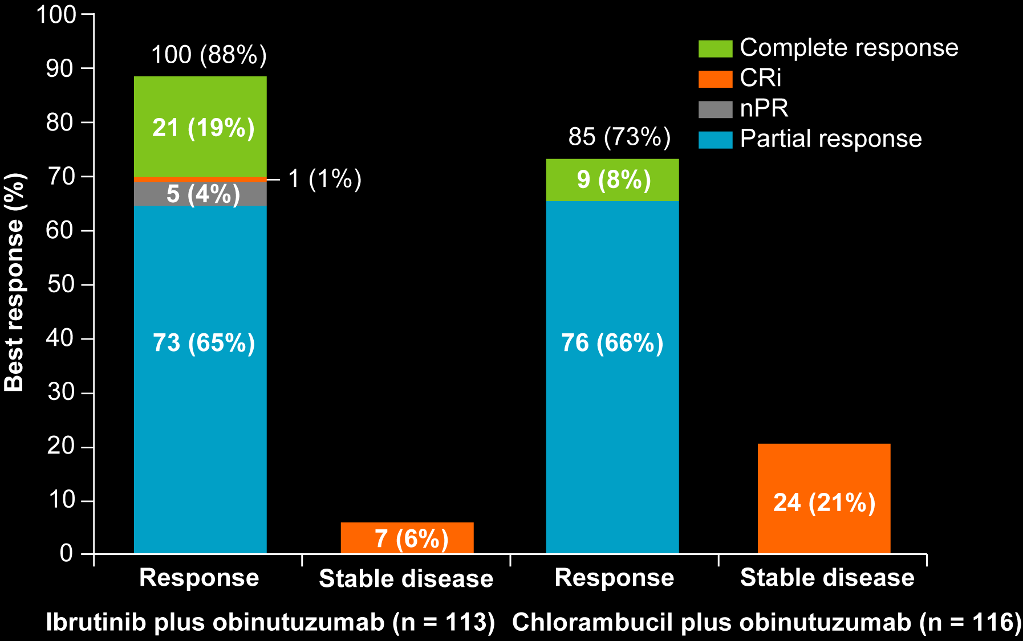
iLLUMINATE: A Phase III Trial of Ibrutinib and Obinutuzumab as First-Line Therapy for CLL
Best response | Ibrutinib plus obinutuzumab | Chlorambucil plus obinutuzumab | Rate ratio | p-value
Overall response | 88% | 73% | 1.21 | 0.0035
Complete response or CRi | 19% | 8% | 2.51 | 0.0096
Moreno C et al. Lancet Oncol 2019;20(1):43-56.

Slide 21
FDA Approval of Ibrutinib with Obinutuzumab as the First Nonchemotherapy Combination Regimen for Treatment-Naïve CLL Press Release – January 28, 2019
The US Food and Drug Administration approved ibrutinib in combination with obinutuzumab for patients with treatment-naïve chronic lymphocytic leukemia/small lymphocytic lymphoma (CLL/SLL). This is the first approval for a nonchemotherapy combination regimen for treatment-naïve CLL/SLL.
This approval is based on results from the Phase III iLLUMINATE study (PCYC-1130). The approval expands the label for ibrutinib in front-line CLL/SLL beyond its use as monotherapy to include use in combination with obinutuzumab.
https://www.prnewswire.com/news-releases/us-fda-approves-imbruvica-ibrutinib-plus-obinutuzumab-as-first-non-chemotherapy-combination-regimen-for-treatment-naive-patients-with-chronic-lymphocytic-leukemia-300784844.html

Slide 22
CLL14: A Phase III Study of Obinutuzumab with Venetoclax or Chlorambucil for Patients with Previously Untreated CLL and Coexisting Medical Conditions
Chlorambucil +
obinutuzumab
Eligibility (n = 445)
Previously untreated CLL requiring treatment Total CIRS score > 6
R
Venetoclax +
obinutuzumab
Primary endpoint: Progression-free survival
www.clinicaltrials.gov. Accessed May 2019 (NCT02242942).

Slide 23
Phase III CLL14 Trial of Venetoclax with Obinutuzumab Meets Its Primary PFS Endpoint Press Release — October 31, 2018
“The randomized Phase III CLL14 study, which evaluated fixed-duration venetoclax in combination with obinutuzumab in people with previously untreated chronic lymphocytic leukemia (CLL) and co-existing medical conditions, met its primary endpoint and showed a statistically significant reduction in the risk of disease worsening or death (progression-free survival [PFS] as assessed by investigator) compared to standard-of-care obinutuzumab plus chlorambucil. The results showed that no new safety signals or increase in known toxicities of venetoclax or obinutuzumab were observed with the treatment combination.”
https://www.businesswire.com/news/home/20181031005831/en/Phase-III-Data-Showed-Venclexta-Gazyva-Reduced

Slide 24
FDA Approves Venetoclax for First-Line CLL or SLL Press Release – May 15, 2019
“On May 15, 2019, the Food and Drug Administration approved venetoclax for adult patients with chronic lymphocytic leukemia (CLL) or small lymphocytic lymphoma (SLL).
Approval was based on CLL14 (NCT02242942), a randomized (1:1), multicenter, open label, actively controlled trial of venetoclax in combination with obinutuzumab (VEN+G) versus obinutuzumab in combination with chlorambucil (GClb) in 432 patients with previously untreated CLL with coexisting medical conditions.”
https://www.fda.gov/drugs/resources-information-approved-drugs/fda-approves-venetoclax-cll-and-sll

Slide 25
Effect of Fixed-Duration Venetoclax plus Obinutuzumab (VenG) on Progression-Free Survival (PFS), and Rates and Duration of Minimal Residual Disease Negativity (MRD–) in Previously Untreated Patients (pts) with Chronic Lymphocytic Leukemia (CLL) and Comorbidities
Fischer K et al. ASCO 2019;Abstract 7502.
Hematologic Malignancies — Lymphoma and Chronic Lymphocytic Leukemia
Tuesday, June 4th, 10:09-10:21 AM, E451

Slide 26
Phase II CAPTIVATE Study: MRD Response to First-Line Ibrutinib (IBR) and Venetoclax (VEN) in CLL
MRD response in peripheral blood
MRD response in bone marrow
3%
CLL cells/leukocytes
<0.01%
0.01%-<1.0%
≥1.0%
Sample not evaluable
77%
86%
93%
93%
13%
7%
3%
10%
7%
7%
High rates of undetectable MRD (77%) in peripheral blood after 6 cycles of first-line IBR + VEN
Confirmed undetectable MRD in 11 of 14 patients (79%) after 12 cycles of first-line IBR + VEN
Adverse events consistent with historical safety profile of single-agent IBR and those expected with VEN; no new safety signals
Wierda WG et al. Proc ASCO 2018;Abstract 7502.

Slide 27
Select Ongoing Phase III Trials of Novel Combination Approaches for Newly Diagnosed CLL
ç
Trial | Phase | N | Randomization
FLAIR (ISRCTN01844152) | III | 1,576 | FCR Ibrutinib Ibrutinib/rituximab Ibrutinib/venetoclax
GAIA (CLL13) (NCT02950051) | III | 920 | FCR or BR Venetoclax/rituximab Venetoclax/obinutuzumab Venetoclax/obinutuzumab/ibrutinib
GLOW (CLL3011) (NCT03462719) | III | 200 | Ibrutinib/venetoclax Chlorambucil/obinutuzumab
Elevate CLL TN (ACE-CL-007) (NCT02475681) | III | 535 | Acalabrutinib Acalabrutinib/obinutuzumab Chlorambucil/obinutuzumab
www.clinicaltrials.gov. Accessed May 2019; www.isrctn.com. Accessed May 2019

Slide 28
Acalabrutinib versus Ibrutinib
Acalabrutinib is more selective for BTK with less off-target kinase inhibition compared to ibrutinib in vitro
Kinase inhibition
average IC₅₀ (nM)
ç
Acalabrutinib
Ibrutinib
Kinase | Acalabrutinib | Ibrutinib
BTK | 5.1 | 1.5
TEC | 126.0 | 10
ITK | >1,000 | 4.9
BMX | 46 | 0.8
TXK | 368 | 2.0
EGFR | >1,000 | 5.3
ERBB2 | ~1,000 | 6.4
ERBB4 | 16 | 3.4
BLK | >1,000 | 0.1
JAK3 | >1,000 | 32
Kinase selectivity profiling at 1 μM
Larger red circles represent stronger inhibition
BLK = B lymphocyte kinase; BMX = bone marrow tyrosine kinase gene in chromosome X; BTK = Bruton tyrosine kinase; EGFR = epidermal growth factor receptor; ERBB2 = erb-b2 receptor tyrosine kinase; ERBB4 = erb-b4 receptor tyrosine kinase; IC50 = inhibitory concentration of 50%; ITK = interleukin-2-inducible T-cell kinase; JAK3 = Janus kinase 3; TEC = tyrosine kinase expressed in hepatocellular carcinoma; TXK = T and X cell expressed kinase.
Barf T et al. J Pharmacol Exp Ther 2017;363(2):240-52.

Slide 29
Acalabrutinib Monotherapy in Patients with Relapsed/Refractory Chronic Lymphocytic Leukemia: Updated Results from the Phase 1/2 ACE-CL-001 Study¹ Acalabrutinib in Treatment-Naive (TN) Chronic Lymphocytic Leukemia (CLL): Updated Results from the Phase 1/2 ACE-CL-001 Study²
¹ Byrd JC et al. Proc ASH 2017;Abstract 498.
² Byrd JC et al.
Proc ASH 2018;Abstract 692.

Slide 30
ACE-CL-001: Updated Efficacy and Safety of Acalabrutinib Monotherapy in Patients with Treatment-Naïve and R/R CLL
 | R/R patient cohort (n = 134)¹ | Treatment-naïve patient cohort (n = 99)²
ORR (CR + PR) | 85% | 97%
18-month DOR | 85% | —
18-month PFS | 88% | —
36-month DOR | — | 99%
36-month PFS | — | 98%
Select Grade 3/4 adverse events | R/R patient cohort (n = 134)¹ | Treatment-naïve patient cohort (n = 99)²
Neutropenia | 11% | 7%
Diarrhea | NR | 5%
Pneumonia | 10% | 4%
Hypertension | 3% | 3%
Atrial fibrillation | 2% | 1%
¹ Byrd JC et al. Proc ASH 2017;Abstract 498; ² Byrd JC et al. Proc ASH 2018;Abstract 692.

Slide 31
Phase III ASCEND Trial of Acalabrutinib for R/R CLL Meets Its Primary PFS Endpoint and Will Stop Early Press Release — May 7, 2019
“Positive results from the Phase III ASCEND trial of acalabrutinib in previously-treated patients with chronic lymphocytic leukemia… showed a statistically-significant and clinically-meaningful improvement in progression-free survival (PFS) with acalabrutinib monotherapy compared to a combination regimen of rituximab plus physician’s choice of idelalisib or bendamustine… The safety and tolerability of acalabrutinib was consistent with the known profile.
ASCEND (ACE-CL-309) is a global, randomised, multicentre, open-label Phase III trial evaluating the efficacy of acalabrutinib in previously-treated patients with CLL. In the trial, 310 patients were randomised (1:1) into two groups. Patients in the first group received acalabrutinib monotherapy (100 mg twice daily until disease progression). Patients in the second group received rituximab plus physician’s choice of idelalisib or bendamustine.”
https://www.astrazeneca.com/media-centre/press-releases/2019/calquence-phase-iii-ascend-trial-met-primary-endpoint-at-interim-analysis-in-relapsed-or-refractory-chronic-lymphocytic-leukaemia-and-will-stop-early-07052019.html

Slide 32
Phase III ACE-CL-006 Trial of Acalabrutinib versus Ibrutinib for Patients with Previously Treated, High-Risk CLL
Trial identifier: NCT02477696
Estimated enrollment: 533
Acalabrutinib
Eligibility
Presence of 17p del or 11q del Active disease after ≥1 prior CLL therapy ECOG PS 0-2
R
Ibrutinib
Primary endpoint: PFS
www.clinicaltrials.gov; Accessed May 2019.

Slide 33
Acalabrutinib with Obinutuzumab (Ob) in Treatment-Naive (TN) and Relapsed/Refractory (R/R) Chronic Lymphocytic Leukemia (CLL): Three-Year Follow-Up
Woyach JA et al. ASCO 2019;Abstract 7500.
Hematologic Malignancies — Lymphoma and Chronic Lymphocytic Leukemia
Tuesday, June 4th, 9:45-9:57 AM, E451

Slide 34
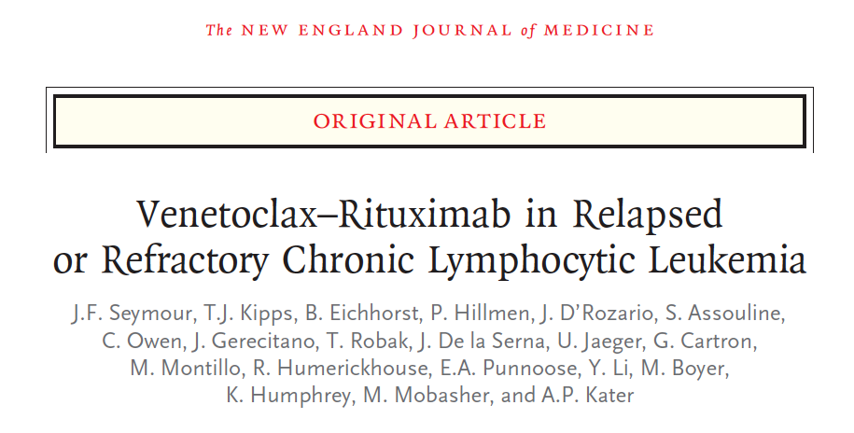
N Engl J Med 2018;378(12):1107-20.

Slide 35
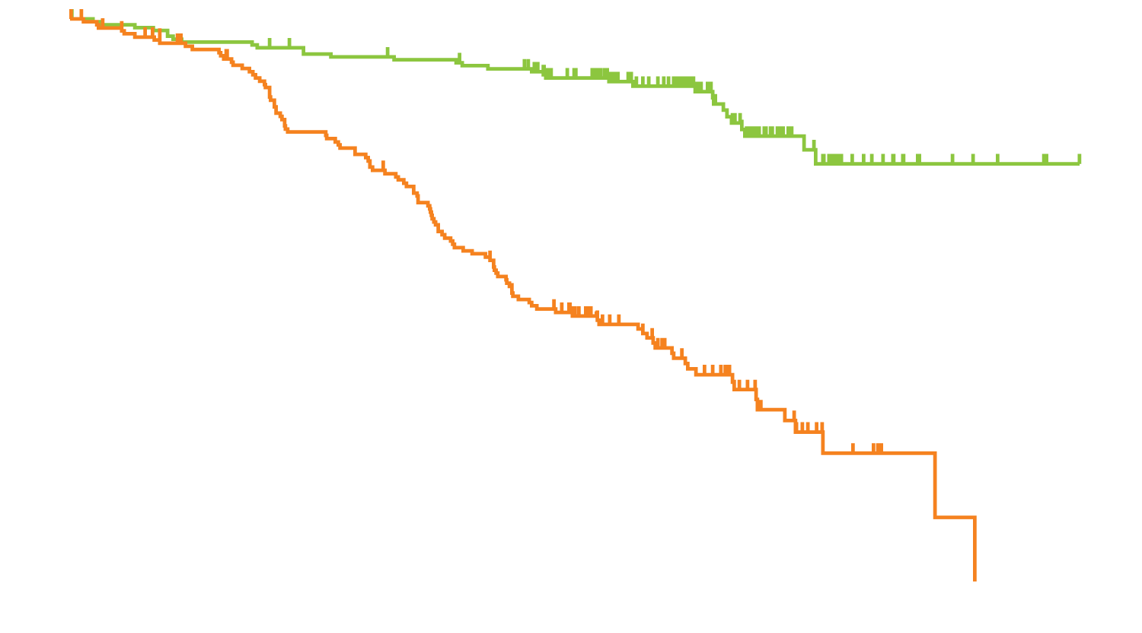
MURANO: Progression-Free Survival and Select Toxicity of Venetoclax-Rituximab in R/R CLL
 | N | Median PFS | HR | p-value
Venetoclax-rituximab | 194 | NR | 0.17 | <0.001
Bendamustine-rituximab | 195 | 17 months
Venetoclax-rituximab group
Grade 3-4 adverse events | Venetoclax-rituximab (n = 194) | Bendamustine- rituximab (n = 188)
Neutropenia | 58% | 39%
Febrile neutropenia | 4% | 10%
Tumor lysis syndrome | 3% | 1%
Progression-free survival (% of patients)
Bendamustine-rituximab group
Months since randomization
Seymour JF et al. N Engl J Med 2018;378(12):1107-20.

Slide 36
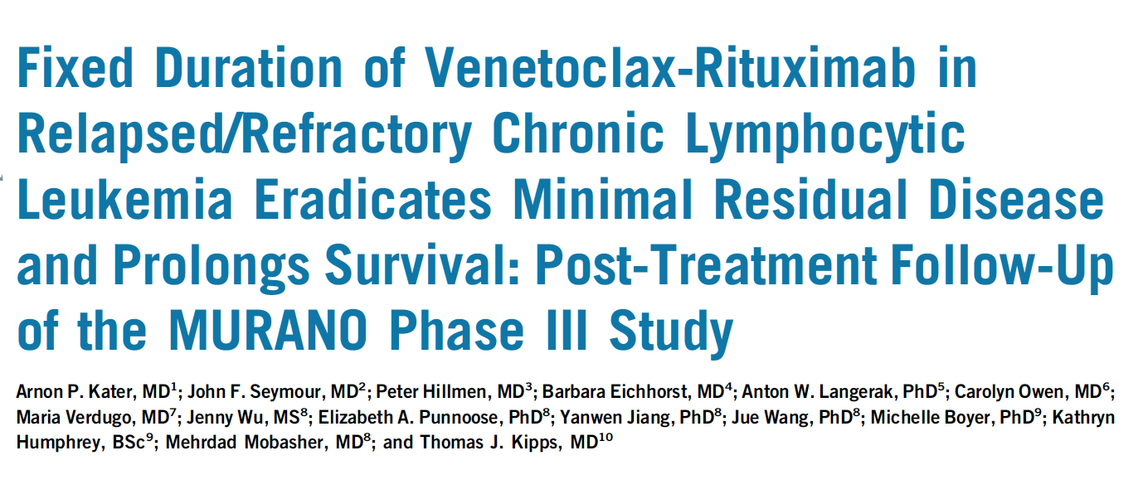
J Clin Oncol 2019;37(4):269-77.

Slide 37
TRANSCEND CLL 004: Minimal Residual Disease (MRD) Negative Responses After Lisocabtagene Maraleucel (Liso-Cel; JCAR017), a CD19-Directed CAR T Cell Product, in Patients (Pts) with Relapsed/Refractory Chronic Lymphocytic Leukemia or Small Lymphocytic Lymphoma (CLL/SLL)
Siddiqi T et al. ASCO 2019;Abstract 7501.
Hematologic Malignancies — Lymphoma and Chronic Lymphocytic Leukemia
Tuesday, June 4th, 9:57-10:09 AM, E451

Slide 38
Follicular Lymphoma

Slide 39
A man in his early 60s with newly diagnosed FL (Dr Cheson)
10/2015: Diagnosed with Grade 2 follicular lymphoma
Patient refuses chemotherapy
Lenalidomide/rituximab (R²)
Completes 1 year of lenalidomide treatment
Restaging PET-CT: Deauville Score = 1
Remains in CR more than 2 years later

Slide 40
A man in his late 40s with relapsed FL (Dr LaCasce)
2011: Rituximab → complete remission
8/2017: Disease recurrence
Lymphadenopathy particularly in abdomen and pelvis
Small mediastinal nodes in chest
9/2017: Rituximab reinitiated x 4 weekly doses
11/2017: Stable disease
Obinutuzumab plus bendamustine x 6 → metabolic complete remission
Opted not to have maintenance

Slide 41
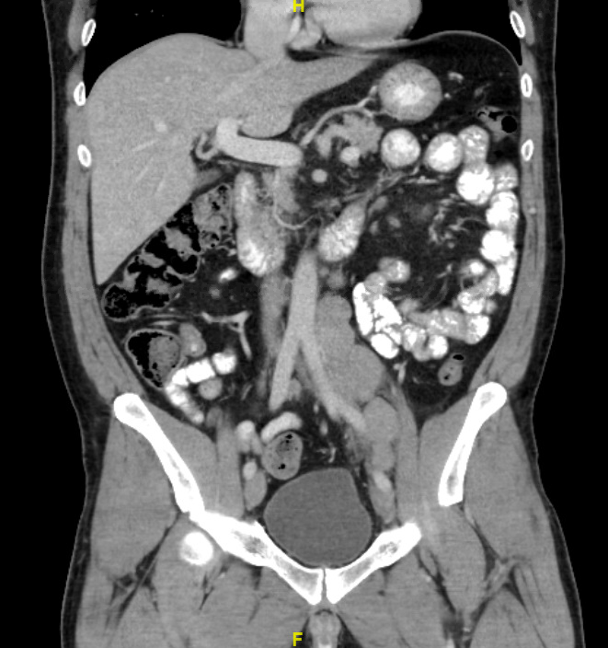
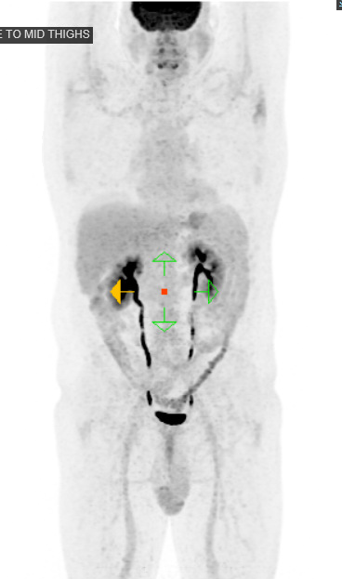
A man in his late 40s (Dr LaCasce)

Slide 42
Obinutuzumab-Based Immunochemotherapy Prolongs Progression-Free Survival and Time to Next Anti-Lymphoma Treatment in Patients with Previously Untreated Follicular Lymphoma: Four-Year Results from the Phase III GALLIUM Study
Townsend W et al. Proc ASH 2018;Abstract 1597.

Slide 43
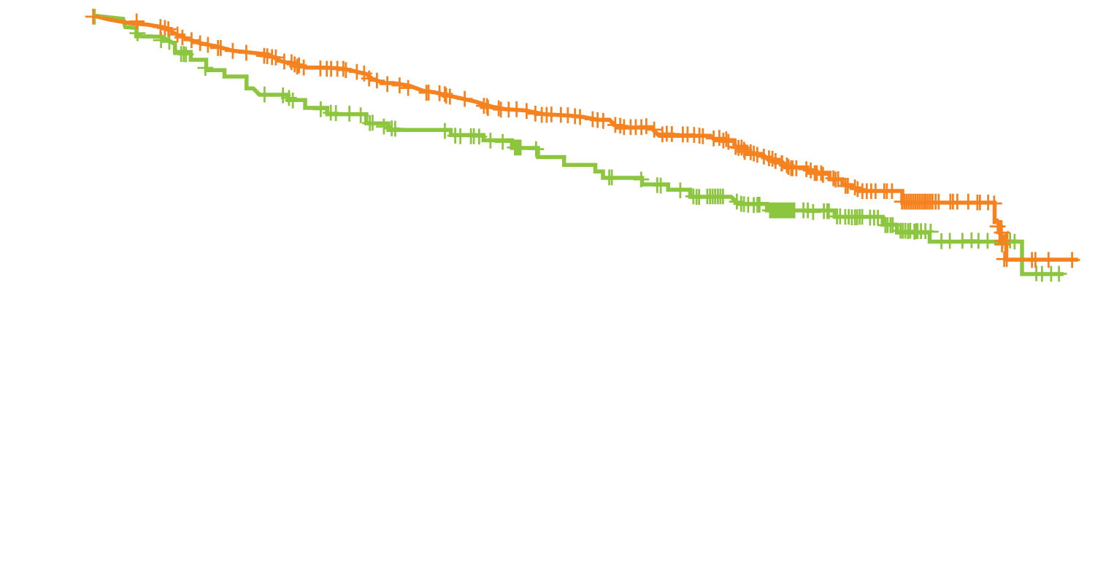
GALLIUM: Four-Year Results with Obinutuzumab-Based Immunochemotherapy for Previously Untreated FL
Progression-free survival
 | G-chemo (n = 601) | R-chemo (n = 601)
Any adverse event (AE) | 99.8% | 99.5%
Grade 3-5 AEs | 79.2% | 71.2%
Infections | 22.2% | 18.6%
Neutropenia | 48.4% | 41.4%
Second cancer | 6.9% | 4.4%
Probability of survival
HR = 0.73
p = 0.0034
R-chemotherapy (N = 601)
G-chemotherapy (N = 601)
Censored
+
G = obinutuzumab; R = rituximab
Time (months)
G-chemo continues to demonstrate clinically meaningful improvements in outcomes relative to R-chemo for patients with previously untreated FL
OS data remain immature, with additional follow-up needed to draw conclusions
Townsend W et al. Proc ASH 2018;Abstract 1597.

Slide 44
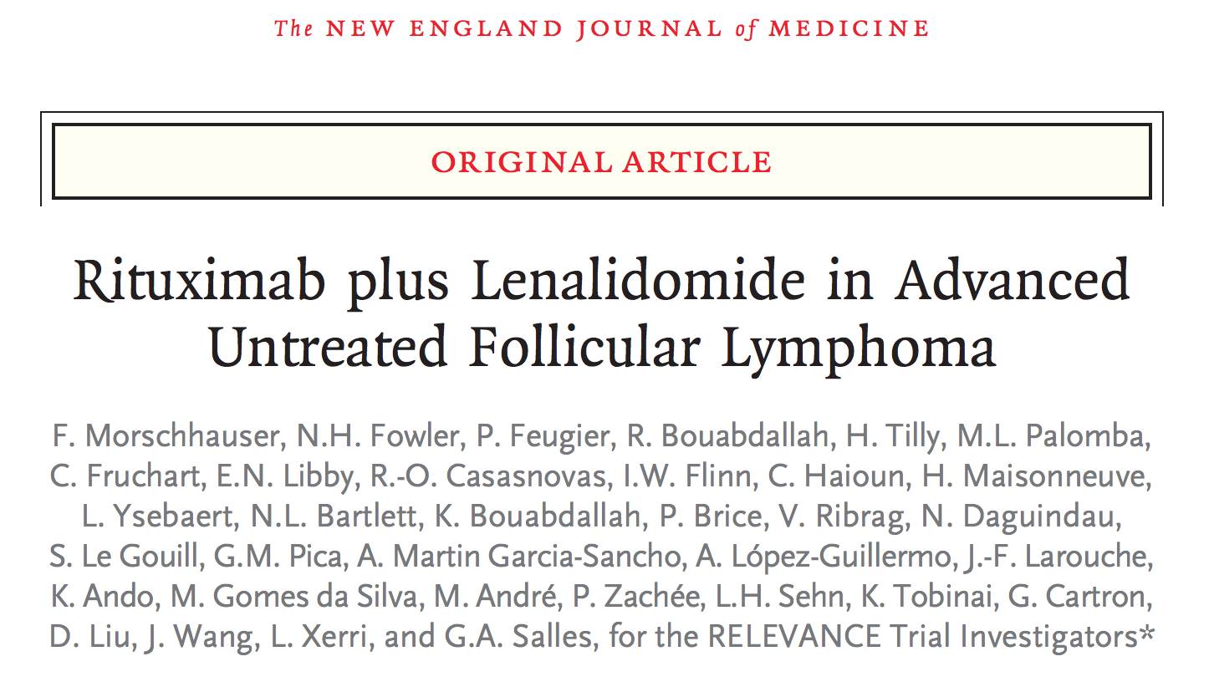
N Engl J Med 2018;379(10):934-47.

Slide 45
RELEVANCE: A Phase III Trial of Rituximab with Lenalidomide versus Rituximab with Chemotherapy for Patients with Untreated FL
Trial identifier: NCT01476787 (Closed)
Rituximab + chemotherapy
R-CHOP, R-CVP or BR
Eligibility
Grade I-IIIa, Stage II-IV untreated FL Symptomatic, requiring treatment
R
Lenalidomide + rituximab
Primary endpoints: Complete response rate at 120 weeks and PFS
Morschhauser F et al. N Engl J Med 2018;379(10):934-47.

Slide 46
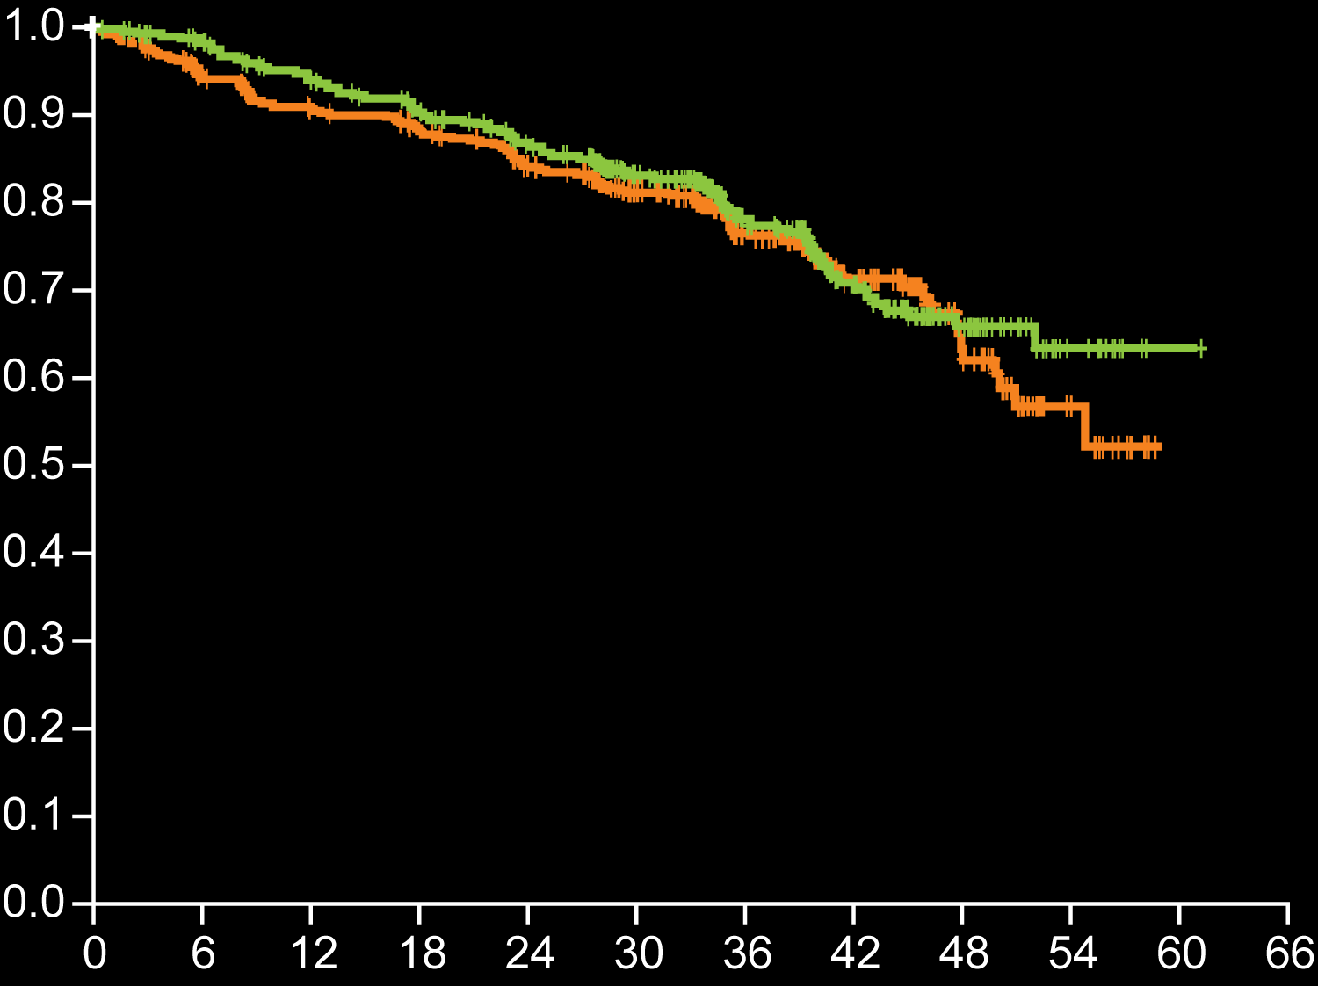
RELEVANCE: Rituximab + Lenalidomide (R²) versus Rituximab + Chemotherapy (R-chemo) in Untreated, Advanced FL
Grade 3-4 adverse events | R² (n = 507) | R-chemo (n = 503)
Neutropenia | 32% | 50%
Febrile neutropenia | 2% | 7%
Cutaneous reactions | 7% | 1%
Diarrhea | 2% | 1%
Tumor lysis syndrome | 1% | <1%
R-chemo
group
Probability of progression-free survival
R² group
HR 1.10, p = 0.48
Months since randomization
Efficacy results were similar between R² and R-chemo in advanced, untreated follicular lymphoma.
The safety profile differed between the 2 groups.
Morschhauser F et al. N Engl J Med 2018;379(10):934-47.

Slide 47
FDA Approves Lenalidomide for Follicular and Marginal Zone Lymphoma Press Release – May 28, 2019
“On May 28, 2019, the Food and Drug Administration approved lenalidomide in combination with a rituximab product for previously treated follicular lymphoma (FL) and previously treated marginal zone lymphoma (MZL).
Approval was based on two clinical trials: AUGMENT (NCT01938001) and MAGNIFY (NCT01996865). In AUGMENT, 358 patients with relapsed or refractory FL or MZL were randomized (1:1) to receive lenalidomide and rituximab or rituximab and placebo. In the single-arm component of MAGNIFY, 232 patients with relapsed or refractory FL, MZL, or mantle cell lymphoma received 12 induction cycles of lenalidomide and rituximab.”
https://www.fda.gov/drugs/resources-information-approved-drugs/fda-approves-lenalidomide-follicular-and-marginal-zone-lymphoma

Slide 48
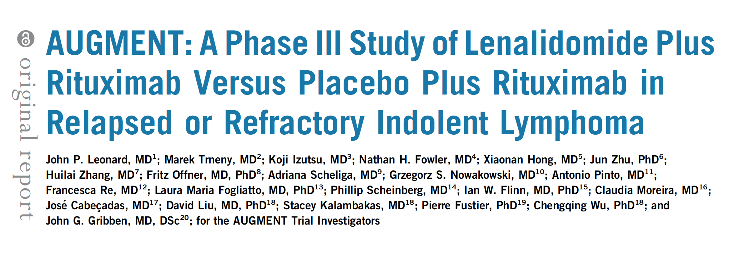
J Clin Oncol 2019;37(14):1188-99.

Slide 49
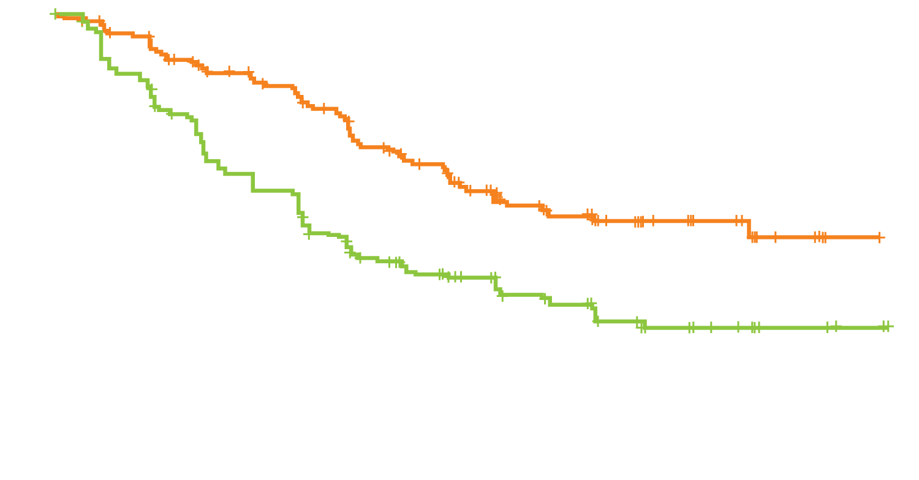
AUGMENT: R² versus Rituximab/Placebo in R/R FL or Marginal Zone Lymphoma
Primary Endpoint PFS
 | R² (n = 178) | R/placebo (n = 180)
ORR | 78% | 53%
CR | 34% | 18%
Median DOR | 36.6 mo | 21.7 mo
R²
Median = 39.4 mo
Progression-free survival probability (IRC assessment)
p < 0.001
HR = 0.46
Rituximab + placebo
Median = 14.1 mo
Months from randomization
Leonard JP et al. J Clin Oncol 2019;37(14):1188-99.

Slide 50
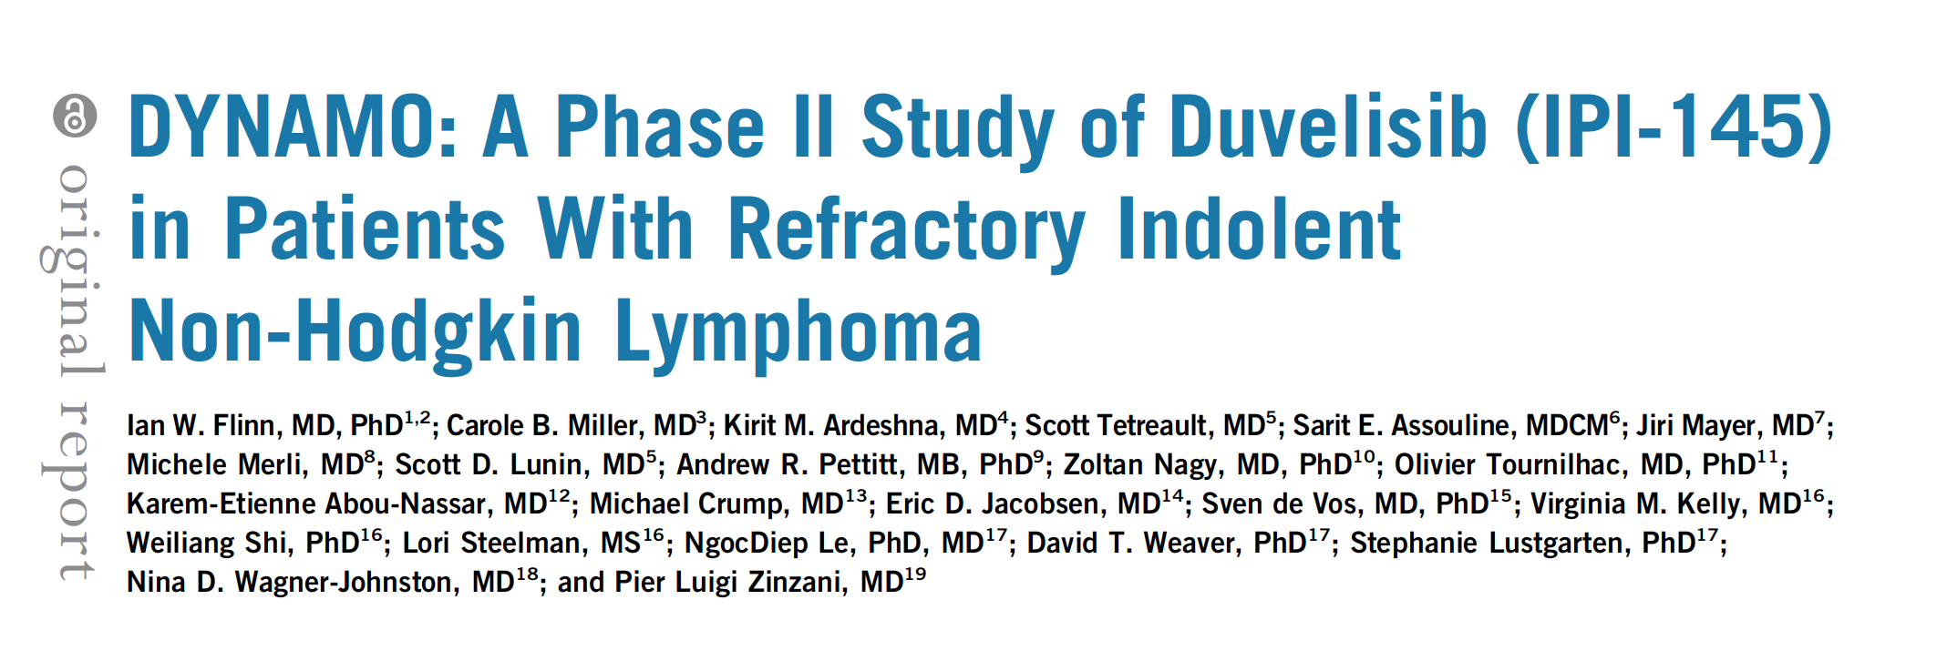
J Clin Oncol 2019;37(11):912-22.

Slide 51
DYNAMO: A Phase II Study of Duvelisib for Double-Refractory Indolent NHL
Of 129 patients with indolent NHL on study, 83 patients with FL received duvelisib
Response in patients with FL (by IRC) | Duvelisib (n = 83)
ORR CR PR | 42.2% 1.2% 41%
Select Grade ≥3 adverse events | n = 129
Neutropenia | 24.8%
Diarrhea | 14.7%
Anemia | 14.7%
Thrombocytopenia | 11.6%
For all treated patients (N = 129):
ORR = 47.3%
Median time to response = 1.87 months
Median DoR = 10 months
Median PFS = 9.5 months
Median OS = 28.9 months
Flinn IW et al. J Clin Oncol 2019;37(11):912-22.

Slide 52
FDA Approves Duvelisib for Patients with CLL, SLL or FL After at Least 2 Prior Therapies Press Release – September 24, 2018
“On Sept. 24, 2018, the Food and Drug Administration granted regular approval to duvelisib for adult patients with relapsed or refractory chronic lymphocytic leukemia (CLL) or small lymphocytic lymphoma (SLL) after at least two prior therapies.
In addition, duvelisib received accelerated approval for adult patients with relapsed or refractory follicular lymphoma (FL) after at least two prior systemic therapies.”
https://www.fda.gov/Drugs/InformationOnDrugs/ApprovedDrugs/ucm621503.htm

Slide 53
PI3K Inhibitors for FL: Indication and Dosing
 | Idelalisib¹ | Copanlisib² | Duvelisib³
Mechanism of action | Selective PI3Kδ inhibitor | Pan-PI3K inhibitor | Dual inhibitor of PI3Kδ,γ
Indication | Relapsed FL after at least 2 prior systemic therapies | Relapsed FL after at least 2 prior systemic therapies | R/R FL after at least 2 prior systemic therapies
Dosing | 150 mg orally, twice daily | 60 mg as a 1-hour IV infusion weekly (3 weeks on, 1 week off) | 25 mg orally, twice daily
¹ Gopal AK et al. N Engl J Med 2014;370(11):1008-18; Idelalisib package insert, October 2018.
² Dreyling M et al. J Clin Oncol 2017;35(35):3898-905; Copanlisib package insert, September 2017.
³ Flinn IW et al. J Clin Oncol 2019;[Epub ahead of print]; Duvelisib package insert, September 2018.

Slide 54
PI3K Inhibitors for FL: Activity and Tolerability
 | Idelalisib¹ | Copanlisib² | Duvelisib³
Activity | ORR: 57% (6% CR) Median time to response: 1.9 mo Median DoR: 12.5 mo | ORR: 59% (12% CR) Median time to response: 1.7 mo Median DoR: 22.6 mo | ORR: 42.2% (1.2% CR) Median time to response: 1.9 mo* Median DoR: 10 mo*
Tolerability | Grade ≥3 AEs: 54% Neutropenia: 27% Diarrhea: 13% Increased ALT: 13% | Grade ≥3 TRAEs: 84% Hyperglycemia: 41% Hypertension: 24% Neutropenia: 24% | Grade ≥3 AEs: 88%* Neutropenia: 25%* Diarrhea: 15%* Increased AST: 3.1%*
* All patients on study (FL, SLL, marginal zone-B lymphoma)
¹ Gopal AK et al. N Engl J Med 2014;370(11):1008-18; Idelalisib package insert, October 2018.
² Dreyling M et al. J Clin Oncol 2017;35(35):3898-905; Copanlisib package insert, September 2017.
³ Flinn IW et al. J Clin Oncol 2019;37(11):912-22; Zinzani PL et al. Proc EHA 2017;Abstract S777; Duvelisib package insert, September 2018.

Slide 55
A woman in her mid-70s with Stage IIIA, bulky Grade 3A FL (Dr LaCasce)
12/2018 ultrasound: 14-cm abdominal mass
Biopsy: Grade 3A follicular lymphoma (LDH, CBC normal)
PET/CT: Mesenteric mass SUV 14.4
R-CHOP x 6
Metabolic complete remission

Slide 56
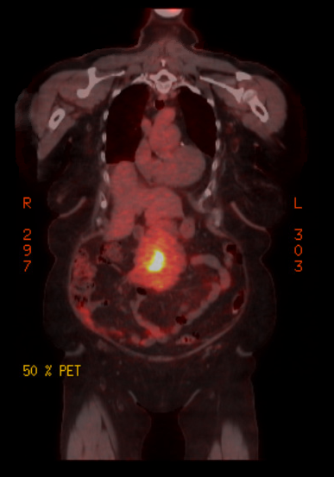
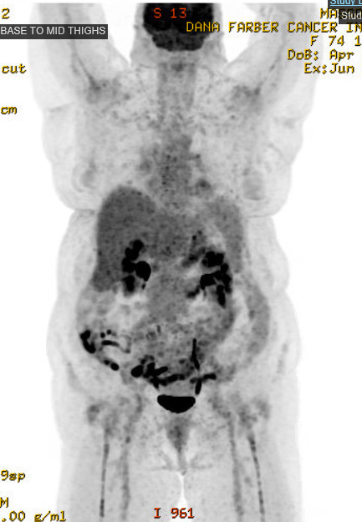
A woman in her mid-70s (Dr LaCasce)

Slide 57
What is your usual preferred initial regimen for a 60-year-old patient with IGHV-unmutated chronic lymphocytic leukemia (CLL) without del(17p) or TP53 mutation who requires treatment?
FCR
BR
Rituximab +/- chlorambucil
Ibrutinib
Ibrutinib + rituximab
Ibrutinib + obinutuzumab
Obinutuzumab + chlorambucil
Obinutuzumab + bendamustine
Obinutuzumab + venetoclax
Other

