Slide 1
Please note, these are the actual video-recorded
proceedings from the live CME event and may include
the use of trade names and other raw, unedited content.

Slide 2
Meet The Professors
Clinical Investigator Perspectives on Key Questions and Emerging Research in the Management of Lymphoma, Chronic Lymphocytic Leukemia and Multiple Myeloma
Sunday, June 2, 2019
7:00 PM - 9:30 PM
Chicago, Illinois
Faculty
Jeremy Abramson, MD
Bruce D Cheson, MD
Ann S LaCasce, MD, MMSc
Noopur Raje, MD
Paul G Richardson, MD
Sonali M Smith, MD
Moderator
Neil Love, MD

Slide 3
Module 3: Hodgkin and Other Lymphomas

Slide 4
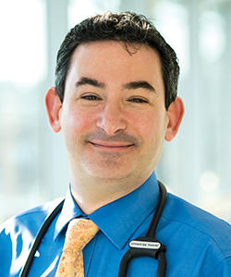
Jeremy Abramson, MD
Director, Center for Lymphoma
Massachusetts General Hospital
Associate Professor of Medicine
Harvard Medical School
Boston, Massachusetts

Slide 5
Disclosures for Jeremy Abramson, MD
Consulting Agreements | AbbVie Inc, Amgen Inc, Bayer HealthCare Pharmaceuticals, Celgene Corporation, EMD Serono Inc, Genentech, Gilead Sciences Inc, Janssen Biotech Inc, Juno Therapeutics, a Celgene Company, Karyopharm Therapeutics, Kite Pharma Inc, Merck, Novartis, Seattle Genetics, Verastem Inc.

Slide 6
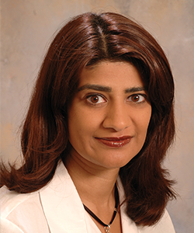
Sonali M Smith, MD
Elwood V Jensen Professor of Medicine
Director, Lymphoma Program
The University of Chicago
Chicago, Illinois

Slide 7
Disclosures for Sonali M Smith, MD
Consulting Agreements | AbbVie Inc, AstraZeneca Pharmaceuticals LP, Bayer HealthCare Pharmaceuticals, Genentech, Gilead Sciences Inc, Kite Pharma Inc, Nordic Nanovector, Pharmacyclics LLC, an AbbVie Company, Portola Pharmaceuticals Inc, Seattle Genetics, TG Therapeutics Inc
Contracted Research | Celgene Corporation, Forty Seven Inc, Genentech, Pharmacyclics LLC, an AbbVie Company, Portola Pharmaceuticals Inc, Roche Laboratories Inc
Other Remunerated Activities | Educational lecture — Genentech; Medical science liaison, commercial teams — Kite Pharma Inc

Slide 8
Hodgkin Lymphoma

Slide 9
A man in his early 20s with Stage IVB classical Hodgkin lymphoma (Dr Smith)
3/2018: Brentuximab vedotin-AVD
  THC and cannabis oil: Psychotic break after 2 cycles → rehab facility
  Resumed BV-AVD after 10-day delay: CR
  Mild cytopenias, nausea; no neuropathy
One year from end of treatment: Remission
Notes:
Gujja Cut 02

Slide 10
A man in his early 20s with Stage IVB classical Hodgkin lymphoma (Dr Smith)

Slide 11
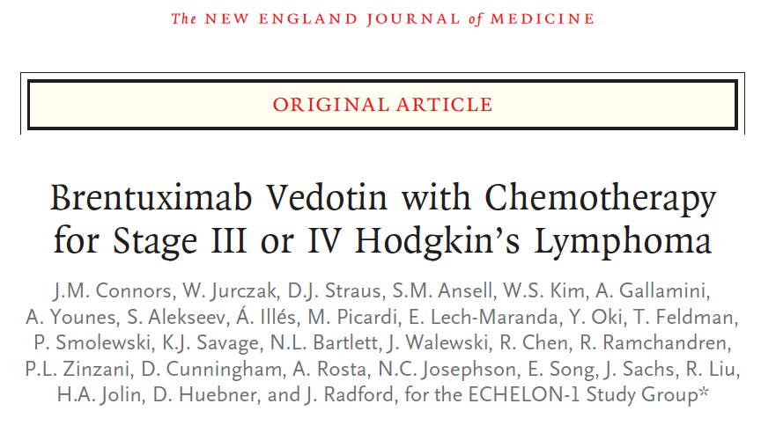
N Engl J Med 2018;378(4):331-44.

Slide 12
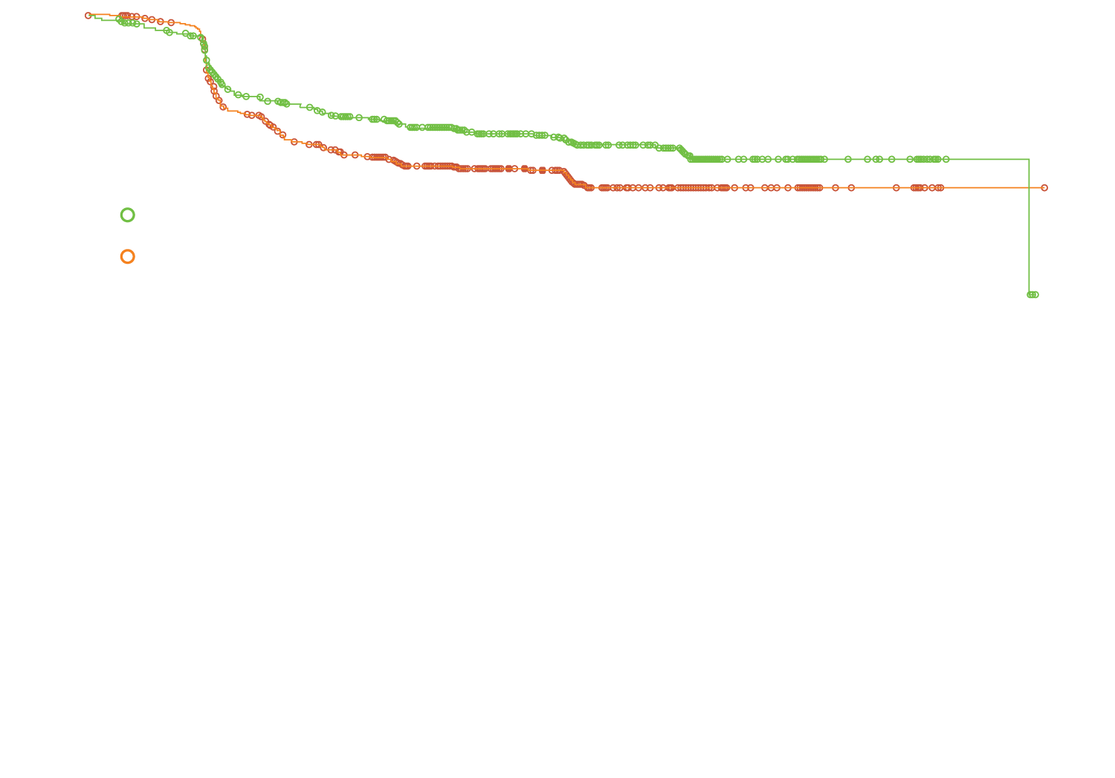
ECHELON-1: Modified PFS and Select Adverse Events for Brentuximab Vedotin (BV) with Chemotherapy
By independent review committee (IRC)
Two-year modified PFS
BV + AVD | 82.1%
ABVD | 77.2%
(n = 664)
(n = 670)
HR = 0.77, p = 0.03
 | BV + AVD |  | ABVD
 | Any grade | Grade 3/4 | Any grade | Grade 3/4
Neutropenia | 58% | 54% | 45% | 39%
Febrile neutropenia | 19% | NR | 8% | NR
Peripheral sensory neuropathy | 29% | 5% | 17% | <1%
Infections | 55% | 18% | 50% | 10%
NR = Not reported
Connors JM et al. N Engl J Med 2018;378(4):331-44.

Slide 13
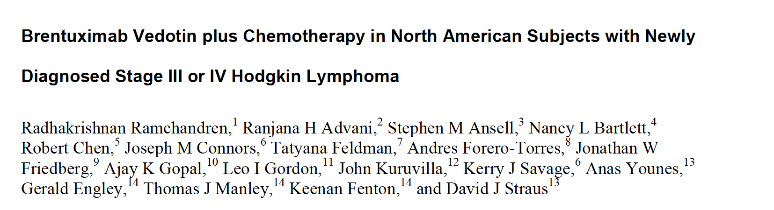
Clin Cancer Res 2019;25(6):1718-26.

Slide 14
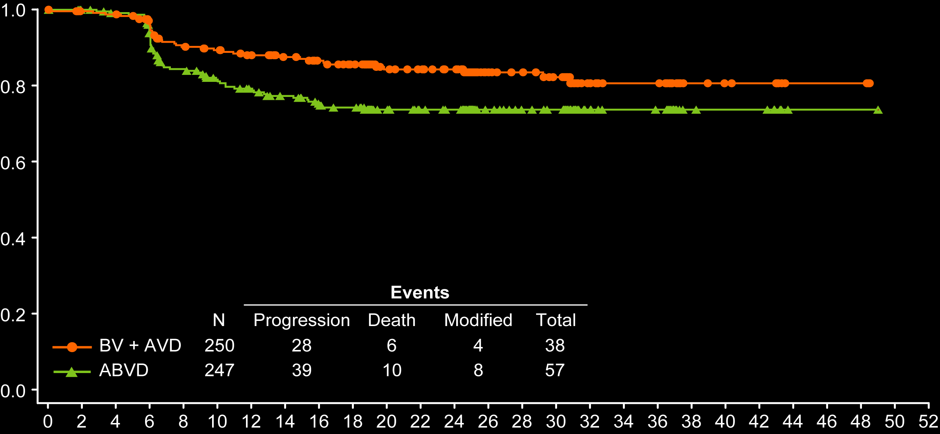
ECHELON-1: Efficacy of Brentuximab Vedotin (BV) with Chemotherapy in North American Patients with Newly Diagnosed Stage III or IV Hodgkin Lymphoma
North American patients | BV + AVD | ABVD | HR, p-value
2-year mPFS | 84.3% | 73.7% | 0.60, p = 0.012
2-year OS | 97.0% | 93.2% | 0.51, p = 0.094
Probability of modified
progression-free survival
Time (months) from randomization
mPFS by regional patient population | HR | p-value
North America | 0.60 | 0.012
Europe | 0.83 | 0.281
Asia | 0.91 | 0.810
Ramchandren R et al. Clin Cancer Res 2019;[Epub ahead of print].

Slide 15
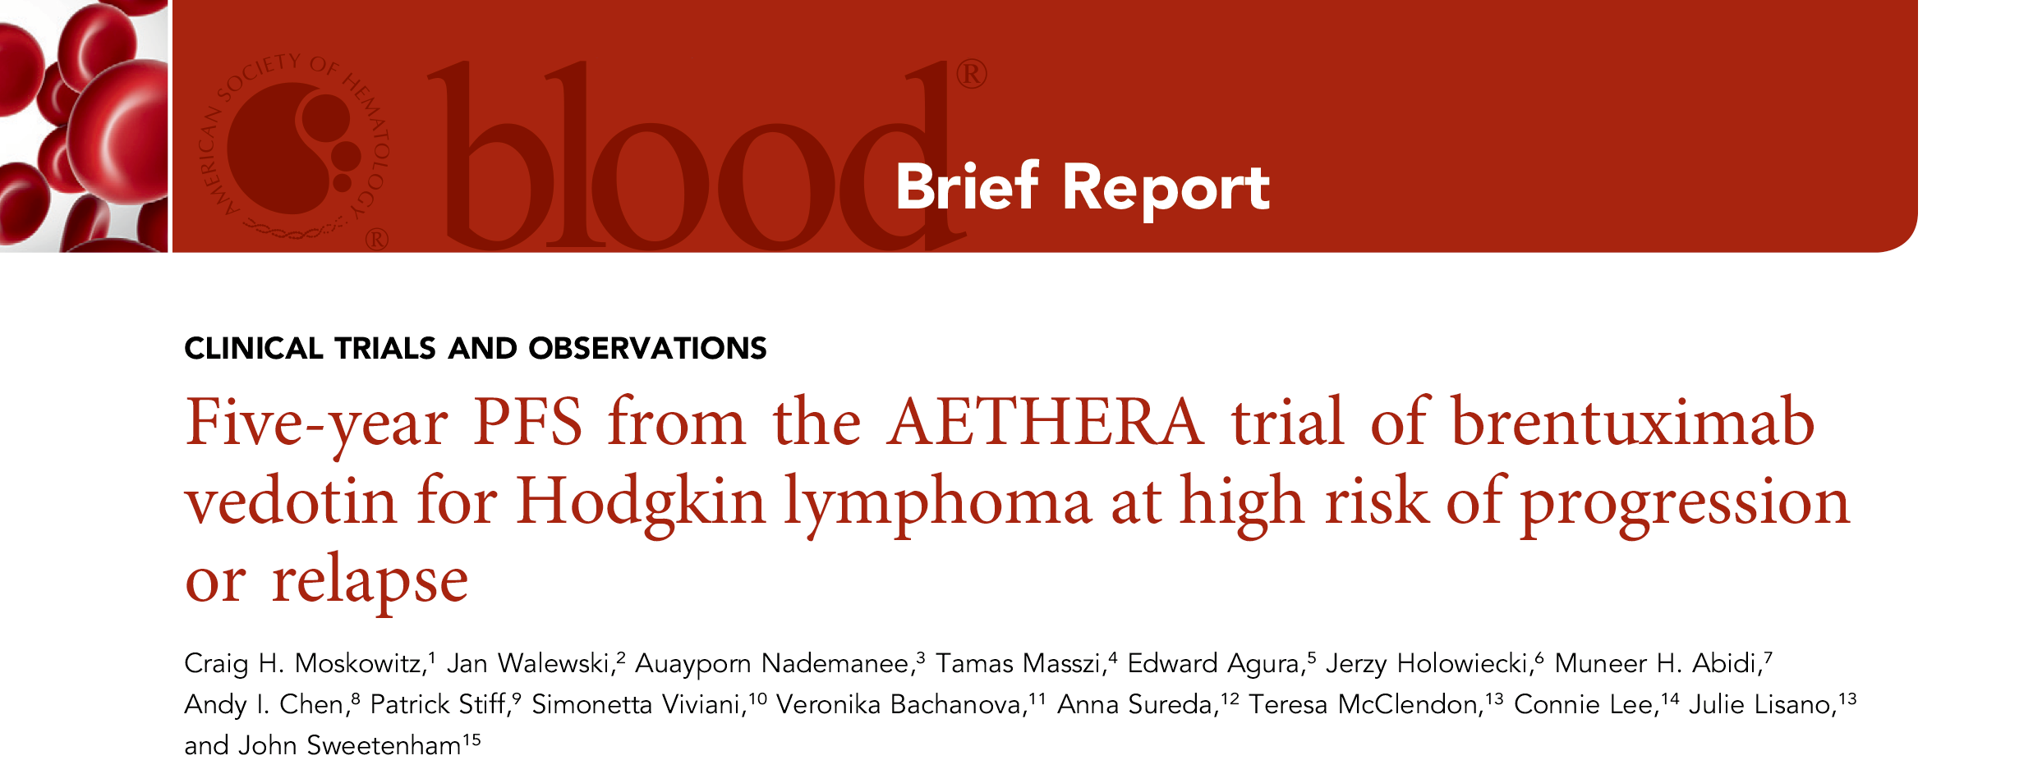
Blood 2018;132(25):2639-42.

Slide 16
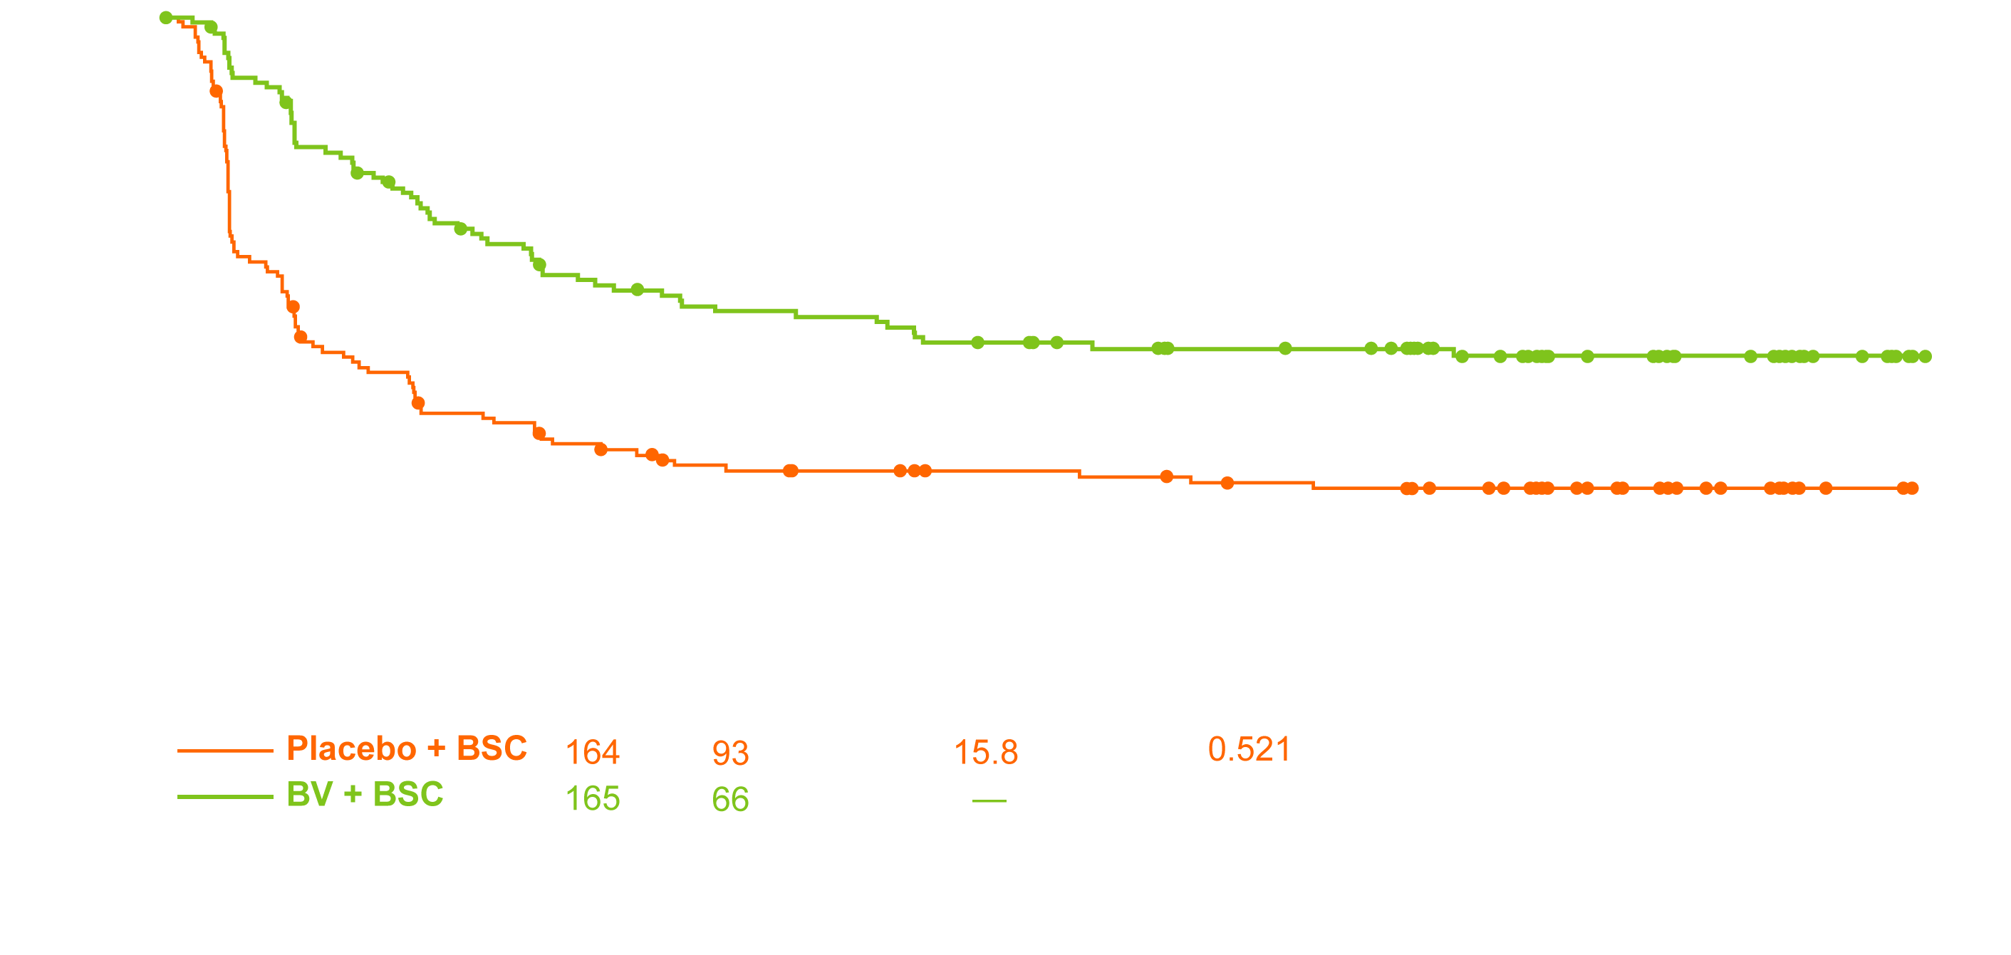
AETHERA: Updated Results at 5 Years of Follow-Up
Progression-free survival
Patients with ≥2 risk factors in the brentuximab vedotin (BV) arm experienced significantly higher PFS at 5 years than did patients in the placebo arm (HR, 0.424).
Compared to placebo, up-front consolidation with BV significantly delayed time to second subsequent therapy.
90% of patients with peripheral neuropathy (PN) in the BV arm continued to show improvement and/or resolution of their PN, the most common adverse event in patients receiving BV.
Moskowitz CH et al. Blood 2018;132(25):2639-42.

Slide 17
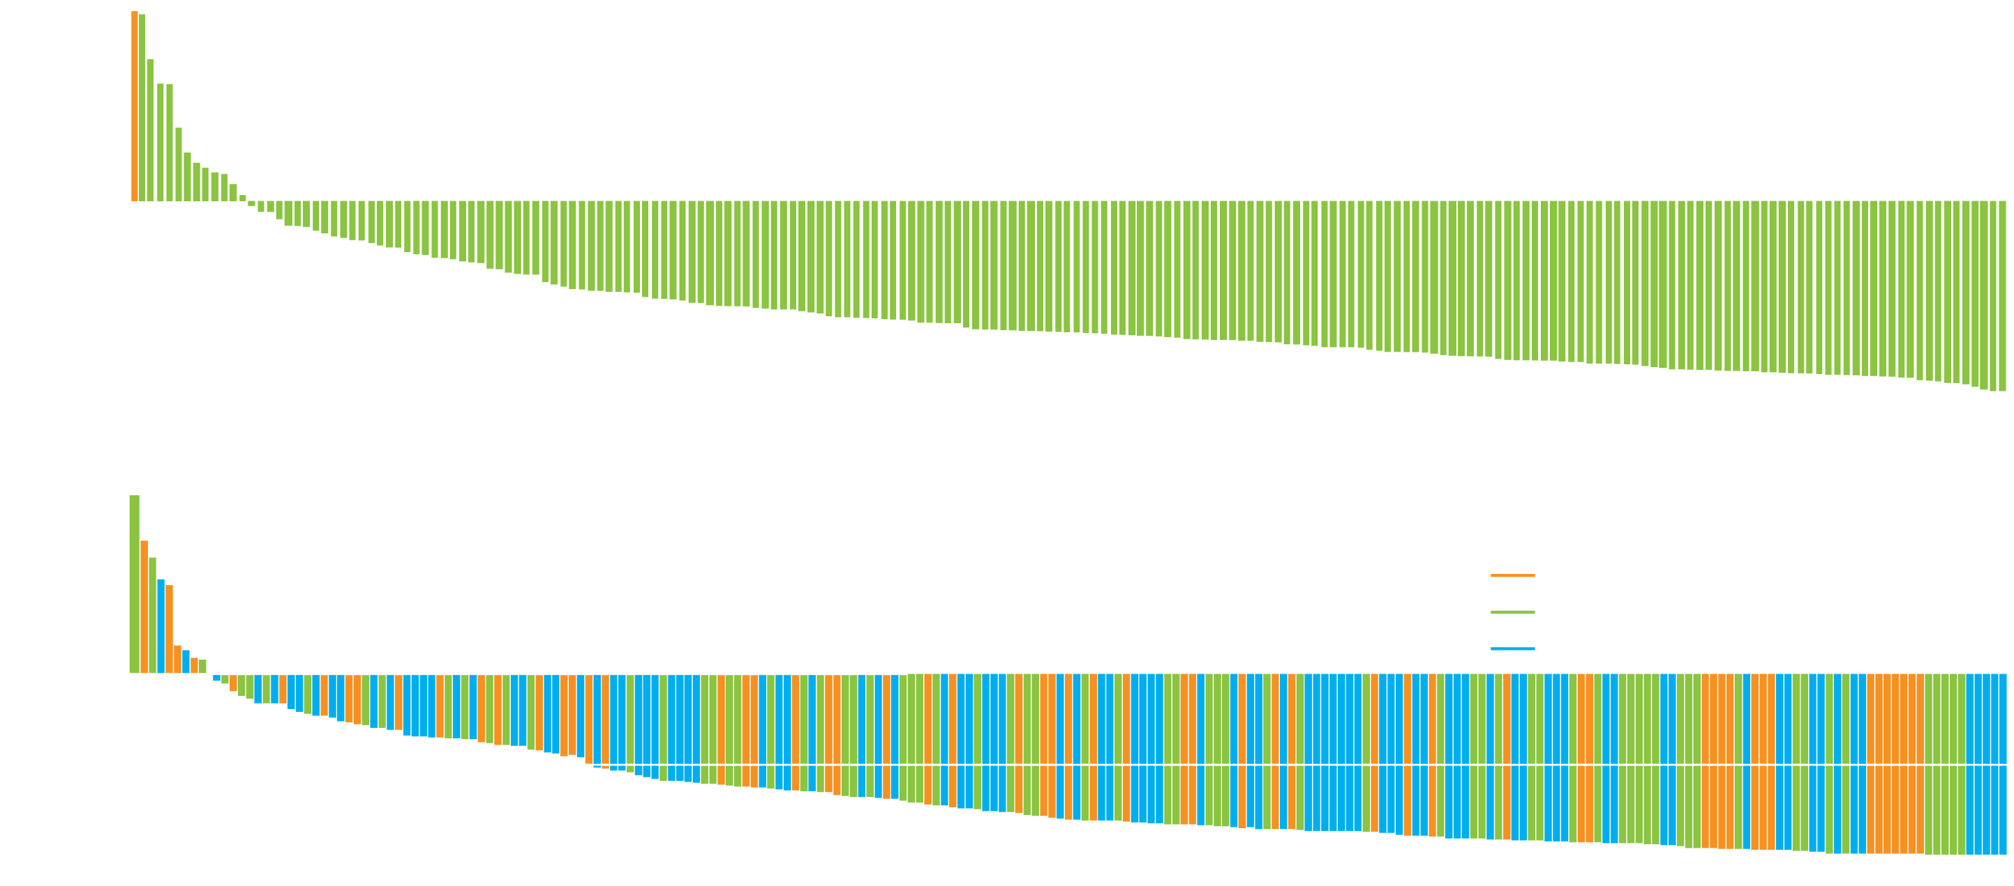
Immune Checkpoint Inhibitors in R/R HL
KEYNOTE-087 (pembrolizumab)
ORR: 69%
CheckMate 205 (nivolumab)
ORR: 69%
Chen R et al. J Clin Oncol 2017;35(19):2125-32; Armand P et al. J Clin Oncol 2018;36(14):1428-39.

Slide 18
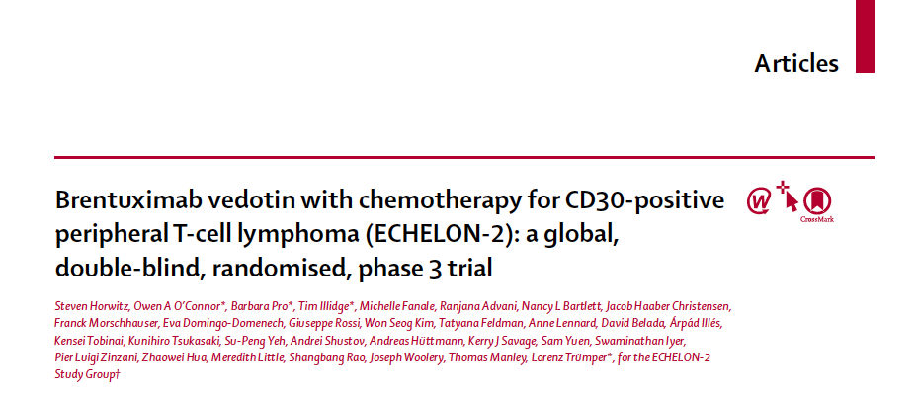
Lancet 2019;393(10168):229-40.

Slide 19
Mantle Cell Lymphoma

Slide 20
A man in his early 60s with Stage IV mantle cell lymphoma involving nodes above and below diaphragm, spleen and GI tract (Dr Abramson)
Ki-67: 60%, TP53 mutation
R-CHOP/R-HiDAC → autologous SCT
  CR, but relapsed 1 year later
Acalabrutinib
  PR: Stable for 9 months → rapid progression in nodes, soft tissue and bone
Venetoclax, with mixed response but overall progression of disease
Being considered for anti-CD19 CAR T-cell therapy on clinical trial

Slide 21
Ibrutinib Monotherapy in Relapsed/Refractory MCL:
Pooled Analysis from 3 Studies
Extended 3-year follow-up analysis
N = 370 patients with relapsed/refractory MCL in 3 studies
(PCYC-1104, SPARK, RAY)
ORR: 69.7% (CR: 27.0%, PR: 42.7%)
Median duration of response: 21.8 mo
Median PFS: 12.5 mo
Median OS: 26.7 mo
Rule S et al. Haematologica 2019;104(5):e211-4.

Slide 22
Phase II Trial of Ibrutinib/Rituximab for Relapsed/Refractory MCL:
Four-Year Follow-Up
N = 50 patients with relapsed/refractory MCL, treated with ibrutinib/rituximab
Median follow-up: 47 mo
Complete remission: 58%
Median PFS: 43 mo
Mostly Grade 1/2 toxicities (fatigue, diarrhea, nausea, arthralgias, myalgias)
Jain P et al. Br J Haematol 2018;182(3):404-11.

Slide 23
Select Ongoing Phase III Trials of Ibrutinib for Newly
Diagnosed MCL
TRIANGLE
Eligibility
Newly diagnosed MCL Stage II-IV (Ann Arbor) Can tolerate high-dose therapy Age 18-65
R-CHOP/R-DHAP → ASCT
R
R-CHOP/R-DHAP + ibrutinib → ASCT
R-CHOP/R-DHAP + ibrutinib
SHINE
Eligibility
Newly diagnosed MCL Stage II-IV (Ann Arbor) ≥65 years of age
Bendamustine + rituximab + placebo
R
Bendamustine + rituximab + ibrutinib
www.clinicaltrials.gov. Accessed May 2019.

Slide 24
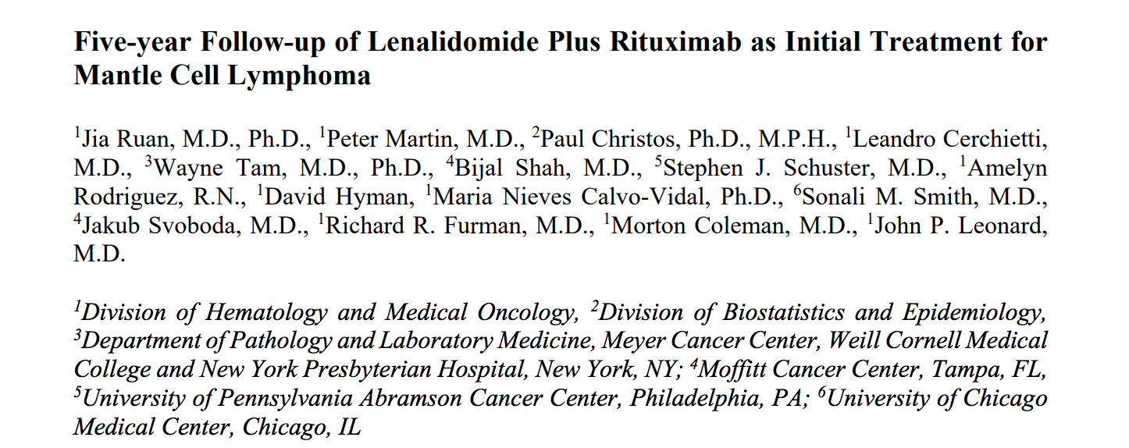
Blood 2018;132(19):2016-25.

Slide 25
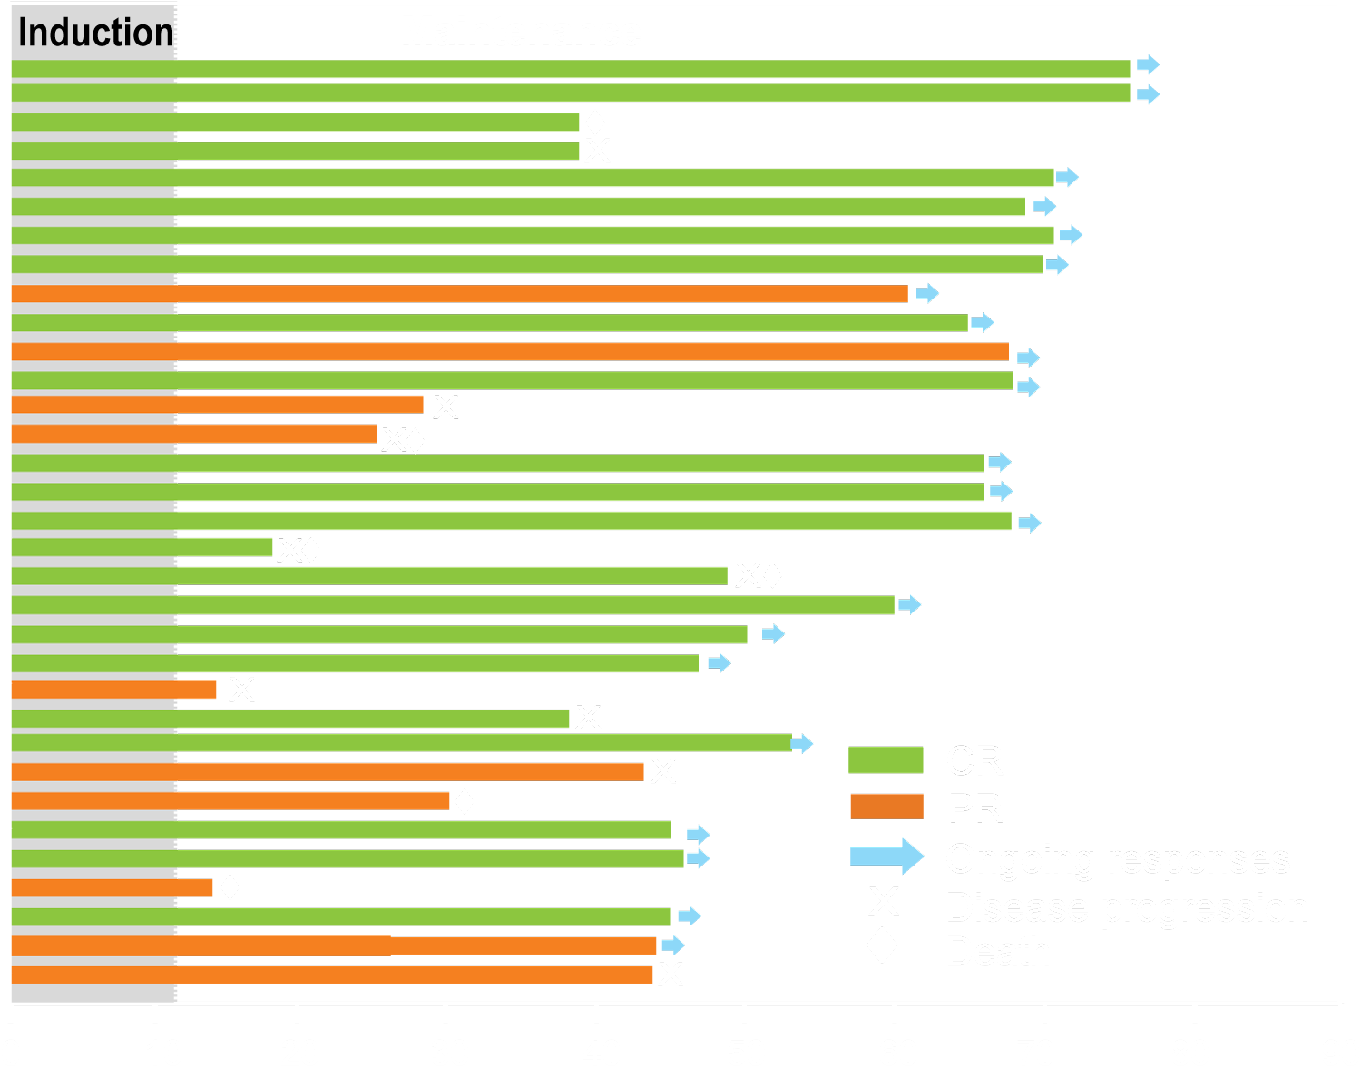
First-Line Lenalidomide + Rituximab in MCL: Response Duration and Select Adverse Events
Induction phase (select AEs)
Events (n = 38) | Any grade | Grade ≥3
Neutropenia | 68% | 42%
Thrombocytopenia | 29% | 11%
Anemia | 47% | 8%
Febrile neutropenia | 3% | 3%
Upper respiratory tract infection | 24% | 0%
Urinary tract infection | 11% | 0%
Diarrhea | 53% | 0%
n = 36
ORR: 92%
CR: 64%
PR: 28%
Subjects
Months
At median follow-up of 64 months, the 5-year PFS and OS were 63.9% and 77.4%, respectively.
Ruan J et al. Blood 2018;132(19):2016-25.

Slide 26
Acalabrutinib in Relapsed or Refractory Mantle Cell Lymphoma (ACE-LY-004): A Single-Arm, Multicentre,
Phase 2 Trial¹
Long-Term Follow-Up of Acalabrutinib Monotherapy in Patients with Relapsed/Refractory Mantle Cell Lymphoma²
¹ Wang M et al.
Lancet 2018;391(10121):659-67.
² Wang M et al.
Proc ASH 2018;Abstract 2876.

Slide 27
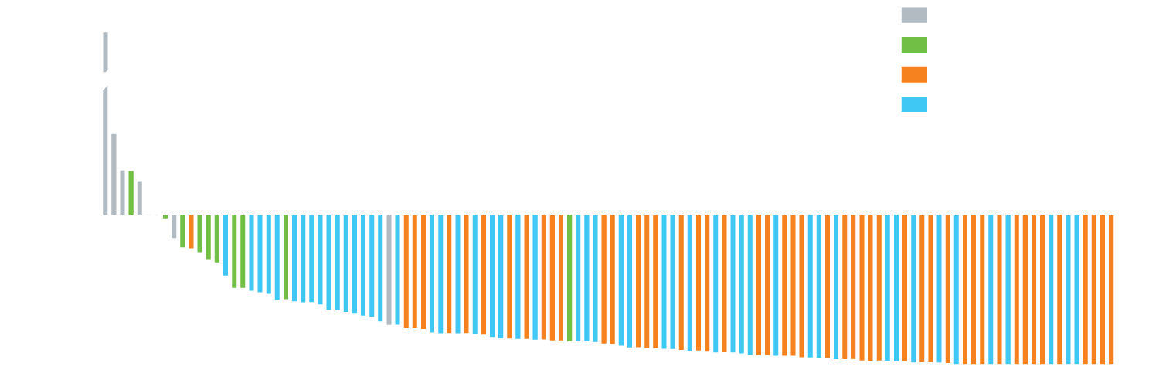
ACE-LY-004 Phase II Trial of Acalabrutinib: Response and Long-Term Follow-Up Results
Maximum change from baseline in the SPD of target lesions for all patients (n = 118)¹
Long-term follow-up >24 mo² | N = 124
Overall response rate Complete response Partial response | 81% 43% 38%
Median PFS | 19.5 mo
The AE profile was largely similar to earlier reporting, with limited additional safety events observed in an additional year of follow-up.²
¹ Wang M et al. Lancet 2018;391(10121):659-67; ² Wang M et al. Proc ASH 2018;Abstract 2876.

Slide 28
ACE-LY-004: Most Common Adverse Events
AEs occurring in ≥15% of all patients
Grade ≥3 AEs occurring in ≥5% of all patients
100
% of Patients
Wang M et al. Lancet 2018;391(10121):659-67; Proc ASH 2017;Abstract 155.

Slide 29
Select Ongoing Phase II or III Clinical Trials of Acalabrutinib in Mantle Cell Lymphoma
Setting | Trial identifier | Phase | N | Study arms | Estimated primary completion date
Newly diagnosed | NCT02972840 | III | 546 | Acalabrutinib + bendamustine/rituximab Placebo + bendamustine/rituximab | October 2022
 | NCT03863184 | II | 24 | Acalabrutinib + lenalidomide/rituximab | May 2022
Relasped/ refractory | NCT03946878 | II | 50 | Acalabrutinib + venetoclax | February 2024
www.clinicaltrials.gov. Accessed May 2019.

Slide 30
Efficacy of Venetoclax Monotherapy in Patients with Relapsed, Refractory Mantle Cell Lymphoma Post BTK Inhibition Therapy
Eyre T et al.
Proc EHA 2018;Abstract S855.

Slide 31
Venetoclax Monotherapy in BTK Inhibitor-Resistant MCL: Results Summary
N = 20 patients with relapsed/refractory MCL whose disease progressed on previous BTK inhibitor (BTKi) therapy
Clinical endpoint | Venetoclax (N = 20)
Overall response rate (ORR) Complete response rate | 60% 20%
Median duration of response | Not reached
Median PFS | 2.6 mo
Median OS | 4.3 mo
ORR among patients with responses to prior BTKi (n = 11) was higher than that among patients with primary resistance to BTKi (n = 9): 72.7% vs 44.4%
No cases of clinical TLS were observed
Eyre T et al. Proc EHA 2018;Abstract S855.

Slide 32
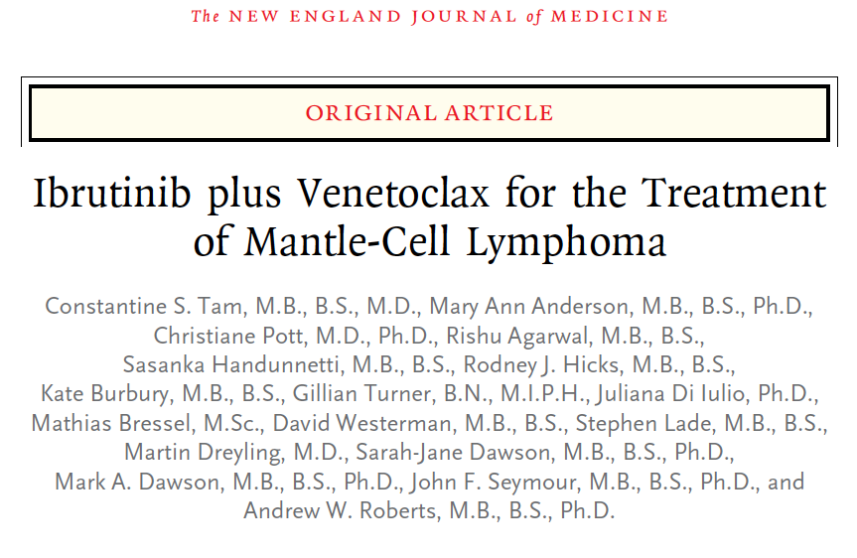
N Engl J Med 2018;378(13):1211-23.

Slide 33
SYMPATICO: A Phase III Trial of Ibrutinib Combined with Venetoclax for Mantle Cell Lymphoma
Trial identifier: NCT03112174 (Open)
Estimated enrollment: 287
Eligibility
Pathologically confirmed MCL with overexpression of cyclin D1 in association with other markers At least 1 but no more than 5 prior treatments No PR or better with most recent treatment Or Disease progression after most recent treatment
Ibrutinib + venetoclax
until PD or unacceptable toxicity
R
Ibrutinib + placebo
until PD or unacceptable toxicity
Primary endpoints: Time to occurrence of TLS and occurrence of dose-limiting toxicities (safety run-in period), progression-free survival
www.clinicaltrials.gov. Accessed May 2019.

Slide 34
SYMPATICO: Efficacy and Tolerability of Ibrutinib + Venetoclax for Mantle Cell Lymphoma
Best response | Without PET (n = 24) | With PET (n = 24)
CR | 16 (67%) | 17 (71%)
PR | 1 (4%) | 0
MRD status
MRD-negative | 16 (67%) | 9 (38%)
MRD not negative | 8 (33%) | 15 (62%)
Events (n = 24) | Any grade | Grade ≥3
Diarrhea | 83% | 12%
Nausea or vomiting | 71% | 0%
Bleeding or bruising | 54% | 4%
Neutropenia | 33% | 33%
Anemia | 29% | 12%
Peripheral sensory neuropathy | 21% | 0%
Tumor lysis syndrome | 8% | 8%
Atrial fibrillation | 8% | 8%
CR at week 16: without PET 42%, with PET 62%
Median PFS: not reached
OS rate: 79% at 12 months, 74% at 18 months
Tam CS et al. N Engl J Med 2018;378(13):1211-23.

Slide 35
Diffuse Large B-Cell Lymphoma

Slide 36
A man in his early 50s with Stage IVA DLBCL (Dr Smith)
R-CHOP: Response after 4 cycles, but significant progression after 6 cycles
R-ICE: Stable disease
R-GEMOX: Near-CR
Autologous SCT
  Recurrence (lungs, left inguinal region) 2 months after transplant
Treatment on 2 clinical trials, including ibrutinib/lenalidomide
CAR T on clinical trial
  Grade 2 neurotoxicity
  Grade 3 CRS but recovers
Currently, 2.5 years out from treatment
Notes:
Gujja Cut 02

Slide 37
A Global, Randomized, Placebo-Controlled, Phase 3 Study of Ibrutinib plus Rituximab, Cyclophosphamide, Doxorubicin, Vincristine, and Prednisone (RCHOP) in Patients with Previously Untreated Non-Germinal Center B-Cell-Like (GCB) Diffuse Large B-Cell Lymphoma (DLBCL)
Younes A et al.
Proc ASH 2018;Abstract 784.

Slide 38
High Efficacy of Lenalidomide plus R-CHOP (R2CHOP) Combination in First Line Treatment of Activated B-Cell (ABC) DLBCL Defined Using Gene-Expression Prophyling: A Combined Analysis from Two Phase 2 Trials
Castellino A et al.
Proc ASH 2018;Abstract 2962.

Slide 39
ROBUST: A Phase III Trial of Lenalidomide and R-CHOP versus
R-CHOP for Untreated ABC-Type DLBCL
Trial identifier: NCT02285062 (closed)
Lenalidomide + R-CHOP
Eligibility (570)
Untreated, ABC-type DLBCL
R
Placebo + R-CHOP
Primary endpoint: Progression-free survival
www.clinicaltrials.gov. Accessed May 2019.

Slide 40
Phase III ROBUST Trial of Lenalidomide + R-CHOP for Newly Diagnosed ABC Subtype DLBCL Fails to Meet PFS Endpoint
Press Release — April 25, 2019
The phase III ROBUST trial evaluating lenalidomide plus rituximab, cyclophosphamide, doxorubicin, vincristine and prednisone (R-CHOP) chemotherapy (R²-CHOP) in patients with previously untreated activated
B-cell (ABC) subtype diffuse large B-cell lymphoma (DLBCL) did not meet the primary endpoint of demonstrating superiority in progression-free survival (PFS) compared to placebo plus R-CHOP. The safety profile of R²-CHOP was consistent with the known safety profiles of the individual medicines, and no new safety signals were identified with the combination.
https://ir.celgene.com/press-releases/press-release-details/2019/Celgene-Reports-First-Quarter-2019-Operating-and-Financial-Results/default.aspx

Slide 41

Variations in CAR Constructs
Lisocabtagene
maraleucel
(JCAR017)
Axicabtagene
ciloleucel
Tisagenlecleucel
FMC63
scFV
scFV
Hinge
CD8
Spacer
CD28
4-1BB
4-1BB
CD3 zeta
CD3 zeta
CD3 zeta

Slide 42
Three Major CAR T-Cell Products for DLBCL
 | Axicabtagene ciloleucel | Tisagenlecleucel | Lisocabtagene maraleucel (JCAR017)
Construct | Anti-CD19-CD28-CD3z | Anti-CD19-41BB-CD3z | Anti-CD19-41BB-CD3z
T cells | Bulk | Bulk | 1:1 CD4:CD8
Dose | 2 x 10⁶/kg (max 2 x 10⁸) | 0.6 to 6.0 x 10⁸ | DL1: 0.5 x 10⁷ DL2: 1.0 x 10⁸
Bridging tx | None allowed | 93% | 72%
Lymphodepletion | Flu/Cy 500/30 x 3d | Flu/Cy 250/25 x 3d Or BR | Flu/Cy 300/30 x 3d
Treatment locale | Inpatient only | Inpatient or outpatient | Inpatient or outpatient
Approval status | FDA approved for DLBCL, high-grade B-cell lymphoma, transformed FL, primary mediastinal B-cell lymphoma | FDA approved for pediatric ALL, DLBCL, high-grade B-cell lymphoma, transformed FL | Not yet FDA approved

Slide 43
Summary of Pivotal CAR T-Cell Therapy Trials in R/R DLBCL
 | ZUMA-1 (N = 108) | JULIET (N = 93) | TRANSCEND-NHL-001 (N = 102)
Agent | Axicabtagene ciloleucel | Tisagenlecleucel | Lisocabtagene maraleucel
Median prior therapies (range) | NR (1-5+) | 3 (1-6) | 3 (1-8)
ORR | 83% | 52% | 75%
CR | 58% | 40% | 55%
CR (>6 months) | 40% | 30% | 31%
Schuster SJ et al. N Engl J Med 2019;380(1):45-56; Borchmann P et al. Proc EHA 2018;Abstract S799; Abramson JS et al. Proc ASCO 2018;Abstract 7505; Locke FL et al. Lancet Oncol 2019;20(1):31-42; Locke FL et al. Proc ASCO 2018;Abstract 3003.

Slide 44
Approved CAR T-Cell Therapy in DLBCL
Approval dates
Axicabtagene ciloleucel (axi-cel): 10/18/17
Tisagenlecleucel: 5/1/18
Mechanism of action
CD19-targeted chimeric antigen receptor (CAR) T-cell immunotherapy
Indication
For the treatment of adult patients with relapsed/refractory large B-cell lymphoma after 2 or more lines of systemic therapy, including DLBCL not otherwise specified, high-grade B-cell lymphoma and DLBCL arising from follicular lymphoma
  Axi-cel is also approved to treat primary mediastinal large B-cell lymphoma
Recommended dose
One infusion of (CAR)-positive viable T cells after lymphodepleting chemotherapy
Tisagenlecleucel package insert, May 2018; Axicabtagene ciloleucel package insert, October 2017

Slide 45
Comparison of Axicabtagene Ciloleucel in ZUMA-1 and Treatment in the “Real World” at 17 US Centers
 | ZUMA-1 | This study
N infused patients | 108 | 165
Patients meeting ZUMA-1 eligibility criteria | 100% | 51%
Age, median (range) | 58 (23-76) | 59 (21-82)
ECOG 0 or 1 | 100% | 84%
Prior autologous transplant | 23% | 31%
DLBCL including HGBCL, not tFL or PMBCL | 78% | 61%
ORR/CR | 82%/58% (Best) | 79%/50% (Day 30)
Grade 3 or higher toxicity | CRS 13%/NEs 31% | CRS 7%/NEs 31%
Nastoupil LJ et al. Proc ASH 2018;Abstract 91.

Slide 46
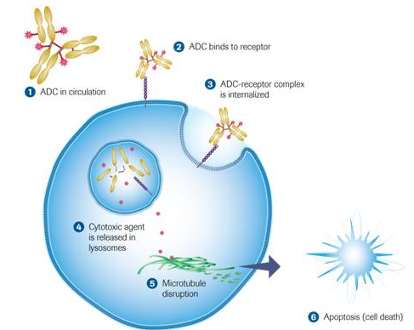
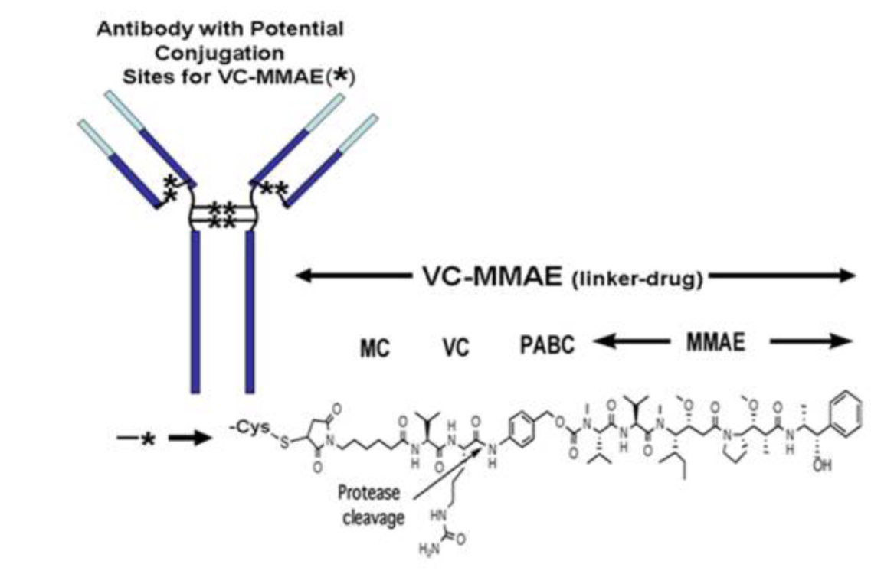
Mechanism of Action of Polatuzumab Vedotin
Polatuzumab vedotin is an antibody-drug conjugate (ADC) consisting of monomethyl auristatin E (MMAE) conjugated to anti-CD22 and CD79b monoclonal antibodies via a cleavable linker molecule
ADC binds to receptor
Antibody with potential
conjugation sites
for VC-MMAE ( )
ADC in circulation
ADC-receptor complex
is internalized
*
VC-MMAE (linker-drug)
MC
VC
PABC
MMAE
Protease
cleavage
Apoptosis
(cell death)
Morschhauser F et al. Proc ASCO 2014;Abstract 8519.

Slide 47
Randomized Phase 2 Trial of Polatuzumab Vedotin (Pola) with Bendamustine and Rituximab (BR) in Relapsed/Refractory (R/R) FL and DLBCL¹
Polatuzumab Vedotin (Pola) plus Bendamustine (B) with Rituximab (R) or Obinutuzumab (G) in Relapsed/Refractory (R/R) Diffuse Large B-Cell Lymphoma (DLBCL): Updated Results of a Phase (Ph) Ib/II Study²
¹ Sehn LH et al.
Proc ASCO 2018;Abstract 7507.
² Sehn LH et al.
Proc ASH 2018;Abstract 1683.

Slide 48
Polatuzumab Vedotin, an Anti-CD79b Antibody-Drug Conjugate, in Combination with BR for R/R DLBCL
Patients with DLBCL | BR (n = 40) | Pola-BR (n = 40) | HR | p-value
Median PFS | 2.0 mo | 7.6 mo | 0.34 | <0.0001
Median OS | 4.7 mo | 12.4 mo | 0.42 | 0.0023
ORR at EOT by IRC | 18% | 45% | — | 0.008
CR | 15% | 40% | — | 0.012
EOT = end of treatment; IRC = independent review committee
Sehn LH et al. Proc ASCO 2018;Abstract 7507; Sehn LH et al. Proc ASH 2018;Abstract 1683.

Slide 49
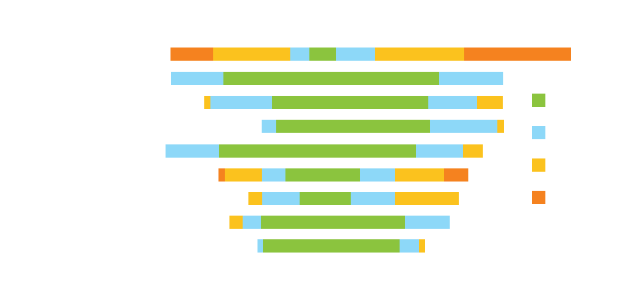
Adverse Events with Polatuzumab Vedotin and BR for R/R DLBCL
BR
Pola-BR
Grade 1
Grade 2
Grade 3
Grade 4
Sehn LH et al. Proc ASCO 2018;Abstract 7507; Sehn LH et al. Proc ASH 2018;Abstract 1683.

Slide 50
POLARIX: An Ongoing Phase III Trial of Polatuzumab Vedotin with
R-CHP versus R-CHOP for Patients with Untreated DLBCL
Trial identifier: NCT03274492 (Open)
Polatuzumab vedotin + R-CHP
Eligibility (target N = 875)
CD20-positive, untreated DLBCL
R
Placebo + R-CHOP
Primary endpoint: Progression-free survival
www.clinicaltrials.gov. Accessed May 2019.

Slide 51
Pembrolizumab in Patients with Relapsed or Refractory Primary Mediastinal Large B-Cell Lymphoma (PMBCL): Data from the KEYNOTE-013 and KEYNOTE-170 Studies
Armand P et al.
Proc ASH 2018;Abstract 228.

Slide 52
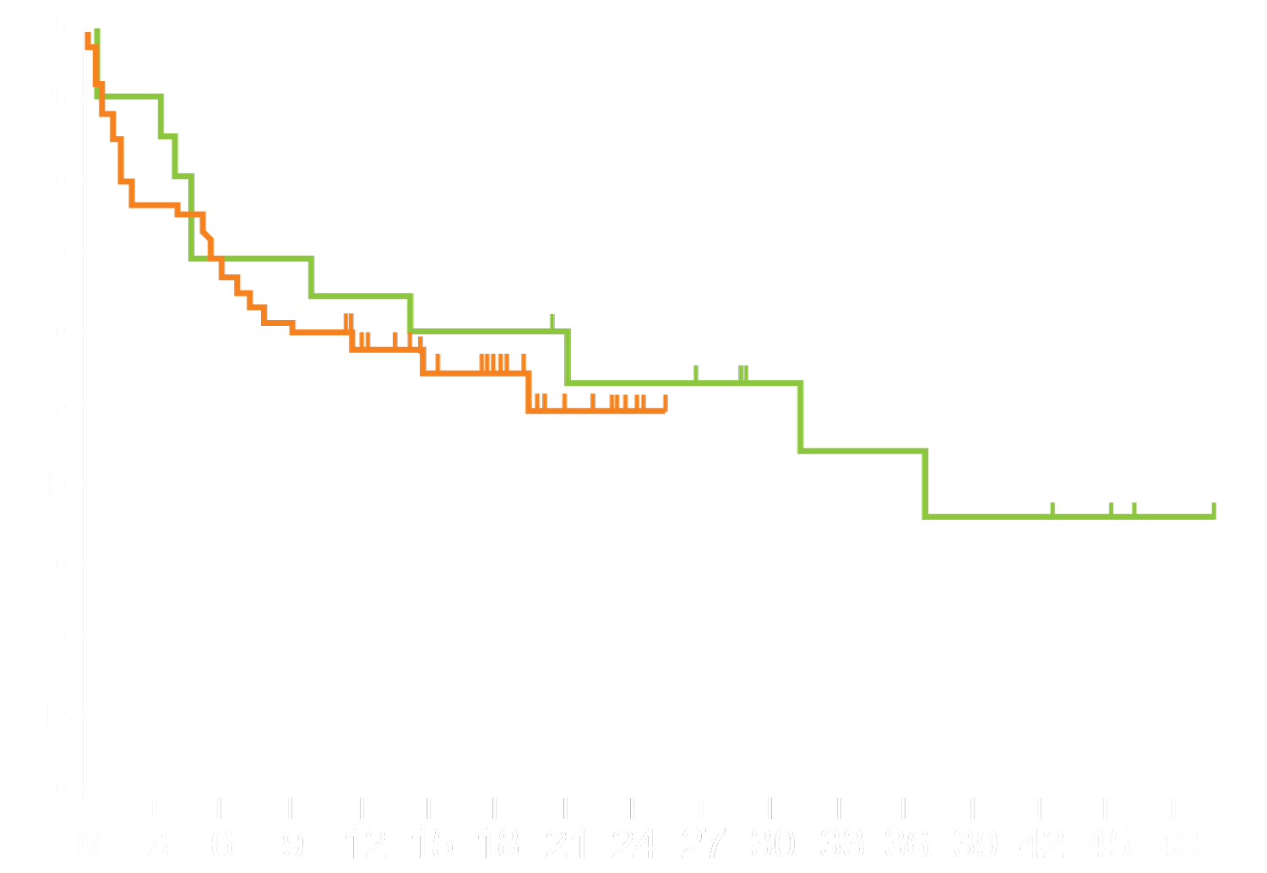
KEYNOTE-013/KEYNOTE-170: Pembrolizumab for Relapsed or Refractory PMBCL
 | KEYNOTE-013 (N = 21) | KEYNOTE-170 (N = 53)
ORR | 48% | 45%
CR | 33% | 13%
Median follow-up | 29.1 mo | 12.5 mo
Median DOR | NR | NR
Median OS | 31.4 mo | NR
12-mo OS | 65% | 58%
Median PFS | 10.4 mo | 5.5 mo
12-mo PFS | 47% | 38%
Overall survival, %
Time, months
KEYNOTE-170: 30 (57%) patients experienced treatment-related AEs (TRAEs)
  Twelve (23%) patients experienced Grade 3 or 4 TRAEs (9% with Grade 3 and 4% with Grade 4 neutropenia)
  Six (11%) patients experienced immune-mediated AEs, including 1 (2%) with Grade 4 pneumonitis
Armand P et al. Proc ASH 2018;Abstract 228.

Slide 53
FDA Approves Pembrolizumab for R/R PMBCL
Press Release – January 28, 2019
On June 13, 2018, the Food and Drug Administration granted accelerated approval to pembrolizumab for the treatment of adult and pediatric patients with refractory primary mediastinal large B-cell lymphoma (PMBCL), or who have relapsed after two or more prior lines of therapy.
Approval was based on data from 53 patients with relapsed or refractory PMBCL enrolled in a multicenter, open-label, single-arm trial, KEYNOTE‑170 (NCT02576990).
https://www.fda.gov/drugs/resources-information-approved-drugs/fda-approves-pembrolizumab-treatment-relapsed-or-refractory-pmbcl

Slide 54
T-Cell Lymphoma

Slide 55
A woman in her early 70s with Stage IIIB peripheral T-cell lymphoma NOS, with 40% CD30 expression (Dr Abramson)
Brentuximab vedotin-CHP
  Peripheral neuropathy
  Dose reduction of brentuximab starting with cycle 4
  CR after 6 cycles of treatment
Now followed with surveillance

Slide 56
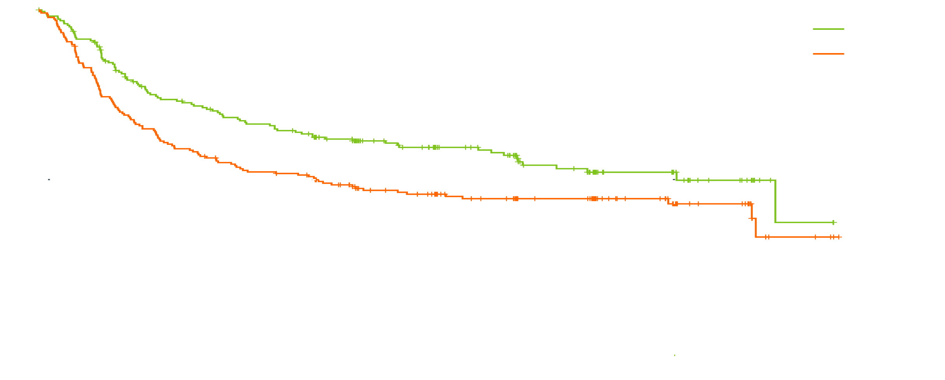
ECHELON-2: Efficacy and Safety Summary
HR 0.71
p = 0.0110
Progression-free survival (%)
Median in CHOP
20.8 months
Median in BV + CHP
48.2 months
Time from randomization (months)
Median OS was not reached in either subgroup (p = 0.0244, HR 0.66), though it was numerically in favor of BV + CHP for key patient subgroups analyzed.
Adverse events, including incidence and severity of febrile neutropenia (BV + CHP = 18%; CHOP = 15%) and peripheral neuropathy (BV + CHP = 52%; CHOP = 55%) were similar between groups.
  Fatal adverse events: BV + CHP = 7 (3%); CHOP = 9 (4%)
Horwitz S et al. Lancet 2019;393(10168):229-40.

Slide 57
FDA Approval of BV in Combination with Chemotherapy for Adults with Previously Untreated Systemic Anaplastic Large Cell Lymphoma (sALCL) or Other CD30-Expressing Peripheral T-Cell Lymphomas (PTCL)
Press Release – November 16, 2018
The FDA has approved BV in combination with CHP chemotherapy (cyclophosphamide/doxorubicin/prednisone) for adults with previously untreated sALCL or other CD30-expressing PTCL, including angioimmunoblastic T-cell lymphoma and PTCL not otherwise specified. The approval is based on the successful outcome of the Phase III ECHELON-2 clinical trial that compared BV with CHP to CHOP (cyclophosphamide/doxorubicin/vincristine/prednisone). The FDA granted breakthrough therapy designation and priority review to this supplemental biologics license application and reviewed it under the Real-Time Oncology Review pilot program leading to approval less than 2 weeks after submission of the completed application.
https://finance.yahoo.com/news/seattle-genetics-announces-fda-approval-155200190.html

Slide 58

An 80-year-old patient with MCL initially treated with BR followed by 2 years of rituximab maintenance experiences disease relapse 3 years later. What would you recommend?
Ibrutinib
Acalabrutinib
Lenalidomide
Lenalidomide + rituximab
Bortezomib
Bortezomib + rituximab
Venetoclax
Venetoclax + rituximab
Other

