Slide 1
Please note, these are the actual video-recorded proceedings from the live CME event and may include the use of trade names and other raw, unedited content.

Slide 2
Meet The Professors Clinical Investigator Perspectives on Key Questions and Emerging Research in the Management of Lymphoma, Chronic Lymphocytic Leukemia and Multiple Myeloma Sunday, June 2, 2019 7:00 PM - 9:30 PM Chicago, Illinois
Faculty
Jeremy Abramson, MD
Bruce D Cheson, MD
Ann S LaCasce, MD, MMSc
Noopur Raje, MD
Paul G Richardson, MD
Sonali M Smith, MD
Moderator Neil Love, MD

Slide 3
Disclosures for Moderator Neil Love, MD
Dr Love is president and CEO of Research To Practice. Research To Practice receives funds in the form of educational grants to develop CME activities from the following commercial interests: AbbVie Inc, Acerta Pharma — A member of the AstraZeneca Group, Adaptive Biotechnologies, Agendia Inc, Agios Pharmaceuticals Inc, Amgen Inc, Ariad Pharmaceuticals Inc, Array BioPharma Inc, Astellas Pharma Global Development Inc, AstraZeneca Pharmaceuticals LP, Bayer HealthCare Pharmaceuticals, Biodesix Inc, bioTheranostics Inc, Boehringer Ingelheim Pharmaceuticals Inc, Boston Biomedical Inc, Bristol-Myers Squibb Company, Celgene Corporation, Clovis Oncology, Daiichi Sankyo Inc, Dendreon Pharmaceuticals Inc, Eisai Inc, Exelixis Inc, Foundation Medicine, Genentech, Genmab, Genomic Health Inc, Gilead Sciences Inc, Guardant Health, Halozyme Inc, ImmunoGen Inc, Incyte Corporation, Infinity Pharmaceuticals Inc, Ipsen Biopharmaceuticals Inc, Janssen Biotech Inc, administered by Janssen Scientific Affairs LLC, Jazz Pharmaceuticals Inc, Kite Pharma Inc, Lexicon Pharmaceuticals Inc, Lilly, Loxo Oncology Inc, a wholly owned subsidiary of Eli Lilly & Company, Merck, Merrimack Pharmaceuticals Inc, Myriad Genetic Laboratories Inc, Natera Inc, Novartis, Oncopeptides, Pfizer Inc, Pharmacyclics LLC, an AbbVie Company, Prometheus Laboratories Inc, Puma Biotechnology Inc, Regeneron Pharmaceuticals Inc, Sandoz Inc, a Novartis Division, Sanofi Genzyme, Seattle Genetics, Sirtex Medical Ltd, Spectrum Pharmaceuticals Inc, Taiho Oncology Inc, Takeda Oncology, Tesaro, Teva Oncology, Tokai Pharmaceuticals Inc and Tolero Pharmaceuticals.
Notes:
3
3
3

Slide 4
RTP ASCO Symposia

Slide 5
The patients I saw today…
57 | F | Low grade gastric NET - octreotide
64 | M | MM - Post ASCT on lenalidomide maintenance
66 | M | Castrate-resistant metastatic prostate cancer - PD on enzalutamide, to start docetaxel
42 | F | Breast cancer, refused adjuvant chemotherapy, now with metastatic disease in the right axilla and bone.
66 | F | CML – CR to imatinib
98 | F | MDS – receiving ESAs
58 | F | Glioblastoma multiforme - Maintenance temozolomide and optune device
85 | F | Recurrent atypical meningioma on observation
60 | F | Metastatic ER + HER2 - breast cancer - almost complete response in the breast after 4 months
82 | M | Breast cancer 8 years ago - followup
48 | M | CML – considering third line bosutinib
61 | M | Primary appendyceal low grade cancer - surgery
62 | F | IgM MGUS for years, now with pancytopenia, bone marrow biopsy showing low grade NHL (possibly WM)
38 | F | mCRC – 2L FOLFIRI/Bevacizumab
59 | M | Lupus anticoagulant/Pulmonary embolism - rivaroxaban
87 | F | Multiple myeloma -bortezomib/dexamethasone/ denosumab
67 | M | Melanoma – PD on ipi/nivo, pt not doing well
67 | F | Metastatic RCC – cape/bev maintenance
68 | M | Metastatic lung adenocarcinoma, PD-L1 70% - 1L pembro, SD for 3 months
59 | M | Stage IIIB Lung adenocarcinoma - Consolidation durvalumab post XRT/Chemo
59 | F | Breast cancer 11 years ago – follow up
86 | M | Anemia secondary to chronic kidney disease - ESA
48 | F | Recurrent cervical SCC – CR to cis/pac/bev, on bev maint 18 months later

Slide 6
The patients I saw today…
79 | M | CLL (serial monitoring of counts) and carcinoid tumor of the lung (active surveillance imaging)
55 | F | Stage 1 node-negative TNBC - Adjuvant chemo
64 | M | AML - Admitted for new onset severe pancytopenia; >50% blasts in marrow. Initiation of Induction chemo
79 | F | Metastatic NSCLC, completed carbo, nab-P, pembrolizumab, now on maintenance pembro
82 | M | Metastatic bladder cancer receiving 1st-line atezolizumab; Tolerating well, with stable disease
50 | M | Metastatic GIST on sunitinib since 2015
45 | M | Newly diagnosed Stage IIIC rectal cancer, currently on neoadjuvant FOLFOX. Plan for subsequent chemoRT and possible resection. Non-compliance
86 | M | Follicular Lymphoma - rituximab
74 | M | Locally advanced, distal esophageal cancer on concurrent chemoRT
72 | M | Hodgkin lymphoma - Brentuximab vedotin induction for 2 cycles with planned AVD x 4 to follow
77 | M | Metastatic NSCLC post carbo, nab-P, pembrolizumab due to start pembro maintenance
81 | F | Locally advanced NSCLCa-N2, refused chemo. Definitive XRT, refused durvalumab consolidation
88 | F | DLBCL dx May 2018, refused chemo. Rituximab + prednisone ~8wks, complete remission. Now, relapsed disease in CNS but refuses WBRT; hospice
55 | M | Gastric cancer receiving FOLFOX
82 | M | Rectal cancer treatment ~10yrs ago - follow-up
57 | M | CLL previously monitored, now with constitutional symptoms, weight loss and increasing WBC
73 | F | Extensive stage SCLC diagnosed 2014, Relapsed in 2017, XRT with CDDP/VP-16. Remains in remission
45 | M | Sokal high risk CML on dasatinib 75mg due to severe thrombocytopenia, tolerating much better, in CcyR
81 | F | S/p lobectomy for incidentally diagnosed Stage 1A NSCLCa. No adjuvant treatment required
55 | F | Newly diagnosed ER/PR-pos, HER2-neg locally advanced, node+ lobular carcinoma s/p bilat mastectomy. Plan: Adjuvant chemo, XRT, hormonal rx

Slide 7
Agenda
Module 1 – Newly Diagnosed and Relapsed/Refractory Multiple Myeloma — Dr Raje and Dr Richardson
Module 2 – Chronic Lymphocytic Leukemia and Follicular Lymphoma — Dr Cheson and Dr LaCasce
Module 3 – Hodgkin and Other Lymphomas — Dr Abramson and Dr Smith

Slide 8
Module 1: Newly Diagnosed and Relapsed/Refractory Multiple Myeloma

Slide 9
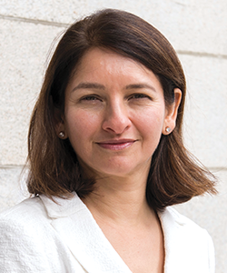
Noopur Raje, MD Director, Center for Multiple Myeloma Massachusetts General Hospital Cancer Center Professor of Medicine Harvard Medical School Boston, Massachusetts

Slide 10
Disclosures for Noopur Raje, MD
Consulting Agreements | Amgen Inc, Bristol-Myers Squibb Company, Celgene Corporation, Janssen Biotech Inc, Merck, Takeda Oncology
Contracted Research | AstraZeneca Pharmaceuticals LP

Slide 11
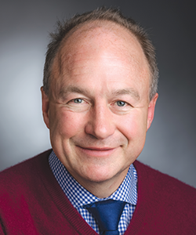
Paul G Richardson, MD Clinical Program Leader Director of Clinical Research Jerome Lipper Multiple Myeloma Center Department of Medical Oncology Dana-Farber Cancer Institute RJ Corman Professor of Medicine Harvard Medical School Boston, Massachusetts

Slide 12
Disclosures for Paul G Richardson, MD
Advisory Committee | Amgen Inc, Celgene Corporation, Janssen Biotech Inc, Karyopharm Therapeutics, Oncopeptides, Takeda Oncology
Contracted Research | Bristol-Myers Squibb Company, Celgene Corporation, Oncopeptides, Takeda Oncology

Slide 13
A man in his early 80s with smoldering multiple myeloma (Dr Raje)
Diagnosed with smoldering multiple myeloma 4 years ago
Increasing anemia (hematocrit 33, Hb 11, normal WBC and platelet count)
SPEP: IgG kappa M band 2.2 gm/dl → 3.5
Multiple lytic lesions and a bone marrow confirmed 30% plasmacytosis
Normal FISH and cytogenetics; hyperdiploidy
RVD lite x 9 cycles → maintenance lenalidomide x 1 year → VGPR
Discontinued lenalidomide due to increasing diarrhea
VGPR x 2 years
Increasing anemia and rising M protein, low-dose CT: Stable
Lenalidomide, ixazomib and dexamethasone

Slide 14
Updated Risk Stratification Model for Smoldering Multiple Myeloma (SMM) Incorporating the Revised IMWG Diagnostic Criteria
Miguel J et al. ASCO 2019;Abstract 8000.
Hematologic Malignancies – Plasma Cell Dyscrasias Oral Session
Sunday, June 2nd, 9:45-9:57 AM, E451

Slide 15
ECOG-E3A06: A Phase III Trial of Lenalidomide versus Observation Alone for Patients with Asymptomatic High-Risk Smoldering Multiple Myeloma
Trial identifier: NCT01169337 (Closed)
Eligibility
Asymptomatic, high-risk smoldering multiple myeloma Measurable M-protein levels No skeletal lytic lesions or hypercalcemia No prior or concurrent systemic or radiation therapy for myeloma
Lenalidomide
R
Observation
Until progression to symptomatic myeloma
Primary endpoint: Progression-free survival
www.clinicaltrials.gov. Accessed May 2019.

Slide 16
E3A06: Randomized Phase III Trial of Lenalidomide versus Observation Alone in Patients with Asymptomatic High-risk Smoldering Multiple Myeloma
Lonial S et al. ASCO 2019;Abstract 8001
Hematologic Malignancies – Plasma Cell Dyscrasias Oral Session
Sunday, June 2nd, 9:57-10:09 AM, E451

Slide 17
A woman in her mid-70s with high-risk multiple myeloma (Dr Richardson)
2/17: Multiple myeloma
FISH with TP53 deletion, monosomy 13, IgH rearrangement, gains of chromosome 5, 9, 15; normal karyotype
Skeletal survey: No lytic lesions
2/17: RVD x 10 → Bortezomib/dex maintenance x 3 → PD

Slide 18
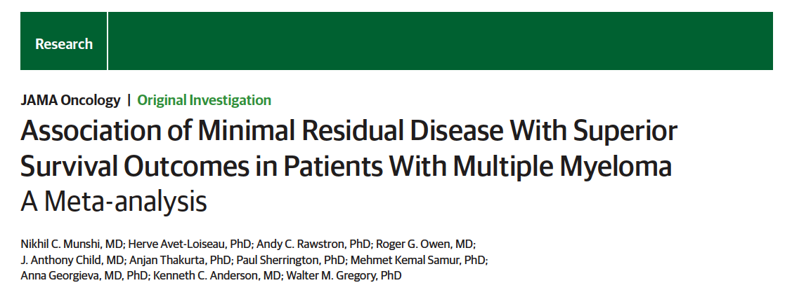
JAMA Oncol 2017;3(1):28-35.

Slide 19
Effect of Minimal Residual Disease Status on Survival Among Complete Responders: Meta-Analysis of 21 Studies
PFS
OS
MRD+
n = 186
Cumulative Surviving, %
PFS, %
MRD-
n = 396
MRD-
n = 430
MRD+
n = 178
Time, y
Time, y
Munshi NC et al. JAMA Oncol 2017;3(1):28-35.

Slide 20
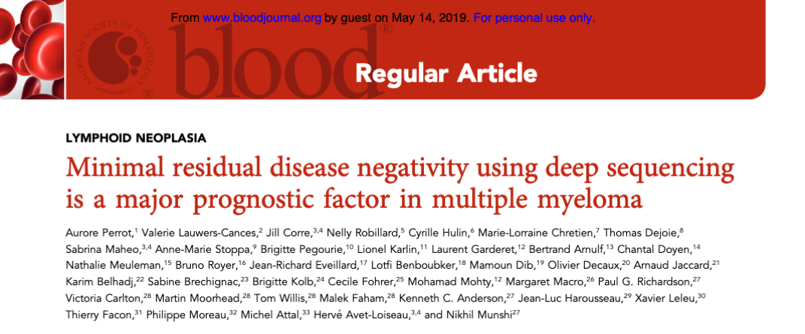
Blood 2018;132(23):2456-64.

Slide 21
IFM 2009: MRD Status and Survival Analyses
PFS by MRD Status at Start of Maintenance
PFS by MRD Status After 12 Months of Maintenance
n = 90
n = 92
Patients (%)
HR 0.22
P < 0.001
Patients (%)
HR 0.18
P < 0.001
n = 276
n = 147
MRD negative Median: Not reached
MRD positive Median: 29 mo
MRD negative Median: Not reached
MRD positive Median: 20 mo
Time since MRD assessment (months)
Time since MRD assessment (months)
MRD status was a strong prognostic indicator for PFS and overall survival (OS HR 0.24, p = 0.001).
MRD negativity was associated with a higher probability of prolonged PFS regardless of treatment group (RVD vs transplant), cytogenetic risk profile or ISS disease stage at diagnosis. These results were similar after completion of maintenance therapy.
HR 0.56;
P < 0.0001
Perrot A et al. Blood 2018;132(23):2456-64.

Slide 22
First NGS-Based Test to Detect Minimal Residual Disease Is Authorized by the FDA Press Release – September 28, 2018
“The US Food and Drug Administration has permitted marketing of a NGS-based test for minimal residual disease (MRD) in patients with acute lymphoblastic leukemia (ALL) or multiple myeloma.
Along with this authorization, the FDA is establishing criteria, called special controls, which clarify the agency’s expectations in assuring the accuracy, reliability and effectiveness of tests intended to be used as an aid to measure MRD to assess the change in burden of disease during and after treatment. These special controls, when met along with general controls, provide a reasonable assurance of safety and effectiveness for these tests.”
https://www.fda.gov/news-events/press-announcements/fda-authorizes-first-next-generation-sequencing-based-test-detect-very-low-levels-remaining-cancer

Slide 23
Efficacy of Carfilzomib Lenalidomide Dexamethasone (KRd) with or without Transplantation in Newly Diagnosed Myeloma According to Risk Status: Results from the FORTE Trial
Gay F et al. ASCO 2019;Abstract 8002.
Hematologic Malignancies – Plasma Cell Dyscrasias Oral Session
Sunday, June 2nd, 10:09 AM - 10:21 AM, E451

Slide 24
Phase 3 Randomized Study of Daratumumab (DARA) + Bortezomib/Thalidomide/Dexamethasone (D-VTd) vs VTd in Transplant-Eligible (TE) Newly Diagnosed Multiple Myeloma (NDMM): CASSIOPEIA Part 1 Results
Moreau P et al. ASCO 2019;Abstract 8003.
Hematologic Malignancies – Plasma Cell Dyscrasias Oral Session
Sunday, June 2nd, 10:45 AM - 10:57 AM, E451

Slide 25
Phase 3 Randomized Study of Daratumumab plus Lenalidomide and Dexamethasone (D-Rd) versus Lenalidomide and Dexamethasone (Rd) in Patients with Newly Diagnosed Multiple Myeloma (NDMM) Ineligible for Transplant (MAIA)
Facon T et al. Proc ASH 2018;Abstract LBA-2.

Slide 26
MAIA Trial Design
DRd:
Dara 16 mg/kg IV weekly x 8 wk, then QOW x 16 wk then q4wk
Len 25 mg PO days 1-21
Dex 40 mg PO or IV qwk
Primary endpoint:
PFS
Secondary endpoints:
TTP, PFS2, TTNT
ORR, rates of sCR, CR, >VGPR
Time to response, DOR
MRD
HRQoL
Safety
Key eligibility criteria
Symptomatic, measurable MM Previously untreated Not considered for ASCT ECOG 0-2
1:1 Randomization (N = 744)
Treatment continues until documented disease progression, unacceptable toxicity or end of study
Rd:
Len 25 mg PO days 1-21
Dex 40 mg PO or IV qwk
Facon F et al. Proc ASH 2018;Abstract LBA-2.

Slide 27
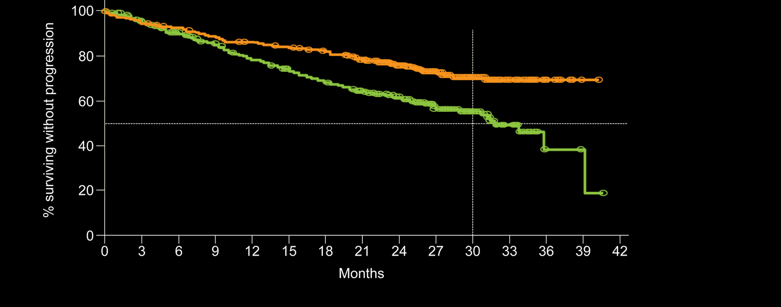
MAIA: Results Summary of D-Rd versus Rd in Transplant- Ineligible Newly Diagnosed Multiple Myeloma
30 mo
71%
D-Rd
Median: not reached
56%
Rd
Median: 31.9 mo
HR 0.56;
P < 0.0001
In the D-Rd treatment arm, 47.6% of patients achieved a CR or better, compared to 24.9% of patients in the Rd treatment arm (p < 0.0001).
Higher rates (5% or more difference) of Grade 3/4 pneumonia, neutropenia and leukopenia were observed in the D-Rd arm; the safety profile is consistent with other studies of daratumumab.
Facon F et al. Proc ASH 2018;Abstract LBA-2.

Slide 28
Phase III CASSIOPEIA Study Meets Primary Endpoint Press Release – October 21, 2018
The study met its primary endpoint for Part 1 of the Phase III CASSIOPEIA study (MMY3006) of daratumumab in combination with bortezomib, thalidomide and dexamethasone (VTD) versus VTD alone as frontline treatment for patients who are candidates for autologous stem cell transplant (ASCT). The first part of the study met the primary endpoint of number of patients that achieved a sCR, which was reported in 28.9% of patients treated with daratumumab in combination with VTD, compared to 20.3% of patients who received VTD alone with an odds ratio of 1.60 (95% CI: 1.21 – 2.12, p ≤ 0.001). In the second part of the study, all responders have been re-randomized to receive either maintenance treatment with daratumumab monotherapy or observation (no treatment).
https://www.globenewswire.com/news-release/2018/10/21/1624371/0/en/Genmab-Announces-Positive-Topline-Results-in-Phase-III-CASSIOPEIA-Study-of-Daratumumab-in-Front-Line-Multiple-Myeloma.html

Slide 29
Phase 3 Randomized Study of Daratumumab + Bortezomib/Thalidomide/Dexamethasone (D-VTD) versus VTD in Transplant-Eligible Newly Diagnosed Multiple Myeloma: Part 1 CASSIOPEIA Results
Moreau P et al. EHA 2019;Abstract S145.

Slide 30
Efficacy and Updated Safety Analysis of a Safety Run-in Cohort from Griffin, a Phase 2 Randomized Study of Daratumumab (Dara), Bortezomib (V), Lenalidomide (R), and Dexamethasone (D; Dara‐Vrd) vs Vrd in Patients (Pts) with Newly Diagnosed (ND) Multiple Myeloma (MM) Eligible for High‐Dose Therapy (HDT) and Autologous Stem Cell Transplantation (ASCT)
Voorhees PM et al. Proc ASH 2018;Abstract 151.

Slide 31
Griffin: Updated Results from Safety Run-in Cohort
All 16 patients in safety cohort had completed ≥9 cycles of dara-VRd, including ≥3 cycles of maintenance, as of July 18, 2018
Clinical variable | Dara-VRd (N = 16)
Response at end of consolidation (cycle 6) ≥VGPR CR or sCR | 16 (100%) 10 (63%)
MRD negativity (10⁻⁵) | 8 (50%)
Stem cell mobilization and transplant | 16 (100%)
Select adverse events (AEs)
≥1 serious AE related to daratumumab | 3 (19%)
Grade 3/4 AEs related to daratumumab | 11 (69%)
Daratumumab-related infusion reactions | 5 (31%)
Voorhees PM et al. Proc ASH 2018;Abstract 151.

Slide 32
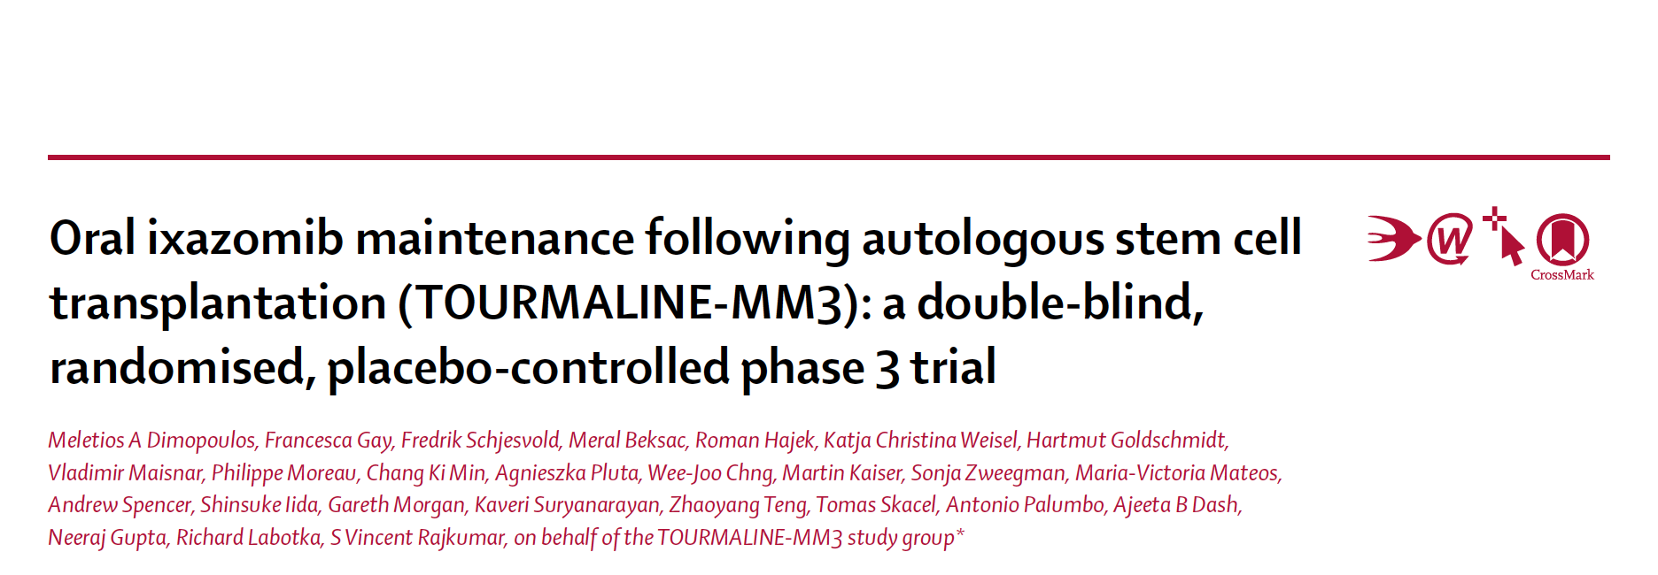
Lancet 2019;393(10168):253-64.

Slide 33
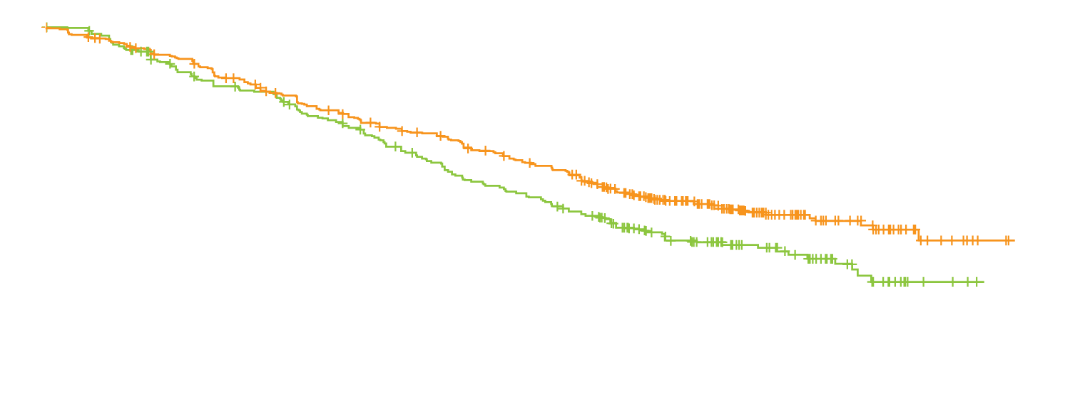
TOURMALINE-MM3: Ixazomib Maintenance in the Post-Transplant Setting
HR 0.72; log-rank test p = 0.0023
MRD(+) at study entry | Ixazomib (n = 225) | Placebo (n = 139)
Converted to MRD(-) at any point | 12% | 7%
PFS | 23.1 mo | 18.5 mo
Probability of progression-free survival
Median PFS
(n = 395) 26.5 mo
(n = 261) 21.3 mo
Ixazomib
Placebo
Months from randomization
Ixazomib maintenance demonstrated a favorable safety profile compared to placebo
Serious adverse events: 27% vs 20%
Grade 3/4 peripheral neuropathy: <1% vs 0
Grade 3/4 thrombotic events: 5% vs 1%
No increase in second malignancies was noted with ixazomib therapy compared to placebo (3% in both study arms)
Dimopoulos MA et al. Lancet 2019;393(10168):253-64.

Slide 34
A man in his late 60s with relapsed/refractory multiple myeloma (Dr Richardson)
9/2017: RVD x 3 → disease progression
2/2018: Carfilzomib, lenalidomide and dexamethasone (KRD) x 2 → PD
Significant pancytopenia requiring frequent transfusions and growth factors
3/18/2018: Daratumumab, pomalidomide and dexamethasone
Pneumocystis pneumonia after 3 cycles (off prophylaxis; sulfa and mepron allergy)
Desensitization to bactrim during hospital admission
6/2018: Resumes dara/pom/dex
12/2018: VGPR after 12 cycles of DPD

Slide 35
Richardson Patient 1

Slide 36
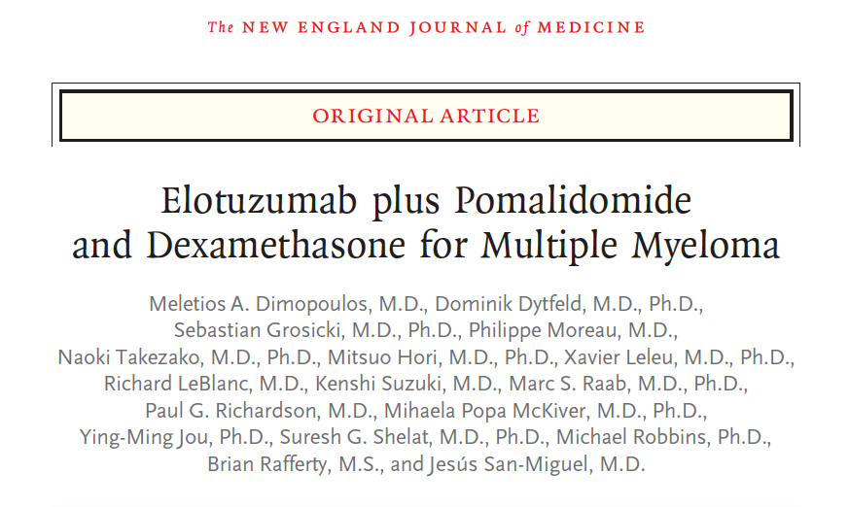
N Engl J Med 2018;379:1811-22.

Slide 37
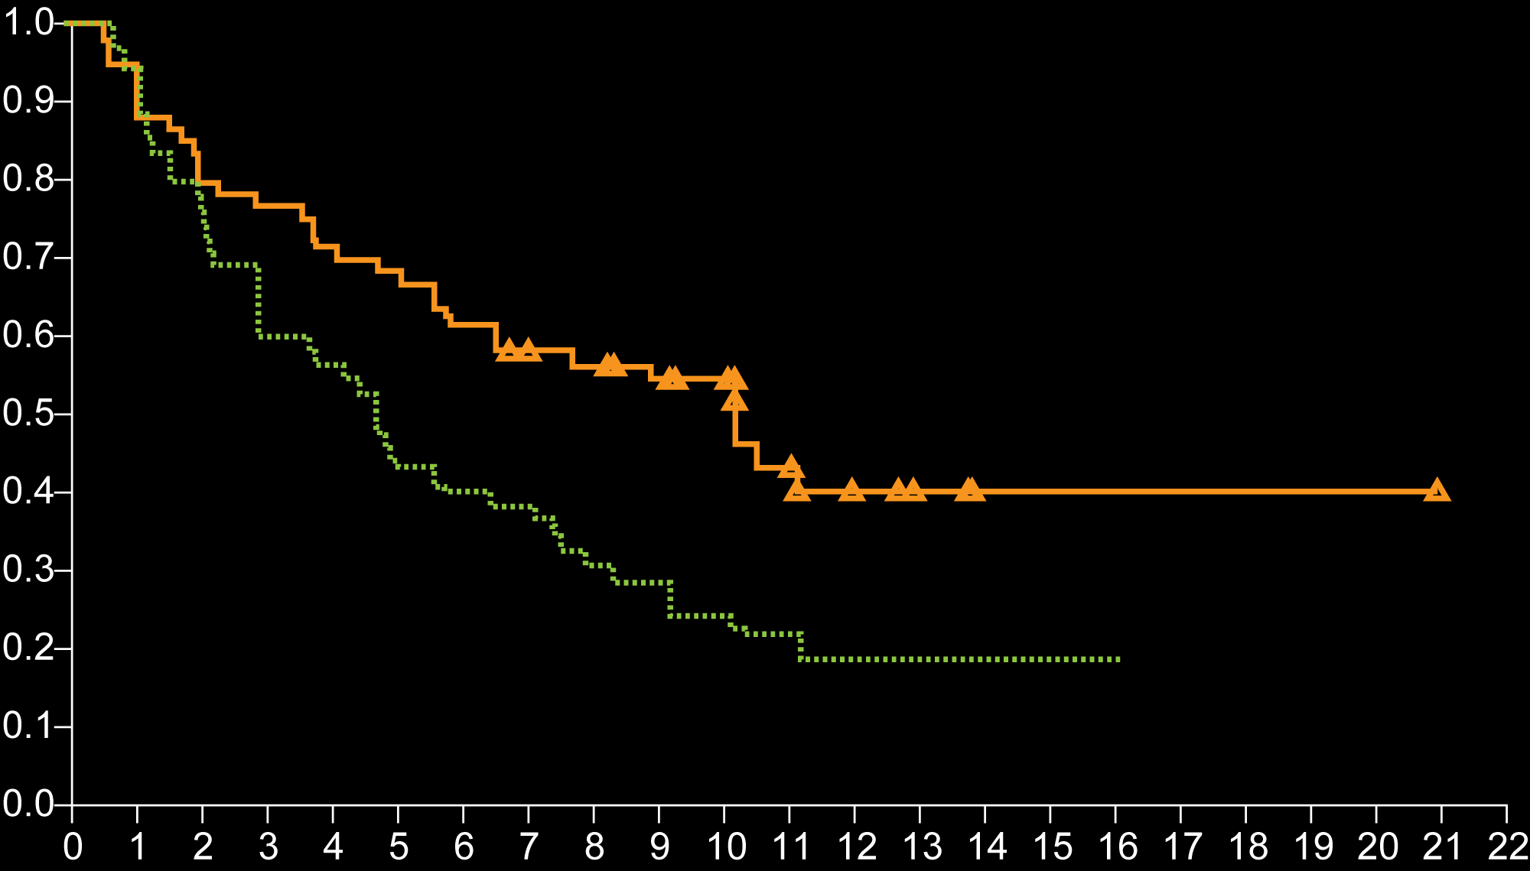
ELOQUENT-3: Pomalidomide/Dexamethasone +/- Elotuzumab for MM Refractory to Lenalidomide and a Proteasome Inhibitor
Hazard ratio for disease progression or death, 0.54 (95% CI, 0.34-0.86)
P = 0.008
Probability of Progression-free Survival
Elotuzumab group
Median PFS: 10.3 mo
Control group
Median PFS: 4.7 mo
Months since Randomization
Rates of Grade 3/4 adverse events were similar between arms (57% with elotuzumab vs 60% in the control group)
Dimopoulos MA et al. N Engl J Med 2018;379:1811-22.

Slide 38
FDA Approves Elotuzumab with Pomalidomide and Dexamethasone for Relapsed or Refractory Multiple Myeloma Press Release – November 7, 2018
“On November 6, the US Food and Drug Administration (FDA) approved elotuzumab injection for intravenous use in combination with pomalidomide and dexamethasone for the treatment of adult patients with multiple myeloma who have received at least two prior therapies, including lenalidomide and a proteasome inhibitor.
In ELOQUENT-3, a randomized, open-label, phase II trial, elotuzumab plus pomalidomide and dexamethasone demonstrated benefit in patients with relapsed or refractory multiple myeloma, doubling both median progression-free survival and overall response rate vs pomalidomide and dexamethasone.”
https://www.ascopost.com/News/59448

Slide 39
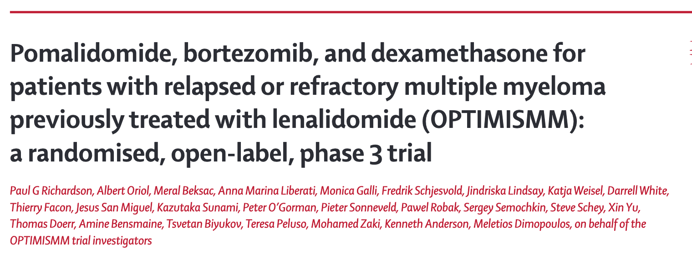
Lancet Oncol 2019;20(6):781-94.

Slide 40
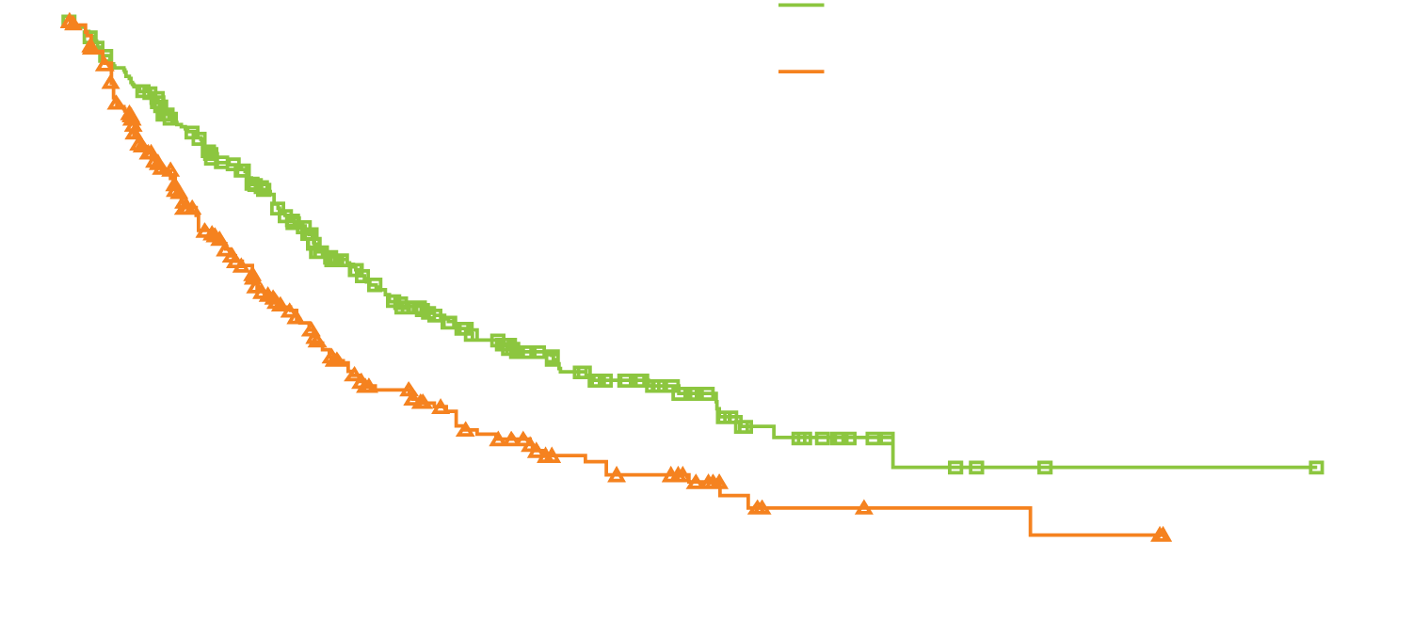
OPTIMISMM: Results Summary
Pomalidomide, bortezomib and dexamethasone
Bortezomib and dexamethasone
HR 0.61; two-sided p < 0.0001
Progression-free survival (%)
Median 11.2 mo
Median 7.1 mo
Months from randomization
Most common Grade 3/4 treatment-emergent adverse events (pomalidomide-containing study arm vs control):
Neutropenia: 42% vs 9%
Infections: 31% vs 18%
Thrombocytopenia: 27% vs 29%
Deaths related to treatment: 8 (6 in the pomalidomide-containing study arm and 2 in the control arm).
Richardson PG et al. Lancet Oncol 2019;20(6):781-94.

Slide 41
FDA Approves Daratumumab Split-Dosing Regimen Press Release – February 12, 2019
“The US Food and Drug Administration (FDA) has approved a split-dosing regimen for daratumumab, a CD38-directed antibody, providing health-care professionals and patients with multiple myeloma an option to split the first infusion over 2 consecutive days.
The approval is based on data from the phase Ib EQUULEUS (MMY1001) clinical study, which demonstrated daratumumab pharmacokinetic concentrations were comparable at the end of weekly dosing, regardless of whether the first dose was administered as a split infusion or as a single infusion.”
https://www.ascopost.com/News/59736

Slide 42
Phase III COLUMBA Study of Subcutaneous Daratumumab Meets Primary Endpoint Press Release – February 25, 2019
“Results from the Phase III COLUMBA study (MMY3012) of subcutaneous (SC) versus intravenous (IV) daratumumab for patients with relapsed or refractory multiple myeloma… showed that SC administration of daratumumab co-formulated with recombinant human hyaluronidase PH20 is non-inferior to IV administration of daratumumab with regard to the co-primary end points of overall response rate (ORR) and Maximum Trough concentration (C_{trough}) of daratumumab on day 1 of the third treatment cycle.”
https://www.globenewswire.com/news-release/2019/02/25/1741776/0/en/Genmab-Announces-Positive-Topline-Results-in-Phase-III-COLUMBA-Study-of-Subcutaneous-Daratumumab.html

Slide 43
Efficacy and Safety of the Randomized, Open-Label, Non-Inferiority, Phase 3 study of Subcutaneous (SC) versus Intravenous (IV) Daratumumab (DARA) Administration in Patients (pts) with Relapsed or Refractory Multiple Myeloma (RRMM): COLUMBA
Mateos M et al. ASCO 2019;Abstract 8005.
Hematologic Malignancies – Plasma Cell Dyscrasias Oral Session
Sunday, June 2nd, 11:09-11:21 AM, E451

Slide 44
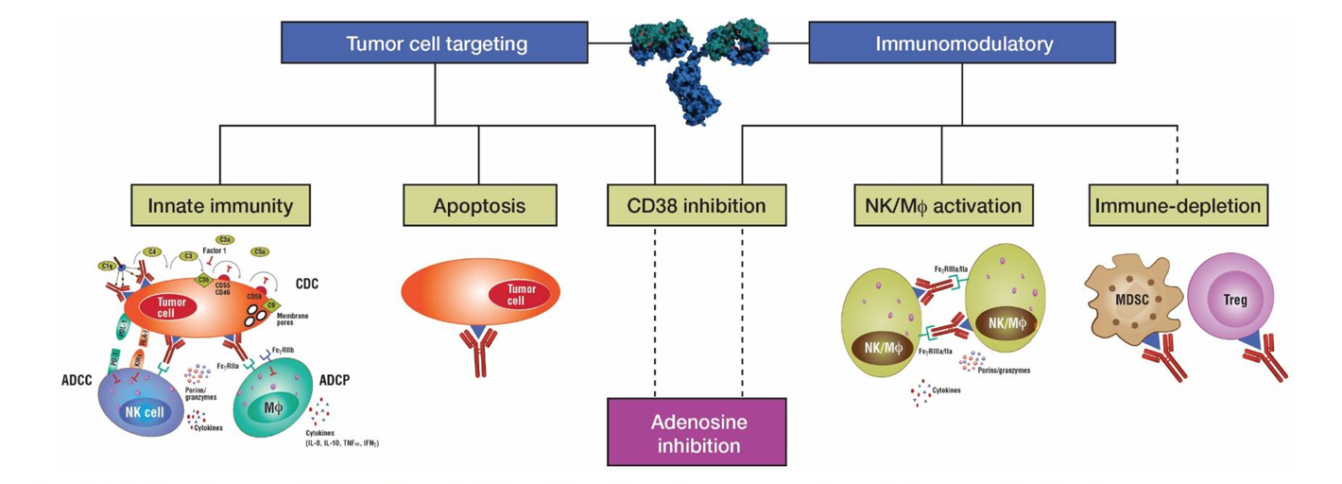
Isatuximab: CD38-Targeted Monoclonal Antibody
Isatuximab targets tumor cells through multiple mechanisms of action, including ADCC, apoptosis and immune cell depletion/inhibition of immunosuppressive cells
Isatuximab
Mikhael J et al. Proc ASCO 2017;Abstract 8007.

Slide 45
Phase III ICARIA-MM Study Meets Primary Endpoint Press Release – February 5, 2019
“The pivotal Phase 3 trial of isatuximab in patients with relapsed/refractory multiple myeloma met the primary endpoint of prolonging progression free survival in patients treated with isatuximab in combination with pomalidomide and low-dose dexamethasone versus pomalidomide and low-dose dexamethasone alone (standard of care).
The randomized, multi-center, open label Phase 3 study, known as ICARIA-MM, enrolled 307 patients with relapsed/refractory multiple myeloma across 96 centers spanning 24 countries. All study participants received two or more prior anti-myeloma therapies, including at least two consecutive cycles of lenalidomide and a proteasome inhibitor given alone or in combination.”
https://news.sanofigenzyme.com/press-release/isatuximab-phase-3-trial-meets-primary-endpoint-prolonging-progression-free-survival-p

Slide 46
A Phase III Randomized, Open Label, Multicenter Study Comparing Isatuximab, Pomalidomide, and Low-Dose Dexamethasone versus Pomalidomide and Low-Dose Dexamethasone in Patients with Relapsed/Refractory Multiple Myeloma (RRMM)
Richardson P et al. ASCO 2019;Abstract 8004.
Hematologic Malignancies – Plasma Cell Dyscrasias Oral Session
Sunday, June 2nd, 10:57-11:09 AM, E451

Slide 47
First Clinical (Phase 1b/2a) Study of Iberdomide (CC-220; IBER), a CELMoD, in Combination with Dexamethasone (DEX) in Patients (pts) with Relapsed/Refractory Multiple Myeloma (RRMM)
Lonial S et al. ASCO 2019;Abstract 8006.
Hematologic Malignancies – Plasma Cell Dyscrasias Oral Session
Sunday, June 2nd, 11:45 AM - 11:57 AM, E451

Slide 48
Evaluation of Venetoclax (Ven) Alone or in Combinations for Relapsed/Refractory Multiple Myeloma
Clinical variable | Ven alone¹ | Ven + bortezomib² | Ven + carfilzomib + dexamethasone³
ORR – All patients | 21% | 67% | 83%
ORR – Patients with t(11;14) | 40% | 78% | 100%
ORR – Patients without t(11;14) | 6% | 65% | 78%
Tumor lysis syndrome | 0% | 0% | 2%
¹ Kumar S et al. Blood 2017;130(22):2401-9; ² Moreau P et al. Blood 2017;30(132):2392-400; ³ Costa LJ et al. Proc ASCO 2018;Abstract 8004.

Slide 49
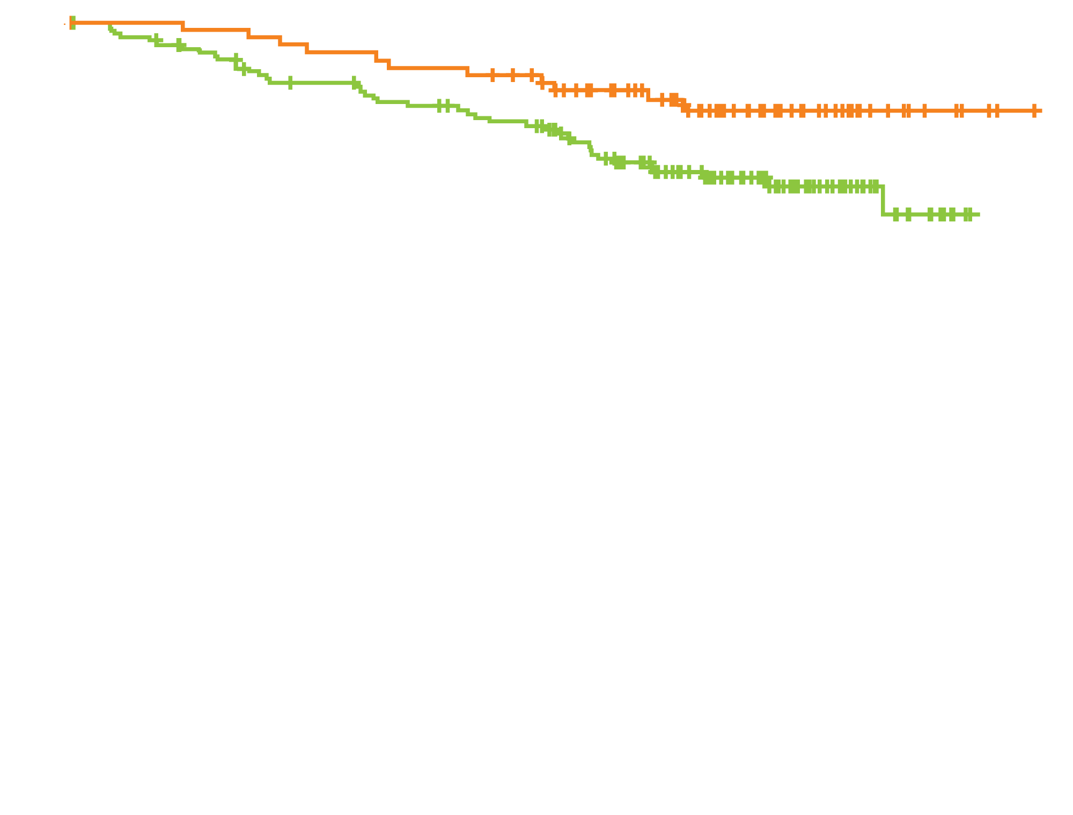
BELLINI: Increased Risk of Death with Venetoclax for Patients with R/R MM
 | Ven + Bd (N = 194) | Pbo + Bd (N = 97)
Events (%) | 41 (21.1) | 11 (11.3)
Median OS (months) | Not reached | Not reached
HR (95% CI) | 2.03 (1.04, 3.94)
Overall survival (ITT)
Ven + Bd
Pbo + Bd
Time (months)
Median PFS: 22.4 months with venetoclax vs 11.5 months with placebo (HR = 0.63)
Objective response rate: 82.0% with venetoclax vs 68.0% with placebo
https://www.fda.gov/drugs/drug-safety-and-availability/fda-warns-about-risks-associated-investigational-use-venclexta-multiple-myeloma

Slide 50
FDA Issues Warning About Risks Associated with Investigational Use of Venetoclax for Multiple Myeloma Press Release – March 21, 2019
“FDA reviewed data from the BELLINI clinical trial (NCT02755597, Study M14-031) evaluating the use of venetoclax combined with bortezomib, a proteasome inhibitor, and dexamethasone in patients with multiple myeloma. The interim trial results demonstrated an increased risk of death for patients receiving venetoclax as compared to the control group. On March 6, 2019, the FDA required no new patients be enrolled on the Bellini trial. Patients who are receiving clinical benefit can continue treatment in the trial after they reconsent.
The FDA suspended enrollment in other ongoing multiple myeloma clinical trials of venetoclax. Patients who are receiving clinical benefit can continue treatment in these trials after they reconsent. FDA will be working directly with sponsors of venetoclax, as well as other investigators conducting clinical trials in patients with multiple myeloma, to determine the extent of the safety issue. The agency will communicate any new information as appropriate.”
https://www.fda.gov/drugs/drug-safety-and-availability/fda-warns-about-risks-associated-investigational-use-venclexta-multiple-myeloma

Slide 51
A man in his early 70s with relapsed/refractory multiple myeloma (Dr Raje)
Diagnosed 7 years ago with IgG kappa multiple myeloma
RVD → transplant → lenalidomide maintenance
Carfilzomib, pomalidomide and dexamethasone
Daratumumab, bortezomib and dexamethasone
FISH: p53 mutation with NRAS and KRAS activation on genome sequencing
Progressed with a pathological fracture of the right femur
Internal fixation
Bridging therapy with cyclophosphamide and carfilzomib → CAR T cells
MRD-negative 13 months after CAR T cells

Slide 52
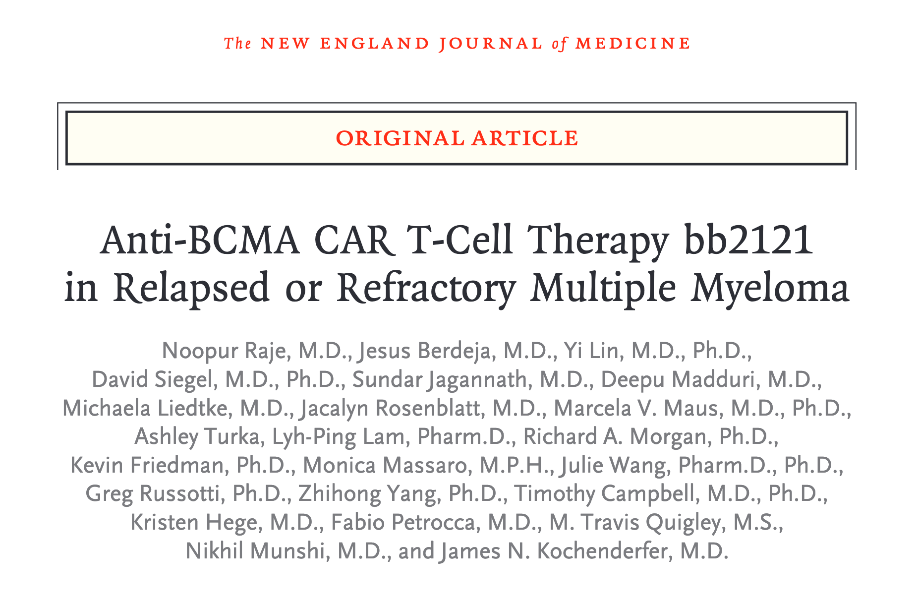
N Engl J Med 2019;380:1726-37.

Slide 53
Anti-BCMA CAR T-Cell Therapy for R/R MM: Select Adverse Events
Adverse event | Anti-BCMA CAR T-Cell Therapy (n = 33)
 | Any grade | Grade 3 | Grade 4
Any AE | 100% | 12% | 85%
Neutropenia | 85% | 6% | 79%
Leukopenia | 61% | 18% | 39%
Anemia | 58% | 45% | 0%
Thrombocytopenia | 58% | 15% | 30%
Cytokine release syndrome | 76% | 6% | 0%
Neurotoxicity | 42% | 0% | 3%
Raje N et al. N Engl J Med 2019;380:1726-37.

Slide 54
Initial Results from a Phase I Clinical Study of bb21217, a Next-Generation Anti-BCMA CAR T Cell Therapy
Shah N et al. Proc ASH 2018;Abstract 488.

Slide 55
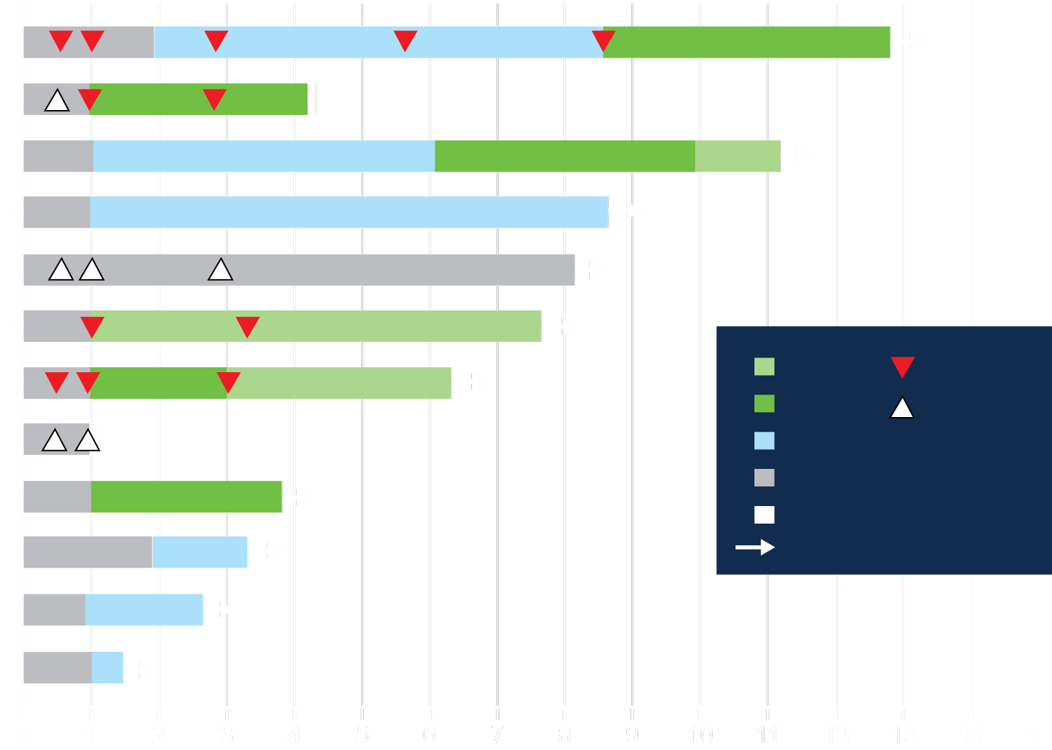
CRB-402 Phase I Study of bb21217: Clinical Responses and Duration of Response at the 150 x 10⁶ CAR+ T-Cell Dose
Clinical response over time
 | Clinical response
 | Bb21217 treated (N = 12)
ORR, n (%) [95% CI] | 10 (83.3) [51.6, 97.9]
sCR/CR | 3 (25)
≥VGPR | 6 (50)
MRD status in bone marrow, n
MRD-evaluable responders | 4
MRD-neg | 4
Median time to first response (min, max), mo | 1 (1, 2)
Median time to best response (min, max), mo | 1 (1, 10)
Median follow-up duration (min, max), mo | 5.9 (1.0, 11.8)
CR/sCR
VGPR
PR
Stable disease
PD
Response ongoing
MRD-
MRD+
Months on Study
10/12 patients (83%) achieved an ORR at the first tested dose
100% MRD negativity in 4/4 responders evaluable for MRD status
Shah N et al. Proc ASH 2018;Abstract 488.

Slide 56
Select Ongoing BCMA CAR-T Trials in Relapsed/Refractory Multiple Myeloma
Trial identifier | Phase | N | CAR-T construct | Estimated primary completion date
EVOLVE (NCT03430011) | I/II | 118 | JCARH125 | March 2021
KarMMa (NCT03361748) | II | 150 | bb2121 | November 2024
CARTITUDE-1 (NCT03548207) | Ib/II | 110 | LCAR-B38M | September 2021
CARTIFAN-1 (NCT03758417) | II | 60 | LCAR-B38M | July 2020
P-BCMA-101-001 (NCT03288493) | I | 40 | P-BCMA-101 | December 2021
www.clinicaltrials.gov. Accessed May 2019.

Slide 57
Evaluation of AMG 420, an Anti-BCMA Bispecific T-Cell Engager (BiTE) Immunotherapy, in R/R Multiple Myeloma (MM) Patients: Updated Results of a First-in-Human (FIH) Phase I Dose Escalation Study
Topp M et al. ASCO 2019;Abstract 8007.
Hematologic Malignancies – Plasma Cell Dyscrasias Oral Session
Sunday, June 2nd, 11:57 AM-12:09 PM, E451

Slide 58
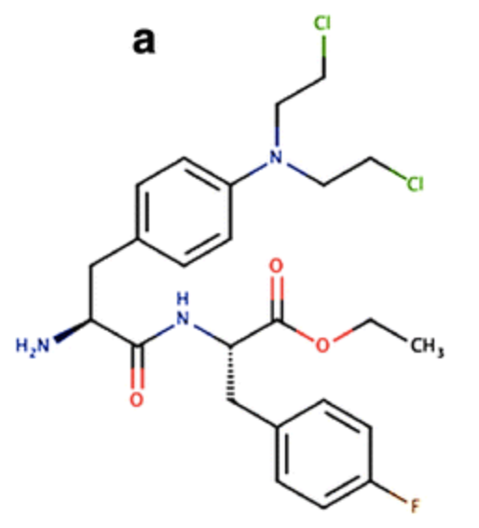
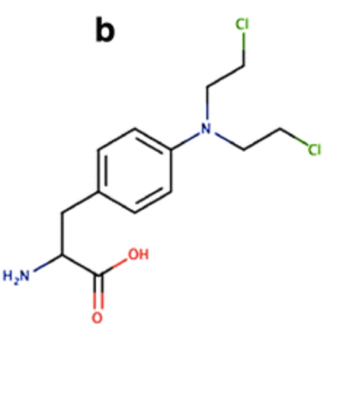
Melflufen: A Derivative of the Alkylating Agent Melphalan
Melphalan
Melflufen (J1)
Melflufen is susceptible to hydrolysis by aminopeptidases that are frequently expressed or overexpressed in tumor tissue, providing the molecule with a target-directed delivery to cells
In vitro studies with melflufen demonstrated it led to a 10- to 20-fold higher intracellular concentration of melphalan in comparison with melphalan alone in various malignant cells
Delforoush M et al. BMC Cancer 2016;16:263.

Slide 59
First Report on Overall Survival (OS) and Improved Progression Free Survival (PFS) in a Completed Phase 2a Study of Melflufen in Advanced Relapsed Refractory Multiple Myeloma (RRMM)
Richardson P et al. Proc ASH 2017;Abstract 3150.

Slide 60
Phase IIa O-12-M1 Trial of Melflufen with Dexamethasone in Patients with Relapsed/Refractory Multiple Myeloma
Patients had received at least 2 prior therapies, including lenalidomide and bortezomib (Median lines of prior therapy: 4)
Clinical variable | Melflufen (n = 45)
ORR (VGPR: 5 pts; PR: 9 pts) | 31%
Duration of response | 8.4 mo
Median PFS | 5.7 mo
Median OS | 20.7 mo
Grade 3/4 adverse events
Thrombocytopenia | 58%
Neutropenia | 51%
Anemia | 42%
Richardson P et al. Proc ASH 2017;Abstract 3150.

Slide 61
OP-106 Horizon — Melflufen Therapy for RRMM Patients Refractory to Daratumumab and/or Pomalidomide; Updated Results and First Report on PFS
Richardson P et al. Proc ASH 2018;Abstract 600.

Slide 62
HORIZON: Efficacy and Safety of Melflufen for R/R MM
Patients had received at least 2 prior therapies, including an immunomodulatory agent (IMiD) and a proteasome inhibitor (PI), and their disease was refractory to pomalidomide and/or daratumumab
Median lines of prior therapy: 5
Overall response rate (n = 82): 33%
Safety | Melflufen (n = 83)
Any Grade 3/4 adverse event | 75%
Neutropenia | 61%
Thrombocytopenia | 59%
Anemia | 25%
Infection | 7%
Treatment discontinuation due to AEs | 13%
Richardson P et al. Proc ASH 2018;Abstract 600; https://www.ashclinicalnews.org/on-location/good-news-horizon-melflufen-induces-response-heavily-refractory-myeloma-2/

Slide 63
Phase III OCEAN Trial Design
Melflufen +
dexamethasone
Trial identifier: NCT03151811
Eligibility (n = 450)
2-4 lines of prior therapy Prior proteasome inhibitor Refractory to lenalidomide
R
Pomalidomide +
dexamethasone
Primary endpoint: Progression-free survival
www.clinicaltrials.gov. Accessed May 2019.

Slide 64
Have you or would you order an MRD assay to inform the decision regarding autotransplant after induction treatment?
I have
I have not but would for the right patient
I have not and would not

