Slide 1
Please note, these are the actual video-recorded proceedings from the live CME event and may include the use of trade names and other raw, unedited content.

Slide 2
Breakfast with the Investigators Management of Melanoma Monday, June 3, 2019 6:45 AM – 7:45 AM Chicago, Illinois
Faculty
Professor Georgina Long, BSc, PhD, MBBS
Jason J Luke, MD
Jeffrey S Weber, MD, PhD
Moderator Neil Love, MD

Slide 3
Disclosures for Moderator Neil Love, MD
Dr Love is president and CEO of Research To Practice. Research To Practice receives funds in the form of educational grants to develop CME activities from the following commercial interests: AbbVie Inc, Acerta Pharma — A member of the AstraZeneca Group, Adaptive Biotechnologies, Agendia Inc, Agios Pharmaceuticals Inc, Amgen Inc, Ariad Pharmaceuticals Inc, Array BioPharma Inc, Astellas Pharma Global Development Inc, AstraZeneca Pharmaceuticals LP, Bayer HealthCare Pharmaceuticals, Biodesix Inc, bioTheranostics Inc, Boehringer Ingelheim Pharmaceuticals Inc, Boston Biomedical Inc, Bristol-Myers Squibb Company, Celgene Corporation, Clovis Oncology, Daiichi Sankyo Inc, Dendreon Pharmaceuticals Inc, Eisai Inc, Exelixis Inc, Foundation Medicine, Genentech, Genmab, Genomic Health Inc, Gilead Sciences Inc, Guardant Health, Halozyme Inc, ImmunoGen Inc, Incyte Corporation, Infinity Pharmaceuticals Inc, Ipsen Biopharmaceuticals Inc, Janssen Biotech Inc, administered by Janssen Scientific Affairs LLC, Jazz Pharmaceuticals Inc, Kite Pharma Inc, Lexicon Pharmaceuticals Inc, Lilly, Loxo Oncology Inc, a wholly owned subsidiary of Eli Lilly & Company, Merck, Merrimack Pharmaceuticals Inc, Myriad Genetic Laboratories Inc, Natera Inc, Novartis, Oncopeptides, Pfizer Inc, Pharmacyclics LLC, an AbbVie Company, Prometheus Laboratories Inc, Puma Biotechnology Inc, Regeneron Pharmaceuticals Inc, Sandoz Inc, a Novartis Division, Sanofi Genzyme, Seattle Genetics, Sirtex Medical Ltd, Spectrum Pharmaceuticals Inc, Taiho Oncology Inc, Takeda Oncology, Tesaro, Teva Oncology, Tokai Pharmaceuticals Inc and Tolero Pharmaceuticals.
Notes:
3
3
3

Slide 4
Professor Georgina Long, BSc, PhD, MBBS Co-Medical Director of Melanoma Institute Australia Chair of Melanoma Medical Oncology and Translational Research, Melanoma Institute Australia and Royal North Shore Hospital The University of Sydney Sydney, Australia

Slide 5
Disclosures for Professor Georgina Long, BSc, PhD, MBBS
Advisory Committee | Aduro Biotech, Agena Bioscience Inc, Amgen Inc, Bristol-Myers Squibb Company, Merck, Novartis, OncoSec Medical, Pierre Fabre, Roche Laboratories Inc

Slide 6
Jason J Luke, MD Associate Professor and Director of the Cancer Immunotherapeutic Center University of Pittsburgh Medical Center and Hillman Cancer Center Pittsburgh, Pennsylvania

Slide 7
Disclosures for Jason J Luke, MD
Advisory Committee | 7 Hills Pharma LLC, Actym Therapeutics, Alphamab Oncology, Array BioPharma Inc, BD, Benevir Biopharm Inc, Mavupharma, Tempest Therapeutics
Consulting Agreements | AbbVie Inc, Aduro Biotech, Astellas Pharma Global Development Inc, AstraZeneca Pharmaceuticals LP, Bayer HealthCare Pharmaceuticals, Bristol-Myers Squibb Company, Castle Biosciences Incorporated, CheckMate Pharmaceuticals, Compugen, EMD Serono Inc, IDEAYA Biosciences, Immunocore, Incyte Corporation, Janssen Biotech Inc, Jounce Therapeutics Inc, Leap Therapeutics Inc, Merck, Mersana Therapeutics, NewLink Genetics Corporation, Novartis, RefleXion Medical, Spring Bank Pharmaceuticals, Tempest Therapeutics, Vividion
Contracted Research | AbbVie Inc, Array BioPharma Inc, AstraZeneca Pharmaceuticals LP, Boston Biomedical Inc, Bristol-Myers Squibb Company, Celldex Therapeutics, CheckMate Pharmaceuticals, Compugen, Corvus Pharmaceuticals, Delcath Systems Inc, EMD Serono Inc, Evelo Biosciences, Five Prime Therapeutics Inc, FLX Bio Inc, Genentech, Immunocore, Incyte Corporation, Leap Therapeutics Inc, MacroGenics Inc, Merck, Novartis, Palleon Pharmaceuticals, Pharmacyclics LLC, an AbbVie Company, Tesaro, Xencor
Data and Safety Monitoring Board/Committee | TTC Oncology

Slide 8
Jeffrey S Weber, MD, PhD Deputy Director Laura and Isaac Perlmutter Cancer Center Professor of Medicine NYU Langone Medical Center New York, New York

Slide 9
Disclosures for Jeffrey S Weber, MD, PhD
Consulting Agreements | Altor Bioscience Corp, Array BioPharma Inc, AstraZeneca Pharmaceuticals LP, Biond Biologics, Blueprint Medicines, Bristol-Myers Squibb Company, Celldex Therapeutics, CytomX Therapeutics, Genentech, GlaxoSmithKline, Incyte Corporation, Merck, Pfizer Inc, Protean LLC, Sellas Life Sciences, Takeda Oncology
Contracted Research | NextCure Inc
Ownership Interest | Altor Bioscience Corp, Biond Biologics, CytomX Therapeutics, Protean LLC
Patents | Biodesix Inc, Moffitt Cancer Center

Slide 10
RTP ASCO Symposia

Slide 11
The patients I saw today…
79 | M | CLL (serial monitoring of counts) and carcinoid tumor of the lung (active surveillance imaging)
55 | F | Stage 1 node-negative TNBC - Adjuvant chemo
64 | M | AML - Admitted for new onset severe pancytopenia; >50% blasts in marrow. Initiation of Induction chemo
79 | F | Metastatic NSCLC, completed carbo, nab-P, pembrolizumab, now on maintenance pembro
82 | M | Metastatic bladder cancer receiving 1st-line atezolizumab; Tolerating well, with stable disease
50 | M | Metastatic GIST on sunitinib since 2015
45 | M | Newly diagnosed Stage IIIC rectal cancer, currently on neoadjuvant FOLFOX. Plan for subsequent chemoRT and possible resection. Non-compliance
75 | F | Myelodysplastic Syndrome 5q-, receiving lenalidomide but tolerating very poorly
74 | M | Locally advanced, distal esophageal cancer on concurrent chemoRT
66 | M | Melanoma – adjuvant nivolumab
77 | M | Metastatic NSCLC post carbo, nab-P, pembrolizumab due to start pembro maintenance
81 | F | Locally advanced NSCLCa-N2, refused chemo. Definitive XRT, refused durvalumab consolidation
88 | F | DLBCL dx May 2018, refused chemo. Rituximab + prednisone ~8wks, complete remission. Now, relapsed disease in CNS but refuses WBRT; hospice
72 | F | Melanoma - encorafenib/binimetinib
82 | M | Rectal cancer treatment ~10yrs ago - follow-up
57 | M | CLL previously monitored, now with constitutional symptoms, weight loss and increasing WBC
73 | F | Extensive stage SCLC diagnosed 2014, Relapsed in 2017, XRT with CDDP/VP-16. Remains in remission
45 | M | Sokal high risk CML on dasatinib 75mg due to severe thrombocytopenia, tolerating much better, in CcyR
81 | F | S/p lobectomy for incidentally diagnosed Stage 1A NSCLCa. No adjuvant treatment required
55 | F | Newly diagnosed ER/PR-pos, HER2-neg locally advanced, node+ lobular carcinoma s/p bilat mastectomy. Plan: Adjuvant chemo, XRT, hormonal rx

Slide 12
The patients I saw today…
57 | F | Low grade gastric NET - octreotide
64 | M | MM - Post ASCT on lenalidomide maintenance
66 | M | Castrate-resistant metastatic prostate cancer - PD on enzalutamide, to start docetaxel
42 | F | Breast cancer, refused adjuvant chemotherapy, now with metastatic disease in the right axilla and bone.
66 | F | CML – CR to imatinib
98 | F | MDS – receiving ESAs
58 | F | Glioblastoma multiforme - Maintenance temozolomide and optune device
85 | F | Recurrent atypical meningioma on observation
60 | F | Metastatic ER + HER2 - breast cancer - almost complete response in the breast after 4 months
82 | M | Breast cancer 8 years ago - followup
48 | M | CML – considering third line bosutinib
61 | M | Primary appendyceal low grade cancer - surgery
62 | F | IgM MGUS for years, now with pancytopenia, bone marrow biopsy showing low grade NHL (possibly WM)
38 | F | mCRC – 2L FOLFIRI/Bevacizumab
59 | M | Lupus anticoagulant/Pulmonary embolism - rivaroxaban
70 | M | Metastatic melanoma - in remission on nivolumab for almost 3 years
67 | M | Melanoma – PD on ipi/nivo, pt not doing well
67 | F | Metastatic RCC – cape/bev maintenance
68 | M | Metastatic lung adenocarcinoma, PD-L1 70% - 1L pembro, SD for 3 months
59 | M | Stage IIIB Lung adenocarcinoma - Consolidation durvalumab post XRT/Chemo
59 | F | Breast cancer 11 years ago – follow up
86 | M | Anemia secondary to chronic kidney disease - ESA
48 | F | Recurrent cervical SCC – CR to cis/pac/bev, on bev maint 18 months later

Slide 13
Agenda
Module 1 – Adjuvant Systemic Therapy of Melanoma
Module 2 – BRAF/MEK Inhibitor Combinations in the Management of Metastatic Melanoma
Module 3 – Immune Checkpoint Inhibitors in the Management of Metastatic Melanoma

Slide 14
Module 1 – Adjuvant Systemic Therapy of Melanoma

Slide 15
A man in his early 50s with T3bN2aM0 melanoma and BRAF V600E tumor mutation who has a history of Crohn’s disease in remission (Dr Weber)
Adjuvant dabrafenib and trametinib x 12 months
Recurrent episodes of fever and fatigue every few months
Steroids, restart therapy after being without fever for 48 hours
Colitis flare managed with steroid taper
Currently off therapy and followed with CT scans only

Slide 16
A man in his mid-60s with BRAF wild-type in-transit local recurrence after adjuvant nivolumab (Dr Long)
Stage IIIC melanoma
Resection → adjuvant nivolumab
In-transit local recurrence on scalp at 24 weeks
Resection

Slide 17
A woman in her mid-40s with Stage IIIC, BRAF wild-type melanoma (Dr Luke)
Adjuvant nivolumab
Thyroid function
At second dose TSH 0.3 mU/mL, asymptomatic
At 1 week: TSH 20 mU/mL, FT4 0.5 ng/dl
Itchy rash on upper chest, back
Levothyroxine, moisturizing creams
Fatigue, but continues normal daily activities
Continues nivolumab monthly now at 9 months without evidence of recurrence

Slide 18
FDA Approvals/Indications for Checkpoint Inhibitors and Targeted Therapy as Adjuvant Treatment for Melanoma
Agent, approval date | Indication | Pivotal trial
Ipilimumab October 28, 2015 | For pts with pathologic involvement of regional lymph nodes of >1 mm in patients who have undergone complete resection, including total lymphadenectomy | EORTC-18071
Nivolumab December 20, 2017 | For pts with lymph node involvement or metastatic disease who have undergone complete resection, in the adjuvant setting | CHECKMATE 238
Dabrafenib + trametinib April 30, 2018 | For pts with BRAF V600E or V600K mutation, as detected by an FDA-approved test, and involvement of lymph node(s) after complete resection | COMBI-AD
Pembrolizumab February 15, 2019 | For pts with involvement of lymph node(s) after complete resection | KEYNOTE-054
www.accessdata.fda.gov. Accessed May 9, 2019.

Slide 19
Adjuvant Therapy with Nivolumab (NIVO) versus Ipilimumab (IPI) After Complete Resection of Stage III/IV Melanoma: Updated Results from a Phase III Trial (CheckMate 238)
Jeffrey S Weber et al.
Proc ASCO 2018;Abstract 9502.

Slide 20
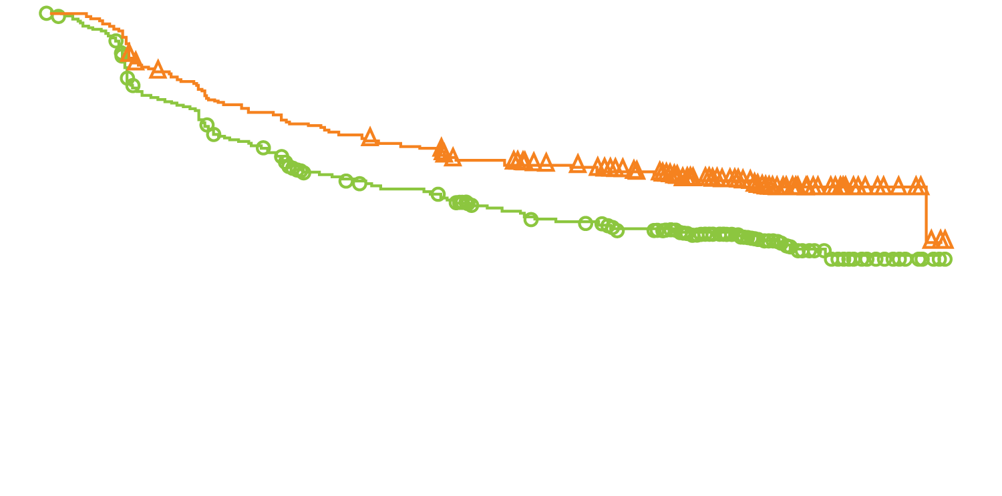
CheckMate 238: Recurrence-Free Survival with Adjuvant Nivolumab versus Ipilimumab in the Intention-To-Treat Population
Endpoint | Nivolumab (N = 453) | Ipilimumab (N = 453) | Hazard ratio | p-value
Median RFS | 30.8 mo | 24.1 mo | 0.66 | <0.0001
70%
66%
63%
60%
RFS (%)
53%
50%
NIVO
IPI
Months
Weber J et al. Proc ASCO 2018;Abstract 9502.

Slide 21
Adjuvant Therapy with Nivolumab versus Ipilimumab After Complete Resection of Stage III/IV Melanoma: Updated Results from a Phase III Trial (CheckMate 238)
 | Nivolumab (n = 453) | Ipilimumab (n = 453) | HR | p-value
RFS, 24-mo rates
ITT population | 62.6% | 50.2% | 0.66 | <0.0001
Stage IIIB | 70.8% | 60.7%
Stage IIIC | 58.0% | 45.4%
Stage IV | 58.0% | 44.3%
PD-L1 ≥5% | 75.5% | 58.4%
PD-L1 <5% | 55.2% | 45.5%
BRAF mutant | 61.9% | 51.7%
BRAF wild type | 63.5% | 46.2%
DMFS, 24-mo rates | 70.5% | 63.7% | 0.76 | 0.034
Weber J et al. Proc ASCO 2018;Abstract 9502.

Slide 22
CheckMate 238: Adverse Events with Adjuvant Nivolumab versus Ipilimumab in Resected Stage III or IV Melanoma
Any AE | Nivolumab (n = 452) | Ipilimumab (n = 453)
Any AE | 96.9% | 98.5%
Any AE Grade ≥3 | 25.4% | 55.2%
Any AE leading to death | 0.0% | 0.4%
Any serious AE | 17.5% | 40.4%
Any AE leading to discontinuation | 9.7% | 42.6%
Specific AE
Pruritus | 23.2% | 33.6%
Diarrhea | 24.3% | 45.9%
Hypothyroidism | 10.8% | 6.8%
Abdominal pain | 6.4% | 10.2%
Weber J et al. N Engl J Med 2017;377:1824-35.

Slide 23
CheckMate 915 Phase III Trial Schema
Target accrual: 1,943
Eligibility
Completely resected Stage IIIB/C/D or Stage IV melanoma No prior anticancer treatment, except surgery and/or adjuvant RT after neurosurgical resection of CNS lesions No prior treatment with interferon, anti-PD-1, anti-PD-L1, anti-PD-L2, anti-CD137 or anti-CTLA-4
Nivolumab + ipilimumab
R
Nivolumab
Primary endpoint: Recurrence-free survival
www.clinicaltrials.gov. Accessed May 9, 2019 (NCT03068455).

Slide 24
FDA Approves Pembrolizumab for Adjuvant Treatment of Melanoma Press Release – February 15, 2019
“The Food and Drug Administration approved pembrolizumab for the adjuvant treatment of patients with melanoma with involvement of lymph node(s) following complete resection.
Approval was based on EORTC1325/KEYNOTE‑054 (NCT02362594), a randomized, double-blind, placebo-controlled, trial in 1019 patients with completely resected, stage IIIA (>1 mm lymph node metastasis), IIIB or IIIC melanoma (AJCC 7th ed). Patients with mucosal or ocular melanoma were not eligible. Patients were randomly allocated (1:1) to receive pembrolizumab 200 mg every three weeks or placebo for up to 1 year until disease recurrence or unacceptable toxicity. Enrollment required complete resection of melanoma with negative margins, lymph node dissection, and completion of radiotherapy, if indicated, within 13 weeks prior to starting treatment.”
https://www.fda.gov/drugs/drug-approvals-and-databases/fda-approves-pembrolizumab-adjuvant-treatment-melanoma

Slide 25
KEYNOTE-054: Primary Endpoint (Recurrence-Free Survival) for Adjuvant Pembrolizumab versus Placebo in Resected Stage III Melanoma
ITT
PD-L1-positive tumors
Cohort | Intention-to-treat (n = 1,019) |  |  | PD-L1-positive tumors (n = 853)
 | 1-y RFS | HR | p-value | 1-y RFS | HR | p-value
Pembrolizumab | 75% | 0.57 | <0.001 | 77% | 0.54 | <0.001
Placebo | 61% |  |  | 63%
Eggermont AMM et al. N Engl J Med 2018;378(19):1789-801.

Slide 26
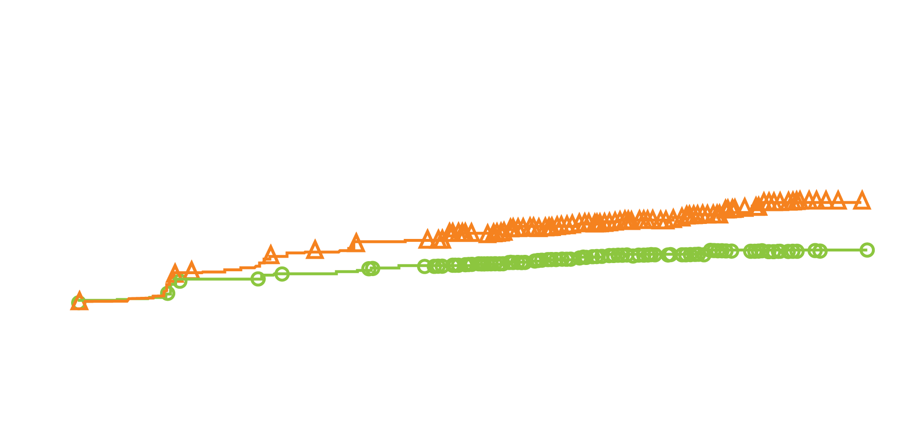
KEYNOTE-054: Secondary Endpoint for Adjuvant Pembrolizumab versus Placebo in Resected Stage III Melanoma
Cohort | Cumulative incidence of distant metastasis as first recurrence site (18 mo) | HR | 99% CI
Pembrolizumab (n = 514) | 17% | 0.53 | 0.37-0.76
Placebo (n = 505) | 30%
Cumulative incidence of distant metastasis
Months
Eggermont AMM et al. N Engl J Med 2018;378(19):1789-801.

Slide 27
KEYNOTE-716 Phase III Trial Schema
Target accrual: 954
Eligibility
Surgically resected and histologically/pathologically confirmed new diagnosis of Stage IIB or IIC cutaneous melanoma No prior treatment beyond surgery No prior treatment with anti-PD-1, anti-PD-L1, anti-PD-L2, anti-CD137 or anti-CTLA-4
Pembrolizumab
q3wk x 17 cycles
R
Placebo
Primary endpoint: Recurrence-free survival
www.clinicaltrials.gov. Accessed May 9, 2019 (NCT03553836).

Slide 28
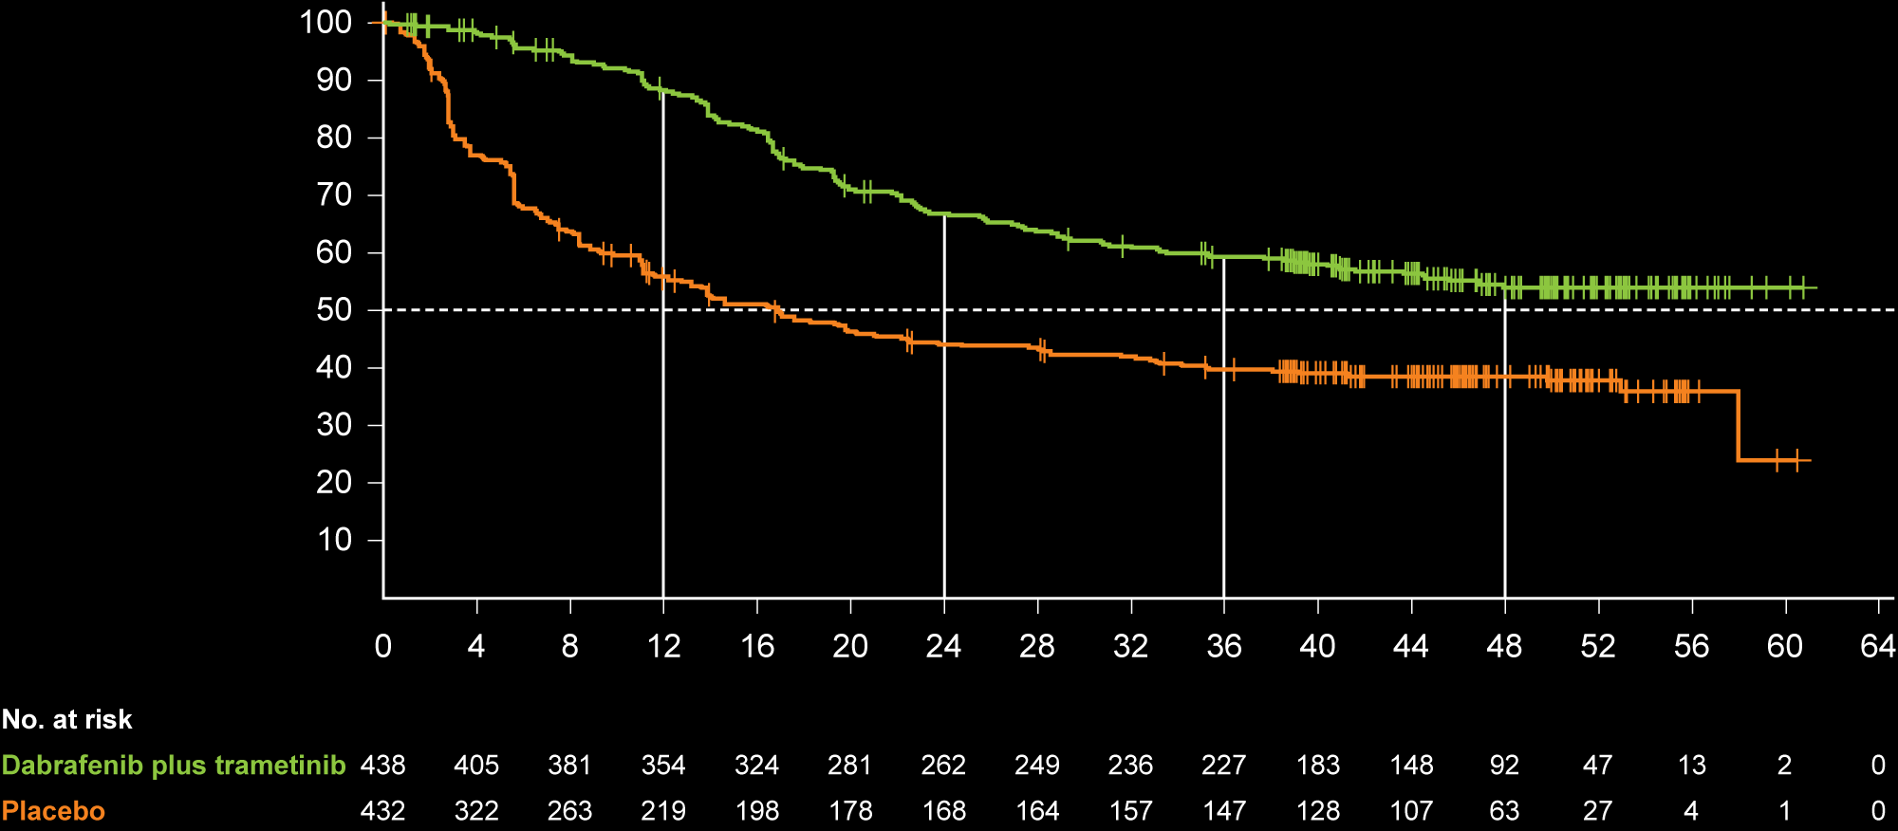
COMBI-AD: Updated Relapse-Free Survival (RFS) with Adjuvant Dabrafenib/ Trametinib for Completely Resected, Stage III BRAF V600-Mutant Melanoma
1 year, 88%
Median follow-up: 44 months
Hazard ratio: 0.49
2 year, 67%
3 year, 59%
4 year, 54%
Relapse-free survival (%)
1 year, 56%
2 year, 44%
3 year, 40%
4 year, 38%
Time since random assignment (months)
Hauschild A et al. J Clin Oncol 2018;36(35):3441-9.

Slide 29
COMBI-AD: Updated RFS by Disease Stage (AJCC, 7th Edition)
 | 1-y RFS |  | 2-y RFS |  | 3-y RFS |  | 4-y RFS
Stage | D/T | Placebo | D/T | Placebo | D/T | Placebo | D/T | Placebo
IIIA | 97% | 79% | 84% | 69% | 80% | 62% | 69% | 62%
IIIB | 87% | 59% | 66% | 44% | 58% | 39% | 56% | 37%
IIIC | 86% | 42% | 61% | 34% | 51% | 31% | 46% | 30%
IIIB/C | 86% | 51% | 63% | 39% | 54% | 35% | 51% | 34%
Hauschild A et al. J Clin Oncol 2018;36(35):3441-9.

Slide 30
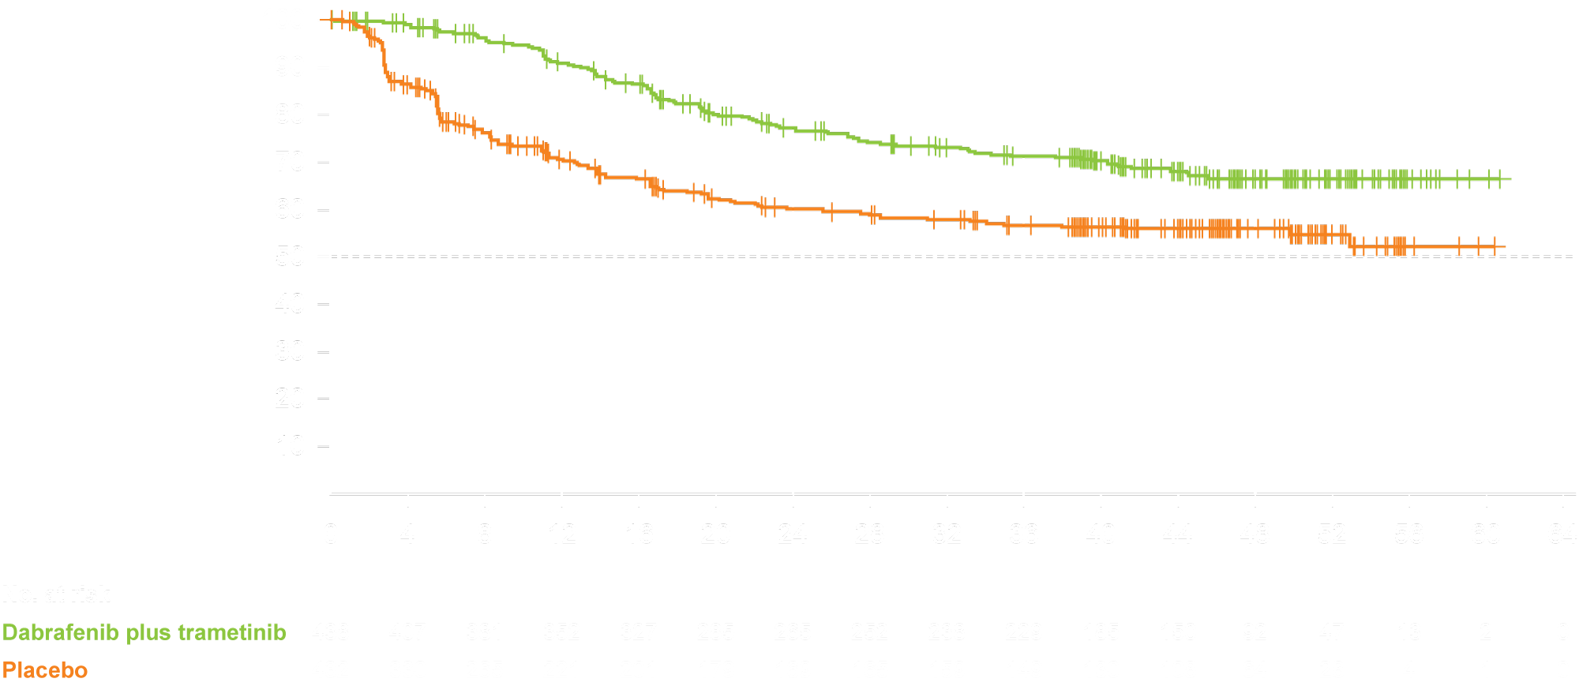
COMBI-AD: Distant Metastasis-Free Survival
1 year, 91%
Median follow-up: 44 months
Hazard ratio: 0.53
2 year, 77%
3 year, 71%
4 year, 67%
1 year, 70%
Distant metastasis-free survival (%)
2 year, 60%
3 year, 57%
4 year, 56%
Time since random assignment (months)
Hauschild A et al. J Clin Oncol 2018;36(35):3441-9.

Slide 31
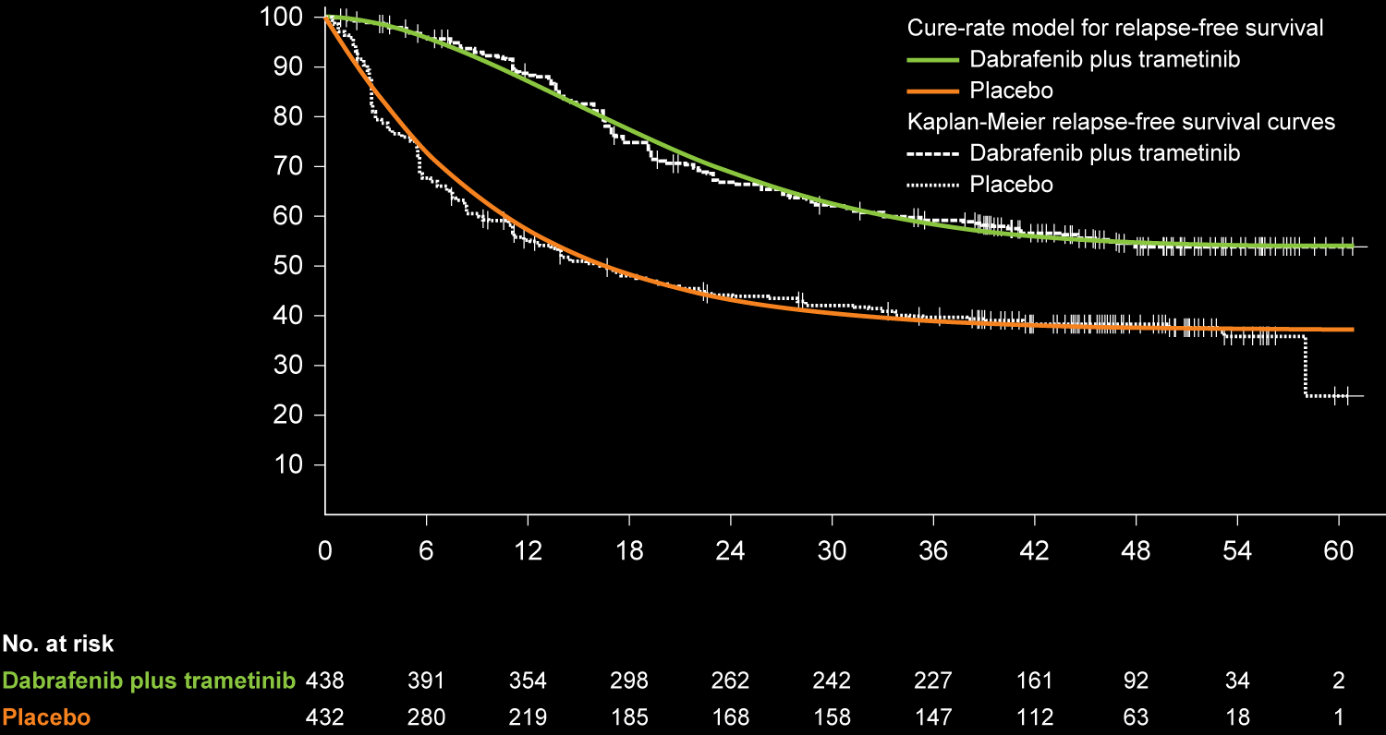
COMBI-AD: Estimated Cure Rate (Based on the Weibull Mixture Cure-Rate Analysis)
Estimated cure rate
54%
37%
Relapse-free survival (%)
Time since random assignment (months)
Hauschild A et al. J Clin Oncol 2018;36(35):3441-9.

Slide 32
COMBI-AD: Select Adverse Events in Completely Resected, Stage III BRAF V600-Mutant Melanoma
Any adverse event (AE) | Dabrafenib plus trametinib (N = 435) | Placebo (N = 432)
Any AE | 97.0% | 88.0%
Any AE Grade ≥3 | 41.0% | 14.0%
Any AE leading to discontinuation | 26.0% | 3.0%
Specific AE
Pyrexia | 63.0% | 11.0%
Diarrhea | 33.0% | 15.0%
Influenza-like illness | 15.0% | 7.0%
Peripheral edema | 13.0% | 4.0%
Long GV et al. N Engl J Med 2017;377:1813-23.

Slide 33
Module 2 – BRAF/MEK Inhibitor Combinations in the Management of Metastatic Melanoma

Slide 34
A woman in her mid-70s with newly diagnosed Stage IV melanoma and a BRAF V600K tumor mutation (Dr Long)
Rheumatoid arthritis
Controlled on methotrexate
Encorafenib and binimetinib
Well tolerated

Slide 35
A man in his mid-50s with Stage IV melanoma, including brain metastases and a BRAF tumor mutation (Dr Luke)
2016: Stage IIIB melanoma, initially treated with ipilimumab
Hypophysitis requiring hydrocortisone
1.5 years later: Lung and nodal metastases
BRAF mutation on NGS
Dabrafenib and trametinib
Recurrent fevers: Dose reductions, multiple treatment holidays
Nivolumab but develops headache and mental status changes within 1 month
MRI: Multifocal brain metastases with edema and midline shift
Improvement with steroids
Encorafenib and binimetinib
Tapered off steroids, improvement in quality of life

Slide 36
FDA Approvals/Indications for BRAF/MEK Inhibitor Combinations in Metastatic Melanoma
Agent, approval date | Indication | Pivotal trial
Dabrafenib/trametinib January 10, 2014 (Accelerated) November 20, 2015 (Full) | BRAF V600E or V600K mutation-positive unresectable or metastatic melanoma | COMBI-d COMBI-v
Vemurafenib/cobimetinib November 10, 2015 | BRAF V600E or V600K mutation-positive unresectable or metastatic melanoma | coBRIM
Encorafenib/binimetinib June 27, 2018 | Unresectable or metastatic melanoma with a BRAF V600E or V600K mutation | COLUMBUS
www.accessdata.fda.gov. Accessed May 9, 2019.

Slide 37
Five-Year Analysis on the Long-Term Effects of Dabrafenib plus Trametinib (D + T) in Patients with BRAF V600–Mutant Unresectable or Metastatic Melanoma
Nathan P et al. ASCO 2019;Abstract 9507
Melanoma / Skin Cancers Oral Session
Tuesday, June 4th, 11:57 AM - 12:09 PM, S406

Slide 38
FDA Approves Encorafenib and Binimetinib in Combination for Unresectable or Metastatic Melanoma with BRAF Mutations Press Release – June 27, 2018
“The Food and Drug Administration approved encorafenib and binimetinib in combination for patients with unresectable or metastatic melanoma with a BRAF V600E or V600K mutation, as detected by an FDA-approved test.
Approval was based on a randomized, active-controlled, open-label, multicenter trial (COLUMBUS; NCT01909453) in 577 patients with BRAF V600E or V600K mutation-positive unresectable or metastatic melanoma. Patients were randomized (1:1:1) to receive binimetinib 45 mg twice daily plus encorafenib 450 mg once daily, encorafenib 300 mg once daily, or vemurafenib 960 mg twice daily. Treatment continued until disease progression or unacceptable toxicity.”
https://www.fda.gov/drugs/resources-information-approved-drugs/fda-approves-encorafenib-and-binimetinib-combination-unresectable-or-metastatic-melanoma-braf

Slide 39
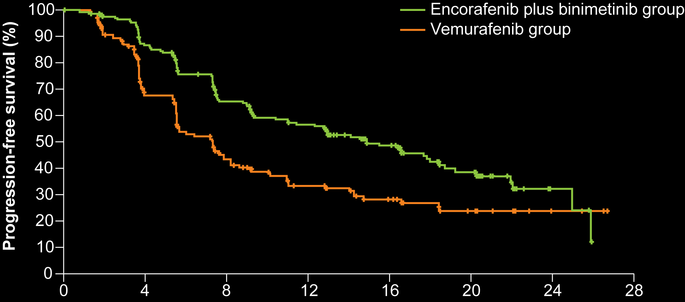
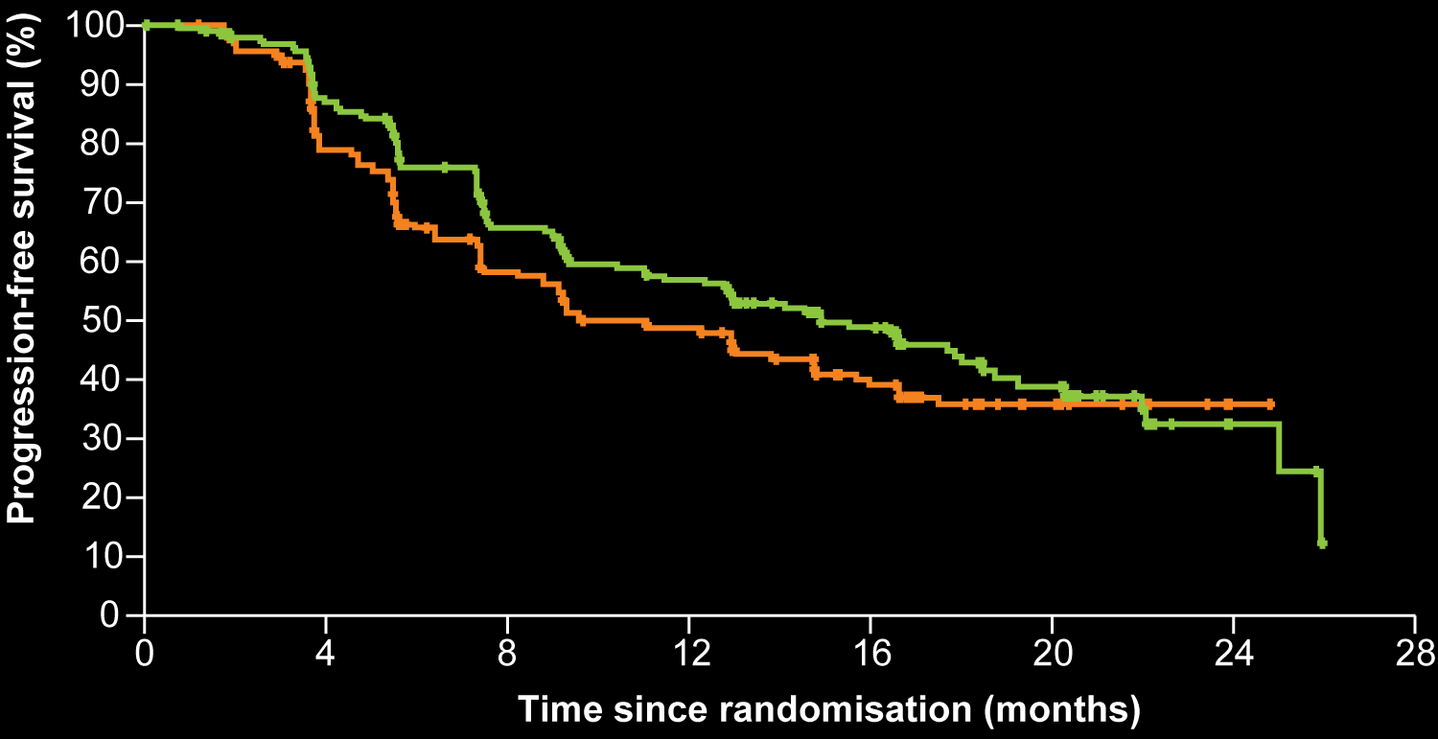
COLUMBUS: Progression-Free Survival with Encorafenib + Binimetinib versus Vemurafenib or Encorafenib in BRAF-Mutant Melanoma
Cohort | Median PFS (mo) | HR | p-value
Encorafenib + binimetinib (n = 192) | 14.9 | 0.54 | <0.0001
Vemurafenib (n = 191) | 7.3
Cohort | Median PFS (mo) | HR | p-value
Encorafenib + binimetinib (n =192) | 14.9 | 0.75 | 0.051
Encorafenib (n = 194) | 9.6
Time since randomisation (months)
Time since randomisation (months)
Dummer R et al. Lancet Oncol 2018;19:603-15.

Slide 40
COLUMBUS: Overall Survival with Encorafenib + Binimetinib versus Vemurafenib or Encorafenib in BRAF-Mutant Melanoma
Cohort | Median OS (mo) | HR | p-value
Encorafenib + binimetinib (n = 192) | 33.6 mo | 0.61 | <0.0001
Vemurafenib (n = 191) | 16.9 mo
Cohort | Median OS (mo) | HR | p-value
Encorafenib + binimetinib (n = 192) | 33.6 mo | 0.81 | 0.12
Encorafenib (n = 194) | 23.5 mo
Encorafenib plus binimetinib group
Vemurafenib group
Encorafenib plus binimetinib group
Encorafenib group
Overall survival (%)
Overall survival (%)
Time since randomisation (months)
Time since randomisation (months)
Dummer R et al. Lancet Oncol 2018;19:1315-27.

Slide 41
COLUMBUS: Adverse Events with Encorafenib/Binimetinib versus Vemurafenib or Encorafenib for BRAF-Mutant Melanoma
Any AE | Encorafenib + binimetinib (N = 192) | Encorafenib (N = 192) | Vemurafenib (N = 186)
Any AE Grade ≥3 | 58% | 66% | 63%
Any serious AE | 34% | 34% | 37%
Any AE leading to discontinuation | 6% | 10% | 14%
Specific AE
Nausea | 42% | 38% | 34%
Diarrhea | 37% | 14% | 34%
Vomiting | 30% | 27% | 15%
Pyrexia | 19% | 15% | 28%
Dummer R et al. Lancet Oncol 2018;19:603-15.

Slide 42
DREAMseq Phase III Trial Schema
Disease
Progression
Target accrual: 300
Eligibility
Unresectable Stage III or IV melanoma BRAF V600 mutation Prior adjuvant systemic therapy but not CTLA-4 or PD-1 pathway-blocking antibody or BRAF/MEK inhibitor
Nivolumab + ipilimumab
→ maintenance nivo
Dabrafenib + trametinib
R
Dabrafenib + trametinib
Nivolumab + ipilimumab
→ maintenance nivo
Primary endpoint: Overall survival
www.clinicaltrials.gov. Accessed May 2, 2019 (NCT02224781).

Slide 43
Select Ongoing Clinical Trials Sequencing Immunotherapy and Targeted Therapy
NCT identifier | Phase | Enrollment | Description
DREAMseq (NCT02224781) | III | 300 | Dabrafenib + trametinib → ipilimumab + nivolumab Ipilimumab + nivolumab → dabrafenib + trametinib
SECOMBIT (NCT02631447) | II | 230 | Encorafenib + binimetinib until PD → nivolumab + ipilimumab x 4 → nivolumab until PD Nivolumab + ipilimumab x 4 → nivolumab until PD → encorafenib + binimetinib until PD Encorafenib + binimetinib → nivolumab + ipilimumab x 4 → nivolumab until PD → encorafenib + binimetinib until PD
COWBOY (NCT02968303) | II | 200 | Vemurafenib + cobimetinib x 6 wk → nivolumab + ipilimumab Nivolumab + ipilimumab
www.clinicaltrials.gov. Accessed May 10, 2019.

Slide 44
Module 3 – Immune Checkpoint Inhibitors in the Management of Metastatic Melanoma

Slide 45
A man in his late 30s with Stage IV, BRAF wild-type melanoma, including 2 small brain metastases (Dr Weber)
Bilateral hepatic metastases (BRAF wild type)
Single-agent PD-1 antibody (regression at week 12, regrowth at week 24)
MRI scan of the brain: 2 small R-sided cerebral lesions <1 cm
Stereotactic radiosurgery, with disease regression
New left supraclavicular lesion (3 cm)
Switched to ipilimumab and nivolumab x 4 induction doses
LFTs elevated to Grade 2: Steroids, with resolution
Maintenance nivolumab q2wk
After 9 months: CR of hepatic lesions, supraclavicular lesion decreased to 1 cm
Resection of supraclavicular lesion
Significant vitiligo of the beard, lashes and eyebrows
Maintenance nivolumab continued

Slide 46
FDA Approvals/Indications for Checkpoint Inhibitors in Metastatic Melanoma
Agent | Indication | Pivotal trial
Pembrolizumab* September 4, 2014 December 18, 2015 | Unresectable or metastatic melanoma | KEYNOTE-002 KEYNOTE-006
Nivolumab September 30, 2015 | Unresectable or metastatic melanoma | CheckMate 037 CheckMate 066
Nivolumab/ipilimumab December 22, 2014 | Unresectable or metastatic melanoma | CheckMate 069 CheckMate 067
Ipilimumab March 25, 2011 | Unresectable or metastatic melanoma | MDX010-20
* On May 23, 2017 pembrolizumab was approved for patients with unresectable or metastatic, microsatellite instability-high or mismatch repair-deficient solid tumors progressing after prior treatment who have no satisfactory alternative treatment options.
www.accessdata.fda.gov; Accessed May 10, 2019; Pembrolizumab, nivolumab and ipilimumab package inserts

Slide 47
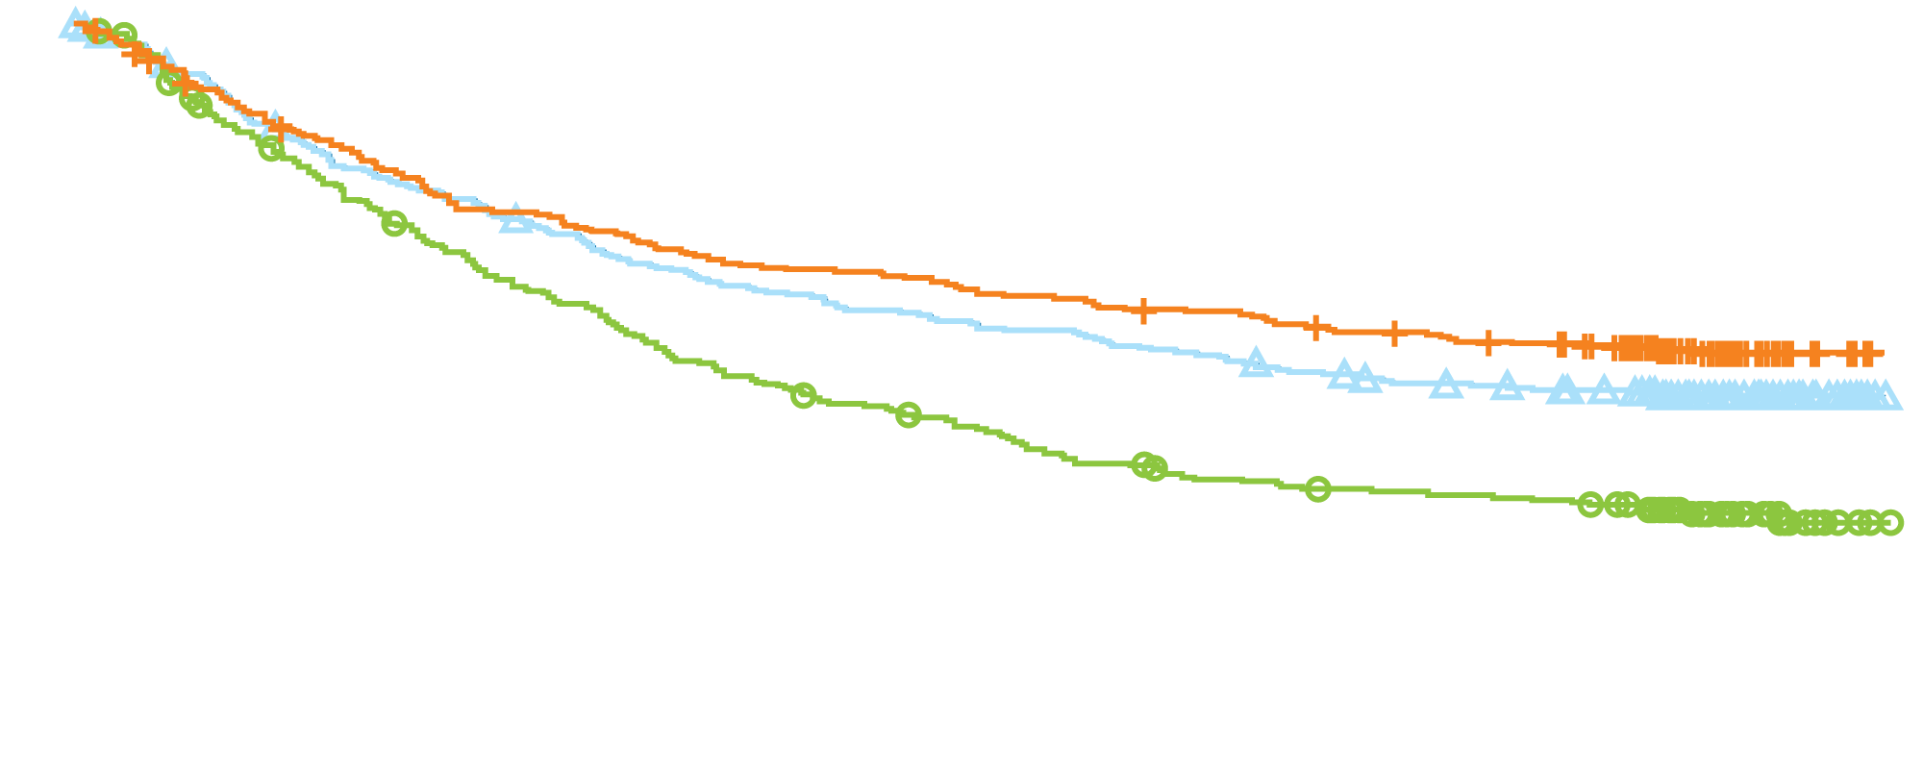
CheckMate 067: Overall Survival with Combined Nivolumab and Ipilimumab in Advanced Melanoma
Cohort | Median OS (mo) | 4-y OS | HR | p-value
Nivolumab plus ipilimumab | NR | 53% | 0.54 | p < 0.0001
Nivolumab | 36.9 | 46% | 0.65 | p < 0.0001
Ipilimumab | 19.9 | 30% | — | —
53% Nivolumab plus ipilimumab
Overall survival (%)
46% Nivolumab
30% Ipilimumab
Time since randomization (months)
Hodi FS et al. Lancet Oncol 2018;19:1480-92.

Slide 48
CheckMate 067: Adverse Events with Combined Nivolumab and Ipilimumab in Advanced Melanoma
Any AE | Nivolumab plus ipilimumab (n = 313) | Nivolumab (n = 313) | Ipilimumab (n = 311)
Any AE | 96.0% | 86.0% | 86.0%
Any AE Grade ≥3 | 59.0% | 21.0% | 28.0%
Any AE leading to death | <1.0% | <1.0% | <1.0%
Any AE leading to discontinuation | 39.0% | 12.0% | 16.0%
Specific AE
Rash | 30.0% | 23.0% | 22.0%
Pruritus | 35.0% | 21.0% | 36.0%
Dyspnea | 12.0% | 6.0% | 4.0%
Pneumonitis | 7.0% | 2.0% | 2.0%
Wolchok JD et al. N Engl J Med 2017;377:1345-56.

Slide 49
Immunotherapy for CNS Metastatic Disease from Melanoma
Trial | Drug(s) | Phase | N | Disease | CNS ORR
NCT00623766 | Ipilimumab | II | 51 21 | Melanoma asymptomatic brain mets Melanoma symptomatic brain mets | 16% (8/51) 5% (1/21)
NCT02085070 | Pembrolizumab | II | 18 | Melanoma | 22% (4/18)
CheckMate 204 | Nivo + ipi | II | 75 | Melanoma | 56% (42/75)
NCT02374242 | Nivo + ipi Nivolumab Nivolumab | II | 35 25 16 | Melanoma asymptomatic brain mets Melanoma asymptomatic brain mets Melanoma symptomatic brain mets | 46% (16/35) 20% (5/25) 6% (1/16)
Kamath SD, Kumthekar PU. Front Oncol 2018;8:414.

Slide 50
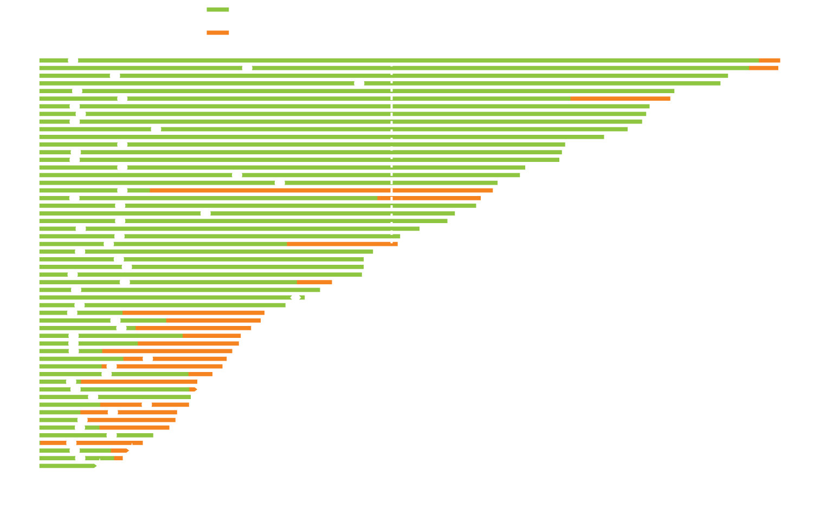
CheckMate 204: A Phase II Study of Combined Nivolumab and Ipilimumab for Melanoma Metastatic to the Brain
Time to and Duration of Intracranial Response
Rate of intracranial benefit: 57%
CR (brain): 26%
PR (brain): 30%
Tawbi H et al. N Engl J Med 2018;379:722-30.

Slide 51
Efficacy and Safety of the Combination of Nivolumab (NIVO) plus Ipilimumab (IPI) in Patients with Symptomatic Melanoma Brain Metastases (CheckMate 204)
Tawbi H et al. ASCO 2019;Abstract 9501
Melanoma / Skin Cancers Oral Session
Tuesday, June 4th, 9:57 AM - 10:09 AM, S406

Slide 52
Phase 3 International Trial of Adjuvant Whole Brain Radiotherapy (WBRT) or Observation (Obs) Following Local Treatment of 1-3 Melanoma Brain Metastases (MBMs)
Fogarty G et al. ASCO 2019;Abstract 9500
Melanoma / Skin Cancers Oral Session
Tuesday, June 4th, 9:45 AM - 9:57 AM, S406

Slide 53
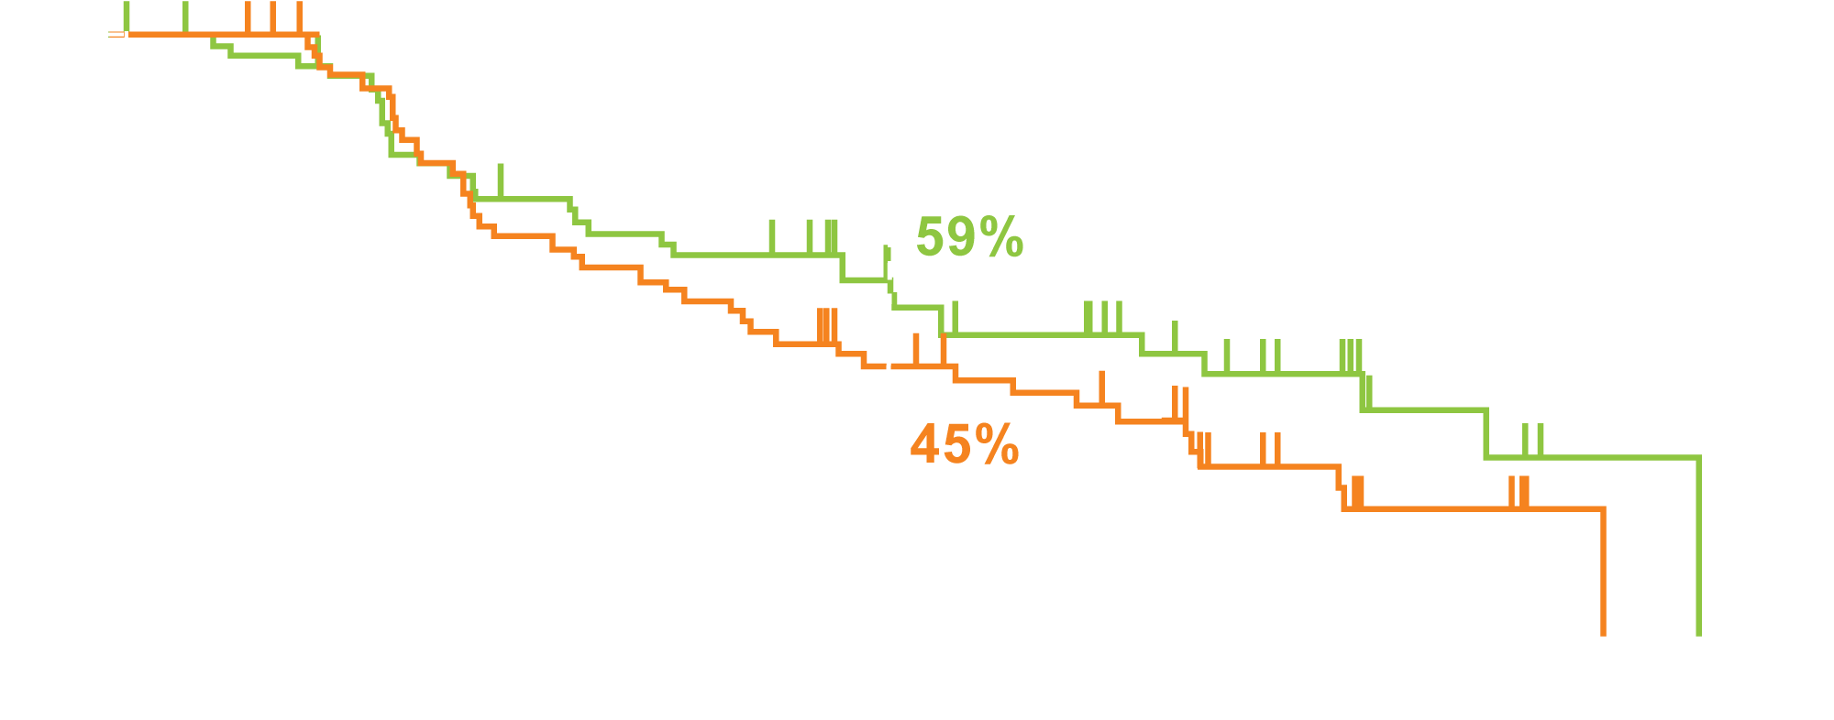
KEYNOTE-022 Part 3: Phase II Randomized Study of First-Line Dabrafenib and Trametinib Plus Pembrolizumab or Placebo for BRAF-Mutant Advanced Melanoma
 | Pembro + D + T (n = 60) | Placebo + D + T (n = 59) | HR | p-value
Median PFS | 16.0 mo | 10.3 mo | 0.66 | 0.043
PFS did not reach statistical significance threshold per study design (required HR for significance ≤0.62, P ≤ 0.025)
PFS %
Time, months
Ascierto PA et al. Proc ESMO 2018;Abstract 1244O.

Slide 54
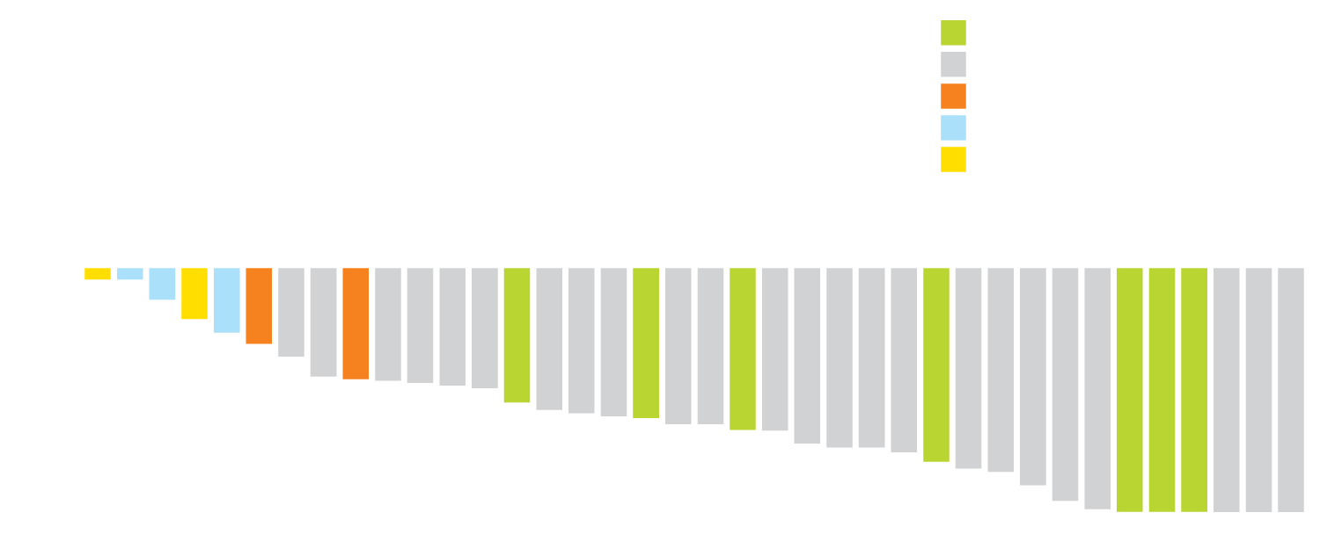
Atezolizumab in Combination with Vemurafenib and Cobimetinib in BRAF V600-Mutant Metastatic Melanoma
Maximum Change in Sum of Largest Diameters by Best Overall Response
CR
PR
PD
SD
NE
ORR: 31/38 (81.6%)
Median PFS: 12.9 mo
Six (15.4%) discontinued the study due to an AE
(Dyspnea, ALT/AST increase, myalgia, rash)
Maximum change from baseline in sum of largest diameters (%)
Sullivan RJ et al. Proc ASCO 2017;Abstract 3063.

Slide 55
Select Ongoing Phase III Clinical Trials of Combination Immunotherapy and Targeted Agents in Metastatic Melanoma
NCT | Enrollment | Description
COMBI-i NCT02967692 | 538 | Anti-PD-1 antibody + dabrafenib + trametinib Placebo + dabrafenib + trametinib
TRILOGY NCT02908672 | 513 | Atezolizumab + cobimetinib + vemurafenib (720 mg) Placebo + cobimetinib + vemurafenib (960 mg)
www.clinicaltrials.gov. Accessed May 10, 2019.

Slide 56
Investigation of Promising Novel Therapies

Slide 57
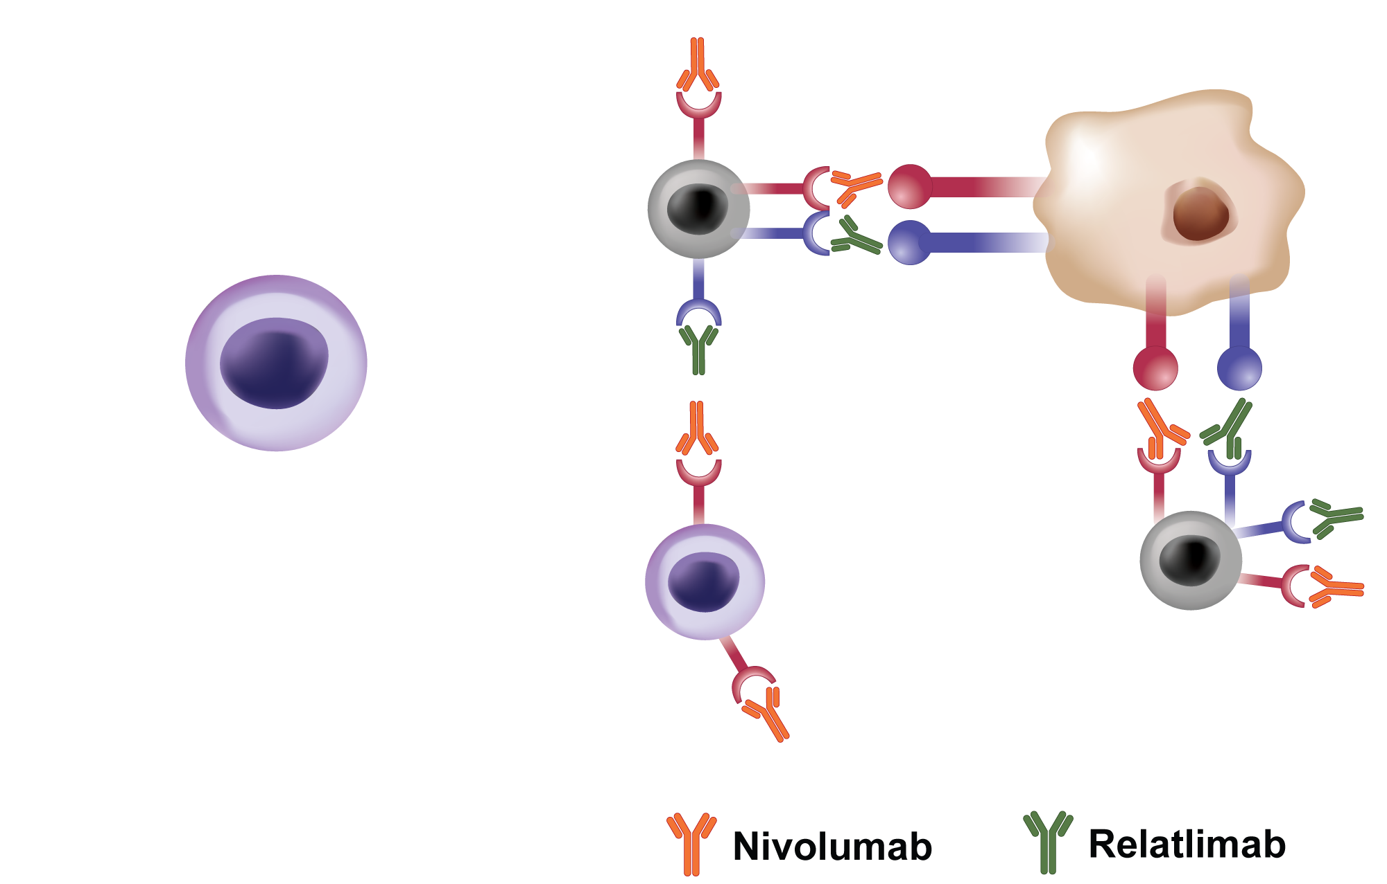
Role of LAG-3 and PD-1 in T-Cell Exhaustion and Proposed Clinical Utility of Relatlimab and Nivolumab
Anti-PD-(L)1 therapy naïve: LAG-3 may limit therapy response
Anti-PD-(L)1 therapy experienced: LAG-3 may contribute to therapy resistance
CD = cluster of differentiation
Lipson EJ et al. Proc ESMO 2018;Abstract 1302TiP.

Slide 58
Antitumor Activity in a Phase I/IIa Study of Relatlimab + Nivolumab in Melanoma Previously Treated with Anti-PD-1/PD-L1 Therapy
 | Allª (N = 61) | LAG-3 ≥ 1%^{b} (N = 33)
ORR, n (%)^{c} | 7 (11.5)^{d} | 6 (18)^{d}
Best overall response, n (%)^{c}
CR | 1 (1.6) | 1 (3.0)
PR | 6 (9.8)^{d} | 5 (15)^{d}
SD | 23 (38) | 15 (45)
PD | 25 (41) | 8 (24)
Clinical progression^{e} | 6 (9.8) | 4 (12)
DCR (CR + PR + SD), n (%)^{c} | 30 (49) | 21 (64)
ORR was 11.5% and DCR was 49%
LAG-3 expression (≥1%) enriched for response
Median duration of response was not reached (range, 0.1+ to 39+)
ª Response-evaluable patients. ^{b} Immune-cell LAG-3 expression evaluated by IHC. ^{c} Tumor response evaluated by investigator per RECIST v1.1. ^{d} One unconfirmed response. ^{e} Occurred prior to first radiographic scan.
Ascierto PA et al. Proc ESMO 2017;Abstract LBA18.

Slide 59
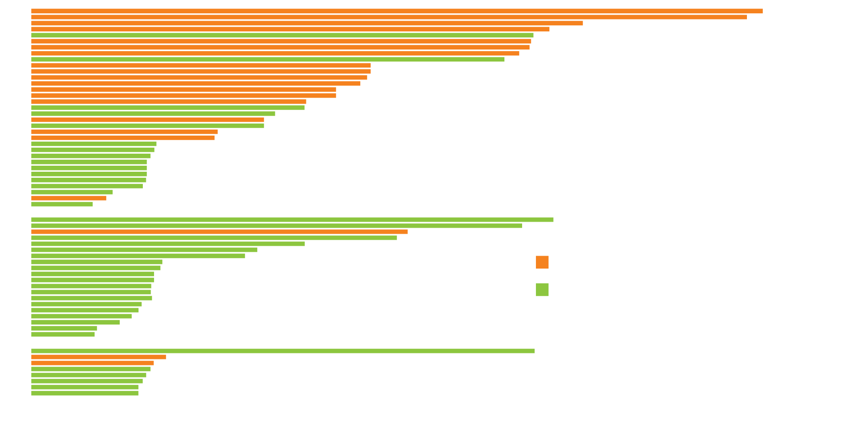
Antitumor Activity in a Phase I/IIa Study of Relatlimab + Nivolumab in Melanoma Previously Treated with Anti-PD-1/PD-L1 Therapy
LAG-3 ≥1%
LAG-3 <1%
LAG-3 unknown
Weeks^{d}
ª Response-evaluable patients; all progressed during prior anti-PD-(L)1 therapy. ^{b} Censored on last visit. ^{c} One response was unconﬁrmed. ^{d} Evaluations are planned for every 8 weeks.
PFS = progression-free survival
Ascierto PA et al. Proc ESMO 2017;Abstract LBA18.

Slide 60
Phase II/III Trial Schema: Relatlimab Added to Nivolumab
Target accrual: 700
Eligibility
Stage III (unresectable) or Stage IV melanoma Treatment naïve for unresectable or metastatic melanoma No active brain metastases No active, known or suspected autoimmune disease
Relatlimab + nivolumab
R
Nivolumab
Primary endpoint: Progression-free survival
www.clinicaltrials.gov. Accessed May 9, 2019 (NCT03470922).

Slide 61
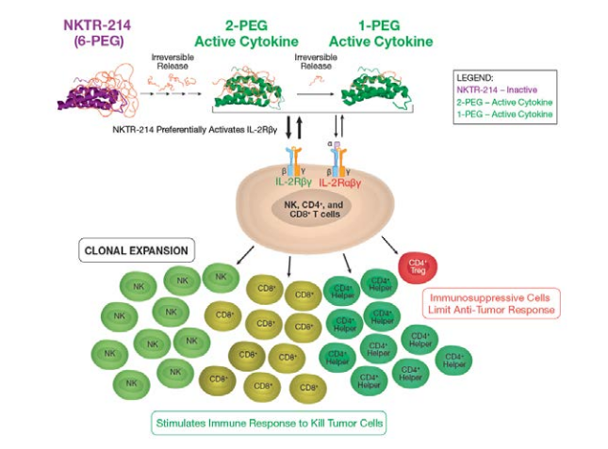
Mechanism of Action of Bempegaldesleukin (NKTR-214)
NKTR-214 is a CD122-biased cytokine agonist conjugated with multiple releasable chains of polyethylene glycol (PEG), designed to provide sustained signaling through the IL-2Rβγ pathway to preferentially activate and expand effector CD8+ T and NK cells over Tregs in the tumor
Parisi G et al. Proc AACR 2018;Abstract 3566.

Slide 62
Safety in a First-in-Human Study of NKTR-214 in Patients with Advanced or Metastatic Solid Tumors (N = 28)
Majority of patients had a diagnosis of metastatic RCC (n = 15; 53.6%) or melanoma (n = 7; 25.0%)
All patients had received prior anticancer treatment (Median: 2 [range: 1-12]):
16 (57.1%) had received targeted therapy;
16 (57.1%) had received an immune checkpoint inhibitor;
6 (21.4%) had received an immune checkpoint inhibitor in addition to other immunotherapy
Treatment-emergent AE with NKTR-214 0.006 mg/kg q3wk (recommended Phase II dose) | Grades 1-2 | Grades 3-5
Fatigue | 9 (82%) | 0
Hypotension | 8 (73%) | 1 (9%)
Flu-like symptoms | 8 (73%) | 0
Pruritis | 7 (64%) | 0
Rash | 6 (55%) | 0
Decreased appetite | 6 (55%) | 0
Cough | 5 (45%) | 0
Bentebibel SE et al. Cancer Discov 2019;9(6):711-21.

Slide 63
PIVOT-02 Phase I/II Study of Bempegaldesleukin (NKTR-214) with Nivolumab (Melanoma Cohort)
Patients with Previously Untreated Metastatic Melanoma
Investigator-assessed ORR: 19/38 (50%)
Median duration of response: Not reached
Diab A et al. Proc Immunotherapy Bridge, Melanoma Bridge 2018;Abstract O15.

Slide 64
Bempegaldesleukin (NKTR-214) Phase III Trial Schema
Target accrual: 764
Eligibility
Stage III (unresectable) or Stage IV melanoma Treatment-naïve for unresectable or metastatic melanoma No active brain metastases No active, known or suspected autoimmune disease
Bempegaldesleukin + nivolumab
R
Nivolumab
Primary endpoints: Overall response rate, PFS, OS
www.clinicaltrials.gov. Accessed May 9, 2019 (NCT03635983).

Slide 65
Regulatory and reimbursement issues aside, for a younger patient (<65 years old) with primary BRAF V600E-mutant melanoma for whom you are recommending adjuvant therapy, what is your usual choice of treatment?
Nivolumab
Nivolumab/ipilimumab
Pembrolizumab
Ipilimumab
Dabrafenib/trametinib
Other

Slide 66
What is your usual first-line treatment for an asymptomatic, clinically stable younger patient with BRAF-mutant metastatic melanoma and PD-L1 expression of 0%?
Nivolumab
Nivolumab/ipilimumab
Pembrolizumab
Vemurafenib/cobimetinib
Dabrafenib/trametinib
Encorafenib/binimetinib
Ipilimumab
Other

Slide 67
What is your usual initial treatment approach for an asymptomatic younger patient with BRAF-mutant metastatic melanoma including multiple bilateral brain metastases?
Whole-brain radiation therapy
Nivolumab
Nivolumab/ipilimumab
Pembrolizumab
Vemurafenib/cobimetinib
Dabrafenib/trametinib
Encorafenib/binimetinib
Ipilimumab
Other

