Slide 1
Please note, these are the actual video-recorded proceedings from the live CME event and may include the use of trade names and other raw, unedited content.

Slide 2
Selection and Sequence of Therapy for ER-Positive, HER2-Negative Metastatic BC (mBC); Novel Agents and Strategies Under Evaluation in ER-Positive Disease
Fabrice ANDRE Gustave Roussy

Slide 3
Disclosures
Contracted Research | AstraZeneca Pharmaceuticals LP, Lilly, Novartis, Pfizer Inc, Roche Laboratories Inc

Slide 4
A postmenopausal woman in her mid-50s with strongly ER/PR-positive, HER2-negative metastatic breast cancer (Dr André)
7 years ago: 2.5-cm, Grade 1 ER-positive (100%), PR-positive (80%), HER2-negative IDC with 6 positive nodes and low Ki-67 (8%)
Conservative surgery → adjuvant chemotherapy, radiation therapy and 5 years of adjuvant letrozole
Metastases from adenocarcinoma of the breast to cervical lymph node, iliac bone and L1 spine
ER-positive (80%), PR-positive (70%), HER2 IHC1+, Ki-67 low

Slide 5
A woman in her mid-70s with de novo ER/PR-positive, HER2-negative metastatic breast cancer to the liver (Dr André)
5-cm ER-positive (60%), PR-positive (40%), HER2-negative (IHC1+) IDC, with a Ki-67 of 30%
Scan: Massive involvement of the liver
ALT 2-fold increase, bilirubin normal, PS = 1
Palbociclib and letrozole
Progressive disease after 20 months

Slide 6
Outline
CDK4/6 inhibitors: transformative or incremental?
PI3K inhibitors: how to use them? What is their potential value?
New targets

Slide 7
CDK4 pathway
Cell signaling
Regulates
expression
ER
Cyclin D1
CDK4
p21
p16
P
P
Rb
Rb
E2F
E2F
G1/S transition
cell proliferation
Hamilton E & Infante JR. Cancer Treat Rev. 2016;45:129–138.

Slide 8
Impact of CDK4/6 inhibitors (abemaciclib, palbociclib, ribociclib) on PFS
Line | Trial | Schema | PFS HR compared to endocrine alone
First line | PALOMA-1 | Letrozole ± palbociclib | 0.49
 | PALOMA-2 | Letrozole ± palbociclib | 0.58
 | MONALEESA-2 | Letrozole ± ribociclib | 0.56
 | MONALEESA-7 | NSAI/tamoxifen ± ribociclib | 0.55
 | MONARCH 3 | Letrozole or anastrozole, ± abemaciclib | 0.54
Second line | PALOMA-3 | Fulvestrant ± palbociclib | 0.46
 | MONARCH 2 | Fulvestrant ± abemaciclib | 0.55
 | MONALEESA-3 | Fulvestrant ± ribociclib | 0.57

Slide 9
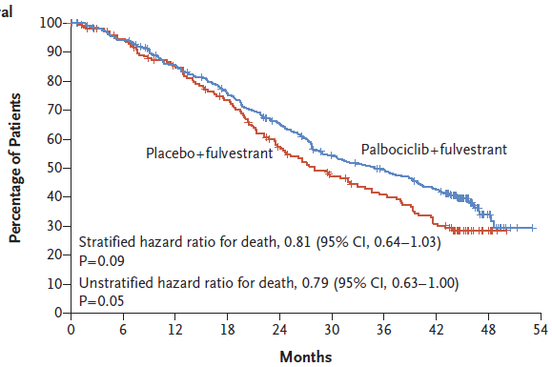
Impact on OS
Turner NC et al. N Engl J Med 2018;379(20):1926-36.

Slide 10
Phase III MONALEESA-7 trial of premenopausal patients with HR+/HER2− advanced breast cancer (ABC) treated with endocrine therapy ± ribociclib: Overall survival (OS) results.
Hurvitz SA et al.
ASCO 2019;Abstract LBA1008.
Oral Abstract Session, Tuesday, June 4, 11:57 AM - 12:09 PM, Hall D1

Slide 11
Safety profile
 | Palbo-letrozole | Ribo-letrozole | Abema-letrozole
Neutropenia (grade 3/4) | 62% | 59% | 21%
Anemia (any grade) | 28% (vs 11%) | 20% (vs 5%) | 28% (vs 5%)
Thrombocytopenia (grade 3/4) | 2% (vs 0%) | NR | NR
Fatigue (any) | 39% (vs28%) | 38% (vs 30%) | 40% (vs 31%)
QT prolongation (>480 msec) | NR | 3% | NR
Diarrhea (grade 2-4) | 0% | 1% (grade 3) | 36%
Alopecia (any grade) | 15% (vs 6%) | 33% (vs 15%) | 26% (vs 10%)
Increased Alanine Amino Transferase | NR | 9% (vs 1%) | 6% (vs 2%)
Phlebitis (any) | Overincidence not well assessed, but signal
Finn, NEJM, 2016, Hortobagyi, NEJM, 2016, Goetz, J Clin Oncol, 2018

Slide 12
Abemaciclib for brain metastases: CNS concentration in ongoing Phase II study
Plasma, CSF, and Resected Tumor Tissue
Concentrations of Abemaciclib
Patients with brain metastases
Part A:
HR+/HER2+
breast cancer
(23 to 56 patients)
Part B:
HR+/HER2-
breast cancer
(23 to 56 patients)
Part D:
NSCLC
(23 to 56 patients)
Part E:
Melanoma
(23 to 56 patients)
Primary endpoint:
Objective intracranial response rate
Exploratory
Measurable levels of abemaciclib were detected in brain tumor tissue.
Concentrations of abemaciclib in the plasma and tumor tissue were comparable and consistent with the CSF concentration for each of the patients.
Part C: HR+ breast cancer,
NSCLC or melanoma and clinically indicated for surgical resection (after receiving 5-14 days of therapy)
(~8 patients)
Part F: HR+ breast cancer, NSCLC or melanoma and leptomeningeal metastases
(± parenchymal brain metastases)
(~15 patients)
Sahebjam S et al. Proc ASCO 2016;Abstract 526.

Slide 13
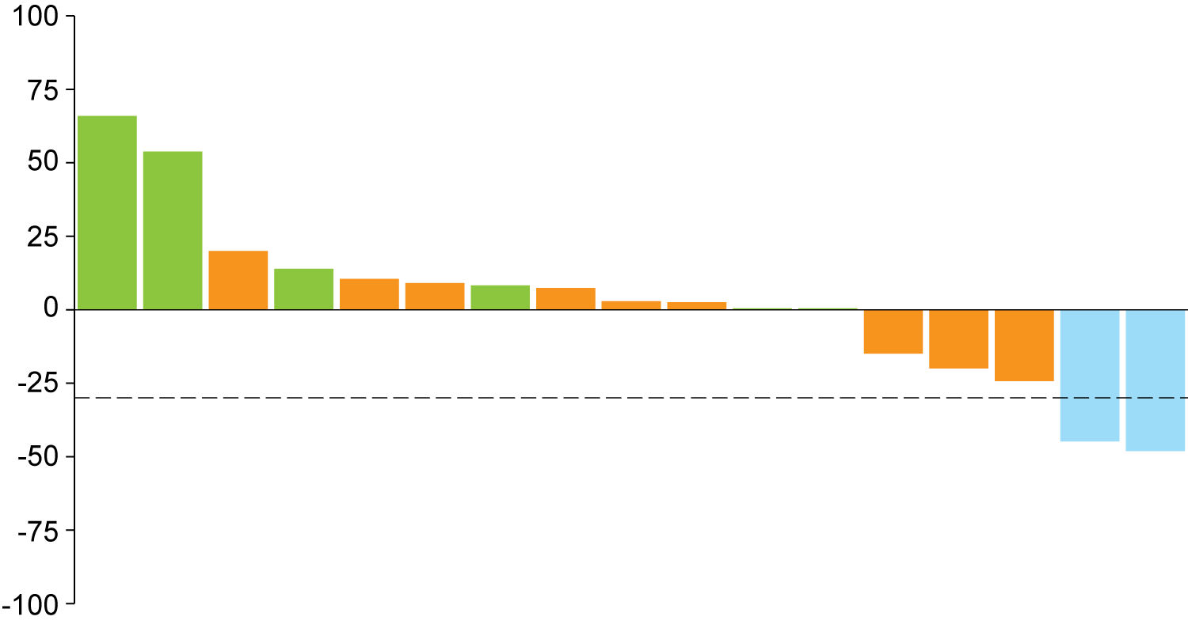
Abemaciclib for ER+ brain metastases
Efficacy population patients with response | N = 23
OIRR, n (%), (95% CI) | 2 (8.7), (0.0, 20.2)
CR, n (%) | 0
PR, n (%) | 2 (8.7)
SD, n (%) | 10 (43.5)
SD^{c} ≥ 6 months, n (%) | 2 (8.7)
PD or early death, n (%) | 8 (34.8)
CBR, n (%), (95% CI) | 4 (17.4), (1.9, 32.9)
CNS Responseª Summary^{b}



% Change from Baseline





❒
❒

█ CR
█ SD
█ PR
█ PD
█ NE


 Received concomitant endocrine therapy
 Tumors previously treated with WBRT
❒ Tumors previously treated with SRS
Individual Patients
ª Response criteria per RANO-BM. ^{b} 6 patients had no postbaseline tumor measurements and therefore were not included in this waterfall plot.
^{c} Patients with SD ≥6 months are included in the number of patients with SD.
Tolaney S et al. Proc ASCO 2017;Abstract 1019.

Slide 14
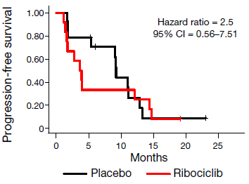
Predictive biomarkers on baseline samples (validated in several independent studies)
Cell signaling
RB1 mutations
Cyclin E
CDK2
Cyclin D1
CDK4
p21
p16
CCNE1 expression
P
P
Rb
Rb
E2F
Bertucci F et al. Nature 2019;569:560-4.
E2F
G1/S transition
cell proliferation
Turner NC et al. J Clin Oncol 2019;37(14):1169-78.
Hamilton E & Infante JR. Cancer Treat Rev. 2016;45:129–138.

Slide 15
Outline
CDK4/6 inhibitors: transformative or incremental?
PI3K inhibitors: how to use them? What is their potential value?
New targets

Slide 16
PI3 kinase pathway
Isoforms of catalytic subunit
30-40% activating mutations
of PIK3CA in HR+/HER2 mBC
PI3K
Catalytic
subunit
p110
α
β
δ
γ
Regulatory
subunit
p85
AKT
Cell cycle
metabolism
PIP2
PIP3
PTEN

Slide 17
SOLAR-1: A Phase III randomized, controlled trial (NCT02437318)
PBO + FUL 500 mg IM* n=172
ALP 300 mg QD PO + FUL 500 mg IM*
n=169
PIK3CA-mutant cohort (PCR, exon 7,9,20) (n=341)
Primary endpoint
PFS in PIK3CA-mutant cohort (locally assessed)
Secondary endpoints include:
OS (PIK3CA-mutant cohort)
PFS (PIK3CA-non-mutant cohort)
PFS (PIK3CA mutation in ctDNA)
OS (PIK3CA-non-mutant cohort)
ORR/CBR
Safety
Men or postmenopausal women, with HR+, HER2– ABC
Recurrence/progression on/after prior AI
Identified PIK3CA status (in archival or fresh tumor tissue)
Measurable disease or ≥1 predominantly lytic bone lesion
ECOG performance status ≤1
(N=572)
R
1:1, stratified by presence of liver/lung metastases and prior CDK4/6 inhibitor treatment
PBO + FUL 500 mg IM*
n=116
ALP 300 mg QD PO + FUL 500 mg IM*
n=115
PIK3CA-non-mutant cohort (n=231)
R
*Fulvestrant given on Day 1 and Day 15 of the first 28-day cycle, then Day 1 of subsequent 28 day cycles.

Slide 18
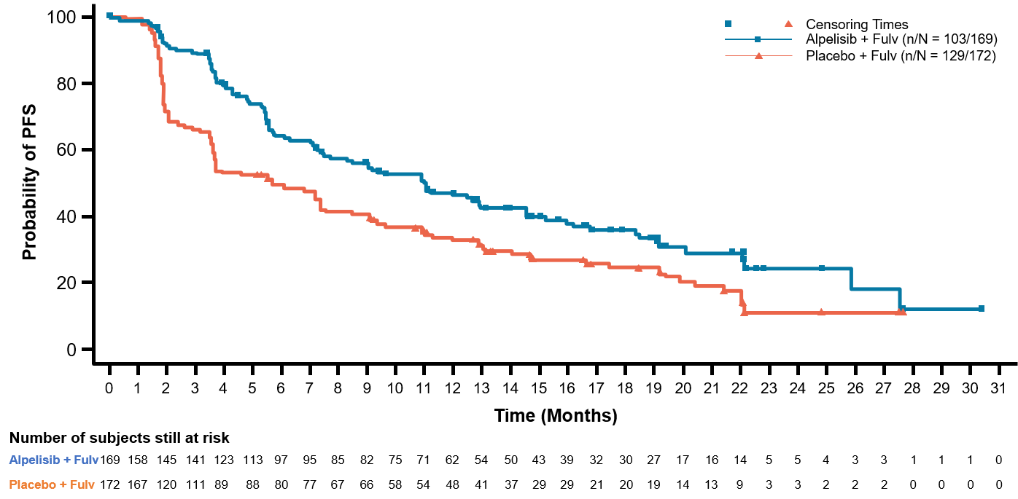
Impact of alpha-specific PI3K inhibitors (SOLAR-1 trial)
Data cut-off: Jun 12, 2018 | Alpelisib + fulvestrant (N=169) | Placebo + fulvestrant (N=172)
Number of PFS events, n (%) | 103 (60.9) | 129 (75.0)
Median PFS (95% CI) | 11.0 (7.5–14.5) | 5.7 (3.7–7.4)
HR (95% CI) | 0.65 (0.50–0.85)
p-value | 0.00065
No effect on PIK3CA-WT
Preliminary OS: HR:0.73 (0.48-1.10)
Andre F et al. N Engl J Med 2019;380(20):1929-40; Juric D et al. SABCS 2018;Abstract GS3-08.

Slide 19
Adverse events in the total population
AEs ≥20% in either arm, % | Alpelisib + fulvestrant N=284 |  |  | Placebo + fulvestrant N=287
 | All | Grade 3 | Grade 4 | All | Grade 3 | Grade 4
Any adverse event | 282 (99.3) | 183 (64.4) | 33 (11.6) | 264 (92.0) | 87 (30.3) | 15 (5.2)
Hyperglycemia | 181 (63.7) | 93 (32.7) | 11 (3.9) | 28 (9.8) | 1 (0.3) | 1 (0.3)
Diarrhea | 164 (57.7) | 19 (6.7) | 0 | 45 (15.7) | 1 (0.3) | 0
Nausea | 127 (44.7) | 7 (2.5) | 0 | 64 (22.3) | 1 (0.3) | 0
Decreased appetite | 101 (35.6) | 2 (0.7) | 0 | 30 (10.5) | 1 (0.3) | 0
Rash* | 101 (35.6) | 28 (9.9) | 0 | 17 (5.9) | 1 (0.3) | 0
Vomiting | 77 (27.1) | 2 (0.7) | 0 | 28 (9.8) | 1 (0.3) | 0
Decreased weight | 76 (26.8) | 11 (3.9) | 0 | 6 (2.1) | 0 | 0
Stomatitis | 70 (24.6) | 7 (2.5) | 0 | 18 (6.3) | 0 | 0
Fatigue | 69 (24.3) | 10 (3.5) | 0 | 49 (17.1) | 3 (1.0) | 0
Asthenia | 58 (20.4) | 5 (1.8) | 0 | 37 (12.9) | 0 | 0
Management Hyperglycemia:
Early detection: day 8 visit,
metformin if glycemia (or Hb1c) above normal level
Exclude diabetic patients
Management Rash:
Topical steroids, antihistamine (prophylaxis ++)
Andre F et al. ESMO Congress 2018;Abstract LBA3_PR.

Slide 20
Outline
CDK4/6 inhibitors: transformative or incremental?
PI3K inhibitors: how to use them? What is their potential value?
New targets

Slide 21
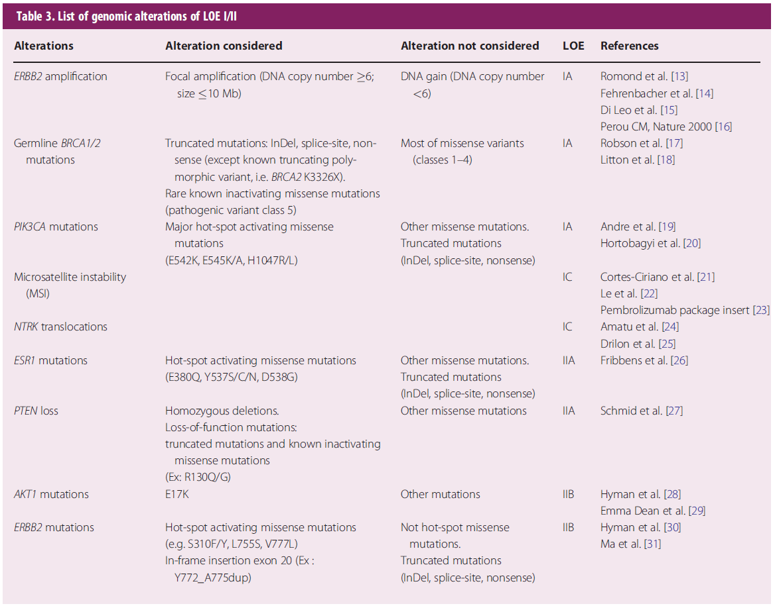
List of actionable alterations in breast cancer
Condorelli R et al. Ann Oncol 2019;30(3):365-73.

Slide 22
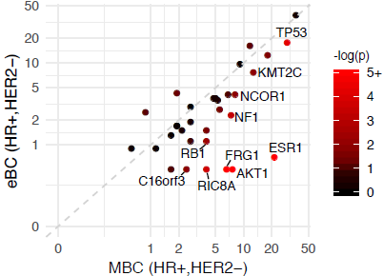
Which genomic alterations are acquired after resistance to ET and could be a target?
MethylTransferase:
epigenetics
ER pathway
CDK4 pathway
PI3K pathway
Bertucci F et al. Nature 2019;569:560-4.

Slide 23
Randomized Phase II Trial of Venetoclax + Fulvestrant versus Fulvestrant in Estrogen Receptor+, HER2– Locally Advanced or Metastatic Breast Cancer Following Recurrence or Progression During or After a CDK4/6 Inhibitor: VERONICA
Lindeman GJ et al. ASCO 2019;Abstract TPS1108
Breast Cancer – Metastatic
Sunday, June 2nd, 2019

