Slide 1
Please note, these are the actual video-recorded proceedings from the live CME event and may include the use of trade names and other raw, unedited content.

Slide 2
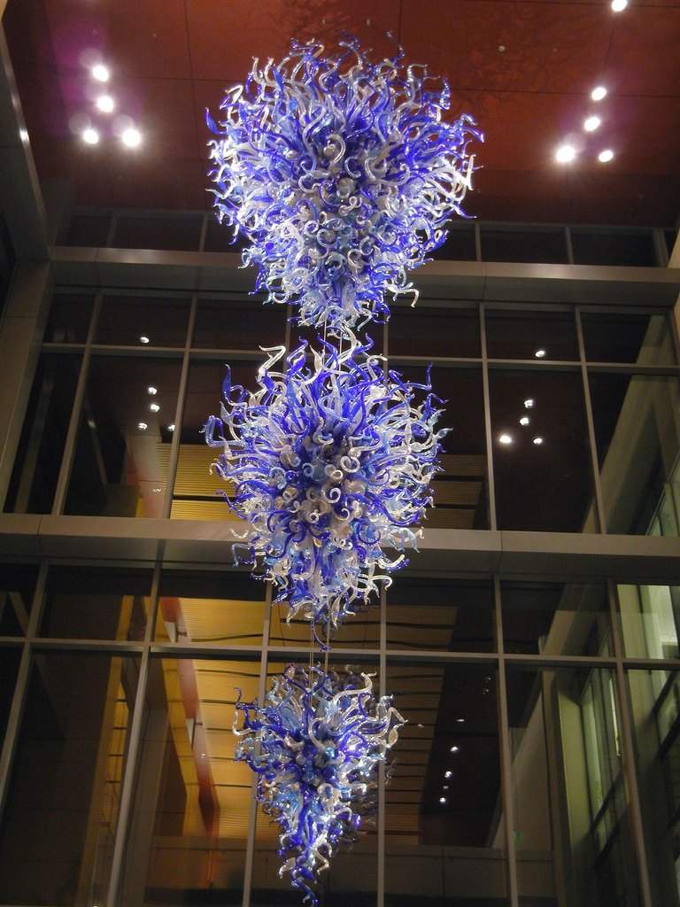
Protocol and Off-Protocol
Decision-Making for Patients
with HER2-Positive mBC
June 2019
Mark Pegram, M.D.
Susy Yuan-Huey Hung Professor of Medical Oncology
Associate Director for Clinical Research
Director, Stanford Breast Oncology Program
Associate Dean for Clinical Research Quality
Stanford Comprehensive Cancer Institute

Slide 3
Disclosures
Advisory Committee and Consulting Agreements | Genentech, Pfizer Inc, Puma Biotechnology Inc, Roche Laboratories Inc, Samsung Bioepis

Slide 4
A woman in her mid-60s with widespread ER-negative, HER2-positive metastatic breast cancer, including disease progression in the brain (Dr Pegram)
15 to 20 months after completion of (neo)adjuvant chemotherapy/trastuzumab: Bilateral hydronephrosis
Workup: Multiple bone metastases in the skull, right acetabulum, right iliac crest
Pertuzumab, trastuzumab and docetaxel
After 6 cycles: Bone metastases improvement, bilateral hydronephrosis resolves
Progressive disease after 6 months
T-DM1 x 6 cycles until disease progression in the liver and lungs
HER2CLIMB (tucatinib in combination with capecitabine/trastuzumab) → PR
After 6 more months: Headache, right limb ataxia → 2 brain mets by brain MRI
Stereotactic RT with good response, extracranial disease remains under control
Notes:
Gujja Cut 02

Slide 5
A woman in her late 50s with HER2-positive hepatic metastases from breast cancer (Dr Pegram)
12/2015: Left-sided, ER-positive, PR-negative, HER2-positive IDC
Early 2016: TCHP x 6 → lumpectomy/SLNB
Pathologic stage: ypT1cN1(mic)M0
Completes 1 year adjuvant trastuzumab
Adjuvant anastrozole → exemestane → tamoxifen (intolerable arthralgias)
10/2018: Chest wall lesions and biopsy-confirmed HER2-positive hepatic metastases
Brain MRI: Negative
Notes:
Gujja Cut 02

Slide 6
PRESENTATION OUTLINE:
HER2-specific and pan-HER TKI update, including CNS activity
HER2-directed ADCs
Fc-engineered HER2 MAb margetuximab

Slide 7
Tucatinib (ONT-380) -- 005 Triplet Cohort Response
tucatinib + capecitabine + trastuzumab (n = 23)
ORR: 14/23 (61%)
Median Duration of Response: 10 months (95% CI: 2.8-19.3)
-30%
Without brain mets (n = 14)
With brain mets (n = 9)
P = Prior pertuzumab treatment (n = 18)
Note: Bars represent change in measurable lesions but some patients also have nonmeasurable lesions. In addition, 4 patients in the Triplet cohort had nonmeasurable lesions only and are therefore not able to be represented on the waterfall.
Murthy R, et al. Lancet Oncology, VOLUME 19, ISSUE 7, P880-888, JULY 01, 2018
Hamilton E, et al., SABCS 2016, Abstract P4-21-01

Slide 8
ONT-380-005 –Triplet Study: Severity of Most Common AEs
 | Tucatinib + Capecitabine + Trastuzumab (n = 27)
 | Grade 1 | Grade 2 | Grade 3 | Total
AEs (≥20%)
Diarrhea | 14 (52%) | 4 (15%) | 3 (11%) | 21 (78%)
Nausea | 11 (41%) | 6 (22%) | 0 | 17 (63%)
Palmar-Plantar Erythrodysaesthesia Syndrome | 2 (7%) | 13 (48%) | 3 (11%) | 18 (67%)
Vomiting | 9 (33%) | 2 (7%) | 0 | 11 (41%)
Fatigue | 5 (19%) | 3 (11%) | 3 (11%) | 11 (41%)
Decreased Appetite | 2 (7%) | 4 (15%) | 0 | 6 (22%)
Upper Respiratory Tract Infection | 3 (11%) | 3 (11%) | 0 | 6 (22%)
Hypokalaemia | 4 (15%) | 2 (7%) | 0 | 6 (22%)
LFT Abnormalities
Increased AST | 15 (56%) | 6 (22%) | 2 (7%) | 23 (85%)
Increased ALT | 15 (56%) | 2 (7%) | 2 (7%) | 19 (70%)
Increased Bilirubin | 8 (30%) | 4 (15%) | 2 (7%) | 14 (52%)
Tucatinib has an acceptable safety profile at the
RP2D (300 mg PO BID)
Most (~70%) treatment-emergent adverse events
were Grade 1
No instance of CHF
3 patients (11%) had transient Grade 3 LFT
elevations -- continued therapy after dose reduction
3 patients (11%) had Grade 3 diarrhea seen only
in capecitabine-containing cohorts -- consistent
with single agent capecitabine treatment
No deaths 2º to treatment-emergent adverse events
1 DLT (cerebral edema) in triplet cohort
Safety profile consistent with previous tucatinib
studies, and known side effects of
capecitabine and trastuzumab
Note: Two Grade 4 AEs were reported for cerebral edema and breast implant infection and no Grade 5 events were reported
Murthy R, et al. Lancet Oncology, VOLUME 19, ISSUE 7, P880-888, JULY 01, 2018
Hamilton E, et al., SABCS 2016, Abstract P4-21-01

Slide 9
Current HER2CLIMB Pivotal Phase II Trial Design
Patient Population
Metastatic HER2+ breast cancer with progression after pertuzumab, trastuzumab, and T-DM1
Patients with and without brain metastases
2:1
n=480*
*Actual enrollment
612 (CT.gov)
capecitabine + trastuzumab + tucatinib
Primary endpoint:
PFS in all pts
Secondary endpoints:
PFS in pts w/ brain metastases
OS in all pts
capecitabine + trastuzumab + placebo
Stratified for brain metastases, ECOG status and region of world
Hierarchical testing of endpoints; each endpoint must be positive to enable testing of subsequent endpoint (PFS → PFS in subset of patients with brain metastases → OS)
Goal of ≥50% improvement in PFS
Control arm PFS estimate = 4.5 months (historical PFS:TH3RESA control=3.3 months)
Multi-center, multi-national
Estimated primary completion date September 2020 (clinicaltrials.gov)
NCT02614794

Slide 10
NALA Trial (ASCO 2019) Global Phase III Registration Study Design
Capecitabine + Neratinib or Lapatinib as 3L+ in Patients With HER2+ mBC
Time to intervention for
symptomatic CNS disease
longer in the N+C arm
PFS HR = 0.76;
95% CI 0.63–0.93; p = 0.006
(12m PFS 28.8% vs 14.8%
for N+C vs L+C, respectively)
OS HR = NOT significant
(0.88; 95% CI 0.72–
1.07; p = 0.2086)
ORR in patients with
measurable disease
32.8% vs 26.7% (N+C vs L+C);
p = 0.1201
“Tolerability was similar
between the two arms” - ??
Grade 3 diarrhea increased
with N+C (24.4% vs 12.5%)
≥ 3rd-line therapy for patients with HER2+ metastatic breast cancer
Prior T-DM1, pertuzumab acceptable; prior lapatinib, capecitabine not permitted
Patients with asymptomatic CNS metastatic disease are eligible to enroll*
*TBCRC 022 – 49% CNS ORR (N+C), N=37; 29% G3 diarrhea¹
STUDY OBJECTIVES:
Co-primary endpoints: PFS (central) and OS
Secondary endpoints: PFS (local), ORR, DoR, CBR, time to intervention for CNS metastases, safety, health outcomes
Neratinib 240 mg + capecitabine 1500 mg/m²
PD
Metastatic
Breast Cancer:
Received ≥ 2 prior lines of HER2-directed therapy
R
1:1
Follow-up
(Survival)
Lapatinib 1250 mg + capecitabine 2000 mg/m²
Randomize
n=300 each arm
PD
Freedman RA, et al. JCO (2019) 37:13, 1081-89
CBR is defined as Complete Response (CR) or Partial Response (PR) or Stable Disease (SD) for ≥ 24 weeks
Loperamide prophylaxis required in neratinib arm
CBR=clinical benefit rate; CNS=central nervous system; mBC=metastatic breast cancer; PD=progressive disease.
ClinicalTrials.gov Identifier: NCT01808573

Slide 11
Neratinib Efficacy in HER2-Mutant Nonamplified Metastatic Breast Cancer
HER2 mutation frequency: 5/309 (1.6%),
4/51 (7.8%) in invasive lobular (P=0.026).
At progression, emergence of several
other HER2 mutations, including T798I
(analogous to EGFR T790M “gatekeeper”
resistance mutation). CBR = 31%.
PR by RECIST v1.1
Courtesy Baselga_St-Gallen-2017

Slide 12
Pyrotinib (an irreversible pan-ErbB receptor tyrosine kinase inhibitor) combined with capecitabine in HER2+ metastatic breast cancer previously treated with trastuzumab and taxanes: A randomized phase III study
Jiang Z, et al. Journal of Clinical Oncology 37, no. 15_suppl
(May 20 2019) 1001-1001. NCT02973737.

Slide 13
HER2 MAb/ADC BBB Penetration
T-DM1 in HER2+ brain mets
ZEPHIR Trial
Patient 216
ORR = 30.2% (N = 53)
Extracranial ORR = 35.1%
PET results demonstrate that
⁸⁹Zr-trastuzumab does gain
access to the CNS in patients
with HER2+ brain metastases.
Fabi A, et al. Oncotarget. 2017;8(38):64481-89.

Slide 14
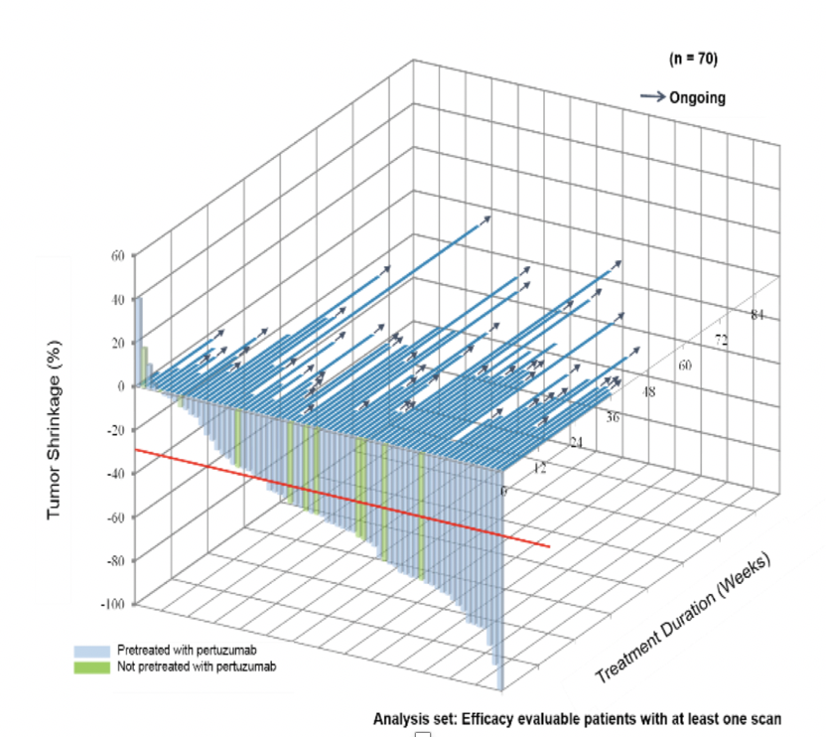
Trastuzumab deruxtecan (DS-8201a) Poster # P6-17-02 – San Antonio Breast Cancer Symposium® – December 4–8, 2018.
HER2+
Data
ILD risk significantly associated with dose,
p < 0.001
(Cox proportional hazards)
ILD monitoring and management plan implemented
DAR = 8
DAR = Drug to antibody ratio
HER2-“low” data*
*Modi S, et al. A phase III, multicenter, randomized,
open label trial of trastuzumab deruxtecan
(DS-8201a) versus investigator’s choice in HER2-low
breast cancer: J Clin Oncol 37, 2019
(suppl; abstr TPS1102)
Poster # P6-17-02 – San Antonio Breast Cancer Symposium® – December 4–8, 2018
Poster Session (Board #182a): Sunday June 2, 8:00 AM to 11:00 AM, ASCO 2019

Slide 15
Phase II DESTINY-Breast01 Trial Meets Its Primary Endpoint Press Release – May 8, 2019
Positive top-line results were announced for the Phase II DESTINY-Breast01 trial of trastuzumab deruxtecan (DS-8201). The HER2-targeting antibody drug conjugate (ADC) was evaluated in patients with HER2-positive, unresectable and/or metastatic breast cancer previously treated with trastuzumab emtansine.
“The response rate in DESTINY-Breast01, as assessed by an independent review committee, confirms in a heavily-pretreated, global patient population the unprecedented clinical activity in the recently-published Phase I trial. The safety and tolerability profile of trastuzumab deruxtecan was also consistent with previous experience. These results are expected to support planned global regulatory submissions, including a Biologics License Application with the US Food and Drug Administration (FDA) anticipated in the second half of 2019.”
https://www.astrazeneca.com/media-centre/press-releases/2019/trastuzumab-deruxtecan-demonstrated-clinically-meaningful-response-in-patients-with-refractory-her2-positive-metastatic-breast-cancer-a-population-with-high-unmet-need-08052019.html

Slide 16
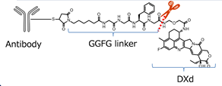
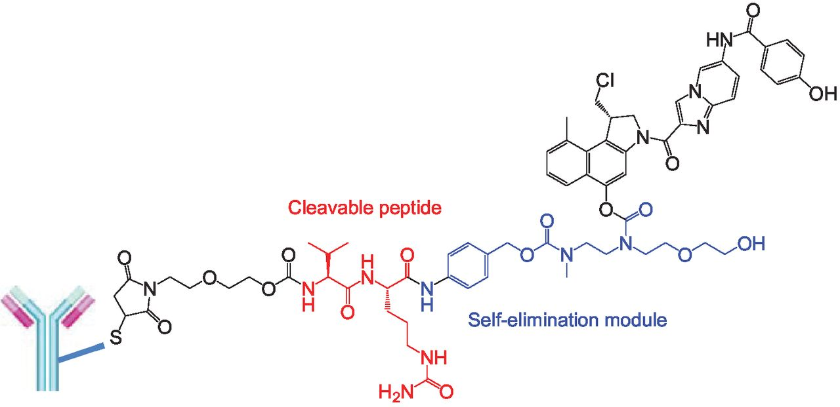
Antibody-drug conjugates (ADCs) in HER2-low MBC patients
 | DS-8201a (Abstract #:2501) | SYD985 (Abstract #:1014)
Trial phase | Phase I | Phase I
Antibody | Trastuzumab | Trastuzumab
Payload | Deruxtecan (Topoisomerase I inhibitor) | Duocarmycin (alkylating agents)
Population | Heavily pretreated MBC | Heavily pretreated MBC
HER2 low definition | IHC 1+/2+/ISH- | IHC 1+/2+/ISH-
ORRs (95%CI) | 10/26, 38.5% (20.2, 59.4) | HR+ (N=32): 27%
 |  | HR- (N=17): 40%
M Pegram

Slide 17
Fc Receptors Modulate Antitumor Activity of Trastuzumab
Paul
Mike
Leny
The trastuzumab Fc-domain/FcgRIIIa
Complex is a Potent Mediator of ADCC
Pegram, et al., Proc Am Assoc Cancer Res
38: 602, 1997 (abstr 4044).
Adapted from Clynes et al. Nature Med. 2000;6:443-446

Slide 18
Improved Outcomes in Patients with High binding FcR Alleles
FcγRIIIa V allele carriers
CHER-LOB trial
Neoadjuvant
C+T C+L C+T+L
A Musolino, et al. The Pharmacogenomics Journal
16, 472–477 (2016).
NSABP B31
Adjuvant
Parma Data, MBC
Gavin PG, et al. JAMA Oncol. 2017; 3(3): 335-341.
Musolino, A. et al. J Clin Oncol 26:1789-1796, 2008.

Slide 19
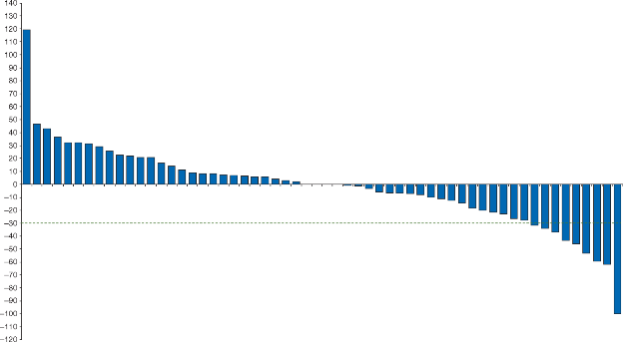
Margetuximab Plus Chemotherapy vs Trastuzumab Plus Chemotherapy in the Treatment of HER2+ Metastatic Breast Cancer (SOPHIA)*
Five amino acid substitutions in IgG1 Fc domain
Enhanced binding to low affinity variants of activating Fcγ receptor: CD16A
Diminished binding to inhibitory Fcγ receptor: CD32B
Bang, et al. Annals of Oncology, Volume 28, Issue 4, 1 April 2017, Pages 855–861
Hope S. Rugo, Mark D. Pegram, William John Gradishar, et al., ASCO 2016 Abstract 164475
ROCKVILLE, MD, Feb. 06, 2019 (GLOBE NEWSWIRE) –
Patients in the margetuximab arm experienced a 24% risk reduction in PFS compared to patients in the trastuzumab arm (HR=0.76, p=0.033).
In a pre-specified analysis, amongst the ~85% CD16A (FcγRIIIa) 158F allele carriers, which has been previously associated with diminished clinical response to trastuzumab, patients in the margetuximab arm experienced a 32% risk reduction in PFS compared to patients in the trastuzumab arm (HR=0.68, p=0.005).
*Hope Rugo: Oral Abstract Session, Tue, 9:45 AM-12:45 PM, ASCO 2019 abstract #1000
ClinicalTrials.gov Identifier: NCT02492711

Slide 20
SUMMARY
Small molecule, orally bioavailable HER2 TKI Tucatinib (ONT-380) is highly active and achieves CNS penetration – Pivotal trial (cape/tras +/- tucatinib/placebo) is ongoing. Neratinib has activity in the CNS but is saddled by GI toxicity
ADC Trastuzumab deruxtecan (DS-8201a) with unique linker/payload
– active even in HER2 “low” -- Phase II/III
-- caution interstitial pneumonitis
Fc-engineered anti-HER2 MAb with enhanced immune effector function (ADCC) -- Margetuximab – positive phase III trial (margetux vs. tras with salvage chemo)
James H. Clark Center
Stanford University
Stanford Bio-X Program:
Biology, Medicine, Chemistry,
Physics and Engineering

