Slide 1
Please note, these are the actual video-recorded
proceedings from the live CME event and may include
the use of trade names and other raw, unedited content.

Slide 2

Immunotherapy as a Rational Therapeutic Strategy in
Breast Cancer
Sara M. Tolaney, MD, MPH
Dana-Farber Cancer Institute

Slide 3
Disclosures
Advisory Committee | AstraZeneca Pharmaceuticals LP, Celldex Therapeutics, Eisai Inc, Genentech, Immunomedics Inc, Lilly, Merck, NanoString Technologies, Nektar, Novartis, Pfizer Inc, Puma Biotechnology Inc, Roche Laboratories Inc, Sanofi Genzyme
Consulting Agreements | AstraZeneca Pharmaceuticals LP, Eisai Inc, Lilly, Merck, NanoString Technologies, Nektar, Novartis, Pfizer Inc, Tesaro
Contracted Research | AstraZeneca Pharmaceuticals LP, Bristol-Myers Squibb Company, Cyclacel Pharmaceuticals Inc, Eisai Inc, Exelixis Inc, Genentech, Lilly, Merck, NanoString Technologies, Nektar, Novartis, Pfizer Inc, Roche Laboratories Inc

Slide 4
A woman in her early 60s with BRCA wild-type metastatic TNBC
(Dr Tolaney)
2013: TNBC
  Neoadjuvant dd-ACT → left mastectomy and axillary dissection
Prior to radiation therapy, recurrent TNBC in the mastectomy incision
  PET: No distant disease
Concurrent cisplatin and radiation therapy
  New skin lesions 3 months later
Eribulin → progressed with new R axillary LN
4/2015: Nab paclitaxel and atezolizumab on a Phase I clinical trial
  Resolution of erythema, improvement in axillary LN
Remains on therapy now 4 years later, NED
  Mild asymptomatic pneumonitis on scans

Slide 5
A woman in her mid-60s with BRCA wild-type, metastatic TNBC
(Dr Tolaney)
2006: TNBC → adjuvant dd-ACT
2010: Recurred with multiple sites of adenopathy
Capecitabine → vinorelbine → paclitaxel → eribulin → cisplatin
Clinical trial: Veliparib and dinaciclib
Clinical trial: Pembrolizumab
  After 2 weeks: Confusion, polyuria, polydipsia, nausea; blood glucose of 1010 and an anion gap → diabetes, requiring insulin pump
  Hypothyroidism
3/2016: Restaging scans — CR on pembrolizumab
Patient decided to hold therapy, remained off all treatment for 8 months
Recurrent disease

Slide 6
Immunotherapy in Breast Cancer
Most work to date has focused on use of checkpoint inhibitors in TNBC
  Relatively higher mutational load
  More immune cells in tumor and area surrounding the tumor
  Higher rate of PD-L1 positivity

Slide 7
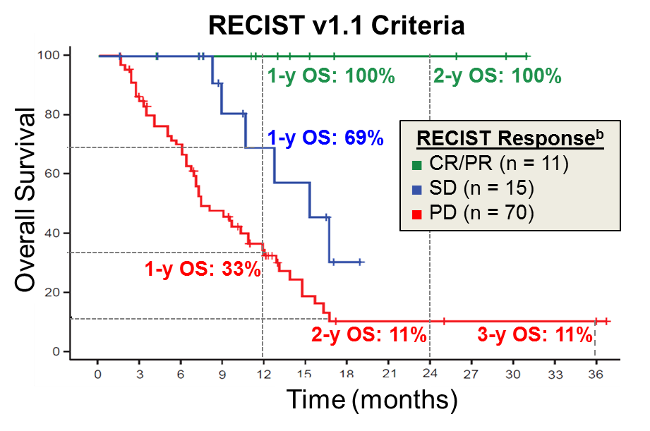
Monotherapy Activity for Metastatic TNBC: Line of Therapy Matters
Atezolizumab
Atezolizumab
(n = 115)
Pembrolizumab
(n =222)
30%
26%
23%
CR
20%
PR
Objective Response Rate (%)
CR
PR
10%
6.8%
4.7%
0%
1L
2L+
1L
2L+
Keynote-086, Cohort B
Keynote-086, Cohort A
N=96
Median OS: 9.3 mo
Emens et al, JAMA Onc 2018
Adams et al, Ann Onc 2018

Slide 8
Checkpoint Inhibitor Monotherapy
Limited activity in metastatic TNBC as monotherapy
  Higher ORR in 1L (~20%) compared to >2L (5%)
  PD-L1+ and High TILs maybe associated with better long term outcomes
  Achieving response associated with improved OS

Slide 9
Update on KEYNOTE-119: Pembrolizumab Monotherapy for Patients with Pretreated Metastatic TNBC
Press Release – May 20, 2019
The Phase III KEYNOTE-119 trial evaluating pembrolizumab as monotherapy for the second- or third-line treatment of metastatic TNBC did not meet its primary endpoint of superior overall survival compared to chemotherapy (capecitabine, eribulin, gemcitabine or vinorelbine).
https://investors.merck.com/news/press-release-details/2019/Merck-Provides-Update-on-Phase-3-KEYNOTE-119-Study-of-KEYTRUDA-pembrolizumab-Monotherapy-in-Previously-Treated-Patients-with-Metastatic-Triple-Negative-Breast-Cancer/default.aspx

Slide 10
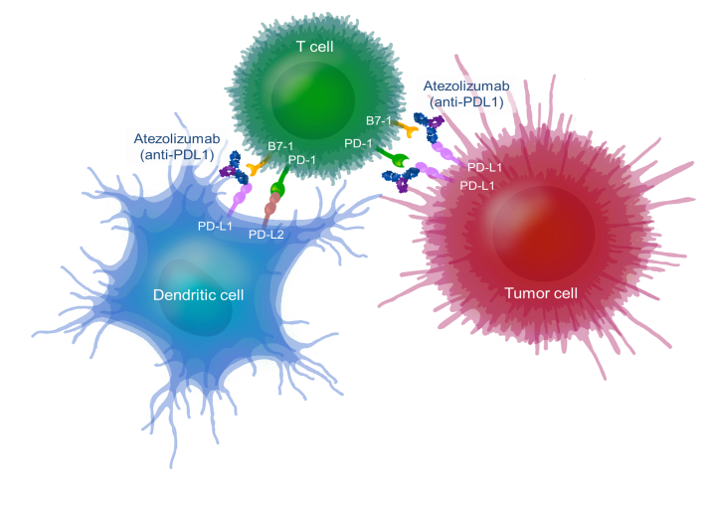
Atezolizumab + nab-Paclitaxel
Combination of checkpoint inhibitors and chemotherapy may be synergistic
Adams S, et al. SABCS 2015

Slide 11
IMpassion130 study design
Key IMpassion130 eligibility criteriaª:
Metastatic or inoperable locally advanced TNBC
  Histologically documented^{b}
No prior therapy for advanced TNBC
  Prior chemo in the curative setting, including taxanes, allowed if TFI ≥ 12 mo
ECOG PS 0-1
Stratification factors:
Prior taxane use (yes vs no)
Liver metastases (yes vs no)
PD-L1 status on IC (positive [≥ 1%] vs negative [< 1%])^{c}
Atezo + nab-P arm:
Atezolizumab 840 mg IV
  On days 1 and 15 of 28-day cycle
+ nab-paclitaxel 100 mg/m² IV
  On days 1, 8 and 15 of 28-day cycle
R
^{1:1}
RECIST v1.1 PD or toxicity
Double blind; no crossover permitted
Plac + nab-P arm:
Placebo IV
  On days 1 and 15 of 28-day cycle
+ nab-paclitaxel 100 mg/m² IV
  On days 1, 8 and 15 of 28-day cycle
Co-primary endpoints were PFS and OS in the ITT and PD-L1+ populations^{d}
  Key secondary efficacy endpoints (ORR and DOR) and safety were also evaluated
Schmid et al, NEJM 2018

Slide 12
IMpassion130 PFS/OS in ITT/PD-L1+
Schmid et al, NEJM 2018

Slide 13
IMpassion130: AESIs suggestive of potential immune-related etiology
AESI, n (%)ª | Atezo + nab-P (n = 452) |  | Plac + nab-P (n = 438)
 | Any Grade | Grade 3-4 | Any Grade | Grade 3-4
All | 259 (57%) | 34 (8%) | 183 (42%) | 19 (4%)
Important AESIs
Hepatitis (all) | 69 (15%) | 23 (5%) | 62 (14%) | 13 (3%)
Hepatitis (diagnosis) | 10 (2%) | 6 (1%) | 7 (2%) | 1 (< 1%)
Hepatitis (lab abnormalities) | 62 (14%) | 17 (4%) | 58 (13%) | 12 (3%)
Hypothyroidism | 78 (17%) | 0 | 19 (4%) | 0
Hyperthyroidism | 20 (4%) | 1 (< 1%) | 6 (1%) | 0
Pneumonitis | 14 (3%) | 1 (< 1%) | 1 (< 1%) | 0
Meningoencephalitis^{b} | 5 (1%) | 0 | 2 (< 1%) | 0
Colitis | 5 (1%) | 1 (< 1%) | 3 (1%) | 1 (< 1%)
Adrenal insufficiency | 4 (1%) | 1 (< 1%) | 0 | 0
Pancreatitis | 2 (< 1%) | 1 (< 1%) | 0 | 0
Diabetes mellitus | 1 (< 1%) | 1 (< 1%) | 2 (< 1%) | 1 (< 1%)
Nephritis | 1 (< 1%) | 0 | 0 | 0
Other AESIs^{c}
Rash | 154 (34%) | 4 (1%) | 114 (26%) | 2 (< 1%)
Infusion-related reactions | 5 (1%) | 0 | 5 (1%) | 0
1 grade 5 AESI per arm
(both treatment related):
  Atezo + nab-P: autoimmune hepatitis
  Plac + nab-P: hepatic failure
All hypothyroidism AESIs were grade 1-2; none led to discontinuation
  Atezo + nab-P: 17%
  Plac + nab-P: 4%
Pneumonitis was infrequent with only 1 grade 3-4 event in the Atezo + nab-P arm
  Atezo + nab-P: 3%
  Plac + nab-P: < 1%
Hepatitis rates were balanced

Slide 14
First FDA Approval of Immunotherapy in Breast Cancer
3/8/2019: FDA granted accelerated approval of atezolizumab with nab-paclitaxel in patients with unresectable locally advanced or metastatic TNBC whose tumors express PDL1 as determined by an FDA-approved test.
  SP-142 assays approved as a companion diagnostic

Slide 15
Questions that arise post IMpassion130
Do these results apply to other chemotherapy combinations and in other lines of treatment?
Would these same results have been seen with another antibody test for PD-L1?
Would this benefit have been seen in patients who recur within 12 mo of adjuvant therapy?
Will longer follow-up have consistent benefit in survival?

Slide 16
TONIC Trial
Kok et al, ASCO 2018

Slide 17
ENHANCE-1: Eribulin + Pembrolizumab Efficacy
Tolaney SM et al, SABCS 2017

Slide 18
KN355 Study Schema – Phase III Study
Primary objectives
PFS in all and PD-L1-positive
OS in all and PD-L1-positive
Secondary objectives
ORR, DCR, DOR in all and PD-L1-positive
Safety
Exploratory objectives
irORR, irPFS, irDCR, irDOR
ePROs
Correlative studies
Sample size: 828
Recently or newly obtained tumor biopsy
Central determination of TNBC and PD-L1
Previously untreated locally recurrent inoperable or metastatic TNBC
Completion of surgery or adjuvant treatment, whichever occurred last, ≥6 months prior to first disease recurrence
ECOG PS 0-1
No systemic steroids >physiologic dose
No active autoimmune disease that required systemic treatment in past 2 years
No active central nervous system metastases
Pembrolizumab +
Chemotherapy*
Progressive Disease#/
Cessation of Study Therapy
Protocol-Specified Follow-Up
2:1
Placebo**
+
Chemotherapy
#Treatment may be continued until confirmation of PD
*Paclitaxel, nab-paclitaxel or
gemcitabine/carboplatin
**Normal saline
Stratification factors
1. Chemotherapy treatment on study (taxane vs gemcitabine/carboplatin)
2. PD-L1 tumor status (positive vs negative)
3. Prior treatment with same class chemotherapy in the (neo)adjuvant setting (yes vs no)
Notes:
Pembro KN-355 study pdf
P1, A
Pembro KN-355 study pdf
P3, B
Pembro KN-355 study pdf
P4, C

Slide 19
Questions that arise post IMpassion130
Do these results apply to other chemotherapy combinations and in other lines of treatment?
Would these same results have been seen with another antibody test for PD-L1?
Would this benefit have been seen in patients who recur within 12 mo of adjuvant therapy?
Will longer follow-up have consistent benefit in survival?

Slide 20
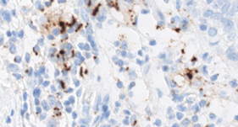
IMpassion130: PD-L1 Status
~40% of patients had PD-L1-positive tumours (majority of samples were from the primary breast tumor)
Defined as >1% PD-L1 on tumour-infiltrating immune cells
PD-L1 IHC (SP142) Assay
PD-L1 on IC | PD-L1 on TC
PD-L1 IC+
41%
PD-L1 TC+
9%
34%
7%
2%
The majority of patients with expression
of PD-L1 on TC are included within the
PD-L1 IC+ population
PD-L1 measured by SP142 PD-L1 IHC assay
H&E, Haematoxylin and Eosin
Emens et al, SABCS 2018

Slide 21
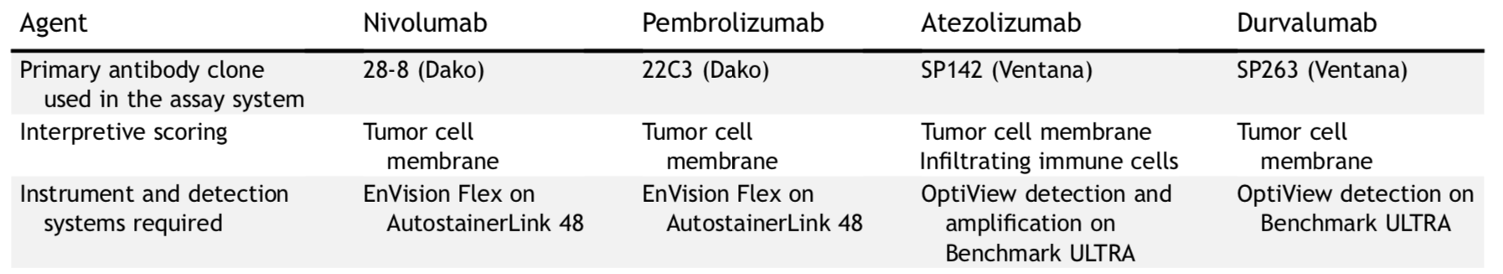
PD-L1 IHC Staining
Hirsch FR, et al. J Thorac Oncol 2017
Scott M et al, ESMO Breast 2019

Slide 22
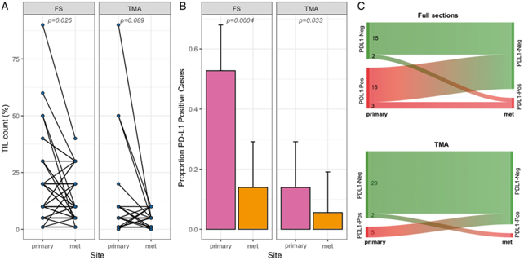
Immunologic Differences Between Primary and Metastatic Tumor Samples
Percent TIL counts in full sections and TMAs.
PD-L1 + rates (≥1% stromal or tumor cells)
Change in PD-L1 status between the primary and metastatic cohorts.
Szekely, et al (Pusztai), Ann Oncol 2018

Slide 23
Questions that arise post IMpassion130
Do these results apply to other chemotherapy combinations and in other lines of treatment?
Would these same results have been seen with another antibody test for PD-L1?
Would this benefit have been seen in patients who recur within 12 mo of adjuvant therapy?
Will longer follow-up have consistent benefit in survival?

Slide 24
Questions that arise post IMpassion130
Do these results apply to other chemotherapy combinations and in other lines of treatment?
Would these same results have been seen with another antibody test for PD-L1?
Would this benefit have been seen in patients who recur within 12 mo of adjuvant therapy?
  KN355: allowed pts within 6 mo adjuvant therapy
  IMpassion132: pts with recurrence within 12 mo of adjuvant therapy

Slide 25
Questions that arise post IMpassion130
Do these results apply to other chemotherapy combinations?
Would these same results have been seen with another antibody test for PD-L1?
Would this benefit have been seen in patients who recur within 12 mo of adjuvant therapy?
Will longer follow-up have consistent benefit in survival?
  Awaiting further data

Slide 26
Select ongoing phase III trials of immune checkpoint inhibitors in metastatic TNBC
Name | Phase | Arms | Clinicaltrials.gov
IMpassion130 | III | nab-paclitaxel nab-paclitaxel + atezolizumab | NCT02425891
IMpassion131 | III | paclitaxel paclitaxel + atezolizumab | NCT03125902
IMpassion132 | III | Carboplatin/gemcitabine or capecitabine Carboplatin/gemcitabine or capecitabine + atezolizumab | NCT03371017
KEYNOTE-355 | III | chemotherapy (nab, pac, c/g) chemotherapy + pembrolizumab | NCT01042379

Slide 27
Summary
Checkpoint inhibitors as monotherapy have very limited activity
  Responders with prolonged survival
  Activity more robust in 1L setting
Atezolizumab + Nab-paclitaxel is now standard first line therapy for patients with metastatic PD-L1+ TNBC
  Further work needed to understand optimal methods for PD-L1 testing, and best chemotherapy combinations
Studies ongoing exploring other combination strategies
  Work ongoing to see if there will be a role for immunotherapy in other subtypes, and in the early disease setting

