Slide 1
Please note, these are the actual video-recorded proceedings from the live CME event and may include the use of trade names and other raw, unedited content.

Slide 2
Role of PARP Inhibitors, Novel Agents in mBC; Male Breast Cancer
Tiffany A. Traina, MD
Clinical Director, Breast Medicine Service
Section Head, TNBC Clinical Research Program
Associate Attending
Memorial Sloan Kettering Cancer Center
June 3, 2019

Slide 3
Disclosures
Consulting Agreements | Aduro Biotech, Advaxis Inc, Astellas Pharma Global Development Inc, AstraZeneca Pharmaceuticals LP, Athenex, Bristol-Myers Squibb Company, Celgene Corporation, Genentech, Genomic Health Inc, Halozyme Inc, Innocrin Pharmaceuticals Inc, Medivation Inc, a Pfizer Company, Merck, Pfizer Inc, Puma Biotechnology Inc, Roche Laboratories Inc, Samsung Bioepis
Contracted Research | Astellas Pharma Global Development Inc, AstraZeneca Pharmaceuticals LP, Daiichi Sankyo Inc, Eisai Inc, Genentech, Immunomedics Inc, Innocrin Pharmaceuticals Inc, Novartis, Pfizer Inc, Roche Laboratories Inc
Speakers Bureau | Genentech, Roche Laboratories Inc

Slide 4
A woman in her early 60s (Dr Traina)
20 years ago: ER-positive DCIS → BCS, RT and tamoxifen x 5 years
8 years ago: 1.8-cm, node-negative TNBC → bilateral mastectomy, adjuvant TAC
Pathogenic BRCA2 mutation
Risk-reducing BSO
2/2018: Right chest wall recurrence with nodular rash across prior irradiated field and beyond
Biopsy-proven metastatic TNBC not amenable to resection or additional RT
Olaparib monotherapy
4/2018: CR
5/2019: Continues olaparib, NED

Slide 5
A woman in her early 70s with gBRCA wild-type AR-positive metastatic TNBC (Dr Traina)
12/2007 - 4/2008: TNBC → bilateral mastectomy, SLNB → adjuvant TC x 4
2016: Metastasis to sternum, uncertain pulmonary metastases
Sternum biopsy: AR 90% TNBC
3/2016: Investigational antiandrogen → partial response
2/2019: Discontinued study drug
Remains on observation per patient preference

Slide 6
A man in his early 60s with ER/PR-positive, HER2-negative metastatic breast cancer who has a strong family history of ovarian cancer and a gBRCA2 mutation (Dr Traina)
9/2016: Primary ER/PR-positive, HER2-negative right breast cancer and bone mets
10/2016: Tamoxifen and denosumab
3/2017: Progressive disease in lung, LN, bone, chest wall → nab paclitaxel
8/2018: Progressive disease → presented for consideration of trials
Germline BRCA testing: BRCA2
Somatic mutation analysis: No actionable targets
9/2018: Clinical trial — CYP17 antagonist
2/2019: Progressive disease → increased mass in R breast, thoracic adenopathy
Olaparib monotherapy
Symptomatically improved by cycle 2, mild nausea

Slide 7
Topics
PARP inhibitors in MBC
FDA-approved agents
Other PARP inhibitors under investigation
Novel agents for metastatic TNBC
Antibody Drug Conjugates
AKT inhibitors
AR antagonists
Male Breast Cancer

Slide 8
OlympiAD: Phase III trial of olaparib in gBRCA mutation associated breast cancer
Olaparib
300mg tablets BID
TPC: Capecitabine
Eribulin
Vinorelbine
Primary endpoint: PFS by blinded independent central review (BICR)
Robson et al, NEJM 2017

Slide 9
Olaparib associated with a 42% increase in median PFS as compared to treatment of physician’s choice
4.2mo → 7mo
Robson et al, NEJM 2017

Slide 10
Overall survival in prespecified subgroups
No prior chemotherapy for mBC (1L)
Prior chemotherapy for mBC (2/3L)
 | Olaparib | TPC
Deaths, n (%) | 30 (50.8) | 21 (75.0)
Median OS, mo | 22.6 | 14.7
HR 0.51 (95%CI 0.29–0.90; p = 0.02)
Alive at 6 mo, % | 93.2 | 88.5
Alive at 18 mo, % | 62.1 | 46.2
Median follow-up, mo | 25.5 | 26.9
 | Olaparib | TPC
Deaths, n (%) | 100 (68.5) | 41 (59.4)
Median OS, mo | 18.8 | 17.2
HR 1.13 (95%CI 0.79–1.64; p = NS)
Alive at 6 mo, % | 93.1 | 84.9
Alive at 18 mo, % | 50.8 | 48.8
Median follow-up, mo | 25.2 | 26.0
1.0
1.0
0.9
0.9
0.8
0.8
0.7
0.7
0.6
0.6
Probability of overall survival
0.5
0.5
0.4
0.4
0.3
0.3
0.2
0.2
0.1
0.1
0.0
0.0
0
4
8
12
16
20
24
28
32
36
40
0
4
8
12
16
20
24
28
32
36
40
Time from randomization (months)
Time from randomization (months)
OS in ITT: 17.1mo vs. 19.3 (HR 0.90; 95% CI 0.66–1.23; p = 0.513)
Robson et al AACR 2018

Slide 11
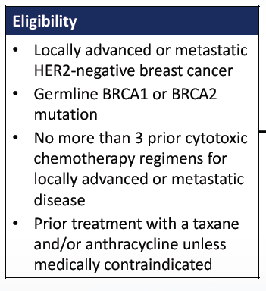
EMBRACA: Phase III trial of talazoparib in gBRCA mutation associated BC
Talazoparib
1mg daily
2:1
N=431
TPC: Capecitabine
Eribulin
Vinorelbine
Gemcitabine
Litton et al SABCS 2017

Slide 12
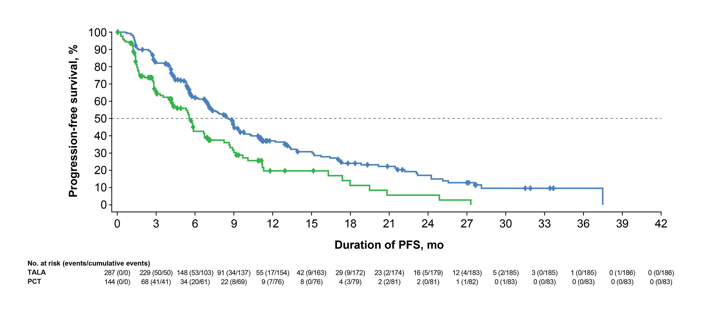
Talazoparib increased mPFS by 46%
 | TALA (n = 287) | Overall PCT (n = 144)
Events, no. (%) | 186 (65%) | 83 (58%)
Median, mo (95% CI) | 8.6 (7.2, 9.3) | 5.6 (4.2, 6.7)
 | Hazard ratio, 0.54, 95% CI, 0.41, 0.71 P < .0001
TALA
Overall PCT
1-Year PFS 37% vs 20% mPFS 5.6mo vs 8.6mo
Litton et al NEJM 2018

Slide 13
Summary (OlympiAD and EMBRACA)
 | OlympiAD | EMBRACA
HR (PFS) | 0.58 (0.43-0.80) | 0.54 (0.41-0.71)
HR (OS) | 0.90 (0.66-1.23) | 0.76 (0.54-1.06)
HR (OS) 1st Line setting | 0.51 (0.29-0.90) | NR
ORR | 59.9% (vs 28.8% TPC) | 67.6% (vs 27.2% TPC)
Deterioration HRQoL | 0.44 (0.25-0.77) | 0.38 (0.26-0.56)
SAE ≥ Grade 3 | 36.6% (vs 50.5% TPC) | 25.5% (v. 25.4% TPC)
Anemia ≥ Grade 3 | 16.1% | 39.2%
Neutropenia ≥ Grade 3 | 9.3% | 20.9%
Thrombocytopenia ≥ Grade 3 | 2.4% | 14.7%
MDS/AML | 0 | 0
Nausea (any grade) | 58.0% | 48.6%
Alopecia (any grade) | 3.4% | 25.2%

Slide 14
Next steps in PARP inhibition
Extending PARPi therapy
Other PARPi in development
Combinations (conventional cytotoxics)
Combinations (targeted agents)
PIK3CAi
VEGF (e.g. cedirinib)
Increase replication stress (ATMi, ATRi)
IO (innate immunity?)
Early stage disease (adjuvant olaparib, neoadjuvant talazoparib)
Other genes, somatic mutations
Veliparib
BrighTNess: C+P+V vs. C+P vs. P Neoadjuvant TNBC → AC.
Addition of V did not inc pCR
BROCADE: C+P+V vs. C+P in met gBRCA
Niraparib
BRAVO: Niraparib vs. TPC in met gBRCA. Closed early and has not reported
Rucaparib
Phase II of rucaparib in patients with metastatic BC with high loss of heterozygosity/HRD

Slide 15
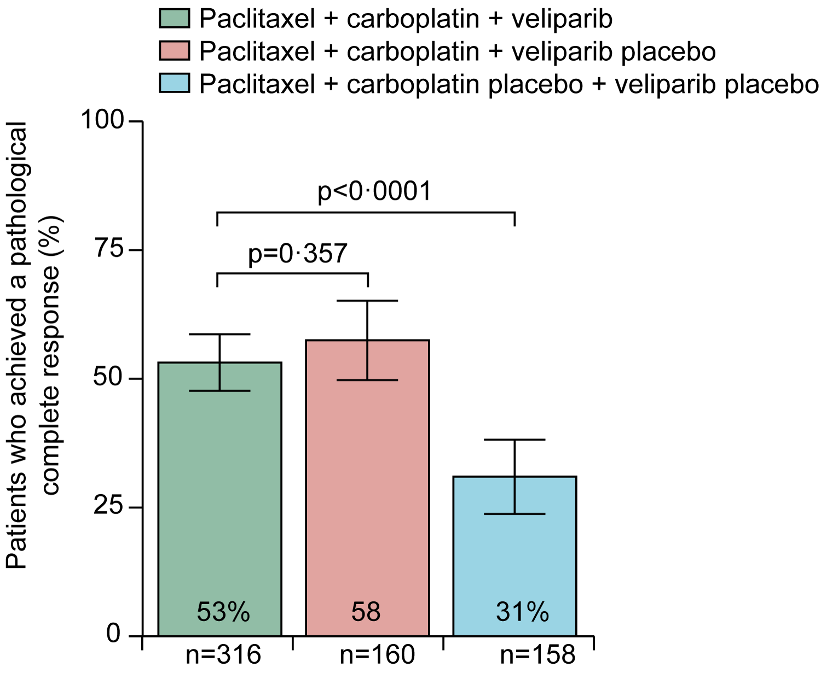
BrighTNess: Phase III trial evaluating addition of veliparib + carboplatin or carboplatin alone to neoadjuvant chemotherapy in TNBC — pCR results
Loibl S et al. Lancet Oncol 2018; 19(4):497-509.

Slide 16
TOPACIO (KEYNOTE-162): Phase II trial of niraparib + pembrolizumab in metastatic TNBC
Biomarker-selected populations
Efficacy evaluable patients | ORR (CR+PR) | DCR (CR+PR+SD)
tBRCAmut patients (n=15) | 9 (60%) | 12 (80%)
HRRmut + tBRCAmut (n=20) | 11 (55%) | 16 (80%)
PD-L1-positive patients (n=25) | 9 (36%) | 13 (52%)
Overall response rate in all (biomarker-unselected) patients (N=46): 28%, DCR: 50%
Vinayak S et al. ASCO 2018; Abstract 1011

Slide 17
Engineering ADCs in TNBC
The target
Selectivity
Level of expression
ADC internalization
Intracellular trafficking
The linker
Cleavable vs. non-cleavable
The payload
Tubulin directed
DNA damaging

Slide 18
Sacituzumab: TNBC Efficacy mTNBC, ≥2 priors, s/p taxane. No biomarker selection. N=110
ORR 34%, DoR 7.7mo
Bardia et al, NEJM 2019

Slide 19
ASCENT: Randomized Phase III Completed Accrual
TROPICS-02: Launch of Ph III trial in ER+ MBC
NCT03901339

Slide 20
Other ADCs in TNBC… trastuzumab deruxtecan
HER2 “low”
Trastuzumab deruxtecan
DS-8201a
DAR = 8
Poster # P6-17-02 – San Antonio Breast Cancer Symposium® – December 4–8, 2018

Slide 21
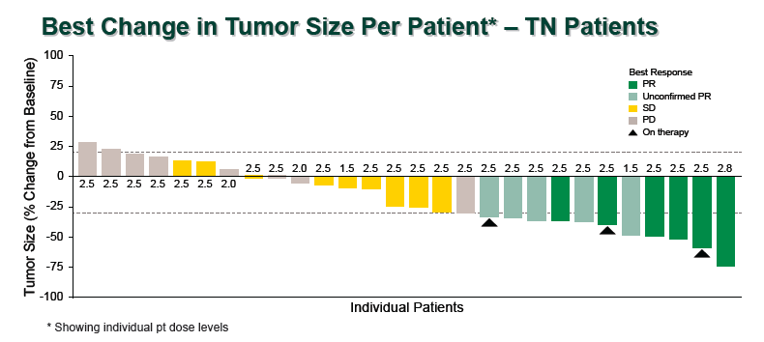
Other ADCs in TNBC… ladiratuzumab vedotin
Metastatic TNBC, ≥2 prior chemotherapy
Results: ORR 25%, mPFS 11 weeks (95% CI, 6-12 weeks)
Treatment related AEs, all grade: alopecia 41%, neutropenia 25%, neuropathy 20%, vomiting 24%
Forero et al SABCS 2016, Modi et al SABCS 2017

Slide 22
AKT inhibition in 1st line mTNBC
Paclitaxel +/- capivasertib
Ipatasertib
PIK3CA/AKT/PTEN altered
mPFS 4.9mo vs. 9m
 | PFS | OS
ITT N=138 | 4.2 vs 5.9 m. HR 0.74 (0.5, 1.08) p = 0.06 | 12.6 vs 19.1 m. HR 0.61 (0.37, 0.99) p = 0.02
PIK3CA/AKT1/PTEN Altered N=28 | 3.8 vs 9.3 m. HR 0.3 (0.11-0.79) p = 0.01 | 10.4 vs NR. HR 0.37 (0.12-1.12) p = 0.61
PIK3CA/AKT1/PTEN WT N=84 | 4.4 vs 5.3 m. HR 1.13 (0.7, 1.82) p = 0.067 | 13.2 vs 16.6 m. HR 0.84 (0.48, 1.49) p = 0.56
Schmid, et al, ASCO 2018; Kim et al, Lancet Onc 2017

Slide 23
AR as a target in TNBC
 | AR >0% | AR >10% | CBR24 | CBR16 | mPFS
Bicalutamide¹ | — | 12% | 19% | — | 12 wks
Enzalutamide² | 79% | *55% | *29% | *35% | *14.7 wks
Abiraterone³ | — | 38% | 20% | — | 11.2 wks
Seviteronel⁴ | Phase I published; Phase II manuscript in preparation
Bicalutamide + palbociclib⁵ | Phase I completed; Phase II ongoing
Enzalutamide + taselisib | Phase I complete
¹Gucalp et al. CCR. 2013; ²Traina et al. J Clin Oncol. 2018;
³Bonnefoi et al. Annals Oncol. 2016; ⁴ Gucalp et al ASCO 2017; ⁵Gucalp et al SABCS 2017

Slide 24
Male Breast Cancer
International Male Breast Cancer Program
20 years, 93 centers, 9 countries
Characterization of Male Breast Cancer
N=1822
Median age @ dx 68y
M1 5%
85% invasive ductal ca
Majority (49%) luminal B
99.3% ER+, 82% PR+
Only 77% received adjuvant endocrine tx
Only 4% had BCS
ER, PR, AR associated with OS and RFS. Grade, Ki67, IHC surrogates did not.
Cardoso F et al Ann Oncol 2018; Gucalp et al Breast Ca Res Treat 2019

Slide 25
Hope for patients with metastatic TNBC
PARP inhibitors for gBRCAm
Antibody drug conjugates
AKT inhibitors
Checkpoint inhibitors
AR antagonists
Tamoxifen
Aromatase inhibitors
Fulvestrant
CDK4/6 inhibitors
PI3K inhibitors
Trastuzumab
Pertuzumab
TDM1
Lapatinib
Neratinib
DS8201a

