Slide 1
Established Management Paradigms and Biologic Rationale for the Evaluation of Immune Checkpoint Inhibitors for Patients with Locally Advanced Non-Small Cell Lung Cancer
Shruti Jolly, MD
Professor, Department of Radiation Oncology
Co-Lead, UM Thoracic Oncology CRT program
Michigan Medicine, University of Michigan Rogel Cancer Center

Slide 2
Disclosures
Advisory Committee | AstraZeneca Pharmaceuticals LP, Varian Medical Systems Inc

Slide 3
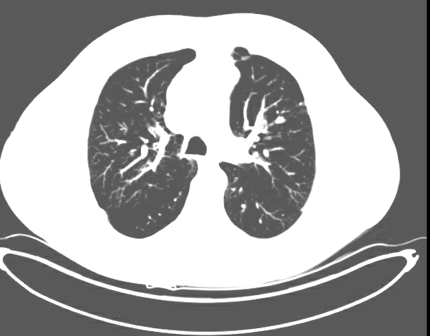
A 65-year-old former smoker with Stage IIIB squamous cell lung cancer and a history of COPD completes 6 cycles of carboplatin/paclitaxel/radiation therapy but develops Grade 2 esophagitis resulting in a 10-lb weight loss. Durvalumab is planned but not started, and the esophagitis totally resolves in 6 weeks.
Before chemoradiation therapy
After chemoradiation therapy

Slide 4
Should durvalumab be initiated at this point?
Yes
Yes
Yes
Yes
Yes
Yes
Yes
Yes

Slide 5
Should PD-L1 levels generally be tested in patients with locally advanced NSCLC? Should durvalumab be used as consolidation treatment after chemoradiation therapy for patients with locally advanced NSCLC and a PD-L1 TPS of ≤1%?
Test PD-L1 levels?
Durvalumab for TPS ≤1%?
No
Yes
Yes
Yes
Yes
Yes
Yes
Yes
Yes
Yes
No
Yes
Yes
Yes
No
Yes

Slide 6
Should durvalumab be used as consolidation treatment after chemoradiation therapy for patients with locally advanced NSCLC with an EGFR or ALK mutation?
Yes, for both
Yes, for both
Yes, for both
No
Yes, for ALK only
No
Yes, for both
Yes, for both

Slide 7
Outline
Background/historical perspective
Radiation advancements
Role of immunotherapy
PACIFIC trial
Future direction

Slide 8
Locally Advanced NSCLC
Approximately 1/3 of NSCLC are diagnosed at stage III
Standard of care for inoperable patients is concurrent platinum-based chemotherapy with concurrent RT (60 Gy)
Survival with chemoradiotherapy alone
Median PFS 8-10 months
5-year OS 15%-25%
Locally advanced NSCLC is highly aggressive
Normal lung is highly radiosensitive
Patients with lung cancer are generally older with smoking history and have overall poor pulmonary and cardiac function

Slide 9
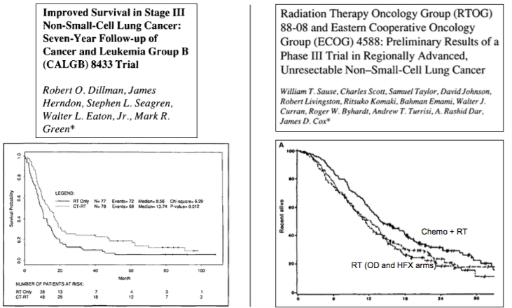
Role of Chemotherapy and Sequencing of Chemo/RT
RTOG-7301 – RT alone - 5y OS of 5% and RT dose of 60 Gy in 6 weeks
CALGB-8433 and RTOG-8808 evaluated role of induction chemo followed by RT

Slide 10
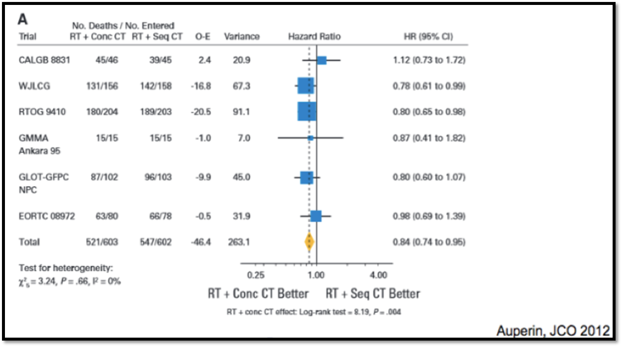
Role of Chemotherapy and Sequencing of Chemo/RT
Auperin meta-analysis
~1200 patients meta-analysis with 6y median follow up
Concurrent CRT better than sequential CRT
4.5% 5y OS absolute benefit (11 to 15%)

Slide 11
RTOG 0617: Standard- versus High-Dose RT with Concurrent and Consolidation Chemotherapy with or without Cetuximab
Bradley JD et al. Lancet Oncol 2015;16(2):187-99.

Slide 12
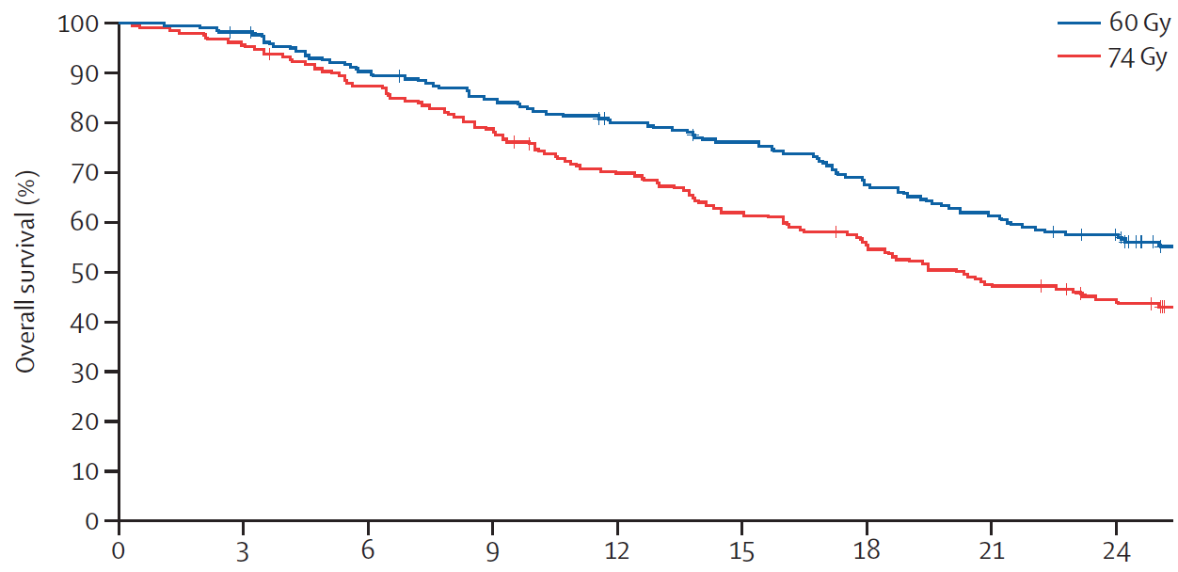
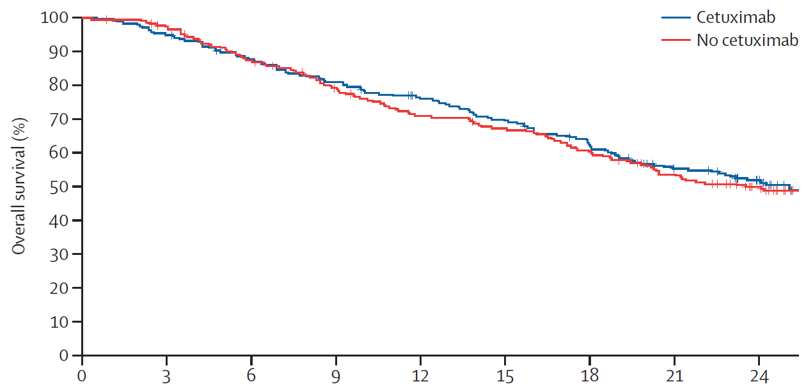
RTOG 0617: Effect of RT Dose and Cetuximab on OS
Median OS:
28.7
20.3
Median OS:
25.0
24.0
HR 1.38, p = 0.004
HR 1.07, p = 0.29
Time (months)
Time (months)
Factors predictive of OS: Radiation dose (60 Gy), maximum esophagitis grade, PTV size, heart V5 and V30
Bradley JD et al. Lancet Oncol 2015;16(2):187-99.

Slide 13
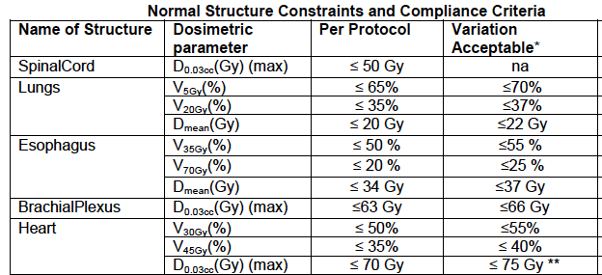
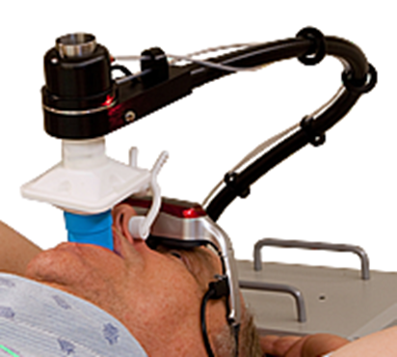
Delivery of Radiation
RT planning can be complex
Trade-offs need to be made to deliver dose to tumor while sparing esophagus, heart and normal lung tissue

Slide 14
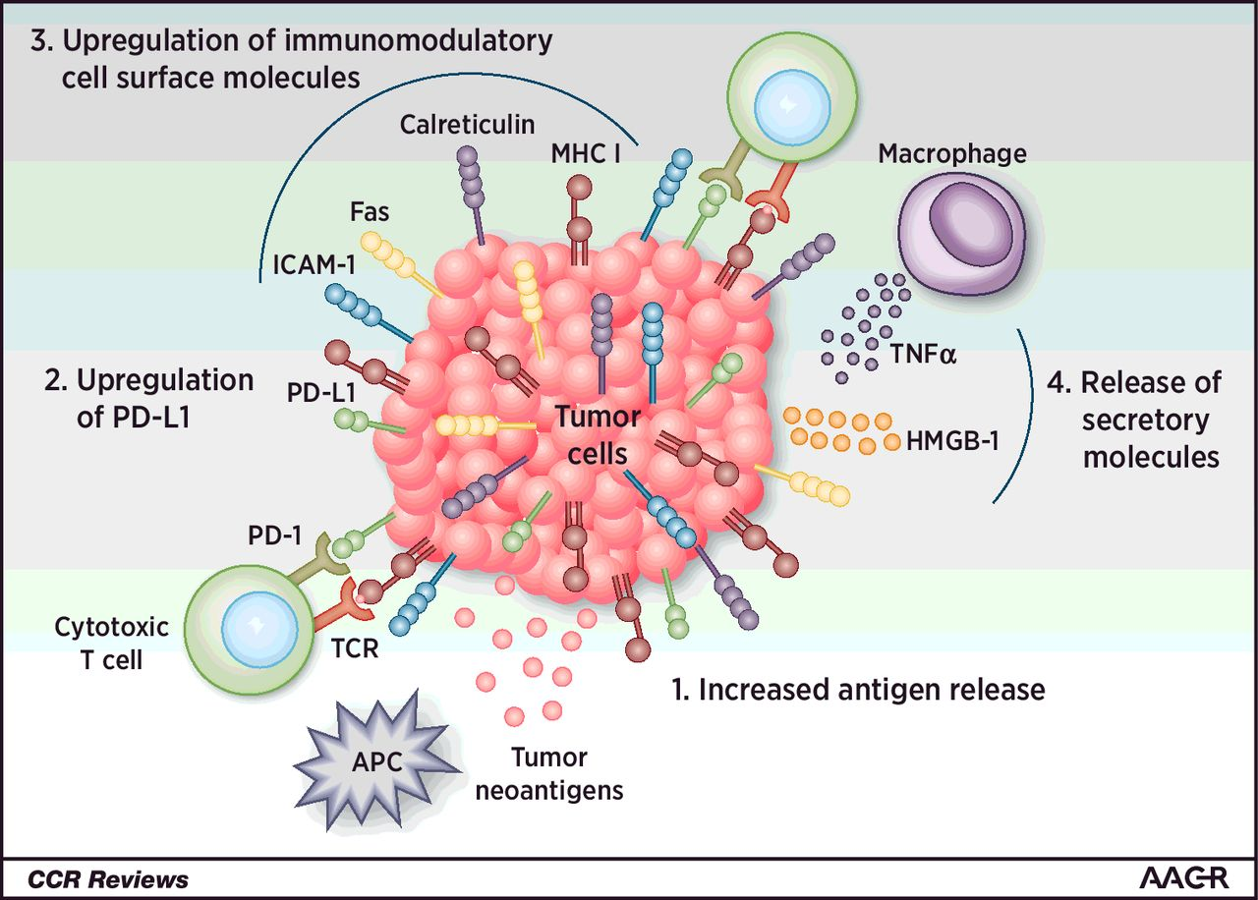
Rationale for Integration of RT with Immunotherapy
Eric C. Ko et al. Clin Cancer Res 2018;24:5792-5806

Slide 15
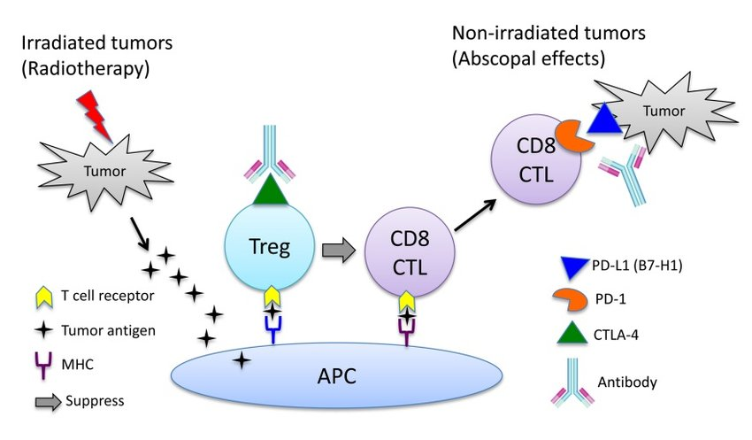
Rationale for Integration of RT with Immunotherapy

Slide 16
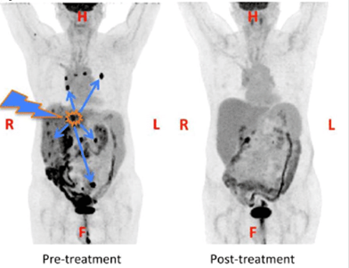
Abscopal Effect
Golden, Encouse & Formenti, Silvia. (2014). Is tumor (R)ejection by the immune system the "5th R" of radiobiology? Oncoimmunology. 3. e28133. 10.4161/onci.28133.

Slide 17
PACIFIC trial — Phase III PRT
Antonia SJ et al. N Engl J Med 2017;377:1919-1929. Antonia SJ et al. N Engl J Med 2018;379:2342-2350.

Slide 18
PACIFIC trial
In post-hoc analysis – patients with PDL1<1% did not show improved OS
Small patient numbers
In post-hoc analysis - patients who started Durvalumab sooner (<14 days) showed better OS
Since only those patients without progression should receive durvalumab, post-chemo RT imaging has to be ordered much sooner than 6-12 wks.
Antonia SJ et al. N Engl J Med 2017;377:1919-1929. Antonia SJ et al. N Engl J Med 2018;379:2342-2350.

Slide 19
Summary
In stage III locally advanced unresectable NSCLC s/p concurrent chemoradiotherapy – Durvalumab 10mg/kg q 2 weeks for 1 year is the new therapeutic option in good performance status patients
Overall, well tolerated
Should be started within 2-4 weeks of completion of CRT whenever clinically possible
PDL1<1% and EGFR positive patients may not derive the same benefit
Understanding RT techniques and managing toxicities in the setting of IO are important areas of research

