Slide 1
Existing and Recently Approved Approaches for Patients with R/R CLL
Christopher R Flowers, MD, MS
Chair, Professor
Department of Lymphoma/Myeloma
The University of Texas
MD Anderson Cancer Center
Houston, Texas

Slide 2
Disclosures
Consulting Agreements | AbbVie Inc, Bayer HealthCare Pharmaceuticals, Denovo Biopharma, Gilead Sciences Inc, Janssen Biotech Inc, Karyopharm Therapeutics, OptumRx Inc, Pharmacyclics LLC, an AbbVie Company, Spectrum Pharmaceuticals Inc
Contracted Research | AbbVie Inc, Acerta Pharma — A member of the AstraZeneca Group, Burroughs Wellcome Fund, Celgene Corporation, Eastern Cooperative Oncology Group, Genentech, Gilead Sciences Inc, Janssen Biotech Inc, National Cancer Institute, Roche Laboratories Inc, Takeda Oncology, TG Therapeutics Inc, V Foundation for Cancer Research
Uncompensated Consulting | Celgene Corporation, Genentech, Roche Laboratories Inc

Slide 3
Reimbursement and regulatory issues aside, which second-line therapy would you recommend for a 60-year-old patient with IGHV-mutated CLL without del(17p) or TP53 mutation who responded to the following agent and then experienced disease progression 3 years later?
FCR
Ibrutinib
Venetoclax + rituximab
Venetoclax + rituximab
Ibrutinib
Venetoclax + rituximab
Venetoclax + rituximab
Venetoclax + rituximab
Ibrutinib
Venetoclax + rituximab
Venetoclax + rituximab
Venetoclax + rituximab
Ibrutinib
Venetoclax
Venetoclax + rituximab
Venetoclax + rituximab

Slide 4
Reimbursement and regulatory issues aside, which second-line systemic therapy would you recommend for a 75-year-old patient with IGHV-mutated CLL without del(17p) or TP53 mutation who responded to the following agent and then experienced disease progression 3 years later?
Ibrutinib
BR
Venetoclax + rituximab
Venetoclax + rituximab or acalabrutinib
Venetoclax + rituximab
Ibrutinib
Venetoclax + rituximab
Ibrutinib
Venetoclax + rituximab
Ibrutinib
Venetoclax + rituximab
Venetoclax + rituximab
Venetoclax
Ibrutinib
Venetoclax + rituximab
Venetoclax + rituximab
BR = bendamustine/rituximab

Slide 5
For a patient with CLL who is receiving venetoclax and has normal renal function, do you generally follow the package insert (PI) guidelines for tumor lysis syndrome (TLS) prophylaxis? At approximately what creatinine clearance (CrCl) do you consider a patient who is receiving venetoclax for CLL to be at higher risk for TLS?
PI guidelines
CrCl
Yes
60 mL/min
Yes
80 mL/min
Yes
<70 mL/min
Yes
60 mL/min
No (accelerated dose ramp-up over 2 wk with monitoring/prophylaxis)
<50 mL/min
Yes
60 mL/min
Yes
50 mL/min

Slide 6
Reimbursement and regulatory issues aside, which third-line therapy would you generally recommend for a 60-year-old patient with IGHV-mutated CLL without del(17p) or TP53 mutation who responds to BR for 24 months, experiences disease relapse, then receives ibrutinib for 18 months followed by disease progression?
Venetoclax + rituximab
Venetoclax + rituximab
Venetoclax + rituximab
Venetoclax + rituximab
Venetoclax
Venetoclax
Venetoclax + rituximab

Slide 7
Based on current clinical trial data and your personal experience, how would you compare duvelisib to idelalisib for CLL in terms of efficacy and tolerability/toxicity?
Efficacy
Tolerability/toxicity
They are about the same
They are about the same
They are about the same
They are about the same
They are about the same
They are about the same
There are not enough available data to make the comparison at this time
They are about the same
They are about the same
They are about the same
They are about the same
They are about the same
They are about the same
They are about the same

Slide 8
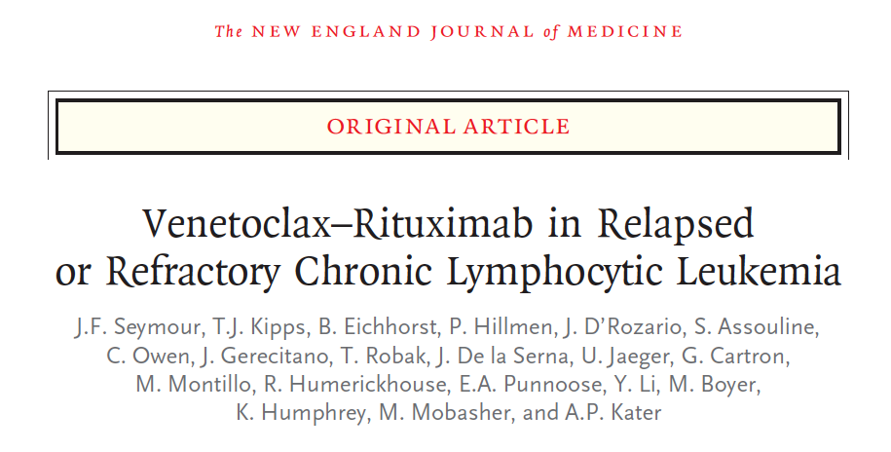
N Engl J Med 2018;378(12):1107-20.

Slide 9
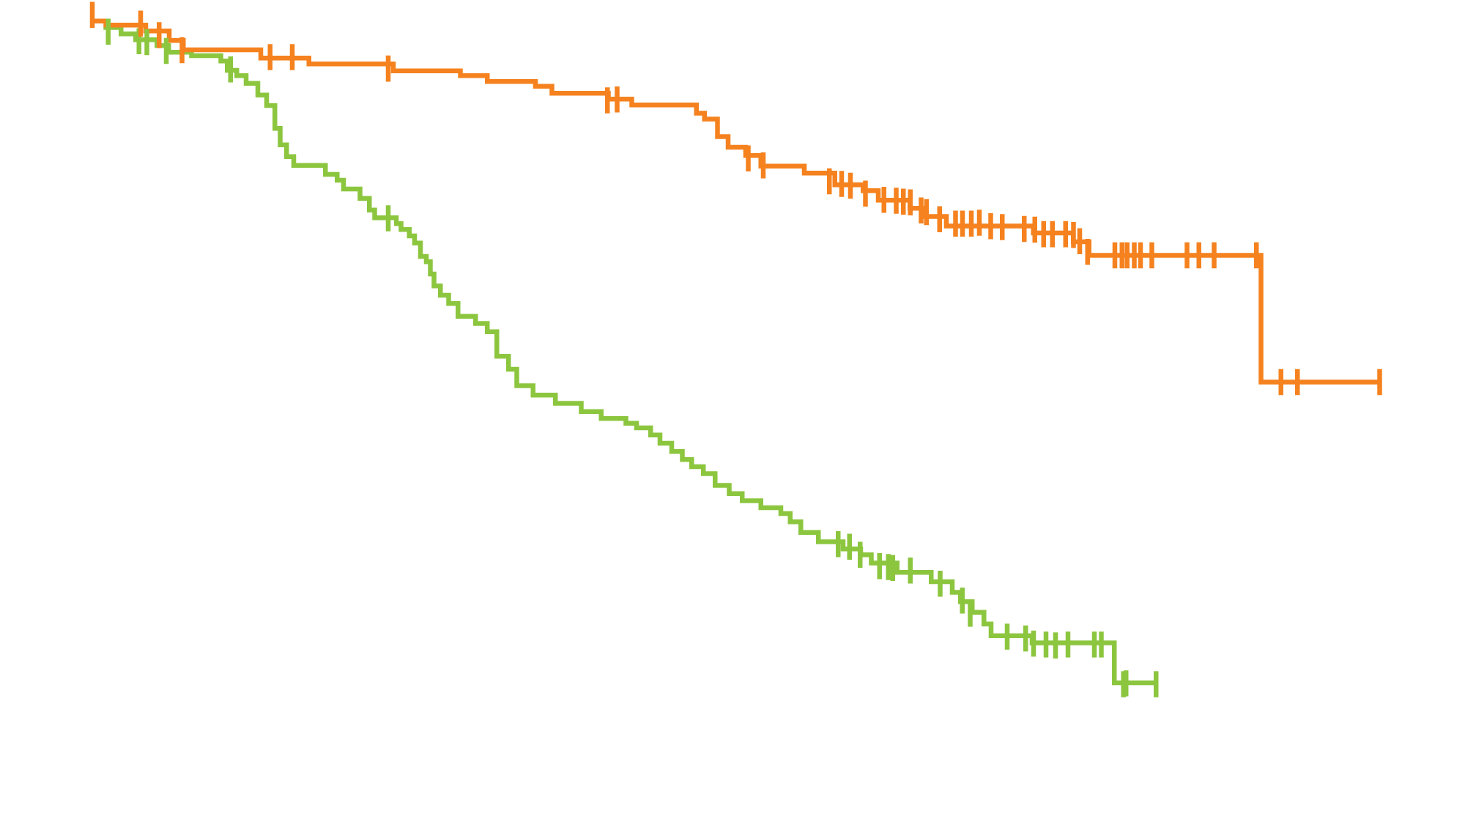
MURANO: Progression-Free Survival (ITT) at 36-Month Follow-Up
 | N | Median PFS | HR | p-value
Ven-R | 194 | NR | 0.16 | <0.0001
BR | 195 | 17 mo
Progression-free survival (% of patients)
VenR (N = 194)
BR (N = 195)
Censored
+
Time (months)
Seymour JF et al. Proc ASH 2018;Abstract 184.
Seymour JF et al. N Engl J Med 2018;378(12):1107-20.

Slide 10
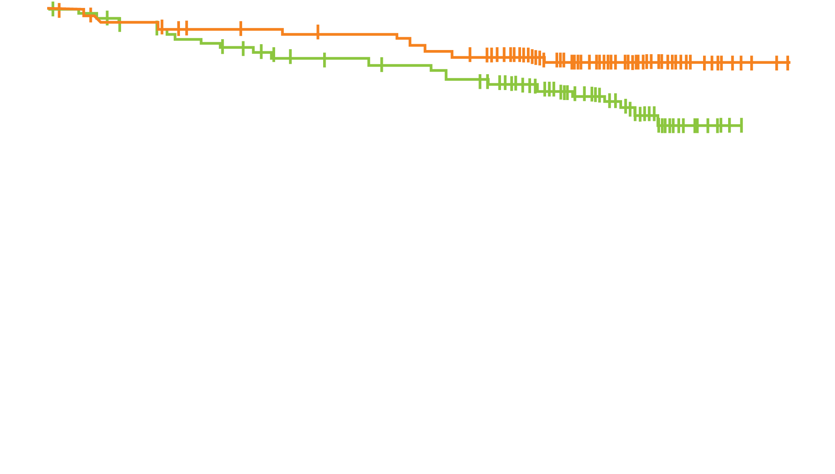
MURANO: Overall Survival (ITT) at 36-Month Follow-Up
3-yr OS Rate
Ven-R: 87.9%
BR: 79.5%
Overall survival
(% of patients)
 | N | HR | p-value
Ven-R | 194 | 0.50 | 0.0093
BR | 195
VenR (N = 194)
BR (N = 195)
Censored
+
Time (months)
Seymour JF et al. Proc ASH 2018;Abstract 184.

Slide 11
MURANO: Select Grade 3/4 Adverse Events
 | Venetoclax-Rituximab (n = 194) | Bendamustine-Rituximab (n = 188)
Grade 3/4 adverse event | 82.0% | 70.2%
Neutropenia | 57.7% | 38.8%
Infections and infestations | 17.5% | 21.8%
Anemia | 10.8% | 13.8%
Thrombocytopenia | 5.7% | 10.1%
Febrile neutropenia | 3.6% | 9.6%
Pneumonia | 5.2% | 8.0%
Infusion-related reaction | 1.5% | 5.3%
Tumor lysis syndrome | 3.1% | 1.1%
No new safety signals were observed at 36-month follow-up
Seymour JF et al. N Engl J Med 2018;378(12):1107-20.
Seymour JF et al. Proc ASH 2018;Abstract 184.

Slide 12
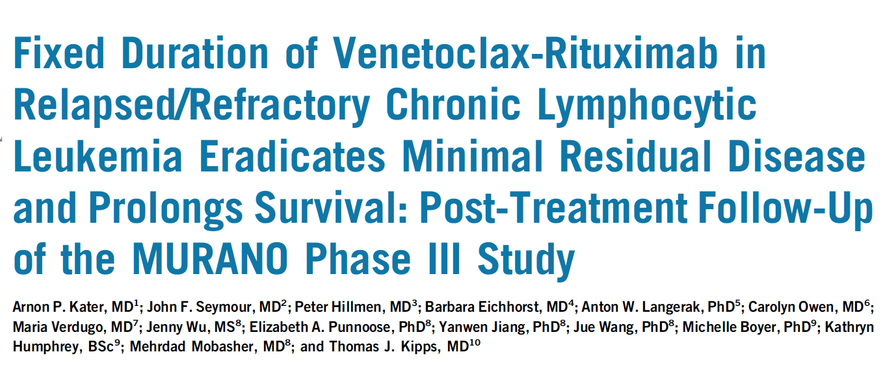
J Clin Oncol 2019;37(4):269-77.

Slide 13
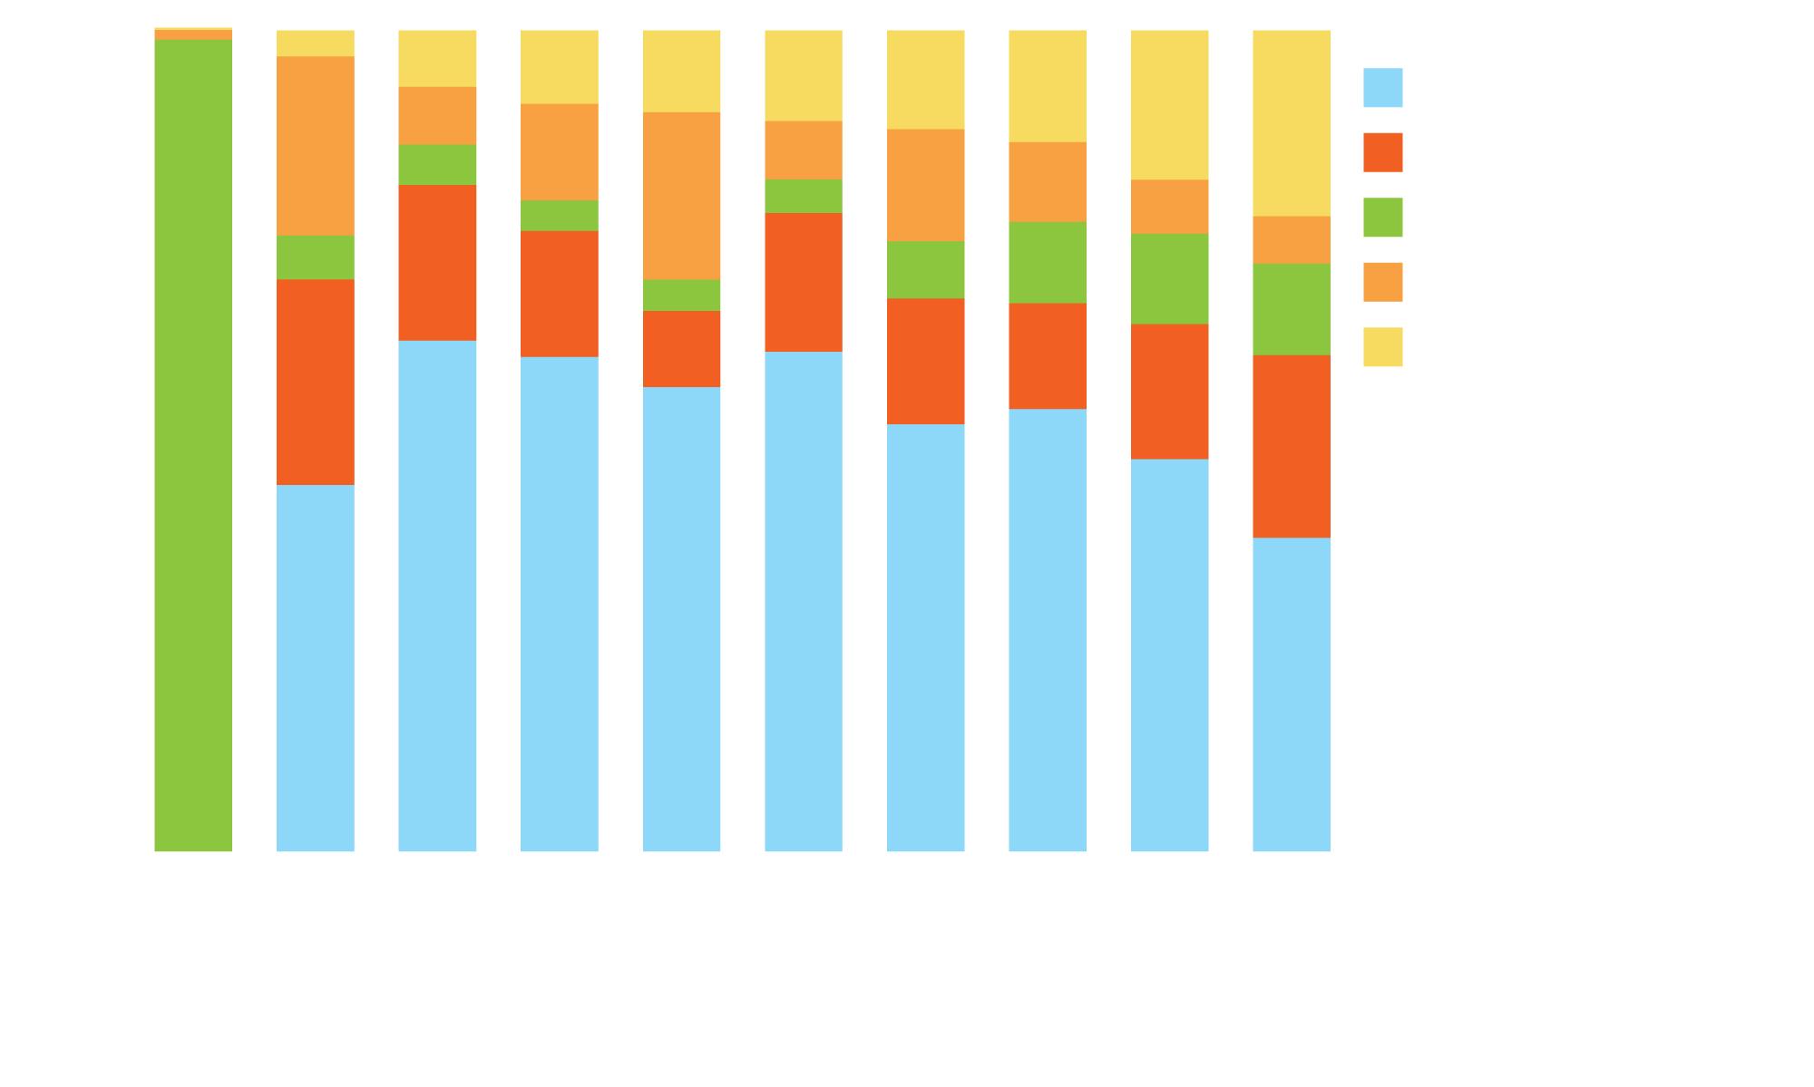
MURANO: Peripheral Blood (PB) MRD Kinetics for Venetoclax + Rituximab (VenR) at Various Timepoints
VenR (n = 194)
Rate of PB undetectable MRD (uMRD) at EOCT was higher for patients who received Ven, with superiority sustained through month 24 (EOT).
Continued benefit was observed with VenR compared to bendamustine/rituximab.
uMRD rates were durable and predicted longer PFS, which establishes the impact of PB MRD on the benefit of fixed-duration Ven-containing therapy.
Low conversion to detectable MRD and sustained PFS after completion of 2 years of VenR demonstrate the feasibility of this regimen.
MRD Category (%)
Time (months)
EOCT = end of combination therapy; EOT = end of treatment
Kater AP et al. J Clin Oncol 2019;37(4):269-77.

Slide 14
Venetoclax TLS Rate Depends on Starting Dose and Ramp-Up
Phase 1: shorter (2-3 week) ramp-up and higher starting doses
TLS rate 13%
(10/77; 5 laboratory, 5 clinical) including 2 fatal events and 3 acute renal failure
CLL monotherapy 5-week ramp-up (n = 168): Laboratory TLS rate 2%
No TLS with clinical consequences or sudden death
Venetoclax + rituximab or + obinutuzumab similar

Slide 15
FDA Approves Duvelisib for Patients with CLL, SLL or FL After at Least 2 Prior Therapies Press Release – September 24, 2018
“On Sept. 24, 2018, the Food and Drug Administration granted regular approval to duvelisib for adult patients with relapsed or refractory chronic lymphocytic leukemia (CLL) or small lymphocytic lymphoma (SLL) after at least two prior therapies.
In addition, duvelisib received accelerated approval for adult patients with relapsed or refractory follicular lymphoma (FL) after at least two prior systemic therapies.
The CLL and SLL indication is based on a randomized, multicenter, open-label trial (NCT02004522) comparing duvelisib to ofatumumab in patients with relapsed or refractory CLL or SLL. The trial randomized patients (1:1) to either duvelisib 25 mg orally twice daily or ofatumumab. Ofatumumab was administered intravenously at an initial dose of 300 mg, followed one week later by 2000 mg once weekly for 7 doses, and then 2000 mg once every 4 weeks for 4 additional doses.”
https://www.fda.gov/Drugs/InformationOnDrugs/ApprovedDrugs/ucm621503.htm

Slide 16
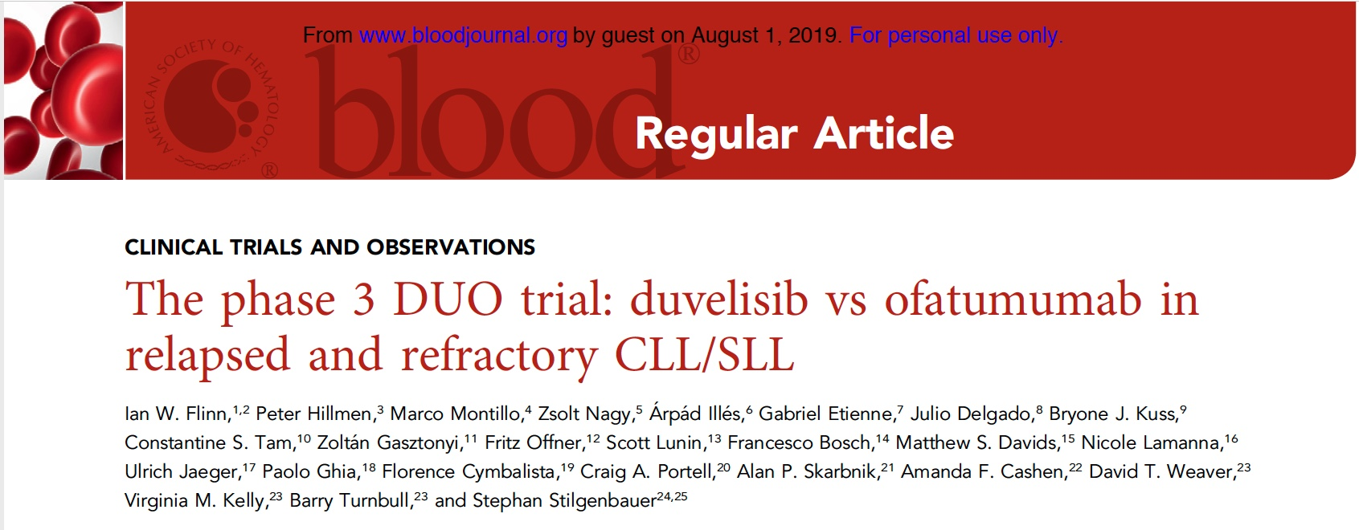
Blood 2018;132(23):2446-55.

Slide 17
Phase III DUO Study Design
Optional crossover study
Duvelisib
25 mg BID continuously
Ofatumumab
Eligibility (N = 319)
Relapsed or refractory CLL/SLL patients
1:1
R
Ofatumumab IV
Duvelisib
Primary Endpoint: PFS by IRC in ITT
Secondary Endpoints: ORR, DoR, OS, Safety
Flinn IW et al. Blood 2018;132(23):2446-55.

Slide 18
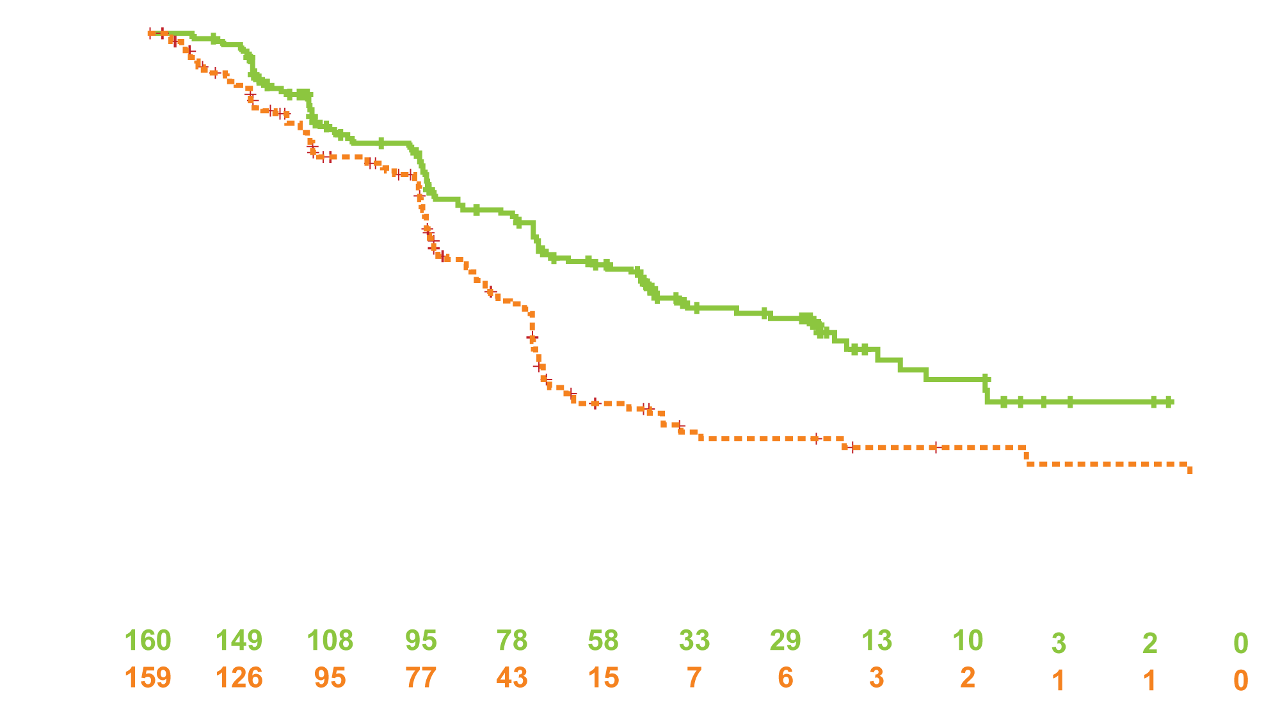
DUO: PFS for Duvelisib versus Ofatumumab in R/R CLL
Independent Review Committee Assessment
Probability of progression-free survival
Time (months)
Flinn IW et al. Blood 2018;132(23):2446-55.

Slide 19
DUO: ORR per IRC Assessment
Percent response
Overall Response Rate
Lymph Node Response Rate
Flinn IW et al. Blood 2018;132(23):2446-55.

Slide 20
DUO: Select Adverse Events
Adverse event | All grades |  | Grade 3 and above
 | Duvelisib | Ofatumumab | Duvelisib | Ofatumumab
Hematologic
Neutropenia | 33% | 21% | 30% | 17%
Anemia | 23% | 10% | 13% | 5%
Thrombocytopenia | 15% | 6% | 8% | 2%
Nonhematologic
Diarrhea | 51% | 12% | 15% | 1%
Pyrexia | 29% | 10% | 3% | 1%
Nausea | 23% | 11% | 0 | 0
Pneumonia | 18% | 6% | 14% | 1%
URTI | 16% | 8% | 0 | 0
Colitis | 13% | 1% | 12% | 1%
Flinn IW et al. Blood 2018;132(23):2446-55.

