Slide 1
Please note, these are the actual video-recorded
proceedings from the live CME event and may include
the use of trade names and other raw, unedited content.

Slide 2
Module 12:
Renal Cell and Bladder Cancer
Drs Quinn and Plimack

Slide 3
Do you have any patients in your practice with...
 | % responding “yes” | Median among those responding “yes”
Metastatic renal cell carcinoma | 94% | 5
Nonmetastatic renal cell carcinoma | 82% | 3
Metastatic bladder cancer | 80% | 4
Nonmetastatic bladder cancer | 80% | 3

Slide 4
Have you administered the following (on or off a clinical trial) to a patient with renal cell carcinoma?
Use of new agents/strategies
 | % responding “yes” | Median among those responding “yes”
Anti-PD-1/PD-L1 antibody in combination with an anti-CTLA-4 antibody | 76% | 2
Cabozantinib | 71% | 2

Slide 5
Have you administered the following (on or off a clinical trial) to a patient with bladder cancer?
Use of new agents/strategies
 | % responding “yes” | Median among those responding “yes”
Anti-PD-1/PD-L1 antibody as first-line treatment for metastatic disease | 63% | 2

Slide 6




Renal Cell Cancer
Miami, Feb 2019
David I Quinn
MBBS (Hons) PhD FRACP FACP
Associate Professor of Medicine Chief, Section of GU Medical Oncology
Division of Medical Oncology
Medical Director, Norris Cancer Hospital & Clinics
Member, USC Institute of Urology
Kenneth J. Norris Comprehensive Cancer Center
Keck School of Medicine
University of Southern California

Slide 7
Disclosures
Advisory Committee and Consulting Agreements | Astellas Pharma Global Development Inc, AstraZeneca Pharmaceuticals LP, Bayer HealthCare Pharmaceuticals, Bristol-Myers Squibb Company, Celgene Corporation, Clovis Oncology, Dendreon Pharmaceuticals Inc, Exelixis Inc, Genentech, Janssen Biotech Inc, Merck, Novartis, Pfizer Inc, Roche Laboratories Inc, Sanofi Genzyme
Contracted Research | Astellas Pharma Global Development Inc, Bayer HealthCare Pharmaceuticals, Bristol-Myers Squibb Company, Genentech, Merck, Pfizer Inc
Data and Safety Monitoring Board/Committee | Eisai Inc, US Biotest Inc

Slide 8
CheckMate 214: Phase 3 Study of Nivolumab + Ipilimumab vs Sunitinib in 1L Advanced/Metastatic RCC^{1,2}
N=1070
Eligibility:
Adv/metastatic (AJCC Stage 4) RCC
No prior systemic Tx for RCC unless 1 prior adjuvant/neoadjuvant Tx (no VEGF/VEGFR targeted therapy)
  KPS ≥70%
  Measurable disease (RECIST 1.1 defined)
Tumor tissue available for PD-L1 testing
Nivolumab 3 mg/kg +
Ipilimumab 1 mg/kg
q3w for 4w, then
Nivolumab 3 mg/kg IV q2w
R
1:1
Until disease progression or unacceptable toxicity
Sunitinib
50 mg PO qd
4 weeks on, 2 weeks off
Primary Outcome Measure: PFS, OS, ORR
Secondary Outcome Measures: Safety
Key Exploratory Measures: antitumor activity (ORR, PFS, OS) in favorable risk patients, outcomes by tumor PD-L1 expression level, health-related QoL based on FKSI-19
1. Escudier B et al. Oral Presentation at ESMO 2017. LBA5. 2. Clinicaltrials.gov. NCT02231749. Accessed February 2019.
Notes:
Ref 2: pg 3; Estimated Enrollment; eligibility critiera
Ref 2: column 2; Figure 2
Ref 1: title
Ref 2: pg 2; Official Title
Ref 1: column 2; Figure 2
Ref 2: pg 2-3; study arms
Ref 1: column 2; study objectives; bullet 3
Ref 2: pg 1 current primary outcomes; current secondary outcomes

Slide 9
CheckMate 214: OS in IMDC Intermediate- /Poor-Risk Patients
Median follow-up: 25.2 months
OS in IMDC Intermediate/Poor Risk Patients
Median OS, months (95% CI))
NIVO + IPI | NR (28.2–NE)
SUN | 26.0 (22.1–NE)
1.0
0.9
Hazard ratio (99.8% CI), 0.63 (0.44–0.89)
P<0.0001
0.8
0.7
0.6
Overall Survival (Probability)
0.5
0.4
0.3
0.2
0.1
0.0
0
3
6
9
12
15
18
21
24
27
30
33
No. at Risk
Time (months)
NIVO + IPI
425
399
372
348
332
318
300
241
119
44
2
0
SUN
422
387
352
315
288
253
225
179
89
34
3
0
Adapted from Escudier et al, 2017.
*Pneumonitis, immune mediated bronchitis, lower GI hemorrhage, hemophagocytic syndrome, sudden death, liver toxicity, lung infection.
†Cardiac arrest (n = 2), heart failure, multiple organ failure.
Escudier B et al. Oral Presentation at ESMO 2017. LBA5.

Slide 10
CheckMate 214: OS by Tumor PD-L1 Expression in IMDC Intermediate/Poor-Risk Patients
PD-L1 <1% (n = 562)
PD-L1 ≥1% (n = 214)
1
.
0
1
.
0
0
.
9
0
.
9
0
.
8
0
.
8
0
.
7
0
.
7
0
.
6
0
.
6
Overall Survival (Probability)
0
.
5
0
.
5
0
.
4
Median OS (95% CI), months
NIVO + IPI | NR (28.2–NE)
SUN | NR (24.0–NE)
0
.
4
Median OS (95% CI), months
NIVO + IPI | NR (NE–NE)
SUN | 19.6 (14.8–NE)
0
.
3
0
.
3
0
.
2
0
.
2
HR (95% CI), 0.73 (0.56–0.96)
P = 0.0249
0
.
1
HR (95% CI), 0.45 (0.29–0.71)
P <0.001
0
.
1
0
.
0
0
.
0
0
3
6
9
1
2
1
5
1
8
2
1
2
4
2
7
3
0
3
3
0
3
6
9
1
2
1
5
1
8
2
1
2
4
2
7
3
0
3
3
NIVO + IPI
SUN
No. at Risk
Months
Months
284 |  | 251 |  | 223 |  | 200 |  | 76 |  | 0
278 |  | 239 |  | 198 |  | 157 |  | 61 |  | 1
100 |  | 87 |  | 83 |  | 76 |  | 33 |  | 2
114 |  | 90 |  | 72 |  | 55 |  | 21 |  | 2
Motzer RJ et al. Oral presentation at SITC 2017. Abstract O38.

Slide 11
CheckMate 214: ORR and PFS in IMDC Favorable-Risk Patients
 | N = 249*
Outcome | NIVO + IPI N = 125 | SUN N = 124
Confirmed ORR,† % (95% CI) | 29 (21-38) | 52 (43-61)
 | P = 0.0002
PFS,‡ median (95% CI), months | 15.3 (9.7-20.3) | 25.1 (20.9-NE)
 | HR (99.1% CI) 2.18 (1.29-3.68)
 | P < 0.0001
Only 26 of 249 pts who are PD-L1 positive in good risk group
*11% of patients in both arms had tumor PD-L1 expression ≥1%. †IRRC-assessed by RECIST v1.1. ‡IRRC-assessed.
Escudier B et al. Oral presentation at ESMO 2017. LBA5

Slide 12
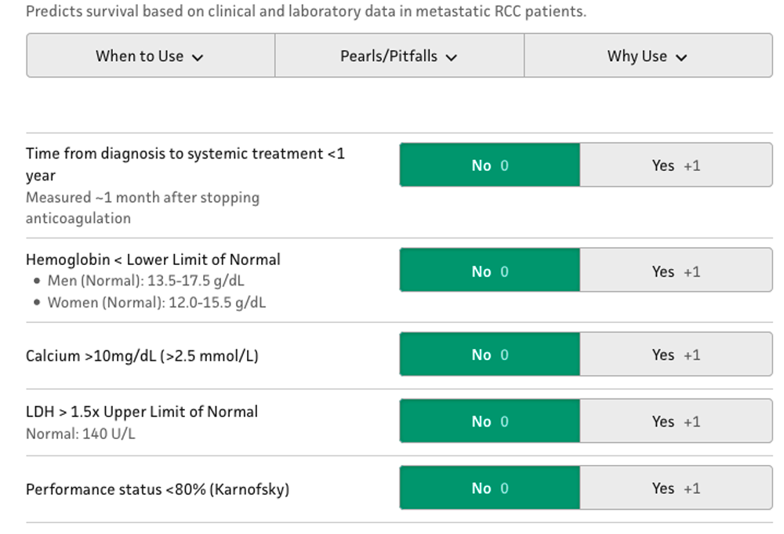
Memorial Sloan Kettering Cancer Center (MSKCC/Motzer) Score for Metastatic Renal Cell Carcinoma (RCC)
Predicted outcomes
Score | Risk | Median survival
0 | Good | 20 months
1-2 | Intermediate | 10 months
≥3 | High | 4 months
This nomogram is often used for selecting patients to enroll in clinical trials.
The score retrospectively identified some variables associated with survival, which may ultimately help predict outcomes.
https://www.mdcalc.com/memorial-sloan-kettering-cancer-center-mskcc-motzer-score-metastatic-renal-cell-carcinoma-rcc

Slide 13
Alliance A031203/CABOSUN: Randomized Phase II Trial of
First-line Cabozantinib vs Sunitinib in Intermediate- or Poor-Risk Patients With Advanced RCC¹
Cabozantinib
60 mg qd orally
(6-week cycles)
Tumor assessment by RECIST v1.1 every 12 weeks
Treatment until disease progression or intolerable toxicity
Advanced RCC (N=157)
Clear cell component
Measurable disease
No prior systemic therapy
ECOG PS 0-2
IMDC intermediate- or poor-risk groups
CNS metastases allowed if adequately treated and stable for 3 months
Randomization 1:1
No crossover allowed
Sunitinib
50 mg qd orally
(4 weeks on/2 weeks off)
Primary endpoint
PFS by investigator assessment
Secondary endpoints
OS, ORR, safety
Stratification
IMDC risk group²: intermediate, poor
Bone metastases: yes, no
ECOG PS=Eastern Cooperative Oncology Group performance status; IMDC=International Metastatic Renal Cell Carcinoma Database Consortium; qd=once daily; RECIST=Response Evaluation Criteria in Solid Tumors.
1. Choueiri TK, et al. J Clin Oncol. 2017;35:591-597. 2. Heng DY, et al. J Clin Oncol. 2009;27:5794-5799.

Slide 14
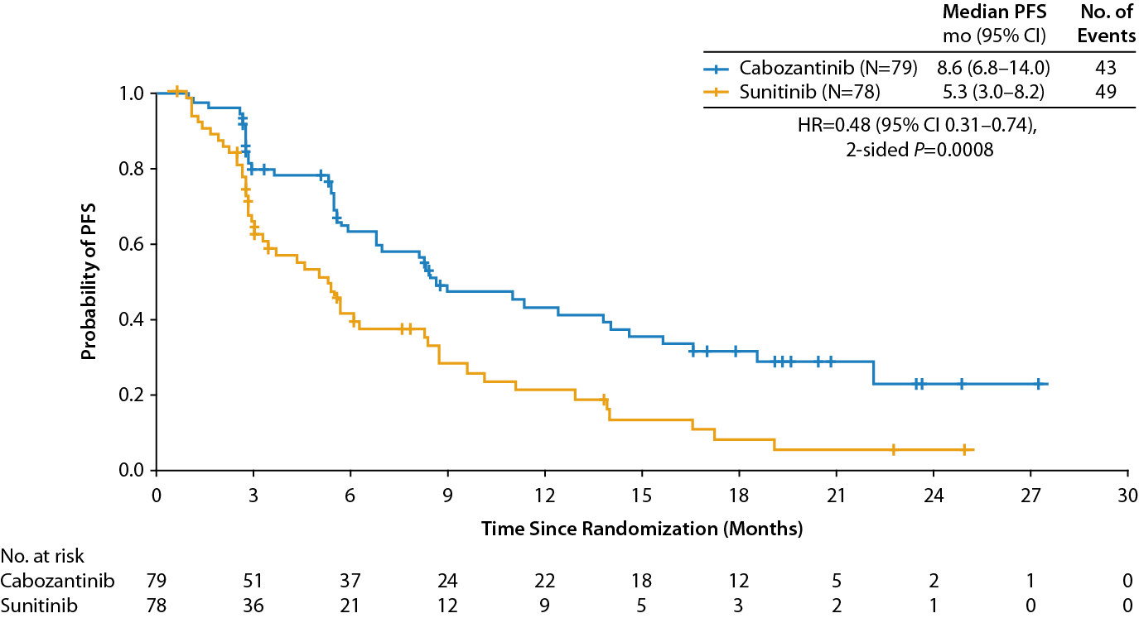
Alliance A031203/CABOSUN:
Kaplan-Meier Plot of PFS per IRC
Data cutoff: September 15, 2016.
IRC=independent radiology committee; mo=months.
Choueiri TK, et al. Poster. ESMO. 2017 (abstr LBA38).

Slide 15
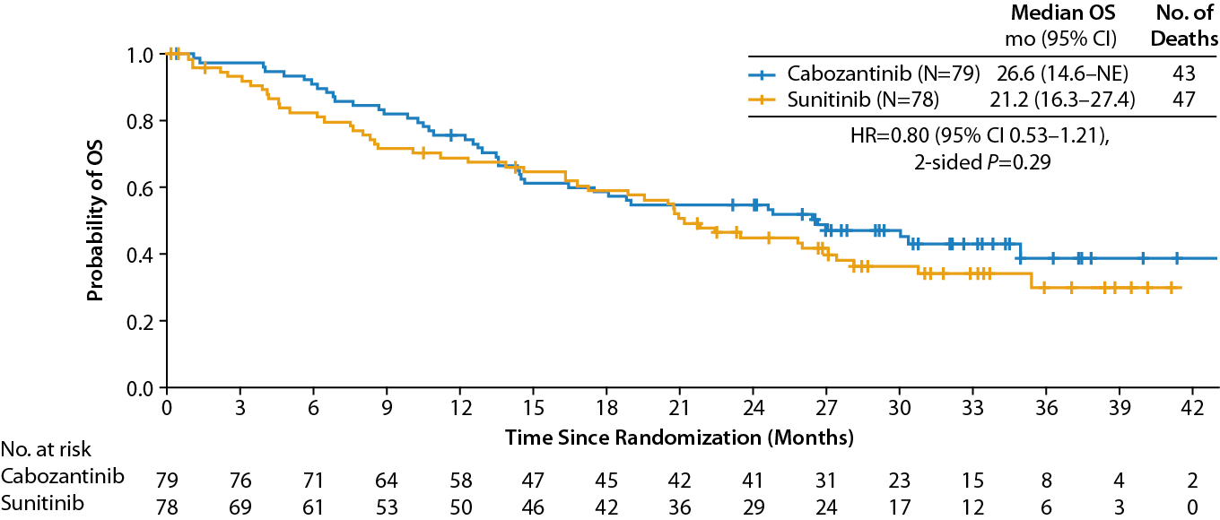
Alliance A031203/CABOSUN:
Overall Survival
Data cutoff: July 1, 2017.
IRC=independent radiology committee; mo=months; NE=not evaluable.
Choueiri TK, et al. Poster. ESMO. 2017 (abstr LBA38).

Slide 16
IMmotion151: Study Design
Key Eligibility:
Treatment-naive advanced or metastatic RCC
Clear cell and/or sarcomatoid histology
KPS ≥ 70
Tumor tissue available for PD-L1 staining
Atezolizumab 1200 mg IV q3w^{b}
+
Bevacizumab 15 mg/kg IV q3w^{b}
Stratification:
MSKCC risk score
Liver metastases
PD-L1 IC IHC status
(< 1% vs ≥ 1%)ª
N = 915
R
1:1
Sunitinib 50 mg/day orally
(4 wk on, 2 wk off)
Primary Endpoints
  PFS by investigator-assessment in PD-L1+ patients
  OS in ITT
ª ≥ 1% IC: 40% prevalence using SP142 IHC assay; ^{b} No dose reduction for atezolizumab or bevacizumab.
Motzer RJ et al. GU Symposium 2018;
J Clin Oncol 36, 2018 (suppl 6S; abstr 578)

Slide 17
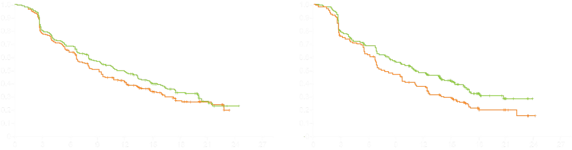
IMmotion151: Progression-Free Survival in the Intention-to-Treat (ITT) and PD-L1-Positive Populations
ITT Population PD-L1+ Population
Progression-free survival
Progression-free survival
Months
Months
ITT population | N | Median PFS (mo) | HR
Atezo + Bev | 454 | 11.2 | 0.83
Sunitinib | 461 | 8.4
PD-L1+ population | N | Median PFS (mo) | HR
Atezo + Bev | 178 | 11.2 | 0.74
Sunitinib | 184 | 7.7
Motzer RJ et al. Genitourinary Cancers Symposium 2018;Abstract 578.

Slide 18
JAVELIN RENAL 101: Phase III Study of Avelumab in Combination With Axitinib vs Sunitinib Monotherapy in Treatment-naïve Patients With Advanced RCC
Selected Eligibility Criteria (N=886)
Treatment-naïve, advanced RCC with a clear cell component
≥1 measurable lesion as defined by RECIST v1.1
Tumor tissue available for PD-L1 staining
ECOG PS 0 or 1
Avelumab 10 mg/kg IV q2w
+ Axitinib 5 mg po bid
(6-week cycle)
R
1:1
Sunitinib
50 mg po qd
(4 weeks on/2 weeks off)
Primary Endpoints: PFS assessed by IRC in PD-L1+ group*, OS in PD-L1+ group*
Key Secondary Endpoints: PFS per IRC in overall population, OS in overall population
Secondary Endpoints: ORR, DCR, TTR, DOR, safety, PK, PRO, ADA relationship between treatment response and tumor or blood biomarkers, immune-related PFS, ORR, DCR, TTR, and DOR per immune-related RECIST
Stratification: ECOG PS (0 vs 1) and geographic region (US, Canada/Western Europe, rest of the world)
Statistical Analyses:
  For the primary PFS endpoint, 336 events would provide 90% power to detect a HR of 0.65 at significance level of 0.004.
  A gatekeeping strategy, which tested the overall population only if PFS in the PD-L1+ group was significant, was used to control for type 1 error.
  Interim analysis was planned for approximately 235 PFS events (70% of total required PFS events) in the PD-L1+ group.
bid=twice a day; ECOG=Eastern Cooperative Oncology Group; PK=pharmacokinetics; PO=orally; PRO=patient-reported outcomes; qd=every day; RECIST=Response Evaluation Criteria in Solid Tumors; TKI=tyrosine kinase inhibitor. * ≥1% PD-L1 expression on tumor-infiltrating immune cells using Ventana PD-L1 (SP263) IHC assay
Motzer RJ, et al. Presented at ESMO. 2018 (abstr LBA6_PR).
https://clinicaltrials.gov/ct2/show/NCT02684006

Slide 19
JAVELIN RENAL 101: PFS per IRC
PD-L1+ group
Overall population
PD-L1+ group: Minimum follow-up, 6 months. Median follow-up, 9.9 months (avelumab + axitinib) and 8.4 months (sunitinib).
Overall population: Minimum follow-up, 6 months. Median follow-up, 10.8 months (avelumab + axitinib) and 8.6 months (sunitinib).
The PFS analysis crossed the prespecified efficacy boundary based on the alpha-spending function (P=.001)
Motzer RJ, et al. Presented at ESMO. 2018 (abstr LBA6_PR).

Slide 20
JAVELIN RENAL 101: OS in Overall Population
Median follow-up, 12.0 months (avelumab + axitinib) and 11.5 months (sunitinib).
Motzer RJ, et al. Presented at ESMO. 2018 (abstr LBA6_PR).

Slide 21
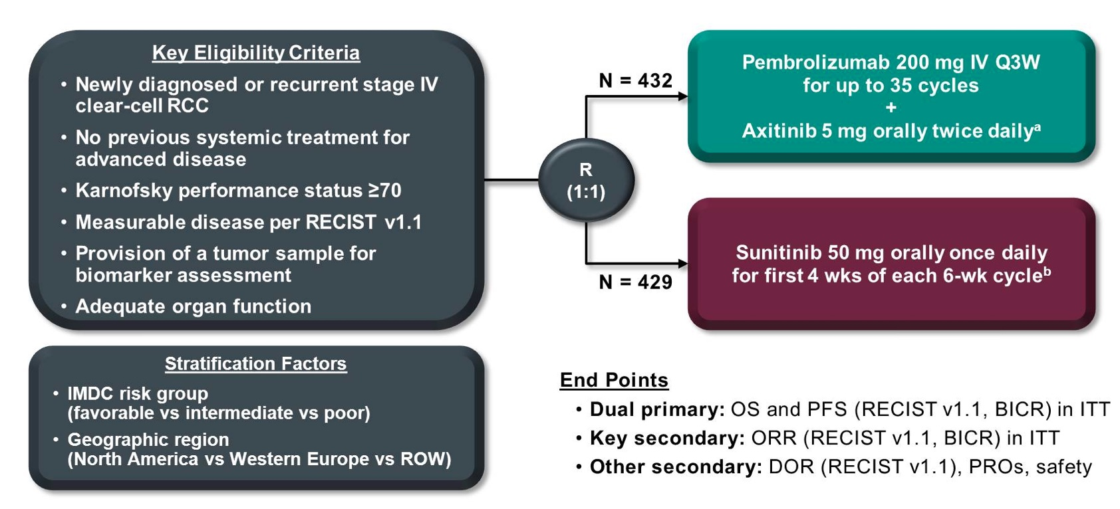
KEYNOTE-426 Study Design
Powles T et al. Genitourinary Cancers Symposium 2019; Abstract 543.

Slide 22
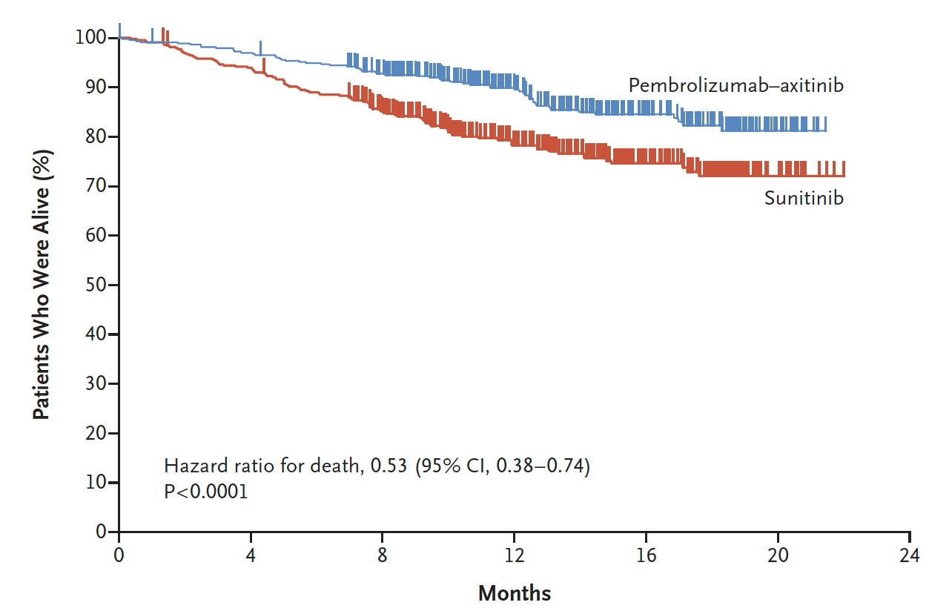
KEYNOTE-426: Overall Survival
 | Pembro-Axitinib (n = 432) | Sunitinib (n = 429)
12-mos survival rate | 89.9% | 78.3%
Rini BI et al. NEJM 2019 Feb 16;Epub ahead of print

Slide 23
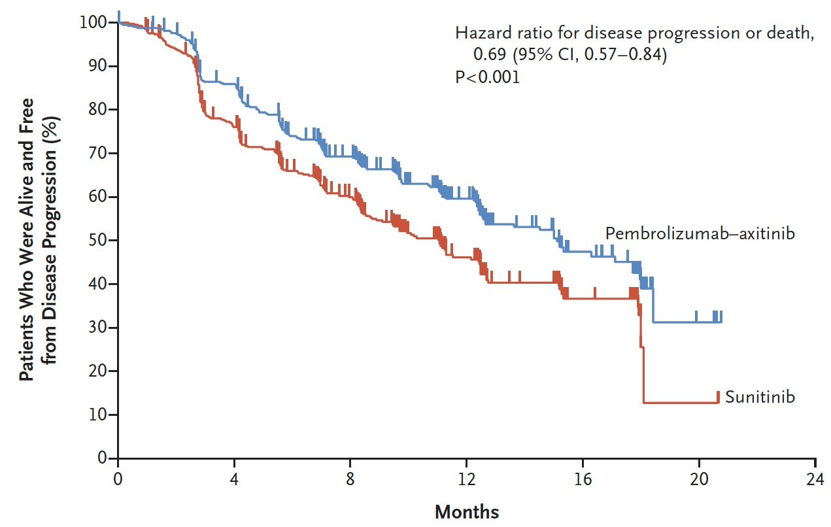
KEYNOTE-426: Progression-Free Survival
 | Pembro-Axitinib (n = 432) | Sunitinib (n = 429)
Median PFS | 15.1 mo | 11.1 mo
Rini BI et al. NEJM 2019 Feb 16;Epub ahead of print

Slide 24
David Quinn’s Preferred Therapeutic Sequencing and Decision Points For Metastatic RCC 2019
Baseline: Cytoreductive Nephrectomy; Control Critical Metastases: Brain, Bone; General health measures: TSH, Vitamin D
Interleukin-2, HD^{Ψ}
Sunitinib
Pazopanib
Nivolumab + Ipi
Nivolumab
?VEGF + CPI
Axitinib
Everolimus + Lenvatinib
Cabozantinib
Sorafenib
Everolimus
Bevacizumab
Temsirolimus*
^{Ψ}highly selected patients

Slide 25
Module 12:
Renal Cell and Bladder Cancer
Drs Quinn and Plimack

Slide 26

Urothelial Bladder Cancer
Elizabeth R Plimack MD MS
Chief, Division of Genitourinary Medical Oncology
Director, Genitourinary Clinical Research
Associate Professor, Hematology/Oncology
Fox Chase Cancer Center, Temple Health

Slide 27
Disclosures
Advisory Committee | Bristol-Myers Squibb Company, Genentech, Incyte Corporation, Janssen Biotech Inc, Merck
Contracted Research | Astellas Pharma Global Development Inc, AstraZeneca Pharmaceuticals LP, Bristol-Myers Squibb Company, Genentech, Merck, Peloton Therapeutics Inc, Pfizer Inc
Data and Safety Monitoring Board/Committee | AstraZeneca Pharmaceuticals, Pfizer Inc

Slide 28
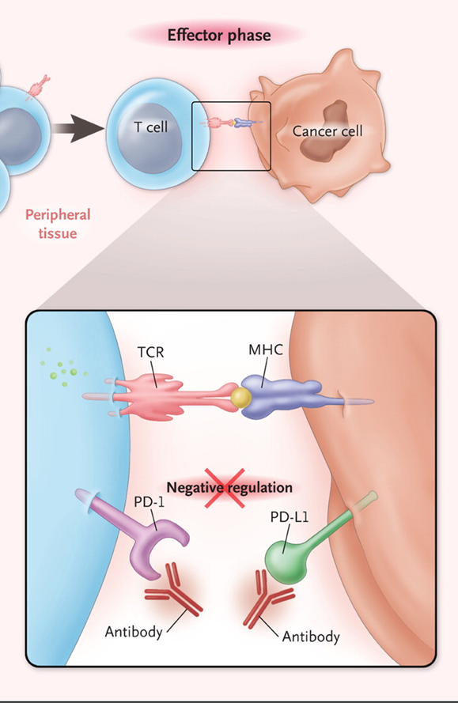
Checkpoint inhibitors
US FDA approved for UC
Agent | Ab Inhibits: | Schedule | Post Platinum | Frontline Cis-ineligible
atezolizumab | PD-L1 | Q3 Weeks | accelerated | accelerated
Nivolumab | PD-1 | Q4 Weeks | accelerated | -
Durvalumab | PD-L1 | Q2 Weeks | accelerated | -
Avelumab | PD-L1 | Q2 Weeks | accelerated | -
Pembrolizumab | PD-1 | Q3 Weeks | Level 1 | accelerated

Slide 29
First Line Systemic Therapy for Metastatic Disease

Slide 30
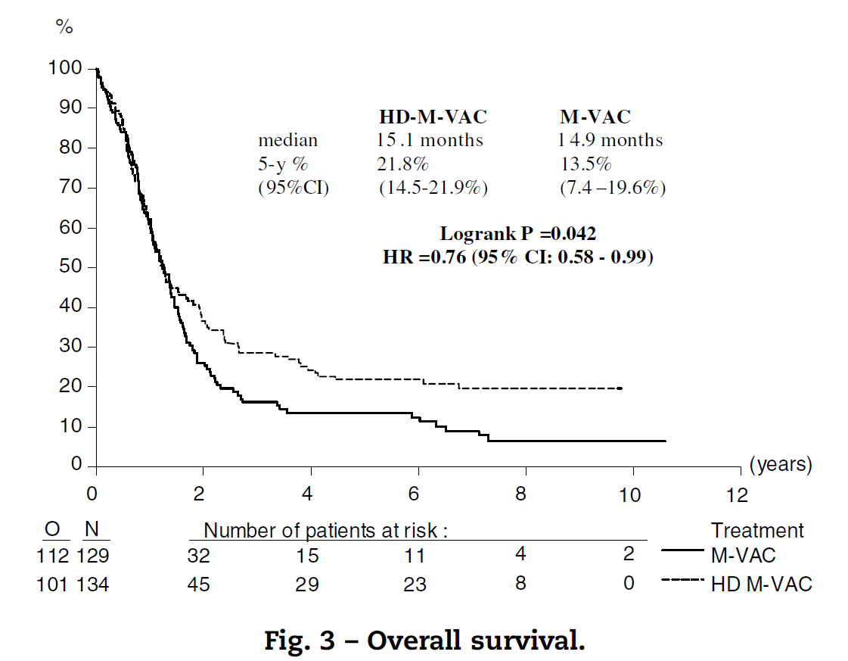
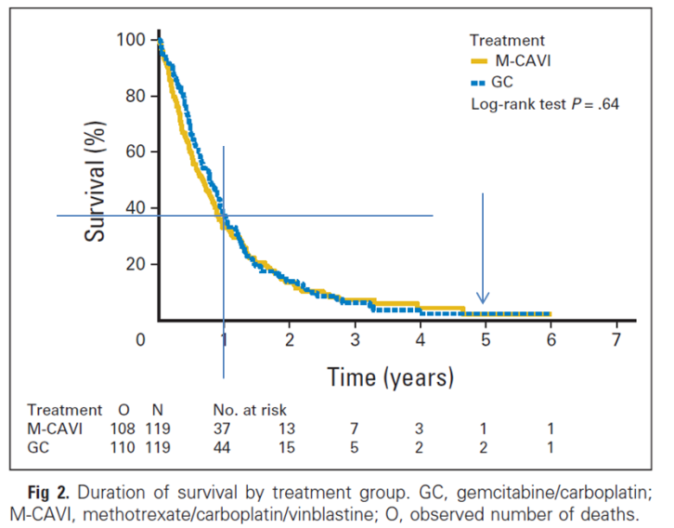
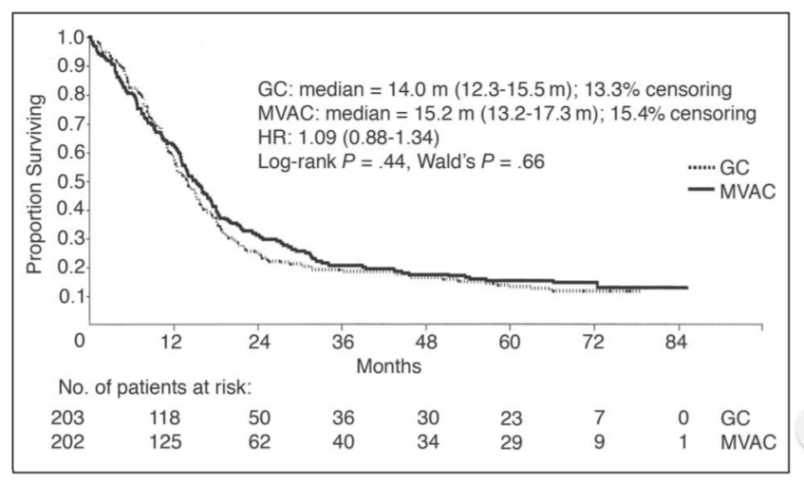
Cisplatin based chemo for UC yields durable responses. Cis is the original “tail on the curve”
Cisplatin Eligible
Gemcitabine Carboplatin
Gemcitabine Cisplatin
ORR 49%
CR 12 %
mOS 14 mo
Dose Dense MVAC
ORR 72%
CR 25%
mOS 15.1 mo
ORR 36%
CR 3%
mOS 9.3 mo
Von Der Masse et al. JCO, 2005
De Santis M et al. J Clin Oncol. 2012
Sternberg CN et al. Eur J Cancer, 2006

Slide 31
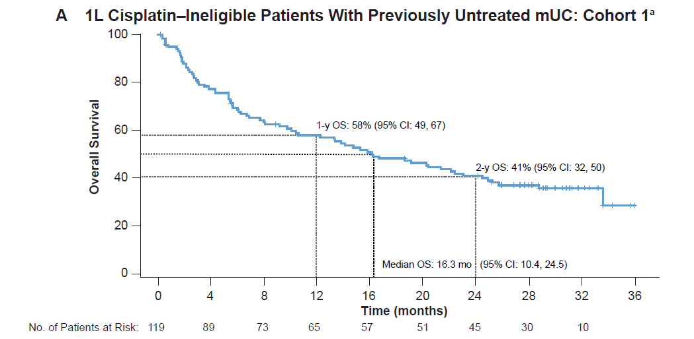
Atezolizumab first line cisplatin ineligible
Atezolizumab
n=119 patients
Median F/up: 29.3 months
Overall Response Rate: 24%
Median OS: 16.3 months
58% alive at 12 months
Balar, et al. ASCO 2018

Slide 32
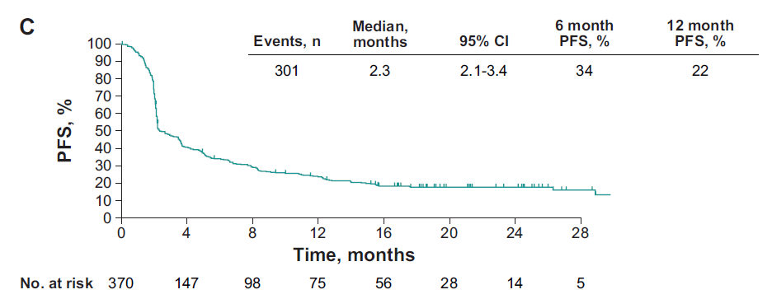
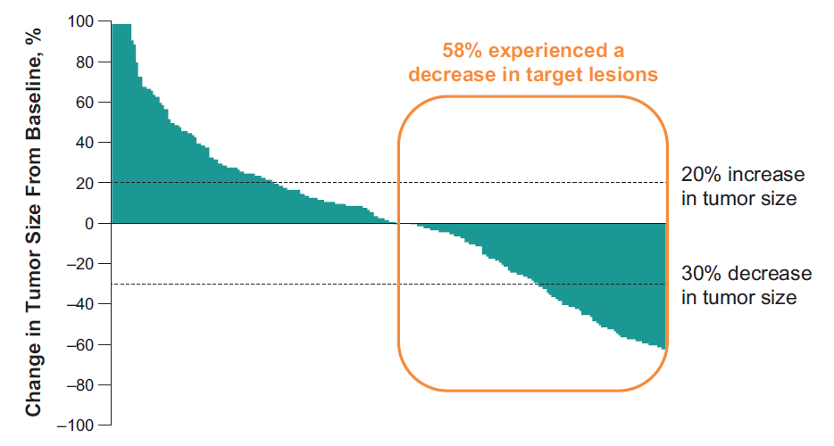
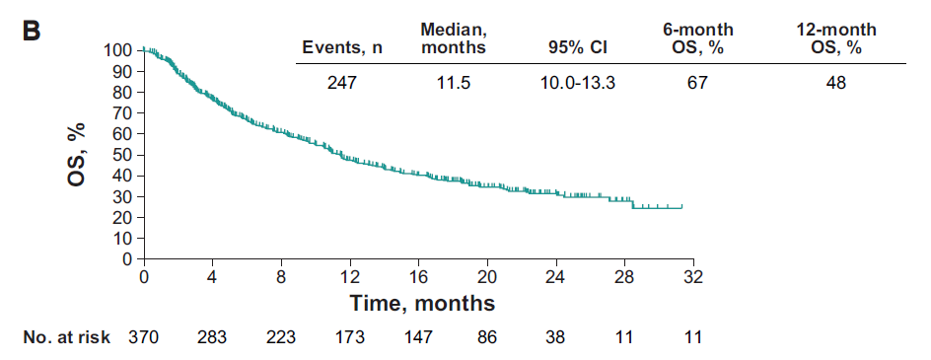
Pembrolizumab in first line cisplatin ineligible pts
Pembrolizumab
n=370 patients
Median F/up: 17 months
Overall Response Rate: 29%
Median OS: 11.5 months
48% Alive at 12 months
Vuky, et al. ASCO 2018

Slide 33
Response Rates to First Line Therapy for Metastatic Urothelial Carcinoma
CISPLATIN ELIGIBLE
CISPLATIN IN-ELIGIBLE

Slide 34

May 18 2018 FDA warning
FDA Alerts Health Care Professionals and Oncology Clinical Investigators about an Efficacy Issue Identified in Clinical Trials for Some Patients Taking Pembrolizumab or Atezolizumab as Monotherapy to Treat Urothelial Cancer with Low Expression of PD-L1
[5/18/2018] The U.S. Food and Drug Administration is alerting health care professionals, oncology clinical investigators, and the public about decreased survival associated with the use of pembrolizumab or atezolizumab as single therapy (monotherapy) in clinical trials to treat patients with metastatic urothelial cancer who have not received prior therapy and who have low expression of the protein programmed death ligand 1 (PD-L1).
In two ongoing clinical trials (KEYNOTE-361 and IMVIGOR-130), the Data Monitoring Committees’ (DMC) early reviews found patients in the monotherapy arms of both trials with PD-L1 low status had decreased survival compared to patients who received cisplatin- or carboplatin-based chemotherapy. There was no change in the adverse event profile of pembrolizumab or atezolizumab. Both Merck, manufacturer of pembrolizumab, and Genentech, manufacturer of atezolizumab, have stopped enrolling patients whose tumors have PD-L1 low status to the pembrolizumab or atezolizumab monotherapy arms per the DMCs’ recommendations.
The clinical trials compare platinum-based chemotherapy combined with pembrolizumab or atezolizumab to platinum-based chemotherapy alone. Both trials enrolled a third arm of monotherapy with pembrolizumab or atezolizumab to compare to platinum-based chemotherapy alone. The monotherapy arms remain open only to patients whose tumors have PD-L1 high status. The combination arms and the chemotherapy arms of both studies also remain open. The FDA is reviewing the findings of the ongoing clinical trials and will communicate new information as necessary.
Both pembrolizumab and atezolizumab are currently approved under accelerated approval for the treatment of locally advanced or metastatic urothelial carcinoma patients who are not eligible for cisplatin-containing chemotherapy, irrespective of PD-L1 status. Patients taking pembrolizumab or atezolizumab for other approved uses should continue to take their medication as directed by their health care professional.
Health care professionals should be aware that the populations enrolled in the ongoing clinical trials were eligible for platinum-containing chemotherapy, and therefore differ from those enrolled in the trials that led to the accelerated approvals of both pembrolizumab and atezolizumab in the treatment of patients with locally advanced or metastatic urothelial carcinoma who are not eligible for cisplatin-containing chemotherapy. FDA recommends providers select patients for the treatment of locally advanced or metastatic urothelial cancer using the criteria described in Section 14 of each label. These criteria supported the approvals for pembrolizumab and atezolizumab for initial monotherapy in cisplatin-ineligible patients. Pembrolizumab and atezolizumab are also currently approved by the FDA for the treatment of multiple types of other cancers.
Patients should talk to their doctor if they have questions or concerns about either drug. Health care professionals and patients are encouraged to report any adverse events or side effects related to the use of these products and other similar products to FDA’s MedWatch Adverse Event Reporting program.

Slide 35
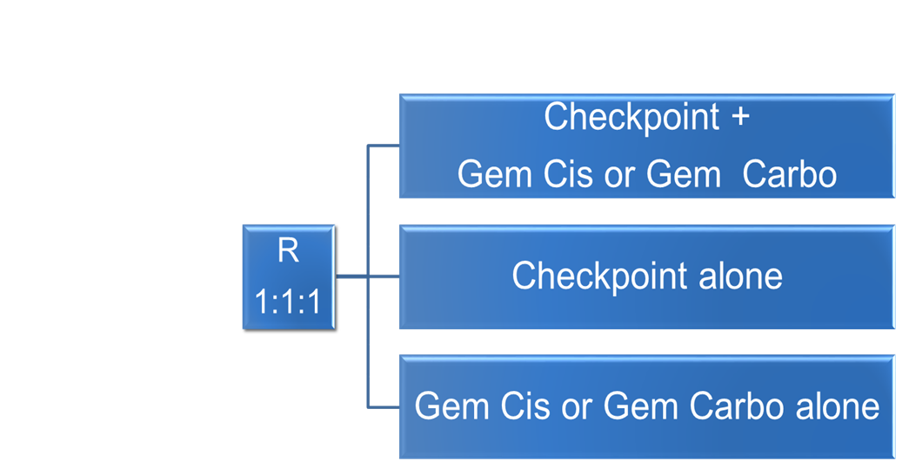
May 18 2018 FDA warning
Alert! decreased survival associated with the use of pembrolizumab or atezolizumab as monotherapy in clinical trials of patients with metastatic urothelial cancer who have not received prior therapy and who have low expression of PD-L1
However…
The studies cited compare monotherapy to platinum chemotherapy
FDA Alerts Health Care Professionals and Oncology Clinical Investigators about an Efficacy Issue Identified in Clinical Trials for Some Patients Taking pembrolizumab (pembrolizumab) or atezolizumab as Monotherapy to Treat Urothelial Cancer with Low Expression of PD-L1
[5/18/2018] The U.S. Food and Drug Administration is alerting health care professionals, oncology clinical investigators, and the public about decreased survival associated with the use of pembrolizumab or atezolizumab as single therapy (monotherapy) in clinical trials to treat patients with metastatic urothelial cancer who have not received prior therapy and who have low expression of the protein programmed death ligand 1 (PD-L1).
In two ongoing clinical trials (KEYNOTE-361 and IMVIGOR-130), the Data Monitoring Committees’ (DMC) early reviews found patients in the monotherapy arms of both trials with PD-L1 low status had decreased survival compared to patients who received cisplatin- or carboplatin-based chemotherapy. There was no change in the adverse event profile of pembrolizumab or atezolizumab. Both Merck, manufacturer of pembrolizumab, and Genentech, manufacturer of atezolizumab, have stopped enrolling patients whose tumors have PD-L1 low status to the pembrolizumab or atezolizumab monotherapy arms per the DMCs’ recommendations.
The clinical trials compare platinum-based chemotherapy combined with pembrolizumab or atezolizumab to platinum-based chemotherapy alone. Both trials enrolled a third arm of monotherapy with pembrolizumab or atezolizumab to compare to platinum-based chemotherapy alone. The monotherapy arms remain open only to patients whose tumors have PD-L1 high status. The combination arms and the chemotherapy arms of both studies also remain open. The FDA is reviewing the findings of the ongoing clinical trials and will communicate new information as necessary.
Both pembrolizumab and atezolizumab are currently approved under accelerated approval for the treatment of locally advanced or metastatic urothelial carcinoma patients who are not eligible for cisplatin-containing chemotherapy, irrespective of PD-L1 status. Patients taking pembrolizumab or atezolizumab for other approved uses should continue to take their medication as directed by their health care professional.
Health care professionals should be aware that the populations enrolled in the ongoing clinical trials were eligible for platinum-containing chemotherapy, and therefore differ from those enrolled in the trials that led to the accelerated approvals of both pembrolizumab and atezolizumab in the treatment of patients with locally advanced or metastatic urothelial carcinoma who are not eligible for cisplatin-containing chemotherapy. FDA recommends providers select patients for the treatment of locally advanced or metastatic urothelial cancer using the criteria described in Section 14 of each label. These criteria supported the approvals for pembrolizumab and atezolizumab for initial monotherapy in cisplatin-ineligible patients. Pembrolizumab and atezolizumab are also currently approved by the FDA for the treatment of multiple types of other cancers.
Patients should talk to their doctor if they have questions or concerns about either drug. Health care professionals and patients are encouraged to report any adverse events or side effects related to the use of these products and other similar products to FDA’s MedWatch Adverse Event Reporting program.

Slide 36
May 18 2018 FDA warning
Alert! decreased survival associated with the use of pembrolizumab or atezolizumab as monotherapy in clinical trials of patients with metastatic urothelial cancer who have not received prior therapy and who have low expression of PD-L1
However…
The studies cited compare monotherapy to platinum chemotherapy
FDA Alerts Health Care Professionals and Oncology Clinical Investigators about an Efficacy Issue Identified in Clinical Trials for Some Patients Taking pembrolizumab (pembrolizumab) or atezolizumab as Monotherapy to Treat Urothelial Cancer with Low Expression of PD-L1
[5/18/2018] The U.S. Food and Drug Administration is alerting health care professionals, oncology clinical investigators, and the public about decreased survival associated with the use of pembrolizumab or atezolizumab as single therapy (monotherapy) in clinical trials to treat patients with metastatic urothelial cancer who have not received prior therapy and who have low expression of the protein programmed death ligand 1 (PD-L1).
In two ongoing clinical trials (KEYNOTE-361 and IMVIGOR-130), the Data Monitoring Committees’ (DMC) early reviews found patients in the monotherapy arms of both trials with PD-L1 low status had decreased survival compared to patients who received cisplatin- or carboplatin-based chemotherapy. There was no change in the adverse event profile of pembrolizumab or atezolizumab. Both Merck, manufacturer of pembrolizumab, and Genentech, manufacturer of atezolizumab, have stopped enrolling patients whose tumors have PD-L1 low status to the pembrolizumab or atezolizumab monotherapy arms per the DMCs’ recommendations.
The clinical trials compare platinum-based chemotherapy combined with pembrolizumab or atezolizumab to platinum-based chemotherapy alone. Both trials enrolled a third arm of monotherapy with pembrolizumab or atezolizumab to compare to platinum-based chemotherapy alone. The monotherapy arms remain open only to patients whose tumors have PD-L1 high status. The combination arms and the chemotherapy arms of both studies also remain open. The FDA is reviewing the findings of the ongoing clinical trials and will communicate new information as necessary.
Both pembrolizumab and atezolizumab are currently approved under accelerated approval for the treatment of locally advanced or metastatic urothelial carcinoma patients who are not eligible for cisplatin-containing chemotherapy, irrespective of PD-L1 status. Patients taking pembrolizumab or atezolizumab for other approved uses should continue to take their medication as directed by their health care professional.
Health care professionals should be aware that the populations enrolled in the ongoing clinical trials were eligible for platinum-containing chemotherapy, and therefore differ from those enrolled in the trials that led to the accelerated approvals of both pembrolizumab and atezolizumab in the treatment of patients with locally advanced or metastatic urothelial carcinoma who are not eligible for cisplatin-containing chemotherapy. FDA recommends providers select patients for the treatment of locally advanced or metastatic urothelial cancer using the criteria described in Section 14 of each label. These criteria supported the approvals for pembrolizumab and atezolizumab for initial monotherapy in cisplatin-ineligible patients. Pembrolizumab and atezolizumab are also currently approved by the FDA for the treatment of multiple types of other cancers.
Patients should talk to their doctor if they have questions or concerns about either drug. Health care professionals and patients are encouraged to report any adverse events or side effects related to the use of these products and other similar products to FDA’s MedWatch Adverse Event Reporting program.
Enrolled cisplatin eligible and ineligible patients.

Slide 37
June/July 2018: FDA and EMA restrict the indication for treatment 1st line to pts who are cisplatin ineligible and PD-L1+
For pembrolizumab, pts must be cisplatin ineligible and PD-L1+ by CPS score [CPS ≥ 10]
FDA has limited the use of atezolizumab and pembrolizumab for patients with locally advanced or metastatic urothelial cancer who are not eligible for cisplatin-containing therapy.
The Agency took this action on June 19, 2018, due to decreased survival associated with the use of pembrolizumab (pembrolizumab) or atezolizumab (atezolizumab) as single therapy (monotherapy) compared to platinum-based chemotherapy in clinical trials to treat patients with metastatic urothelial cancer who have not received prior therapy and who have low expression of the protein programmed death ligand 1 (PD-L1).
The labels of both drugs have been revised to reflect the limitation in the indication. The indications read as follows:
Pembrolizumab is indicated for the treatment of patients with locally advanced or metastatic urothelial carcinoma who are not eligible for cisplatin-containing therapy and whose tumors express PD-L1 (Combined Positive Score ≥ 10), or in patients who are not eligible for any platinum-containing chemotherapy regardless of PD-L1 status.
Atezolizumab is indicated for the treatment of patients with locally advanced or metastatic urothelial carcinoma who:
Are not eligible for cisplatin-containing therapy, and whose tumors express PD-L1 (PD-L1 stained tumor-infiltrating immune cells [IC] covering ≥5% of the tumor area), as determined by an FDA-approved test, or
Are not eligible for any platinum-containing therapy regardless of PD-L1 status.
On July 2, 2018, the FDA approved the Ventana PD-L1 (SP142) Assay (Ventana Medical Systems, Inc.) for PD‑L1 expression in ≥ 5% IC in urothelial carcinoma tissue. The test should be used to select patients with locally advanced or metastatic urothelial carcinoma for treatment with atezolizumab (atezolizumab, Genentech Inc.). The FDA also updated the Prescribing Information for atezolizumab to require use of an FDA-approved test for patient selection.
The tests used in the trial to determine PD-L1 expression are listed in Section 14 of each drug label. The FDA is reviewing the findings of ongoing analyses and will communicate new information regarding the PD-L1 assays and indications as it becomes available.
For atezolizumab, pts must be cisplatin ineligible and PD-L1+ by IC score [IC ≥ 5%]

Slide 38
Take Home Points: 1st line mUC
Chemotherapy is highly active in this space
Cisplatin eligible patients should get cisplatin
Cisplatin ineligible patients should get gem carbo unless they are PD-L1 positive using the specific companion diagnostic test*
Patients ineligible for any chemotherapy can be considered for checkpoint inhibitor therapy regardless of PD-L1 status
*Access to these specific companion diagnostic tests is highly variable and limited at many institutions

Slide 39
Breakthrough Therapies

Slide 40

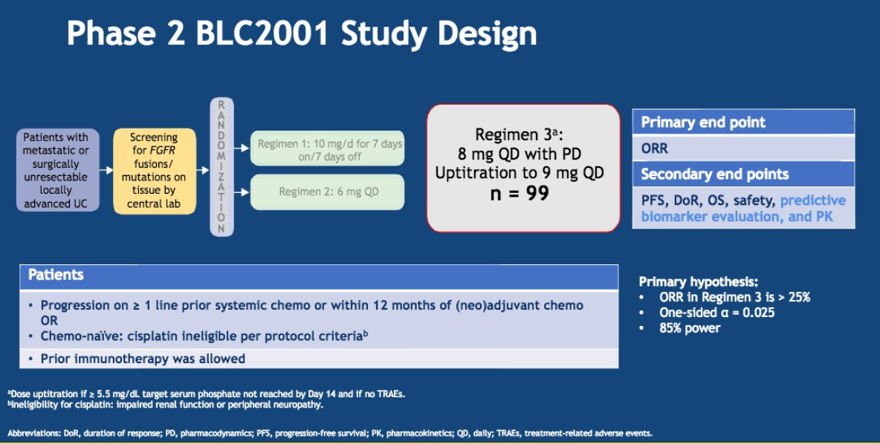
Phase II Erdafitinib: oral pan-FGFR (1-4) inhibitor
FGFR mutation or fusion required for enrollment (prevalence in met UC: 15-20%)
At least 1 prior systemic therapy. Prior checkpoint allowed.
Siefker Radtke ASCO 2018

Slide 41
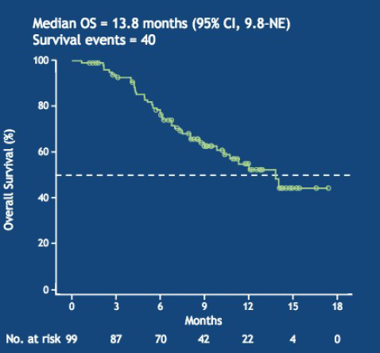
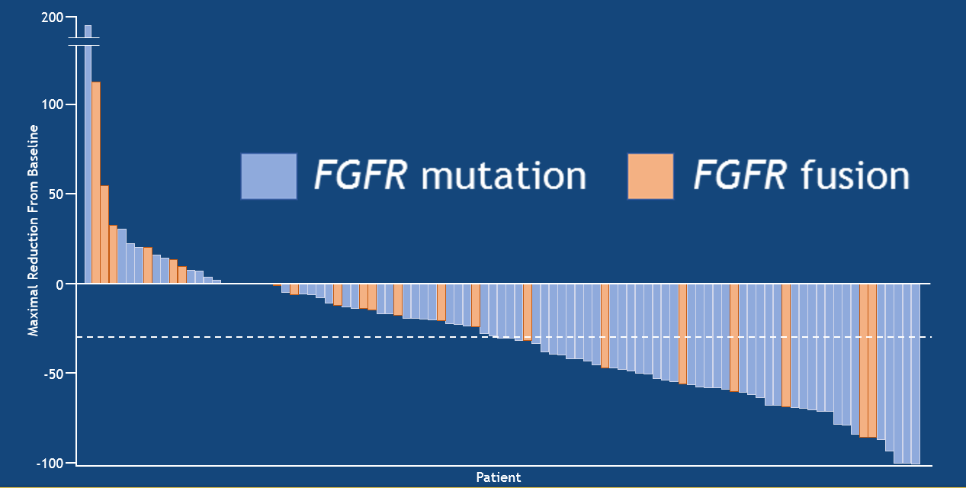
Phase II Erdafitinib: oral pan-FGFR (1-4) inhibitor
ORR 40%, mOS 13.8 months
Siefker Radtke ASCO 2018

Slide 42

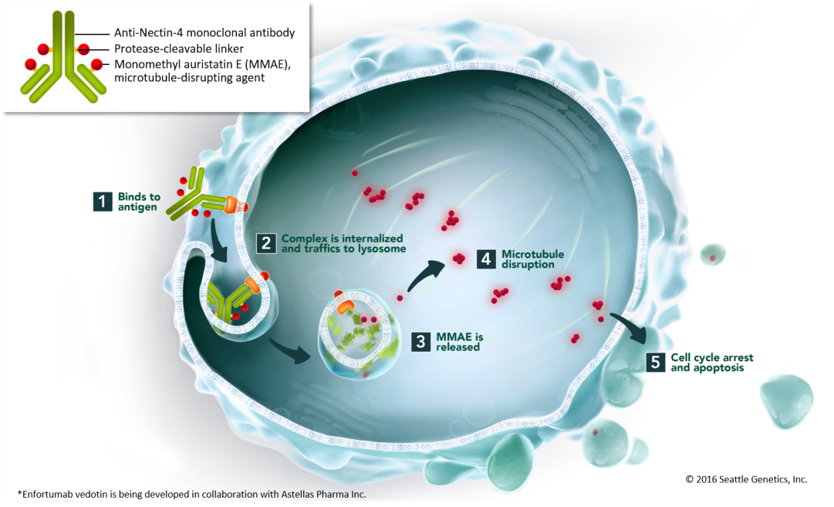
Enfortumab Vedotin Is an Antibody-Drug Conjugate Targeting Nectin-4
Enfortumab vedotin (EV) is a fully humanized monoclonal antibody against Nectin-4 conjugated with the microtubule-disrupting agent monomethyl auristatin E by a protease‑cleavable linker
Nectin-4, a transmembrane cell adhesion molecule¹, was found to be highly expressed in 97% of mUC patient samples³
Rosenberg ASCO 2018

Slide 43
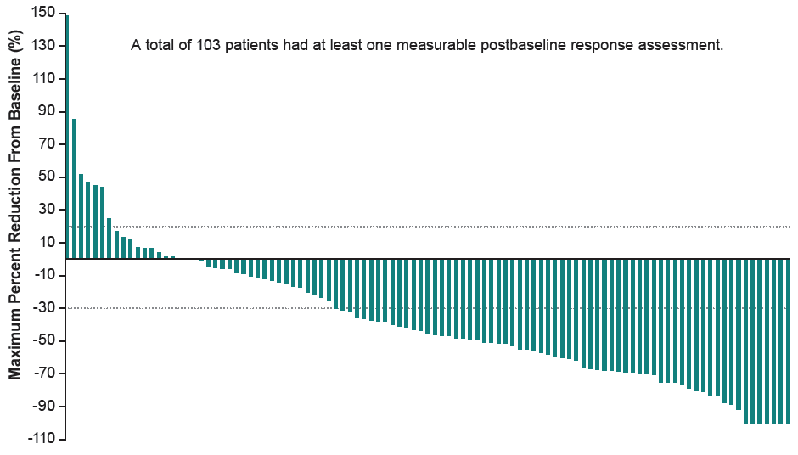
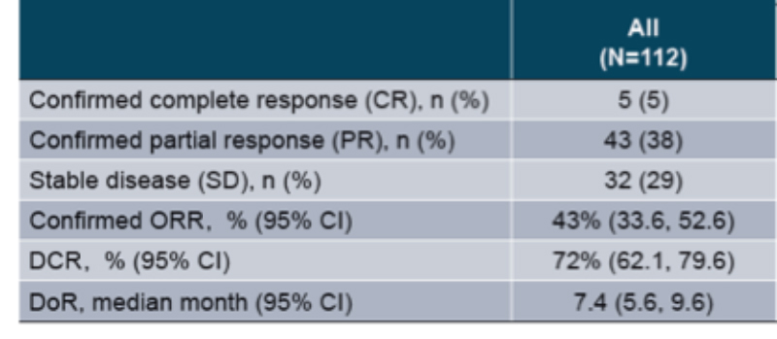
Phase I EV-101 Trial of Enfortumab Vedotin in Metastatic Urothelial Cancer: Response
A total of 103 patients had at least
1 measurable postbaseline response assessment
Rosenberg JE et al. Genitourinary Cancers Symposium 2019;Abstract 377.

Slide 44
My Recommendations for UC in 2019
Neoadjuvant | Preferred | Alternate
cisplatin eligible | DDMVAC | Gem Cis – standard dosing
cisplatin ineligible | Upfront Surgery | Checkpoint inhibitor on a clinical trial
First line metastatic | Preferred | Alternate
cisplatin eligible | DDMVAC | Gem Cis – standard dosing
cisplatin ineligible, PD-L1+ | Pembrolizumab | atezolizumab
cisplatin ineligible, PD-L1 neg or unkn | Carbo Gem / Clinical Trial | Supportive Care / Clinical Trial
Post Platinum | Preferred | Alternate
Post DDMVAC | Pembrolizumab → Gem → Taxane | Gem, Taxane
Post Gem Cis | atezolizumab → Taxane | Taxane
Post 1st line Checkpoint | Preferred | Alternate
cisplatin eligible (by definition) | Gemcitabine +/- carbo | Taxane

Slide 45
My Recommendations for UC in 2019
Neoadjuvant | Preferred | Alternate
cisplatin eligible | DDMVAC | Gem Cis – standard dosing
cisplatin ineligible | Upfront Surgery | Checkpoint inhibitor on a clinical trial
First line metastatic | Preferred | Alternate
cisplatin eligible | DDMVAC | Gem Cis – standard dosing
cisplatin ineligible, PD-L1+ | Pembrolizumab | atezolizumab
cisplatin ineligible, PD-L1 neg or unkn | Carbo Gem / Clinical Trial | Supportive Care / Clinical Trial
Post Platinum | Preferred | Alternate
Post DDMVAC | Pembrolizumab → Gem → Taxane | Gem, Taxane
Post Gem Cis | atezolizumab → Taxane | Taxane
Post 1st line Checkpoint | Preferred | Alternate
cisplatin eligible (by definition) | Gemcitabine +/- carbo | Taxane

Slide 46
My Recommendations for UC in 2019
Neoadjuvant | Preferred | Alternate
cisplatin eligible | DDMVAC | Gem Cis – standard dosing
cisplatin ineligible | Upfront Surgery | Checkpoint inhibitor on a clinical trial
First line metastatic | Preferred | Alternate
cisplatin eligible | DDMVAC | Gem Cis – standard dosing
cisplatin ineligible, PD-L1+ | Pembrolizumab | atezolizumab
cisplatin ineligible, PD-L1 neg or unkn | Carbo Gem / Clinical Trial | Supportive Care / Clinical Trial
Post Platinum | Preferred | Alternate
Post DDMVAC | Pembrolizumab → Gem → Taxane | Gem, Taxane
Post Gem Cis | atezolizumab → Taxane | Taxane
Post 1st line Checkpoint | Preferred | Alternate
cisplatin eligible (by definition) | Gemcitabine +/- carbo | Taxane

Slide 47
Module 12: Renal Cell and Bladder Cancer
Boards Mini-Review: Dr Quinn
Topic/issue:
Indications for debulking nephrectomy

Slide 48
Sample question
A 66-year-old man presents with abdominal pain and is incidentally found to have a large right kidney mass. Imaging reveals multiple bilateral pulmonary nodules. CT-guided biopsy of one of the lung nodules confirms metastatic clear cell renal cell carcinoma. The kidney lesion is completely asymptomatic. The patient will start therapy with an oral tyrosine kinase inhibitor. What would you recommend with regard to the kidney mass?
Up-front nephrectomy
Nephrectomy after systemic therapy yields a response in the lung nodules
Nephrectomy after 6 months of therapy
No local therapy is needed for the kidney unless symptoms occur
Other

Slide 49
Module 12: Renal Cell and Bladder Cancer
Boards Mini-Review: Dr Plimack
Topic/issue:
Neoadjuvant versus adjuvant systemic treatment for bladder cancer

Slide 50
Sample question
A 66-year-old man presents after 4 months of painless hematuria. Cystoscopy reveals a large mass in the dome of the urinary bladder, which is biopsy confirmed to be muscle-invasive urothelial carcinoma. No disease is present outside the urinary bladder, and the patient has normal renal function. What would you recommend?
Neoadjuvant cisplatin-containing chemotherapy
Neoadjuvant radiation therapy
Check PD-L1 staining and administer a neoadjuvant anti-PD-1/PD-L1 antibody if greater than 10%
Proceed with cystectomy followed by adjuvant therapy
Other

