Slide 1
Please note, these are the actual video-recorded
proceedings from the live CME event and may include
the use of trade names and other raw, unedited content.

Slide 2
Module 5:
Hodgkin and Non-Hodgkin Lymphomas
Drs Leonard and Moskowitz

Slide 3
Do you have any patients in your practice with...
 | % responding “yes” | Median among those responding “yes”
Hodgkin lymphoma | 92% | 5
Follicular lymphoma | 96% | 10
Mantle cell lymphoma | 88% | 2

Slide 4
Have you consulted in some way with a tertiary care expert during the past year (eg, sent for a second opinion, email consult, phone consult) on any cases of…
 | % responding “yes” | Median among those responding “yes”
Hodgkin lymphoma, follicular lymphoma or mantle cell lymphoma | 82% | 2

Slide 5
Have you administered the following (on or off a clinical trial) to a patient with lymphoma?
Use of new agents/strategies
 | % responding “yes” | Median among those responding “yes”
Brentuximab vedotin combined with AVD (doxorubicin/vinblastine/ dacarbazine) as up-front therapy | 41% | 2
Brentuximab vedotin as consolidation after autologous stem cell transplant | 29% | 1
Anti-PD-1 antibody | 39% | 1

Slide 6
Follicular Lymphoma
John P Leonard, MD
Richard T Silver Distinguished Professor of Hematology and Medical Oncology
Associate Dean for Clinical Research
Associate Director, Meyer Cancer Center
Executive Vice Chairman, Weill Department of Medicine

Slide 7
Disclosures
Consulting advice:
Gilead, Celgene, Sutro, Genentech/Roche, Bayer, ADC Therapeutics, MEI Pharma, AstraZeneca, Biotest, Novartis, Merck, MorphoSys, BeiGene, Nordic Nanovector, Sandoz, Karyopharm

Slide 8
GALLIUM: Obinutuzumab vs Rituximab with chemotherapy (and as maintenance)
Marcus R, et al. N Engl J Med. 2017; 377:1331-44.

Slide 9
GALLIUM: Obinutuzumab vs Rituximab with chemotherapy (and as maintenance) improves PFS but not OS
HR 0.75
p = 0.21
HR 0.66
p = 0.001
Marcus R, et al. N Engl J Med. 2017; 377:1331-44.

Slide 10
GALLIUM: Obinutuzumab vs Rituximab with chemotherapy (and as maintenance): Effects across regimens
Hiddemann, et al. J. Clin Oncol 2018

Slide 11
GALLIUM: Obinutuzumab vs Rituximab with chemotherapy (and as maintenance): High grade adverse events
Marcus R, et al. N Engl J Med. 2017; 377:1331-44.

Slide 12
GALLIUM: Obinutuzumab vs Rituximab with chemotherapy (and as maintenance): MRD negativity
Pott C, et al. ASH 2016.

Slide 13
RELEVANCE: Lenalidomide-Rituximab (R²) vs Chemo-R
Previously untreated patients with advanced
FL requiring treatment per GELF (N = 1,030)
Morschhauser F, et al, NEJM 2018

Slide 14
RELEVANCE: Lenalidomide-Rituximab (R²) vs Chemo-R
Similar ORR and CR as initial therapy for FL
Morschhauser F, et al, NEJM 2018

Slide 15
RELEVANCE: Lenalidomide-Rituximab (R²) vs Chemo-R
Similar PFS and OS as initial therapy for FL
Morschhauser F, et al, NEJM 2018

Slide 16
RELEVANCE: Lenalidomide-Rituximab (R²) vs Chemo-R
Safety comparisons
Morschhauser F, et al, NEJM 2018

Slide 17
Idelalisib: selective PI3K (delta) inhibitor in double refractory iNHL
Single-arm phase 2 study (n = 125)
Rituximab + alkylator-refractory iNHL
Idelalisib 150 mg b.i.d. continuously
Therapy maintained until progression
Long-term
follow-up
Tumor response
75
50
ORR 57%
CR 6%
25
FL (n = 72)
SLL (n = 28)
MZL (n = 15)
LPL/WM (n = 10)
0
SPD of measured lymph nodes (best % change from baseline)
−25
−50
−75
−100
Individual patients (n = 125)
2 patients had no baseline evaluation
1 patient had disease progression
on the basis of lymph node biopsy,
no baseline evaluation
Gopal AJ, et al. N Engl J Med. 2014;370:1008-18.

Slide 18
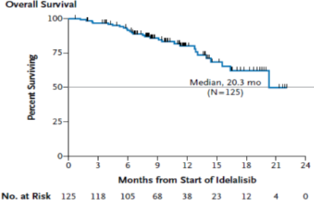
PFS and OS in patients with recurrent iNHL treated with idelalisib
PFS
OS
100
75
50
Median 11 months
(n = 125)
Progressive-free survival (%)
25
Median TTR 1.9 months
Median DoR 12.5 months
0
0
3
6
9
12
15
18
Months from start idelalisib
No. at risk
125 | 100 | 59 | 39 | 20 | 13 | 0
Gopal AJ, et al. N Engl J Med. 2014;370:1008-18.

Slide 19
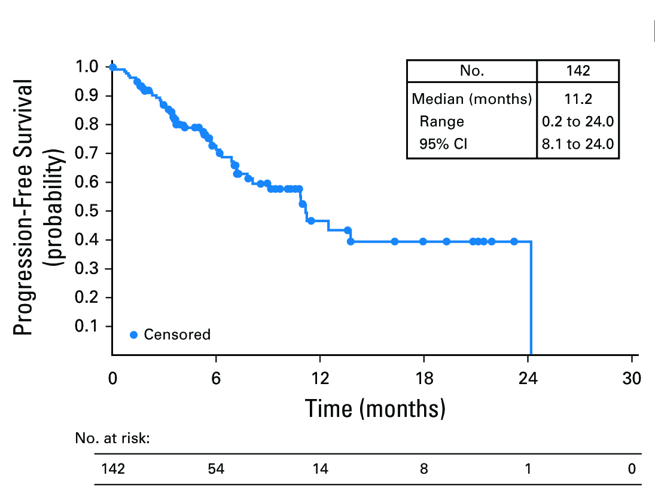
Copanlisib in R/R Indolent Lymphoma
(IV PI3K alpha/delta inhibitor)
60 mg IV day 1, 8, 15 every 28 days
Median, mo | 11.2
Range | 0.2-24.0
95% CI | 8.1-24.0
ORR 59% (12% CR)
No. at Risk
142 54 14 8 1 0

Slide 20
Duvelisib in recurrent indolent NHL
(Oral PI3K delta/gamma inhibitor)
Indolent lymphoma patients “double refractory” to rituximab and chemotherapy/radioimmunotherapy
25 mg po BID continuous dosing (w/PCP prophylaxis)
129 subjects, 83 with FL, median age 65, median 3 prior rx
ORR 46%, median duration 9.9 months
Principal toxicities cytopenias, diarrhea
Led to FDA approval
Zinzani et al, ICML 2017

Slide 21
AUGMENT: R² vs rituximab monotherapy in R/R iNHL
Lenalidomide 20 mg
Rituximab weekly x 4, then every month x 4
R/R
FL or MZL
Placebo
Rituximab weekly x 4, then every month x 4
12 months
Phase 3 study (registration)
Eligible patients: rituximab-naïve or rituximab-sensitive R/R FL or MZL, grades 1, 2, or 3a
Primary endpoint: PFS
HR = 1.6 (improvement of 6.7 months in median PFS)
  implies sample size of N = 350
NCT01938001. Available at: www.clinicaltrials.gov.

Slide 22
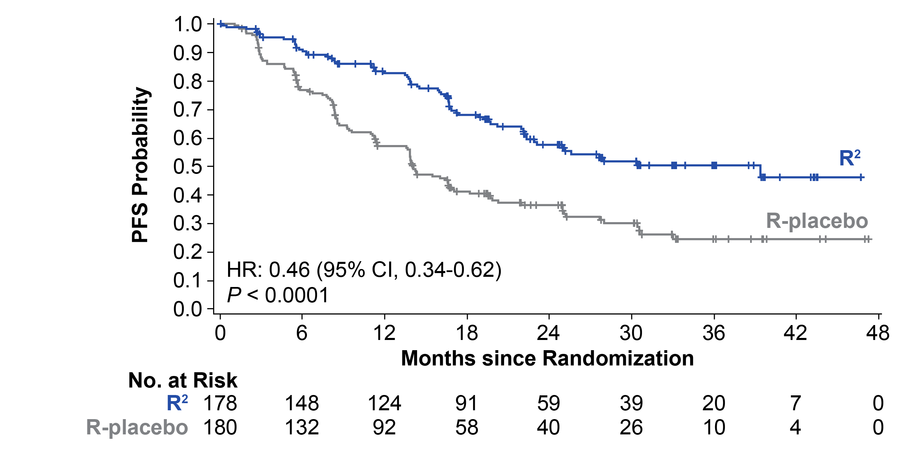
AUGMENT Primary endpoint: progression-free survival (ITT, IRC)
PFS by IRC*
Median follow up: 28.3 months
Median PFS | R² (n = 178) | R-placebo (n = 180) | HR (95% CI) | P Value
By IRC, mo (95% CI) | 39.4 (22.9-NE) | 14.1 (11.4-16.7) | 0.46 (0.34-0.62) | < 0.0001
By investigator, mo (95% CI) | 25.3 (21.2-NE) | 14.3 (12.4-17.7) | 0.51 (0.38-0.69) | < 0.0001
Leonard et al, ASH 2018
*Censoring rules based on FDA guidance.
Data cutoff June 22, 2018.

Slide 23
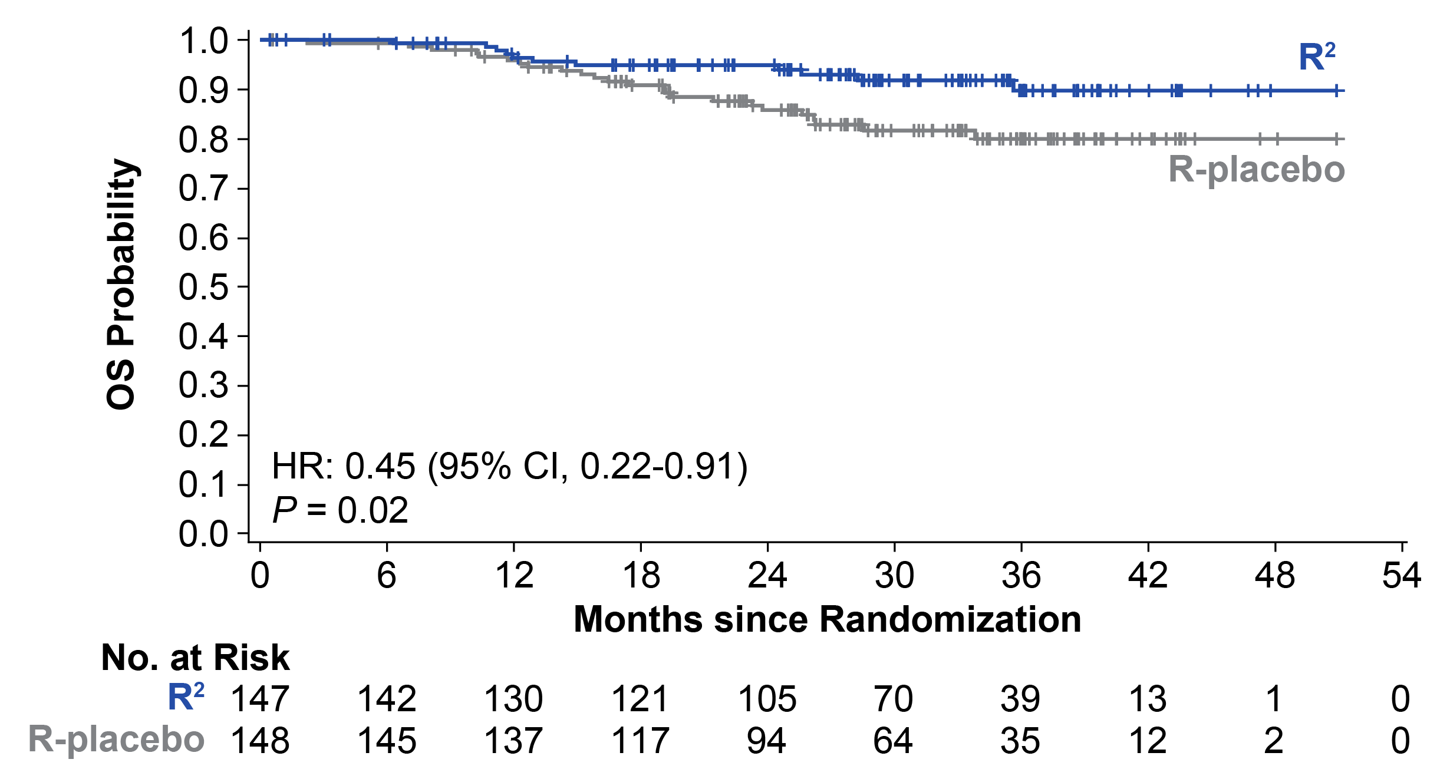
AUGMENT overall survival in FL patients
PFS by IRC*
35 total deaths (11 R², 24 R-placebo)
2-year OS was 95% (95% CI, 90%-98%) for R² and 86% (95% CI, 79%-91%) for R-placebo
Leonard et al, ASH 2018

Slide 24
Follicular Lymphoma Summary
Obinutuzumab upfront with chemotherapy improves PFS but not OS
Lenalidomide + rituximab upfront comparable to chemotherapy + rituximab
Lenalidomide + rituximab improves efficacy vs rituximab alone
PI3K inhibitors active, particularly in relapsed/refractory patient populations

Slide 25
Module 5:
Hodgkin and Non-Hodgkin Lymphomas
Drs Leonard and Moskowitz

Slide 26
Hodgkin Lymphoma and
Mantle Cell Lymphoma
Craig Moskowitz, MD
Physician in Chief, Cancer Service Line
Sylvester Comprehensive Cancer Center
Professor of Medicine, Miller School of Medicine
University of Miami Health System

Slide 27
Disclosures
Research Funding: Merck, Seattle Genetics, ADC Therapeutics
SAB: Novartis, Seattle Genetics, Celgene, Merck, BMS, Genentech, Takeda

Slide 28
HL by the Numbers
Optimal Upfront Treatment
7500 pts
1000 Pts ≥ 60 years
No standard TX
Favorable ES
Unfavorable ES
Unfavorable ES with Bulk
Favorable AS
Unfavorable AS
800
2500
700
2500
1000
75 Fail
300 Fail
125 Fail
500 Fail
300 Fail
TREATMENT FAILS IN 1300 PATIENTS

Slide 29
Advanced Stage Disease

Slide 30
Interim PET adapted strategies
Results from trials for de-escalation post negative PET-2 are favorable across studies
A positive PET-2 after two cycles of ABVD warrants a change in treatment regimen
Omitting bleomycin after a negative interim scan minimizes toxicity without affecting clinical efficacy
Prognostic factors other than PET might affect outcomes
  RATHL study: negative predictive value of interim PET scans after two cycles of ABVD is lower in patients with stage IV or an IPS 4-7
  MTV is the next big thing
PET-2 positive patients comprise a heterogeneous group, RATHL and GITIL trials: PET-2 positive patients with a score of 5 vs 4 are at a particularly higher risk for relapse
OS excellent

Slide 31
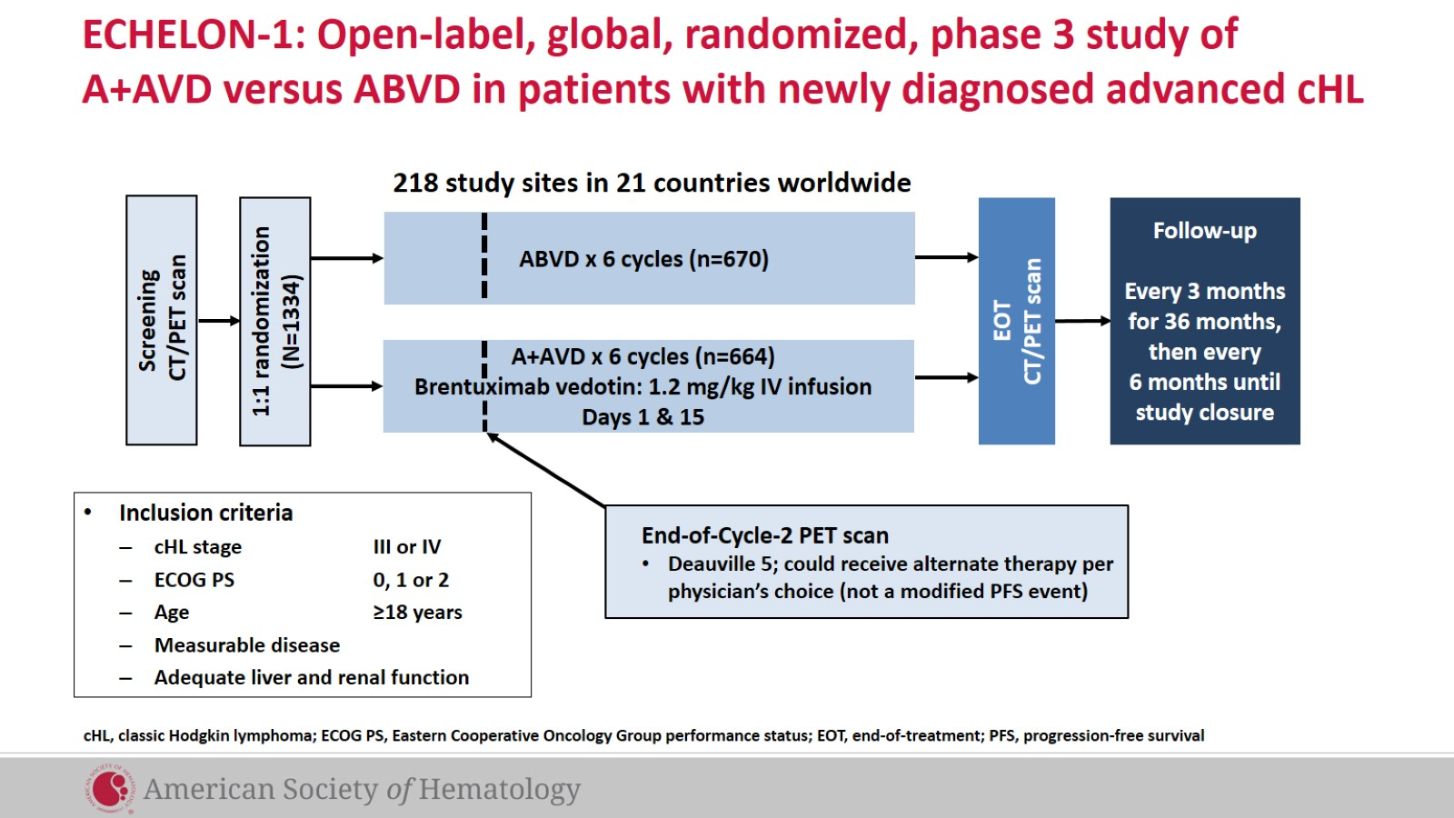
ECHELON-1: Open-label, global, randomized, phase 3 study of A+AVD versus ABVD in patients with newly diagnosed advanced cHL
ECHELON-1: Open-Label, Global, Randomized, Phase 3 Study of BV+AVD Versus ABVD in Patients With Newly Diagnosed Advanced cHL
Connors JM, et al. Blood. 2017;130: Abstract 6.

Slide 32

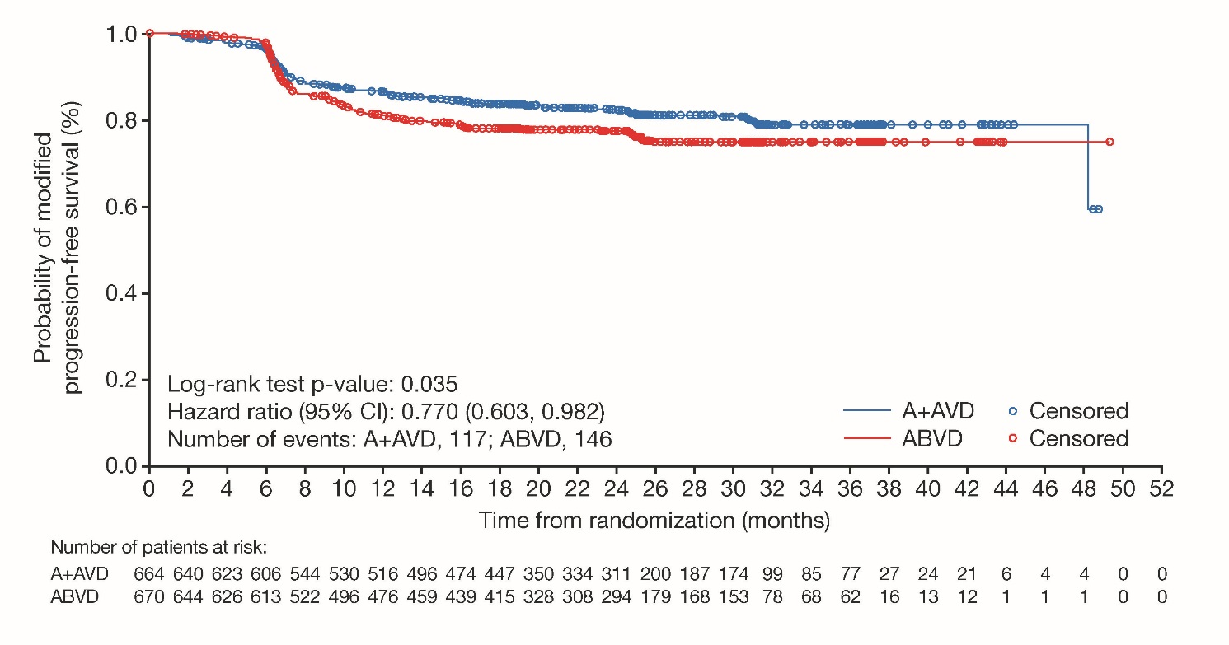
Phase 3 ECHELON-1 Study
BV+AVD associated with 5% improvement in modified PFS
Med age 36 y (range 18-83), Stage 4: 64%, EN sites: 62%, B symptoms: 58%, IPS 2-3: 50%, 4-7: 25%
Global accrual: US: 40%, Europe: 50%, Asia: 10%
BV-AVD
Med fu 24.9 mo
OS: 96.6% vs 94.2%
ABVD
82.1% vs 77.2%
HR 0.77, p = 0.035
No difference in ORR, CR rate, interim Deauville 1-3 scores (89% vs 86%)
Deauville 1-2 at EOT: 85% vs 80% p = 0.03
Differences largely due to events for subsequent therapy in patients with incomplete response
Connors et al NEJM 2017

Slide 33
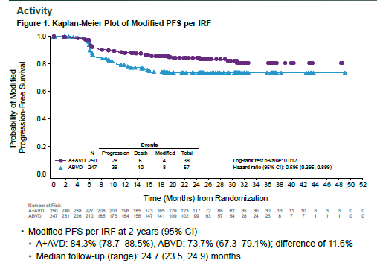
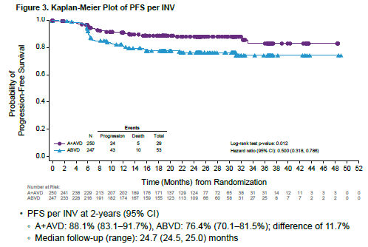
Subsets who benefit from BV-AVD:
North American (NA) Results
Patients in NA seemed to preferentially benefit from BV-AVD
BV-AVD
BV-AVD
ABVD
ABVD
mPFS 84 vs 73% PFS 88% vs 76%
BV-AVD
BV-AVD
European results?
Ramchandren et al ASCO 2018

Slide 34
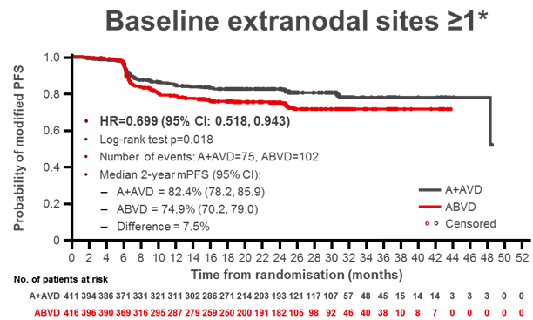
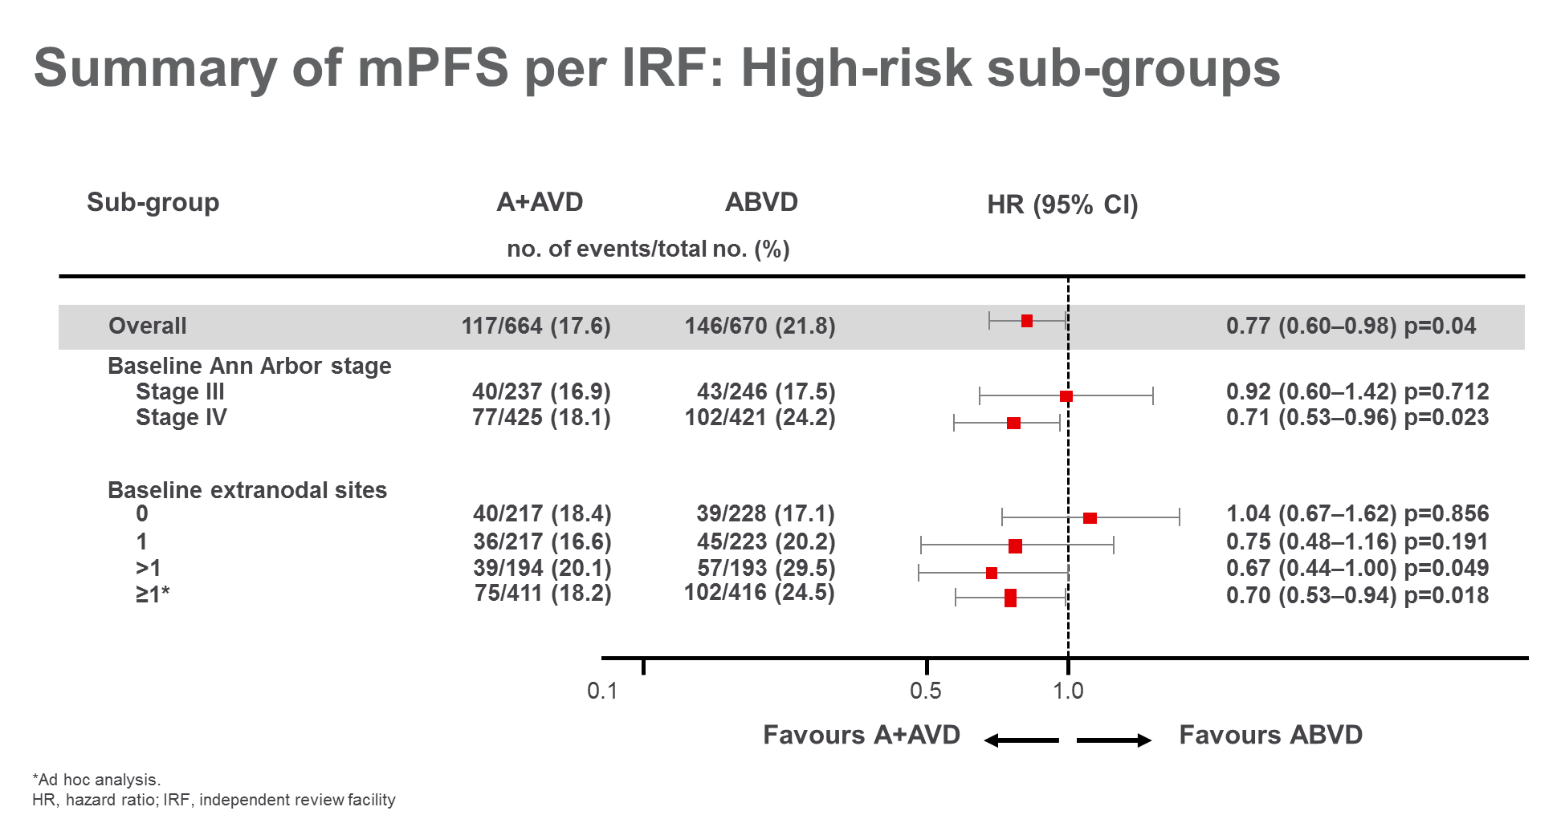
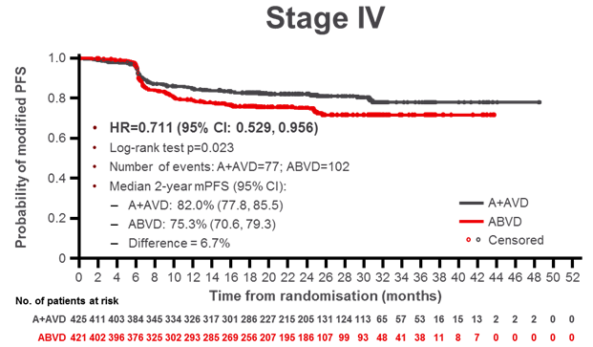
Subsets who benefit from BV-AVD (2-y mPFS)
Statistically significant benefit favoring BV-AVD in patients with 1 or more EN sites or stage IV disease
BV-AVD: 82.4%
ABVD: 74.9%
BV-AVD
BV-AVD: 82%
ABVD: 75.3%
Favours BV-AVD
Courtesy Dr Hutchins EHA 2018

Slide 35
ECHELON-1: Summary
Provides a benchmark of outcomes for 6 x ABVD in interim PET positive patients (2 y PFS 42%)
BV-AVD: Modest mPFS (5%) advantage with no OS advantage
Deauville 1-2 considered negative (other studies 1-3 is negative)
More toxicity (neuropathy, hematologic)
G-CSF is required
Avoids bleomycin
  RATHL results have changed practice in ~ 80% of patients and AVD is used if interim PET negative
Impact of BV-AVD primarily seen in
  North American patients
  PET-2 positive cases
  Stage IV, > 1 EN site
IF there is not adequate nuclear medicine support at your center, I would recommend BV-AVD to most patients with ASHL

Slide 36
Phase 2 CheckMate 205 Newly Diagnosed cHL: Study Design¹
Monotherapy
(4 doses)
Combotherapy
(6 combo-cycles; 12 doses)
Adults with newly diagnosed, untreated, advanced-stage cHL
(stage IIB, III, IV)
Performance status 0-1
N = 51
Follow-up/ observation
Nivolumab
240 mg IV Q2W
Nivolumab 240 mg IV + AVD
Q2W
~8 weeks
~22 weeks
Max 2 years
FDG-PET plus CT/MRI scans
Primary Endpoint
Safety and tolerability
(Grade 3-5 TRAEs)
Additional Endpoints
Discontinuation rate
CR and ORR by IRC
CR and ORR by investigator
mPFS
OS

Slide 37
Response at End of Therapy in Evaluable Patients¹
Status of Non-CR Patients by IRC (n = 12)
IRC | Investigator | Subsequent Therapy
PRª | CR | None
PRª | CR | None
PRª | CR | None
PRª | CR | None
PRª | CR | None
PRª | CR | None
PDª | CR | None
PDª | SD | None
PRª | PD | None
PRª | PD | None
PRª | PR | Bendamustine, nitrogen mustard analog
PD | PD | Cisplatin, cytarabine, etoposide, methylprednisone
ORR: 94%
ORR: 84%
ITT Population
(N = 51)
Response-Evaluable
Population
(n = 46)
Should this be methylprednisolone?
If so, we can change to “ESHAP” since it’ll already be in the abbreviation list

Slide 38






S1826: A Phase III Randomized Trial of Nivolumab or Brentuximab Vedotin Plus AVD in Patients
(Age ≥ 12 Years) With Newly Diagnosed Advanced
Stage Classical Hodgkin Lymphoma
Alex F Herrera, MD
Assistant Professor
Hematology and Hematopoietic Cell Transplantation
City of Hope

Slide 39
MCL

Slide 41
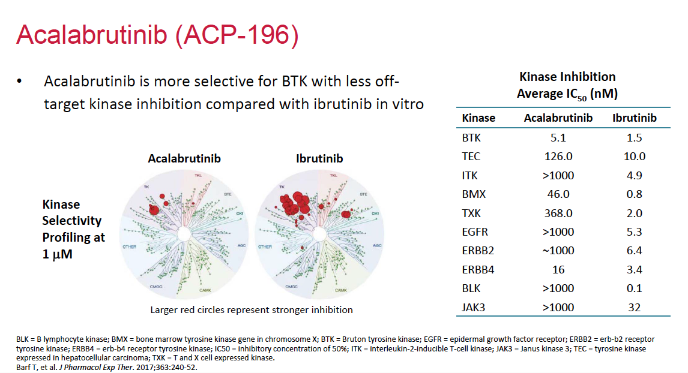

Slide 42
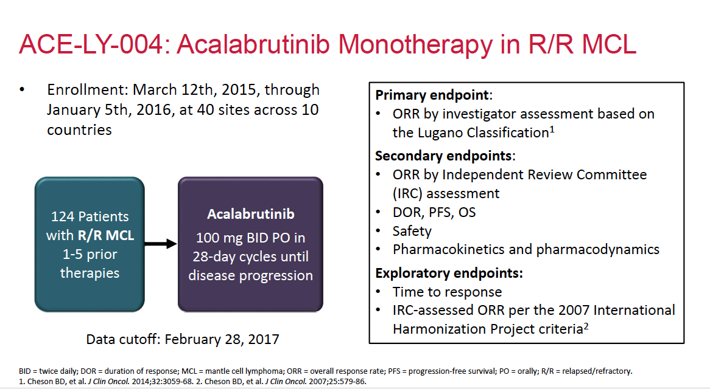

Slide 43
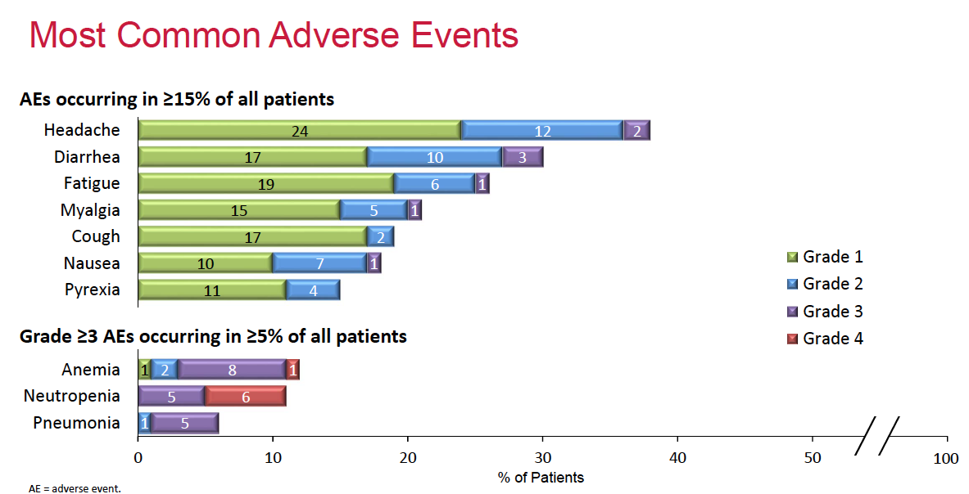

Slide 44
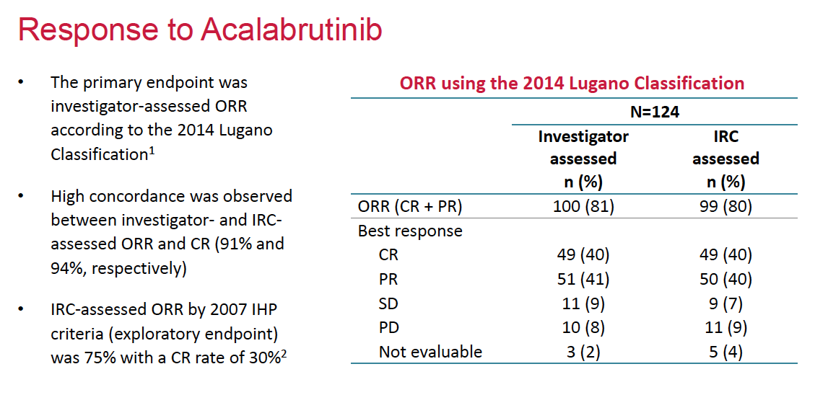

Slide 45
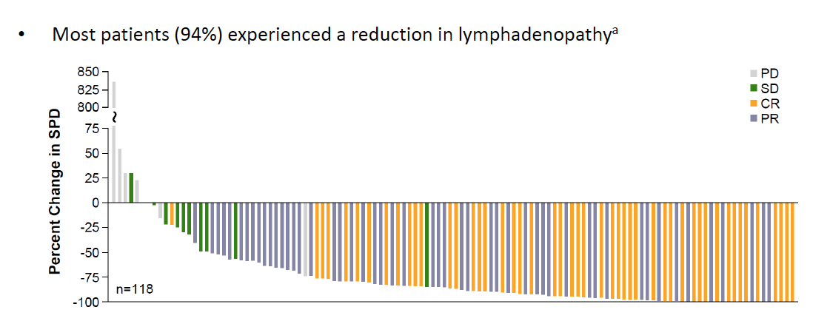
Change in Tumor Burden and Best Response Status per Lugano Classification

Slide 46
Phase II Study of Ibrutinib plus Venetoclax for MCL
Response | Without PET (N = 24) | With PET (N = 24)
Primary endpoint: Complete response (CR) at week 16 | 10 (42%) | 15 (62%)
Best response
Complete response | 16 (67%) | 17 (71%)
Response according to MRD clearance | With Flow Cytometry | With ASO-PCR
In the total population
MRD negative | 16 (67%) | 9 (38%)
MRD not negative** | 8 (33%) | 15 (62%)
** A status of “not negative” included patients who could not be evaluated for MRD clearance and those who remained
MRD-positive
Tam CS et al. N Engl J Med 2018;378:1211-23.

Slide 47
SYMPATICO: Phase III Trial of Ibrutinib Combined with Venetoclax in Mantle Cell Lymphoma
Trial Identifier: NCT03112174 (Open)
Estimated Enrollment: 287
Eligibility:
Pathologically confirmed MCL with overexpression of cyclin D1 in association with other markers
At least 1, but no more than 5 prior treatments
Failure to achieve PR with or PD after most recent treatment regimen
:
Ibrutinib + venetoclax
Until PD or unacceptable toxicity
R
Ibrutinib + placebo
Until PD or unacceptable toxicity
Primary Endpoints: Time to occurrence of TLS and occurrence of dose limiting toxicities (safety run-in period)
Progression-free survival
www.clinicaltrials.gov (Accessed February 2019).

Slide 48
Module 5: Hodgkin and Non- Hodgkin Lymphomas
Boards Mini-Review: Dr Leonard
Topic/issue:
Diagnosis and management of gastrointestinal involvement of mantle cell lymphoma (MCL)

Slide 49
Sample question
A 66-year-old man presents with bilateral cervical adenopathy and weight loss. Excisional biopsy of one of the cervical lymph nodes demonstrates MCL. The patient has no gastrointestinal symptoms, and bone marrow biopsy is negative for MCL. What additional tests should you perform?
Upper gastrointestinal endoscopy
Colonoscopy
Upper gastrointestinal endoscopy and colonoscopy
No gastrointestinal studies because the patient is without symptoms
Other

Slide 50
Module 5: Hodgkin and Non- Hodgkin Lymphomas
Boards Mini-Review: Dr Moskowitz
Topic/issue:
Screening and follow-up for women receiving mediastinal radiation therapy for Hodgkin lymphoma (HL)

Slide 51
Sample question
A 21-year-old woman receives 3 cycles of ABVD for Stage IIB classical HL with cervical nodal involvement, bulky mediastinal adenopathy, night sweats and weight loss and achieves a complete response by PET/CT. She subsequently undergoes radiation therapy to the mediastinum and asks you when she should start screening for breast cancer. She has no family history of breast or ovarian cancer. What do you tell her?
Start screening now
Start screening at age 35
Start screening at age 40
Start screening at age 50
Other

