Slide 1
Please note, these are the actual video-recorded proceedings from the live CME event and may include the use of trade names and other raw, unedited content.

Slide 2
Module 6: Ovarian Cancer
Drs Coleman and Matulonis

Slide 3
Do you have any patients in your practice with...
 | % responding “yes” | Median among those responding “yes”
Ovarian cancer | 82% | 5

Slide 4
Have you consulted in some way with a tertiary care expert during the past year (eg, sent for a second opinion, email consult, phone consult) on any cases of...
 | % responding “yes” | Median among those responding “yes”
Ovarian cancer | 59% | 2

Slide 5
Have you administered the following (on or off a clinical trial) to a patient with ovarian cancer?
Use of new agents/strategies
 | % responding “yes” | Median among those responding “yes”
Olaparib | 41% | 2
Rucaparib | 27% | 1
Niraparib | 27% | 1
Bevacizumab in combination with chemotherapy as postoperative treatment after primary debulking surgery | 57% | 2

Slide 6
The patients I saw today…
69 | F | Ovarian Cancer – Stage 3c, BRCA positive; Neoadjuvant carbo/paclitaxel. Prior breast cancer
65 | M | Pancreatic Cancer - Prior FOLFORINOX. 2nd-line gem/nab-paclitaxel
51 | M | Melanoma - Stage 3; Adjuvant nivo. Rheumatoid arthritis
81 | F | Breast Cancer - 0.9 cm ductal carcinoma, ER/PR-pos, HER2-neg high grade and ki67. Oncotype sent
41 | F | Breast Cancer - node positive. High risk by Mammaprint. Adjuvant AC-T
69 | M | ITP - platelets of 6 on steroids
79 | M | Myeloproliferative Neoplasm – Observing, but with worsening anemia and thrombocytopenia. Planning on azacitadine
49 | F | Benign Hematology - Iron deficiency anemia; IV iron
65 | F | Multiple Myeloma or other plasma cell dyscrasias - New onset renal failure and MGUS. Discussed bone marrow biopsy
51 | F | Multiple Myeloma - Maintenance len after transplant
67 | M | Metastatic pseudo myxoma pertineoi - Starting FOLFOX
55 | F | Breast Cancer - Metastatic TNBC. Started Atezo/nab-P
70 | M | Renal Cell Carcinoma - On reduced dose cabozantnib
61 | M | Hepatocellular Carcinoma - Rapid decline on 1st-line lenvatinib. Referred to hospice
67 | M | Colorectal Cancer - stage 3 sigmoid colon. Discussed 3 months of adjuvant CAPOX
51 | M | Lung Cancer - Extensive stage SCLC, on 1st-line carboplatin, etoposide, atezolizumab
45 | M | Multiple Myeloma - Newly diagnosed, with renal failure. Improving on CyBorD
65 | F | Multiple Myeloma - Newly diagnosed, with 11/14 translocation and p53 mutation on RVd
50 | F | Primary Mediastinal Large B Cell Lymphoma - Newly diagnosed starting RCOP
71 | F | Pancreatic Neuroendocrine Tumor – Metastatic, with objective response on lanreotide
Notes:
http://www.cancerresearchuk.org/health-professional/cancer-statistics/statistics-by-cancer-type/breast-cancer/incidence-invasive#heading-Three

Slide 7
Current and Future Role of PARP Inhibitors in the Treatment of OC
Robert L. Coleman, MD
Professor & Executive Director, Cancer Network Research
Department Gynecologic Oncology & Reproductive Medicine
M.D. Anderson Cancer Center

Slide 8
Disclosures
Advisory Committee and Contracted Research | AbbVie Inc, Array BioPharma Inc, AstraZeneca Pharmaceuticals LP, Clovis Oncology, Eisai Inc, GamaMabs Pharma, Genentech, Genmab, ImmunoGen Inc, Janssen Biotech Inc, Merck, Novartis, Tesaro
Data and Safety Monitoring Board/Committee | AstraZeneca Pharmaceuticals LP

Slide 9
Ovarian Cancer: Natural History
Progression
Death
Diagnosis
Evaluation
? SLL
Secondary
Surgery
Symptoms
Chemo #1
Maintenance
Chemo #2
Chemo #3
Chemo #4+
Supportive
Care
Staging/Debulking
Progression-Free Survival
(12-28 mos)
Post Progression Survival
(12-38 mos)
Duration

Slide 10
Treatment Paradigm for PARP Inhibitors
Progression
Death
Evaluation
? SLL
Secondary
surgery?
Diagnosis
Chemo
#1
Chemo
#2
M
Chemo #3 Tx
M
Chemo
#4+ Tx
y
Symptoms
Maintenance
Concomitant
Concomitant
Supportive
care
Staging/debulking
Under investigation
FDA approved

Slide 11
Treatment Paradigm for PARP Inhibitors
Progression
Death
Evaluation
? SLL
Secondary
surgery?
Diagnosis
Chemo
#1
Chemo
#2
M
Chemo #3
Tx
M
Chemo
#4+
Tx
y
Symptoms
Maintenance
Concomitant
Concomitant
Supportive
care
Staging/debulking
Development

Slide 12
SOLO-1 Study design
Surgery
Chemo
#1
Maintenance
Concomitant
Primary endpoint
Investigator-assessed PFS (modified RECIST 1.1)
Newly diagnosed, FIGO stage III–IV, high-grade serous or endometrioid ovarian, primary peritoneal or fallopian tube cancer
Germline or somatic BRCAm
ECOG performance status 0–1
Cytoreductive surgery*
In clinical complete response or partial response after platinum-based chemotherapy
Olaparib 300 mg bd (N=260)
Study treatment continued until disease progression
Patients with no evidence of disease at 2 years stopped treatment
Patients with a partial response at 2 years could continue treatment
2:1 randomization
Secondary endpoints
Stratified by response to platinum-based chemotherapy
PFS using BICR
PFS2
Overall survival
Time from randomization to first subsequent therapy or death
Time from randomization to second subsequent therapy or death
HRQoL (FACT-O TOI score)
Placebo (N=131)
2 years’ treatment if no evidence of disease

Slide 13
PFS by investigator assessment
 | Olaparib (N=260) | Placebo (N=131)
Events (%) [50.6% maturity] | 102 (39.2) | 96 (73.3)
Median PFS, months | NR | 13.8
 | HR 0.30
 | 95% CI 0.23, 0.41; P<0.0001
100
90
60.4% progression free at 3 years
80
70
60
Olaparib
Investigator-assessed
progression-free survival (%)
50
40
30
20
26.9% progression free at 3 years
10
Placebo
0
0
3
6
9
12
15
18
21
24
27
30
33
36
39
42
45
48
51
54
57
60
Months since randomization
260
240
229
221
212
201
194
184
172
149
138
133
111
88
45
36
4
3
Moore K, et al., NEJM 2018
Olaparib
0
0
0

Slide 14
Most common treatment-emergent adverse events
Olaparib (N=260)
Placebo (N=130)
Nausea
0.8
Fatigue/asthenia*
3.8
1.5
Vomiting
0.4
0.8
Anaemia*
21.5
1.5
Diarrhoea
3.1
Constipation
All grades (frequency ≥25%)
Dysgeusia
Grade ≥3 (frequency ≥5%)
Arthralgia
All grades (frequency ≥25%)
Neutropenia*
Grade ≥3 (frequency ≥5%)
8.5
4.6
100
75
50
25
0
0
25
50
75
100
Adverse events (%)
Moore K, et al., NEJM 2018
*Grouped terms. All-grade thrombocytopenia (grouped term) occurred in 11.2% of patients in the olaparib group and 3.8% of patients in the placebo group and grade ≥3 thrombocytopenia (grouped term) occurred in 0.8% and 1.5%, respectively.

Slide 15
Impact of SOLO-1
Diagnosis
gBRCA testing
Progression
Death
Secondary
Surgery
BRCA-positive
(at a minimum)
Symptoms
Chemo #1
Olaparib
Chemo #2
Chemo #3
Chemo #4+
Bevacizumab?
PARPi ???
Supportive
Care
Staging/Debulking
sBRCA testing

Slide 16
Switch Maintenance: Strategy
Maintenance therapy is defined as treatment following clinical response to platinum or platinum combination
Trials required measurable disease required at chemotherapy induction
But…differ with respect to amount of disease and how defined (CA-125, size)
PR and CR are endpoints for randomization
Maintenance:
Platinum-sensitive
Progression
Death
Chemo
#2
M
Chemo #3
M
Chemo
#4+
M

Slide 17
Switch Maintenance PARPi: Phase III’s
PFS (inv Review – Primary) | Rucaparib | Placebo | HR | P
tBRCA | 16.8 | 5.4 | 0.23 | P<0.0001
tBRCA + HRD | 13.6 | 5.4 | 0.32 | P<0.0001
ITT | 10.8 | 5.4 | 0.37 | P<0.0001
PFS (BICR – Primary) | Niraparib | Placebo | HR | P
tBRCA | 21.0 | 5.5 | 0.26 | P<0.0001
tBRCA + HRD | - | - | -
All non-gBRCA (sBRCA+ HRD + HRC) | 9.3 | 3.9 | 0.45 | P<0.001
ITT (FDA analysis) | 11.3 | 4.7 | 0.42 | Not Given
PFS (Inv Review - Primary) | Olaparib | Placebo | HR | P
gBRCA | 19.1 | 5.5 | 0.30 | P<0.0001
ARIEL 3
NOVA
SOLO 2

Slide 18
Summary: Switch Maintenance Phase III’s
Rucaparib | Placebo | HR | P
16.8 | 5.4 | 0.23 | P<0.0001
13.6 | 5.4 | 0.32 | P<0.0001
10.8 | 5.4 | 0.37 | P<0.0001
Niraparib | Placebo | HR | P
21.0 | 5.5 | 0.26 | P<0.0001
- | - | -
9.3 | 3.9 | 0.45 | P<0.001
11.3 | 4.7 | 0.42 | Not Given
Olaparib | Placebo | HR | P
19.1 | 5.5 | 0.30 | P<0.0001

Slide 19
OREO: PARPi after PARPi
Two cohorts independently powered for PFS, one for BRCAm and one for BRCAwt (HRD pos and HRD neg)
Cohorts
Olaparib
300mg** po bid
All epithelial ovarian cancer*
1 prior PARP inhibitor maintenance period
Known BRCA status
PLUS
Response ≥PR to most recent platinum CT (not bevacizumab)
Entry based on length of first PARP inhibitor exposure
BRCAm →
PARP inhibitor ≥18 mo (after first-line CT)
PARP inhibitor ≥12 mo (after second-line CT)
BRCAwt →
PARP inhibitor ≥12 mo (after first-line CT)
PARP inhibitor ≥6 mo after second- or later-line CT
gBRCAm or sBRCAm
N≈136
Randomise 2:1
Placebo
Primary outcome
PFS
Secondary outcomes
TFST
TSST
FACT-O
Safety and AEs
OS
Stratification factors:
Prior bevacizumab
3 vs ≥4 chemotherapy lines
Olaparib
300mg** po bid
BRCAwt all-comers
N≈280
Randomise 2:1
Placebo
FSI 2Q 2017
PFS readout: BRCAm 4Q 2020
BRCAwt 2Q 2021
CSR 3Q 2022
*Not restricted to high-grade serous ovarian cancer
**Tablet formulation
AEs=adverse events; bid=twice daily; CSR=clinical study report; CT=chemotherapy; FACT-O=Functional Assessment of Cancer Therapy-Ovarian; FSI=first subject in; HRD=homologous recombination deficiency; mo=months; OS=overall survival; PARP=poly ADP ribose polymerase; PFS=progression-free survival; po=by mouth; PR=partial response; TFST=time to first subsequent therapy; TSST=time to second subsequent therapy; wt=wild type
Powered 80% for PFS primary endpoint (BRCAm HR=0.5 [74 events]; BRCAwt HR=0.65 [191 events]), Patients followed to OS for long-term safety

Slide 20
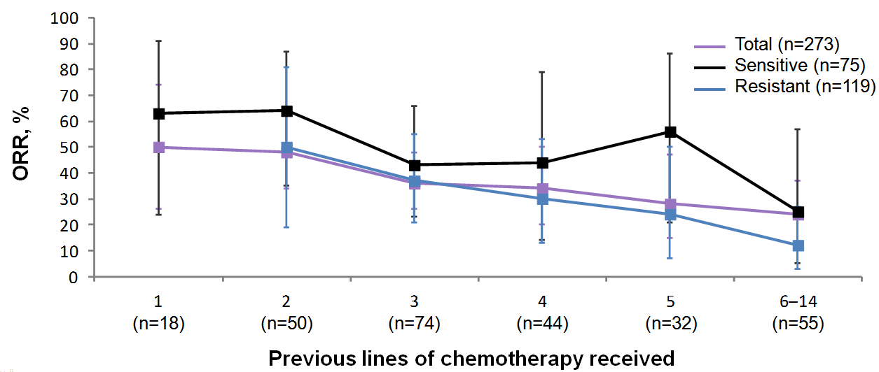
Olaparib as Treatment
Chemotherapy
Matulonis & Coleman, Ann Oncol 2016

Slide 21
Olaparib as Treatment
Chemotherapy
Matulonis & Coleman, Ann Oncol 2016

Slide 22
Rucaparib as Treatment
BRCA^{mt} patients (n=40)
69% ORR (RECIST)
82% ORR (RECIST & CA-125)
83% of patients continuing on treatment (+)
Responses observed in germline and somatic BRCA^{mt} tumors
BRCA-like signature (n=82)
30% ORR (RECIST)
45% ORR (RECIST & CA-125)
52% of patients continuing on treatment (+)
BRCA^{wt} patients without BRCA-like signature (n=70)
13% ORR (RECIST)
21% ORR (RECIST & CA-125)
38% of patients continuing on treatment (+)
Swisher Lancet Oncol 2017
Coleman, ASCO 2016

Slide 23
Rucaparib as Treatment
BRCA^{mt} patients (n=40)
69% ORR (RECIST)
82% ORR (RECIST & CA-125)
83% of patients continuing on treatment (+)
Responses observed in germline and somatic BRCA^{mt} tumors
Swisher Lancet Oncol 2017
Coleman, ASCO 2016

Slide 24
ASCO 2018: QUADRA (Niraparib)

Slide 25
ASCO 2018 : QUADRA – Niraparib as Treatment
BRCA and HRD positive

Slide 26
Treatment Paradigm for 2019
Progression
Death
Secondary
Surgery
Diagnosis
Evaluation
Imaging, Surgery
Rucaparib
FDA approval
(gBRCA and sBRCA)
Olaparib
FDA approval
(gBRCA)
Symptoms
Chemo #1
Maintenance (Bev)
(Olaparib BRCAmut)
Chemo #2
M
Chemo #3
M
M
Chemo #4+
Concomitant Bev
Concomitant
Staging/debulking
Under investigation
Niraparib, Olaparib, Rucaparib
Maintenance FDA approval
or
Bevacizumab
FDA approved

Slide 27
Module 6: Ovarian Cancer
Drs Coleman and Matulonis

Slide 28
Other Recently Approved and Promising Investigational Strategies
Ursula Matulonis, M.D. Chief, Division of Gynecologic Oncology Brock-Wilson Family Chair Dana-Farber Cancer Institute Professor of Medicine Harvard Medical School Boston MA email: Ursula_Matulonis@dfci.Harvard.edu

Slide 29
Disclosures
Advisory Committee | 2X Oncology, FUJIFILM Pharmaceuticals USA Inc, Geneos Therapeutics, ImmunoGen Inc, Mersana Therapeutics
Consulting Agreement | Merck
Data and Safety Monitoring Board/Committee | Advaxis Inc

Slide 30
Mirvetuximab Soravtansine
Mirvetuximab is an antibody drug conjugate that binds to the folate receptor-α (FRα) and uses the cytotoxic maytansinoid, DM4
Approximately 75-80% of high grade serous ovarian cancer expresses FRα
Activity correlates with FRα expression; eligibility criterion for FORWARD1 of ≥50% tumor staining at ≥2+ intensity (i.e., ‘medium’ to ‘high’ receptor expression) needed
The most common adverse events included fatigue, diarrhea, nausea, and blurred vision
Received FDA fast track designation in June 2018

Slide 31
FORWARD 1: Phase 3 study comparing mirvetuximab to standard chemotherapy
Recurrent platinum-resistant ovarian cancer
Measurable cancer by RECIST1.1
Up to 3 prior lines of treatment
Medium-high folate receptor alpha expression positivity
Mirvetuximab 6 mg/kg IV every 3 weeks
Primary Endpoint: PFS Other endpoints: OS and safety
2:1
Standard treatment: PLD Topotecan Weekly paclitaxel
Patient characteristics for FORWARD1 were established by Phase I study of single mirvetuximab¹
46 pts enrolled: ORR was 26%; mPFS was 4.8 months and mDOR was 19.1 weeks.
In patients who had received 3 or fewer prior lines of therapy (n = 23): ORR was 39%, PFS of 6.7 months, and DOR was 19.6 weeks.
NCT02631876 ¹JCO 2016

Slide 32
Mirvetuximab combinations
Mirvetuximab + bevacizumab (ASCO 2018)
Mirvetuximab + pembrolizumab (ESMO 2018) – Rationale: ADC induces T cell infiltration, PD-1 reinvigorates exhausted T cells¹
Mirvetuximab + carboplatin/bevacizumab
Mirvetuximab + rucaparib
¹Muller et al. T-DM1 renders HER2+ breast cancer highly susceptible to CTLA-4/PD-1 blockade, STM 2015

Slide 33
FORWARD II Phase Ib Study: Mirvetuximab Soravtansine with Bevacizumab for Platinum-Resistant Ovarian Cancer
Endpoint | Total (n = 54) | FRα expression |  | Prior lines of therapy |  | FORWARD I- matched (n = 23)
 |  | Low (n = 12) | Medium/high (n = 39) | 1-3 (n = 33) | ≥4 (n = 21)
ORR | 43% | 33% | 49% | 42% | 43% | 48%
Median PFS | 7.8 mo | 6.0 mo | 9.5 mo | 9.9 mo | 7.2 mo | 9.9 mo
Median DOR | 10.6 mo | ND | 10.6 mo | 10.6 mo | ND | 10.6 mo
ND = not determined
FORWARD I-matched: Medium/high FRα expression, 1-3 prior lines of therapy; corresponds to the target population in the pivotal Phase III monotherapy study (NCT02631876)
Grade 3 AEs uncommon, with the exception of hypertension (14%); no Grade 4 AEs observed
Nausea, diarrhea, blurred vision and fatigue were the most commonly observed AEs
O’Malley DM et al. Proc ASCO 2018;Abstract 5549.

Slide 34
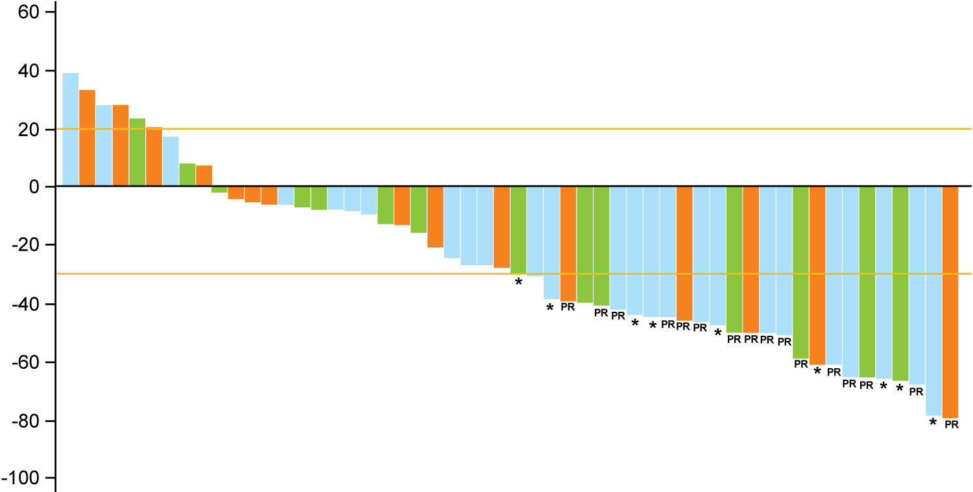
FORWARD II: Mirvetuximab Soravtansine with Pembrolizumab for Platinum-Resistant Ovarian Cancer
Low FRα
Medium FRα
High FRα
 | Total (n = 54) | Medium/ high FRα (n = 39)
ORR | 30% | 31%
Median DOR | 6.9 mo | 8.1 mo
Maximum % change from baseline
PR = partial response
= unconfirmed PR
*
Select any-grade AEs: diarrhea (54%), peripheral neuropathy (41%), blurred vision (39%), increased AST (34%), dry eye (30%), increased ALT (27%), keratopathy (20%), pneumonitis (18%)
Grade 3 AEs: 38% of patients; Grade 4 AEs: 7% of patients
Matulonis UA et al. Proc ESMO 2018;Abstract 949P.

Slide 35
Nivolumab (anti-PD-1) and Avelumab (anti-PD-L1) in recurrent ovarian cancer
Agent | # of pts | RR | Median PFS | Prior therapy
Nivolumab (JCO 2015) | 20 patients 10: 1 mg/kg q2W 10: 3 mg/kg q2W ALL platinum resistant | 15% 1 PR in 1mg/kg 2 CRs in 3mg/kg 1/2 clear cell cancers had CR | 3.5 months | 55% had >3 lines of prior treatment
Avelumab (JAMA Oncology 2019) | 125 patients 10mg/kg q2W | 9.6% 12 PRs PD-L1+: 11.8% (cut-off 1%) PD-L1- : 7.9% | 2.6 months | Median number of prior therapies was 4

Slide 36
Matulonis et al. ASCO 2018

Slide 37
Antitumor Activity: Confirmed Objective Response Rate
 | Cohort A 1 - 3 prior lines; PFI/TFI 3 - 12 months n = 285 | Cohort B 4 - 6 prior lines; PFI/TFI ≥3 months n = 91 | Cohort A + B All-comers n = 376
ORR % (95% CI) | 7.4 (4.6 - 11.0) | 9.9 (4.6 - 17.9) | 8.0 (5.4 - 11.2)
DCR % (95% CI) | 37.2 (31.6 - 43.1) | 37.4 (27.4 - 48.1) | 37.2 (32.3 - 42.3)
Best overall response
Complete response n (%) | 5 (1.7) | 2 (2.2) | 7 (1.9)
Partial response n (%) | 16 (5.6) | 7 (7.7) | 23 (6.1)
Stable disease n (%) | 85 (10.5) | 25 (27.5) | 110 (29.3)
Progressive disease n (%) | 166 (58.2) | 49 (53.8) | 215 (57.2)
Responders (n) | 21 | 9 | 30
Time to response, median months (range) | 2.1 (1.9 - 6.3) | 2.1 (1.8 - 12.3) | 2.1 (1.8 - 12.3)
Duration of response, median months (range) | 8.2 (3.9 - 18.6) | NR (3.3+ - 15.2+) | 8.2 (3.3+ - 18.6 )
Matulonis et al. ASCO 2018

Slide 38
Possible ways to improve the effectiveness of immune checkpoint inhibition in ovarian cancer
Combination with other agents
Cytotoxic agents
Targeted agents
Other immune checkpoint inhibitors
Antiangiogenic therapies

Slide 39
Combination of immune checkpoint inhibitors with cytotoxic agents
Two non-mutually exclusive hypotheses are plausible:
Cytotoxics can increase cell death and inflammation resulting in improved CD8+ T cell infiltration and activation concurrent with immune checkpoint modulators
Cytotoxics will selectively increase somatic mutations in tumors resulting in neo-antigens that prime anti-tumor CD8+ T cells in the presence of immune checkpoint modulation

Slide 40
Phase II study of Pembrolizumab combined with pegylated liposomal doxorubicin for recurrent platinum resistant, ovarian, fallopian tube or peritoneal cancer
Ursula A. Matulonis¹, William Barry¹, Richard T. Penson², Panagiotis Konstantinopoulos¹, Weixiu Luo¹, Mark A. Hoffman³, Neil S. Horowitz⁴, Sarah Farooq¹, Don S. Dizon⁵, Alexi A. Wright¹, Susana M. Campos¹, Jennifer Curtis¹, Carolyn Krasner¹, and Joyce F. Liu¹ ¹Dana-Farber Cancer Institute, Boston MA, ²Massachusetts General Hospital, Boston MA, ³Northwell Health System, Lake Success NY, ⁴Brigham and Women’s Hospital, Boston MA, ⁵Lifespan Cancer Institute, Providence RI

Slide 41
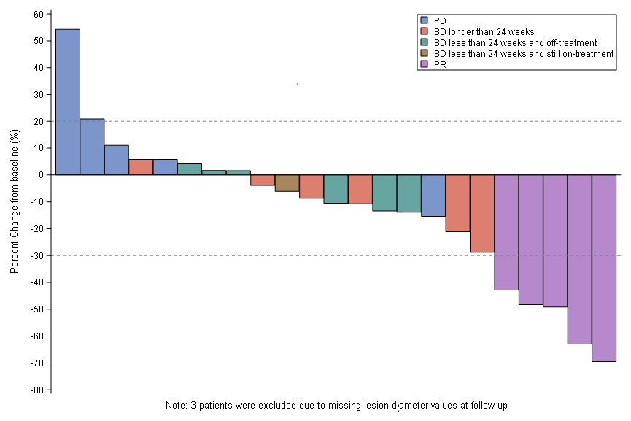
Efficacy results
Best response | Total (n=26)
PR* | 5 (19.23%) 95% CI: 6.6% to 39.%
SD >24 weeks* | 6 (23.08%)
SD <24 weeks; still on treatment | 1 (3.85%)
SD <24 weeks; off treatment | 6 (23.08%)
PD | 5 (19.23%)
Unevaluable** | 3 (11.54%)
CBR= 42.3% 95% CI (23.4%, 63.1%)
*all PRs and SD confirmed by RECIST 1.1 **1 pt had anaphylaxis to PLD and 2 had PD prior to 1st restaging
SGO 2018

Slide 42
TOPACIO: Preliminary activity and safety in patients with platinum-resistant ovarian cancer in a phase 1/2 study of niraparib in combination with pembrolizumab
Panagiotis A. Konstantinopoulos,¹ Pamela Munster,² Andres Forero-Torres,³ Robert W. Holloway,⁴ Lee Schwartzberg,⁵ Ursula A. Matulonis,¹ Jing Wang,⁶ Sujata Arora,⁶ Bruce Dezube,⁶ Shaveta Vinayak⁷
¹Dana-Farber Cancer Institute, Boston, MA; ²University of California San Francisco, San Francisco, CA; ³The University of Alabama at Birmingham, Birmingham, AL; ⁴Florida Hospital Cancer Institute, Orlando, FL; ⁵West Clinic, Memphis, TN; ⁶TESARO, Inc., Waltham, MA; ⁷Case Comprehensive Cancer Center, Case Western Reserve University, Cleveland, OH
ASCO 2018

Slide 43
Rationale for Niraparib in Combination with PD-1 inhibitor
Unrepaired DNA damage resulting from niraparib leads to:
Presence of DNA in the cytoplasm, which leads to
STING (stimulator of interferon gene) pathway activation
STING pathway activation leads to:
Increased expression and release of type 1 interferons
Induction of γ-interferon
Infiltration of effector T cells into the tumor
Mouw & Konstantinopoulos Brit Jour Canc 2018 Jiao et al. Clin Can Res 2017
Sato et al. Nature Commun 2017 Ding et al, Cell Reports 2018

Slide 44
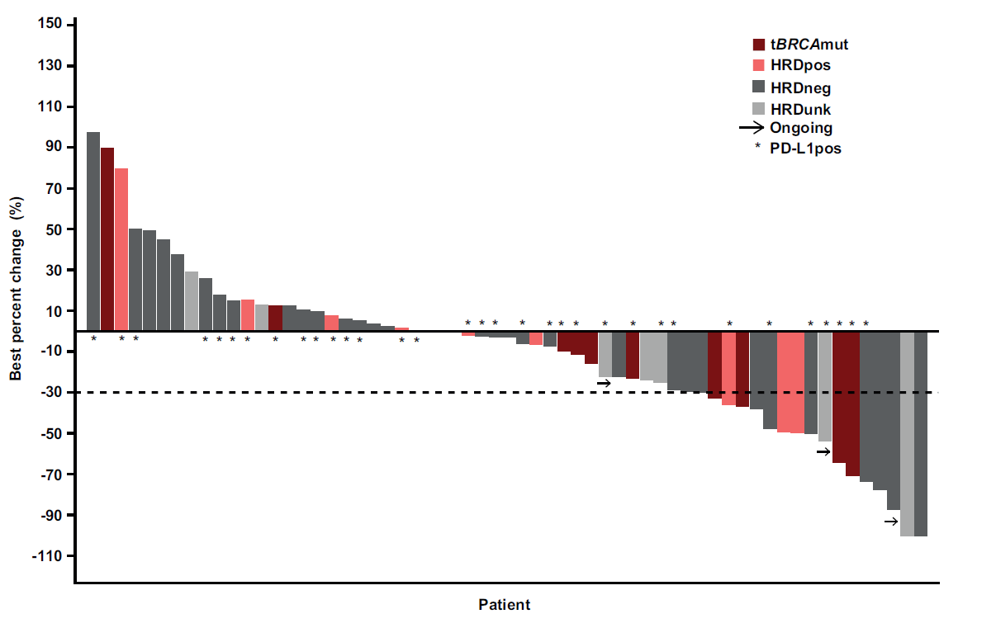
Niraparib and Pembrolizumab Treatment Resulted in Clinical Activity Across a Broad Study Population
ASCO 2018 Panagiotis Konstantinopoulos

Slide 45
Examples of Triplets
TRIPLETS!
Olaparib/Durvalumab/Cediranib | NCT02484404
OPAL study: TSR042/bevacizumab/Niraparib | NCT03574779
Radiation therapy/durvalumab/ tremelimumab | NCT03277482
Others

Slide 46
Module 6: Ovarian Cancer
Boards Mini-Review: Dr Coleman
Topic/issue:
Role of surgery in the management of recurrent ovarian cancer; secondary debulking

Slide 47
Sample question
A 61-year-old woman with Stage IIIC epithelial ovarian adenocarcinoma receives 6 cycles of adjuvant carboplatin/paclitaxel and attains a complete response with normalization of CA-125 and negative PET/CT. Three years later she presents with abdominal distention and an elevated CA-125 of 85 units/mL, and imaging reveals a 3 x 4-cm mass in the pelvis, which is biopsy proven to be recurrent ovarian cancer. She is BRCA wild type. What would you recommend?
Systemic platinum-based combination chemotherapy
Surgical excision and no postoperative chemotherapy
Surgical excision followed by systemic chemotherapy
Intraperitoneal chemotherapy
Other

Slide 48
Module 6: Ovarian Cancer
Boards Mini-Review: Dr Matulonis
Topic/issue:
Neoadjuvant versus adjuvant systemic therapy for primary ovarian cancer, including for patients with BRCA mutations

Slide 49
Sample question
A 67-year-old woman presents with progressive ascites, lower abdominal pain and weight loss for the past 6 months (performance status = 2). She is found to have ascites and bilateral ovarian masses. Blood tests reveal albumin of 2.1 g/dL and CA-125 of 2,100 units/mL. What would you recommend?
Surgical debulking followed by adjuvant systemic therapy
Neoadjuvant systemic therapy followed by surgical debulking
Systemic therapy without surgical debulking
Check the patient’s BRCA status and administer a PARP inhibitor if mutated
Other

