Slide 1
Please note, these are the actual video-recorded
proceedings from the live CME event and may include
the use of trade names and other raw, unedited content.

Slide 2
Module 8:
ER-Positive, HER2-Negative Breast Cancer
Drs Burstein and Sledge

Slide 3
Do you have any patients in your practice with...
 | % responding “yes” | Median among those responding “yes”
ER-positive, HER2-negative breast cancer receiving adjuvant therapy or follow-up after adjuvant therapy | 96% | 30
Metastatic ER-positive, HER2-negative breast cancer | 96% | 7

Slide 4
Have you consulted in some way with a tertiary care expert during the past year (eg, sent for a second opinion, email consult, phone consult) on any cases of...
 | % responding “yes” | Median among those responding “yes”
ER-positive, HER2-negative breast cancer | 61% | 3

Slide 5
Have you administered the following (on or off a clinical trial) to a patient with ER-positive, HER2-negative breast cancer?
Use of new agents/strategies
 | % responding “yes” | Median among those responding “yes”
Neoadjuvant endocrine therapy | 59% | 2
Palbociclib with endocrine therapy | 90% | 5
Ribociclib with endocrine therapy | 22% | 3
Abemaciclib with endocrine therapy | 43% | 2
Abemaciclib monotherapy | 16% | 1
Everolimus with fulvestrant | 59% | 1

Slide 6
In the past year, have you ordered the following for a patient with ER positive, HER2-negative breast cancer?
 | % responding “yes” | Median among those responding “yes”
21-gene Recurrence Score® assay | 90% | 10
70-gene signature assay | 37% | 3
Other genomic assay | 6% | 10

Slide 7
The patients I saw today…
66 | M | Breast Cancer – Observation after adjuvant chemo
59 | M | Benign Hematology - New consult leukocytosis
57 | M | Renal Cell Carcinoma - 2nd line Nivolumab
53 | F | Benign Hematology - Hereditary hemochromatosis
78 | M | Colorectal Cancer - FOLFIRI and bevacizumab
73 | M | Diffuse Large B Cell Lymphoma - Routine f/u in CR since 2018 after 6 cycles RCHOP
83 | M | Myelofibrosis – Anemia, chronic kidney disease, receiving ruxolitinib and darbepoetin Alfa
62 | M | Bladder cancer - Metastatic since 2015. Receiving pemetrexed and has PD. Hospice discussion after failing all std therapies. Not a trial candidate due to cirrhosis and prior sarcoma
74 | F | Breast Cancer – Metastatic triple positive On pertuzumab, trastuzumab and letrozole
69 | F | Head and neck cancer - Concurrent chemoRT with cisplatin high dose as sensitizing agent
50 | F | Breast Cancer - Metastatic, ER-pos, Her2-neg to lung and liver. On weekly paclitaxel
77 | M | Lung Cancer - Recurrent disease on maintenance atezolizumab
70 | F | Cervical cancer - Metastatic, weekly carbo/paclitaxel. Patient had CKD, Crohns and GI fistula
64 | M | Lung Cancer - Maintenance atezolizumab
57 | M | Lung Cancer - 2nd-line atezolizumab Diagnosed 2016 with Stage IV adeno: Carbo/pemetrexed/bev and then maintenance pemetrexed/bev until PD 2019
56 | F | Pancreatic cancer - Whipple for IIB disease at academic center. Released with wound vac. FOLFIRINOX now
80 | M | Gastric Cancer – S/p gastrectomy for Stage I disease. Post op f/u to discuss surveillance
79 | F | Breast Cancer – Palbociclib/anastrozole/denosumab
77 | M | Pancreatic cancer - Liposomal irinotecan, 5FU and LV
57 | F | Multiple myeloma - Diagnosed 2004, transplanted 2007 and in CR for last 12 years!

Slide 8


Recent Clinical Trial Results Guiding the Use of Genomic Classifiers in the Management of Early BC (EBC); Ongoing Evaluation of
CDK4/6 Inhibition in Earlier-Stage Disease
Harold J. Burstein, MD, PhD
hburstein@partners.org
@drhburstein

Slide 9
Disclosures
No relevant conflicts of interest to disclose.

Slide 10
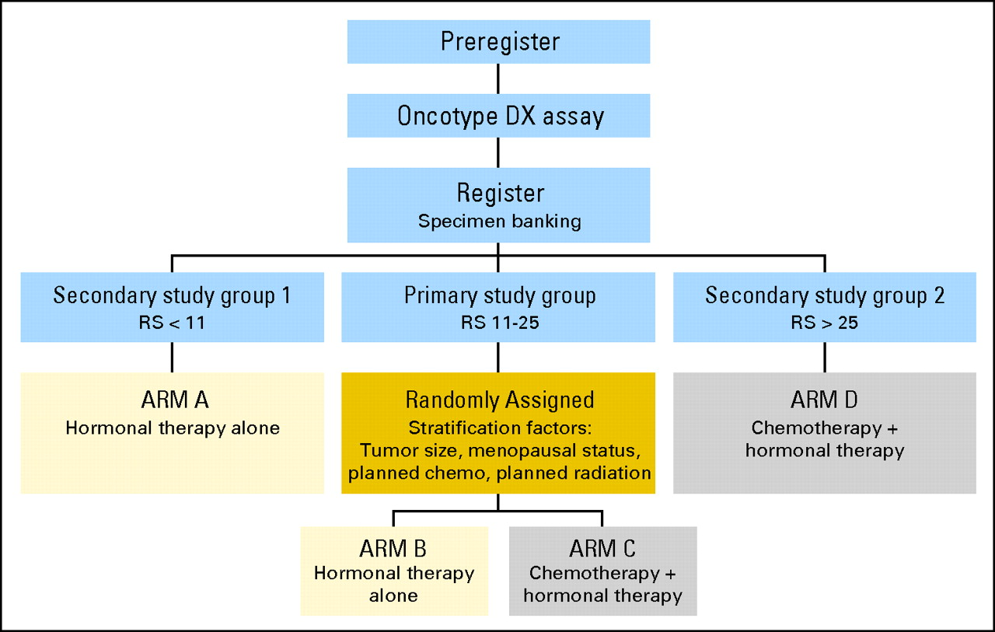
TAILORx
Sparano, J. A. et al. J Clin Oncol; 26:721-728 2008

Slide 11
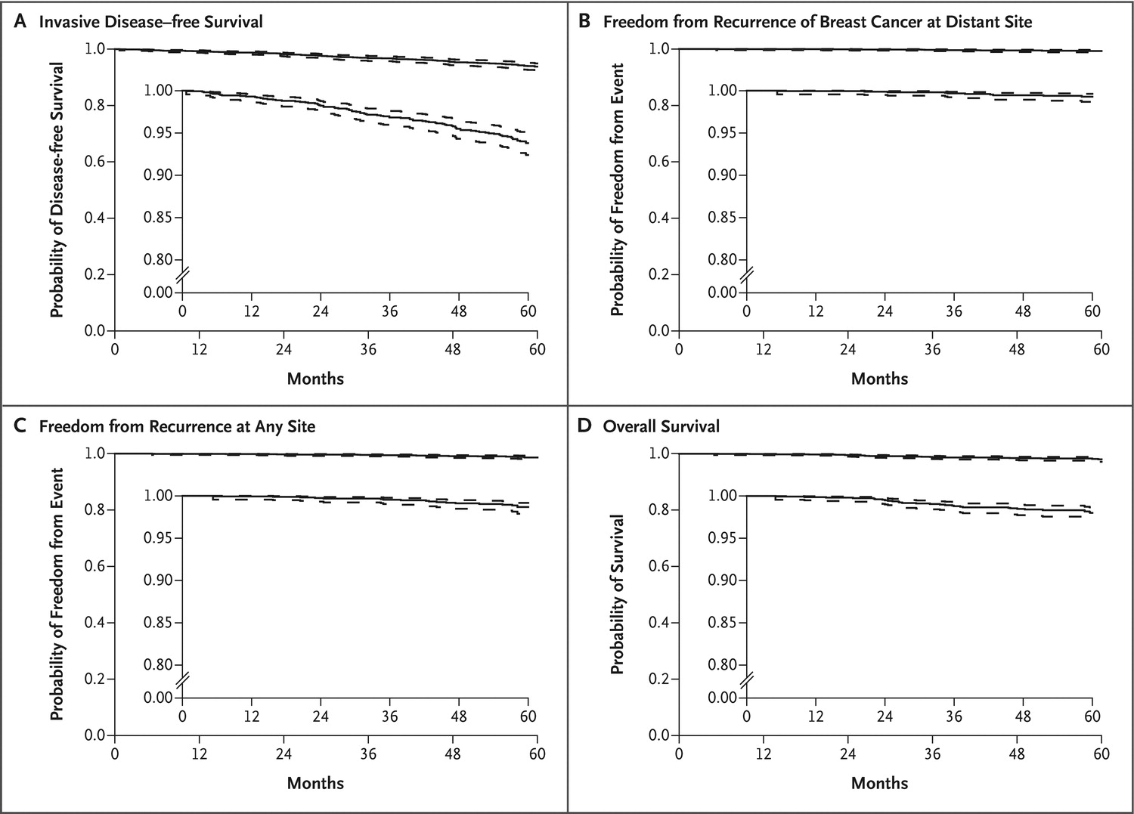
Sparano JA et al. N Engl J Med 2015; 373:2005-14
TAILORx: Outcomes for node-negative, ER positive, HER2 negative cancers
with low recurrence score ( ≤ 10 )
Stage 1: 70%
Stage 2: 30%
Grade 1: 29%
Grade 2: 57%
Grade 3: 14%
Grade = only significant
predictor of recurrence

Slide 12
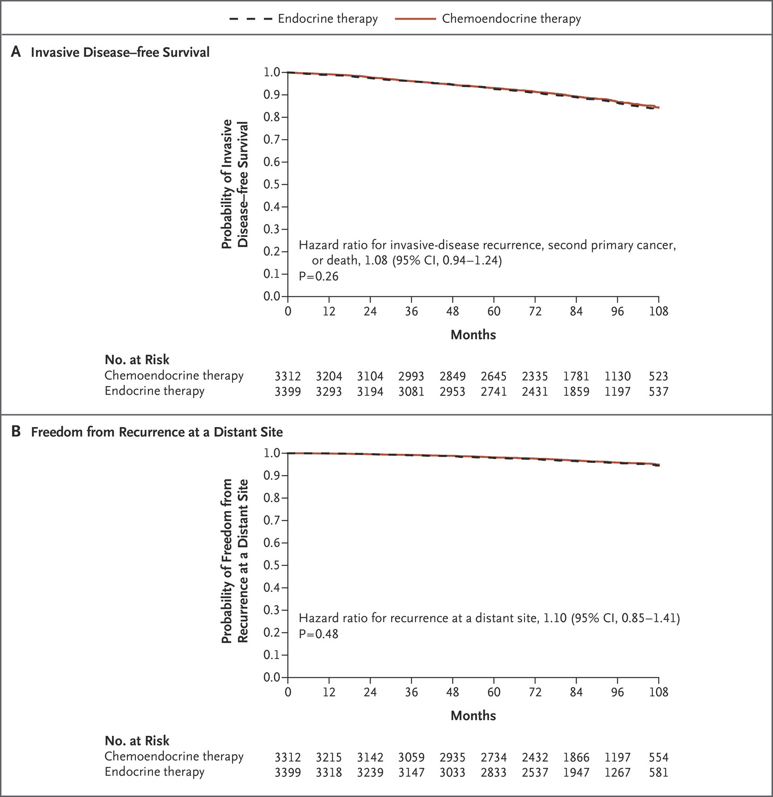

JA Sparano et al.
N Engl J Med 2018.
DOI: 10.1056/NEJMoa1804710
TAILORx –
RS 11-25
Overall Result
“Average” Patient
55 yo, postmenopausal
1.5 cm, grade 2 tumor

Slide 13
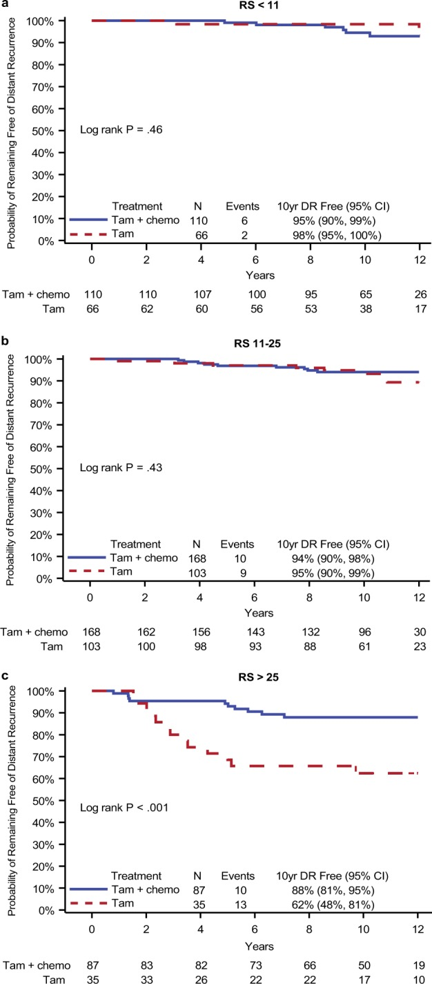
How confident are we that “25” is the right number?
Re-analysis of NSABP B-20 outcomes after removal of HER2 positive cases
Geyer CE, et al. NPJ Breast Cancer. 2018 Nov 14;4:37. doi: 10.1038/s41523-018-0090-6. eCollection 2018.

Slide 14
How confident are we that “25” is the right number?
Recurrence Score Result
Hortobagyi GN et al. SABCS 2018

Slide 15
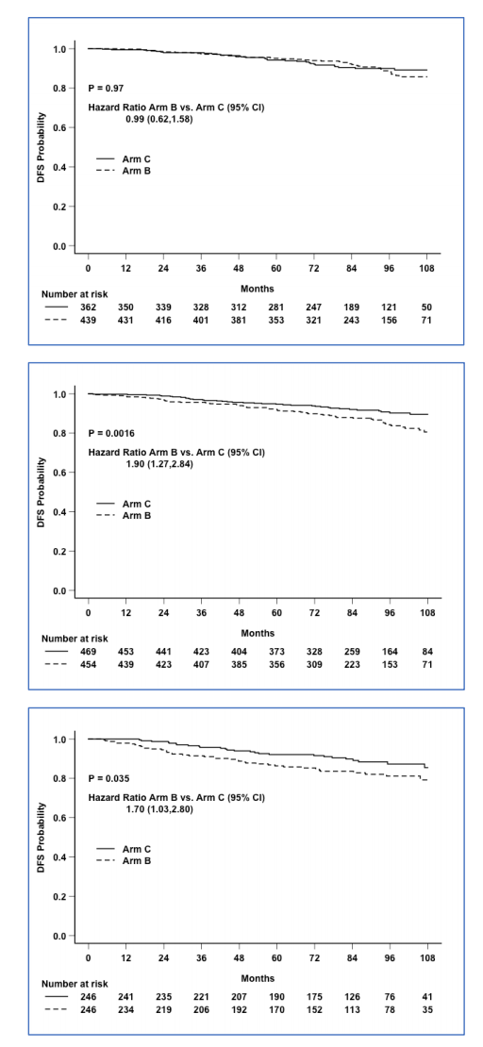
JA Sparano et al.
N Engl J Med 2018. DOI: 10.1056/NEJMoa1804710
Recurrence Score
11-15
16-20
21-25
TAILORx Outcomes in
Younger Women < Age 50
HOW MUCH IS DUE TO
OFS FROM CHEMO?

Slide 16
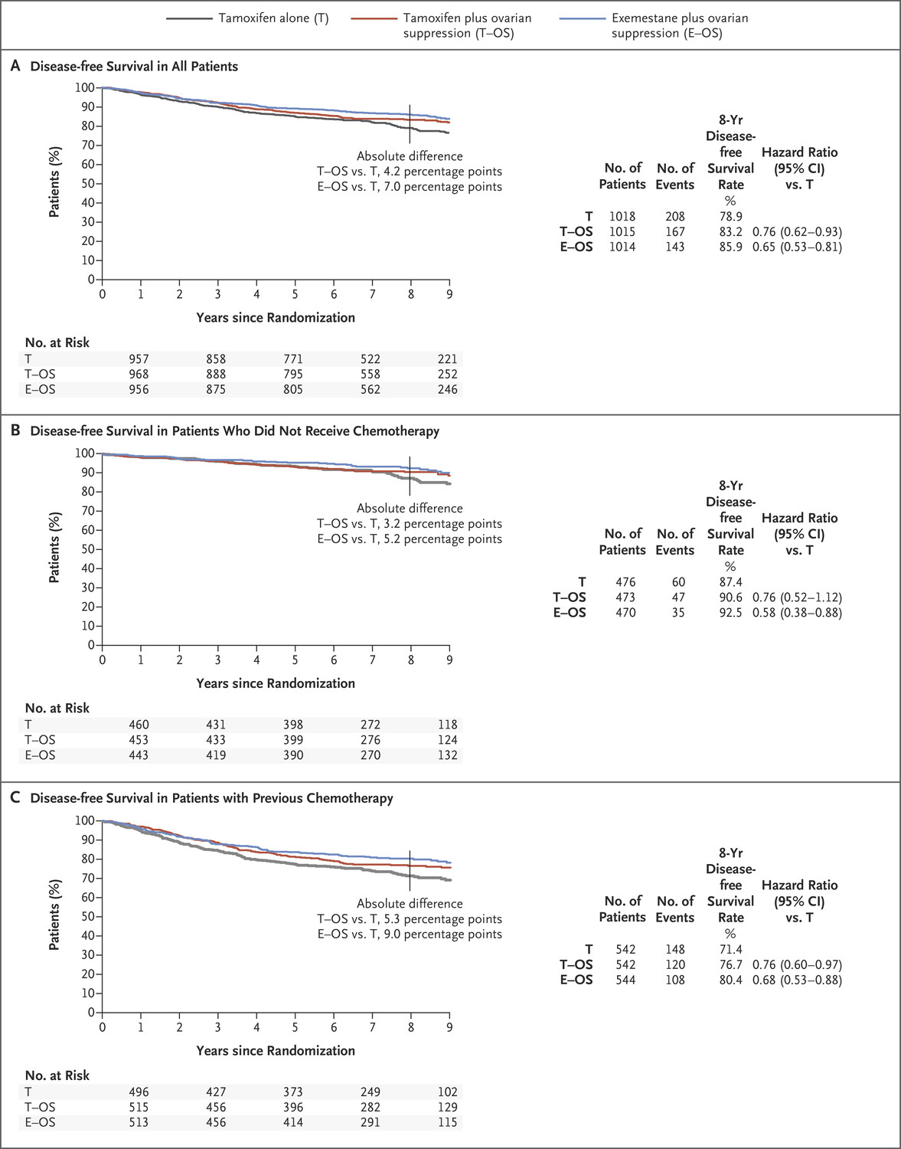
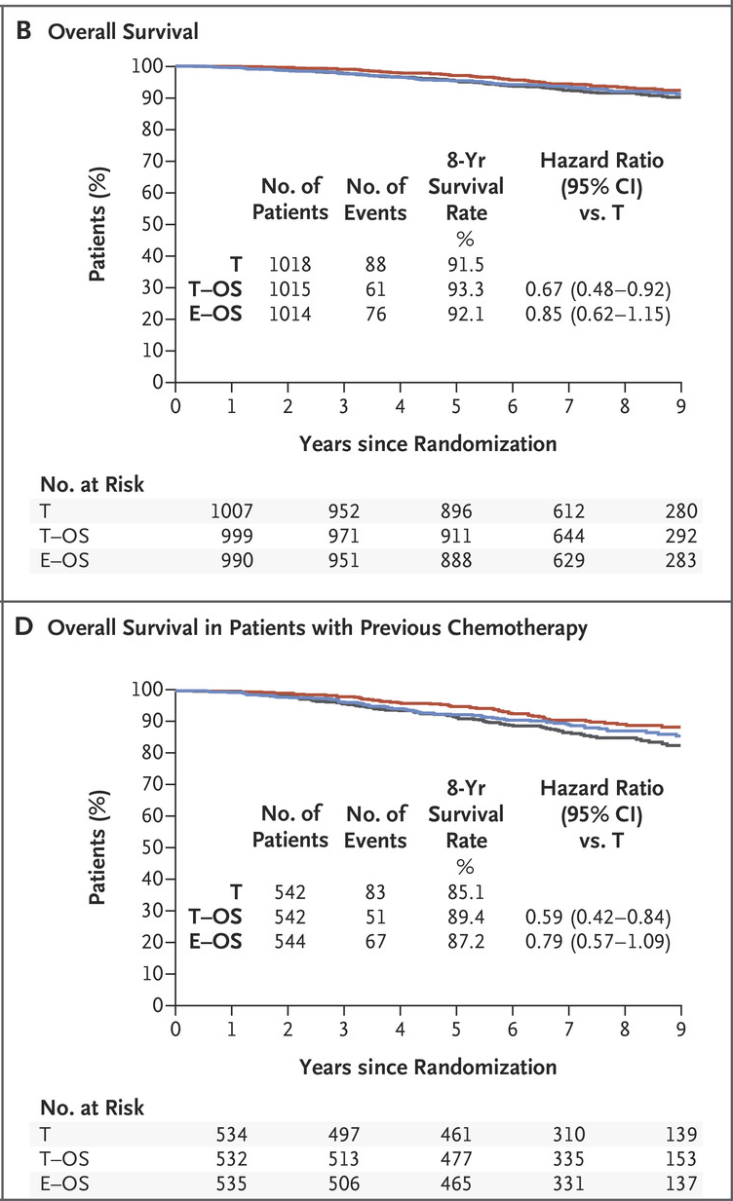
PA Francis et al. N Engl J Med 2018;379:122-137.
SOFT – TEXT Trials: Long Term Follow UP
Kaplan–Meier Estimates of Disease-free Survival after a Median Follow-up of 8 Years in SOFT.

Slide 17
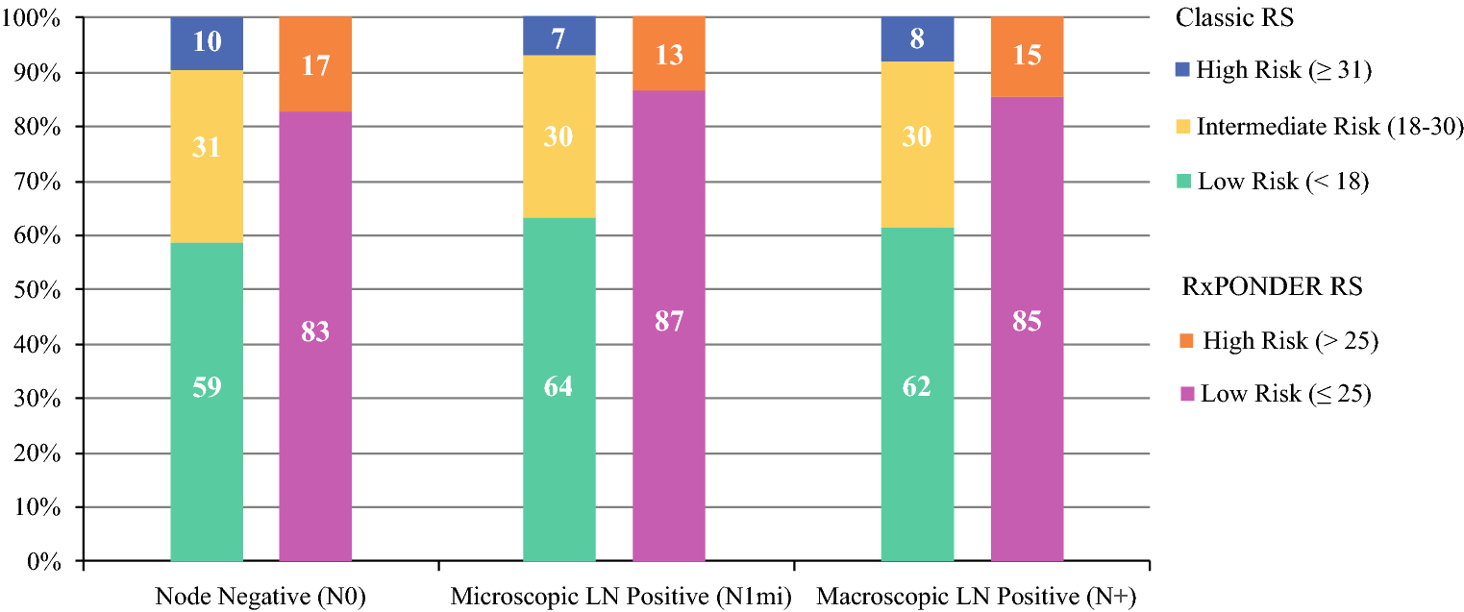
Recurrence score distribution does not differ between lymph node negative and positive tumors
*true for both ductal and lobular histologies
N = 496013 N = 24235 N = 56100
Bello DM, et al. Ann Surg Oncol 2018;25:2884-9

Slide 18
Prospective analysis of ER+ breast cancers by recurrence score:
West German Plan B Study
Overall
No
RS ≤ 11, no chemo
5-year DFS
N0 94.2%
N1 94.4%
N1
N2-3
Nitz U, et al. Breast Cancer Res Treat 2017;165:573-583

Slide 19
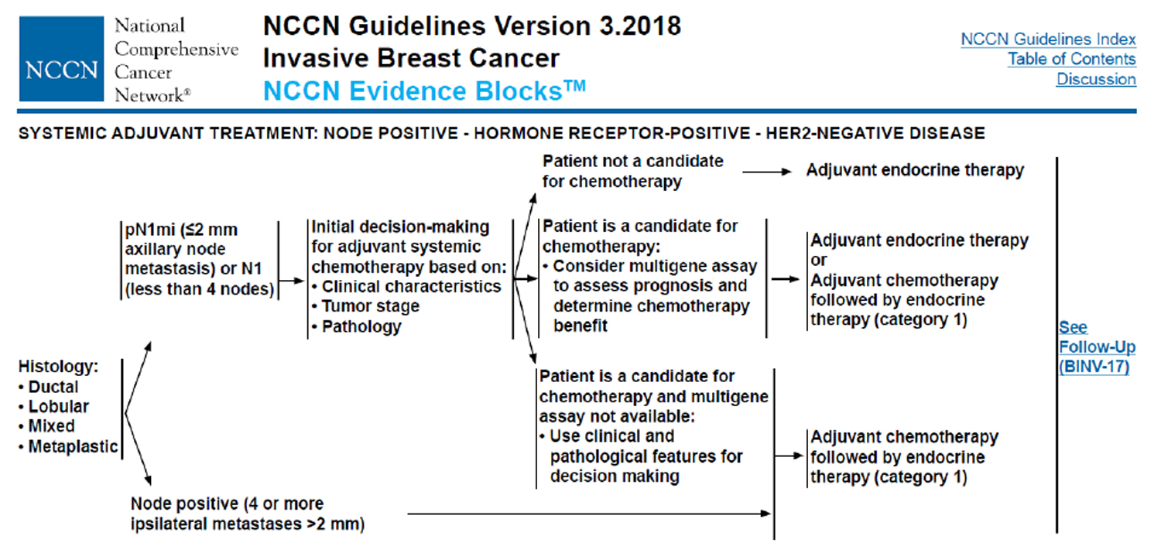
Available at: www.nccn.org

Slide 20
neoMONARCH: Preoperative Abemaciclib
Ki67 Expression and Response at Week 2
Geometric Mean Change
(Primary Endpoint of Study)
Complete Cell Cycle Arrest
8.2 (3.4, 20.2)
p<0.001^{b}
n = 54
n = 56
n = 51
100
OR =
0
11.2 (4.7, 27.4)
p<0.001^{b}
Anastrozole 1 mg
-20
- 63.2
- 92.6
- 90.6
80
Abemaciclib 150 mg + Anastrozole 1 mg
-40
60
Mean Change in Ki67 (%)
Response Rate (%)
-60
40
66.1
58.8
Abemaciclib 150 mg
-80
20
-100
GMR =
14.8
0.20 (0.13, 0.30)
p<0.001ª
0
Responders ^{b}:
8
37
30
0.26 (0.17, 0.38)
p<0.001ª
(Ki67 index <2.7% at 2 weeks)
100
50
*
n = 54
n = 56
n = 51
0
Change from Baseline (%)
-50
-100
Martin M, et al. SABCS 2018
SABCS 2016: presented by Sarah Hurvitz, MD.

Slide 21
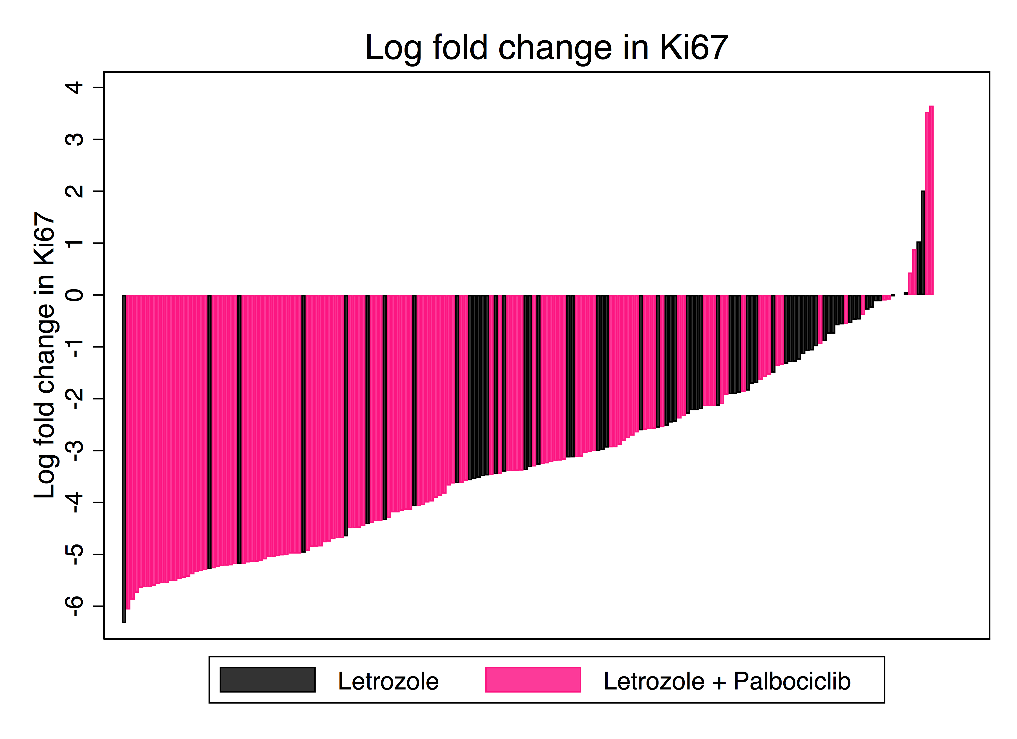
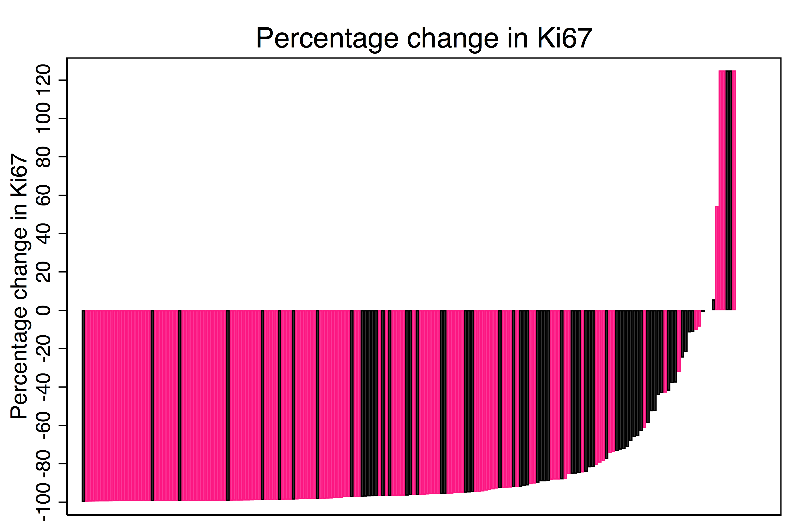
PALLET neoadjuvant trial: Change in Ki67 at 14 weeks
 |  | Log-Fold Change |  | Percentage Change
Group | N | Median | IQR | GeoMean | 95% CI
Letrozole alone (Group A) | 65 | -2.2 | -3.4 to -1.0 | -88.5% | -92.3% to -82.9%
Letrozole + Palbociclib (Groups B+C+D) | 125 | -4.1 | -5.0 to -2.8 | -97.4% | -98.1% to -96.4%
p<0.001
Dowsett M, et al SABCS 2018

Slide 22
DFCI 13-559: Phase II Pilot Feasibility Study:
Palbociclib and Adjuvant Endocrine Therapy
Adjuvant Patients (N=160)
HR+ stage II-III breast cancer
Tolerance of ongoing endocrine therapy (tamoxifen, AI, LHRH agonist)
Continuation of endocrine therapy
Palbociclib 125 mg PO qd, 3 weeks on/ 1 week off
Completion at 2 years
Mayer EL, et al. ASCO 2014

Slide 23
Adjuvant Trials of CDK4/6 inhibitors
RANDOMIZE
Arm A
CDK4/6i
+
Endocrine Treatment
(5+ yrs)
PALLAS NATALEE monarchE
Palbociclib Ribociclib Abemaciclib
N = 5600 N = 4000 N = 4580
Stage 2 or 3 Stage 2 or 3 N+ and 4+, T3, Gr3,
2 years Rx or Ki67>20%
Closed Accruing Accruing
1:1
Arm B
Endocrine treatment
(5+ yrs)

Slide 24
Module 8:
ER-Positive, HER2-Negative Breast Cancer
Drs Burstein and Sledge

Slide 25
Sequence and Selection of Systemic Therapy for Patients with ER-Positive Metastatic BC; Novel Agents in Development
George W Sledge MD
Stanford University

Slide 26
Disclosures
Advisory Committee | Symphogen A/S, Synaffix BV, Syndax Pharmaceuticals Inc, Taiho Oncology Inc
Board of Directors | Tessa Therapeutics
Contracted Research | Pfizer Inc
Ownership Interest | Syndax Pharmaceuticals Inc

Slide 27
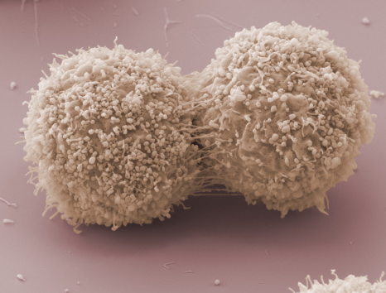
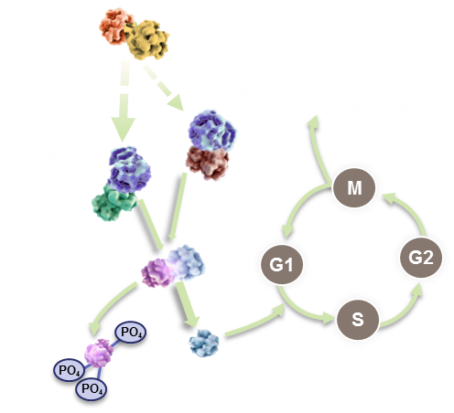
CDK4/6 Inhibition: Basic Biology

Slide 28
FDA-Approved CDK4/6 Inhibitors
O
N
F
HN
N
N
O
N
F
N
N
N
H
N
N
N
O
N
N
HN
N
N
N
N
N
N
N
HN
N
H
LY2835219 (Abemaciclib)²
CDK4 IC₅₀ = 2 nM
CDK6 IC₅₀ = 9.9 nM
CDK9 IC₅₀ = 57 nM
CDK1 IC₅₀ = 1,627 nM
PD0332992
(Palbociclib)¹
CDK4 IC₅₀ = 11 nM
CDK6 IC₅₀ = 16 nM
LEE011
(Ribociclib)³
CDK4 IC₅₀ = 10 nM
CDK6 IC₅₀ = 39 nM
Fry DW et al. Mol Cancer Ther. 2004;3:1427.
Gelbert LM et al. Invest New Drugs. 2014;32:825.
Kim S et al. Mol Cancer Ther. 2013;12(11 Suppl):PR02.

Slide 32
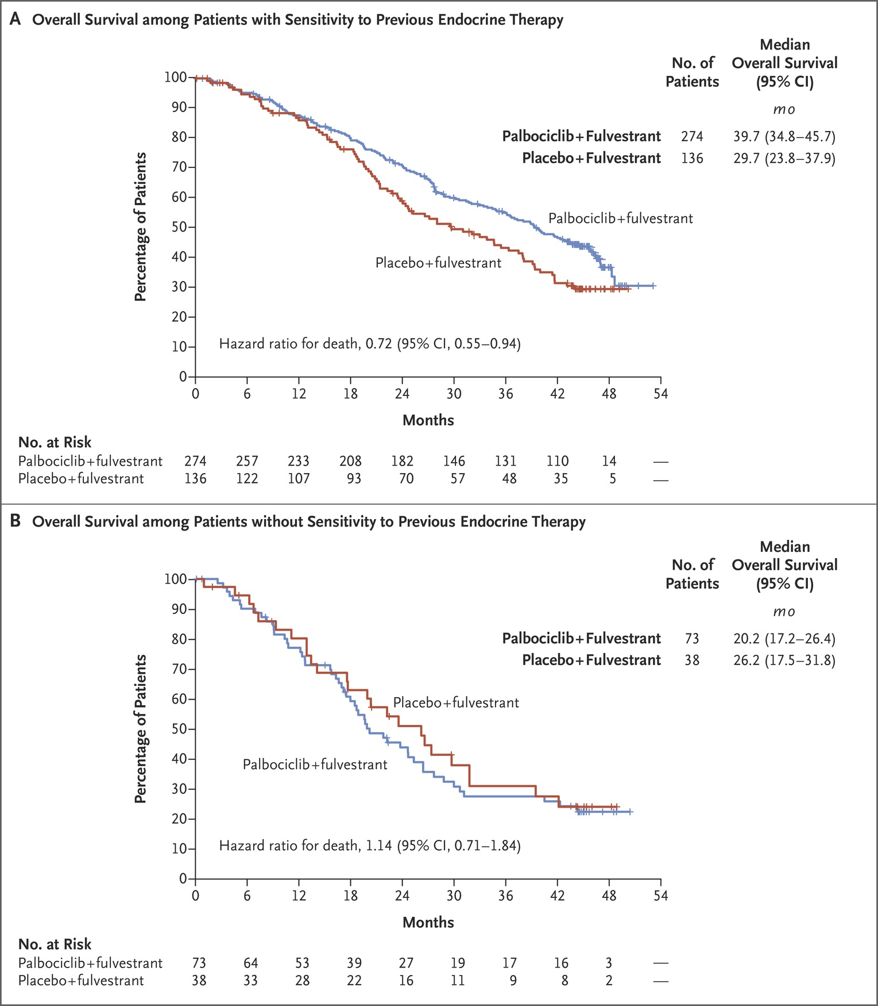

PALOMA 3: Overall Survival According to Patients’ Sensitivity to Previous Endocrine Therapy.
Overall population: no OS advantage (p = 0.09), BUT:
Significant improvement in patients with prior hormone sensitivity.
Turner NC et al. N Engl J Med 2018;379:1926-1936

Slide 34
Other differentiators
Abemaciclib: approved as a single agent; CNS penetration
Logistics: 3 weeks on, one off for palbociclib and ribociclib; continuous for abemaciclib
  Is this a good or a bad thing?
Ribociclib: co-packaging of ribociclib with letrozole (1 prescription, 1 co-pay); somewhat easier for dose adjustments

Slide 35
Future of CDK4/6 Inhibitors
Will there be differential mechanisms of resistance?
  If so, will they translate into actionable interventions?
  CDK 4/6 inhibitors work in patients w/ ESR1 mutations
Will there be differences in long-term toxicity/tolerability?
  May be important if adjuvant trials are positive

Slide 36
SOLAR-1: Background
Strong evidence links hormone resistance to cross-talk between signal transduction pathways and ER signaling
IGF-1R, EGFR, HER2
ER
RAS
PI3K
E
ER
AKT
RAF
TSC2
TSC1
MEK
mTOR
ERK
E
ER
Cell Proliferation
Yue W, et al. J Steroid Biochem Mol Biol. 2007;106:102-110.

Slide 37
SOLAR-1: Alpelisib + Fulvestrant for Men and Postmenopausal Women With HR-Positive ABC
International, randomized, double-blind phase III study
Stratified by presence of liver/lung metastases, prior CDK4/6 inhibitor treatment
Alpelisib† + Fulvestrant‡
(n = 169)
Men or postmenopausal women with HR+/HER2- advanced breast cancer and recurrence/progression on or after prior aromatase inhibitor therapy; ECOG PS 0/1; measurable disease or ≥ 1 predominantly lytic bone lesion
(N = 572)
PIK3CA
mutant*
(n = 341)
Placebo + Fulvestrant‡
(n = 172)
*By tumor tissue.
†300 mg PO QD.
‡500 mg IM on Days 1, 15
of first 28-day cycle, then on
Day 1 in subsequent cycles.
Alpelisib† + Fulvestrant‡
(n = 115)
PIK3CA
non-mutant*
(n = 231)
Placebo + Fulvestrant‡
(n = 116)
Primary endpoint: PFS in PIK3CA-mutant cohort (locally assessed)
Secondary endpoints including: OS, PFS in PIK3CA non-mutant cohort, PFS by PIK3CA status as evaluated with ctDNA, ORR/CBR, safety
Juric. SABCS 2018. Abstr GS3-08.

Slide 38
SOLAR-1: PFS in PIK3CA-Mutant Cohort (Locally Assessed)
PFS | Alpelisib + Fulvestrant (n = 169) | Placebo + Fulvestrant (n = 172)
Median, mos (95% CI) | 11.0 (7.5-14.5) | 5.7 (3.7-7.4)
HR (95% CI) | 0.65 (0.50-0.85); P = .00065
Events, n (%) Progression Death Censored | 103 (60.9) 99 (58.6) 4 (2.4) 66 (39.1) | 129 (75.0) 120 (69.8) 9 (5.2) 43 (25.0)
Similar PFS outcome for alpelisib + fulvestrant vs placebo + fulvestrant in retrospective analysis of PIK3CA mutation status via ctDNA testing
  Median PFS: 10.9 vs 3.7 mos, respectively; HR: 0.55
More patients with measurable disease experienced decreases in tumor burden with alpelisib + fulvestrant vs placebo + fulvestrant (75.9% vs 43.5%, respectively)
Juric. SABCS 2018. Abstr GS3-08. André. ESMO 2018. Abstr LBA3_PR.

Slide 39
SOLAR-1: Interim OS in PIK3CA-Mutant Cohort
OS | Alpelisib + Fulvestrant (n = 169) | Placebo + Fulvestrant (n = 172)
Median, mos (95% CI) | NE (28.1-NE) | 26.9 (21.9-NE)
HR (95% CI) | 0.73 (0.48-1.10); P = .06
Data cutoff (June 12, 2018) included 52% of planned events for final OS analysis
Median follow-up: 15.9 mos (range: 0.4-31.7)
Juric. SABCS 2018. Abstr GS3-08.

Slide 40
SOLAR-1: Hyperglycemia in Alpelisib-Containing Arm
Event, % | Alpelisib + Fulvestrant
Hyperglycemia serious AEs | 10.6
Hyperglycemia-related AEs
Dose interruption | 40.6
Dose adjustment | 43.9
Discontinuation | 6.3
Glucose > 160 mg/dL typically observed by Day 15
  Median duration: 10 days
Fasting plasma glucose and A1C spikes highest in alpelisib recipients who were diabetic (4%) or prediabetic (56%) at BL
  87% with hyperglycemia received antidiabetic medication, typically metformin
Juric. SABCS 2018. Abstr GS3-08.

Slide 41
SOLAR-1: Conclusions
In patients with HR+/HER2- PIK3CA-mutant advanced breast cancer and recurrence/progression on or after prior aromatase inhibitor therapy, addition of alpelisib to fulvestrant significantly prolonged PFS vs placebo plus fulvestrant
  PIK3CA-mutant assessed by tissue (HR: 0.65; 95% CI: 0.50-0.85; P = 0.00065)
  Benefit evident regardless of line of therapy and/or prior CDK4/6 inhibitor treatment; for PIK3CA-mutant determined by ctDNA
OS data not yet mature
Hyperglycemia common on-target adverse event with alpelisib, typically observed early in treatment and transient
  Manageable with oral antidiabetic therapy
Juric. SABCS 2018. Abstr GS3-08.

Slide 42
SOLAR-1: PFS by Prior Therapy in PIK3CA-Mutant Cohort
Median PFS, Mos | Alpelisib + Fulvestrant | Placebo + Fulvestrant | HR (95% CI)
First line (n = 177) Endocrine sensitive* (n = 39) Endocrine resistant† (n = 138) | 11.0 22.1 9.0 | 6.8 19.1 4.7 | 0.71 (0.49-1.03) 0.87 (0.35-2.17) 0.69 (0.46-1.05)
Second line‡ (n = 161) | 10.9 | 3.7 | 0.61 (0.42-0.89)
Prior CDK4/6i therapy Yes (n = 20) No (n = 321) | 5.5 11.0 | 1.8 6.8 | 0.48 (0.17-1.36) 0.67 (0.51-0.87)
*PD > 1 yr after (neo)adjuvant ET; excluded later per protocol amendment.
†PD ≤ 1 yr after (neo)adjuvant ET.
‡PD > 1 yr after (neo)adjuvant ET and while on/after 1 line of ET for ABC or newly diagnosed ABC with PD on/after 1 line of ET.
Juric. SABCS 2018. Abstr GS3-08.

Slide 43
SOLAR-1: AEs Occurring in ≥ 20% of Patients in Either Arm
AE, % | PIK3CA-Mutant Cohort |  |  |  |  |  | PIK3CA Nonmutant Cohort
 | ALP + FUL (n = 169) |  |  | PBO + FUL (n = 171) |  |  | ALP + FUL (n = 115) |  |  | PBO + FUL (n = 116)
 | Any | Gr 3 | Gr 4 | Any | Gr 3 | Gr 4 | Any | Gr 3 | Gr 4 | Any | Gr 3 | Gr 4
Any | 99.4 | 68.6 | 11.8 | 88.9 | 26.9 | 6.4 | 99.1 | 58.3 | 11.3 | 96.6 | 35.3 | 3.4
Hyperglycemia | 65.1 | 32.0 | 4.7 | 8.8 | 0 | 0.6 | 61.7 | 33.9 | 2.6 | 11.2 | 0.9 | 0
Diarrhea | 54.4 | 7.7 | 0 | 11.1 | 0.6 | 0 | 62.6 | 5.2 | 0 | 22.4 | 0 | 0
Nausea | 45.6 | 2.4 | 0 | 19.9 | 0 | 0 | 43.5 | 2.6 | 0 | 25.9 | 0.9 | 0
Rash | 39.6 | 13.0 | 0 | 6.4 | 0.6 | 0 | 29.6 | 5.2 | 0 | 5.2 | 0 | 0
Decreased appetite | 33.7 | 0.6 | 0 | 7.6 | 0 | 0 | 38.3 | 0.9 | 0 | 14.7 | 0.9 | 0
Stomatitis | 26.6 | 3.0 | 0 | 6.4 | 0 | 0 | 21.7 | 1.7 | 0 | 6.0 | 0 | 0
Decreased weight | 26.6 | 3.6 | 0 | 0.6 | 0 | 0 | 27.0 | 4.3 | 0 | 4.3 | 0 | 0
Vomiting | 25.4 | 0 | 0 | 9.4 | 0 | 0 | 29.6 | 1.7 | 0 | 10.3 | 0.9 | 0
Fatigue | 23.7 | 3.0 | 0 | 15.2 | 0 | 0 | 25.2 | 4.3 | 0 | 19.8 | 2.6 | 0
Juric. SABCS 2018. Abstr GS3-08.

Slide 44
Front-Line Trials: Progression-Free Survival
Letrozole +/- Palbociclib
Letrozole +/- Ribociclib
Letrozole +/- Abemaciclib

Slide 45
Is Toxicity a Differentiator?
Neutropenia: Less common with abemaciclib, but neutropenic fever is rare, and you still have to do blood draws
Diarrhea: Grade 3/4 diarrhea more common with abemaciclib, but manageable with standard antidiarrheals and rarely a reason for drug discontinuation
QTc prolongation for ribociclib: EKG requirement

Slide 46
Module 8: ER-Positive, HER2-Negative Breast Cancer
Boards Mini-Review: Dr Sledge
Topic/issue:
Local therapy (surgery/radiation therapy) to the breast in patients with metastatic disease

Slide 47
Sample question
A 55-year-old woman presents with a large left breast mass, which on biopsy is an ER/PR-positive, HER2-negative IDC. PET/CT reveals a single bone lesion in the hip that is asymptomatic. CT-guided biopsy of the bone lesion shows adenocarcinoma consistent with the primary. The patient is started on palbociclib/letrozole with a very good partial response in the breast and improvement in the hip lesion. What would you recommend next?
Continue palbociclib/letrozole
Mastectomy and sentinel lymph node biopsy
Continue palbociclib/letrozole and administer radiation therapy to the hip lesion
Continue palbociclib/letrozole and administer radiation therapy to the breast and hip lesion
Other

Slide 48
Module 8: ER-Positive, HER2-Negative Breast Cancer
Boards Mini-Review: Dr Burstein
Topic/issue:
Fertility preservation, childbearing in patients receiving adjuvant systemic therapy

Slide 49
Sample question
A 32-year-old woman presents with a left breast mass, which on biopsy is an ER/PR-positive, HER2-negative IDC. The patient undergoes right lumpectomy and sentinel lymph node biopsy, and pathology reveals a 2.1-cm left breast tumor with 2 out of 3 positive sentinel lymph nodes. Complete axillary dissection reveals 1 of 9 additional positive nodes. The patient is about to begin dose-dense doxorubicin/cyclophosphamide followed by paclitaxel. She wishes to become pregnant after finishing therapy and asks you how best to preserve her fertility. What would you recommend?
Administer adjuvant chemotherapy and tell the patient that her fertility will be preserved
Refer the patient to a fertility specialist for egg preservation
Administer gonadotropin-like agents during chemotherapy
Do not administer chemotherapy
Other

