Slide 1
Please note, these are the actual video-recorded
proceedings from the live CME event and may include
the use of trade names and other raw, unedited content.

Slide 2
Targeting Folate Receptor Alpha (FRα)
in Patients with Gynecologic Cancers
Michael J Birrer, MD, PhD
Director, O’Neal Comprehensive Cancer Center
Professor of Medicine/Hematology and Oncology
Evalina B Spencer Chair in Oncology
The University of Alabama at Birmingham
Birmingham, Alabama
Research To Practice: Society of Gynecologic Oncology (SGO) Annual Meeting on Women’s Cancer Honolulu, Hawaii 2019

Slide 3
Disclosures
No relevant conflicts of interest to disclose.

Slide 4
Antibody-drug conjugates are currently routinely used in the management of…
Hodgkin lymphoma
HER2-positive breast cancer
Both of the above
Neither of the above
I don’t know

Slide 5
Dr Birrer: A patient with Ovarian Cancer
A woman in her 60s with a primary diagnosis of Stage IIIC ovarian cancer. She initially presented on referral for evaluation of pelvic mass.
On exam a mass was felt in addition to abdominal tenderness and this prompted a CT scan on 2/19/13 that revealed a multicystic enhancing left pelvic mass (8 x 8 x 9cm) with numerous enhancing solid nodules of the peritoneum and omentum as well as a small amount of ascites, highly suspicious for metastatic ovarian cystadenocarcinoma. CA-125 was elevated.

Slide 6
Dr Birrer: Case con’t
Prior to chemotherapy she had NGS testing of her tumor:
FGFR1 (amplification), AKT2 (amplification), TP53 (splice site 375+2T>G), CCNE1 (amplification), CRKL (amplification), MCL1 (amplification), MLL2 (R2105H), and ZNF703 (amplification).
She was optimally debulked and received 1 cycle of taxane/plat chemotherapy and then underwent IP therapy. She was NED at the end of the IP therapy and remained as such for 1.5 years. At that time she was treated for recurrent ovarian cancer with IV taxane/platinum for 6 cycles.

Slide 7
Dr Birrer: Case con’t
She was in CR at the completion of this treatment and remained progression free for 1 year. At that time she was treated with carbo/PLD with a resulting CR at which time she was placed on niraparib maintenance. Unfortunately she progressed rapidly and was diagnosed with platinum-resistant disease.
The patient was placed on the FORWARD I trial of mirvetuximab soravtansine.
She had a PR after the first cycle and remained in response for 18 cycles. She had no ocular toxicities or neuropathy.

Slide 8
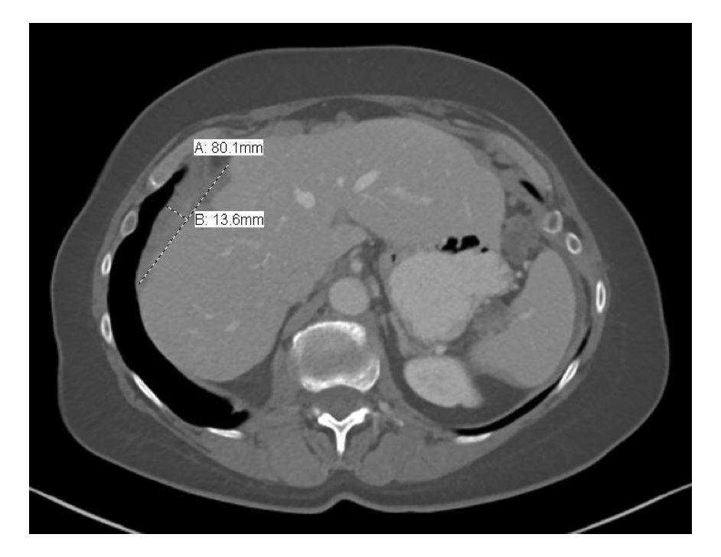
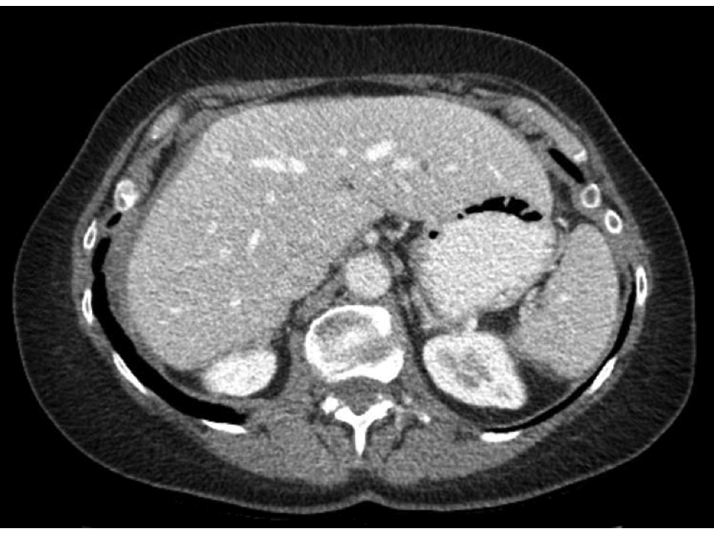
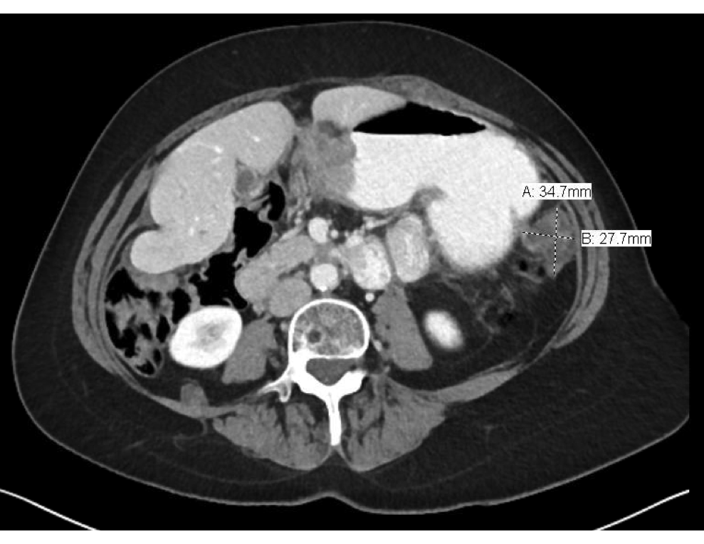
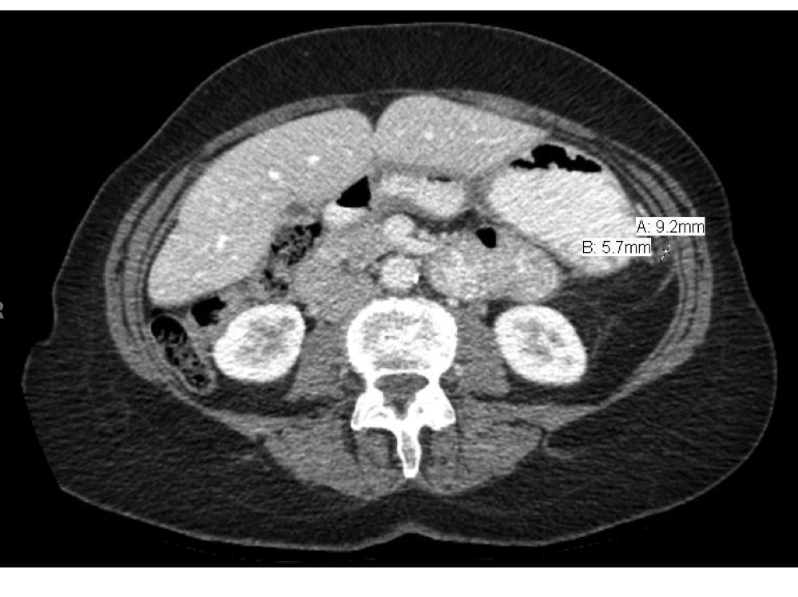
Before starting mirvetuximab
(12/2017)
After 1 month of mirvetuximab
(2/2018)

Slide 9
Dr O’Malley: A patient with Stage IIIC Ovarian Cancer
A woman in her 70s with recurrent stage IIIC HGSOC.
After undergoing tumor reduction surgery she received treatment on GOG 9923 (IP cisplatin/paclitaxel and IV paclitaxel with bevacizumb and veliparib followed by bevacizumab maintenance for 15 cycles).
Recurred 28 months after diagnosis when she was treated on GOG 213 (randomized to surgery) followed by carboplatin/paclitaxel for 6 cycles.

Slide 10
Dr O’Malley: Case cont’d
Recurred 3 months later when she was started on mirvetuximab soravtansine/bevacizumab on FORWARD II.
Treated for 2 years on therapy with a PR. Ultimately, she had to be removed from trial treatment due to recurrent/resistant C-Diff infection (ultimately underwent stool transplant).
Almost immediately progressed and most recently was found to have brain metastasis.

Slide 11
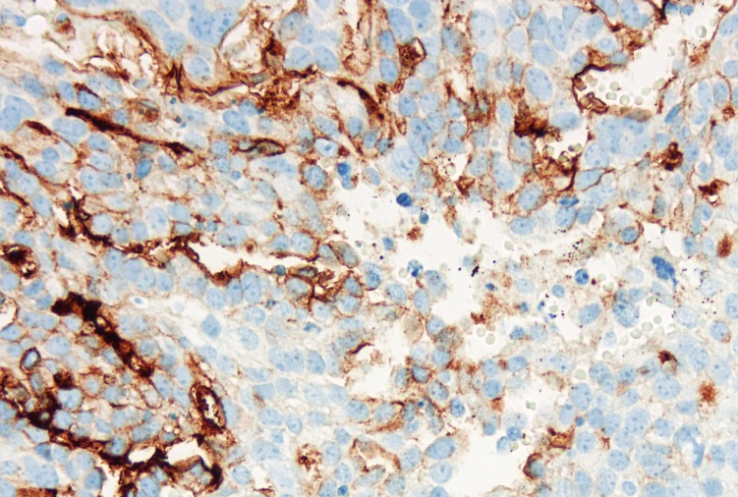
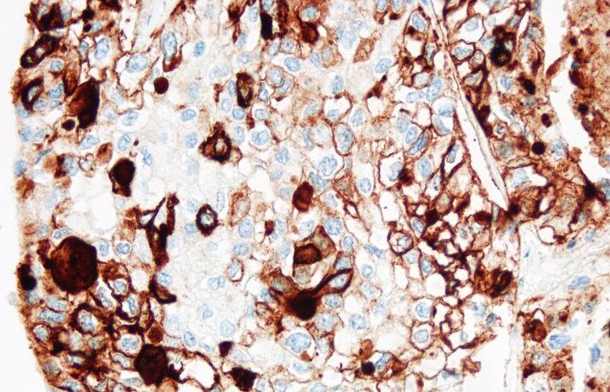
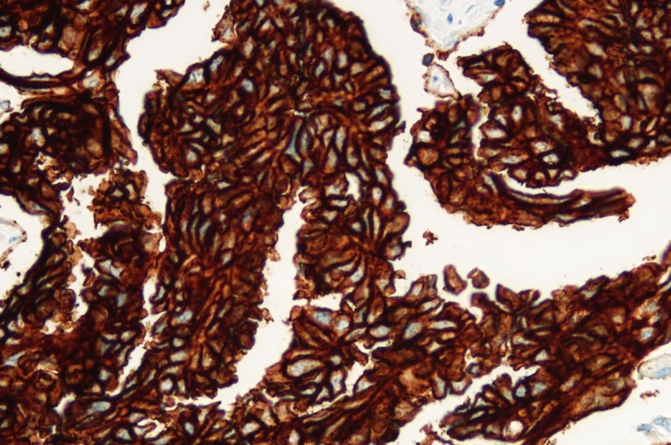
Folate Receptor Alpha
Member of a gene family with high affinity for folate acid
7 exons, a glycosylphosphatidylinositol (GPI)-anchored membrane protein which is also secreted
Most folate enters cell by reduced folate transporter
Expressed ONLY in type 2 aveolar cells and renal tubules
Differentially expressed in multiple cancers
Endometrial cancer Lung cancer Ovarian cancer

Slide 12
Farletuzumab (MORAb-003)
Humanized monoclonal antibody to Folate Receptor Alpha
Blocks phosphorylation by Lyn kinase
Active in ADCC assays
Active in xenograft model
Favorable toxicity profile in primate studies
Low activity in clinical trial and abandoned

Slide 13
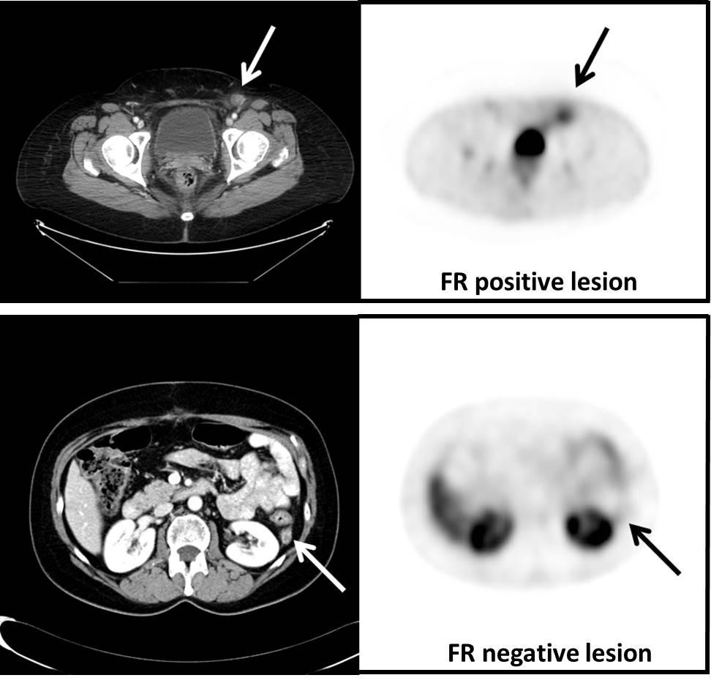
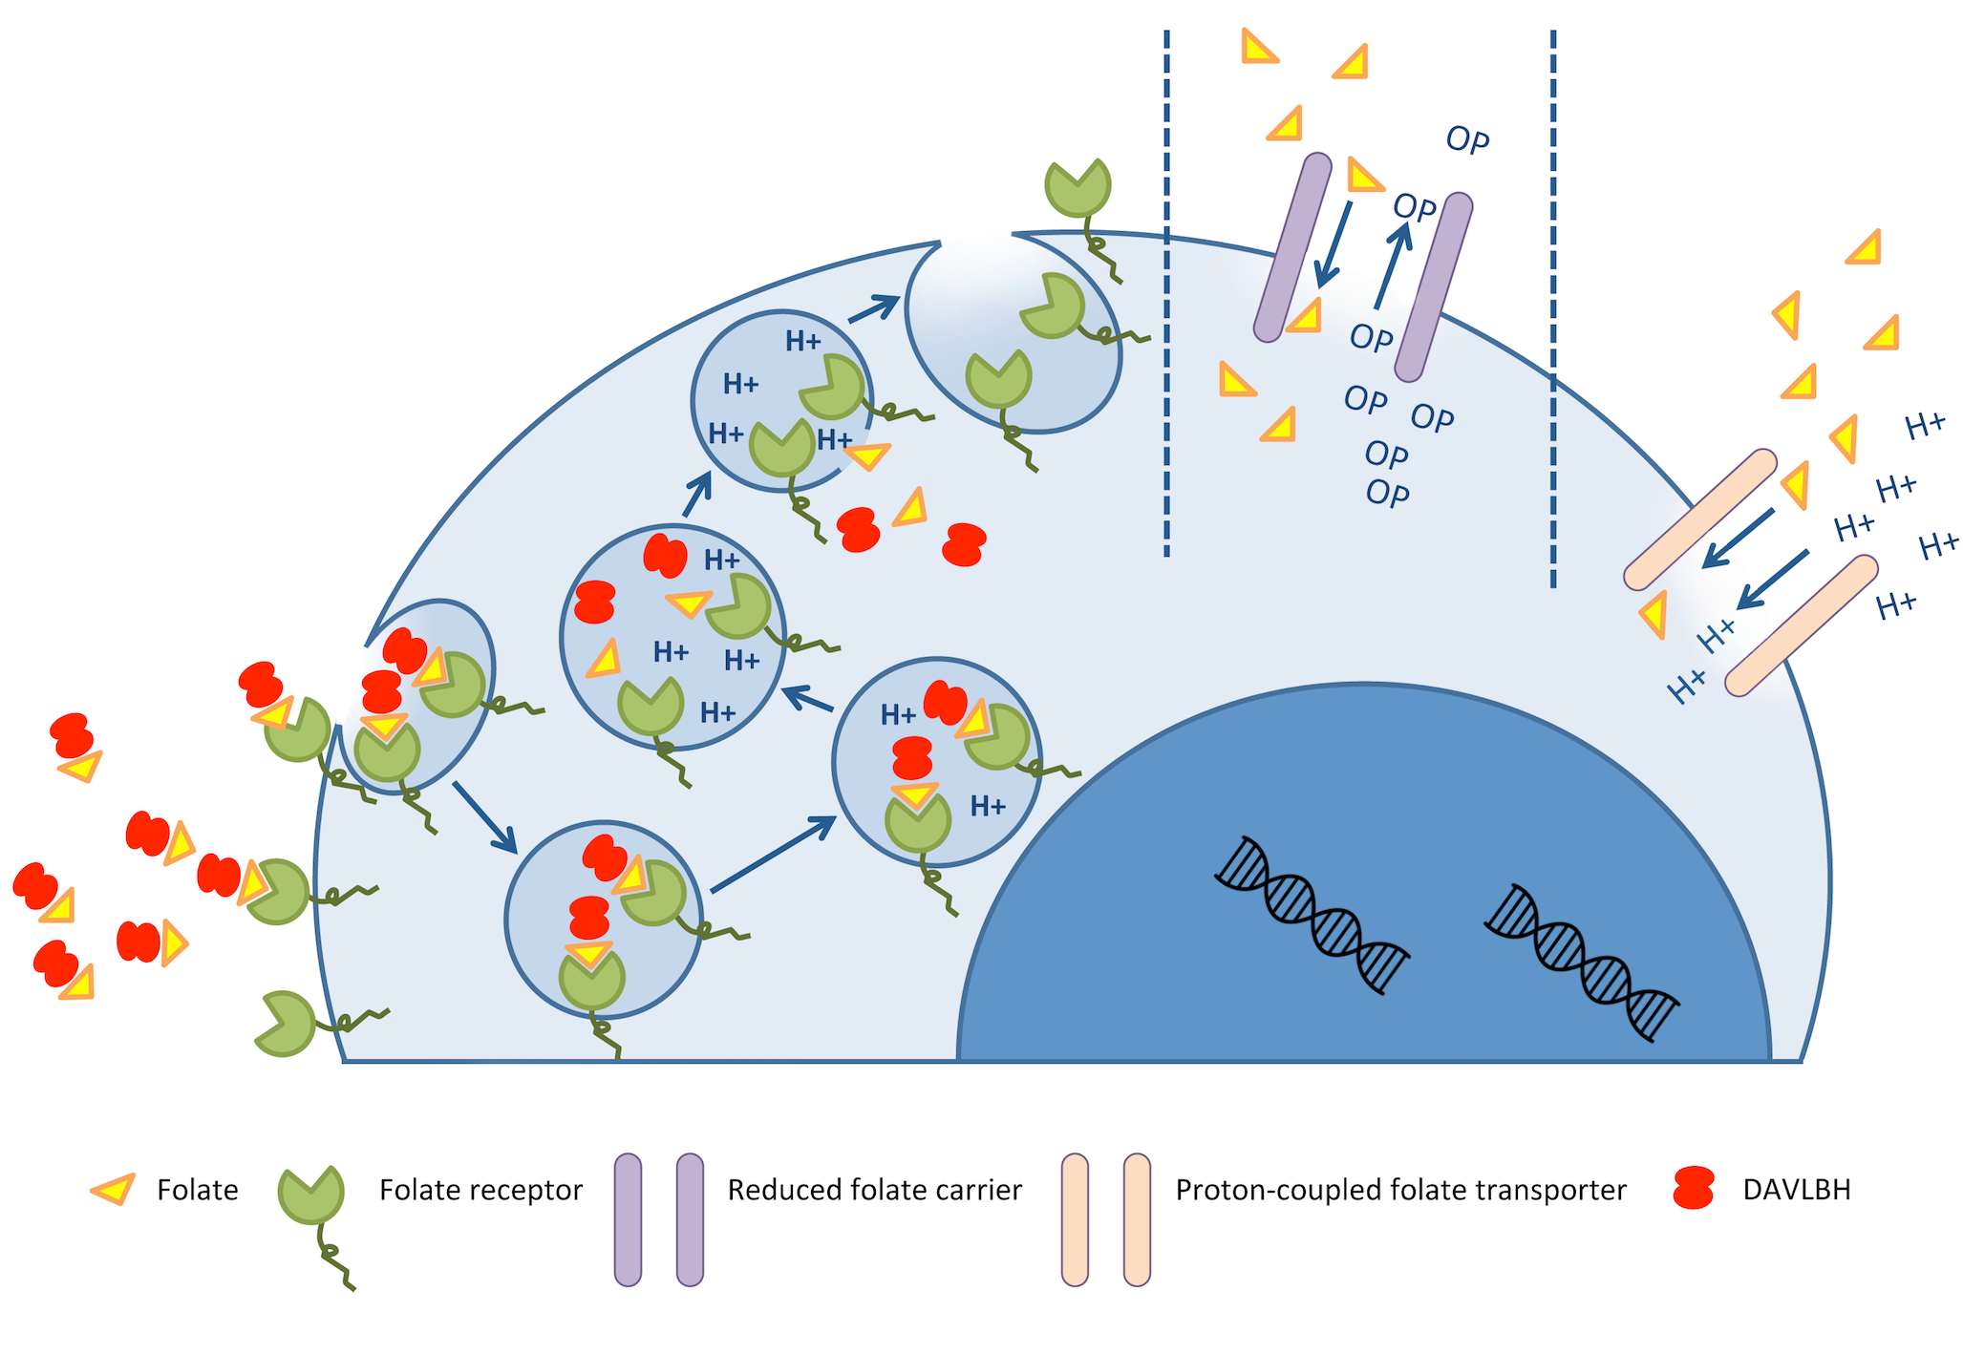
Vintafolide (EC145)
EC145 is a conjugate of folate and vinca alkaloid DAVLBH
Binds folate receptor, delivering DAVLBH into cell via endocytosis
Naumann RW et al. J Clin Oncol 2010;28 [abstract LBA5012b]

Slide 14
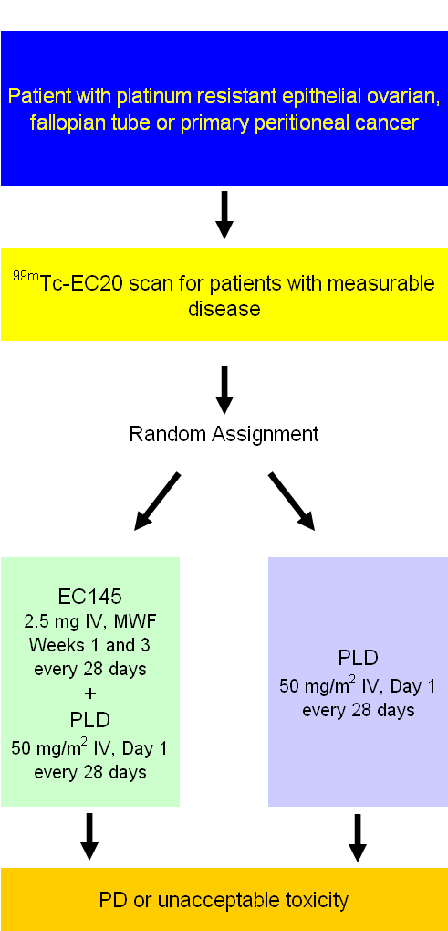
EC145 Phase III Randomized Study Design in Patients with Platinum Resistant Ovarian Cancer
Blinded Randomized study comparing EC145 + PLD vs. PLD alone
Platinum Resistant patients
640 Patients randomized, placebo controlled
Study objectives:
  Compare PFS between arms
  Independent radiology review
  OS in EC20 ++ patients

Slide 15
Phase III Vintafolide Trial Stopped for Futility Following Interim Analysis
Press Release: May 2, 2014
“The Data Safety Monitoring Board (DSMB) of the trial has completed a pre-specified, interim futility analysis and the DSMB recommended that the trial be stopped because vintafolide did not demonstrate efficacy on the pre-specified outcome of Progression-Free Survival (PFS) in patients with platinum-resistant ovarian cancer. The DSMB did not identify any safety concerns for the patients enrolled in the trial. Based on the DSMB recommendation and while further review of the data is conducted, screening and randomization of participants in the trial will be suspended.”
https://www.mrknewsroom.com/news-release/oncology-newsroom/merck-and-endocyte-announce-independent-dsmb-recommends-vintafolide-p

Slide 16
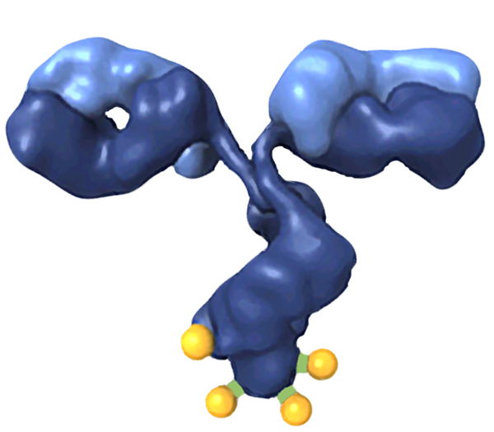
Antibody Drug Conjugates (ADC)
Tumor-targeting antibody
  With or without intrinsic functions
Cell-killing agent
  Derivatives of maytansine (DM1/DM4)
  potent anti-microtubule agent
  DNA damaging agent (IGN)
Linker (disulfide, thioether)
  Keeps conjugate intact in blood
  Releases fully active payload inside cancer cell
  Conjugation approach (through lysines) retains native Ab functions and PK properties
  Flexible linker designs
Design goal: to maximize on target tumor cell killing while reducing off target toxicity

Slide 17
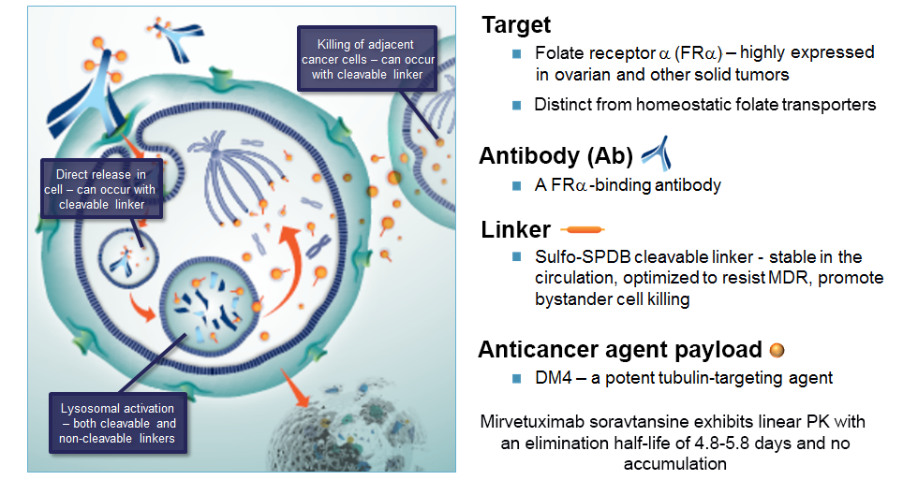
Mirvetuximab Soravtansine (IMGN853) – Antibody-Drug Conjugate Targeting Folate Receptor Alpha

Slide 18
Mirvetuximab 0401 FIH Phase I Trial
Platinum-Resistant Expansion
Platinum-Resistant Ovarian Cancer
Completed (46 pts); Data at ASCO 2016
Ovarian Biopsy Cohort
Completed (27 pts); Data at SGO 2017
  RP2D
  6 mg/kg
  Q3 weeks
Escalation
N=69 pts
Ovarian w/ Corticosteroid Eye Drops
Completed (40 pts); Data at ASCO 2017
Relapsed Endometrial Cancer
Completed (23 pts)
>200 patients have been treated in study 0401
NSCLC
Planned
Notes:
Highlight that it was a phase I with multiple cohorts
Subsequent data slides will be on the 46 platinum resistant ovarian cancer

Slide 19
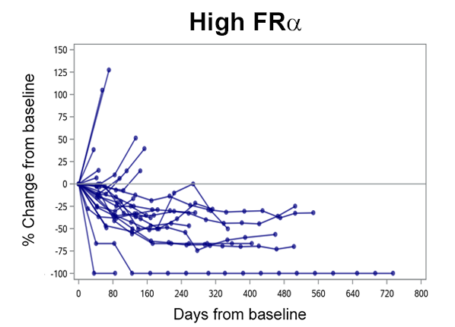
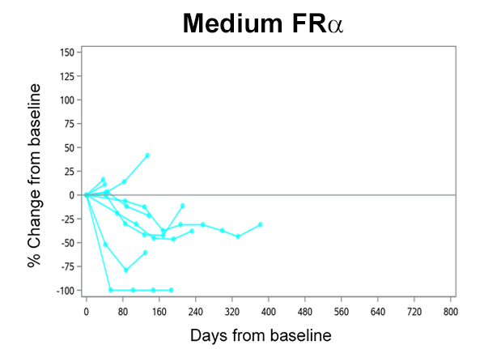
Consistent Activity with Mirvetuximab Monotherapy over Multiple Cohorts
Clinical Benefit Observed in Platinum-Resistant Ovarian Cancer Well Past 1 Year on Treatment
 | ASCO 2016 Analysis¹ |  | ASCO 2017 Pooled Analysis²
 | All Patients (n = 46) | PROC 1-3 priors + med/high FRα expression (n = 16) | All Patients (n = 113) | PROC 1-3 priors + med/high FRα expression (n = 36)
cORR (95% CI) | 26% (14, 41) | 44% (20, 70) | 30% (22, 39) | 47% (30, 65)
mPFS months (95% CI) | 4.8 (3.9, 5.7) | 6.7 (3.9, 11.0) | 4.3 (3.9, 5.4) | 6.7 (4.1, 8.3)
FORWARD I
  ¹Moore et al ASCO 2016
  ²Moore et al ASCO 2017
  cORR: confirmed Objective Response Rate
Study Population

Slide 20
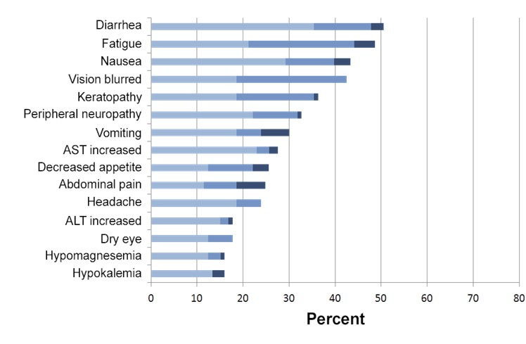

Safety Profile Demonstrated in Phase 1 Study
Well-tolerated across all ovarian cancer cohorts (n = 113)
Adverse events generally low grade and manageable
No grade >3 adverse event
occurred in ≥10% of patients
Consistent adverse event profile for FORWARD I eligible subset
(n = 36) with the pooled population
Drug-related AEs leading to discontinuation seen in 10 patients (9%)

Slide 21
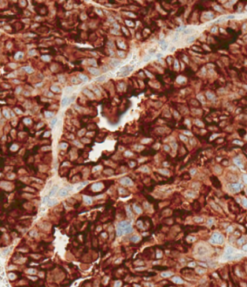
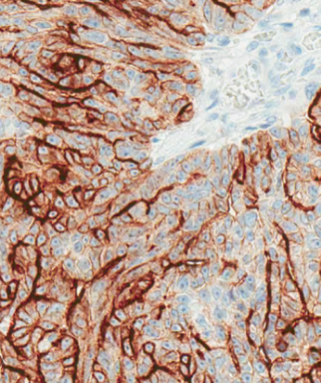
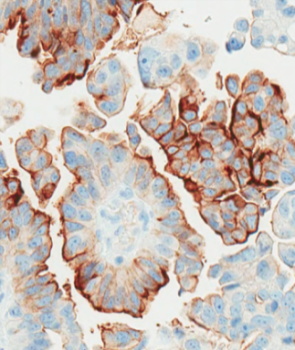
FRα Expression Cutoffs Used in Development and Estimated Patient Eligibility for Ovarian Cancer
Cutoff | Definition | Estimated % of Ovarian Patients* | FRα Enrollment Criteria for Mirvetuximab Studies
High | ≥ 75% of cells with ≥ 2+ intensity | 40%
Medium | 50-74% of cells with ≥ 2+ intensity | 20%
Low | 25-49% of cells with ≥ 2+ intensity | 20%
FRα Negative | < 25% of cells with ≥ 2+ intensity | 20%
FORWARD I
FORWARD II
  Example of FRα High
  Example of FRα Medium
  Example of FRα Low
*Note: based on molecular epidemiology studies and 0401 patient screening

Slide 22
FORWARD I
Mirvetuximab
6 mg/kg AIBW*
Q3W
n = ~222
Co-PIs:
  Kathleen Moore
  Michael Birrer
Partnering with GOG Foundation
Design accepted by FDA and EMA
> 100 sites in US, Canada, W. Europe
Patients with
FRα-positive ovarian cancer
2:1 randomization
Investigator’s
choice
Pac, PLD* or Topo*
n = ~111
FRα Med/High
1- 3 prior Tx
Primary endpoint: PFS (Blinded Independent Central Review)
  Entire population
  Subset with high FRα (~2/3 of patients in study)
Secondary endpoints: ORR, DOR, QoL and OS
Interim analysis for futility at 80 events
* PLD: pegylated liposomal doxorubicin; Topo: topotecan; AIBW = adjusted ideal body weight

Slide 23
FORWARD I: Study Population
Target Population:
    Advanced epithelial ovarian cancer (EOC)
    Primary peritoneal and fallopian tube cancers
FRα positive: ≥ 50% of cells with ≥ 2+ intensity by IHC
Investigators will have to specify which IC chemotherapy their patient would be receiving should she be randomized to the chemotherapy arm

Slide 24
Top Line results from Forward I
March 1, 2019
Did not meet its primary endpoint of PFS in either the entire study population or a pre-specified subset of patients with high FRα expression
ORR was higher in the mirvetuximab arm (22% vs 12% p value 0.015)
In the pre-specified subset:
  PFS was longer in patients who received mirvetuximab (HR 0.69, p = 0.049)
  ORR was higher in patients who received mirvetuximab (24% vs 10%, p = 0.014)
  OS was longer in patients who received mirvetuximab (HR 0.62, p = 0.033)
Mirvetuximab was well-tolerated with fewer patients experiencing grade 3 or greater adverse events (46% vs 61%), fewer dose reductions (20% vs 31%), and fewer discontinuations (5% vs 8%) compared to chemotherapy

Slide 25
Label expansion:
MIRVETUXIMAB
+
Bevacizumab
Bevacizumab expansion cohort ongoing
New cohort: 1-3 priors M/H FRα n=60
+
FORWARD II
Pembrolizumab
Pembrolizumab expansion cohort
ongoing
ENROLLMENT:
Patients with recurrent platinum-resistant or platinum-sensitive FRα-positive ovarian cancer
+
Carboplatin
Mirvetuximab + carboplatin +
bevacizumab triplet expansion
cohort ongoing

