Slide 1
Please note, these are the actual video-recorded
proceedings from the live CME event and may include
the use of trade names and other raw, unedited content.

Slide 2
Role of PARP inhibition in the management of relapsed ovarian cancer
UCL Cancer Institute
Jonathan A Ledermann
UCL Cancer Institute
London, UK
Research To Practice, SGO, Honolulu, March 2019

Slide 3
Disclosures
Advisory Boards and Lecture Fees:
  AstraZeneca; Clovis Oncology;
Advisory Boards:
  Pfizer; Merck/MSD; Seattle Genetics; Roche; Cristal Therapeutics; Artios; Tesaro
IDMC:
  Regeneron
Grants:
  AstraZeneca; Merck/MSD
Travel support:
  Clovis Oncology

Slide 4
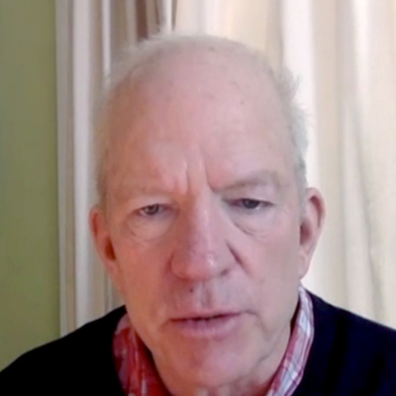
A woman in her mid-60s (gBRCAwt)
Stage IIIC papillary serous ovarian cancer
Primary debulking surgery → carboplatin/paclitaxel x 6
10 months later: Disease recurrence
Carboplatin/paclitaxel/bevacizumab x 6 → bevacizumab
maintenance x 9 months
Ongoing complete response
Dr Polkinghorn

Slide 5
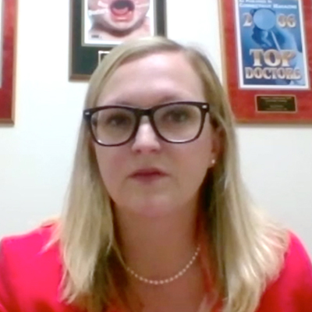
A woman in her late 50s (gBRCA1)
1/2017: Triple-negative breast cancer → mastectomy,
adjuvant docetaxel/cyclophosphamide
8/2017: Prophylactic BSO → Stage IIIC high-grade
serous ovarian cancer → debulking surgery →
carboplatin/paclitaxel x 6
8/2018 (6 months after completion of chemotherapy): Presented to emergency room with massive pleural effusion
Dr Mallen

Slide 6
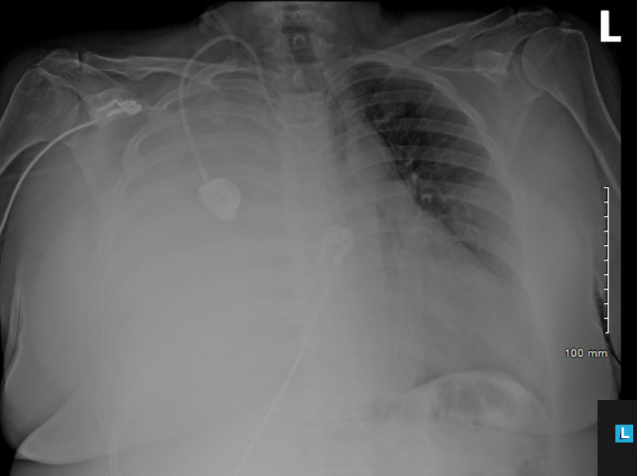
Chest x-ray on admission

Slide 7
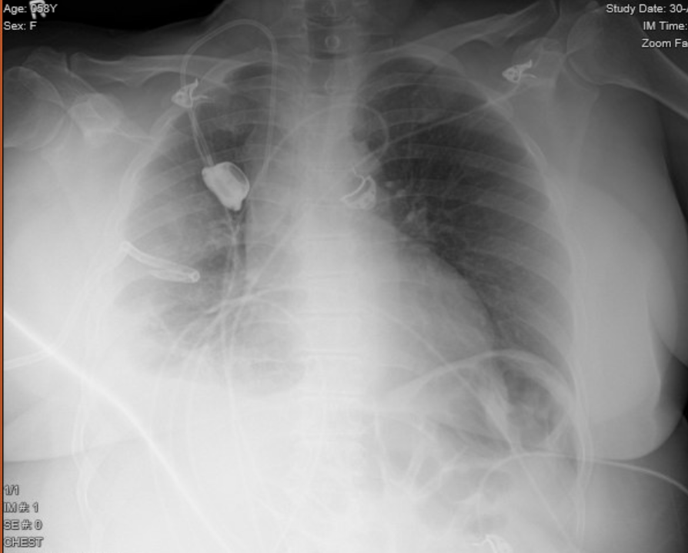
Chest x-ray post thoracentesis/PleurX placement

Slide 8
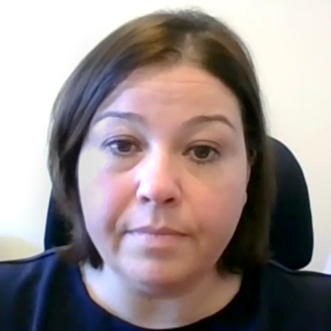
A woman in her late 80s (gBRCAwt)
2014: Presented with weight loss, GI symptoms
9.9-cm pelvic mass, extensive retroperitoneal
adenopathy and 7.4-cm hepatic mass, biopsy confirmed
serous peritoneal adenocarcinoma
Neoadjuvant carboplatin/paclitaxel → debulking surgery → carboplatin/paclitaxel
2017: Recurrence → carboplatin/paclitaxel
6 months later: Disease progression in the abdomen → niraparib 300 mg daily, dose reduced to 100 mg daily due to thrombocytopenia
Dr Godoy

Slide 9
Design Concepts – Phase III Maintenance Trials
  Treats residual disease after chemotherapy
    Tumour shrinkage
    Fall in CA125 levels
  Aim is to delay progression, extend time before further line of chemotherapy and increase survival
PARP inhibitor
Treatment until
disease
progression
Patients:
Platinum-sensitive high-grade ovarian cancer
≥2 previous platinum regimens
Last chemotherapy was platinum-based, to which they had a maintained PR or CR prior to enrolment
Stable CA-125
Randomised
Placebo
SOLO-2
OLAPARIB
NIRAPARIB
RUCAPARIB
NOVA
Primary end point: PFS
ARIEL3
Ledermann J et al. N Engl J Med 2012; Mirza N Engl J Med 2016; Pujade-Lauraine et al Lancet Oncol 2017; Coleman et al Lancet 2017

Slide 10
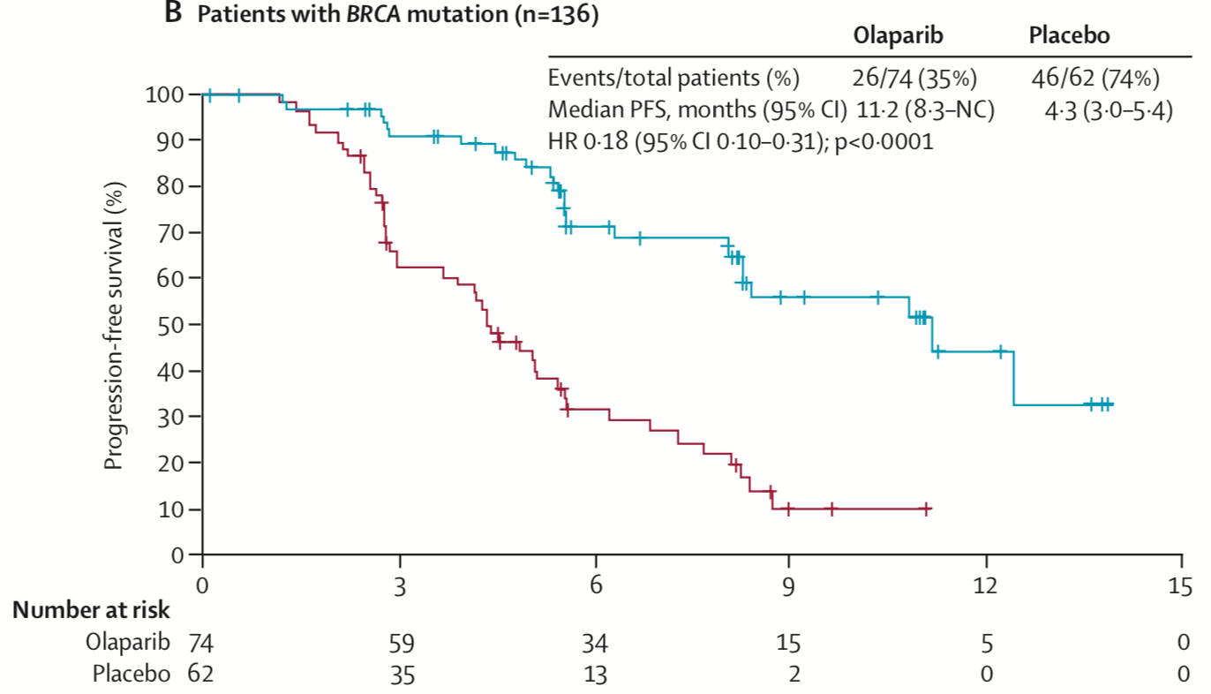
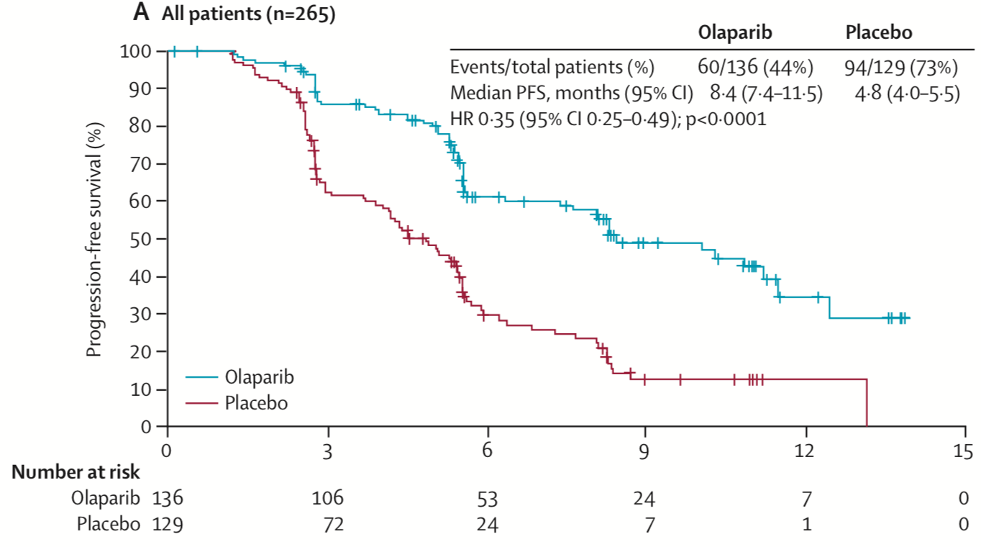
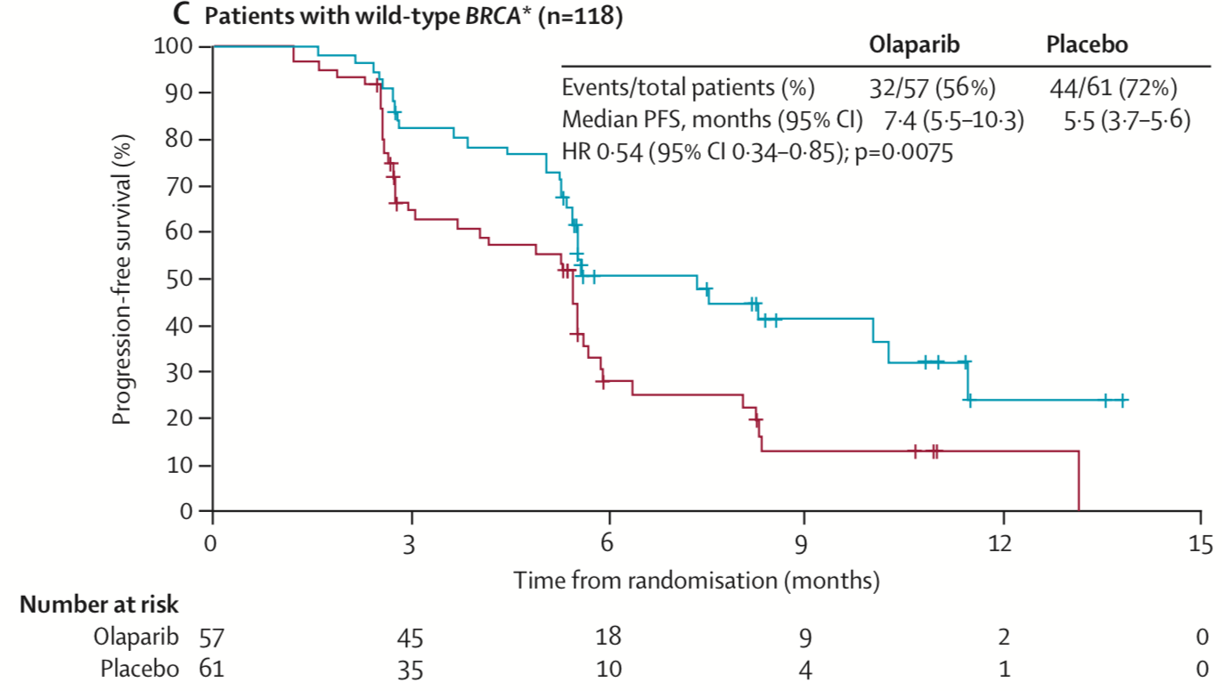
PARP inhibitor maintenance therapy in recurrent ovarian cancer
Study 19 Randomised phase II trial following a response to platinum-based therapy in high grade serous cancer
BRCA^{mut}
BRCA^{wt}
Ledermann et al. N Engl J Med 2012
Ledermann J, et al. Lancet Oncol 2014

Slide 11
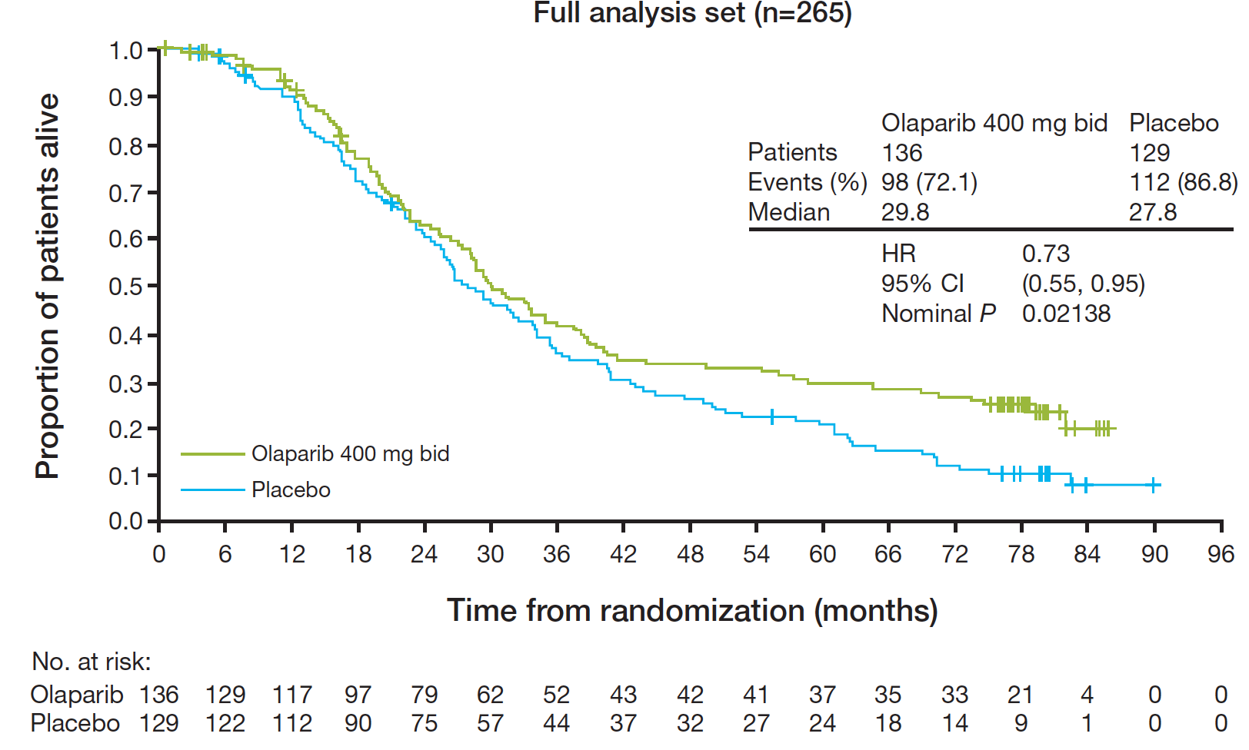
Overall survival (final results) – Olaparib Study 19
15 patients (11%) received olaparib
≥ 6 years
9 BRCAm (3 sBRCA
5 BRCAwt
  1 RAD51B mut; some had no HRR mutations, and 1 neg for HRD testing
  1 No tumour but gBRCA wt
1 patient on placebo (gBRCA mut)
Friedlander Br J Cancer 2018

Slide 12
How to select a PARP inhibitor for maintenance treatment?
BRCA mutation versus BRCA wild-type
Germline BRCA versus somatic BRCA mutation
Histology Serous versus High Grade
Volume of disease
Age of patient
HRD evaluation

Slide 13
PARP inhibitors maintenance post platinum-based chemotherapy – Licensed by FDA
 | Study 19 Olaparib | SOLO2 Olaparib | NOVA Niraparib | ARIEL 3 Rucaparib
N (pts) | 265 | 295 | 533 | 564
Inclusion | HGSOC | BRCA1/2 mutated HGSOC or high-grade endometrioid ovarian cancer | HGSOC | HGSOC or high-grade endometrioid ovarian cancer
Median PFS months | All HGSOC 4.8 v 8.4 mo HR 0.35 BRCA mutation 11.2 v 4.3 mo HR 0.18 BRCA-wt 7.4 v 5.5 mo HR 0.54 | BRCA mutation 19.1 vs 5.5 mo HR 0.30 | gBRCA mutation 21.0 vs 5.5 mo HR 0.27 non gBRCA 9.3 vs 3.9 mo HR 0.45 | tBRCA mutation 16.6 vs 5.4 mo HR 0.23 ITT (with or w/o BRCA mutation) 10.8 vs 5.4 mo HR 0.36
Median OS | 27.8 vs 29.8 months HR 0.73 | 45 vs 27 months HR 0.80 (immature) | immature | immature
Reference | Ledermann et al NEJM 2012; Lancet Oncol 2014 | Pujade-Lauraine, E et al Lancet Oncol 2017 | Mirza, M et al., NEJM 2016 | Coleman, RL et al, Lancet 2017

Slide 14
Does base tumour burden effect outcome of PARP inhibitor?
SOLO-2 patients with CR or PR at study entry
PFS for patients in CR at time of study entry
PFS for patients in PR at time of study entry
 | Olaparib (N=91) | Placebo (N=47)
PFS events, n (%) | 34 (37) | 35 (75)
Median PFS, m | NR | 5.6
HR (95% CI) | 0.26 (0.16–0.42)
 | Olaparib (N=105) | Placebo (N=52)
PFS events, n (%) | 73 (70) | 45 (87)
Median PFS, m | 13.8 | 5.5
HR (95% CI) | 0.37 (0.25–0.54)
1.0
1.0
0.9
0.9
0.8
0.8
0.7
0.7
0.6
0.6
0.5
0.5
Proportion of patients progression free
Proportion of patients progression free
0.4
0.4
0.3
0.3
0.2
0.2
0.1
olaparib 300 mg bid
placebo bid
0.1
olaparib 300 mg bid
placebo bid
0.0
0.0
0
3
6
9
12
15
18
21
24
27
30
33
36
0
3
6
9
12
15
18
21
24
27
30
33
36
Number of patients at risk
Time from randomisation
Number of patients at risk
Time from randomisation
Olaparib 300 mg bid
Placebo bid
91
47
87
36
80
22
69
14
62
12
60
11
54
10
51
9
19
5
16
4
0
0
0
0
Olaparib 300 mg bid
Placebo bid
105
52
95
34
76
15
65
8
56
6
44
6
35
4
31
3
13
2
13
2
3
0
2
0
0
0
0
0
Investigator-assessed progression or death by modified RECIST v1.1
PFS = progression free survival; NR = not reached
Oza et al. ESMO 2017 Poster 965P

Slide 15
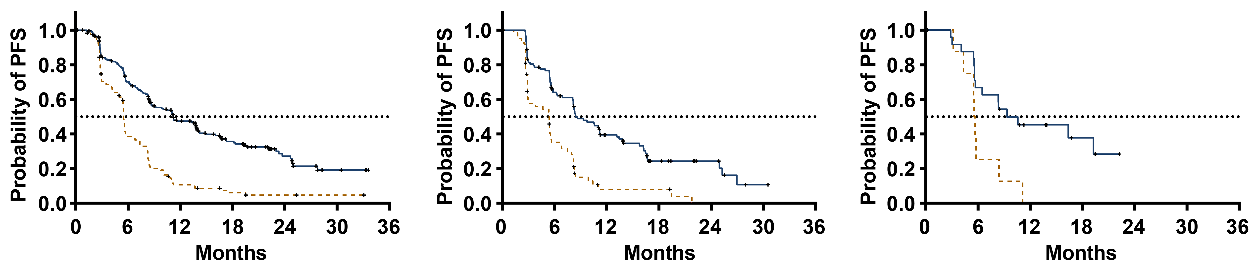
ARIEL 3: Investigator-Assessed PFS – ITT Analysis
Age <65 years
Age 65–74 years
Age ≥75 years
 | Median (months) | 95% CI
Rucaparib | 11.1 | 8.5–13.7
Placebo | 5.4 | 5.3–5.6
 | HR, 0.33; 95% CI, 0.25–0.43
 | Median (months) | 95% CI
Rucaparib | 8.3 | 8.0–11.1
Placebo | 5.3 | 2.8–5.6
 | HR, 0.43; 95% CI, 0.29–0.64
 | Median (months) | 95% CI
Rucaparib | 9.2 | 5.5–NR
Placebo | 5.5 | 3.0–8.3
 | HR, 0.47; 95% CI, 0.16–1.35
At risk (events)
Rucaparib | 237 (0) | 147 (65) | 87 (111) | 48 (130) | 19 (138) | 4 (143) | 0 (143)
Placebo | 117 (0) | 41 (69) | 10 (99) | 4 (103) | 2 (104) | 1 (104) | 0 (104)
At risk (events)
Rucaparib | 113 (0) | 65 (38) | 33 (62) | 13 (73) | 7 (73) | 1 (76) | 0 (76)
Placebo | 64 (0) | 20 (39) | 3 (53) | 3 (53) | 0 (55)
At risk (events)
Rucaparib | 25 (0) | 16 (8) | 8 (13) | 4 (14) | 0 (15)
Placebo | 8 (0) | 2 (6) | 0 (8)
Visit cutoff date: April 15, 2017. HRs were estimated using the Cox proportional hazards model.
CI, confidence interval; HR, hazard ratio; ITT, intention to treat; NR, not reached; PFS, progression-free survival.
Ledermann et al SGO, Honolulu 2019

Slide 16
HRD testing to select PARP inhibitor benefit – NOVA (niraparib), ARIEL3 (rucaparib)
Niraparib (non gBRCA)
Rucaparib all
HRD +ve
 | Niraparib (n=35) | Placebo (n=12)
PFS median (95% CI) (Months) | 20.9 (9.7–NR) | 11.0 (2.0–NR)
Hazard ratio (95% CI); P value | 0.27 (0.081–0.903); P=0.0248
% of patients without progression or death at 12 mo | 62% | 19%
LOH high
BRCA^{wt}
 | Median (months) | 95% CI
Rucaparib (n=106) | 9.7 | 7.9–13.1
Placebo (n=52) | 5.4 | 4.1–5.7
 | HR, 0.44; 95% CI, 0.29–0.66; P<0.0001
sBRCA mut
(n=47)
HRD +ve
 | Niraparib (n=71) | Placebo (n=44)
PFS median (95% CI) (Months) | 9.3 (5.8–15.4) | 3.7 (3.3–5.6)
Hazard ratio (95% CI); P value | 0.38 (0.231–0.628); P=0.0001
% of patients without progression or death at 12 mo | 45% | 11%
BRCA wt
(n=115)
LOH low
BRCA^{wt}
 | Median (months) | 95% CI
Rucaparib (n=107) | 6.7 | 5.4–9.1
Placebo (n=54) | 5.4 | 5.3–7.4
 | HR, 0.58; 95% CI, 0.40–0.85; P=0.0049
HRD - ve
 | Niraparib (n=92) | Placebo (n=42)
PFS median (95% CI) (Months) | 6.9 (5.6–9.6) | 3.8 (3.7–5.6)
Hazard ratio (95% CI); P value | 0.58 (0.361–0.922); P=0.0226
% of patients without progression or death at 12 mo | 27% | 7%
BRCA wt
(n=134)
Mirza et al NEJM 2016; Coleman et al Lancet 2017

Slide 17
Selection of PARP inhibitors for maintenance therapy
More active in tumours with BRCA mutation ( somatic or germline)
  Longer PFS
  Long-term survival benefit may not be dependent on BRCA status
High grade tumours- serous or endometrioid
Baseline disease does not effect magnitude of benefit of PARPi
HRD assays currently do not exclude patients from benefit
Platinum sensitivity remains the best biomarker for benefit from PARPi
Choice of PARP inhibitor is largely dependent on familiarity with the drug and its side effects- differences in activity not clear

Slide 18
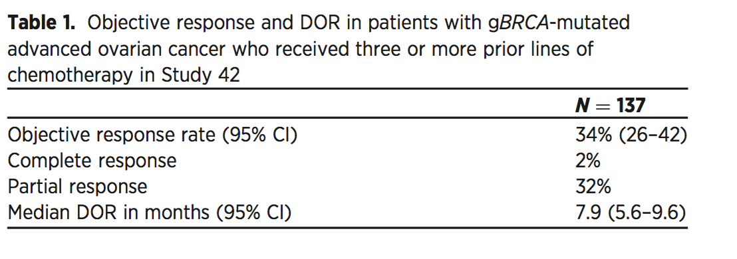
Monotherapy – a substitution for chemotherapy?
Olaparib and rucaparib licensed for treatment of BRCA^{mut} ovarian cancers
Olaparib
Rucaparib
Overall Response Rate % (n) [95% CI]† | Study 10 (n=42) | ARIEL2 (n=64) | Pooled efficacy population (n=106)
 | 59.5 (25) [43.3–74.4] | 50.0 (32) [37.2–62.8] | 53.8 (57) [43.8–63.5]
Best OR, % (n)
Complete response | 9.5 (4) | 7.8 (5) | 8.5 (9)
Partial response | 50.0 (21) | 42.2 (27) | 45.3 (48)
Stable disease | 28.6 (12) | 37.5 (24) | 34.0 (36)
Progressive disease | 4.8 (2) | 10.9 (7) | 8.5 (9)
Not evaluable | 7.1 (3) | 1.6 (1) | 3.8 (4)
  19 December 2014: FDA licensed olaparib for the treatment of BRCA-mutated (BRACAnalysis CDx™) ovarian cancer in patients who have received ≥3 prior lines of therapy.
19 December 2016: FDA- Accelerated approval in patients with a BRCA mutation (FoundationFocus™ CDxBRCA) who have received 2 or more prior lines.
Kaufman, et al. J Clin Oncol 2014
Oza AM et al. Gynecol Oncol. 2017

Slide 19
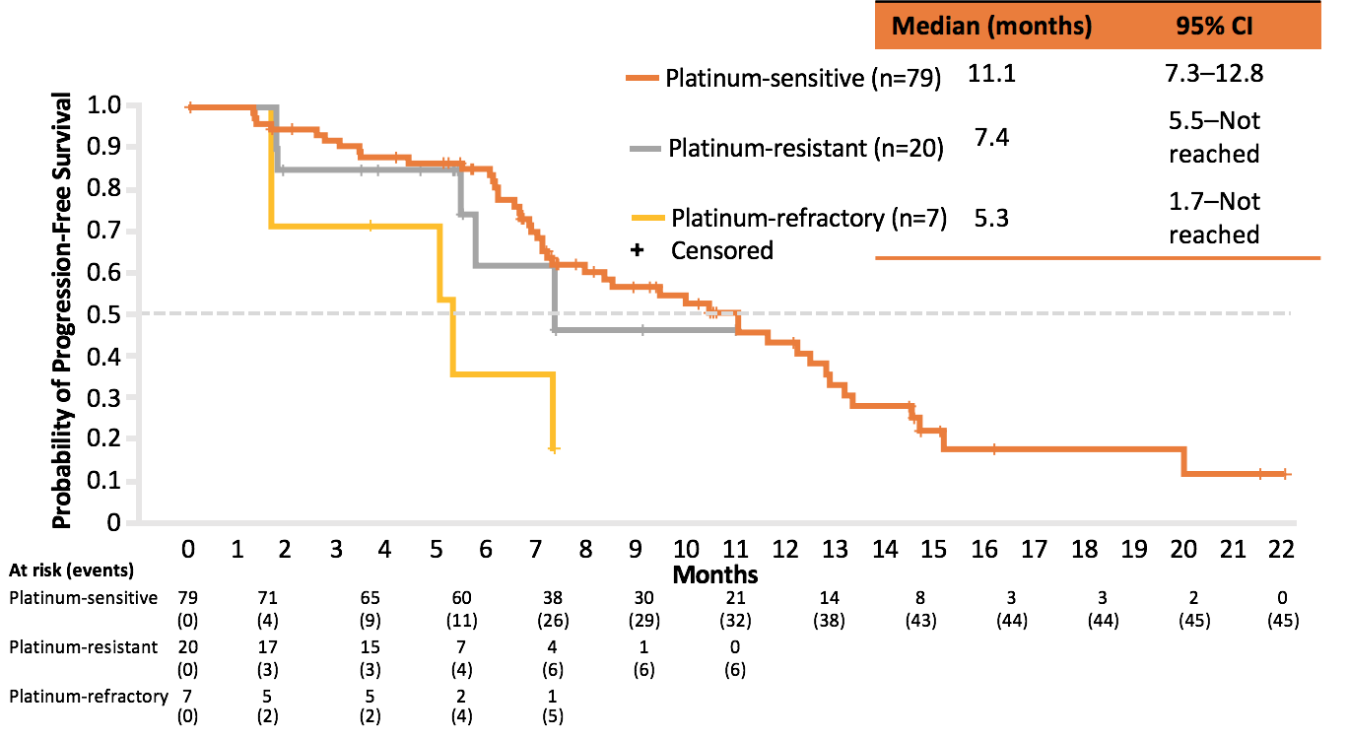
Integrated Efficacy Results: Rucaparib Monotherapy
PFS in Specified Groups According to Platinum Sensitivity
Oza AM et al. Gynecol Oncol. 2017;147:267–275

Slide 20
QUADRA Phase II Trial
Evaluation of niraparib efficacy in late-line recurrent ovarian cancer
Key Eligibility Criteria
Serous epithelial ovarian, fallopian tube or primary peritoneal cancer
Tumor HRD testing and blood gBRCA^{mut} status testing
Completed >3 prior chemotherapy regimens
Following enrollment of 292 patients, study amendment:
  Limited to 3 or 4 previous chemotherapy regimens
  Patients must have experienced a response lasting at least 6 months to first line platinum-based therapy
Patients with histologically diagnosed advanced, relapsed, high-grade serous epithelial ovarian, fallopian tube, or primary peritoneal cancer who have received 3 or more prior lines of chemotherapy
Niraparib 300 mg orally once daily, 28-day cycles
Endpoint assessment
Primary Endpoint
ORR by RECIST in HRD-positive patients who have received 3 or 4 lines of previous chemotherapy, platinum-sensitive, and PARPi-naïve
Moore et al ASCO 2018 Abstract 5514

Slide 21
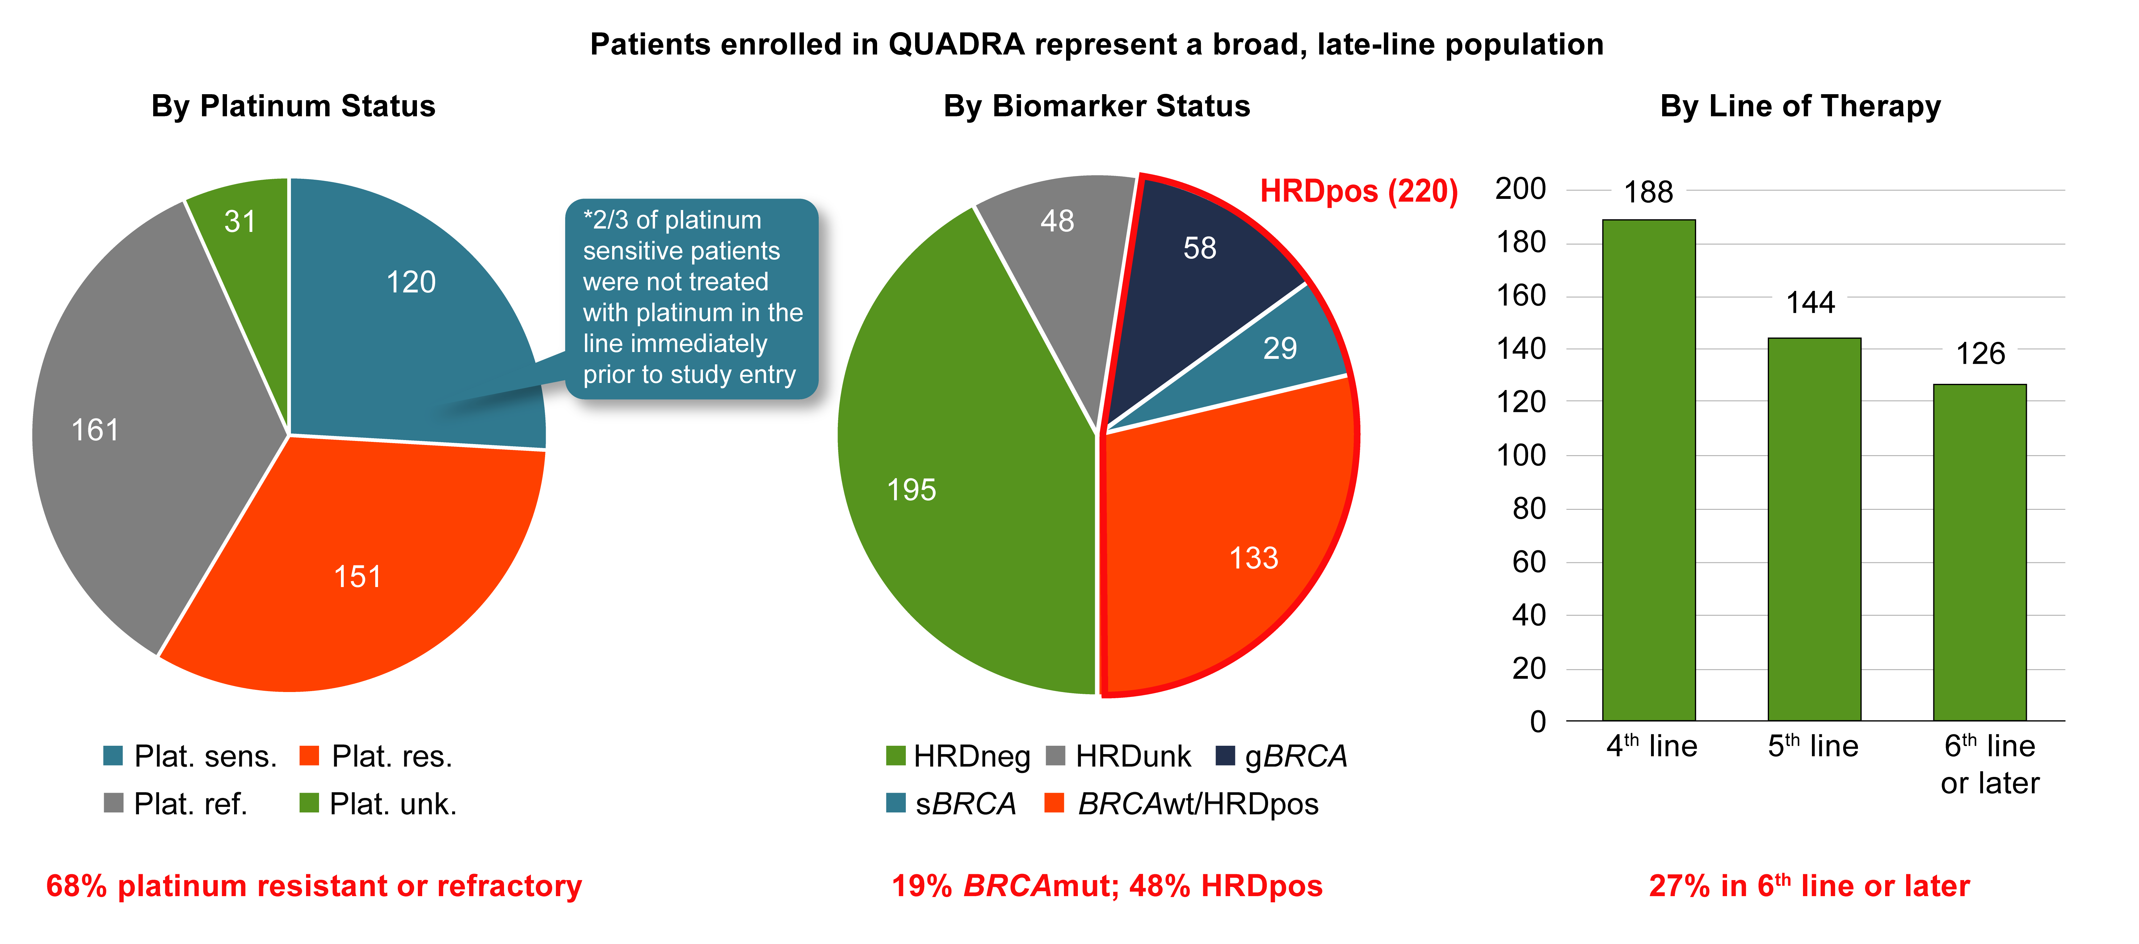
QUADRA – patient characteristics
Plat. sens. = platinum sensitive (time from last platinum until next progression ≥ 6 months), including platinum-ineligible;
Plat. res. = platinum resistant (time from last platinum until next progression between 28 days and 6 months);
Plat. ref. = platinum refractory (progression on or within 28 days from last platinum);
Plat. unk. = platinum status unknown
Moore et al. Proc ASCO 2018;Abstract 5514.

Slide 22
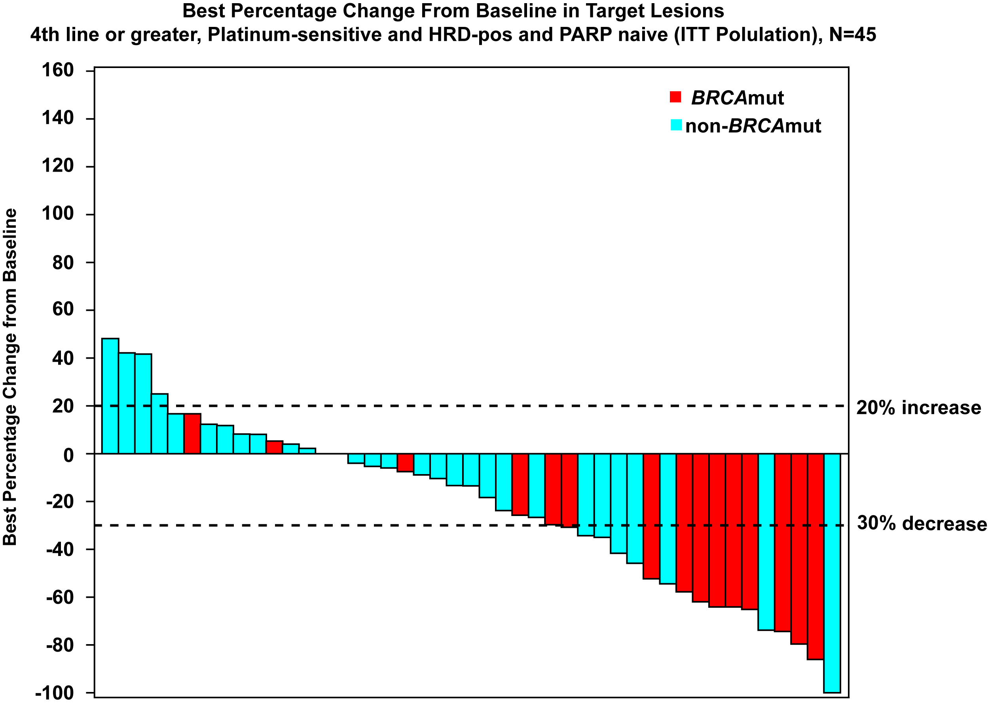
Niraparib Efficacy in HRDpos Population Extends Beyond BRCA^{mut}
Expanded primary population (4th line or later)
Patients with at least one follow-up scan with an evaluable target lesion (n=45) included on the waterfall plot
Moore et al. Proc ASCO 2018;Abstract 5514.

Slide 23
QUADRA – Benefit of niraparib across all populations
In all evaluable patients treated in 4th or later line:
ORR - 10%
CBR16 - 35%
mDOR – 9.4 months (95% CI 6.6-18.3)
44% of responses lasting ≥12 months*
Patients with at least one follow-up scan with an evaluable target lesion treated in 4th or later line (n=379) included on the waterfall plot
Patients previously treated with PARP inhibitors are included
* Based on KM estimate
Moore et al. Proc ASCO 2018;Abstract 5514.
ORR – objective response rate
CBR16 – clinical benefit rate (CR+PR+SD for at least 16 weeks)

Slide 24
Summary
Maintenance therapy with PARP inhibitors (olaparib, niraparib, rucaparib) following platinum-based chemotherapy should now be the standard of care for all patients responding to platinum-based therapy
  Significant delay in tumour progression
  delay in further line of chemotherapy
  possibly an increase in survival
No evidence that one drug is superior to any other
Monotherapy with PARP inhibitors in patients with a BRCA mutation could be considered when platinum therapy is not an option
Emerging data suggest that PARP inhibitors (niraparib) may provide useful disease control for later line therapy.

Slide 25
A woman in her late 60s (gBRCAwt)
Presents with Stage IV ovarian cancer with ascites and
lung and splenic metastases
Debulking surgery → carboplatin/paclitaxel
Good response but persistent disease
Dr Polkinghorn

